Slide 1
Programming
CPSC 217: Introduction to Computer Science for Multidisciplinary Studies I
Winter 2023
Jonathan Hudson, Ph.D.
Instructor
Department of Computer Science
University of Calgary
January 9, 2023
Copyright © 2023

Slide 2
How Do We Solve Problems with a Computer?
First question: How do we learn?

Slide 3
What does it mean to understand something?

Slide 4
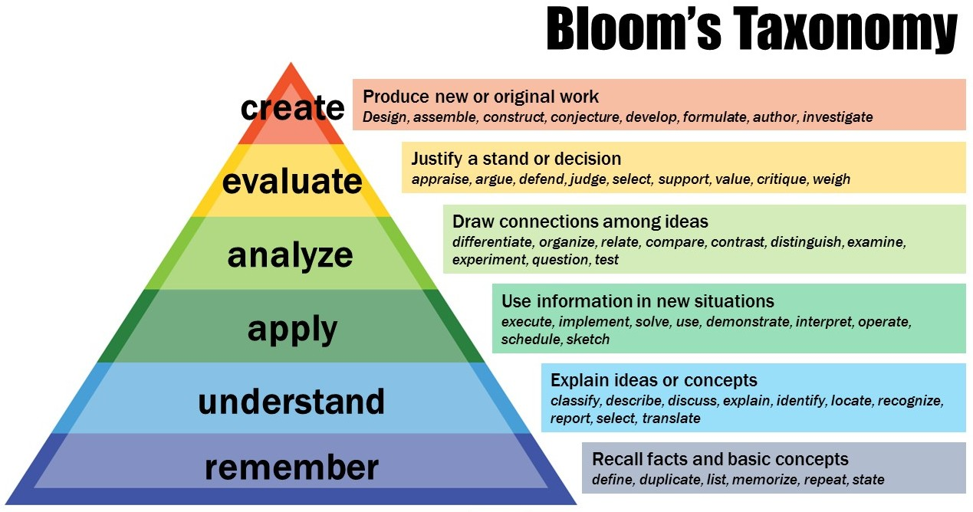
This Photo is licensed under CC BY-NC

Slide 5
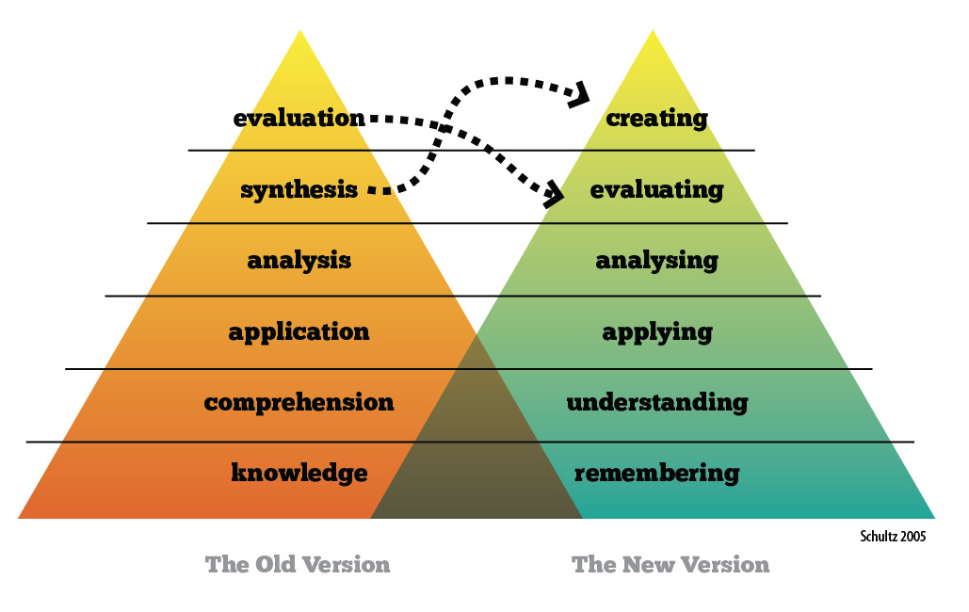
This Photo is licensed under CC BY-SA-NC

Slide 6
Solving Problems
How do we solve problems?

Slide 7
Solving Problems
How do we solve problems?
Break original problem into smaller, more easily solvable parts and repeat on the smaller sub-problems.
Similar process used in expository writing (break topic up into easily-understandable bits, express in coherent way).

Slide 8
Top Down Design
Start with the entire problem
01
Break the problem into approximately 3 to 5 smaller steps
02
Repeat the process for each step that is still too complex
03

Slide 9
What is an Algorithm?

Slide 10
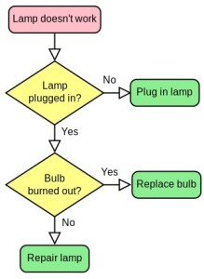
What is an Algorithm?
This Photo by Unknown Author is licensed under CC BY-SA-NC

Slide 11
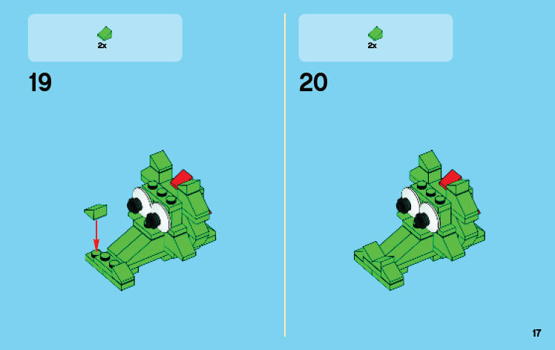
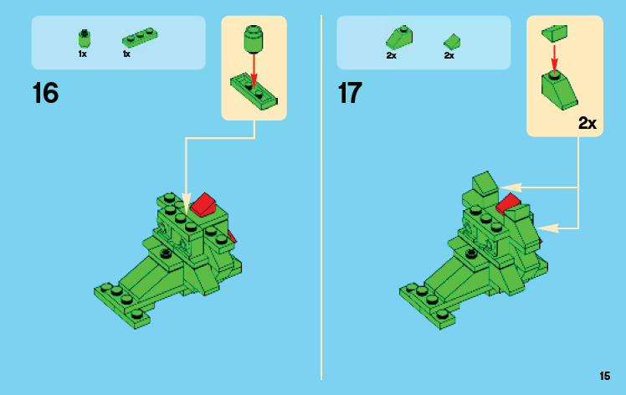
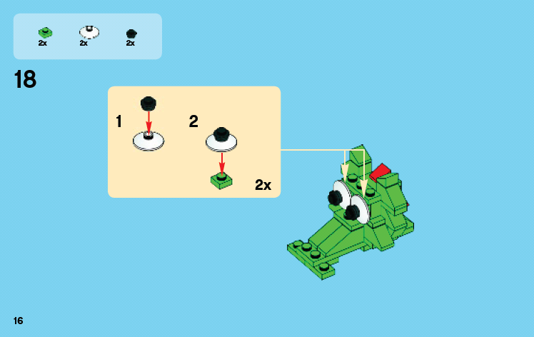
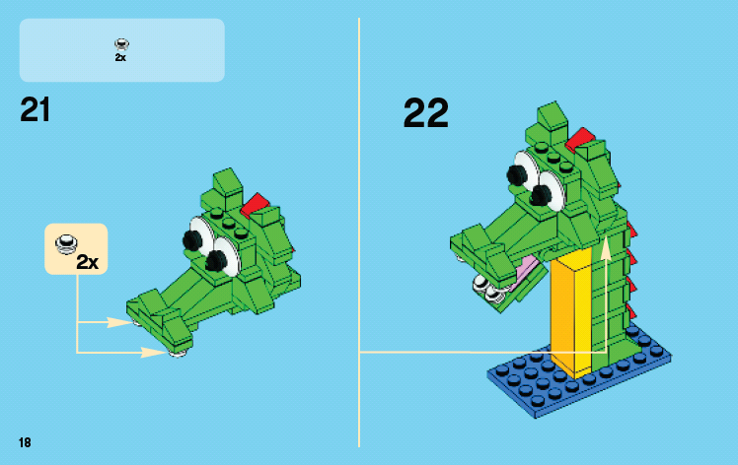

Slide 12
What is an Algorithm?
Algorithm: A finite sequence of effective (unambiguous, possible) steps to solve a problem.
Expressed in English, human-oriented form
Result of top-down design (or other problem solving strategy)
A well written algorithm can be written in any computer programming language
Generally written in pseudo-code and/or visualized in a flowchart

Slide 13
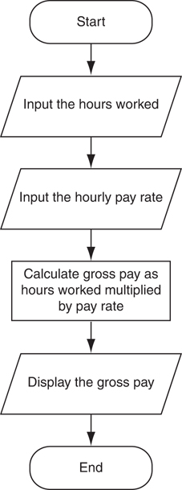
Pseudocode
Pseudocode: fake code
Informal language that has no syntax rule
Not meant to be compiled or executed
Used to create model program
No need to worry about syntax errors, can focus on program’s design
Can be translated directly into actual code in any programming language
Flowchart: diagram that graphically depicts the steps in a program
Ovals are terminal symbols
Parallelograms are input and output symbols
Rectangles are processing symbols
Symbols are connected by arrows that represent the flow of the program

Slide 14
What is Programming?

Slide 15
What is Programming?
Programming: the process of creating software by translating algorithms into a computer language.
Algorithm: human readable form, layout/syntax is free as long as a reasonable person can understand it
Computer Program: computer readable form, precise syntax that must be followed exactly, will do exactly what you say (not what you meant!) - SOFTWARE

Slide 16
Where Are We Going?
Computers are tools that we use to solve problems
Need to understand the problem that we want to solve
Need to understand how a computer works to model the problem
Need to learn how to program the computer to solve the problem

Slide 17
Programming Languages
Many programming languages available
Offer different features
Each has its own strengths and weaknesses
Common features
Allow us to control the behaviour of a computer
Defined syntactic and semantic rules
Syntactic – what does a valid statement look like
Semantic – what is meaning of a statement

Slide 18
Example: Syntax versus Semantics
Python 2:
5 / 2 = 2
5 / 2.0 = 2.5
5.0 / 2 = 2.5
Python 3
5 / 2 = 2.5
5 / 2.0 = 2.5
5.0 / 2 = 2.5
Syntax is the same.
Division is done via /
Semantics are different.
Python 2 division result is based on whether one input has decimals
One decimal value number creates decimals out
Python 3 always produces decimal numbers

Slide 19
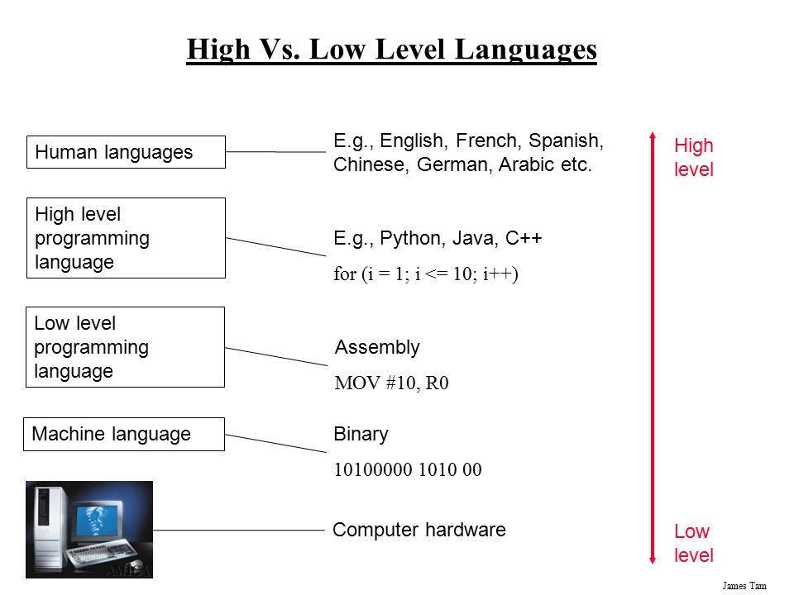
High Level Vs. Low Level Languages
Ambiguity,
Redundancy,..
Accuracy,
Concise,…

Slide 20
High Level Vs. Low Level Languages
Ambiguity,
Redundancy,..
We will be writing in Python (a high-level language), to run source code of a program it is compiled to binary code (machine code) which the hardware stores as electrical information
Accuracy,
Concise,…

Slide 21
Using Python
Python 3 is the official programming language for this course.
There are different ways to tell Python to execute your code:
Interactive coding
System command lines and files

Slide 22
Compiler/Interpreter

Slide 23
Programming
Computer programs are stored in source code files
Human readable / editable
Can also be understood by a computer
typically have the extension .py
.py extension, or any extension is completely option in the computer, I could write a program in a file called jingle.bells and and it would work
Once the file is created, it is run using the installed python program
python myfile.py
Also! python jingle.bells

Slide 24
Compilers Vs. Interpreter
A compiler:
Is like translating an entire book and give it to a reader.
A compiler reads the program and translates it completely before the program starts running
An interpreter
is like translating a line at a time and give the line to the uses until the book is finished.
It processes the program a little at a time, alternately reading lines and performing computations.

Slide 25
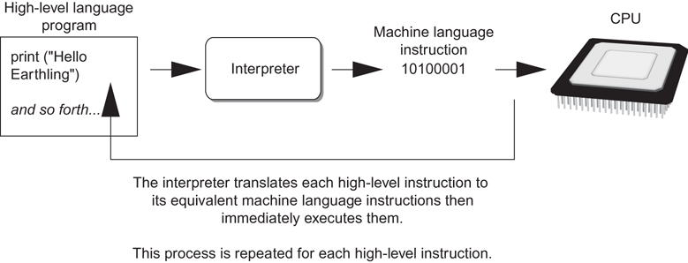
Interpreting code

Slide 26
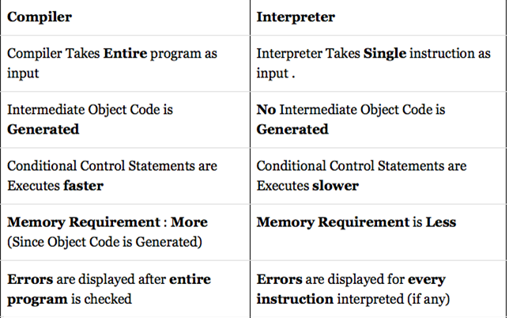
Difference between Compiler and Interpreter

Slide 27
Compiler or Interpreter
Many modern languages use both processes.
Python uses both processes.
Python is a compiled interpreted language
Python is first compiled into a lower-level language, called byte code, and then interpreted by a program called a virtual machine.
(byte code is higher level than machine code, we can still move it between machine types Ex. Win/MacOS. Machine code can only move within same type.)
A virtual machine is created for each machine type.
There is also an interpreter-only mode for Python where we can type instructions line by line. However, it is rare to use this outside of teaching programming.

Slide 28
Coding

Slide 29
Command lines and files
You can check your version using python –V
If the result is 2.X.X then
You will have to use: python3 hello.py

Slide 30
Interactive coding (Interpreter-only mode)
>>> is a Python prompt indicating that python is ready to accept commands
Python Functions:
print() → prints text to the screen
exit() → exits python

Slide 31
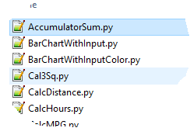
Command Lines and Files
Source code is a file containing your code often referred to as a program.
The filename ends with a .py suffix
e.g. hello.py
To execute from terminal/shell:
python hello.py
To save the output into a file:
python hello.py > output.txt

Slide 32
Onward to … variables!
Jonathan Hudson
jwhudson@ucalgary.ca
https://pages.cpsc.ucalgary.ca/~hudsonj/

