Slide 1
Popular Libraries
CPSC 217: Introduction to Computer Science for Multidisciplinary Studies I
Winter 2023
Jonathan Hudson, Ph.D.
Instructor
Department of Computer Science
University of Calgary
January 9, 2023
Copyright © 2023

Slide 2
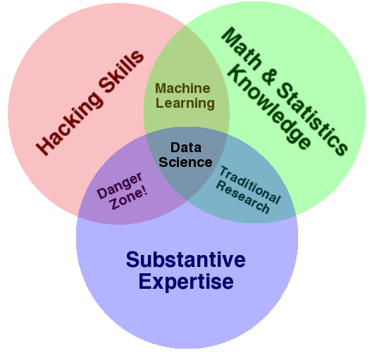
What is Data Science?
Drew Conway’s September 2010 Data Science Venn Diagram
http://drewconway.com/zia/2013/3/26/the-data-science-venn-diagram

Slide 3
Python
Python 3 – Most popular Data Science programming language
R is popular from the Statistics side of things, Julia in Mathematics
Very strong support of packages, tutorials, and knowledge
Ease of integrating more efficient languages behind scenes like C++, etc.
Often prototype in R/others but implement in Python for final production
Interpreted, so can be slow (unless break out to C++ like with numpy)
Not built for multi-thread concurrency without effort (unless break out like with tensorflow for neural networks to use multi-core/GPU)

Slide 4
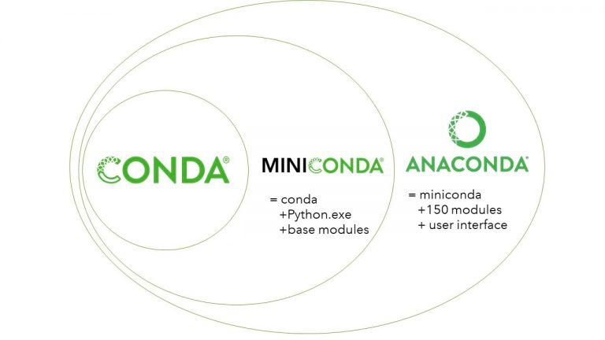
Data Science Installation Method (managed)
Anaconda – Distribution of Python 3 and package manager that allows easy access to most popular data science libraries
Miniconda – Lighter weight than Anaconda as it doesn’t pre-download as many packages
Generally early learning path is to get miniconda
https://docs.conda.io/en/latest/miniconda.html
Then install
The first is for Data Science tasks while the second line of installation is for Machine Learning
Notes:
conda install numpy pandas matplotlib seaborn ipython jupyterlab
conda install scipy scikit-learn tensorflow keras statsmodels

Slide 5
Data Science Installation (lightweight)
Could just use available Jupyter notebook ipython-like environments such as
Google Colaboratory https://colab.research.google.com/ (public)
Syzygy https://ucalgary.syzygy.ca/ (university member host)
Or setup your local install of Python
IDE choice up to you (for Python prefer I like Pycharm)
Recommend virtual environment (good for UofC lab machines)
pip for packages (python package manager)

Slide 6
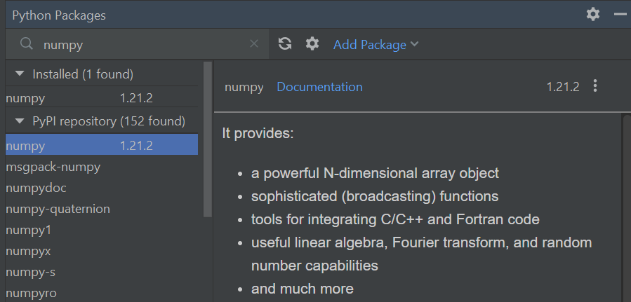
Data Science Installation (IDE-Pycharm)
Bottom bar of Pycharm
Can use terminal to install packages to main IDE Python install
Can also use package manager to do same

Slide 7
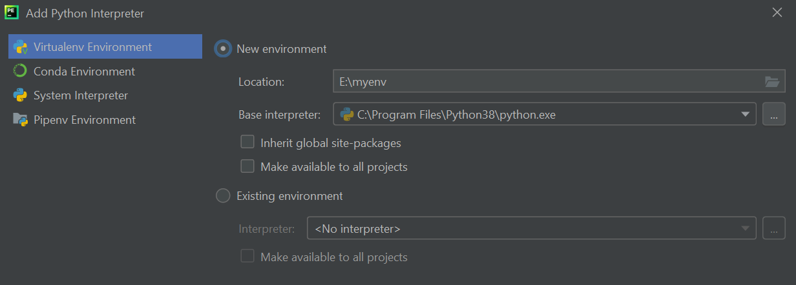
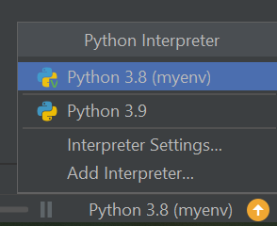
Data Science Installation (IDE-Pycharm)
Instead of using system interpreter you can create virtual environment
Bottom right corner you can toggled between Python interpreters

Slide 8
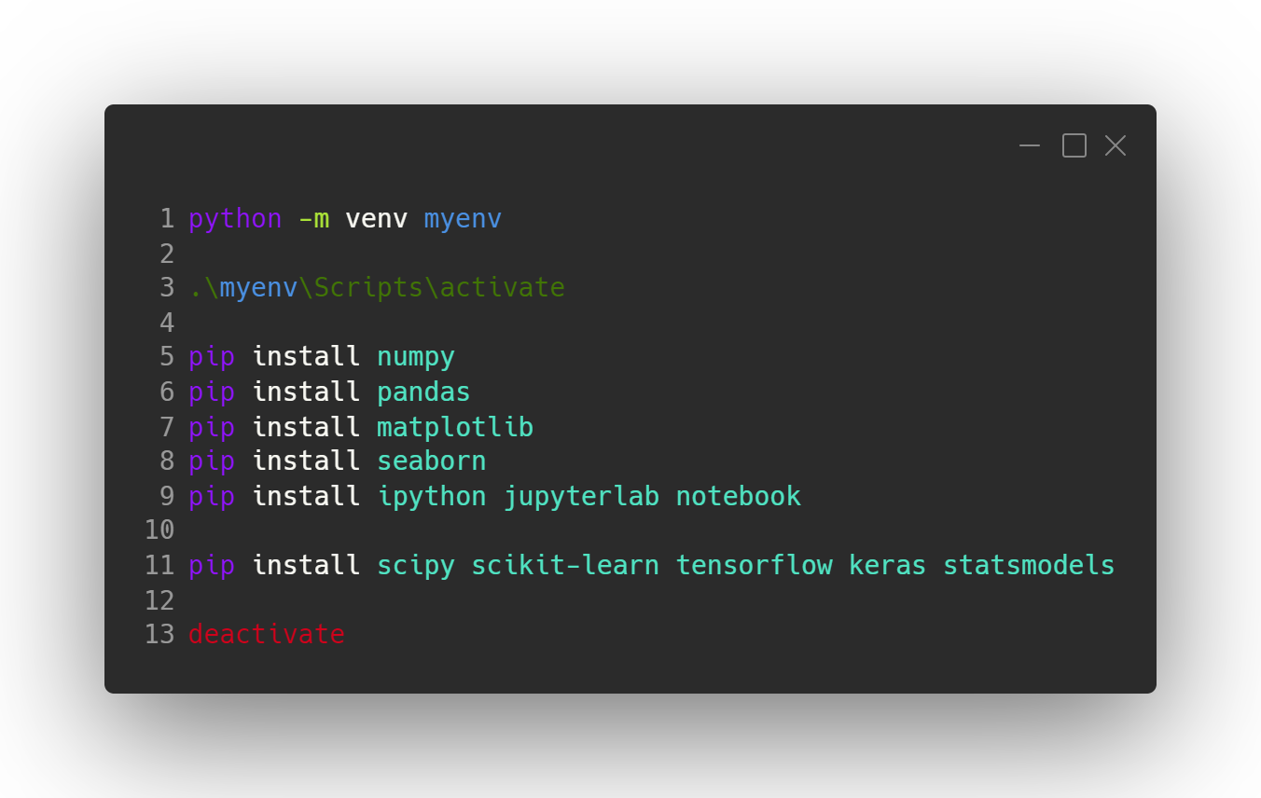
Data Science Installation (windows shell)
Notes:
python -m venv myenv
.\myenv\Scripts\activate
pip install numpy
pip install pandas
pip install matplotlib
pip install seaborn
pip install ipython jupyterlab notebook
pip install scipy scikit-learn tensorflow keras statsmodels
deactivate

Slide 9
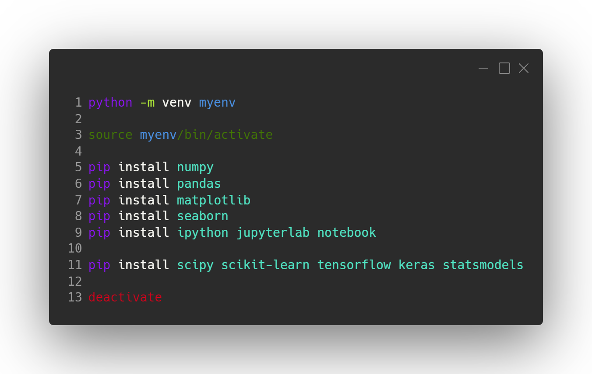
Data Science Installation (unix shell)
Notes:
python -m venv myenv
source myenv/bin/activate
pip install numpy
pip install pandas
pip install matplotlib
pip install seaborn
pip install ipython jupyterlab notebook
pip install scipy scikit-learn tensorflow keras statsmodels
deactivate

Slide 10
Packages - Interaction
IPython (2001)
https://ipython.org/
This is a interactive version of Python. Differences from regular interactive is that it can store state for reference using In and Out blocks (stored as arrays), and you can also break out of it to run shell commands from inside (like to install library or make folders and manage files)
jupyter notebooks (2014)
https://jupyter.org/
GUI to IPython,. Your computer hosts a execution kernel and you access it using a web browser web-based interface (like the Google Colaboratory and Syzygy options given earlier) Can do other languages as well.

Slide 11
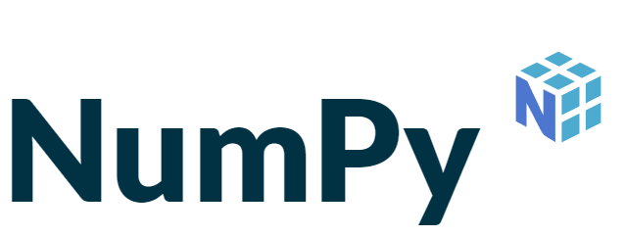
Packages – Standard Data Science
numpy – manipulation of homogenous array-based data, container
https://numpy.org/
pandas – 2010, heterogenous and labeled data like tables or databases, brings spreadsheets like functionality to data handling (on top of numpy)
https://pandas.pydata.org/
matplotlib – publication quality visuals
https://matplotlib.org/
seaborn – better charts on top of matplotlib (compete with R)
https://seaborn.pydata.org/

Slide 12
Packages – Machine Learning
scipy – scikit uses for algorithms, good at storing sparse, common scientific computing tasks (integration, linear algebra, optimization, signal processing, statistics distributions/variables/etc.)
https://scipy.org/
scikit-learn – 2010 machine learning, classification, regression, clustering, etc.
https://scikit-learn.org/stable/index.html
tensorflow – 2015 open-sourced distributed neural network library, 2019 v2.0
https://www.tensorflow.org/
keras – 2015 deep learning library (often on top of tensorflow)
https://keras.io/
statmodels – classical statistics and econometrics
https://www.statsmodels.org/stable/index.html

Slide 13
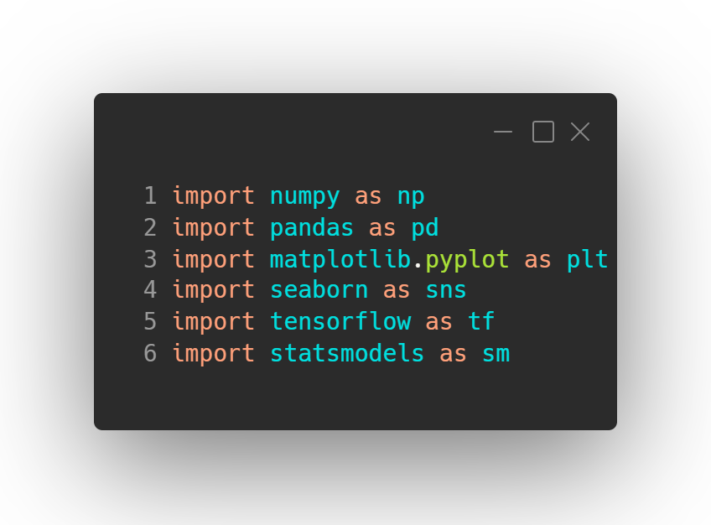
Importing Libraries in Python (style)
Notes:
import numpy as np
import pandas as pd
import matplotlib.pyplot as plt
import seaborn as sns
import tensorflow as tf
import statsmodels as sm

Slide 14
numpy, pandas, matplotlib
numpy - > Numpy is one of the main libraries used in machine learning and data science: it is used for a variety of mathematical computations, written in optimized C code at its base.
pandas -> Pandas is a library for data manipulation. It is highly compatible with Numpy, although it has some subtleties.
matplotlib -> As it name implies, this is Python’s main plotting library. A number of other libraries such as seaborn rely on this.

Slide 15
numpy

Slide 16
numpy
Numerical Python library (2005 brought together disparate library ideas)
More efficient data and storage operations as arrays grow larger
Python integer is more than an integer, and a list more than just values

Slide 17
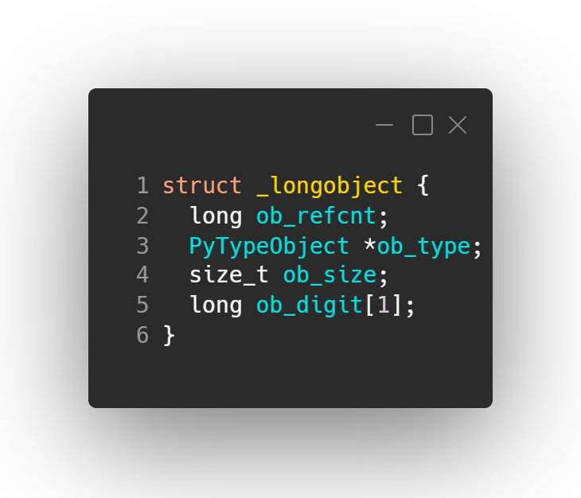
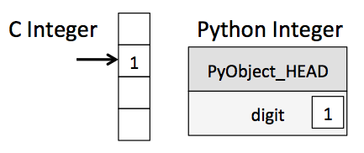
integers?
Python integer is more than an integer
Python 3.4 integer
A C integer is essentially a label for a position in memory whose bytes encode an integer value.
A Python integer is a pointer to a position in memory containing all the Python object information, including the bytes that contain the integer value.

Slide 18
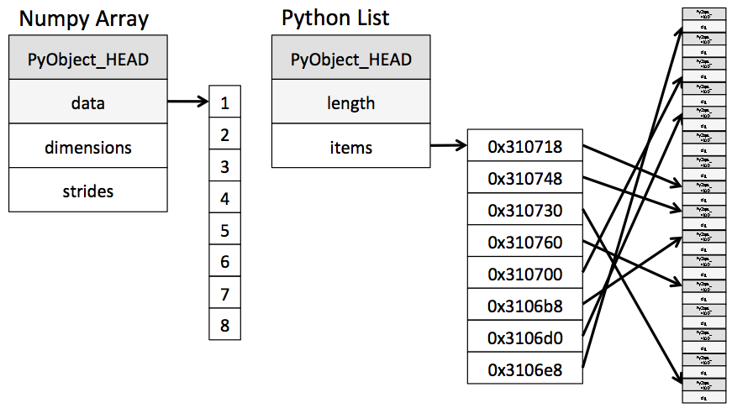
lists?
A Python list is more than just a list of values
A Python list contains a pointer to a block of pointers, each of which in turn points to a full Python object like the Python integer we saw earlier.
numpy arrays are a single pointer to a block of contiguous data.

Slide 19
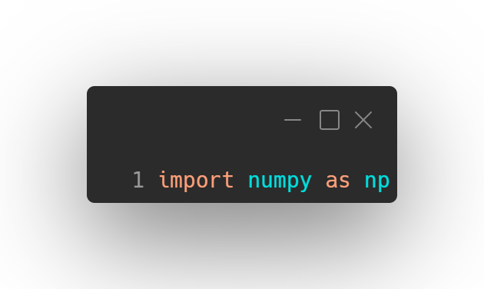
numpy
Numerical Python library
More efficient data and storage operations as arrays grow larger
Python integer is more than an integer, and a list more than just values
numpy arrays allow us to put data all in one place and drastically improve the our ability to manipulate it quickly.
In essences what numpy does is provide a portal from Python through to C implementations of storage arrays, allowing us to access the strengths of that language in ways not normally available in Python.

Slide 20
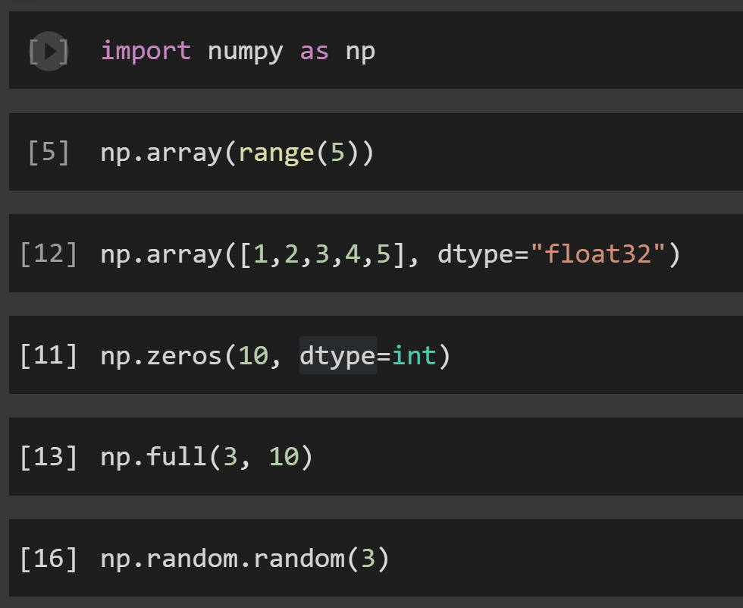
Create
Numerous options to create numpy arrays
Notes:
import numpy as np
np.array(range(5))
np.array([1,2,3,4,5], dtype="float32")
np.zeros(10, dtype=int)
np.full(3, 10)
np.random.random(3)

Slide 21
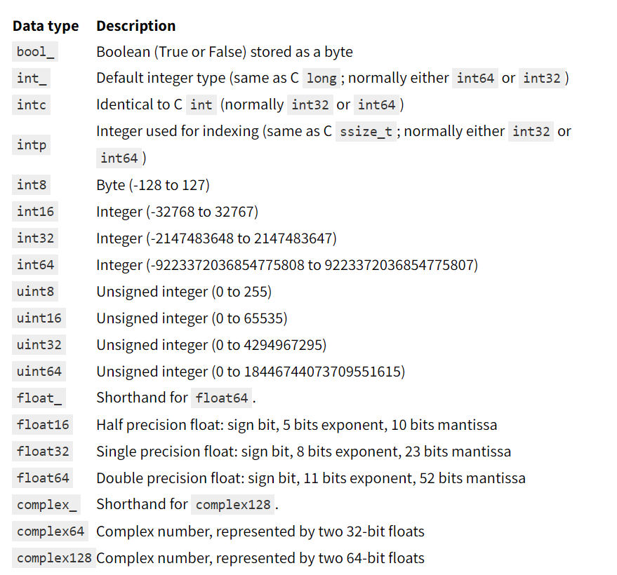
Datatypes
To gain the power of C arrays Python now has to care about all the types that a C programmer has to manage

Slide 22
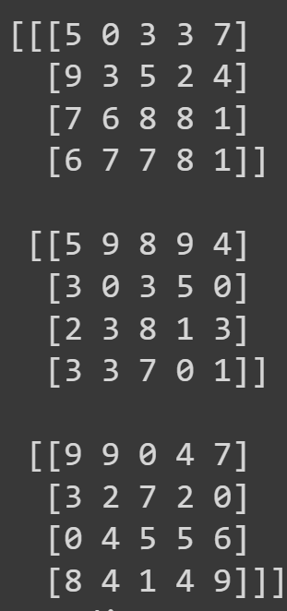
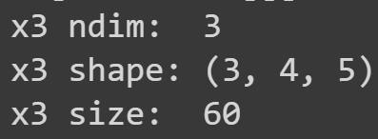
Attributes
Three attributes of all arrays 1.the dimensions (count) 2. tuple of size of each dimension AKA shape 3. Total size which is product of tuple.
Notes:
np.random.seed(0) # seed for reproducibility
x3 = np.random.randint(10, size=(3, 4, 5)) # Three-dimensional array
print(x3)
print("x3 ndim: ", x3.ndim)
print("x3 shape:", x3.shape)
print("x3 size: ", x3.size)

Slide 23
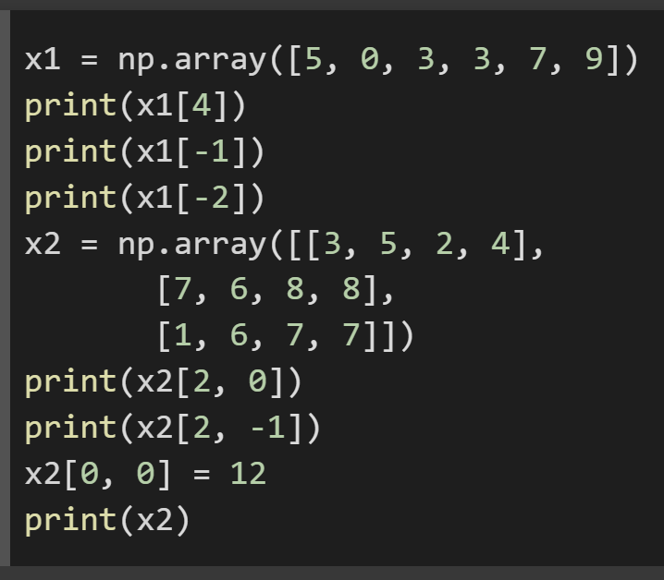
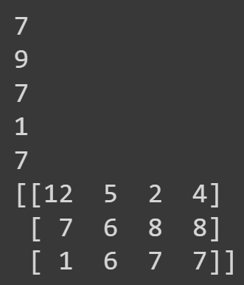
Indexing
Mostly slight notation adjustment for multiple dimensions [a][b] is now [a,b]
Slicing also retained (but slices are NOT copies! [use .copy() to copy])
Notes:
x1 = np.array([5, 0, 3, 3, 7, 9])
print(x1[4])
print(x1[-1])
print(x1[-2])
x2 = np.array([[3, 5, 2, 4],
[7, 6, 8, 8],
[1, 6, 7, 7]])
print(x2[2, 0])
print(x2[2, -1])
x2[0, 0] = 12
print(x2)

Slide 24
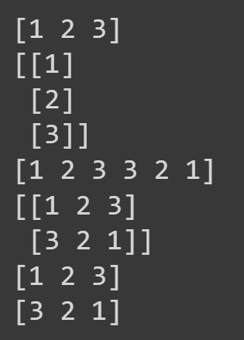
Reshape, Concatenate, Stack, Split
Notes:
x = np.array([1, 2, 3])
y = x.reshape((3, 1))
print(x)
print(y)
z = np.array([3, 2, 1])
w = np.concatenate([x, z])
u = np.stack([x,z])
print(w)
print(u)
a, b = np.split(w, [3])
print(a)
print(b)

Slide 25
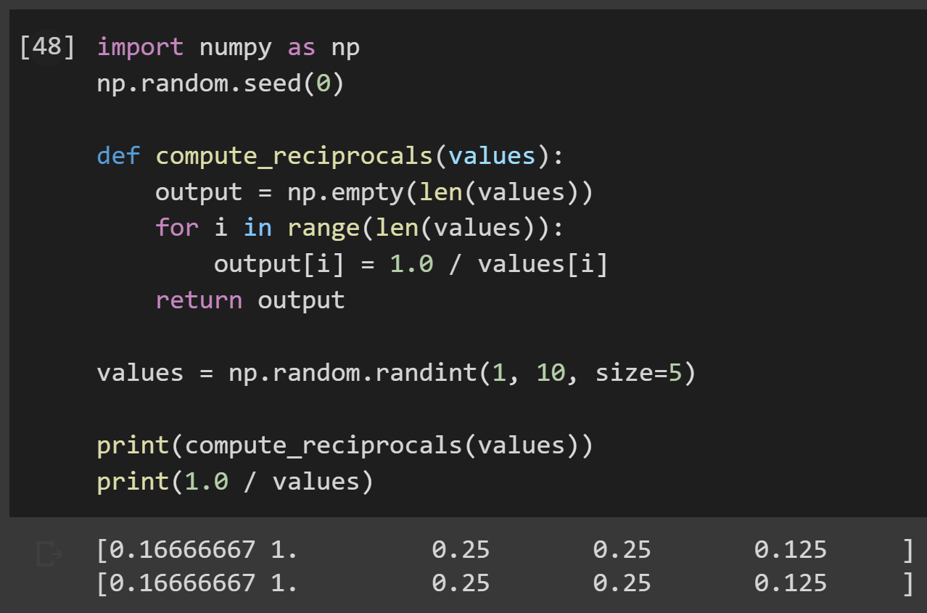
Speed
numpy operations speed comes from a large variety of Universal Functions (Ufuncs) which are ‘vectorized operations’ designed to run at higher speed than if we let Python’s loops manage things
Both computer same answer!
Notes:
import numpy as np
np.random.seed(0)
def compute_reciprocals(values):
output = np.empty(len(values))
for i in range(len(values)):
output[i] = 1.0 / values[i]
return output
values = np.random.randint(1, 10, size=5)
print(compute_reciprocals(values))
print(1.0 / values)

Slide 26
Speed
Both computer same answer!
Milliseconds versus microseconds (a difference in order of magnitude of 1000 here)
Notes:
big_array = np.random.randint(1, 100, size=100000)
print("Python")
%timeit compute_reciprocals(big_array)
print("numpy")
%timeit (1.0 / big_array)

Slide 27
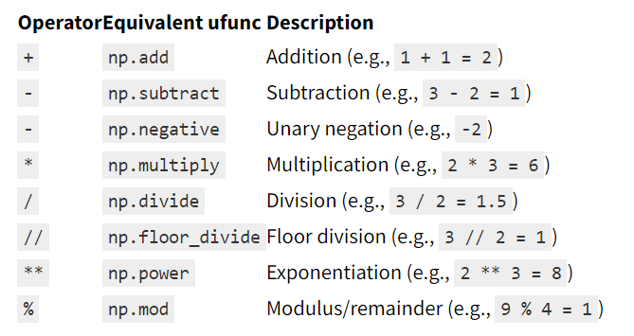
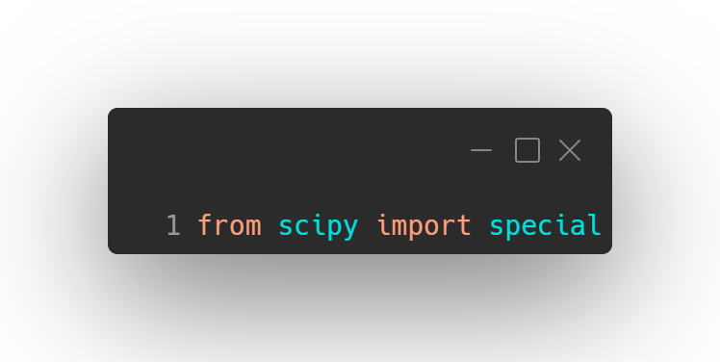
UFuncs
Most Ufuncs are accessible using straight operators, although we can always use the longer form of np.divide for example
Some don’t have operators like
np.abs(array)
np.sin(array), np.cos(array), etc.
np.log2(array), np.ln(array), etc.
np.sqrt(array), np.floor(array), etc.
Others available via scipy under special

Slide 28
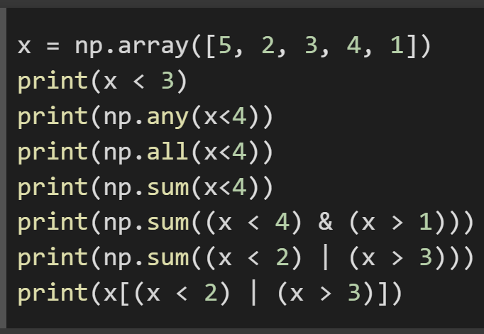
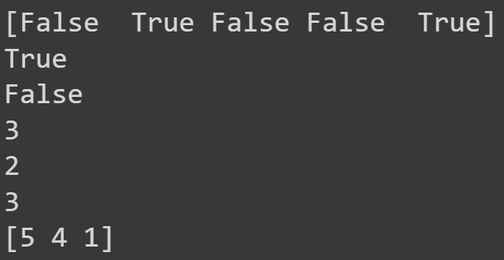
Boolean arrays
Can use booleans to ask questions, combine booleans with bitwise operators
Will product boolean arrays which can then be used as ‘masks’ for filtering
Notes:
x = np.array([5, 2, 3, 4, 1])
print(x < 3)
print(np.any(x<4))
print(np.all(x<4))
print(np.sum(x<4))
print(np.sum((x < 4) & (x > 1)))
print(np.sum((x < 2) | (x > 3)))
print(x[(x < 2) | (x > 3)])

Slide 29
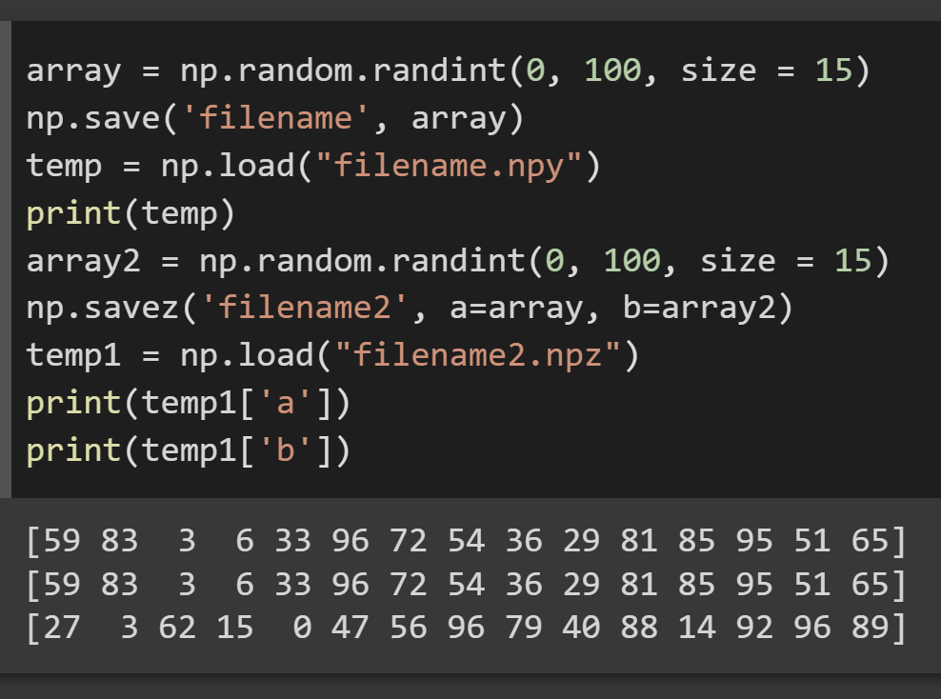
Save/Load
numpy has both straight forward save/load, but also ability to save multiple in a form that multiple arrays can be reloaded and referenced by stored key
Notes:
array = np.random.randint(0, 100, size = 15)
np.save('filename', array)
temp = np.load("filename.npy")
print(temp)
array2 = np.random.randint(0, 100, size = 15)
np.savez('filename2', a=array, b=array2)
temp1 = np.load("filename2.npz")
print(temp1['a'])
print(temp1['b'])

Slide 30
pandas

Slide 31
pandas
pandas (2010) is built on numpy
recognition of outside influences and inside software engineering influences
Outside -> want array storage to work like spreadsheets/databases
Inside -> named data for readability and lookup
Built around Series and Dataframe ideas which are essentially 1 dimensional array of data and multidimensional array of data with row/column labels
Allows us to reference data with names, while maintaining numpy speed

Slide 32
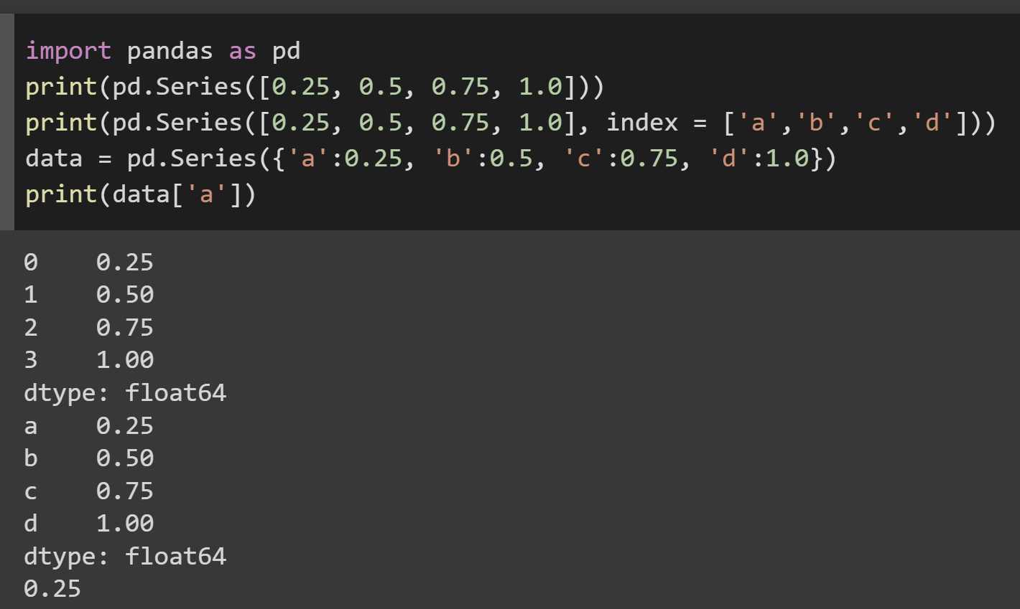
Series
1D data is a Series, which acts like a specialized dictionary (default indices are integers)

Slide 33
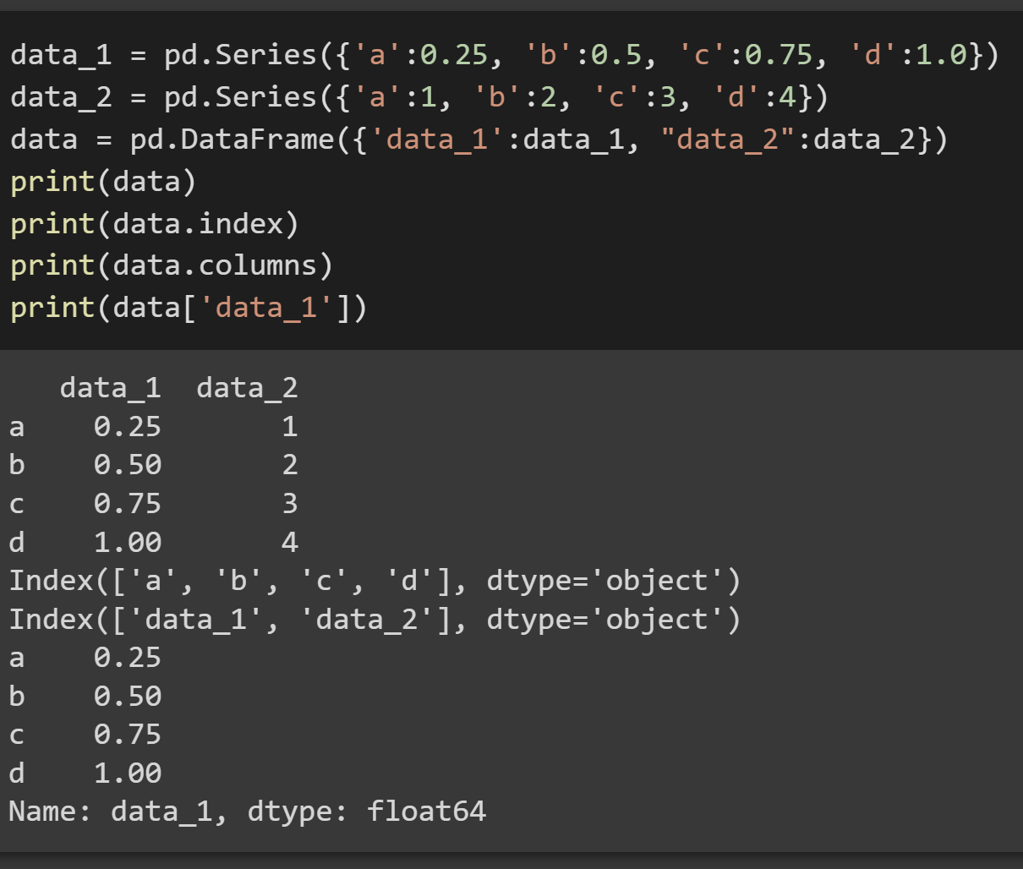
Dataframe
2D data is a DataFrame, which acts like a specialized dictionary of Series

Slide 34
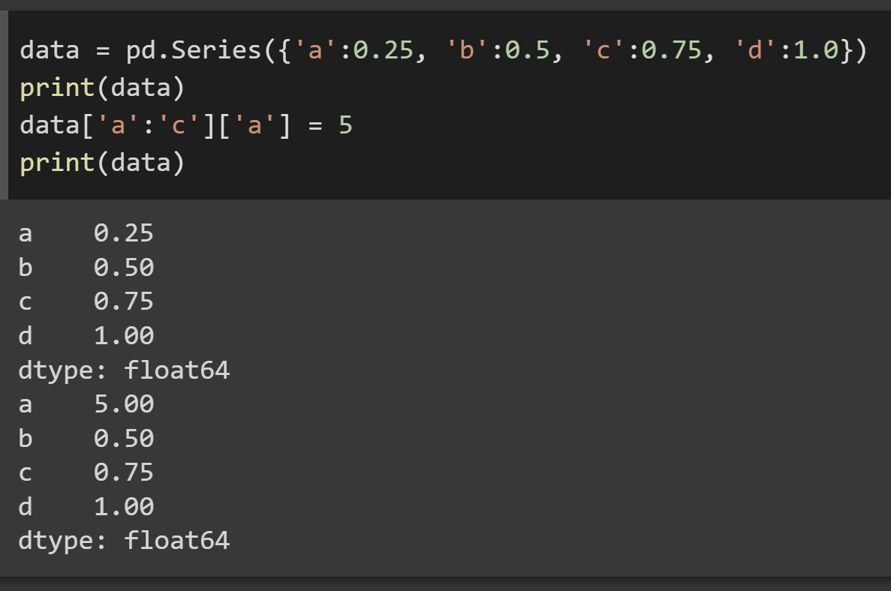
Danger Will Robinson!
Slices are not copies (better thought of a views of data)
This is great for speed as data isn’t copied, but it means modification of slice means modifying the original data

Slide 35
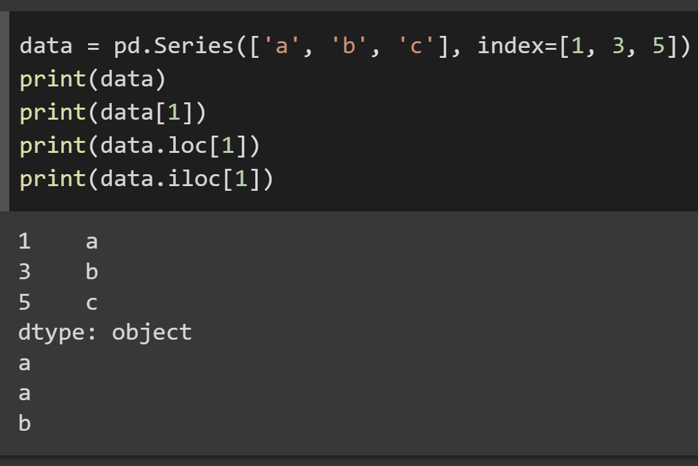
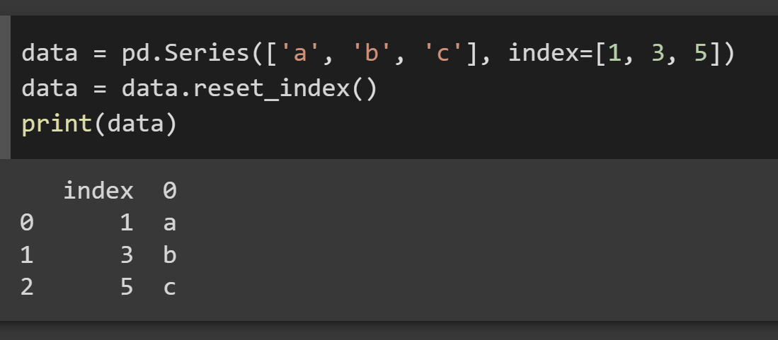
Indexing?
We can index using the dictionary keys (index) but sometimes that can be confusing as there is both the explicit index and an always maintained integer (starts at 0) index as well
loc, iloc is how we ensure we are doing the numerical type
reset_index() useful for pushing current index into column and returning to integer index

Slide 36
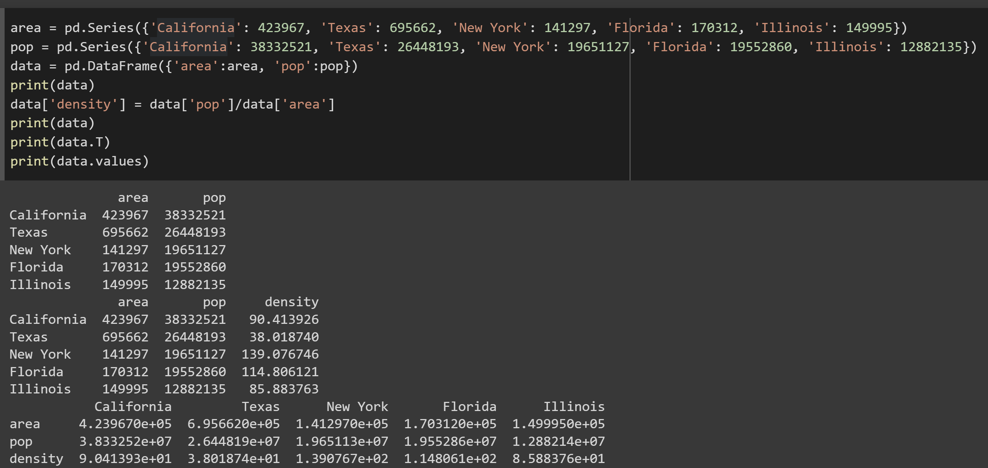
DataFrame operations
DataFrame allow for very quick generation of new columns of data
Can be transposed quickly and values() gives the numpy data

Slide 37
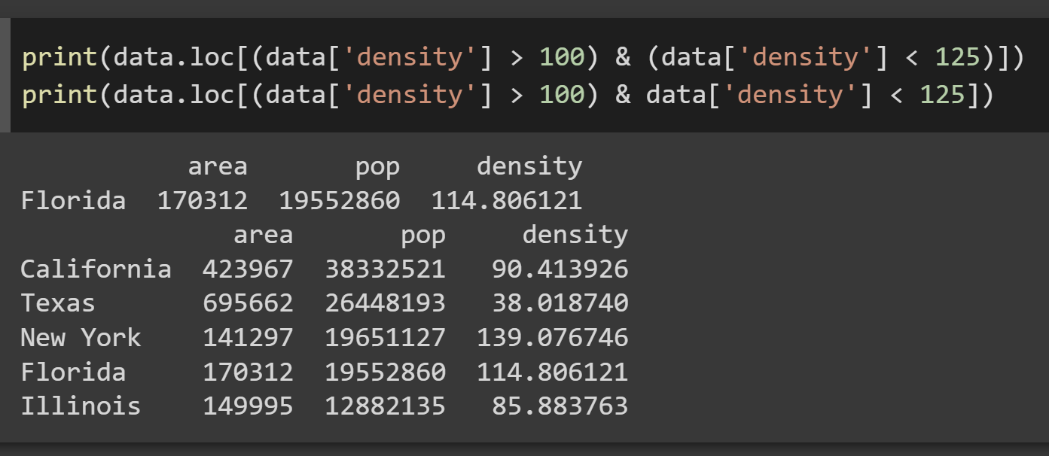
DataFrame operations
Wary of missing ()

Slide 38
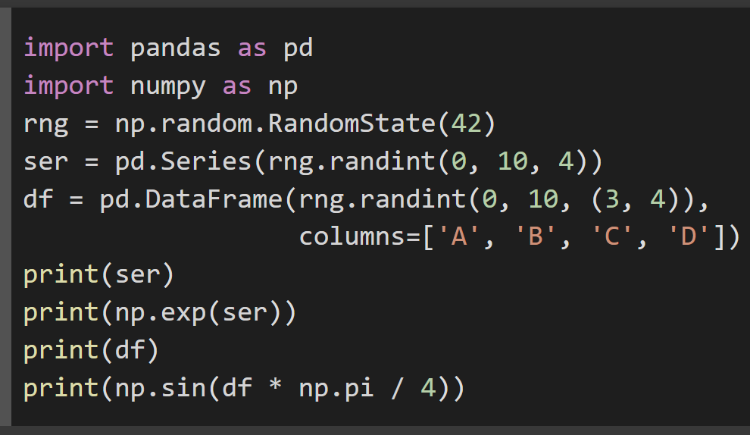
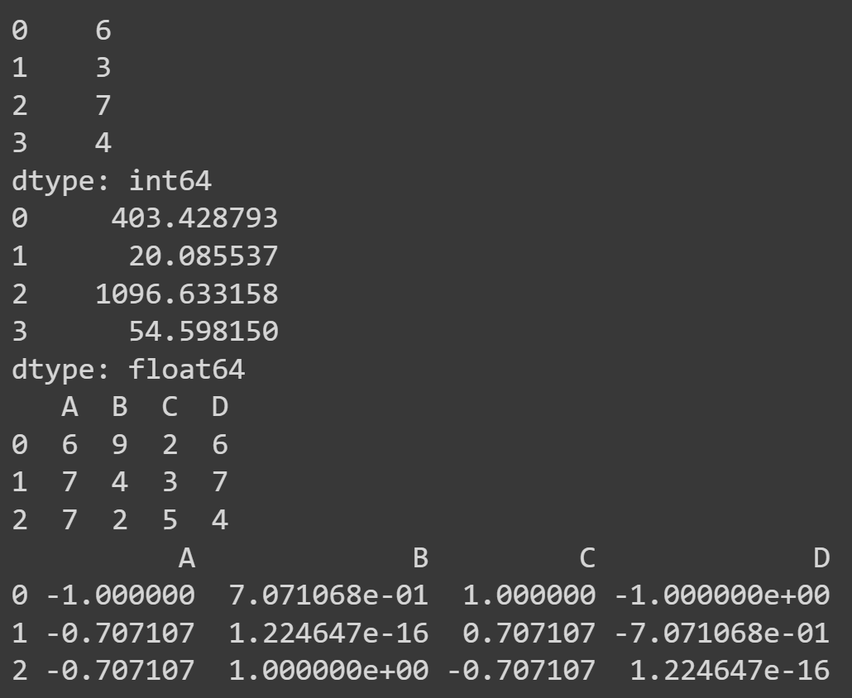
DataFrame UFuncs
numpy Ufuncs can be applied across a whole DataFrame

Slide 39
Capabilities
Missing Data (None/NaN)
Concatenate
Join (like databases)
Aggregate
GroupBy
Filtering, Transform, Apply, Map
Pivot Tables (like excel)
Describe, Correlation, Statistics
Unique, Count, Masking

Slide 40
Reading/Writing Files
Pandas can do many operations like
read_csv, read_excel, read_html, read_json, read_pickle, read_sql
In addition to others for data
Possible to do many things such as setting names, skipping rows, limit rows, etc.
to_csv used to write csv data
Other libraries relevant here Python csv module, json library, beautifulsoup/lxml/html5lib for HTML, binary data using pickle, web-api generally use request, SQL database using sqlite3/sqlalchemy

Slide 41
matplotlib

Slide 42
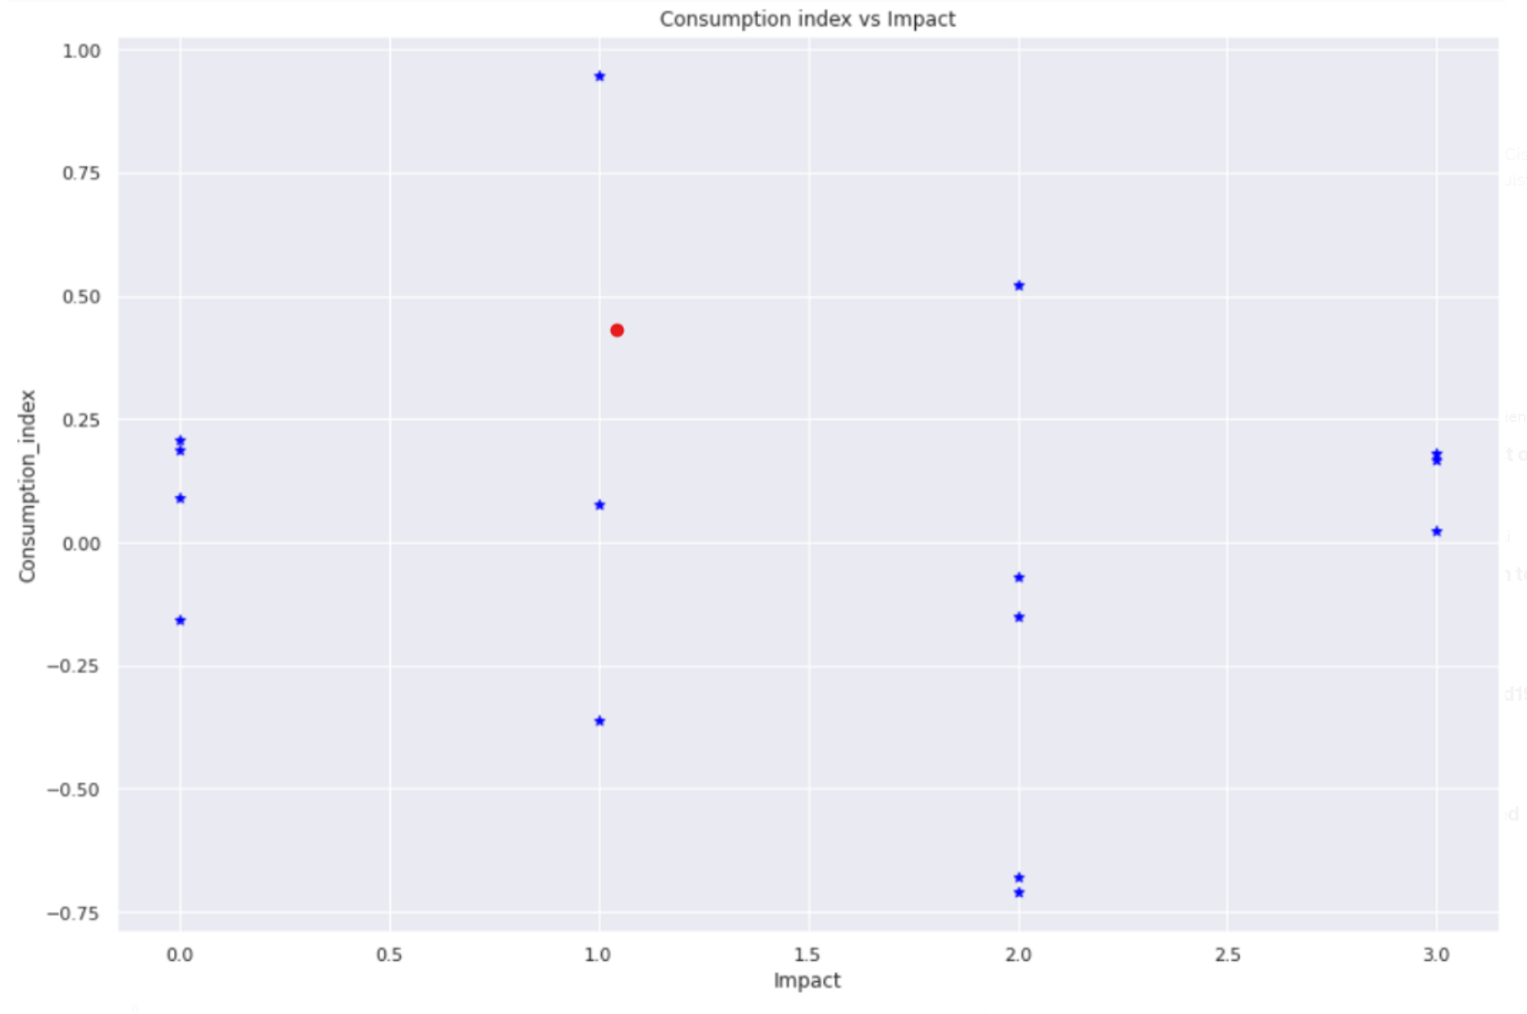
matplotlib charts!
# specify figure to plot on
plt.figure(figsize=(15,10))
# Obtain x and y arrays
x = df2["Impact"]
y = df2["kll_index"]
# plot the scatterplot
plt.scatter(x,y, color="blue", marker="*")
# add title and labels
plt.title("Consumption index vs Impact")
plt.xlabel("Impact")
plt.ylabel("Consumption_index")
plt.show()
https://matplotlib.org/stable/users/getting_started/index.html

Slide 43
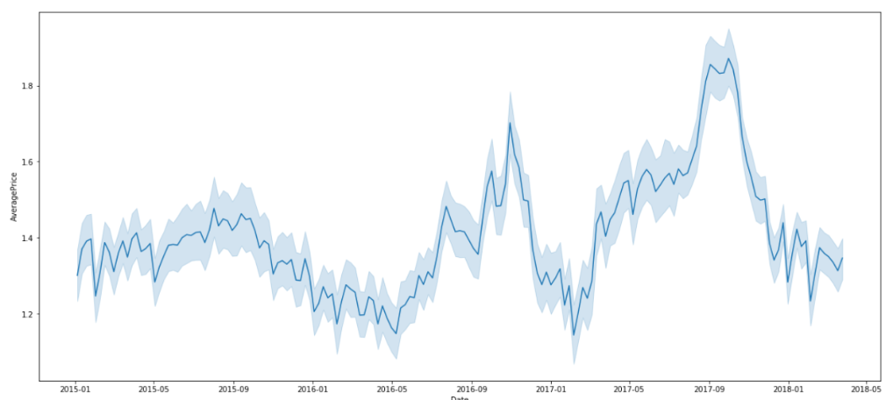
Seaborn?
import seaborn as sns #pip install seaborn
df = pd.read_csv('avocado.csv')'
plt.figure(figsize=(20,9)
sns.lineplot(data=df, x='Date',y='AveragePrice')

Slide 44
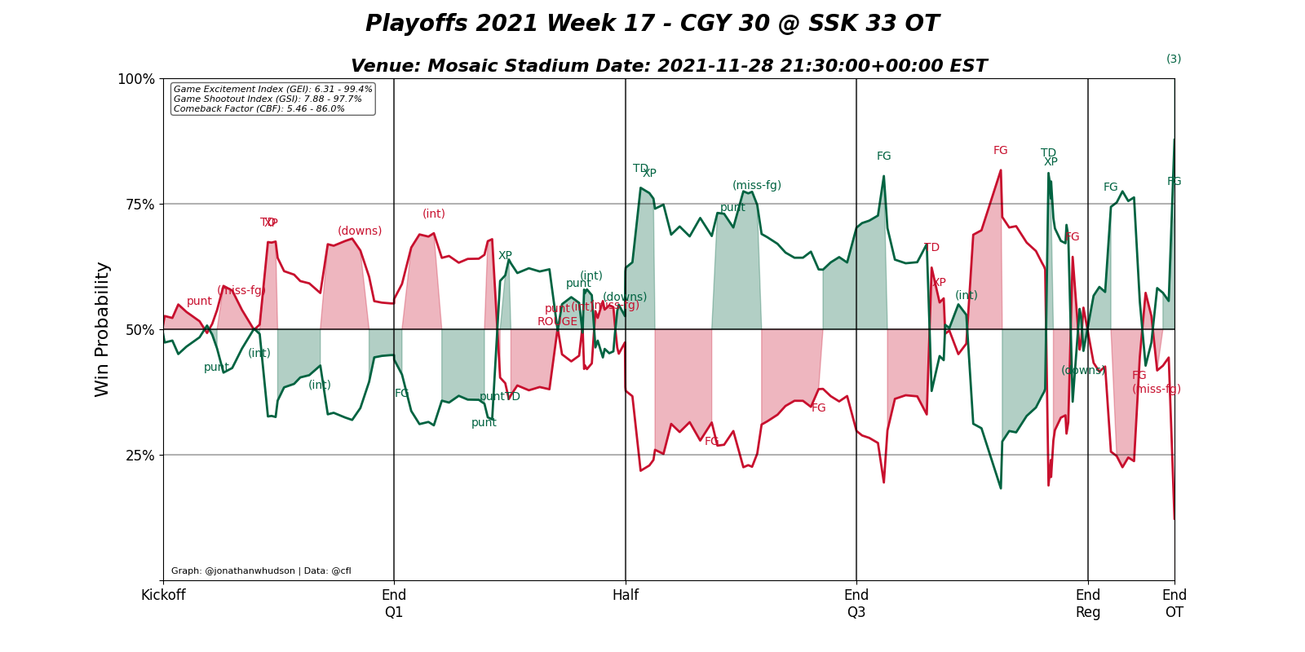
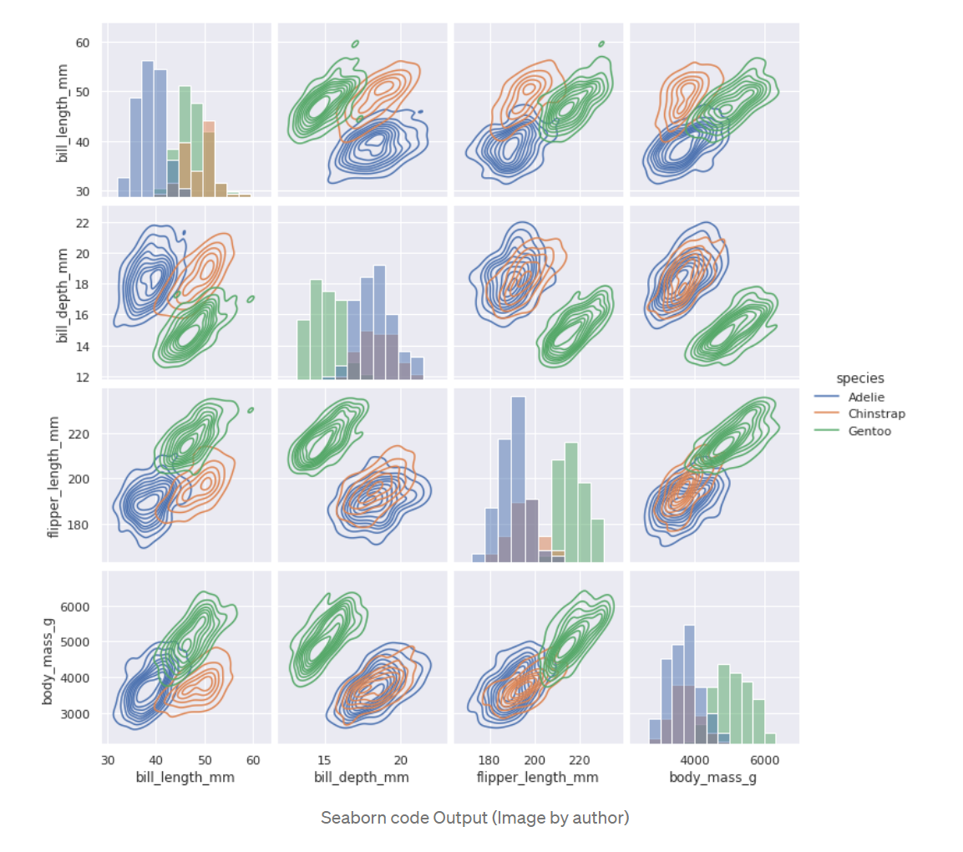
Seaborn?

Slide 45
Onward to … History of Computer Science.
Jonathan Hudson
jwhudson@ucalgary.ca
https://pages.cpsc.ucalgary.ca/~jwhudson/

