Slide 1
Team Contract Workshop
Presented by:
The Individual & Team Performance Lab

Slide 2
“A verbal contract isn’t worth the paper it’s written on.”
- Sam Goldwyn
Notes:
We have contracts for a lot of professional relationships in our lives, so it makes sense that you have one for the team you’re working in.

Slide 3
What is it?
A team contract outlines the agreed upon operating procedures and team norms.
Notes:
The definition of the team contract is and outline of the agreed on operating procedures and team norms. Having this document laid out will guide your behaviours and interactions to maximize the benefits of working in a team.The more detailed you make your outline, the less room there is for interpretation and potentially issues with team members.

Slide 4
Contract Levels
Expectations
Communication
Meetings
Conflict & Decisions
Stress Management
Breaches & Penalties
Notes:
The levels we’ve provided you are the six most prominent areas that can reduce team effectiveness. They are: Expectations, Communication, Meetings, Conflict & Decision Making, Stress Management, and Code of Conduct. However, this list does not have to be conclusive. If you feel there is something missing that you want to add as a team, you can feel free to do so but at a minimum, you will be required to consider each of the aspects we’ve outlined for you.

Slide 5
A. Expectations
“Expectation, without agreement, is just premeditated resentment”
– adapted from Paul Hardy

Slide 6
Project Expectations
Goals, Quality, & Acceptable Outcome(s)
Cs get degrees, but Cs may not be good enough for everyone. Does this project mean the same to everyone in team? What is an acceptable quality of work? Does everyone want the same outcome?
i. Project ii. Member iii. Role
Notes:
One of the biggest challenges students have reported facing in teams are different levels of motivation. For some team members, this project is their priority, whereas others are more concerned about just getting it finished than doing the best possible job. You need to discuss as a team what this project means to each of you, what you want to get out of it, and if there are differences, you have to consider how you can agree on what’s acceptable.

Slide 7
Project Expectations
Team & Individual Deadlines
How will you monitor project deadlines and milestones? How do you make sure that individuals are meeting their deadlines?
i. Project ii. Member iii. Role

Slide 8
Project Expectations
Contribution Equity
If you haven’t experienced a social loafer, it might be you. How will you divide the work? How do you ensure everyone is contributing equally? What will you do if there is inequality?
i. Project ii. Member iii. Role

Slide 9
Member Expectations
Level of Effort & Standard of Work
Discuss as a team what your other priorities are. Is everyone on the same page about how much effort should be given to this project?
i. Project ii. Member iii. Role
Notes:
One of the biggest challenges students have reported facing in teams are different levels of motivation. For some team members, this project is their priority, whereas others are more concerned about just getting it finished than doing the best possible job. You need to discuss as a team what this project means to each of you, what you want to get out of it, and if there are differences, you have to consider how you can agree on what’s acceptable.

Slide 10
Member Expectations
Weekly Time Commitment
Considering everyone’s priorities discussed previously, what is an acceptable amount of time that each member is expected to spend?
i. Project ii. Member iii. Role
Notes:
What’s fair given everyone’s else’s commitments?

Slide 11
Member Expectations
Academic Integrity & Honesty Policies
Why risk it? Plagiarism, pirating, false reports, and improper or missing citations, are bad practice. These could result in serious punishments for individuals and teams.
i. Project ii. Member iii. Role
Notes:
This is pretty self-explanatory. The university is really cracking down on plagiarism. In difficult courses, there is a lot of road-mapping and acts of plagiarism that could result in serious punishments for individuals and teams.

Slide 12
Role Expectations
Titles & Descriptions
Role clarity is key to team effectiveness. Who is responsible for what (e.g., Leader, Technical Lead, Organizer)? What tasks is each role accountable for?
i. Project ii. Member iii. Role
Notes:
One of the biggest issues with teams in industry is around role clarity. If there is even one person who is unclear what their responsibilities are in the team you can end up with unsynchronized workflow, duplicated work, and worse, missed work and deadlines because individuals didn’t realize they had to do something. Make it clear

Slide 13
Role Expectations
Assignment
Roles can be flexible or be assigned to more than one individual, but should always have one accountable person. Are the roles fair?
i. Project ii. Member iii. Role
Notes:
Sometimes it’s fair to have multiple people work on different aspects of the project but there should always be one person who is accountable for the task or role.

Slide 14
B. Communication
“The single biggest problem in communication is the illusion that it has taken place”
– George Bernard Shaw

Slide 15
Communication Medium
How do you want to communicate? Email? Text?
Facebook Messenger? Google Drive?
i. Medium ii. Timelines iii. Conduct

Slide 16
Communication Timelines
Acceptable Hours & Responses
Team members can work different hours (e.g., 9-5, night owls, etc.). When does everyone like to work? What is acceptable for reaching out and expecting responses? How soon do you expect a response?
i. Medium ii. Timelines iii. Conduct

Slide 17
Communication Conduct
How do you want team members to communication within the team (i.e., between members)? Outside of the team (e.g., instructors, mentors, TA)?
i. Medium ii. Timelines iii. Conduct

Slide 18
C. Meetings
“A meeting is an event at which the minutes are kept and hours are lost”
– Unknown

Slide 19
Scheduling
When will you meet? Set a scheduled time, change it if you need to or cancel it if you don’t need it, but at the very least you will always have a time set aside you can get together.
i. Scheduling ii. Involvement iii. Attendance/Notice

Slide 20
Involvement
Meetings are not effective if only one person is participating or prepared. How will the team ensure participation? How should team members prepare for meetings?
i. Scheduling ii. Involvement iii. Attendance/Notice

Slide 21
Attendance & Notice
Life happens. Unexpected events come up. But how should team members deal with unexpected events when it conflicts with a meeting?
i. Scheduling ii. Involvement iii. Attendance/Notice

Slide 22
D. Conflict & Decisions
“Peace is not the absence of conflict, but the ability to cope with it.”
– Dorothy Thomas

Slide 23
Code of Conduct
Conflict can create negative emotions, which can make it difficult to conduct yourself appropriately. But that is no excuse to not be respectful or professional.
i. Conduct ii. Initial/Escalation iii. Decision Making

Slide 24
Initial, Escalation & Resolution
Conflicts can escalate quickly. What steps should to take to de-escalate and resolve a conflict? Who do you trust to make a ruling decision if it can’t be resolved?
i. Conduct ii. Initial/Escalation iii. Decision Making

Slide 25
Decision Making
When you vote majority, someone loses. If someone is not on board with an idea or plan, you could be missing something. Integrate when possible and outline how you can do that. Is there someone you all respect & trust to be a decision judge?
i. Conduct ii. Initial/Escalation iii. Decision Making

Slide 26
E. Stress Management
“There is no health without mental health.”
– David Satcher

Slide 27
Monitoring & Assistance
Each member should have a plan to reduce stress, manage workloads, and prevent burnout. If the plan is not effective, you should be able to find a social support with your team. When in doubt, ask.
i. Monitoring/Assistance ii. Resources

Slide 28
Resources
There is a mental health crisis on campuses where Canadian students feel hopeless, depressed and even suicidal (Macleans, 2012). As a team you can support one another but you should be aware of other resources available to students.
i. Monitoring/Assistance ii. Resources
Notes:
http://www.macleans.ca/education/uniandcollege/the-mental-health-crisis-on-campus/

Slide 29
F. Breaches & Penalties
“People with good intentions make promises but people with good character keep them.”
– Unknown

Slide 30
Breaches
Someone broke the contract, now what? Outline a procedure of how to respectfully make the team member aware of a breach, she/he may not be aware. What happens if he/she does it again?
i. Breaches ii. Penalties

Slide 31
Penalties
Three strikes and you’re out! What are the consequences for breaching the contract? How many times do you need to break it before you’re penalized?
i. Breaches ii. Penalties

Slide 32
Declaration
If you like it, put a signature on it. Signing shows agreement and adds accountability.
Notes:
The definition of the team contract is and outline of the agreed on operating procedures and team norms. Having this document laid out will guide your behaviours and interactions to maximize the benefits of working in a team.The more detailed you make your outline, the less room there is for interpretation and potentially issues with team members.

Slide 33
IF YOU WANT TO GO FAST, GO ALONE.
IF YOU WANT TO GO FAR, GO TOGETHER.

Slide 34


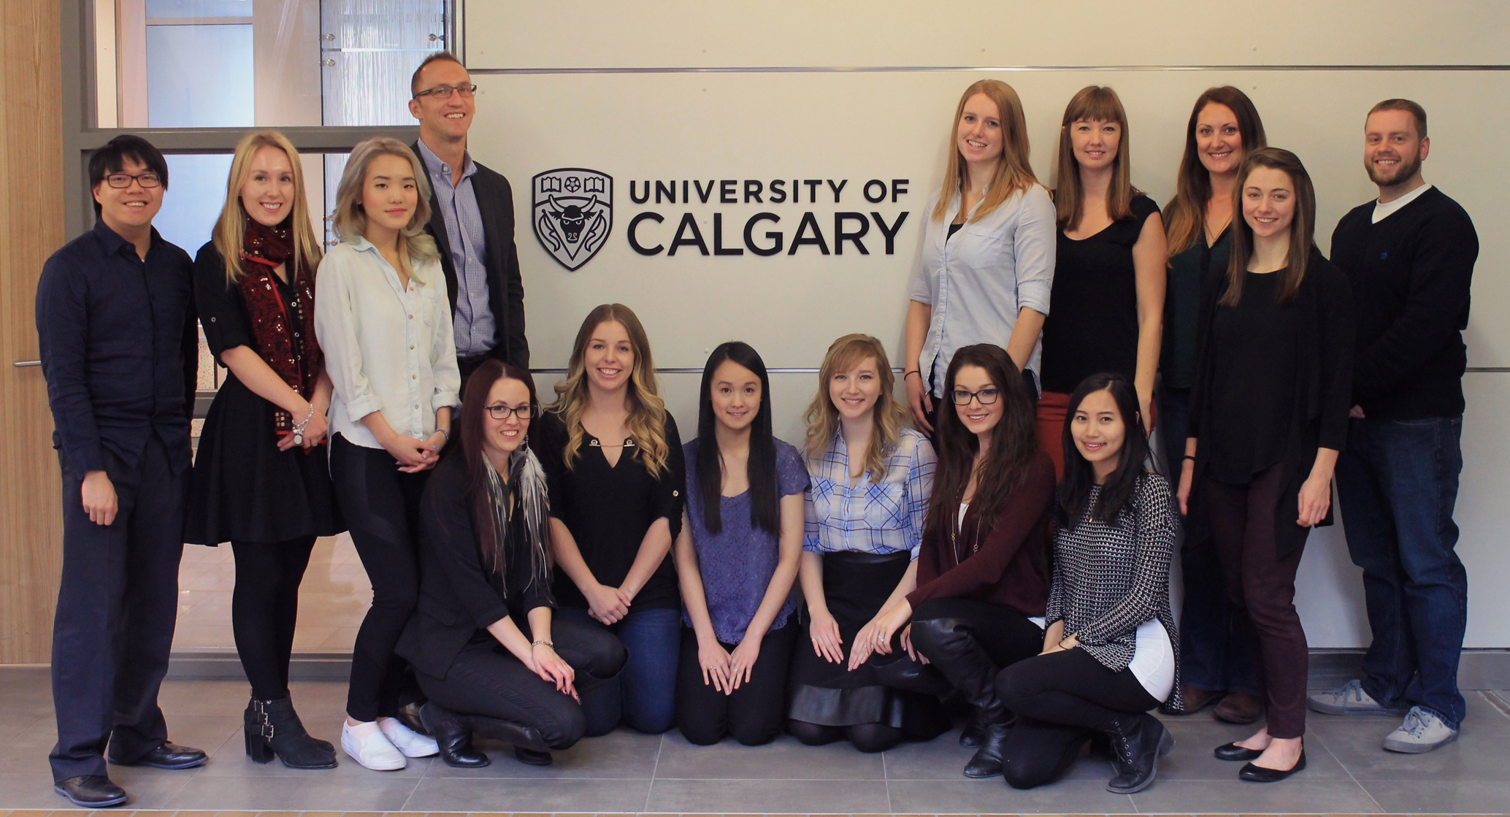
THANK YOU
Contact Tom O’Neill with any comments or suggestions
toneill@ucalgary.ca
@ITPMetrics

