Slide 1
Barrier Counting in
Mixed Wireless Sensor Networks
Shambhavi Srinivasa
Carey Williamson
Zongpeng Li
Department of Computer Science
University of Calgary

Slide 2
Barrier Coverage
Requires a chain of sensors across the deployed region with the coverage areas of adjacent sensors mutually overlapping each other (i.e., to detect intruders)
width
R_{s}
length

Slide 3
Mixed Sensor Networks
Traditional WSNs consist of stationary sensors
Advancements in the field of robotics make it possible to have mobile sensors, which have limited movement range
Mixed Sensor Networks (MSNs) consist of stationary sensors and mobile sensors
Mobile sensors can help to heal coverage gaps and improve barrier coverage
A small number of mobile sensors can provide significant reduction in the percolation threshold (i.e., critical density of sensors at which barrier coverage can be achieved)

Slide 4
Example (1 of 5)
Stationary Sensor
Mobile Sensor

Slide 5
Example (2 of 5)

Slide 6
Example (3 of 5)

Slide 7
Example (4 of 5)

Slide 8
Example (5 of 5)

Slide 9
Prior Related Work
A. Saipulla, B. Liu, G. Xing, X. Fu, and J. Wang, “Barrier Coverage with Sensors of Limited Mobility,” Proceedings of ACM MobiHoc, September 2010.
Introduced notion of MSNs
Discrete (grid-based) locations for mobile sensors
Devised brute force algorithm to detect presence or absence of barrier with limited sensor movement
Demonstrated benefits of having mobile nodes

Slide 10
Our Work
Defined a new variation of barrier coverage problem in Mixed Sensor Networks called the k-connect barrier count problem
Formulated this problem as a variation of the maximum flow problem
Developed exact solutions for k Є {0, 1, 2} using integer linear programming (ILP) formulation
Designed and built MSN simulation environment to test and verify solutions
Used simulator to study effects of sensing radius, movement radius, and the number of mobile sensors on MSN barrier coverage

Slide 11
Problem Definition
k- connect barrier count problem:
“Find the maximum possible number, say η, of simultaneous (i.e., edge-disjoint and vertex-disjoint) strong barriers in a MSN, under the constraint that at most k distinct mobile sensors can be used to construct any given virtual edge.”
That is, an intruder crossing the area of interest is detected by at least η sensors

Slide 12
Research Questions
What is the maximum number of barriers in an arbitrary MSN topology when k Є {0,1,2}?
Where should mobile sensors move to maximize the number of barriers that can be formed?
How do sensing radius, communication radius, movement radius, and the number of mobile sensors affect the barrier coverage probability?
How much benefit do mobile sensors offer?

Slide 13
Research Methodology
MSN Topology
Flow Network
1
2
2
0/1
0/1
1
0/1
s
0/1
t
s
4
t
0/1
3
Flow
0/1
3
4
0/1
Capacity
13
Network flow problem – Max flow problem
Integer Linear Program (ILP) formulation
MSN simulation environment

Slide 14
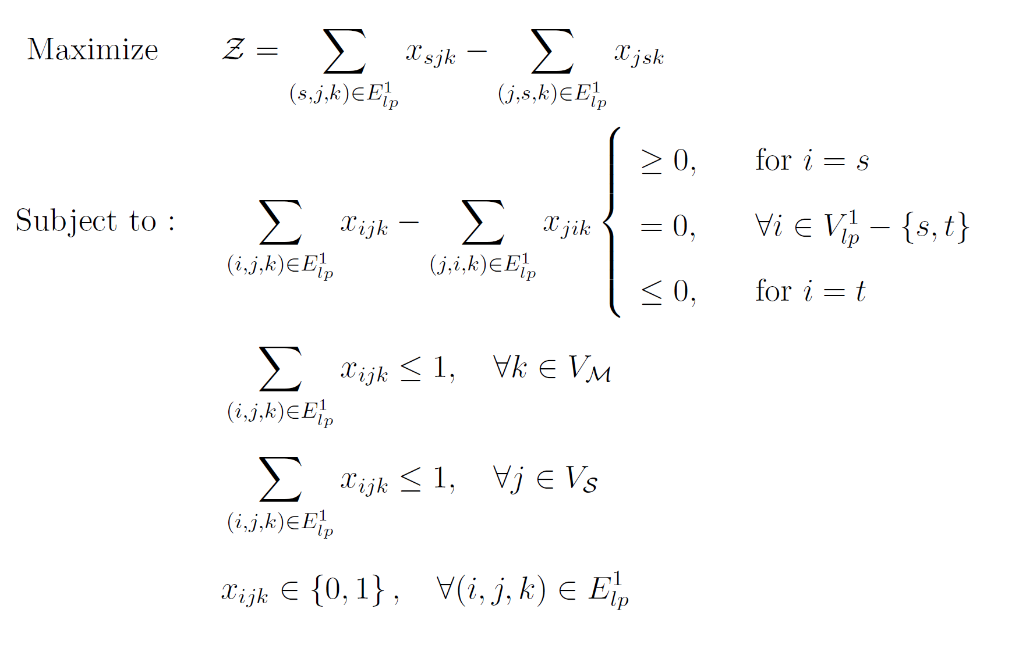
Linear Program Formulation
Maximize
End-to-End
“Flow”
Flow
Conservation
Constraint
Mobility Constraint
Vertex Capacity Constraint
Edge Capacity Constraint

Slide 15
Simulation Tool
15
Written in Java
Key modules:
  Strong barrier module [Lui et al. 2008]
  Mobile barrier module [Saipulla et al. 2010]
  Mixed barrier module
Graphical User Interface (GUI) [Vu et al. 2009]

Slide 16
Mixed Barrier Module
User Input
Information on Simulated Network
Mixed Barrier Experiment
Mixed Deployment
LP Parser
GUI
cplex File
results.txt
Network Topology Parameters
LP Graph
Glpsol
16

Slide 17
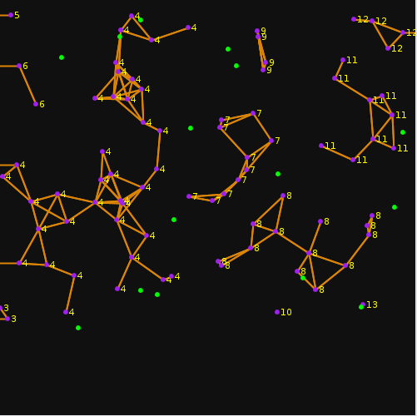
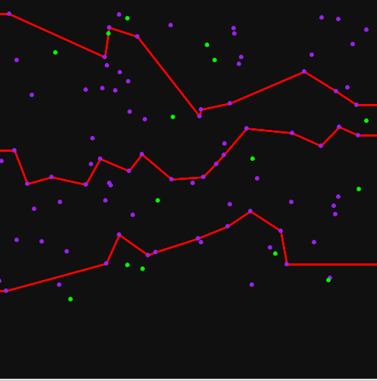
Simulation Tool Screenshots

Slide 18
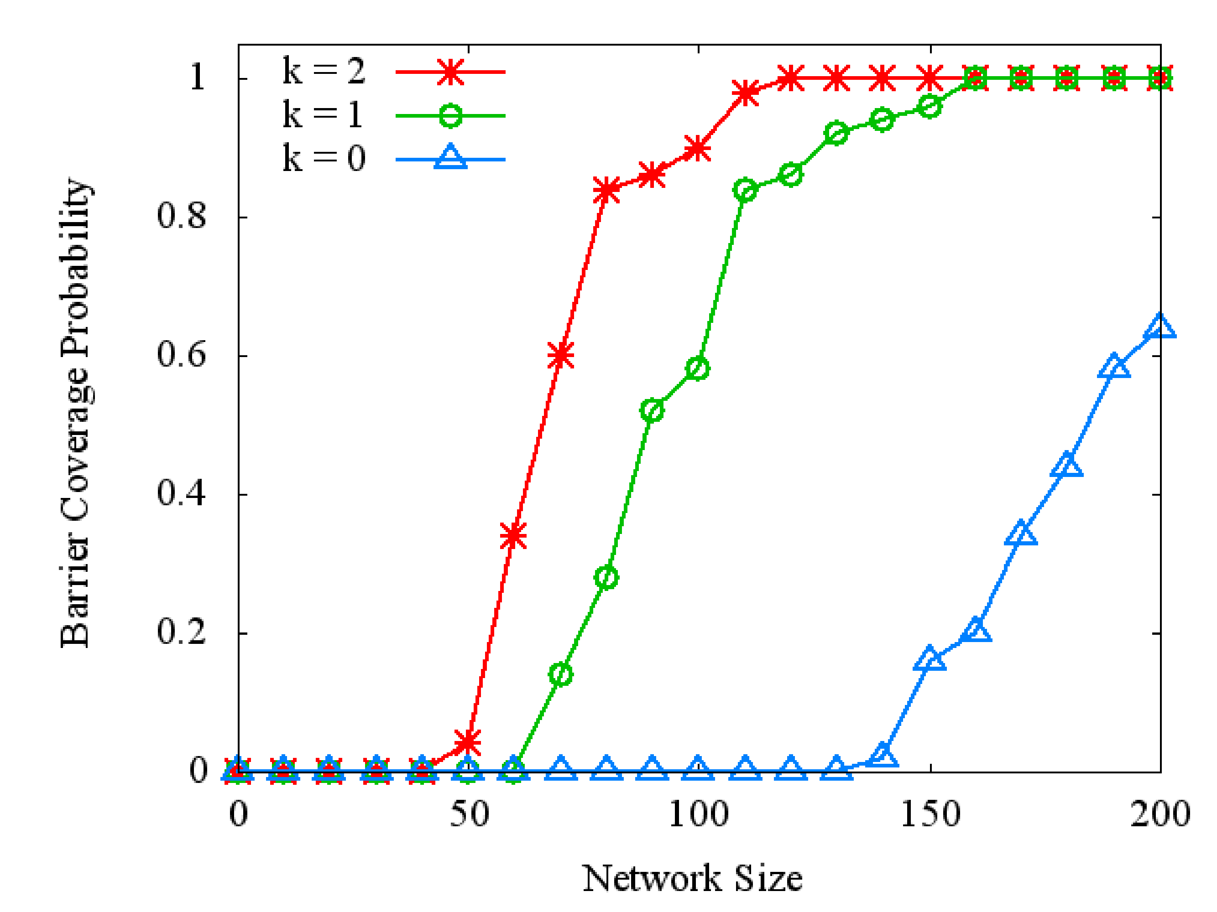
Simulation Results (1 of 3)
Effect of k when Sensing Radius Rs = 10
18

Slide 19
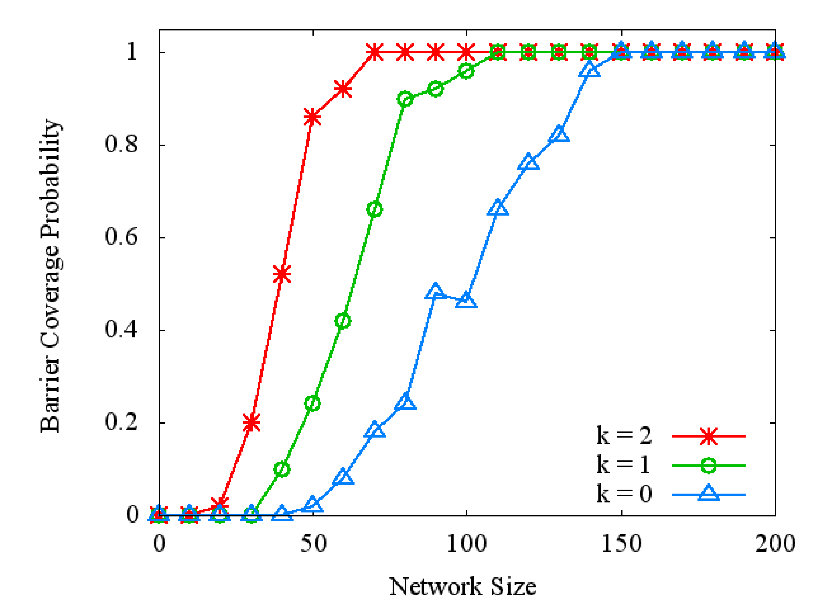
Simulation Results (1 of 3)
Effect of k when Sensing Radius Rs = 20
19

Slide 20
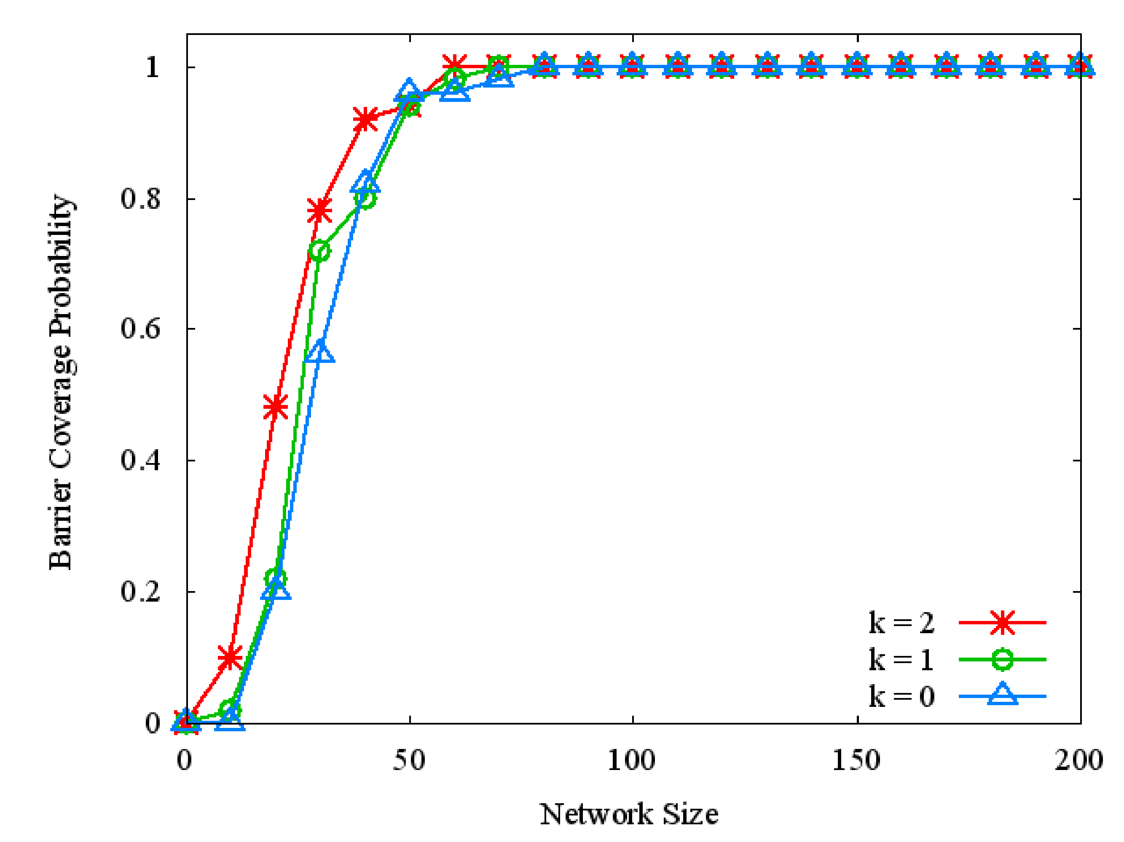
Simulation Results (1 of 3)
Effect of k when Sensing Radius Rs = 50
20

Slide 21
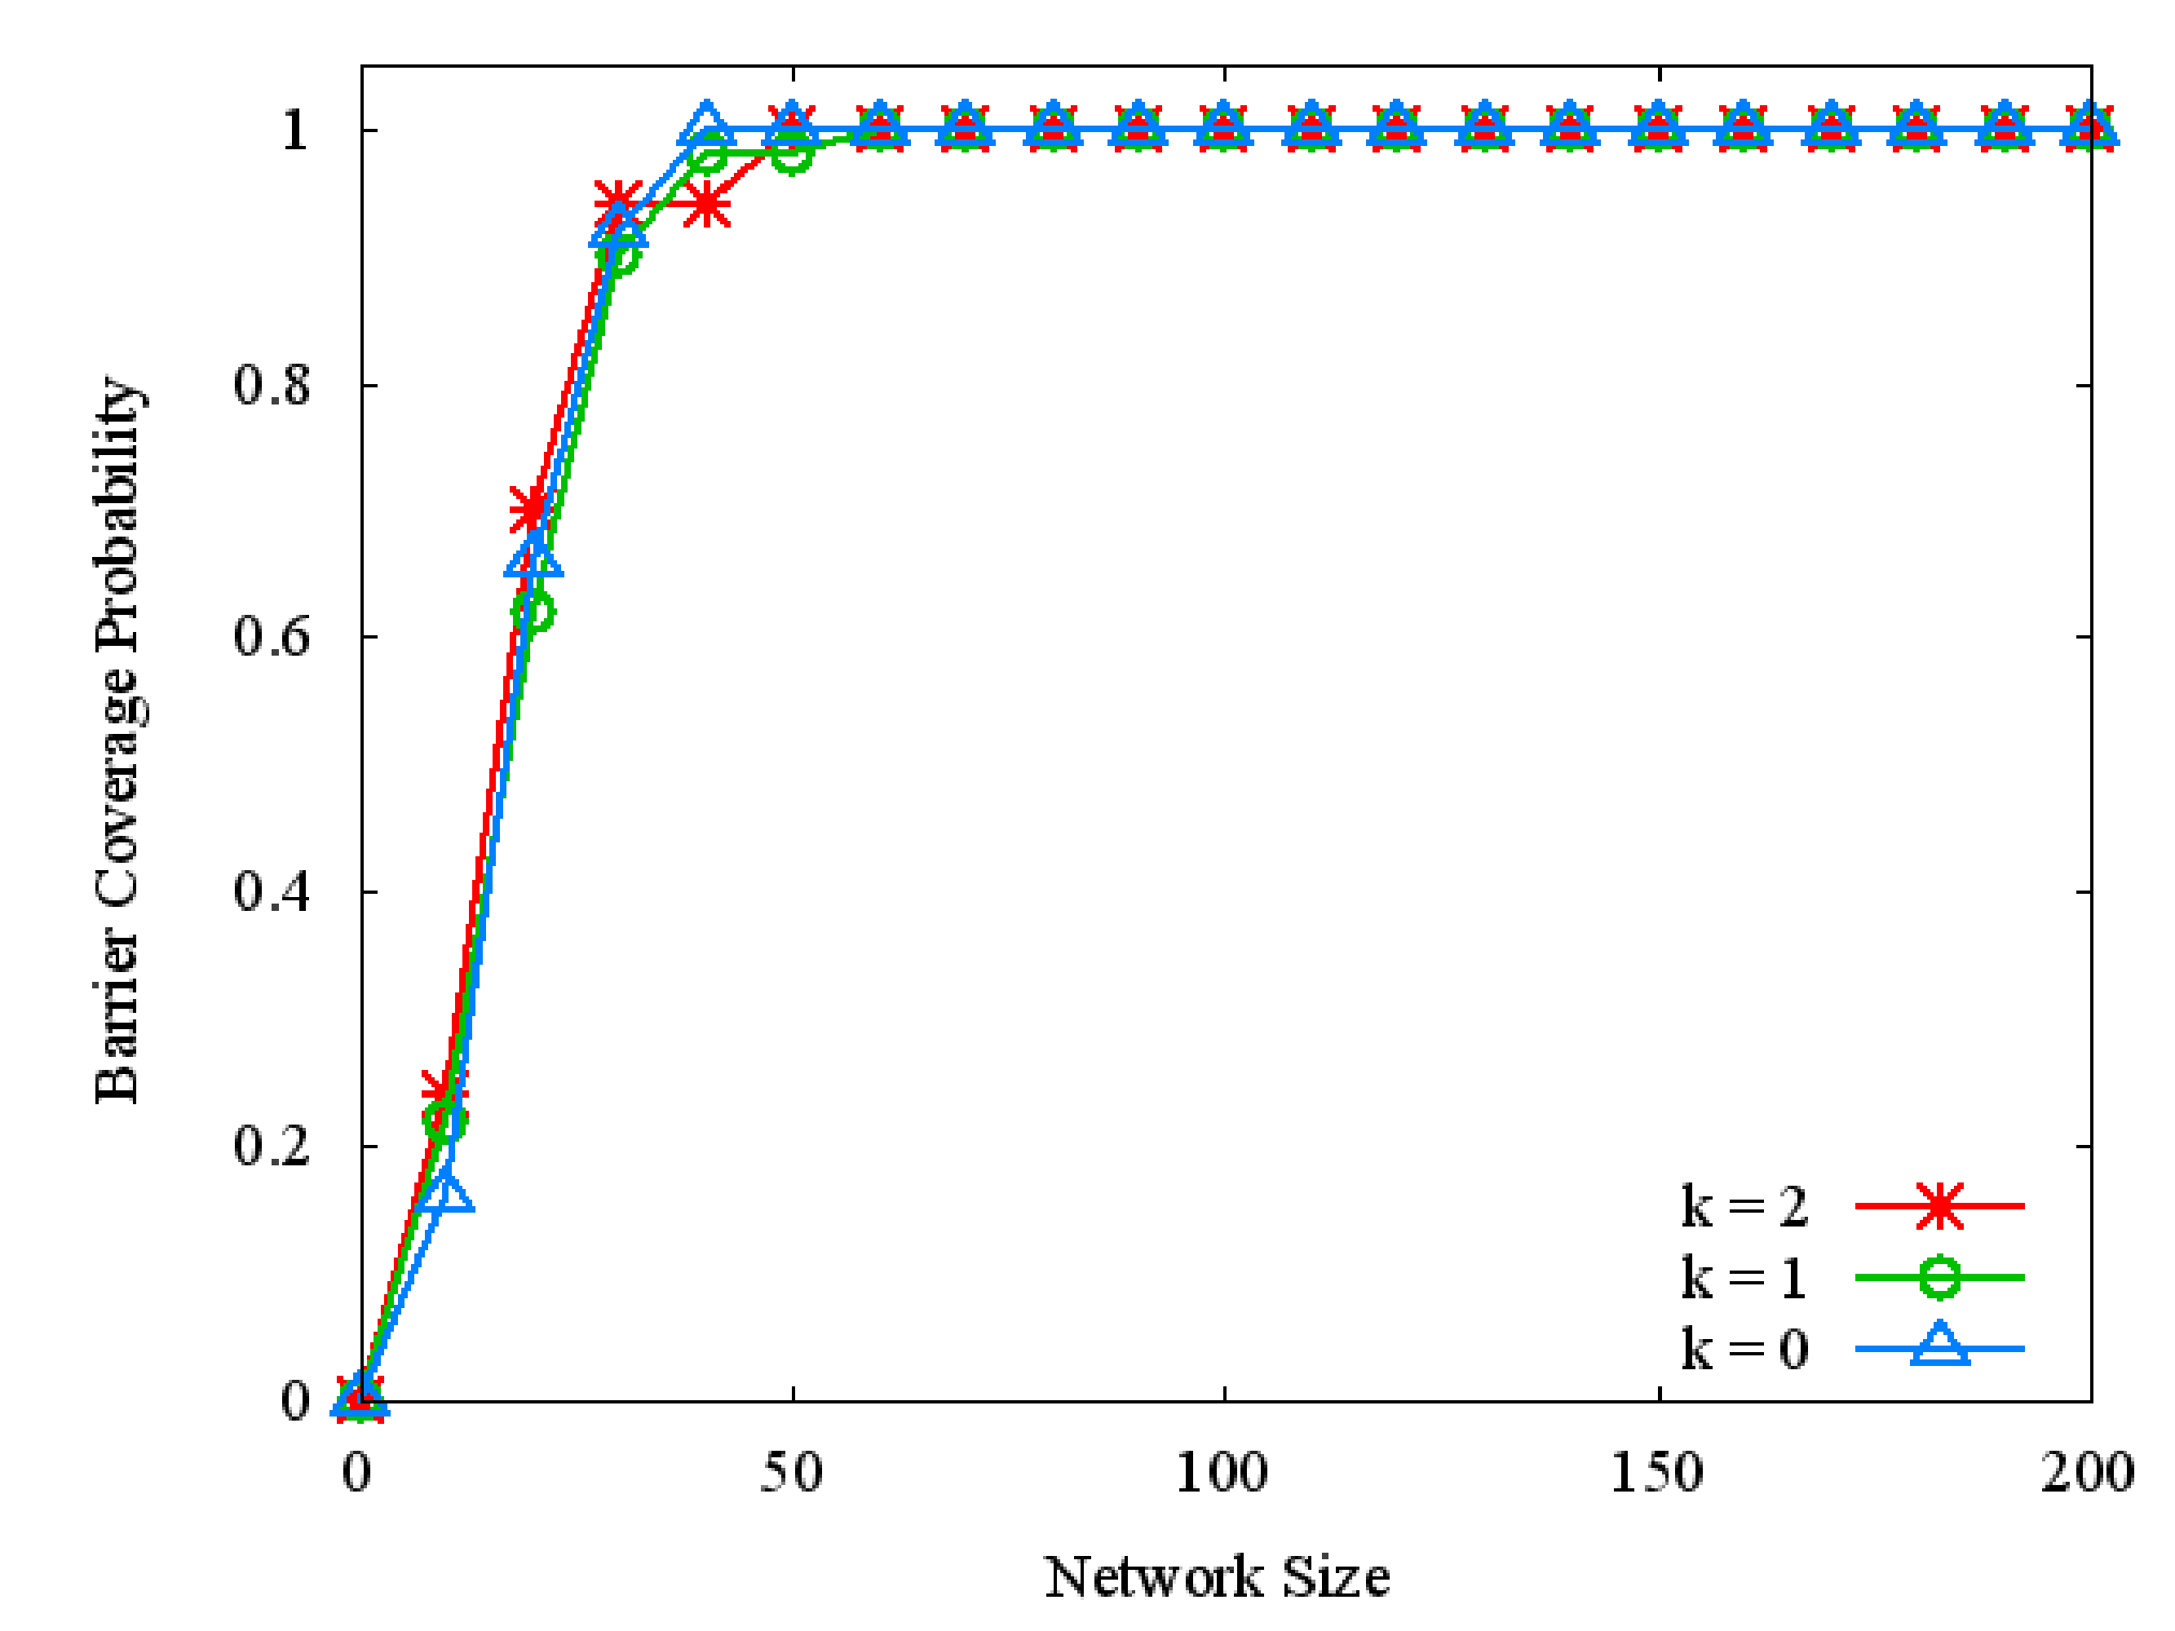
Simulation Results (1 of 3)
Effect of k when Sensing Radius Rs = 75
21

Slide 22
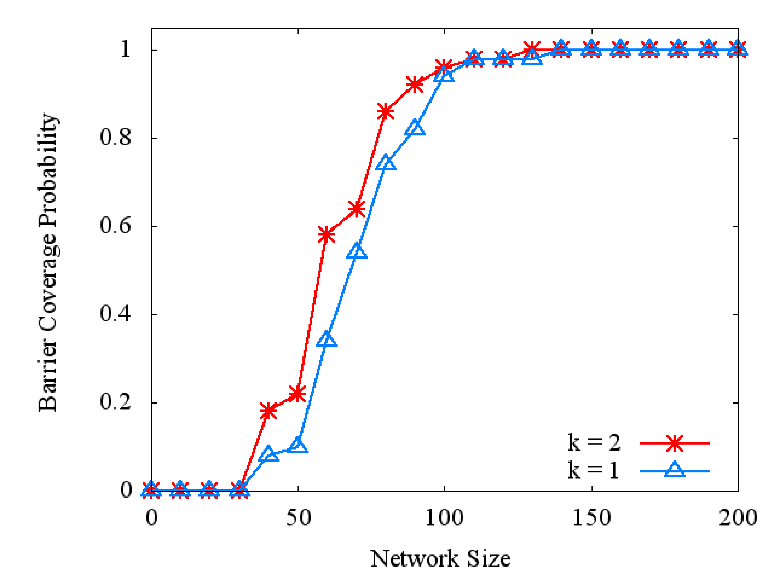
Simulation Results (2 of 3)
Effect of k when Movement Radius Rm = 10
22

Slide 23
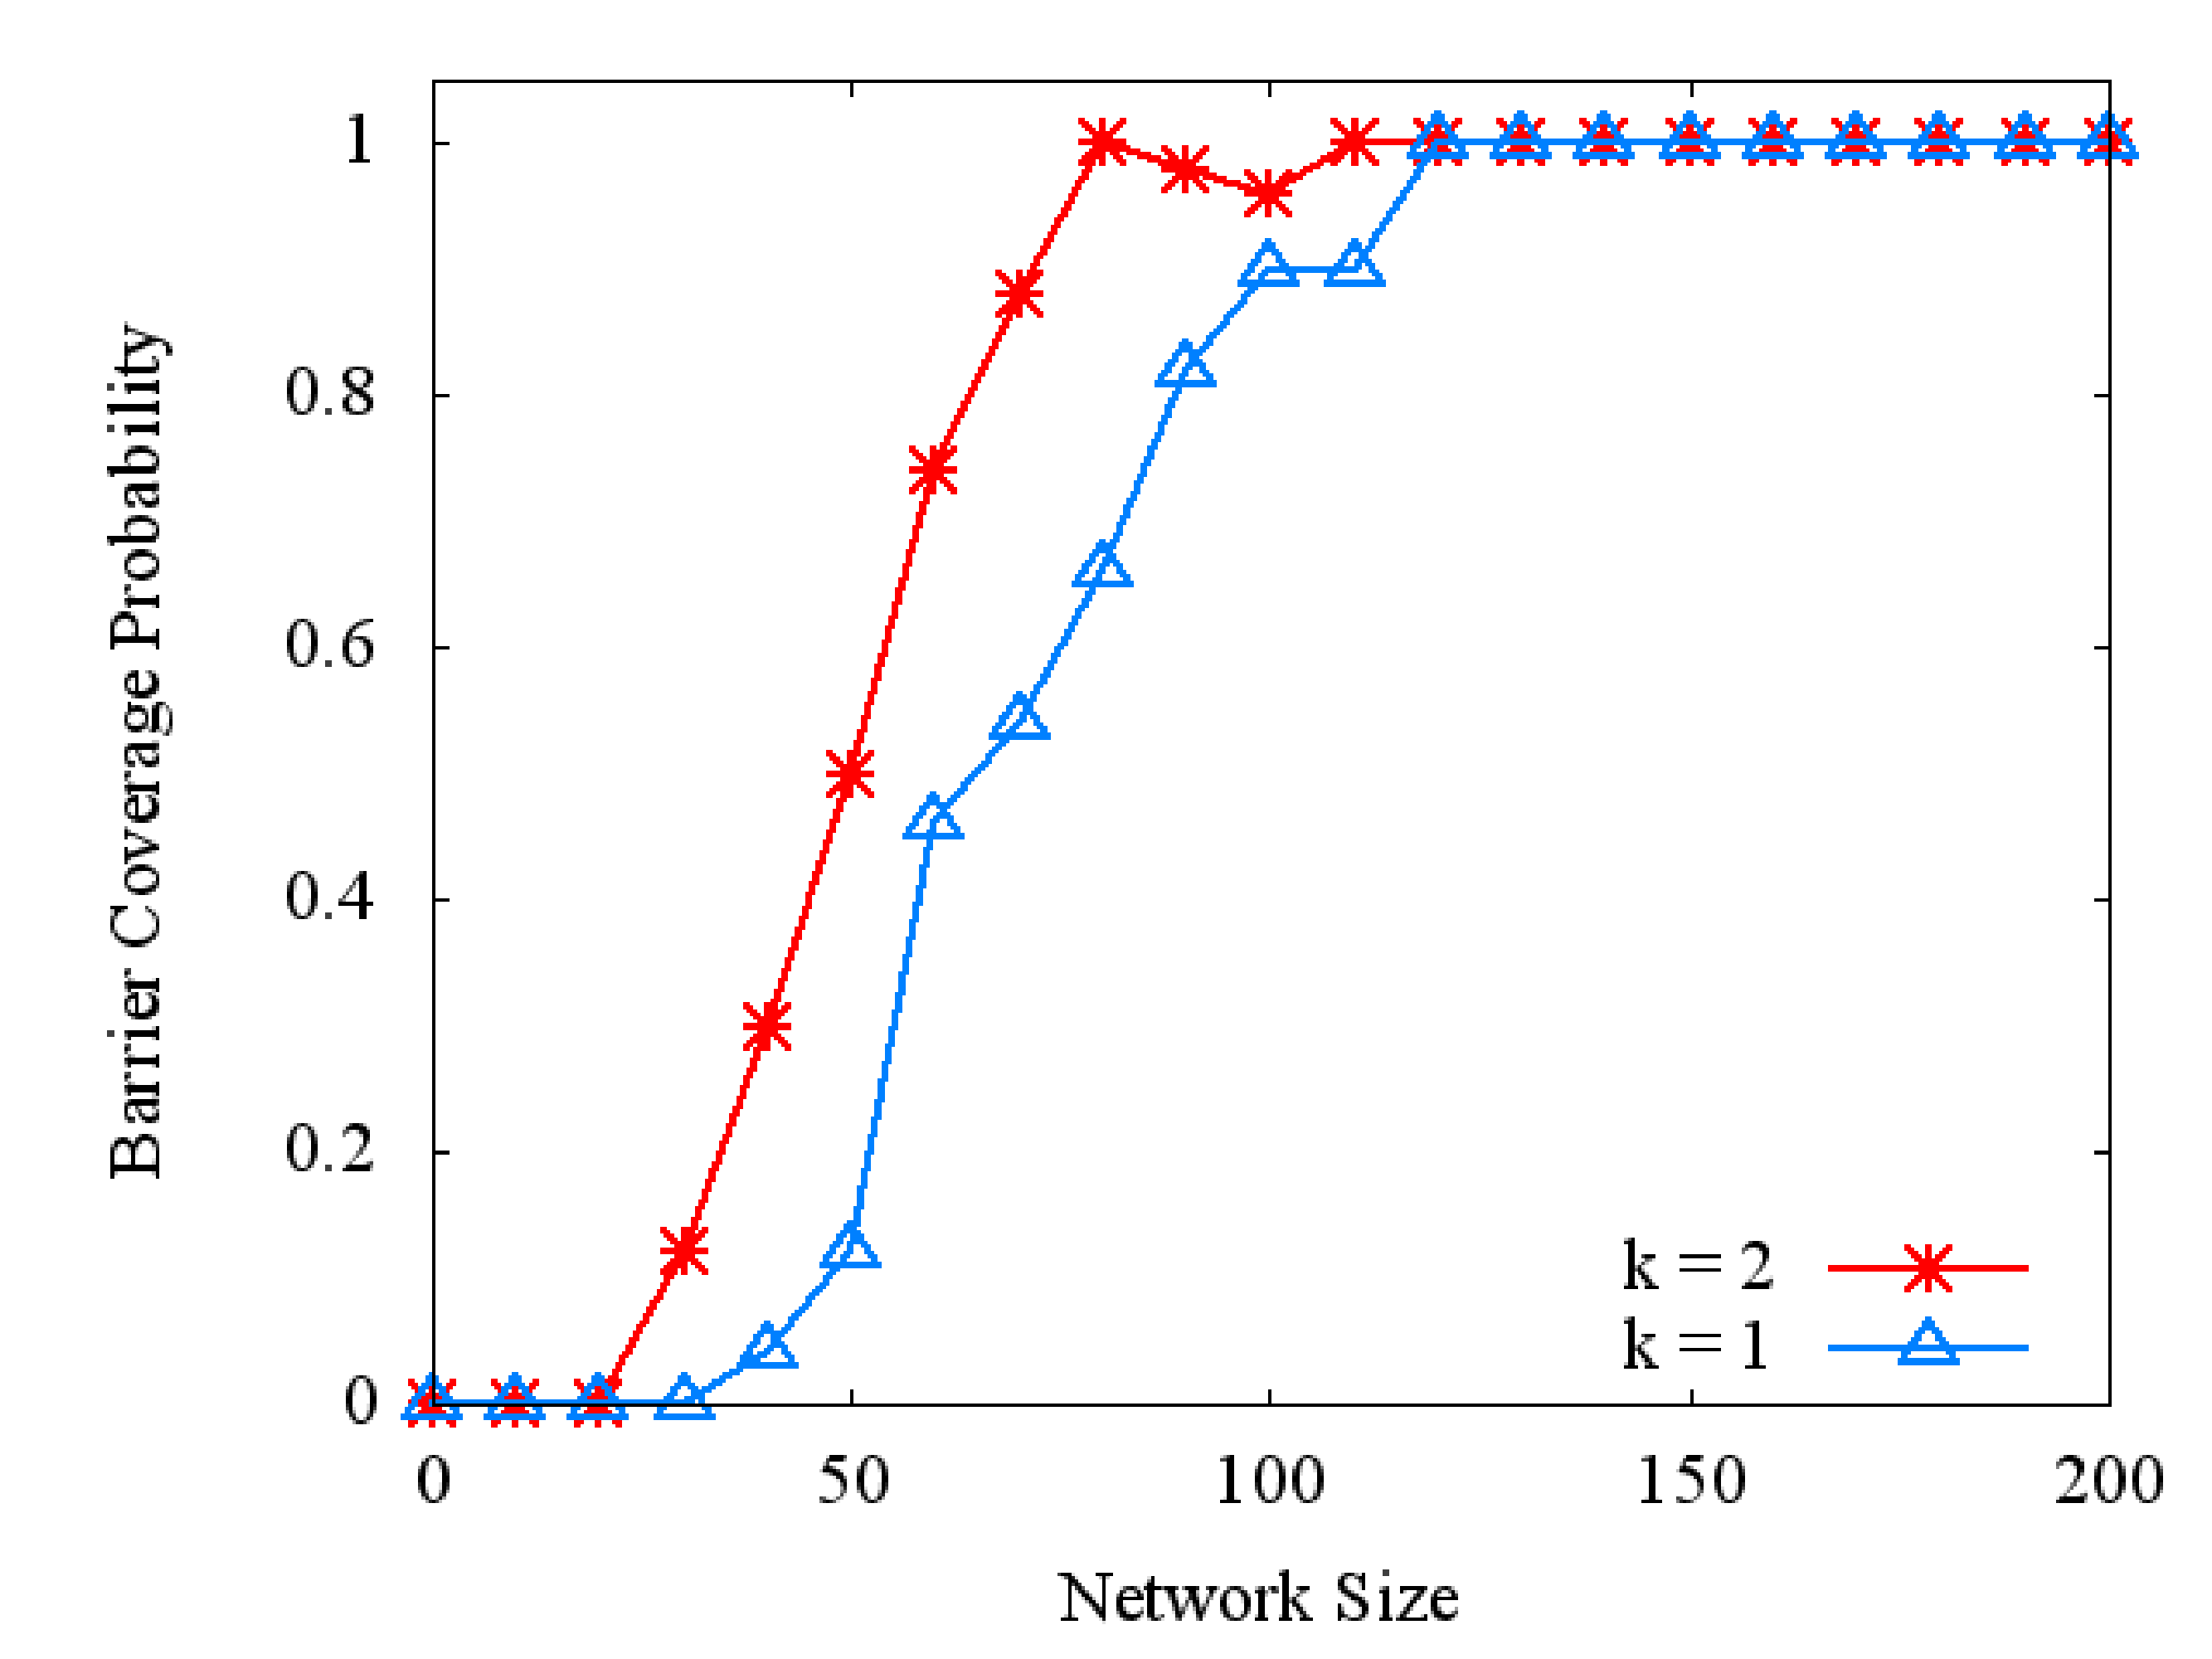
Simulation Results (2 of 3)
Effect of k when Movement Radius Rm = 25
23

Slide 24
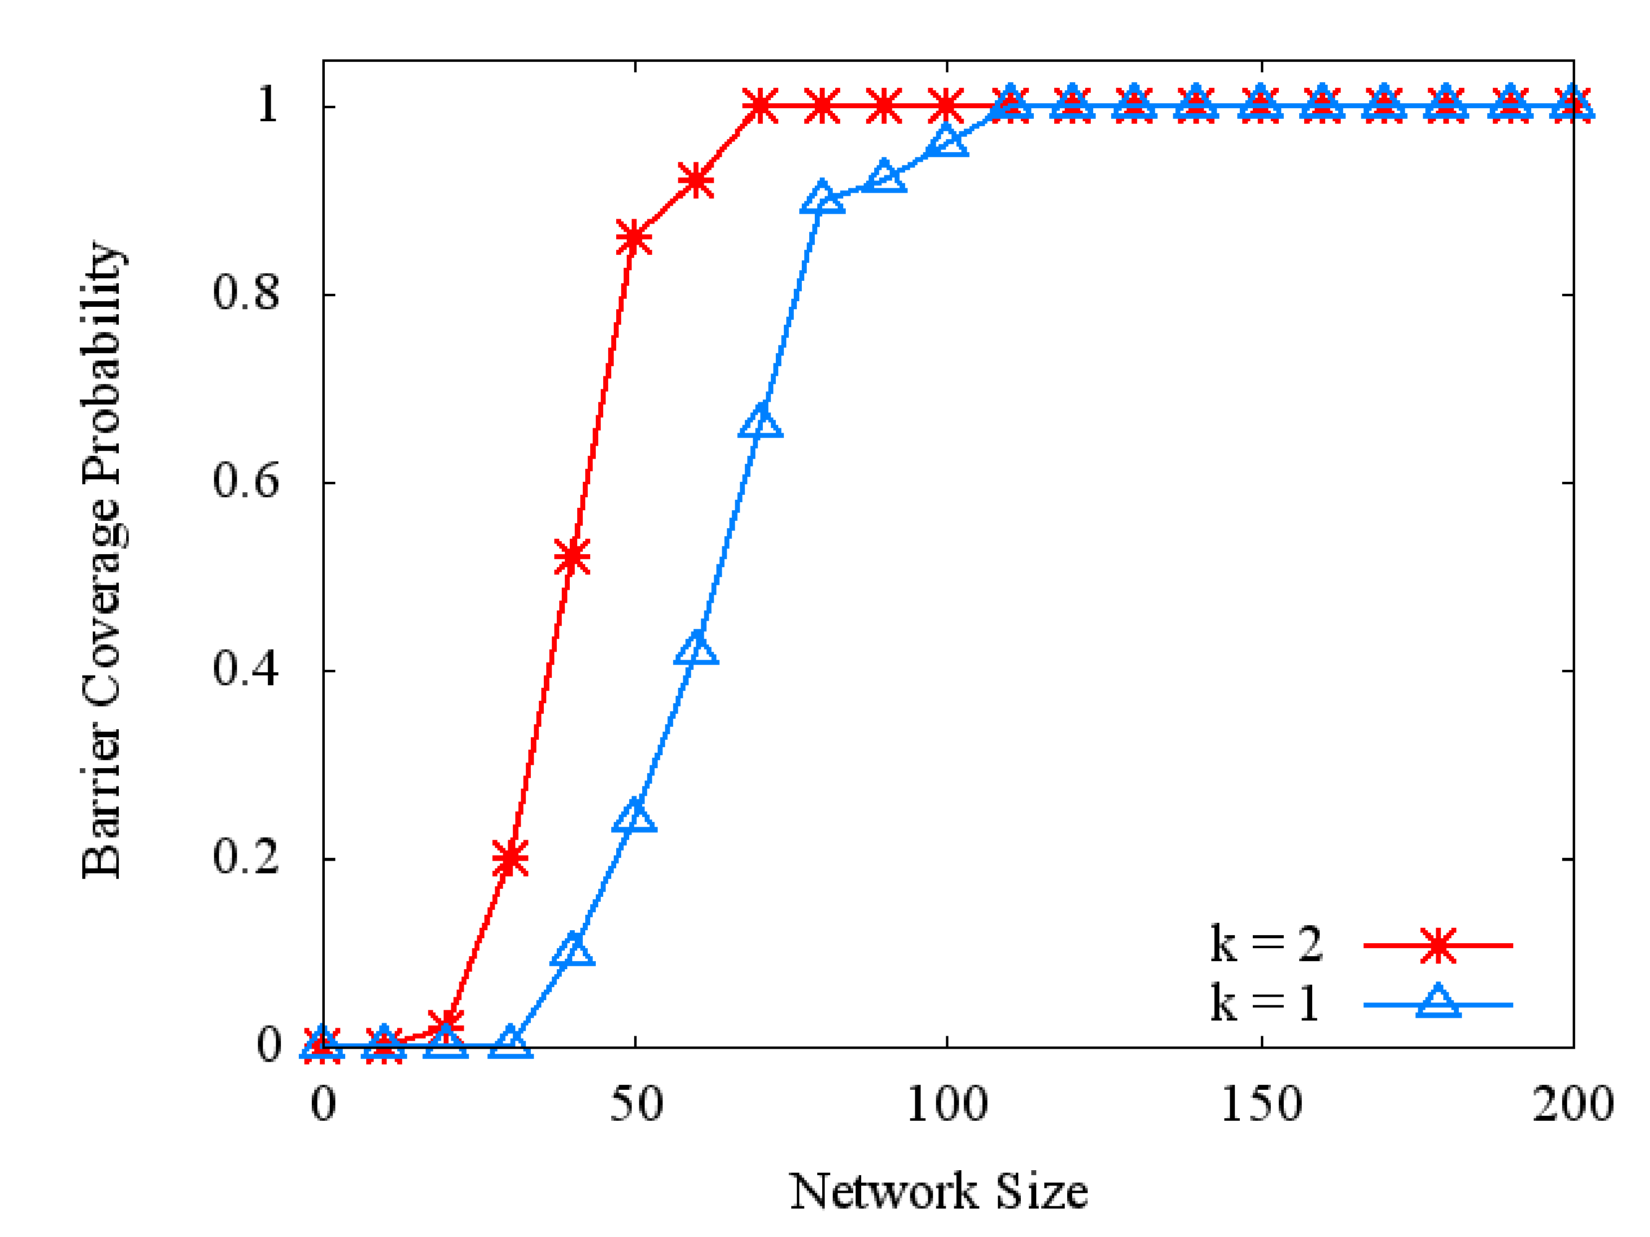
Simulation Results (2 of 3)
Effect of k when Movement Radius Rm = 50
24

Slide 25
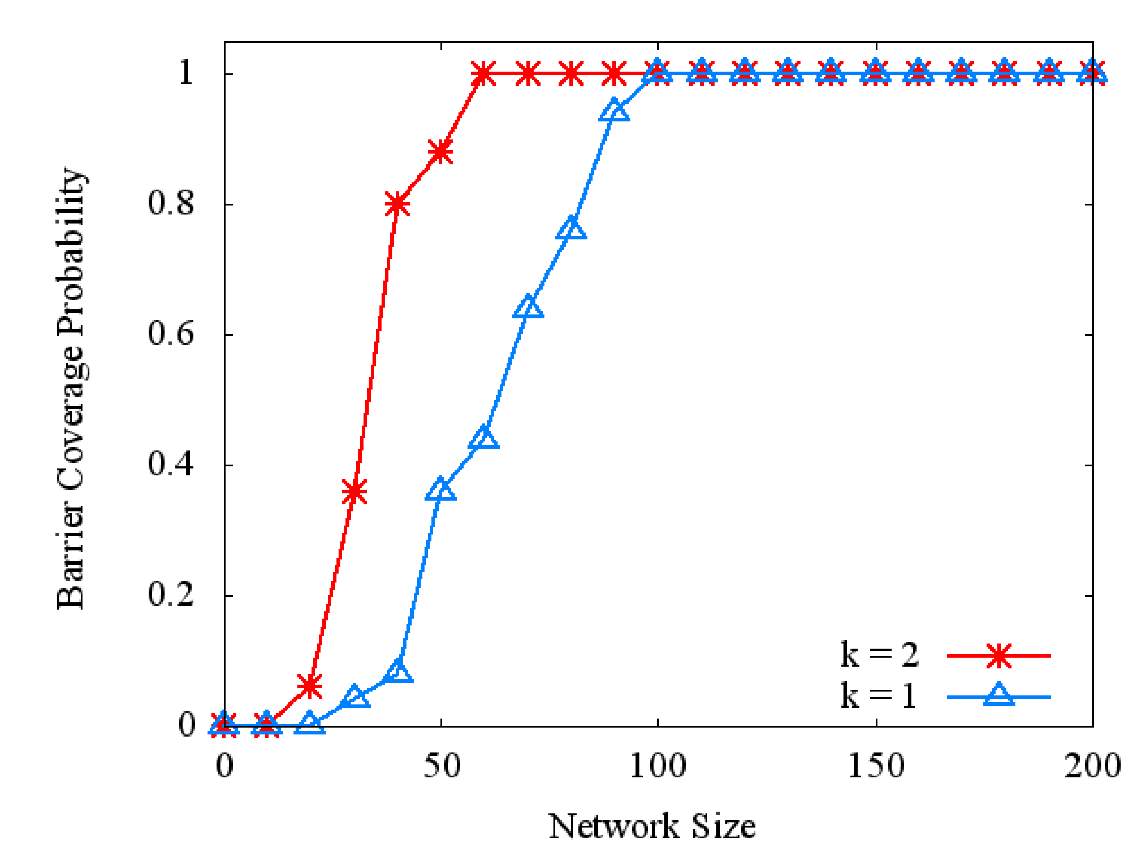
Simulation Results (2 of 3)
Effect of k when Movement Radius Rm = 75
25

Slide 26
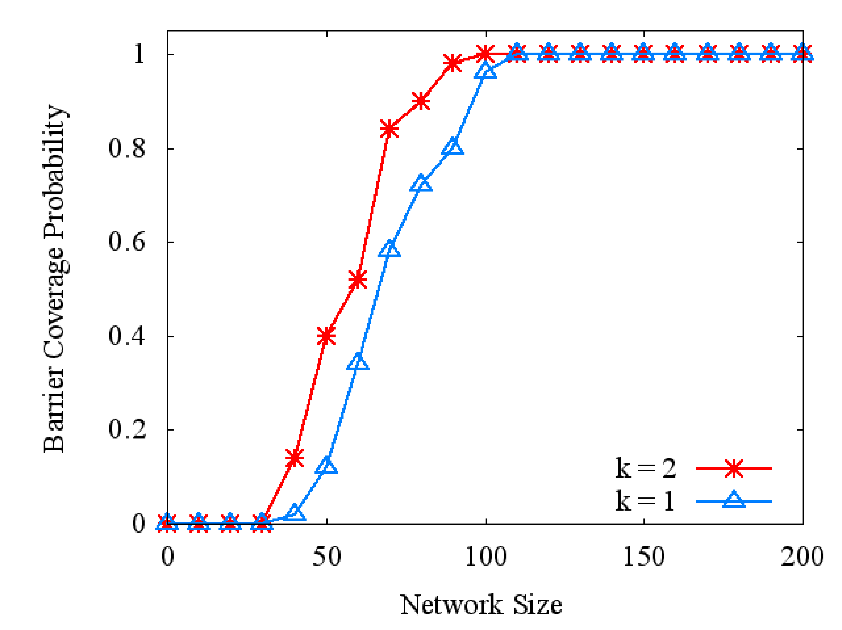
Simulation Results (3 of 3)
Effect of k when Mobile Sensor Percentage Ms = 10%
26

Slide 27
Simulation Results (3 of 3)
Effect of k when Mobile Sensor Percentage Ms = 30%
27

Slide 28
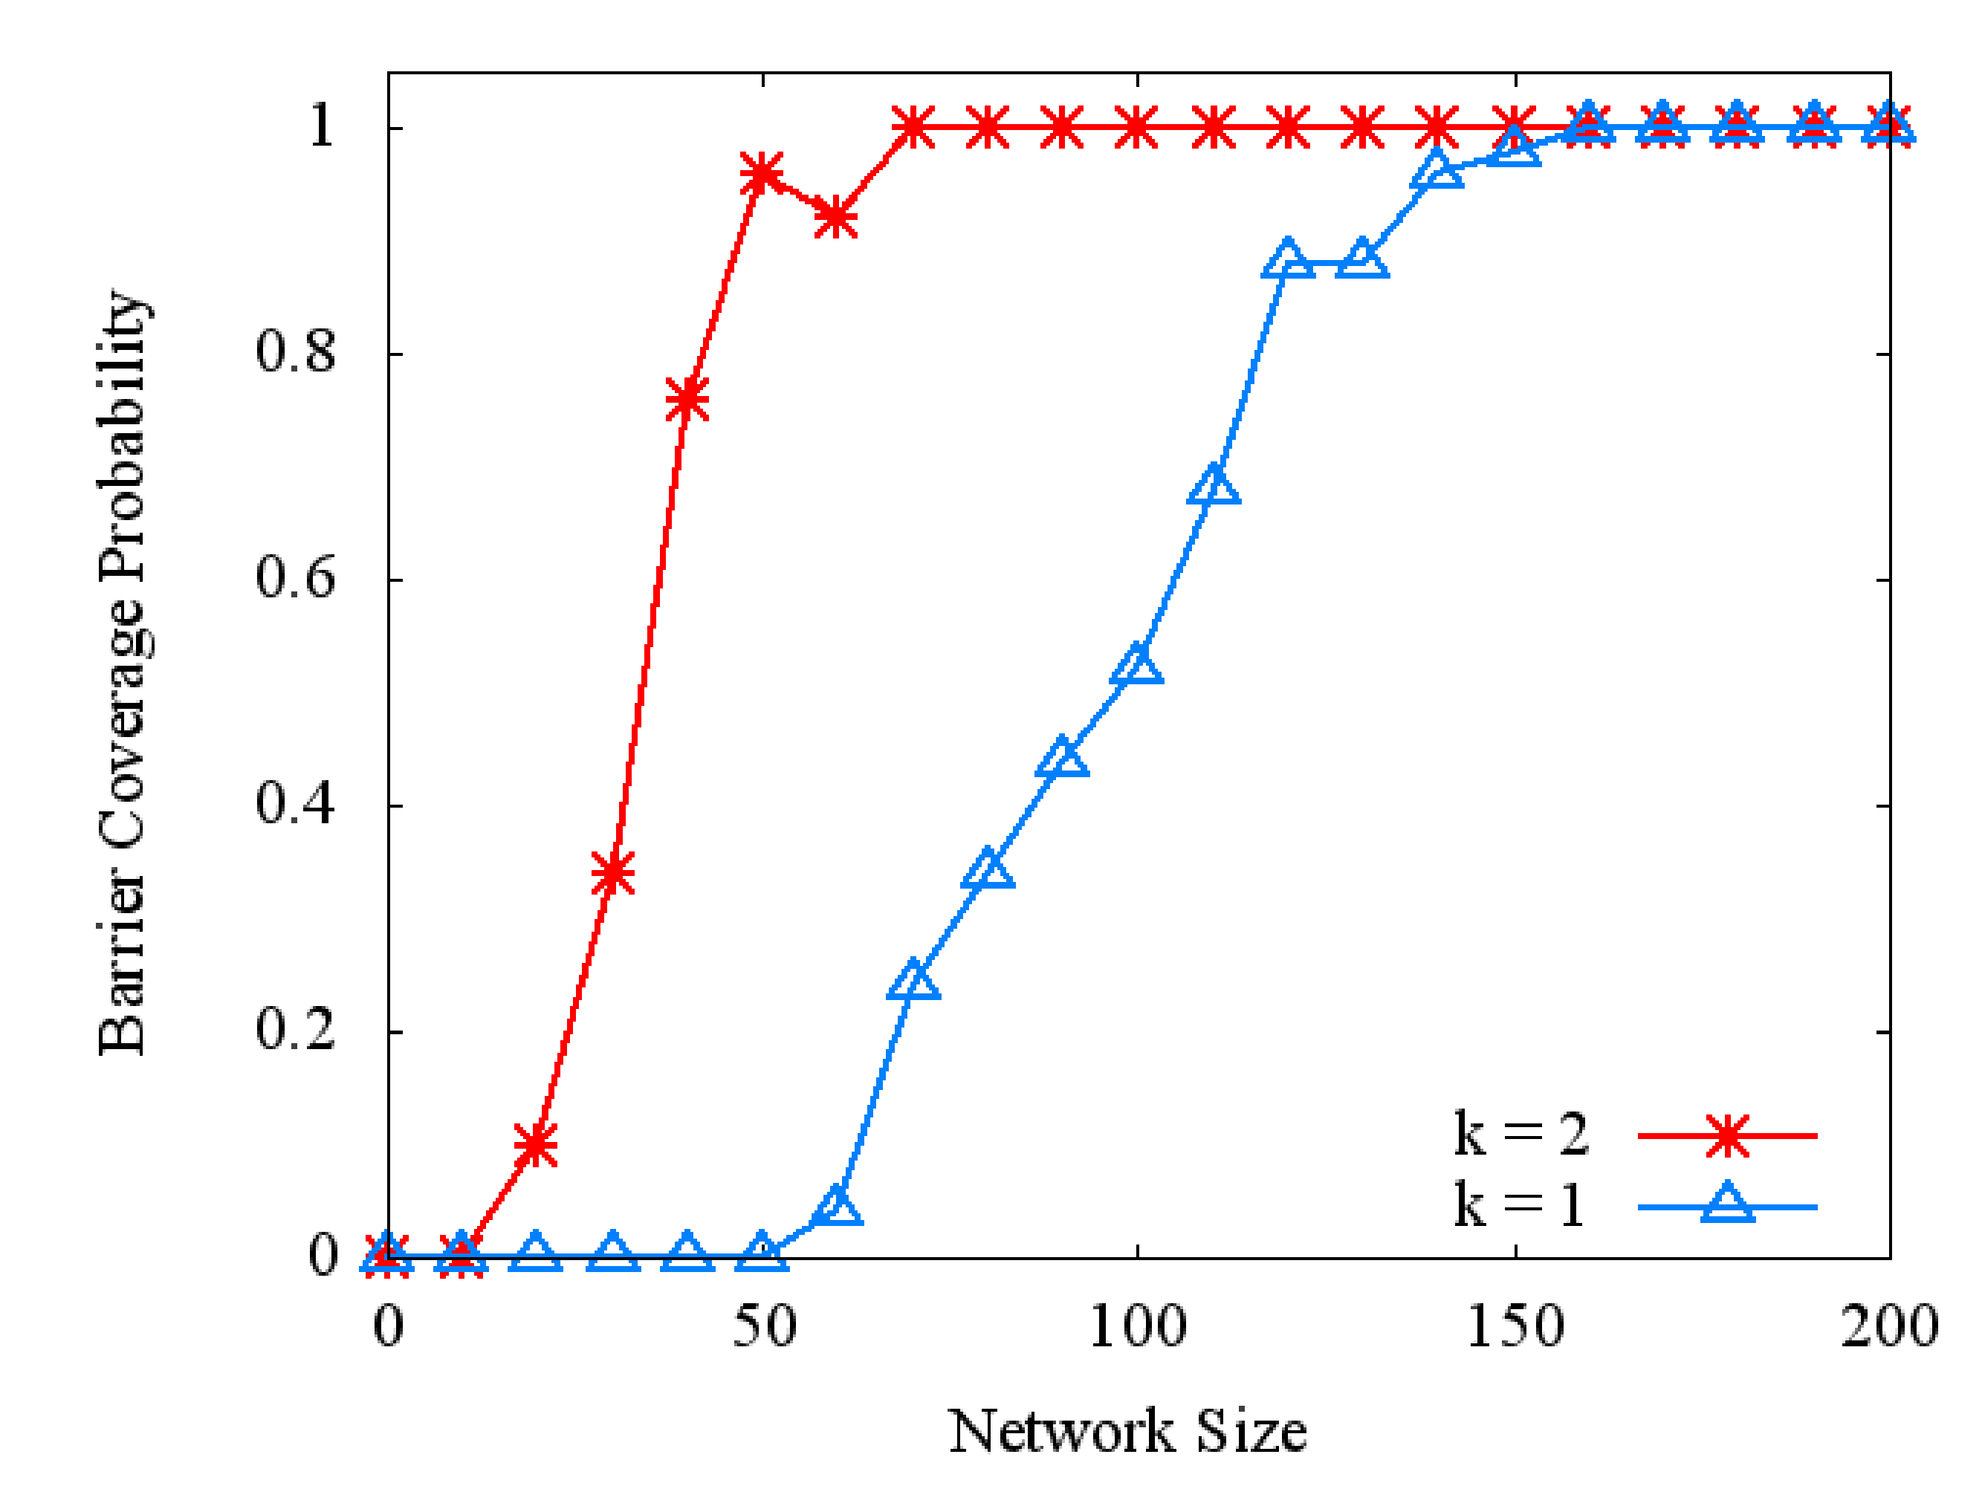
Simulation Results (3 of 3)
Effect of k when Mobile Sensor Percentage Ms = 50%
28

Slide 29
Conclusions
29
Developed exact solutions to the k-connect barrier count problem (i.e., max num barriers) for k Є {0,1,2}, which can be formulated as a max flow problem (ILP)
Presented a simulation environment for MSNs, which was used for validation of ILP solutions
Demonstrated the benefits of mobile sensors by showing the effects of sensing radius, movement radius, and the number of mobile sensors on barrier coverage probability

Slide 30
Future Work
30
Solutions to k-connect barrier count problem for values of k > 2
Optimality criteria: max flow vs min movement
Consideration of more realistic sensing model, wireless channel model, and power consumption for different terrain conditions
Study possible unimodularity of constraint matrices in LP formulations

Slide 31
Research Methodology
1
0/1
2
0/1
0/1
1
2
s
0/1
t
0/1
3
4
0/1
3
4
0/1
31
Mobility Constraint

Slide 32
Research Methodology
1
1/1
2
1/1
1/1
1
2
s
0/1
t
3
4
0/1
3
4
0/1
32
Max flow value = 1

