Slide 1

Autoscaling Effects in
Speed Scaling Systems
CORS 2016
Carey Williamson
Department of Computer Science

Slide 2
Outline
Introduction/Motivation
Background/Related Work
System Model
Analytical Results
Simulation Results
Discussion
Conclusions

Slide 3
Introduction
Dynamic CPU speed scaling systems
Service rate adjusted based on offered load
Classic tradeoff:
  Faster speed → lower response time, higher energy usage
Two key design choices:
  Speed scaler: how fast to run? (static, coupled, decoupled)
  Scheduler: which job to run? (FCFS, PS, FSP, SRPT, LRPT)
Research questions:
  What are the “autoscaling” properties of these systems under coupled (i.e., job-count based) speed scaling?
  In what ways are PS and SRPT similar/different?

Slide 4
Related Work
[Albers 2010] “Energy-Efficient Algorthms”, CACM
[Andrew et al. 2010] “Optimality, Fairness, and Robustness in Speed Scaling Designs”, ACM SIGMETRICS
[Bansal et al. 2007] “Speed Scaling to Manage Energy and Temperature”, JACM
[Elahi et al. 2012] “Decoupled Speed Scaling”, QEST, PEVA
[Wierman et al. 2009] “Power-Aware Speed Scaling in Processor Sharing Systems”, IEEE INFOCOM, PEVA 2012
[Weiser et al. 1994] “Scheduling for Reduced CPU Energy”, USENIX OSDI
[Yao et al. 1995] “A Scheduling Model for Reduced CPU Engergy”, ACM FOCS

Slide 5
System Model (1 of 4)
Review: Birth-death Markov chain model of classic M/M/1 queue
Fixed arrival rate λ
Fixed service rate μ
λ
λ
λ
λ
λ
0
1
2
3
4
μ
μ
μ
μ
μ
Mean system occupancy: N = ρ / (1 – ρ)
Ergodicity requirement: ρ = λ/μ < 1
p_{n} = p₀ (λ/μ)^{n}
U = 1 – p₀ = ρ

Slide 6
System Model (2 of 4)
Birth-death Markov chain model of classic M/M/∞ queue
Fixed arrival rate λ
Service rate scales linearly with system occupancy (α = 1)
λ
λ
λ
λ
λ
0
1
2
3
4
μ
2μ
3μ
4μ
5μ
Mean system occupancy: N = ρ = λ/μ
System occupancy has Poisson distribution
Ergodicity requirement: ρ = λ/μ < ∞
n-1
p_{n} = p₀ ∏ (λ/(i+1)μ)
i=0
U = 1 – p₀ ≠ ρ

Slide 7
System Model (3 of 4)
Birth-death Markov chain model of dynamic speed scaling system
Fixed arrival rate λ
Service rate scales sub-linearly with system occupancy (α = 2)
λ
λ
λ
λ
λ
0
1
2
3
4
μ
√
2μ
√
3μ
√
4μ
√
5μ
n-1
√
Mean system occupancy: N = ρ² = (λ/μ)²
System occupancy has higher variance than Poisson distribution
Ergodicity requirement: ρ = λ/μ < ∞
p_{n} = p₀ ∏ (λ/( i+1)μ)
i=0

Slide 8
System Model (4 of 4)
Birth-death Markov chain model of dynamic speed scaling system
Fixed arrival rate λ
Service rate scales sub-linearly with system occupancy (α ≥ 1)
λ
λ
λ
λ
λ
0
1
2
3
4
α
α
α
α
μ
√
2μ
√
3μ
√
4μ
√
5μ
n-1
α
√
Mean system occupancy: N = ρ^{α} = (λ/μ)^{α}
System occupancy has higher variance than Poisson distribution
Ergodicity requirement: ρ = λ/μ < ∞
p_{n} = p₀ ∏ (λ/( i+1)μ)
i=0

Slide 9
Analytical Insights and Observations
In speed scaling systems, ρ and U differ
Speed scaling systems stabilize even when ρ > 1
In stable speed scaling systems, s = ρ (an invariant)
PS with linear speed scaling behaves like M/M/∞, which has Poisson distribution for system occupancy
Increasing α changes the Poisson structure of PS
At high load, N → ρ^{α} (another invariant property)

Slide 10
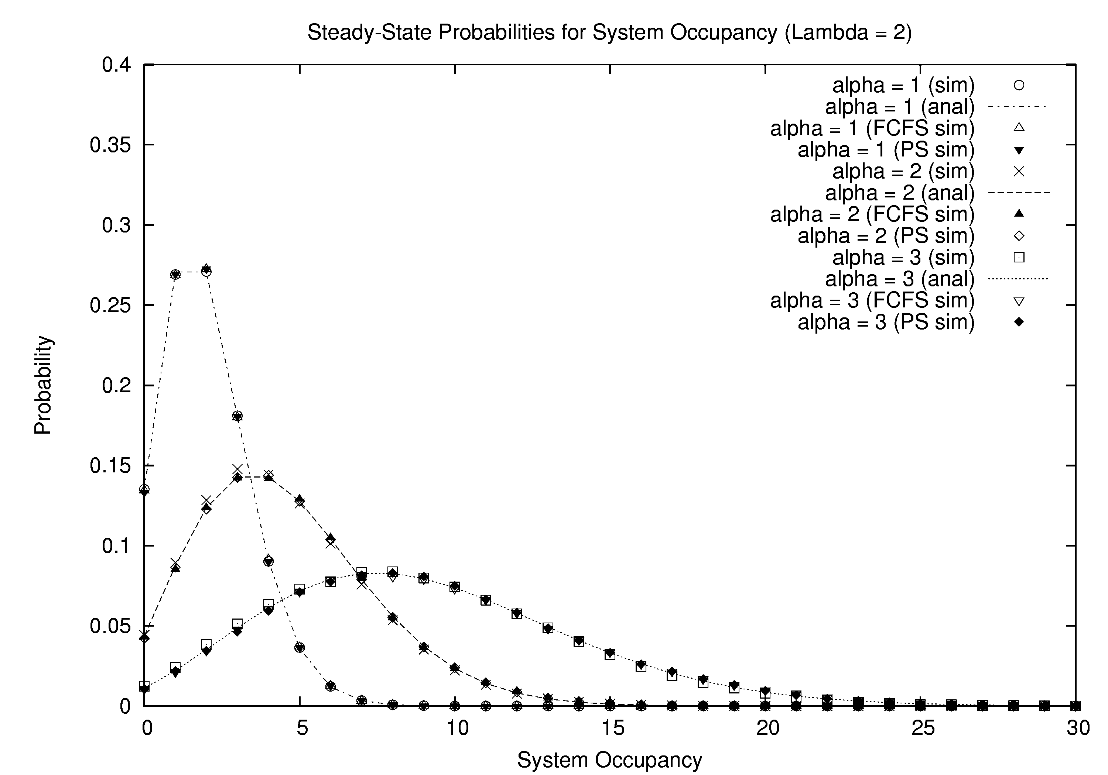
PS Modeling Results

Slide 11
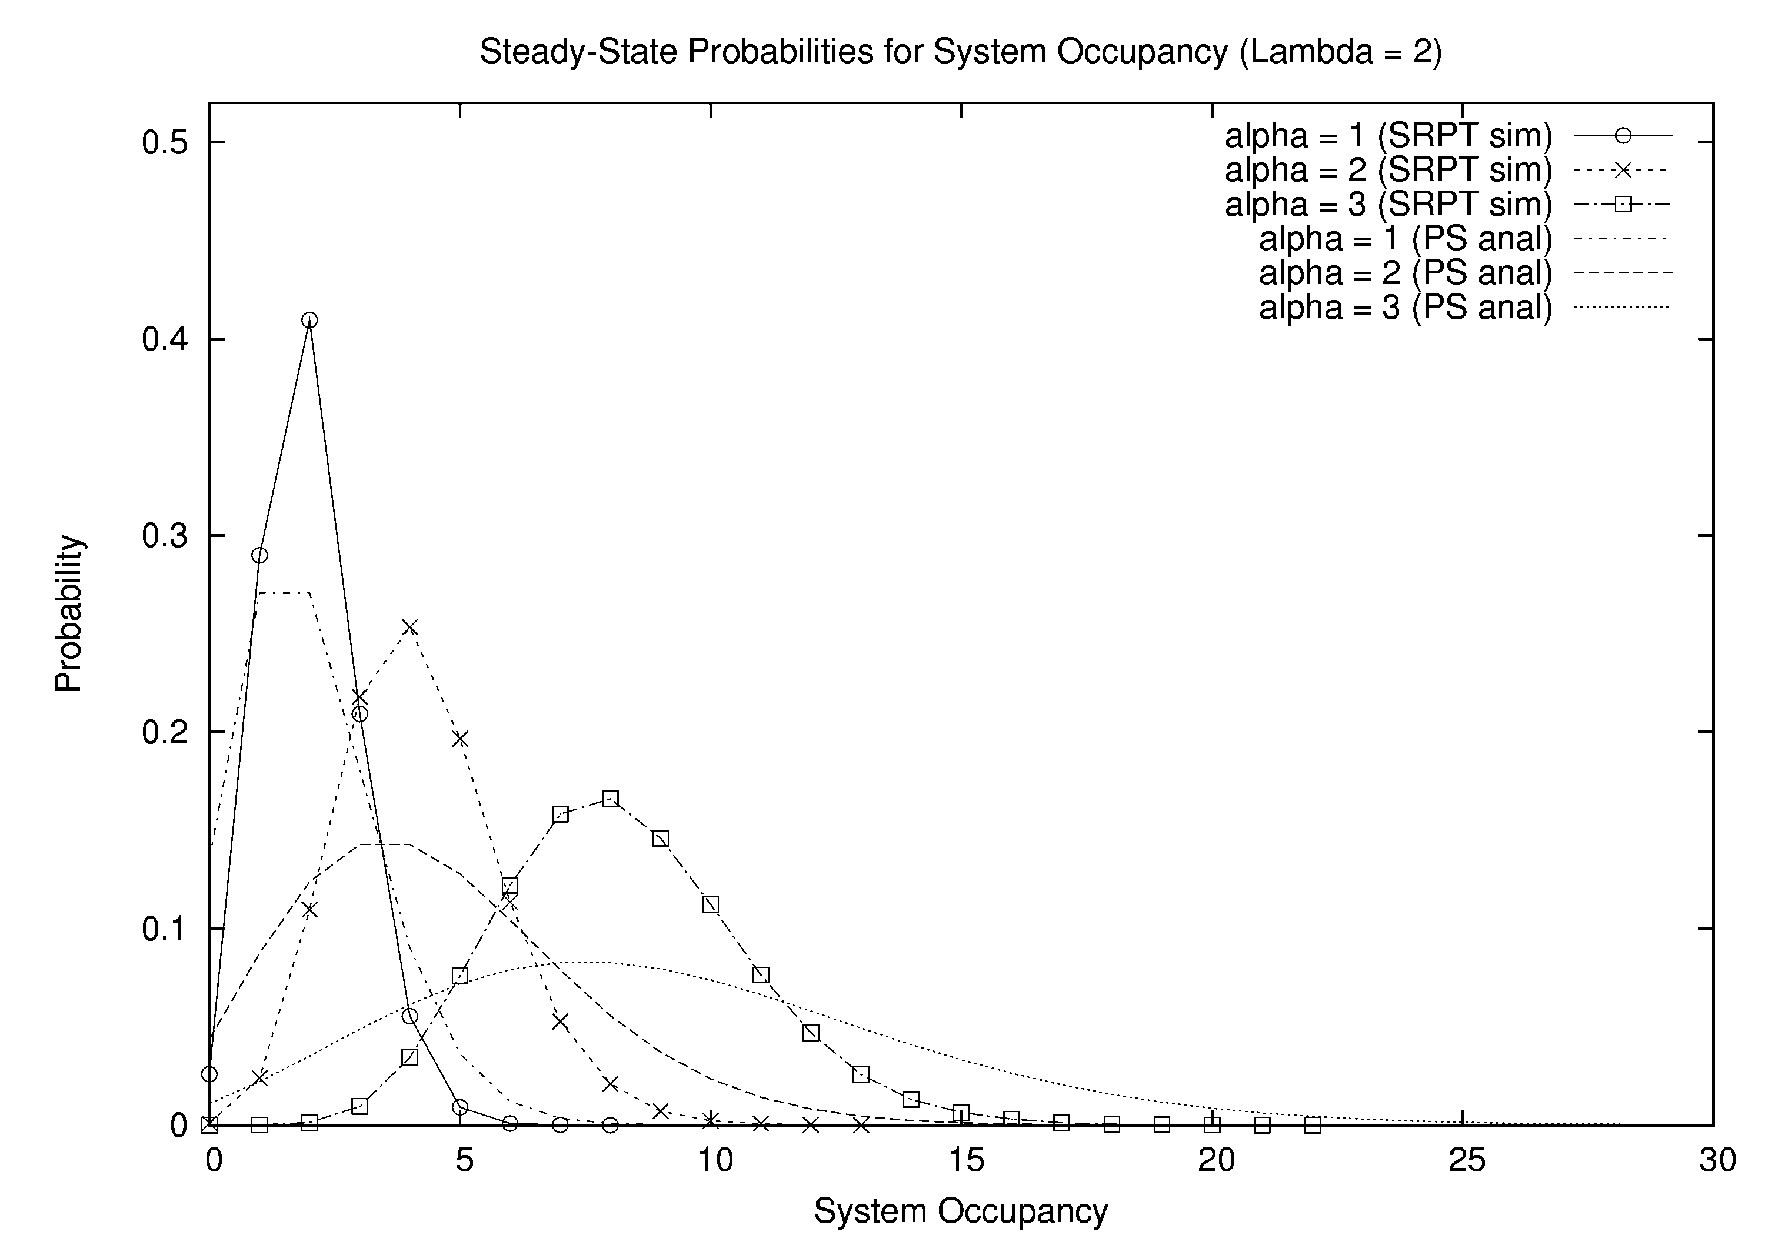
SRPT Simulation Results

Slide 12
PS versus SRPT
Similarities:
  Mean system speed (invariant property)
  Mean system occupancy (invariant property)
  Effect of α (i.e., the shift, squish, and squeeze)
Differences:
  Variance of system occupancy (SRPT is lower)
  Mean response time (SRPT is lower)
  Variance of response time (SRPT is higher)
  PS is always fair; SRPT is unfair (esp. with speed scaling!)
  Compensation effect in PS
  Procrastination/starvation effect in SRPT

Slide 13
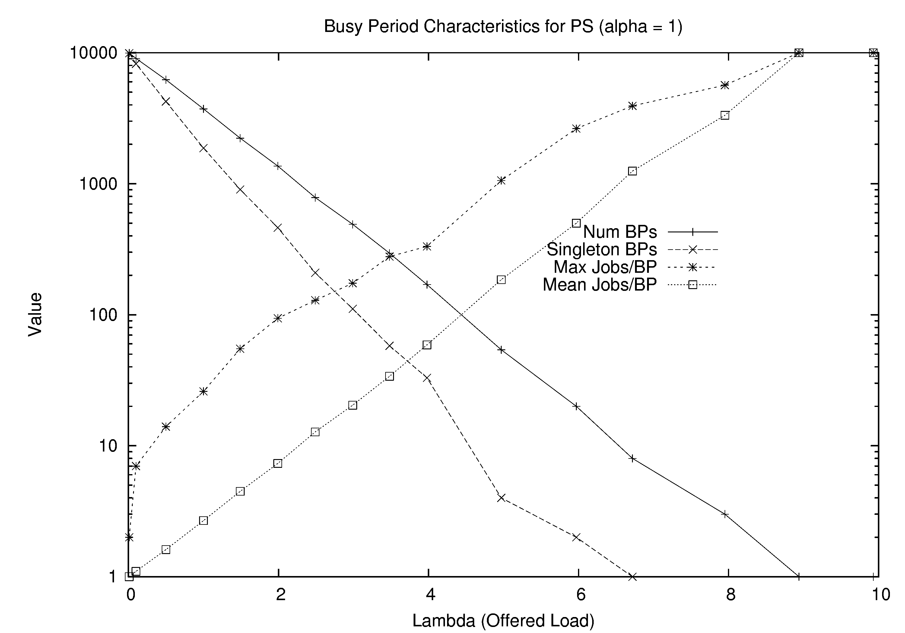
Busy Period Structure for PS (simulation)

Slide 14
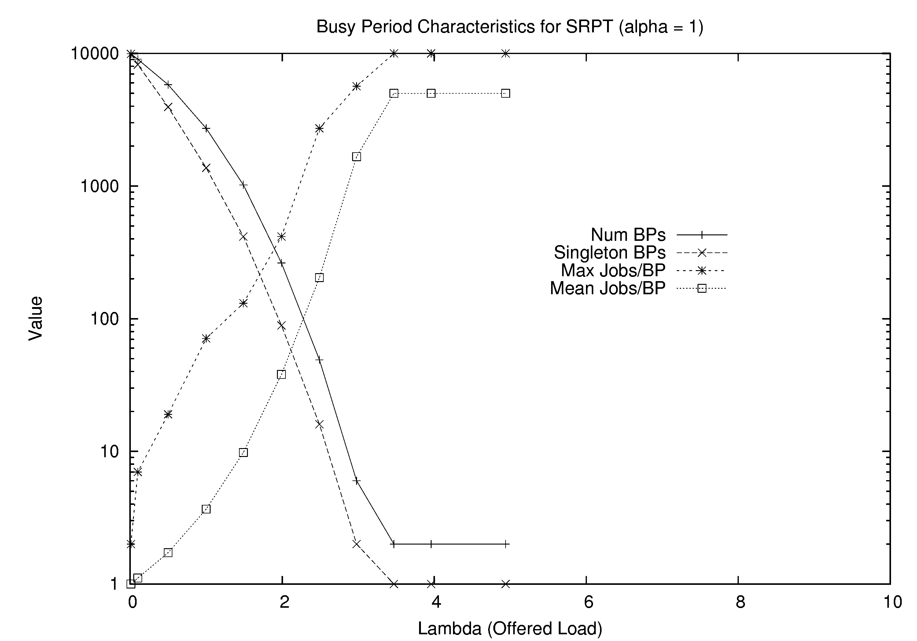
Busy Period Structure for SRPT (simulation)

Slide 15
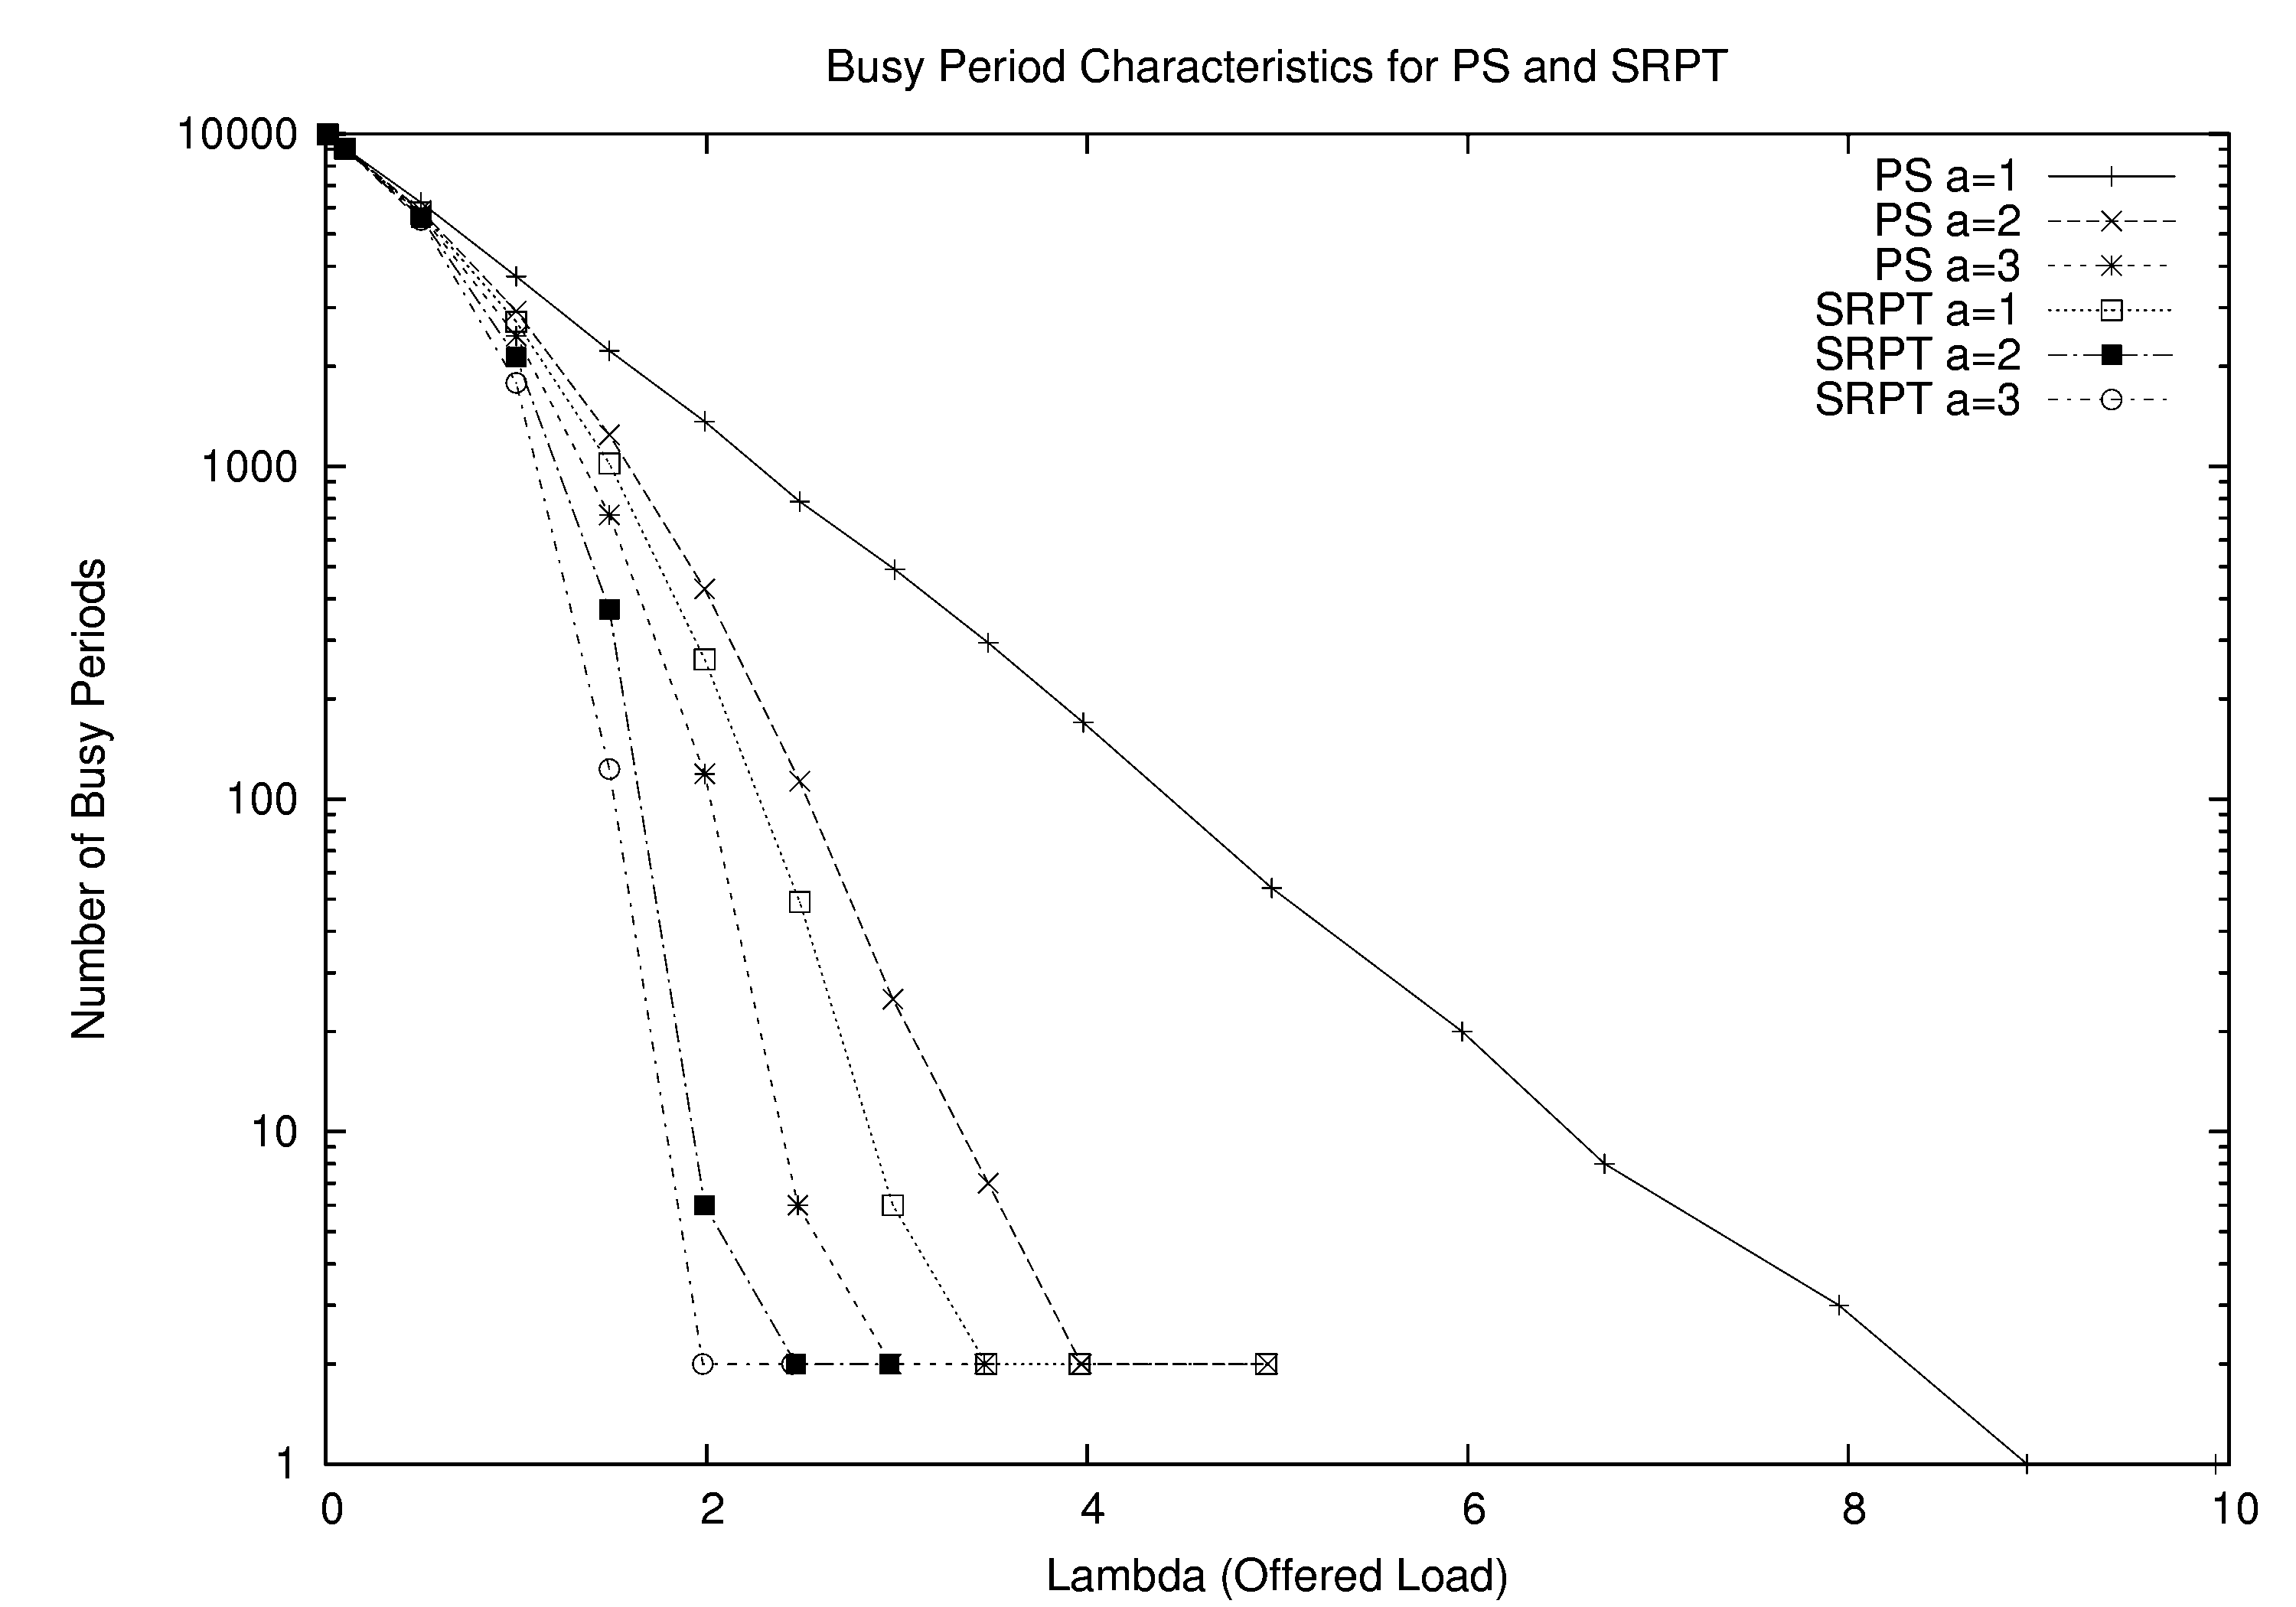
Busy Period Structure for PS and SRPT (simulation)

Slide 16
Simulation Insights and Observations
Under heavy load, busy periods coalesce and U → 1
Saturation points for PS and SRPT are different
  Different “overload regimes” for PS and SRPT
  Gap always exists between them
  Gap shrinks as α increases
  Limiting case (α = ∞) requires ρ < 1 (i.e., fixed rate)
SRPT suffers from starvation under very high load

Slide 17
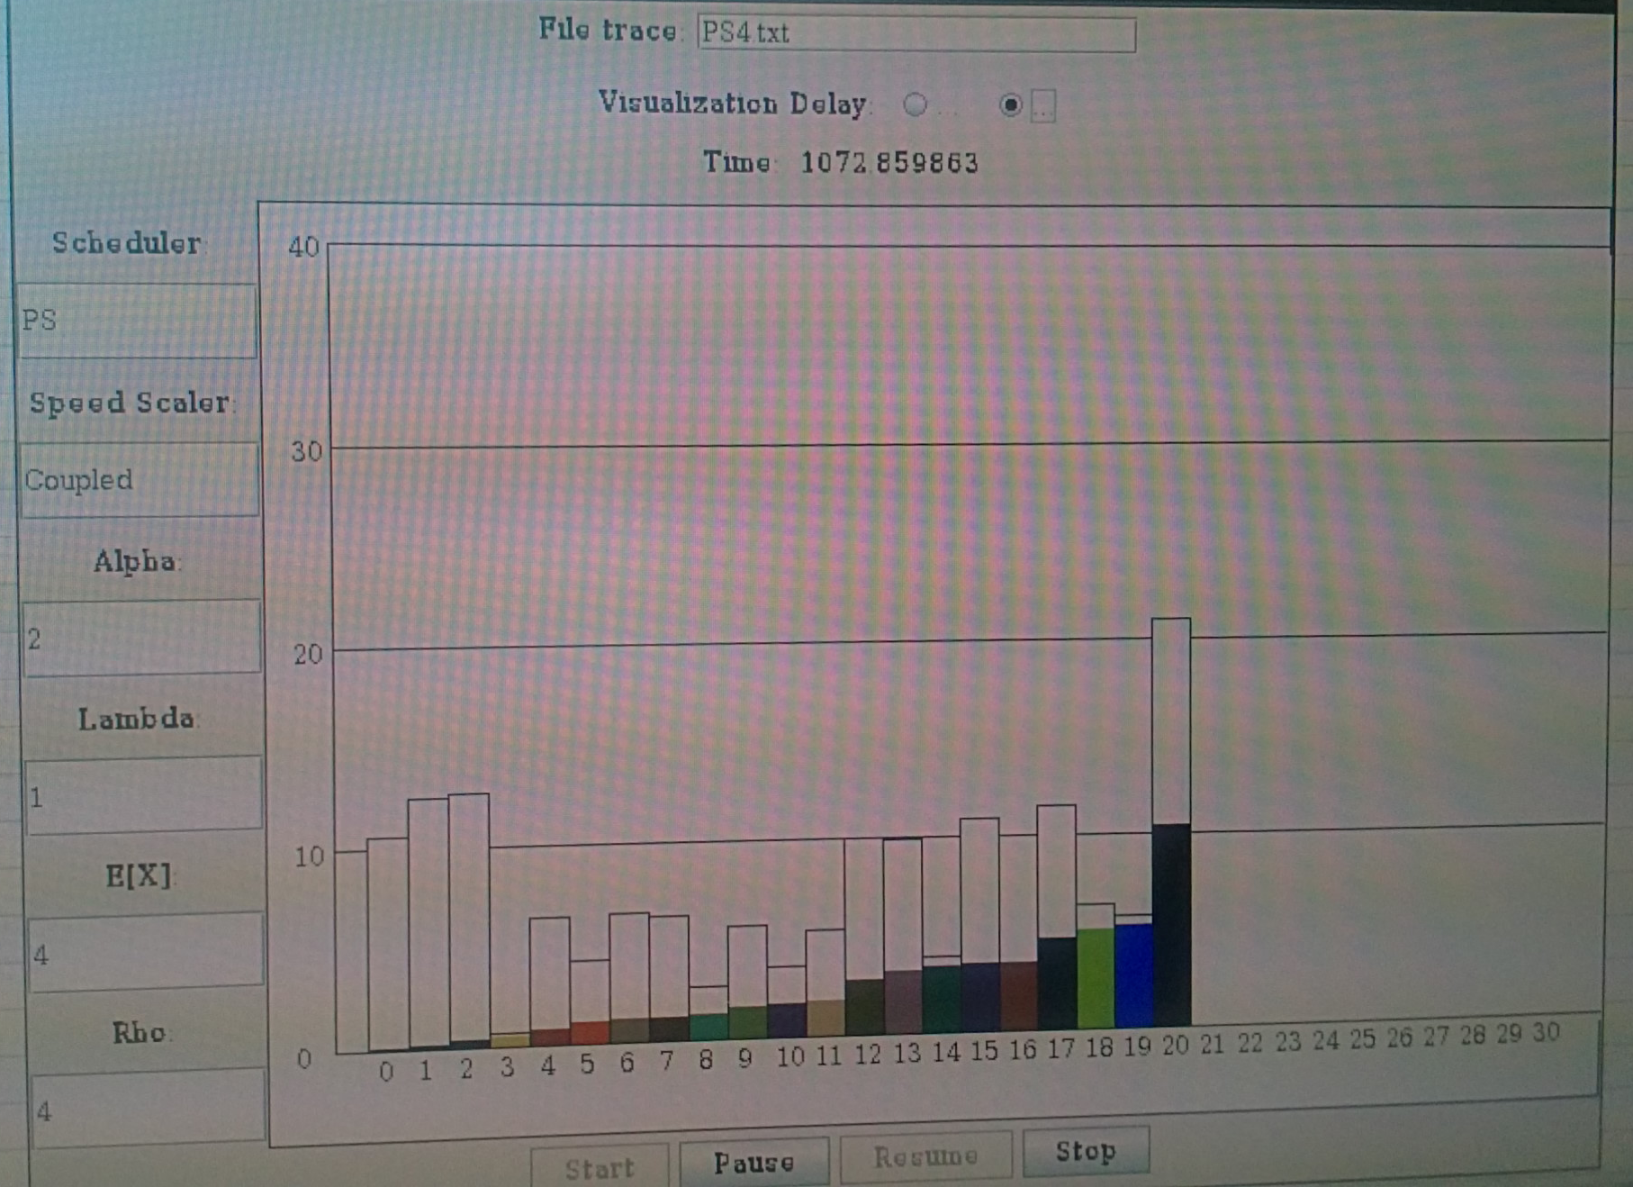
Visualization of PS Simulation

Slide 18
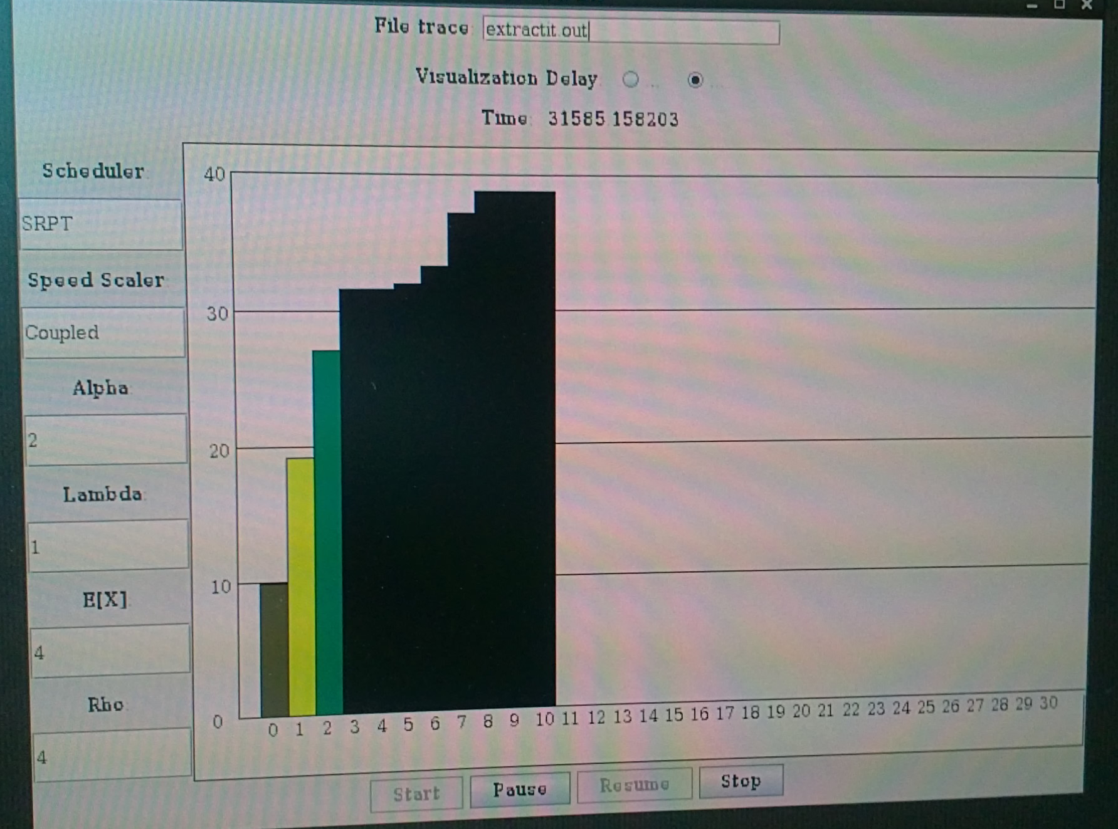
Visualization of SRPT Simulation

Slide 19
Conclusions
The autoscaling properties of dynamic speed scaling systems are many, varied, and interesting!
  Autoscaling effect: stable even at very high offered load (s = ρ)
  Saturation effect: U → 1 at heavy load, with N = ρ^{α}
  The α effect: shift, squish, and squeeze
Invariant properties are helpful for analysis
Differences exist between PS and SRPT
  Variance of system occupancy; mean/variance of response time
  Saturation points for PS and SRPT are different
  SRPT suffers from starvation under very high load
Our results suggest that PS becomes superior to SRPT for coupled speed scaling, if the load is high enough

Slide 20
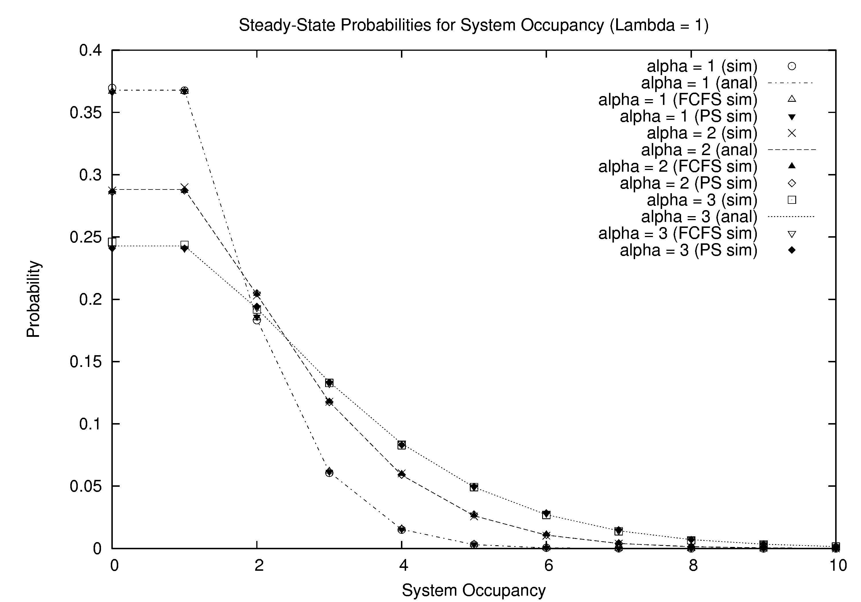
Analytical Results (1 of 3)

Slide 21
Analytical Results (2 of 3)

Slide 22
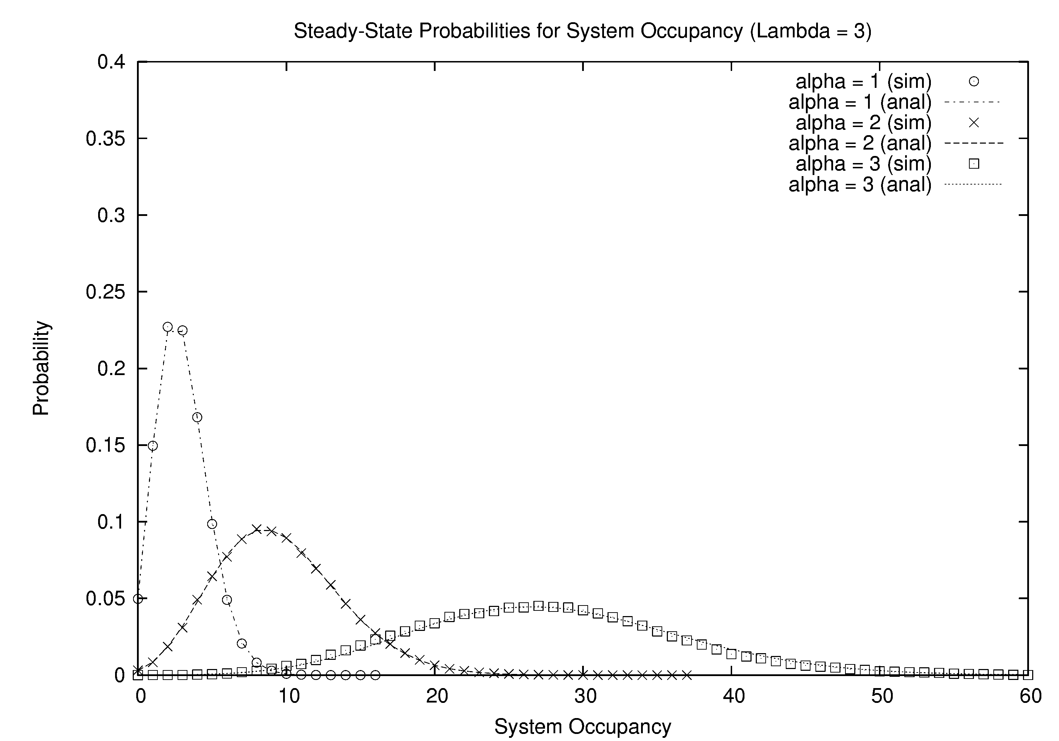
Analytical Results (3 of 3)

Slide 23
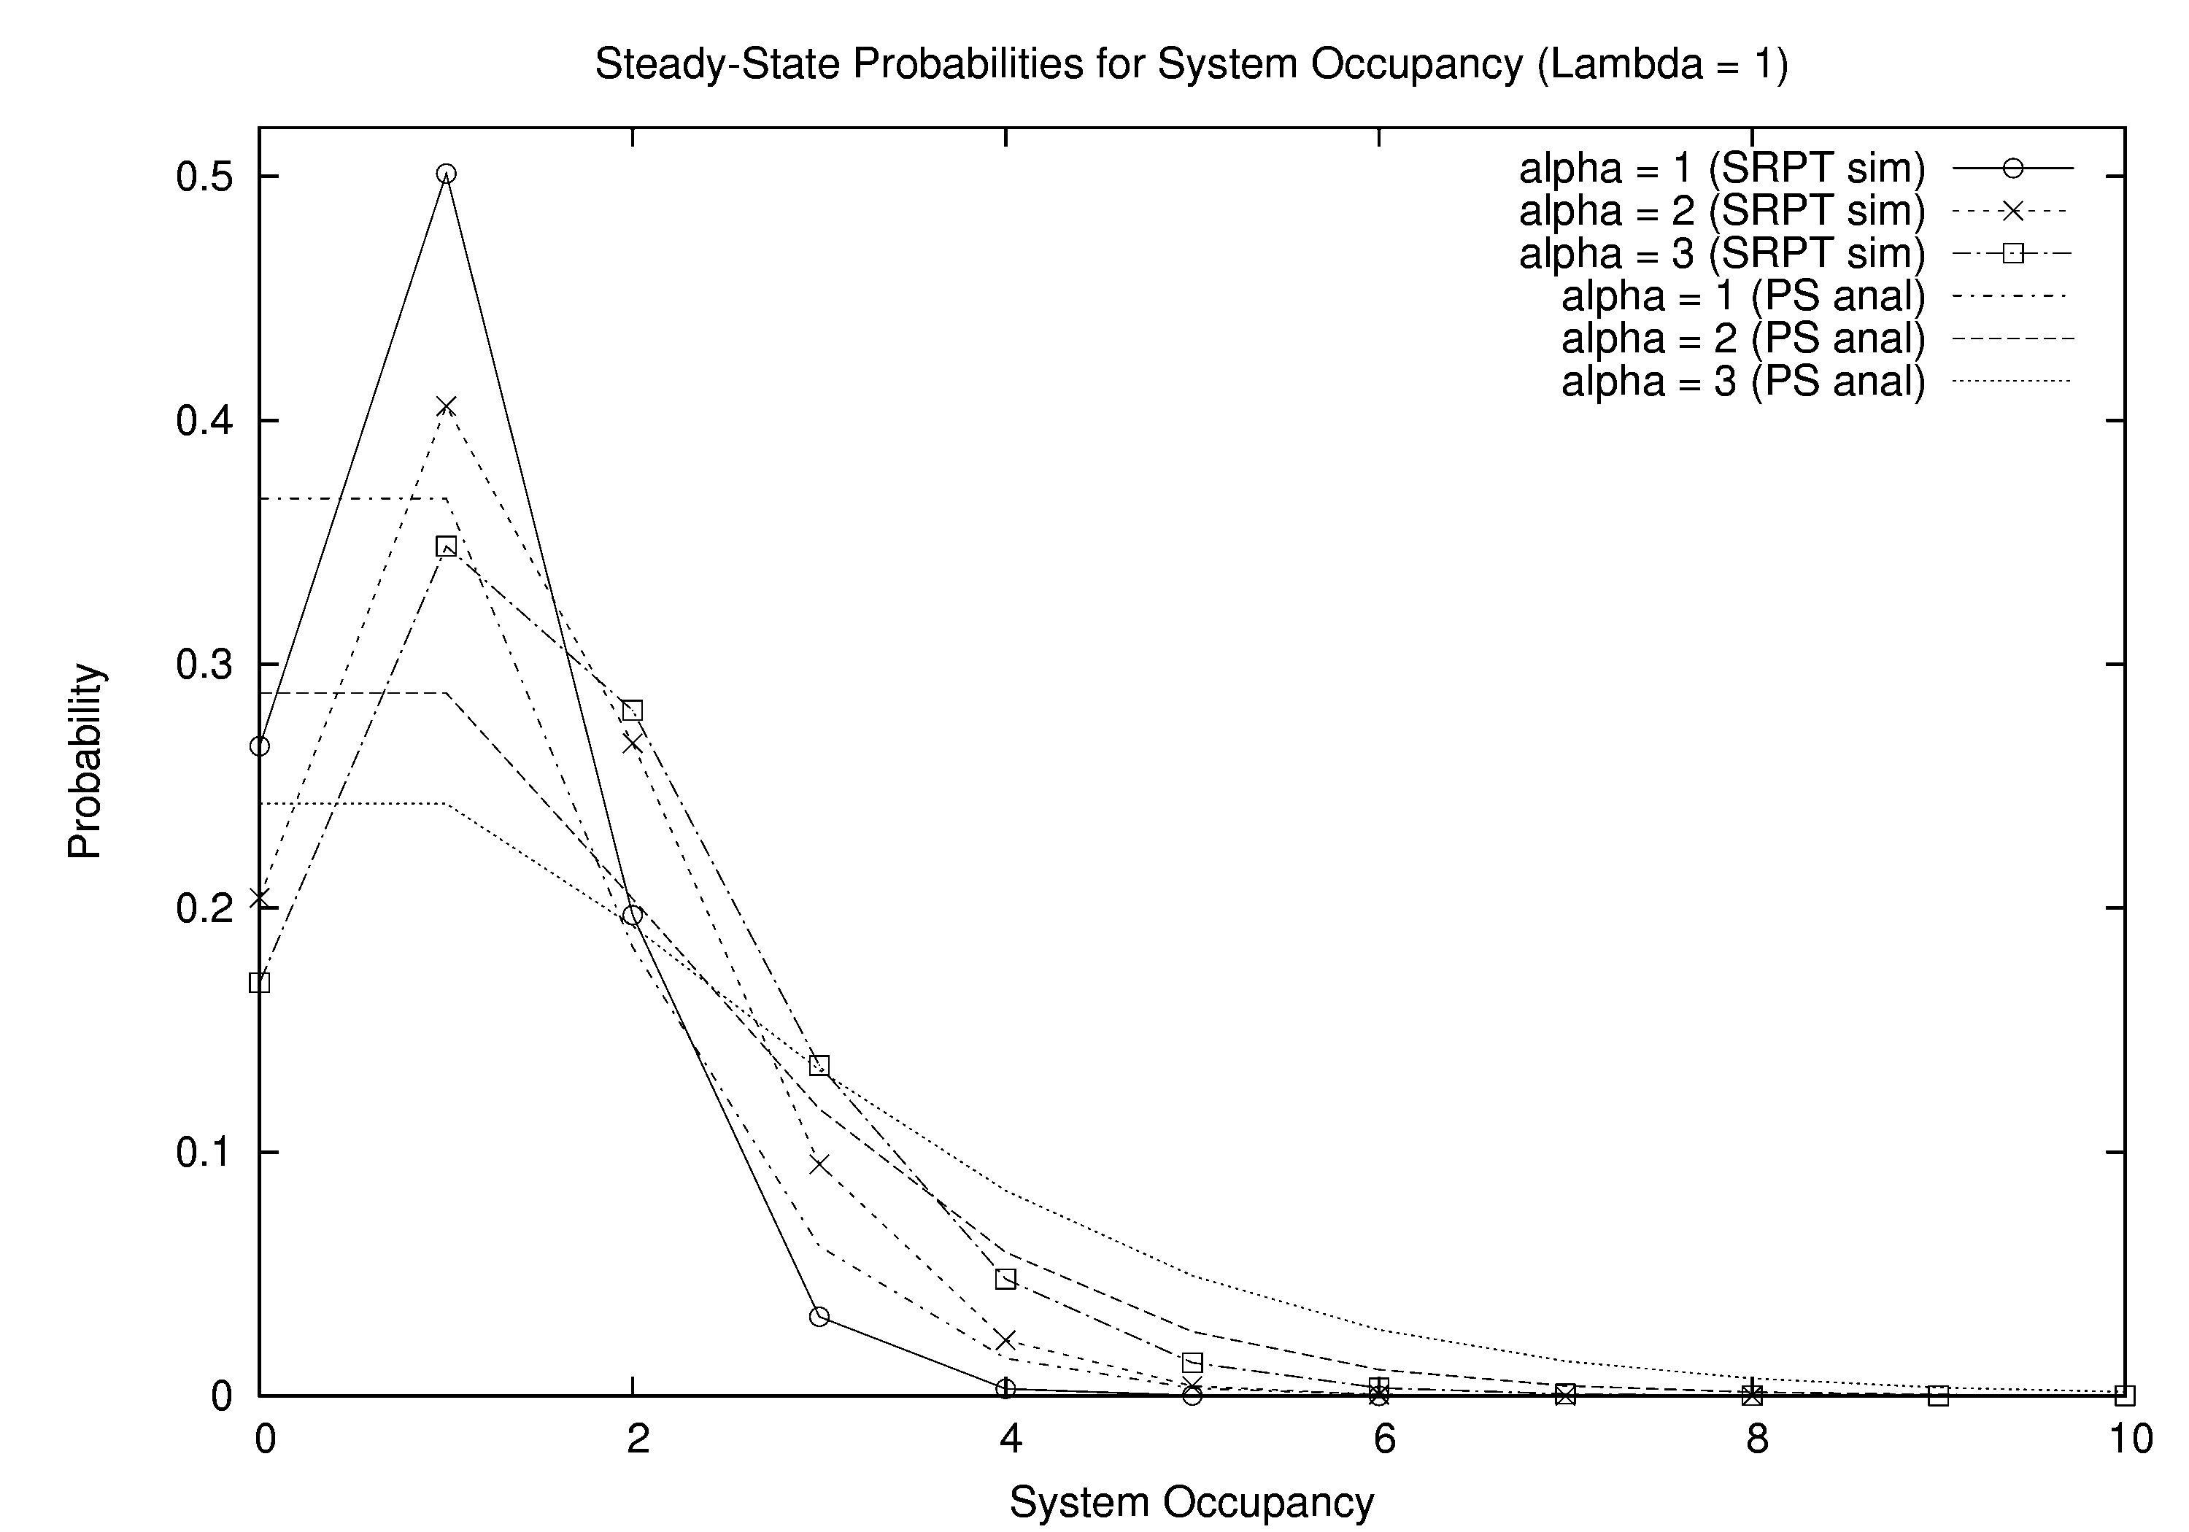
Simulation Results (1 of 3)

Slide 24
Simulation Results (2 of 3)

Slide 25
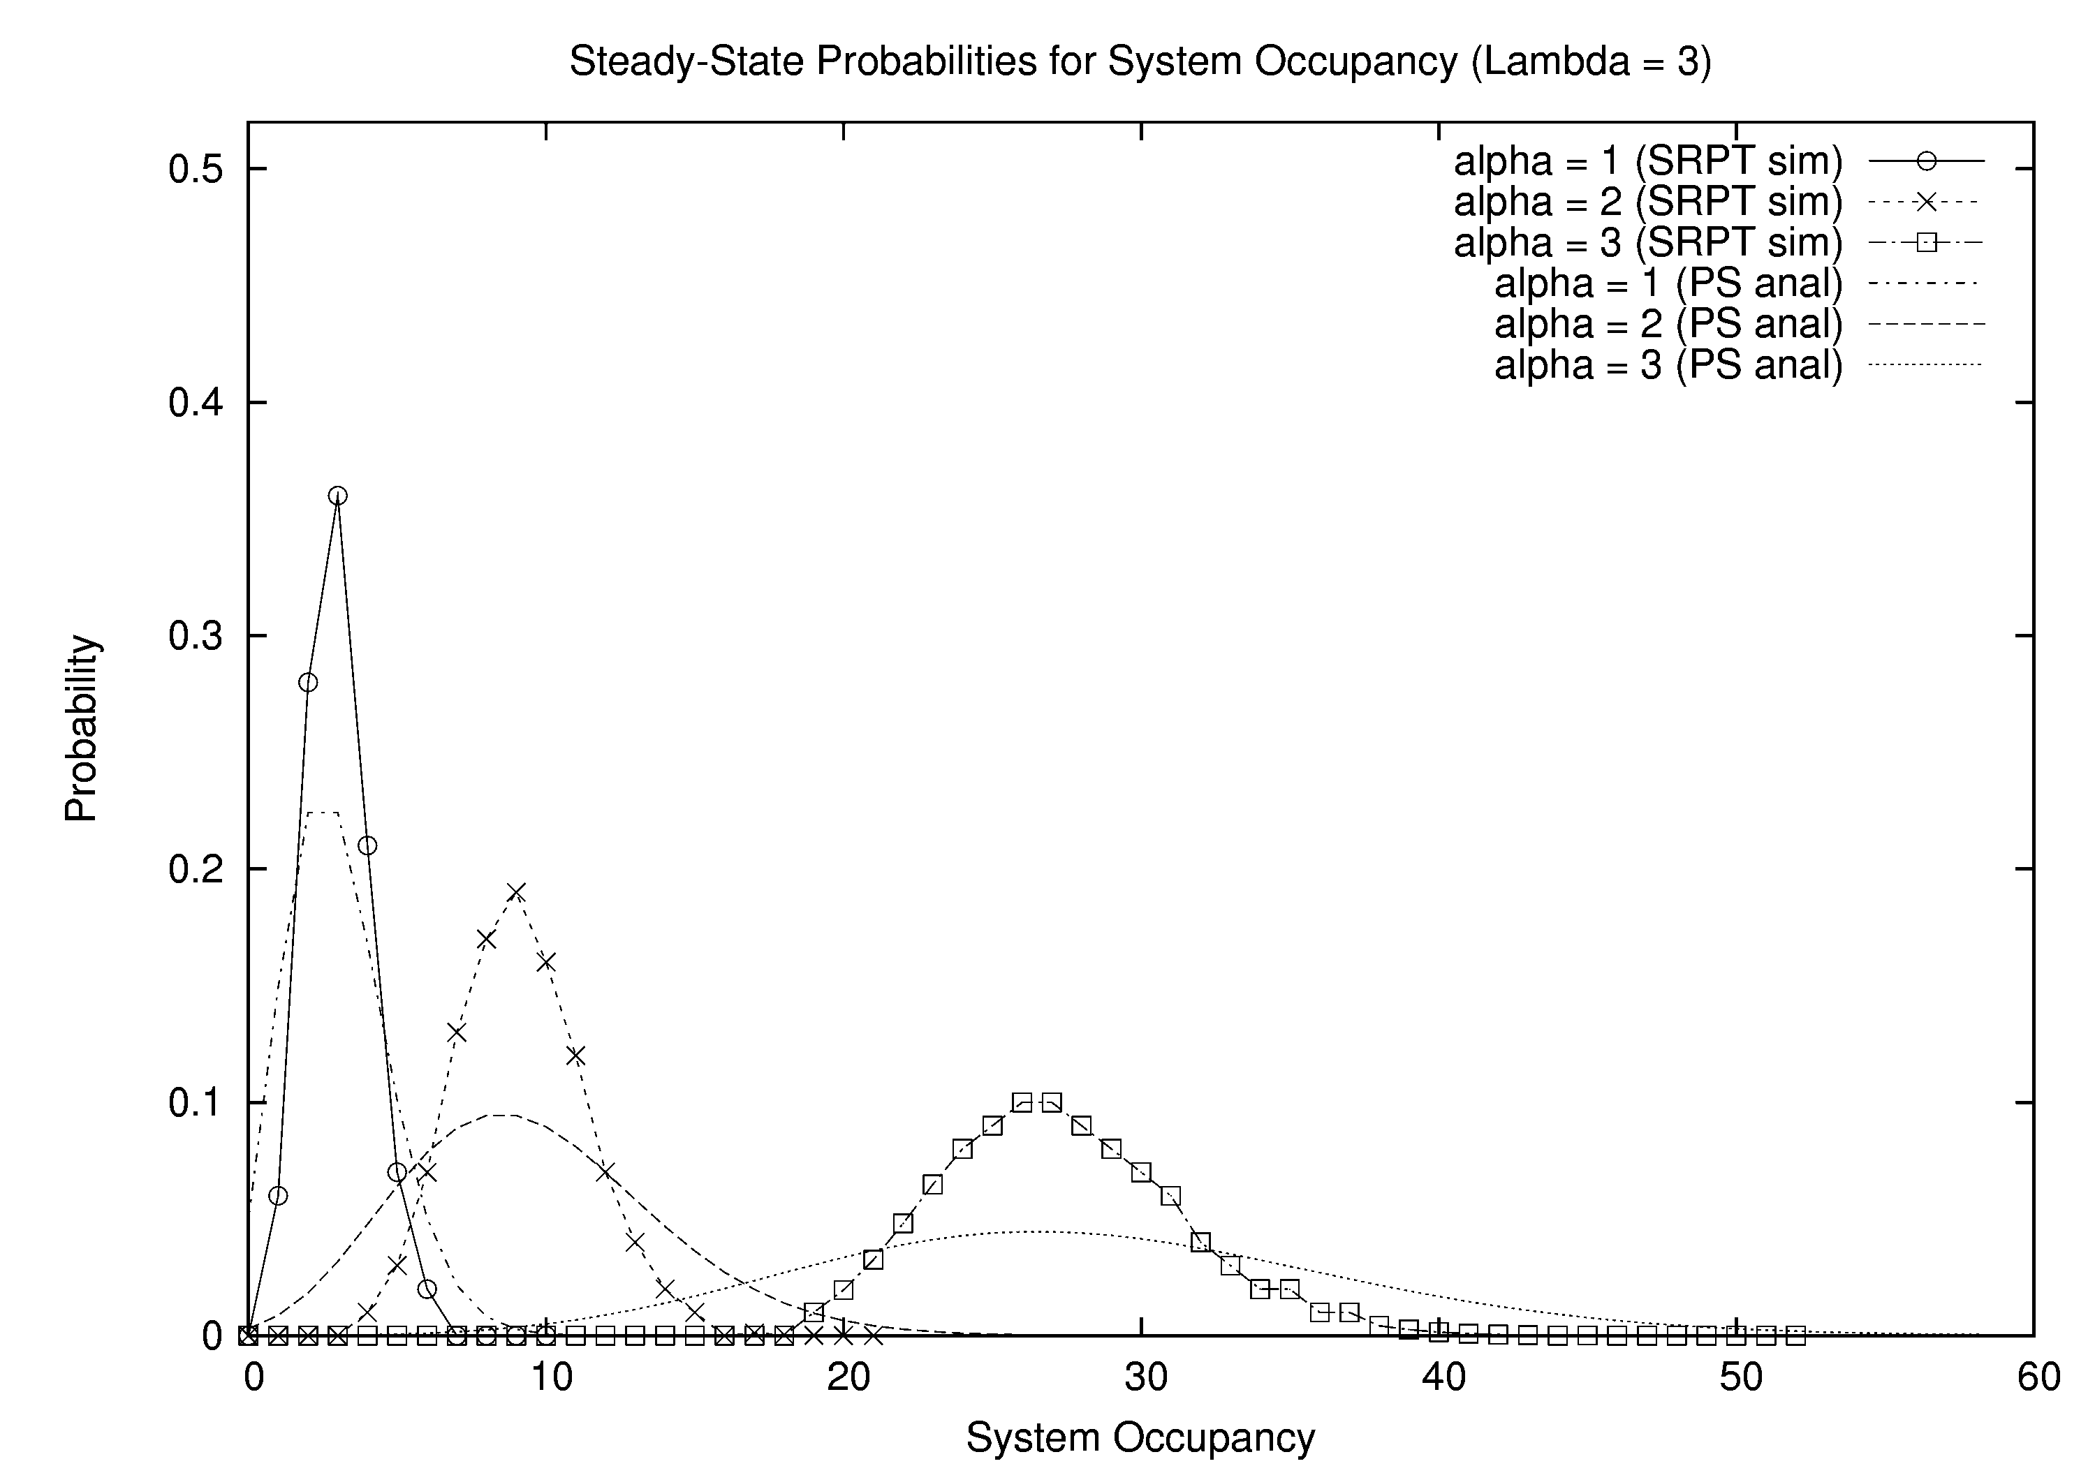
Simulation Results (3 of 3)

Slide 26
Simulation Results (1 of 6)

Slide 27
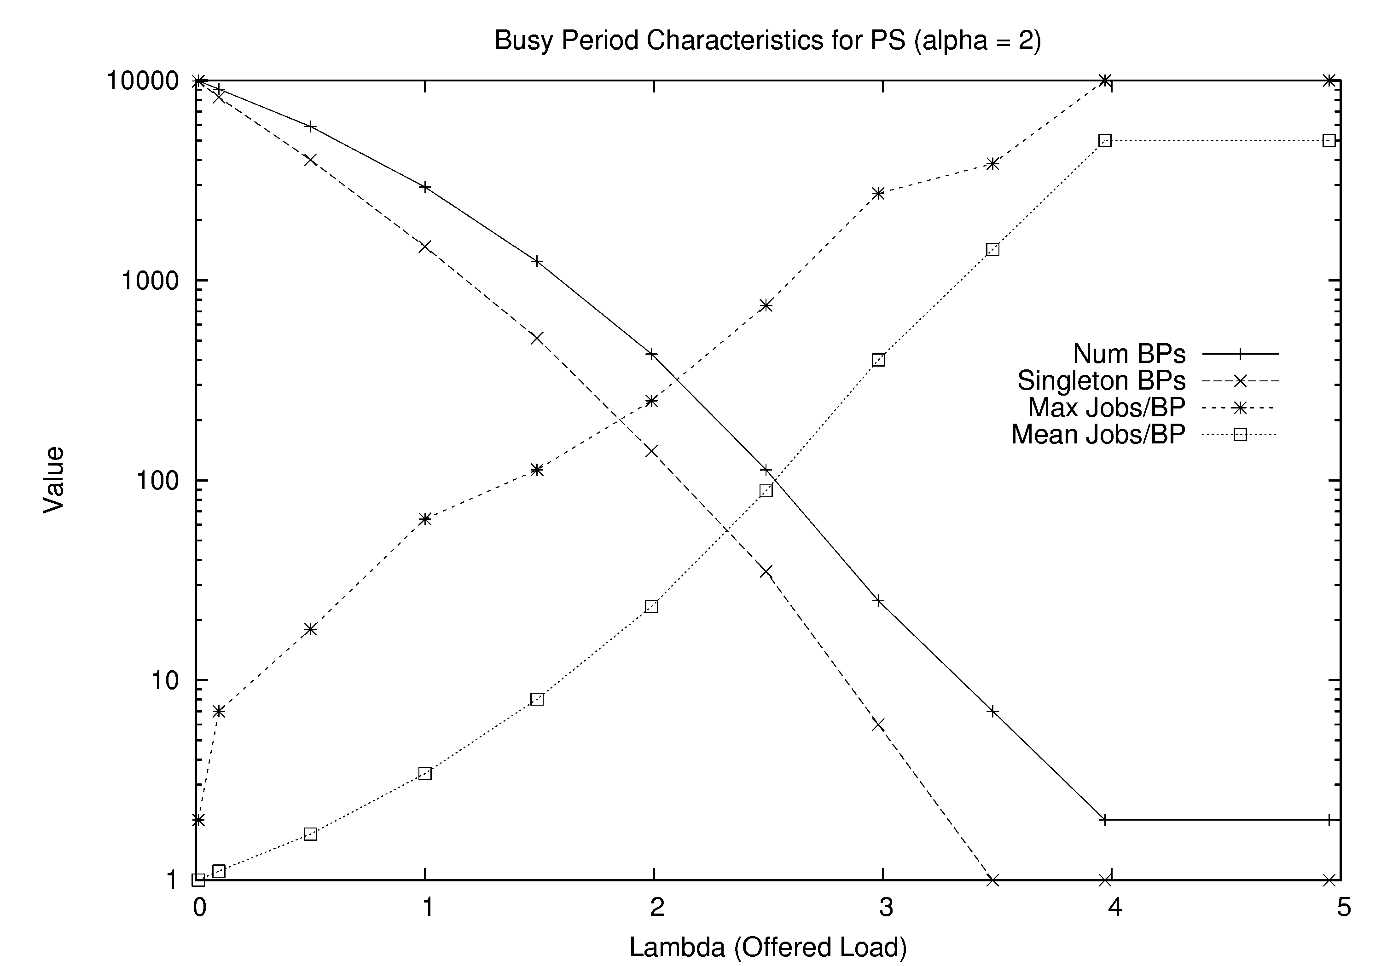
Simulation Results (2 of 6)

Slide 28
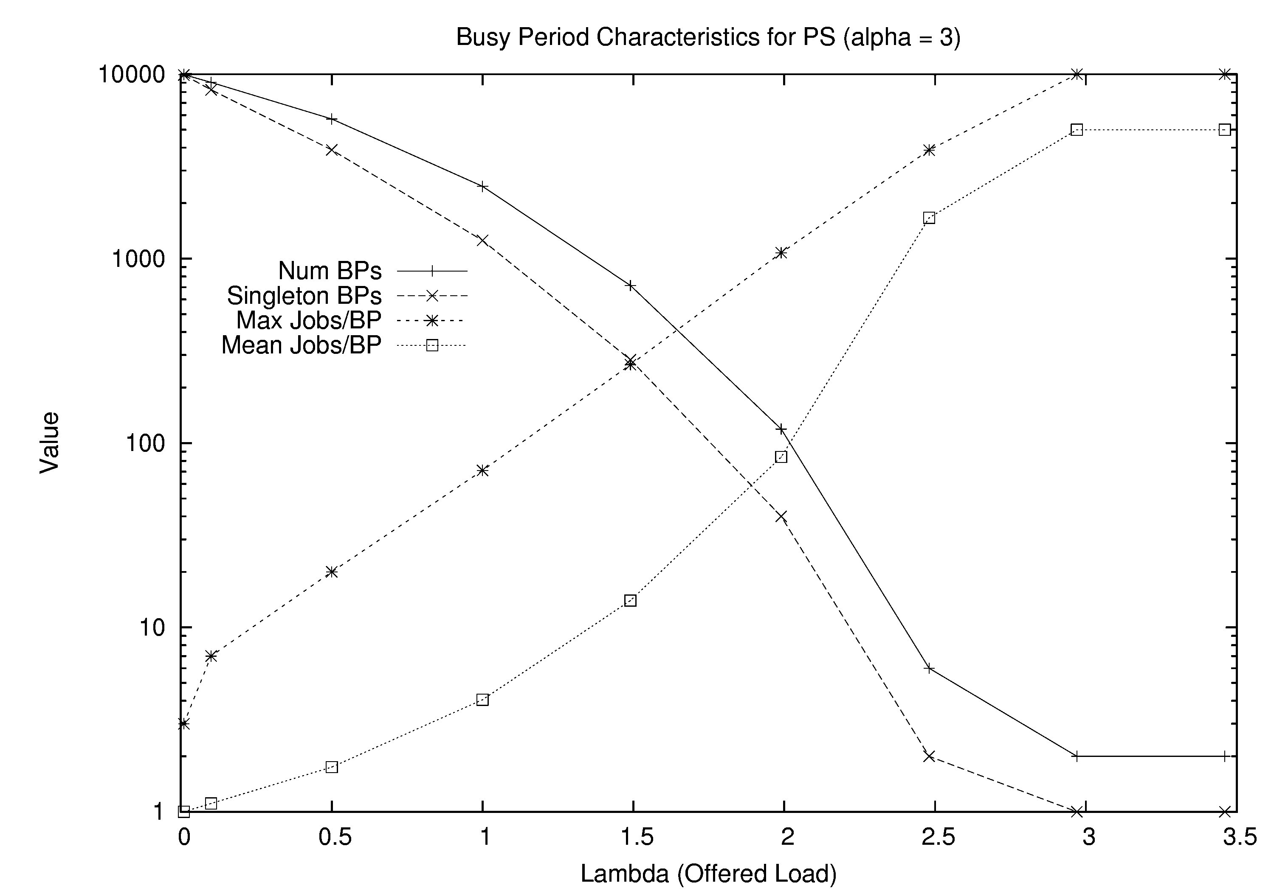
Simulation Results (3 of 6)

Slide 29
Simulation Results (4 of 6)

Slide 30
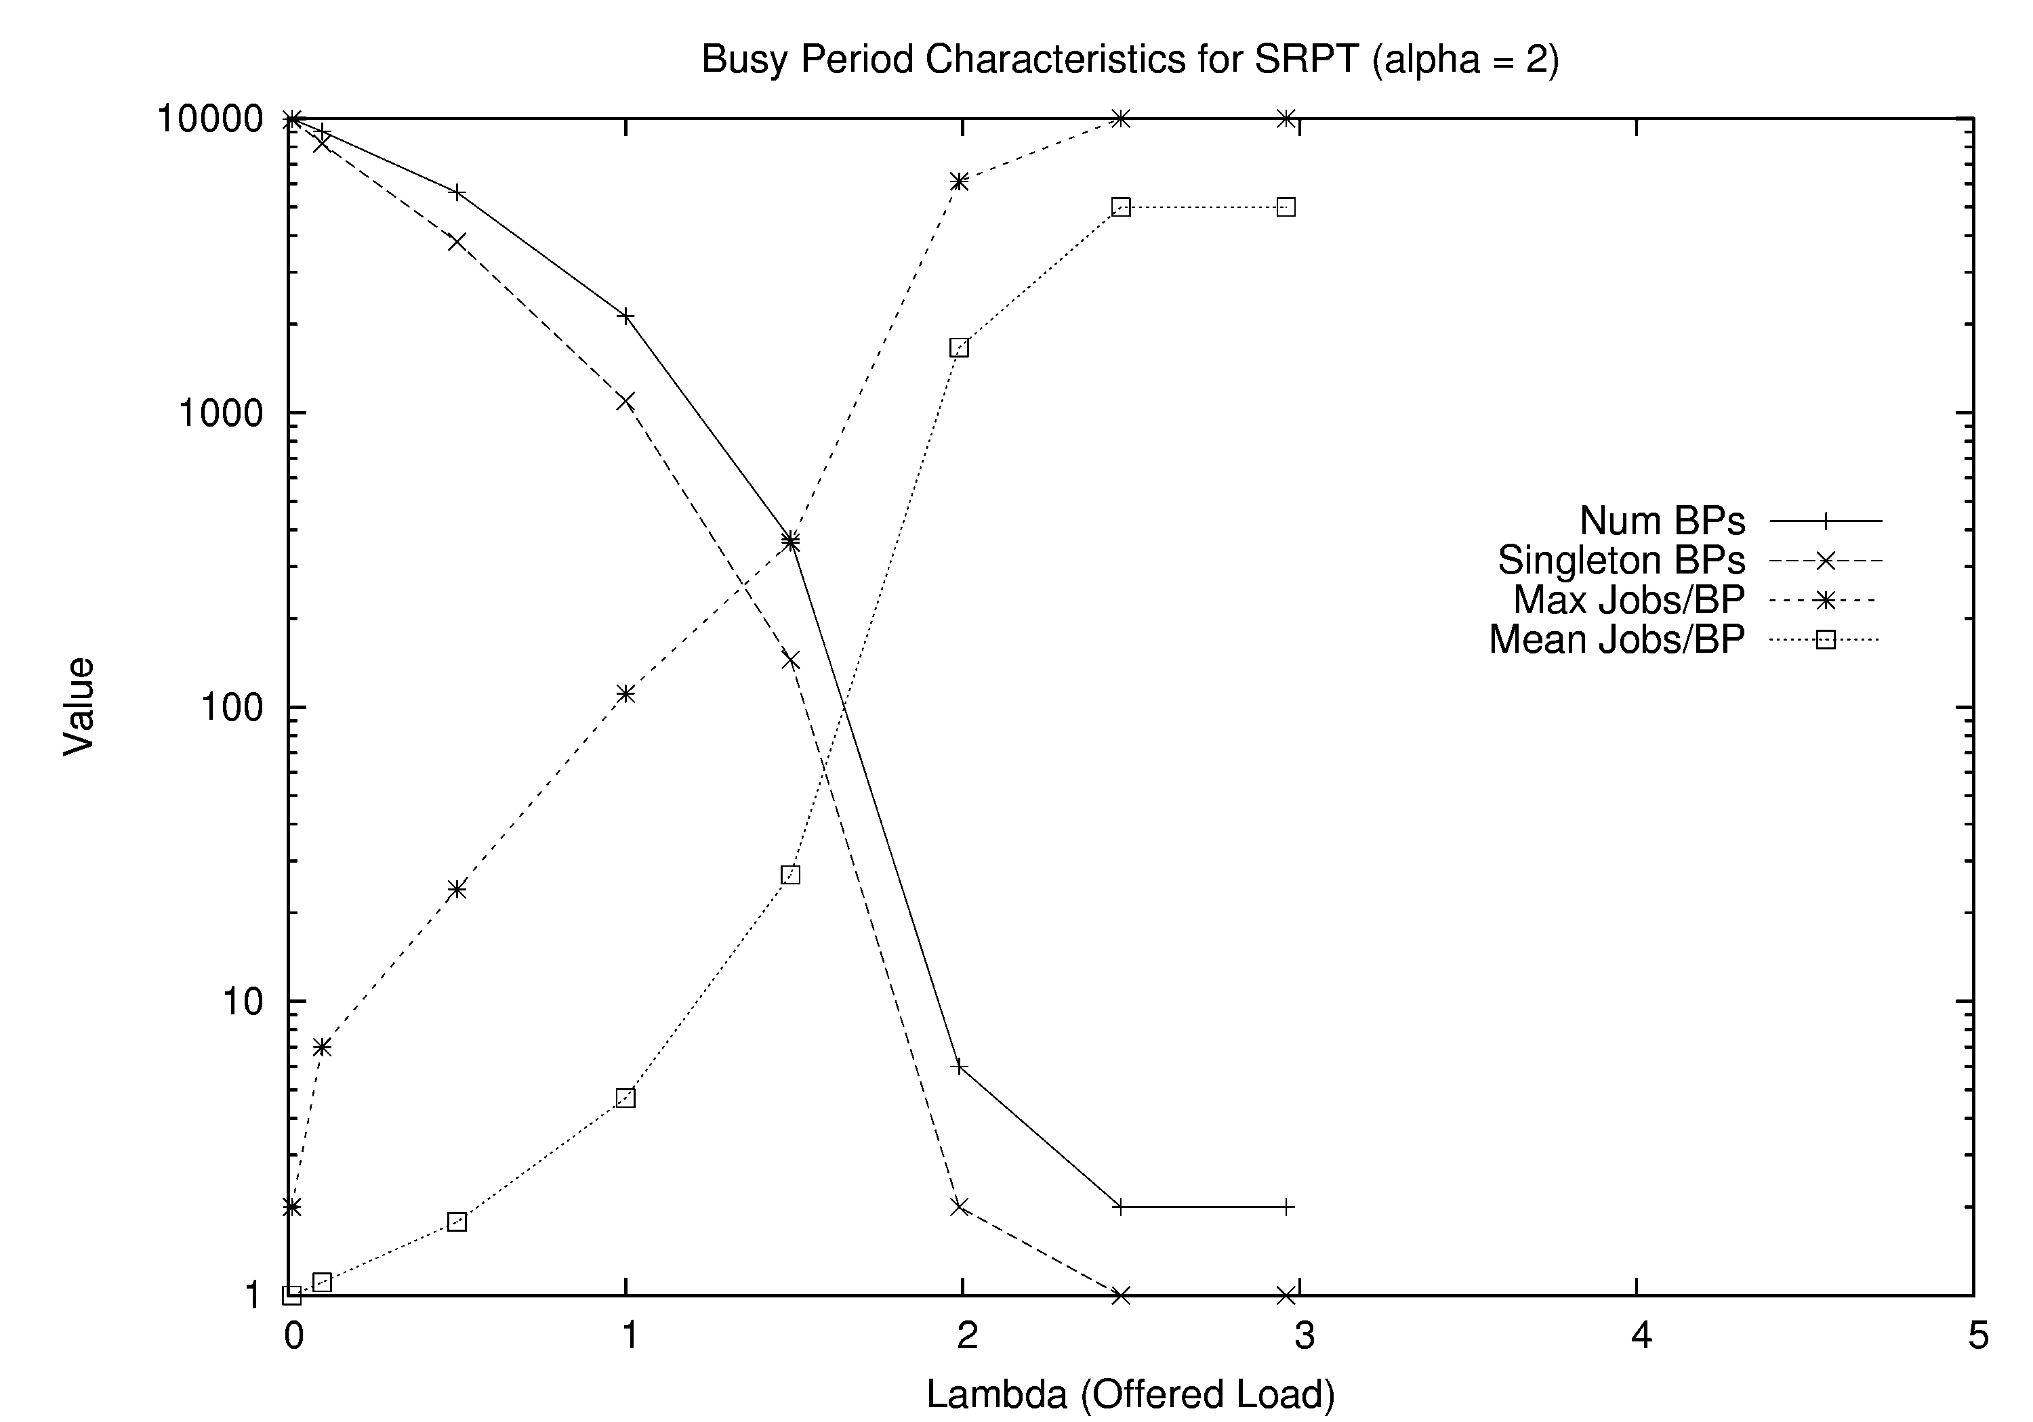
Simulation Results (5 of 6)

Slide 31
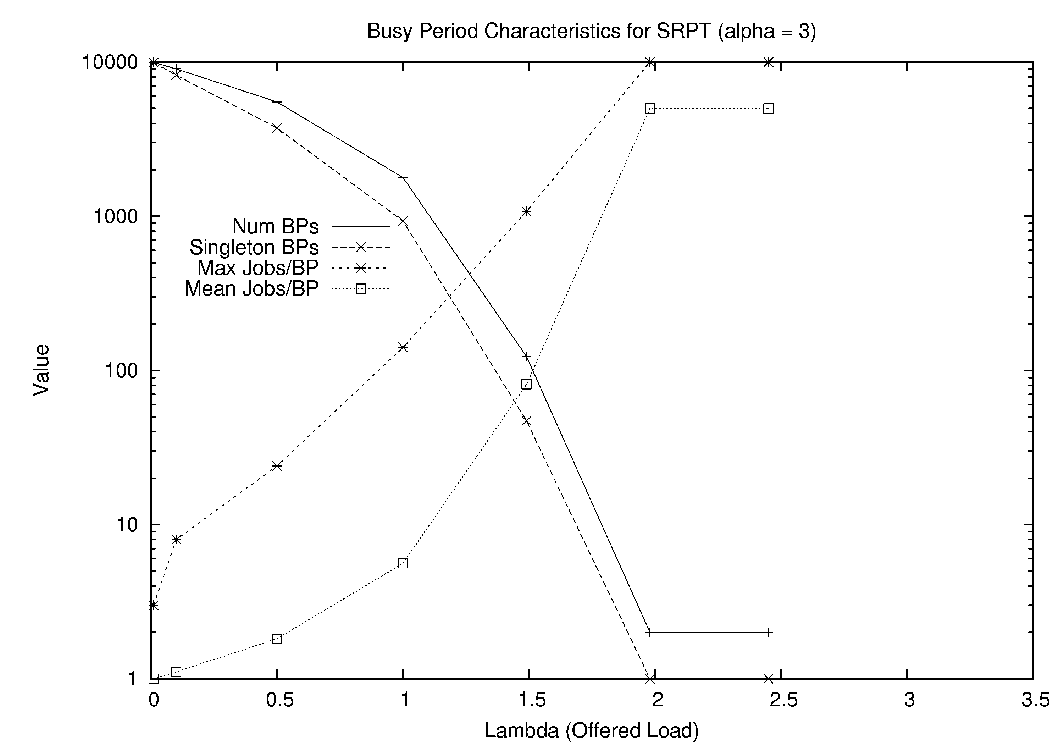
Simulation Results (6 of 6)

