Slide 1

Zoom Session Quality:
A Network-Level View
CPSC 641
Department of Computer Science
University of Calgary

Slide 2
Introduction
Zoom is a popular and widely-adopted solution for online video-conferencing during the pandemic
University of Calgary adopted Zoom as their platform for online teaching and learning since March 2020
Anecdotal reports of Zoom performance problems, especially when using it on campus
2

Slide 3
Research Questions
What does Zoom look like as a network application?
How heavily is it being used at the U of Calgary?
What is the user-level Quality of Experience (QoE)?
What are the root causes of performance problems?
3

Slide 4
Empirical Observations (preview)
Zoom session structure is discernible from traffic.
Zoom uses a TCP connection to manage a session.
Zoom uses 3 UDP ports: audio, video, screen-sharing.
For a 2-person meeting, Zoom runs in P2P mode with only a single UDP connection.
Zoom does dynamic adaptation of video bit rates.
Many Zoom sessions experience disruptions.
Zoom sessions are very resilient in re-establishing.
Zoom has diurnal usage patterns (class schedules).
Zoom traffic grew over 4x between F2020 and F2021.
4

Slide 5
Research Methodology
Small-scale approach
Zoom test sessions
Wireshark
Packet-level view
Analysis/visualization
Structural properties
Key characteristics
Large-scale approach
Campus Zoom traffic
Endace DAG monitor
Connection-level view
Analysis/visualization
Workload characteristics
Performance anomalies
5

Slide 6
Background: Network Traffic Measurement
Network traffic measurement requires hardware or software measurement tools that attach directly to network
Allows you to observe all packet traffic on the network (or a filtered subset for traffic of interest)
Assumes broadcast-based network technology, superuser permission
101101
6

Slide 7
Our Tools for Network Traffic Measurement
Wireshark
  Used for our small-scale Zoom test measurements
  Free and open-source tool (formerly called Ethereal)
  Multi-layer visualization and analysis of packet-level traces
  Supports PCAP file format
Endace DAG
  Used for our large-scale study of campus-level traffic
  Special-purpose hardware for multi-Gbps capture
  Installed in IT data center; port-mirroring on UofC router
  Processed by Zeek (Bro) for connection-level summaries
7

Slide 8
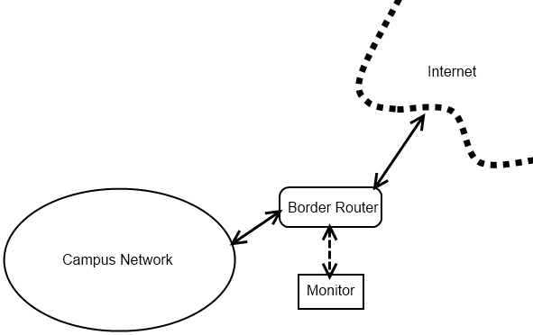
U of C Monitoring & Analysis Infrastructure
orgMappings
Endace
Vertica
Bro/Zeek
UofCMappings
orgMappings
Threat Intel
conn
dns
http
etc
8

Slide 9
Example: packet-level vs. connection-level
Time IP Source Addr IP Dest Addr Size Prot SPort DPort TCP Data SeqNumber TCP AckNum Window Flags
0.000000 192.168.1.201 -> 192.168.1.200 60 TCP 4105 80 1315338075 : 1315338075 0 win: 5840 S
0.003362 192.168.1.200 -> 192.168.1.201 60 TCP 80 4105 1417888236 : 1417888236 1315338076 win: 5792 SA
0.009183 192.168.1.201 -> 192.168.1.200 52 TCP 4105 80 1315338076 : 1315338076 1417888237 win: 5840 A
0.010854 192.168.1.201 -> 192.168.1.200 127 TCP 4105 80 1315338076 : 1315338151 1417888237 win: 5840 PA
0.014309 192.168.1.200 -> 192.168.1.201 52 TCP 80 4105 1417888237 : 1417888237 1315338151 win: 5792 A
0.049848 192.168.1.200 -> 192.168.1.201 1500 TCP 80 4105 1417888237 : 1417889685 1315338151 win: 5792 A
0.056902 192.168.1.200 -> 192.168.1.201 1500 TCP 80 4105 1417889685 : 1417891133 1315338151 win: 5792 A
0.057284 192.168.1.201 -> 192.168.1.200 52 TCP 4105 80 1315338151 : 1315338151 1417889685 win: 8688 A
0.060120 192.168.1.201 -> 192.168.1.200 52 TCP 4105 80 1315338151 : 1315338151 1417891133 win: 11584 A
0.068579 192.168.1.200 -> 192.168.1.201 1500 TCP 80 4105 1417891133 : 1417892581 1315338151 win: 5792 PA
0.075673 192.168.1.200 -> 192.168.1.201 1500 TCP 80 4105 1417892581 : 1417894029 1315338151 win: 5792 A
0.076055 192.168.1.201 -> 192.168.1.200 52 TCP 4105 80 1315338151 : 1315338151 1417892581 win: 14480 A
0.083233 192.168.1.200 -> 192.168.1.201 1500 TCP 80 4105 1417894029 : 1417895477 1315338151 win: 5792 A
0.096728 192.168.1.200 -> 192.168.1.201 1500 TCP 80 4105 1417896925 : 1417898373 1315338151 win: 5792 A
0.103439 192.168.1.200 -> 192.168.1.201 1500 TCP 80 4105 1417898373 : 1417899821 1315338151 win: 5792 A
0.103780 192.168.1.201 -> 192.168.1.200 52 TCP 4105 80 1315338151 : 1315338151 1417894029 win: 17376 A
0.106534 192.168.1.201 -> 192.168.1.200 52 TCP 4105 80 1315338151 : 1315338151 1417898373 win: 21720 A
0.133408 192.168.1.200 -> 192.168.1.201 776 TCP 80 4105 1417904165 : 1417904889 1315338151 win: 5792 FPA
0.139200 192.168.1.201 -> 192.168.1.200 52 TCP 4105 80 1315338151 : 1315338151 1417904165 win: 21720 A
0.140447 192.168.1.201 -> 192.168.1.200 52 TCP 4105 80 1315338151 : 1315338151 1417904890 win: 21720 FA
0.144254 192.168.1.200 -> 192.168.1.201 52 TCP 80 4105 1417904890 : 1417904890 1315338152 win: 5792 A
Connection log entry:
0.000000 192.168.1.201 4105 192.168.1.200 80 0.144254 10 77 11 16654 SF

Slide 10
Terminology
Zoom session
  Client IP from U of C network talking to a Zoom server
Zoom meeting
  Multiple client IPs from U of C network talking to the same Zoom server at the same time (presumably same meeting)
Zoom server
  An IP address from the list of prefixes known for Zoom
  Several different types:
    Zone Controller (ZC)
    Multimedia Router (MMR)
    Other (API, logging, Web, XMPP, etc)
10

Slide 11
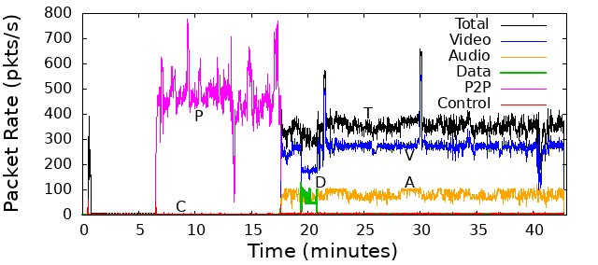
Small-scale Experiments
11

Slide 12
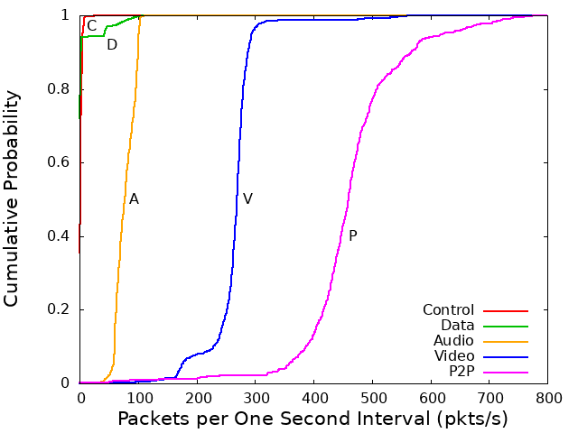
Small-scale Experiments
12

Slide 13
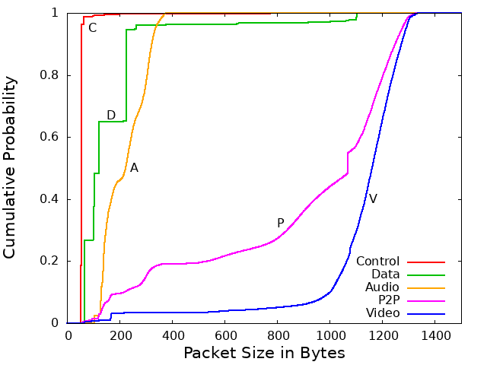
Small-scale Experiments
13

Slide 14
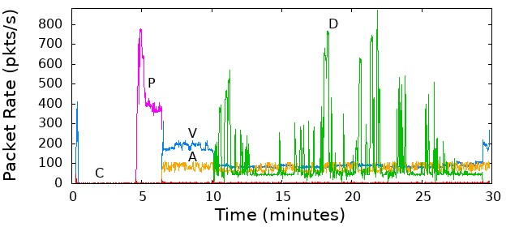
Small-scale Experiments
14

Slide 15
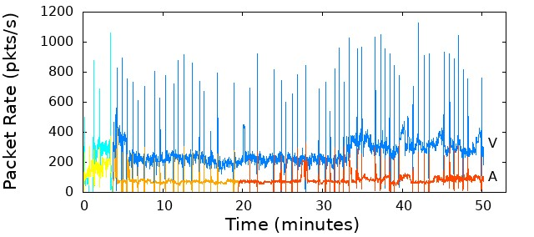
Small-scale Experiments
15

Slide 16
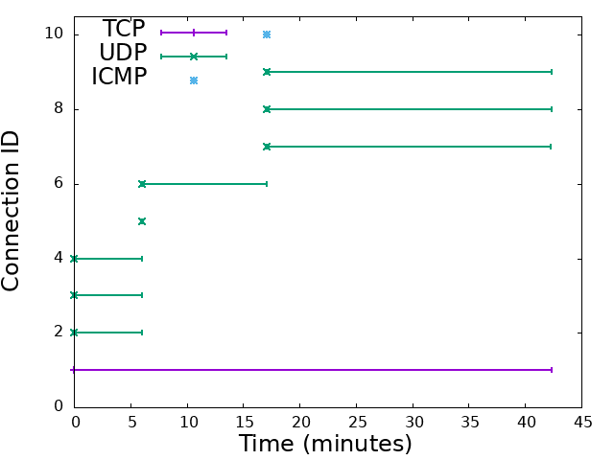
Small-scale Experiments
16

Slide 17
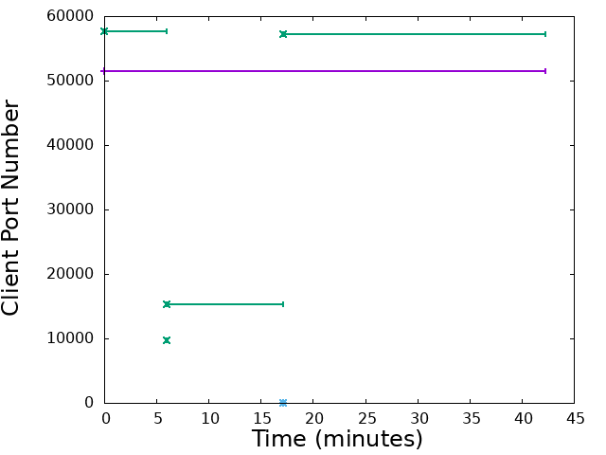
Small-scale Experiments
17

Slide 18
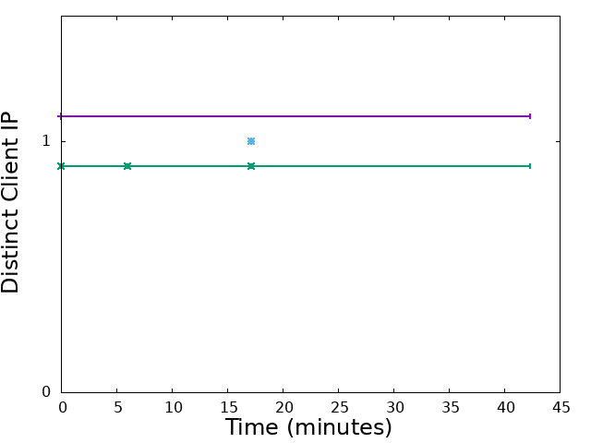
Small-scale Experiments
18

Slide 19
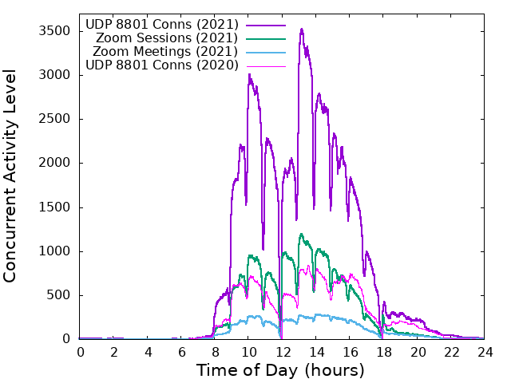
Large-scale Experiments
19

Slide 20
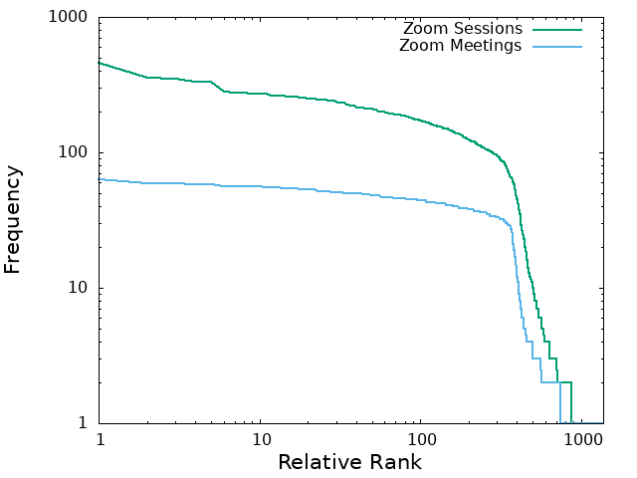
Large-scale Experiments
20

Slide 21
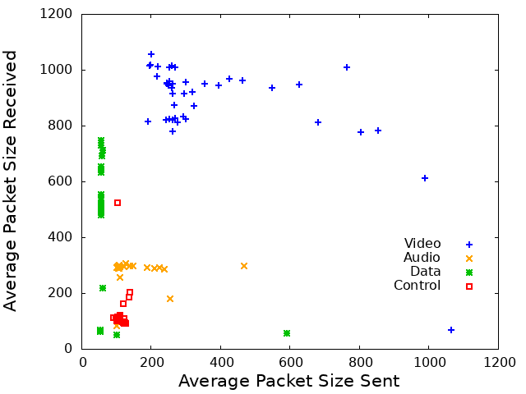
Large-scale Experiments
21

Slide 22
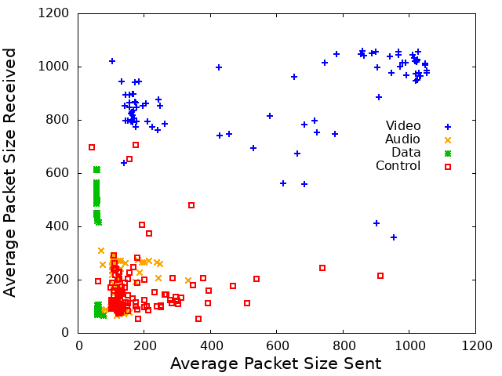
Large-scale Experiments
22

Slide 23
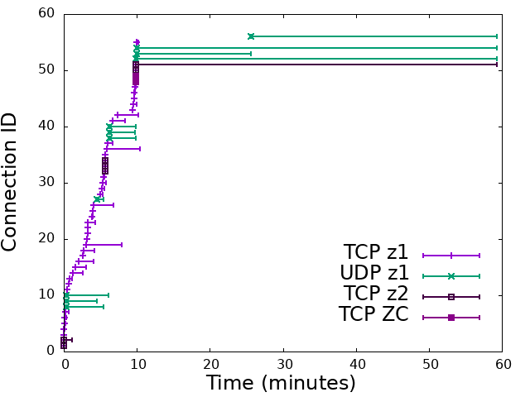
Large-scale Experiments
23

Slide 24
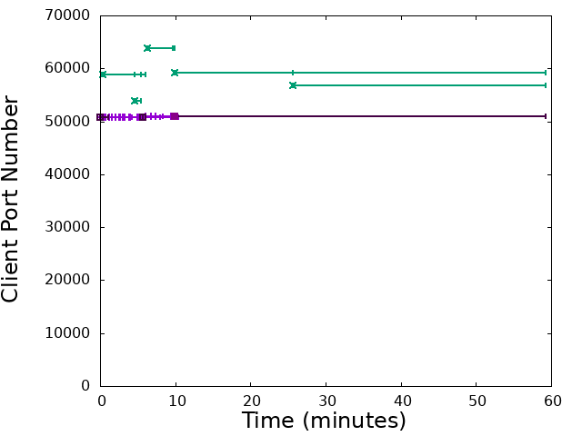
Large-scale Experiments
24

Slide 25
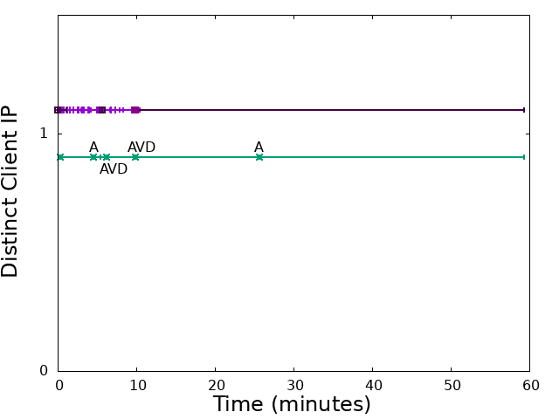
Large-scale Experiments
25

Slide 26
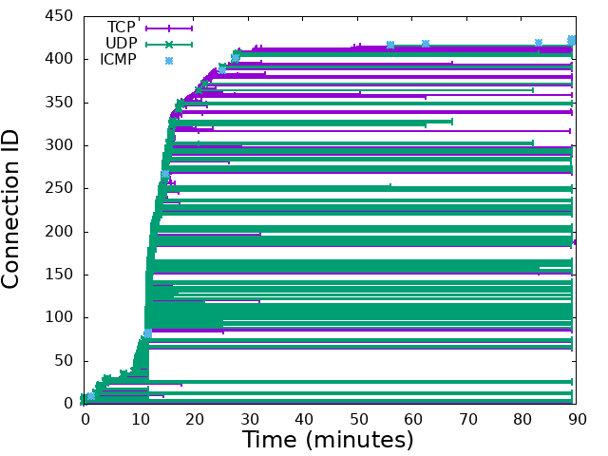
Large-scale Experiments
26

Slide 27
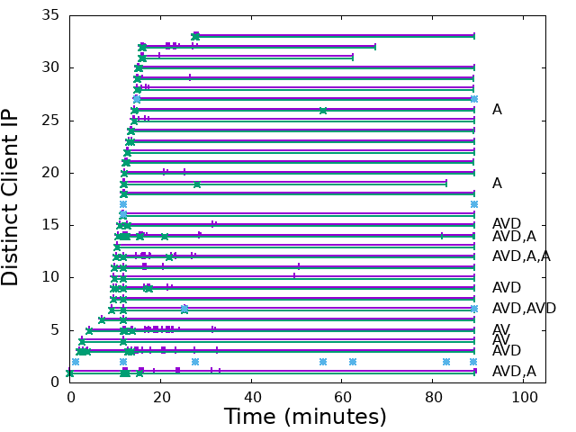
Large-scale Experiments
27

Slide 28
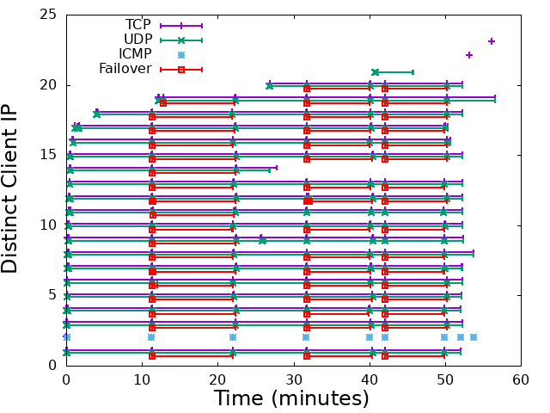
Large-scale Experiments
28

Slide 29
Empirical Observations (recap)
Zoom session structure is discernible from traffic.
Zoom uses a TCP connection to manage a session.
Zoom uses 3 UDP ports: audio, video, screen-sharing.
For a 2-person meeting, Zoom runs in P2P mode with only a single UDP connection.
Zoom does dynamic adaptation of video bit rates.
Many Zoom sessions experience disruptions.
Zoom sessions are very resilient in re-establishing.
Zoom has diurnal usage patterns (class schedules).
Zoom traffic grew over 4x between F2020 and F2021.
29

Slide 30
Limitations
Partial visibility of Zoom sessions
  Can only see traffic between U of C network and Zoom
  If all participants are on campus, we don’t see it
  If all participants are on campus, we don’t see it
Peer-to-peer (P2P) sessions
  A two-person meeting runs in direct P2P mode, in which case neither endpoint is a Zoom address
  Hard to identify; could be other P2P apps; privacy issues
Heuristics
  Identification of Zoom meetings; classification of UDP channels
Monitor issues
  Monitor restarts and possible packet losses at peak hours of the day may result in underestimating Zoom traffic
30

Slide 31
Summary and Conclusions
Our study provides an empirical network-level view of Zoom traffic as seen on our campus network
Zoom usage is 4x higher now than it was a year ago, which places a lot of load on our campus network
Many Zoom performance problems are evident, though the root cause (WiFi? Zoom? TLS?) eludes us
Zoom is surprisingly robust and resilient
Our simple analysis and visualization tools provide an effective means to identify/quantify Zoom issues
31

