Slide 1
MoVIE: A Measurement Tool for
Mobile Video Streaming on Smartphones
Sina Keshvadi, Carey Williamson
Dept. Computer Science,
University of Calgary
ACM/SPEC ICPE 2020
Edmonton, Canada
Notes:
I am Sina Keshvadi and I want to present the paper: MoVIE: A Measurement Tool for Mobile Video Streaming on Smartphones
My co-author is Carey williamson and we are from the department of Computer Science at the University of Calgary.
This presentation is recorded for ICPE 2020 conference.

Slide 2
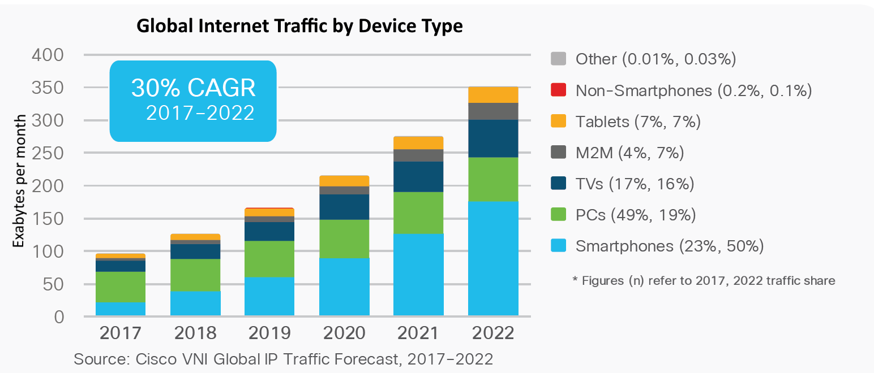
Mobile Traffic
Notes:
Over the past decade, smartphones have become an important part of our lives. Cisco reported that 48% of global Internet traffic in 2019 was consumed by handheld devices such as smartphones and tablets.
The emerging mobile web supported by WiFi and 4G/5G cellular networks enables us to access the Internet from anywhere and at anytime. The Cisco predicted that the smartphone traffic will reach 50% of global traffic at 2022.

Slide 3
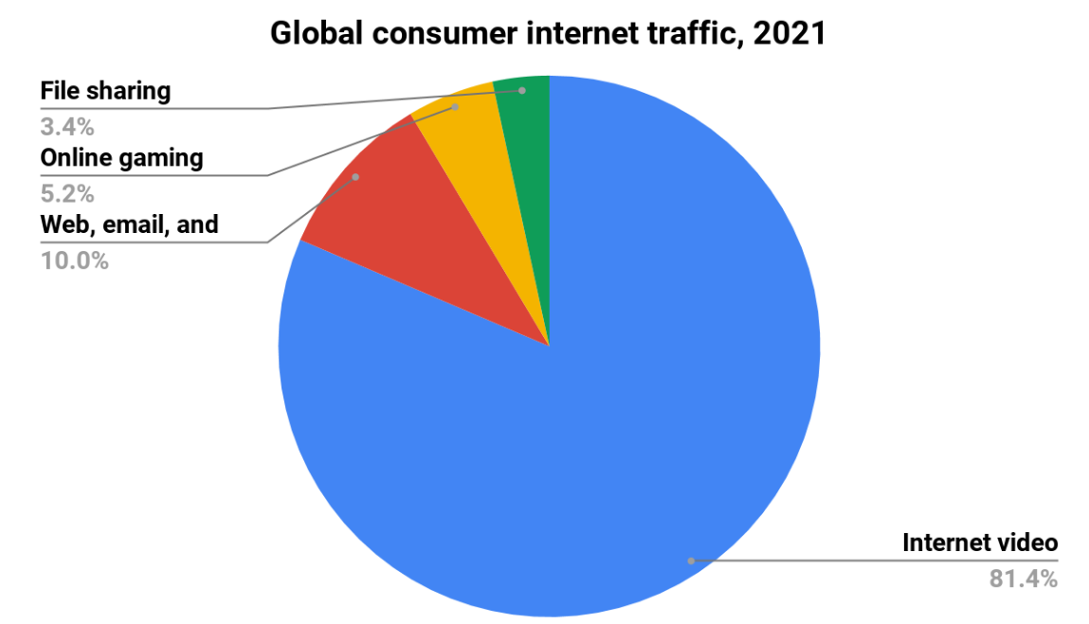
Internet Traffic Prediction by Cisco 2020
Source: Cisco Annual Internet Report (2018–2023) White Paper
Notes:
Among all Internet traffic consumption, video streaming has the biggest share .
Another prediction by Cisco reports that the Internet video will be more than 80 % of internet traffic in 2020. This should be more because of COVID19.
Mobile video streaming is becoming increasingly popular. Everything from entertainment, sports, businesses, educational institutions, and governments are increasingly using video streaming services.

Slide 4
MoVIE (Mobile Video Information Extraction)
A Mobile Traffic Measurement Framework for analyzing video streaming on smartphones from multiple observational viewpoints:
Player view
Flow-level view
Packet-level view
Notes:
These increase in internet usage by smartphones and video streaming services, encourage us to design and implement a Mobile Traffic Measurement Framework called MoVIE for analyzing video streaming on smartphones from multiple observational viewpoints. The characterization of video streaming on mobile devices can provide a comprehensive understanding of video streaming behaviours. By performing measurement we can gain an overview of video streaming, analyze data and optimize our services and hardwares. MoVIE studies video streaming from video player, device generated connections and network protocol viewpoints.

Slide 5
Main Features
Visibility
QoE measurement
Traffic mapping
Comparability
Customizability
Notes:
Before jumping into the movie structure, let’s talk about the main objective and features of the movie.
first MoVIE captures all incoming/outgoing Internet traffic from the smartphone during the video streaming. It simultaneously records all video streaming activities from different viewpoints such as the transmitted TCP/UDP packets, HTTP/HTTPS requests and responses, all video player activities to provide a visibility of video streaming.
The second one is Quality of Experience. User usually expects a Quality of Experience (QoE) that is not always well-reflected by traditional network-layer QoS metrics. MoVIE reports the QoE metrics of video streaming.
The third one is Traffic mapping. We propose a new mechanism to identify relationships between all generated packets, flows, and video player activities. The three observational viewpoints that we have.
Also MoVIE can process up to two video streaming traces simultaneously, which is convenient for comparing video providers, video codecs and so on.
And Finally MoVIE is open-source and we tried to design movie in a way that to be easy to use and Customize.

Slide 6
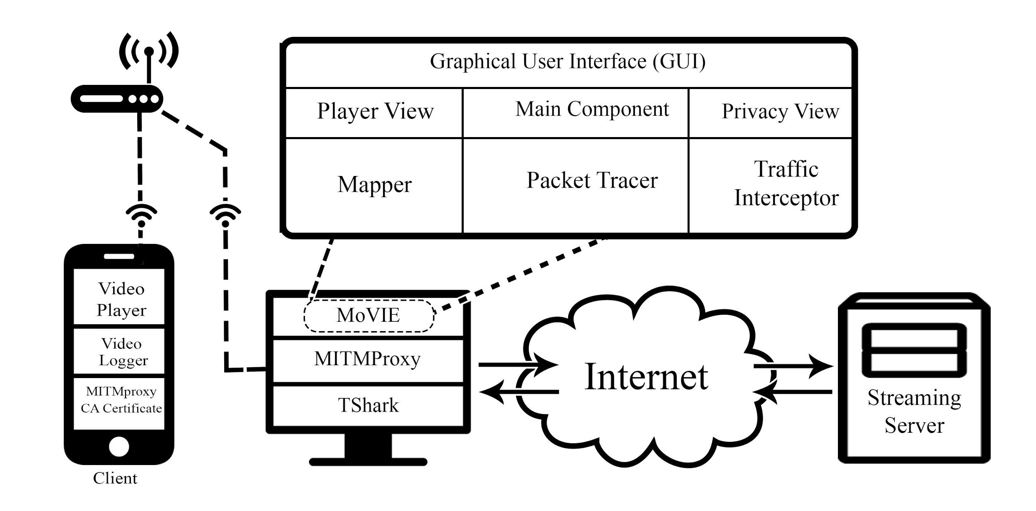
MoVIE’s Structure
Notes:
Here we can see the structure of MoVIE, which consists of seven components. But before talking about these components, lets talk about the Movie setup environment that we streams video sessions from smartphone and collects all information and send them to movie for further analyze.
MoVIE run on a PC that could be Linux, windows or MacOS. Both PC and Smartphone are connected to the same WiFi for communication.
To intercept the network traffic, we used MITMproxy to collect network flows. TShark, a terminal version of Wireshark, is installed on the PC to capture the packet level of the Internet activities generated by the smartphone. Our Android app is installed on the smartphone, and it send the video player activities to the MoVIE. we installed the MITMproxy CA Certificate on the smartphone to give permission to PC to listen to the smartphone traffic.
The PC captures all network traffic,and MoVIe Based on the captured data, provides a graphical view of video streaming traffic.

Slide 7
Components
Traffic Interceptor
Packet Tracer
Player View
Privacy View
Mapper
Main Component
Graphical User Interface (GUI)
Notes:
MoVIe in itself is consists of 7 components. Now I review each component in brief.

Slide 8
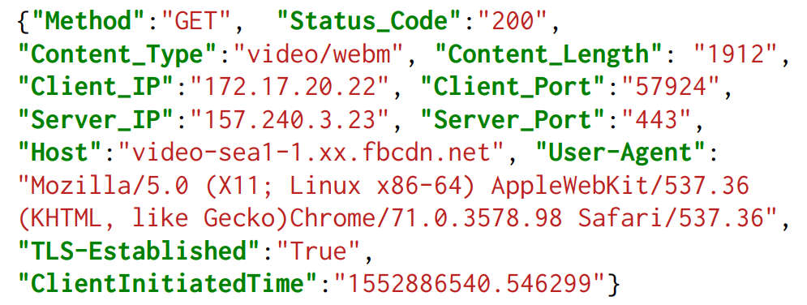
MoVIE’s Components
Traffic Interceptor
Application-layer view of the activities generated by the video streaming.
MITMproxy to transparently intercept all HTTP/HTTPS traffic between the mobile device and the Internet.
Notes:
The first one is Traffic Interceptor. MoVIE characterizes all Internet traffic generated by the mobiledevice during video streaming. To do this we use a Man in the middle attack tool. MITMproxy sits between the two parties, and is able to intercept all transmitted traffic to provide a coarse-grained view of all network activities involving the smartphone. this requires the MITMproxy CA certificate to be installed on the mobile device. Here We can see a few line of a HTTPS response that MITMProxy provides for us.

Slide 9
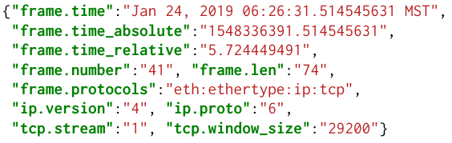
MoVIE’s Components
Traffic Interceptor
Packet Tracer
It captures full packet traces of Internet traffic generated by mobile device during streaming.
TShark, a terminal-oriented version of Wireshark, is a widely-used protocol analyzer, providing a network-level view of traffic.
Notes:
The Packet Tracer component captures full packet traces of Internet traffic generated by smartphone. We use TShark, a terminal version of Wireshark to capture all traffic in JSON format. We can see a sample here. By using TSHARK we can capture a set of fields that movie needs for traffic analyze and bring down the data processing work.

Slide 10
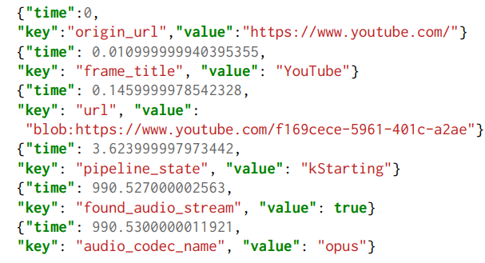
MoVIE’s Components
Traffic Interceptor
Packet Tracer
Player View
It provides a viewpoint of video player activities and events to measure video quality metrics.
An Android app installed on smartphone collects and parses video properties, video player activities, and player events from video player.
Notes:
MoVIE uses video player activities and events to measure video quality metrics.
We developed an Android app to collect and parse video properties [10], video player activities, and player events from video player. This component sends all video player events to the Movie. Here we can see a few line of streaming events.

Slide 11
MoVIE’s Components
Traffic Interceptor
Packet Tracer
Player View
Privacy View
It investigates the captured flows to detect potential trackers and data leaks.
It exploits EasyList to detect advertisement and tracking flows.
Notes:
This component investigates the captured flows to detect potential data leaks. It receives flows from the Traffic Interceptor component and uses EasyList to detect advertisement and tracking flows.
EasyList has a list of all international tracking and advertising URLs, and is the primary filtering list used by ad blockers.

Slide 12
MoVIE’s Components
Traffic Interceptor
Packet Tracer
Player View
Privacy View
Mapper
It maps the captured packets to the flows and then maps video activities to flows.
Classify Flows
Grouping Established Sessions
Classify Packets
Map Packets to Flows
Map Video Activities to Flows
Notes:
MoVIE uses multiple observational viewpoints [1] for its analysis of network traffic, flows, and video player activities. Mapping the network packets captured by TShark to the flows collected from MITMproxy, and relating this information to video player activities, is an important phase of MoVIE.
To do this, it first Classify Flows and then Grouping Established Sessions of those flows. After that it Classify Packets and Maps Packets to Flows. Finally it Map Video Activities to Flows.
In the paper, you can find a detailed description of the this component.

Slide 13
MoVIE’s Components
Traffic Interceptor
Packet Tracer
Player View
Privacy View
Mapper
Main Component
It is the central part of MoVIE that manages and coordinates all the other components.
It analyzes the received data from other components to generate video streaming reports.
Notes:
The Main component is the central part of MoVIE that manages and coordinates all the other components. It receives a flow list from the Traffic Interceptor, a packet list from the Packet Tracer, and the video streaming activities from the Player View component. The Mapper component assigns the connections based on all captured information. Then the Main component analyzes the data. It calculates the video streaming QoE parameters, statistics of packets and flows, categorizes data, and so on. Finally, the Main component invokes the Graphical User Interface to provide a visual representation of the results.

Slide 14
MoVIE’s Components
Traffic Interceptor
Packet Tracer
Player View
Privacy View
Mapper
Main Component
Graphical User Interface (GUI)
It provides the multi-level visual representation in the form of tables and graphs.
The output of MoVIE is generated in HTML5 format which offers several advantages
Portable
Easy to Use
Export Reports
Ready to Publish
Easy to Customize
Notes:
The final component, the Graphical User Interface (GUI) provides the multi-level visual representation in the form of tables and graphs. The output of MoVIE is generated in HTML5 format which offers several advantages.
It’s
Portable
Easy to Use
Easy to Export Reports
Ready to Publish
Easy to Customize

Slide 15
Case Study
360° video streaming from YouTube and Facebook
Notes:
For a case study, we used Movie to study 360° video streaming from YouTube and Facebook

Slide 16
Experimental Setup
Smartphone
  Nexus 6
  Quad-Core 2.7 GHz CPU, 3 GB RAM, running Android 7.0
  Chrome 72.0 as the Web browser
PC
  Core i7, 8-core, 3.6 GHz CPU, 8GB RAM
MITMproxy 4.0
TShark 6.2.2
Video Logger. Our developed video logger app
“Lion Cub” from the National Geographic Channel, streaming platforms: YouTube and Facebook
Notes:
In this experiment, we use Smartphone Nexus 6 that running Android 7.0 with Chrome 72.0 as the Web browser.
Movie was installed on a Linux PC. The MITMproxy version 4.0 and TShark version 6.2.2 also was installed on Linux PC. Our video logger app with Mitmproxy certificate were installed on Smartphone.
We streamed the 360 Lion Cub video from the National Geographic Channel, from two streaming platforms: YouTube and Facebook

Slide 17
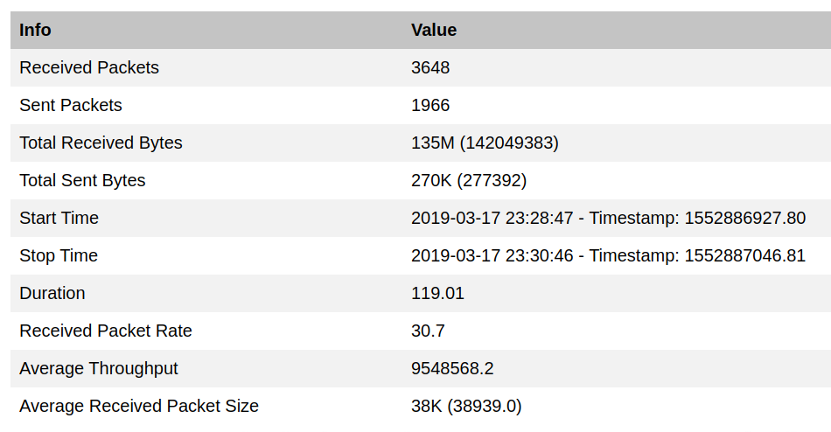
Packet-Level View
Notes:
MoVIE’s report is divided into four parts: The first part of the tool provides a packet-level report of captured network traffic. This report includes a tabular view of network traffic statistics, and graphs of sent/received network traffic.

Slide 18
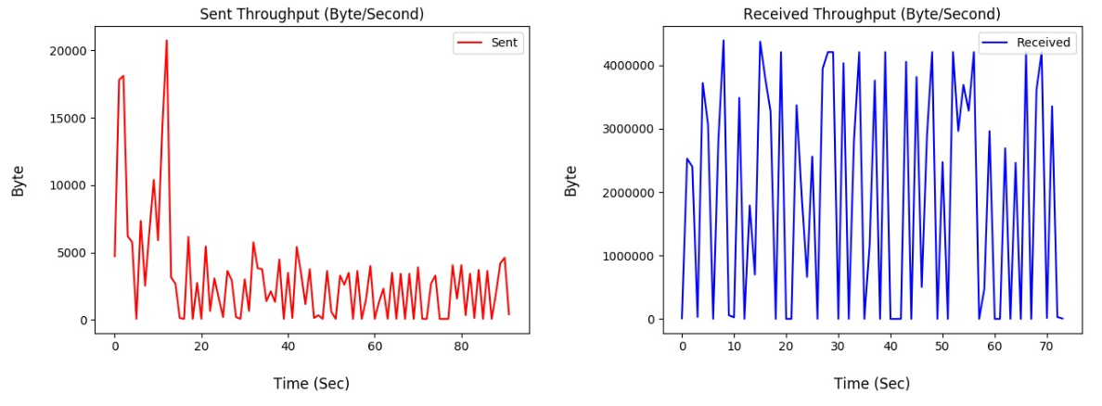
Packet-Level View
Notes:
This part of the tool is useful for studying video streaming behaviour. For instance, the graph of received bytes in here indicates that this video streaming uses an in-memory buffering method. It starts by preloading a certain amount of video and audio in advance, to prevent video stalls.

Slide 19
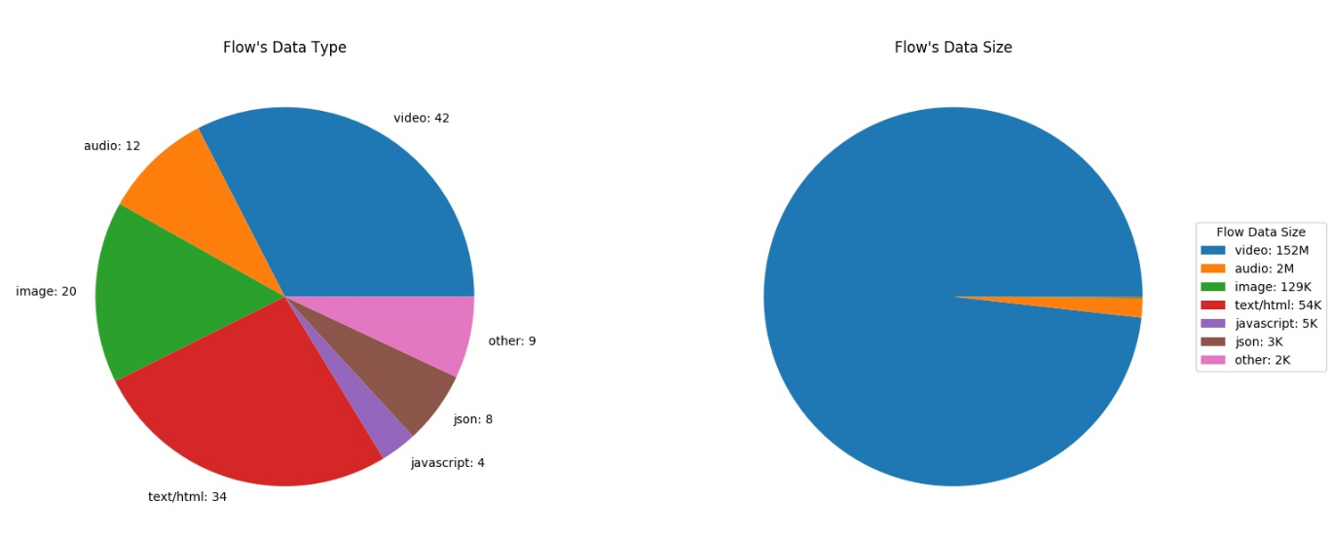
Flow-level View
Notes:
This section presents a flow-level study of the generated HTTP/HTTPS request and response. it reports the statistics about the type and the number of generated flows.
For example, this shows the distribution of flow types and sizes.

Slide 20
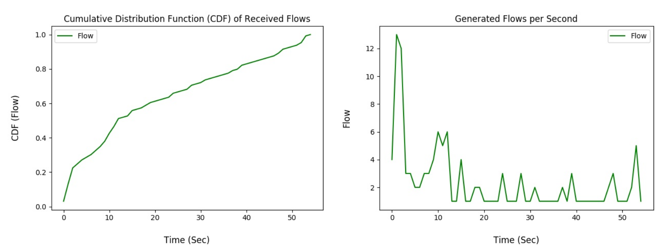
Flow-level View
Notes:
This part of flow-level shows a time-series graph of the flows generated per second during the streaming. Here the browser fetch a Web page,includes links to several resources such as HTML, scripts, CSS, images, and others, for page loading. After that is video streaming and tracking connections

Slide 21
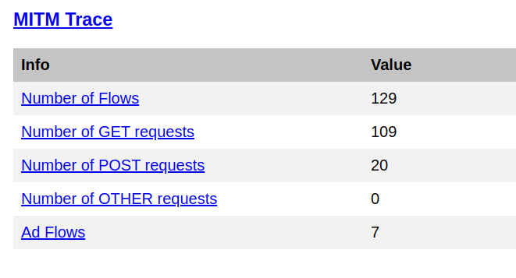
Flow-level View
Notes:
For this example, it recognized 7 flows as advertisements or tracking flows. By clicking on each category, MoVIE provides a detailed flows information of all connections.

Slide 22
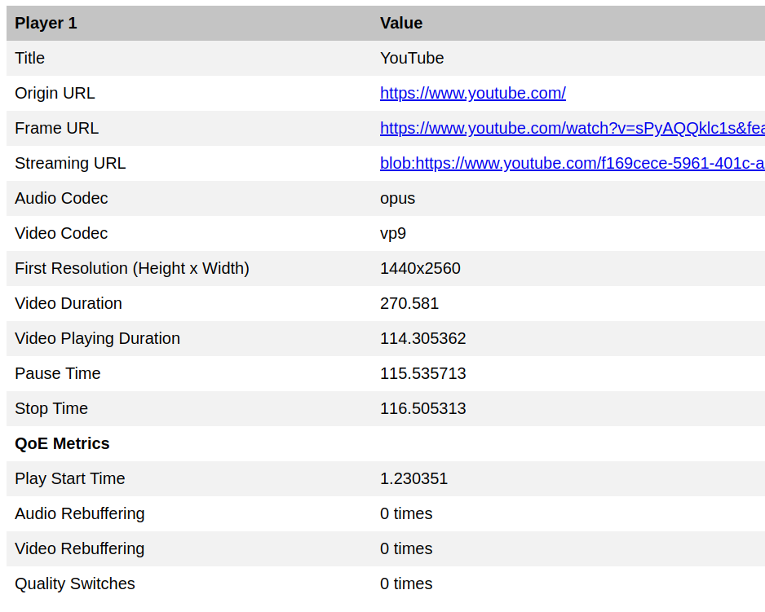
Player-level View
Notes:
In this part of the graphical user interface, MoVIE gives a detailed information about the streaming events. First, it provides the general info about the video such as video/audio codecs, resolution,
and duration. Then it reports the QoE metrics of the streaming that includes startup time, number of quality switches, and number of audio/video rebuffering events.
In addition, it provides a timeline-based report contains all video player activities from fetching the URL to the end of the video streaming.

Slide 23
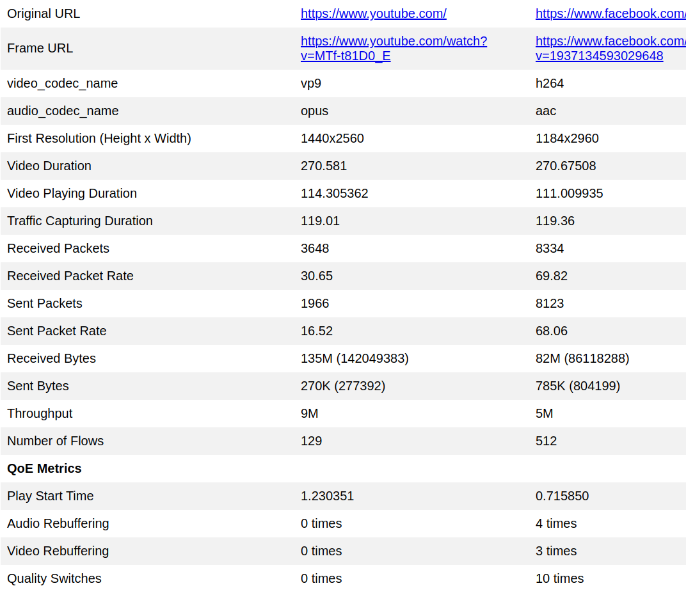
Comparison
Notes:
The last part of the tool provide a comparison of two video streaming experiments. In this study, we compared streaming the same video from YouTube and Facebook.
For example we can see that YouTube uses Opus/VP9 as its audio/video codecs, respectively, while Facebook uses AAC/H.264.

Slide 24
Demo
Let’s see the demo
Demo

Slide 25
FUTURE WORK
Support iOS devices
Sophisticated QoE metrics
Compare more than two video streaming sessions
Cloud-based MoVIE

Slide 26


