Slide 1
An Empirical Measurement Study of Free Live Streaming Services
Sina Keshvadi, Carey Williamson
Department of Computer Science
University of Calgary
PAM 2021
Online

Slide 2
Free Live Streaming Study
Free Live Streaming (FLS) services provide unauthorized broadcasting of live events online, and have attracted millions of viewers
Using these services raises concerns about:
  Performance
  Quality of Experience
  User Privacy

Slide 3
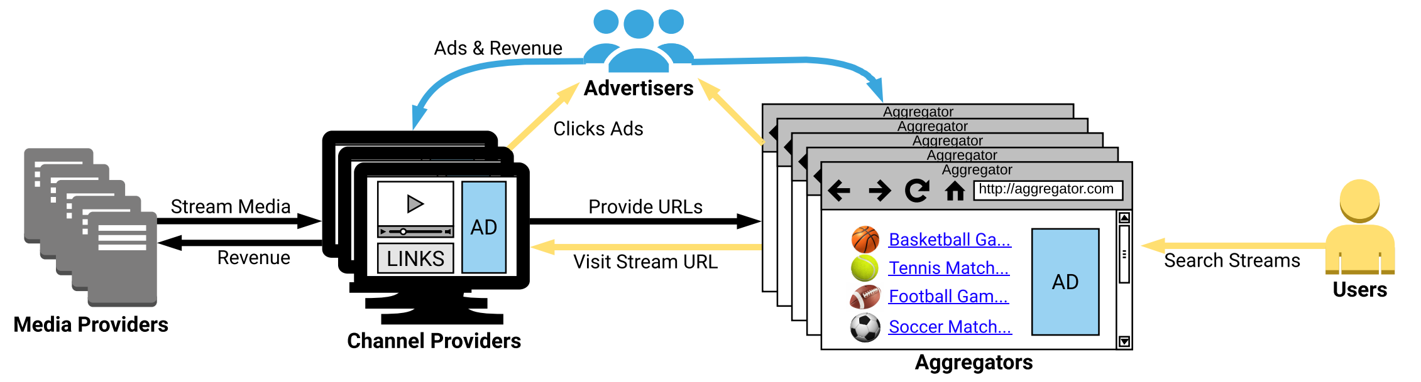
FLS Ecosystem
Media Providers: provide and stream the media content
Channel Providers: receive live streams from media providers and serve them to users
Aggregators: provide a list of available streams for users to browse
Advertisers: support the foregoing three entities through ads and overlays
Users: watch their favourite live stream events found via the aggregators

Slide 4
Research Questions
What are the network and video QoS provided by FLS services?
Are these services scalable for popular events?
What privacy risks are associated with these services?

Slide 5
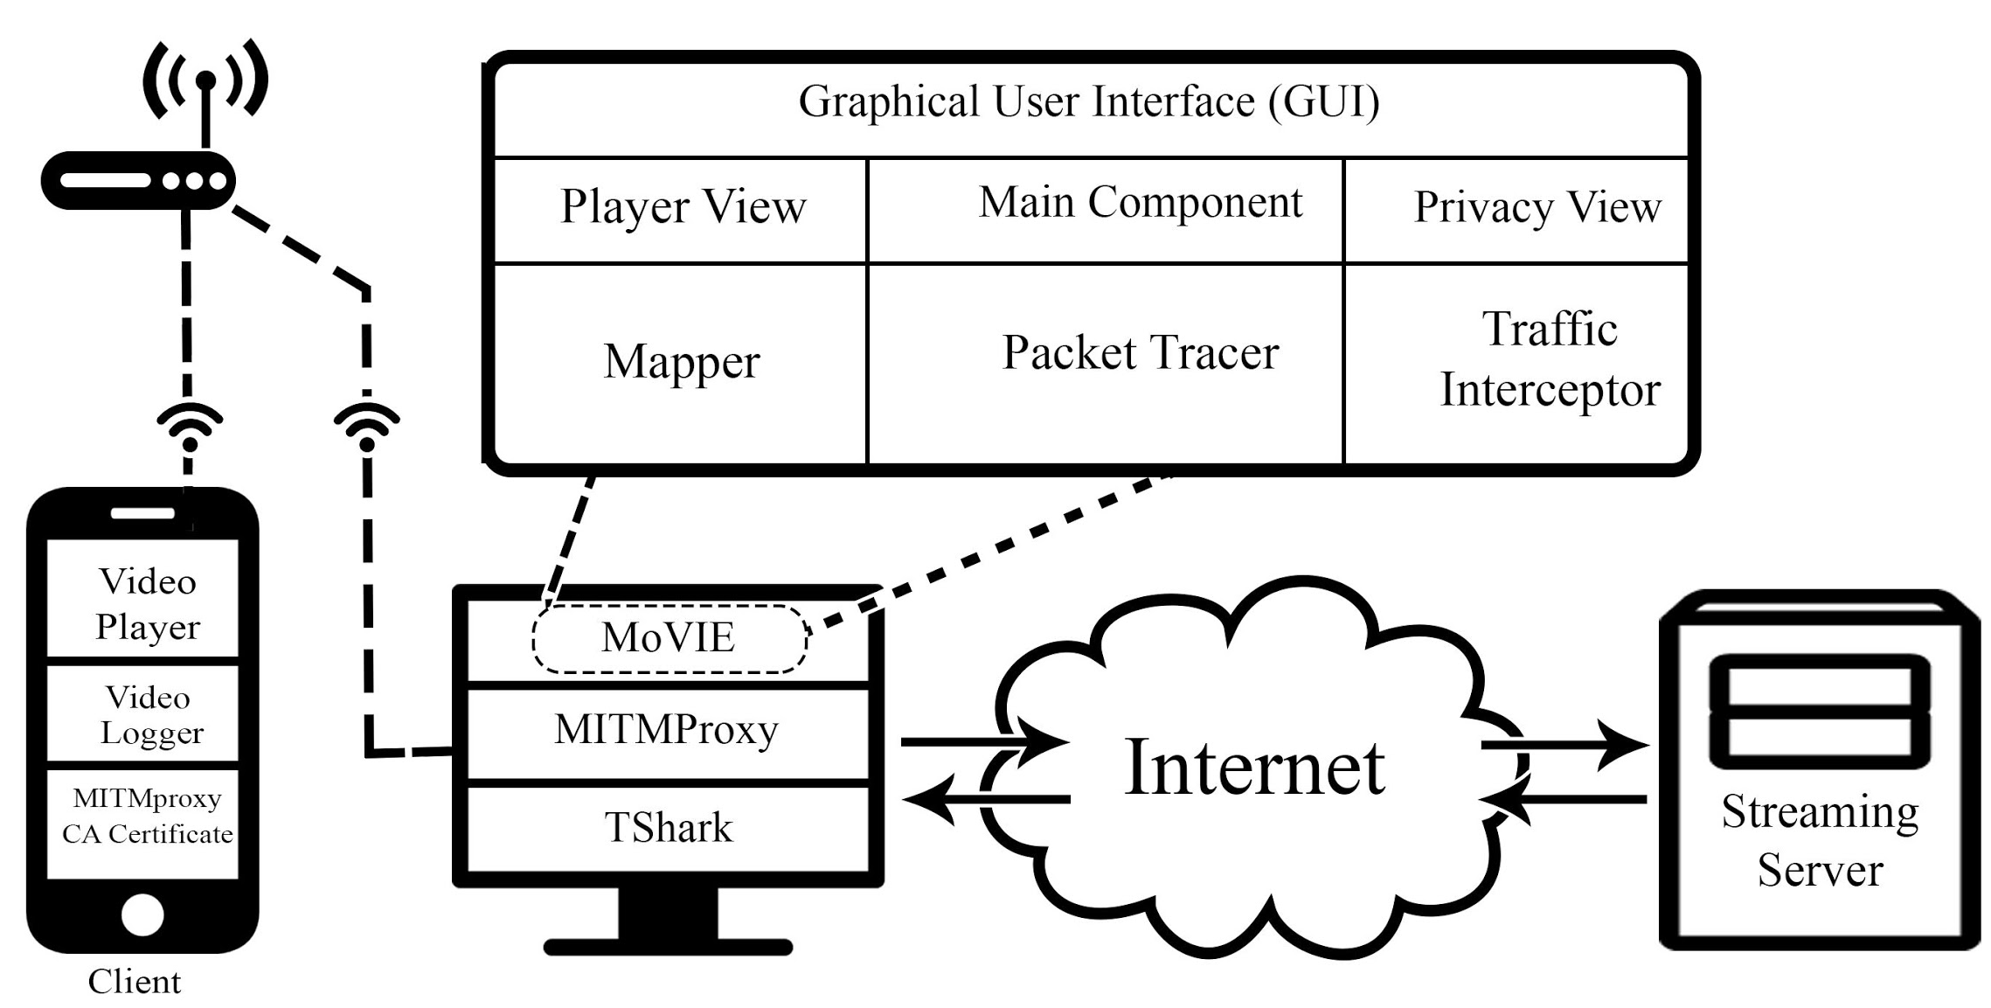
Methodology
MoVIE (Mobile Video Information Extraction) tool to capture and analyze live video streaming sessions
Google Chrome browser for video streaming
Charles proxy for decrypting connections

Slide 6
Data Collection
Reddit is a popular online social network on which users discuss, share, and rate Web content
We selected the top-5 most popular FLS Web sites based on user votes in Reddit for each of NHL (hockey), NBA (basketball), NFL (football), and UEFA (soccer)
Compare with two Canadian legitimate providers: TSN and DAZN
We analyzed the captured data of:
  NBA game in December 2019
  NFL SuperBowl in February 2020
  UEFA playoff game in February 2020
  NHL game in March 2020

Slide 7
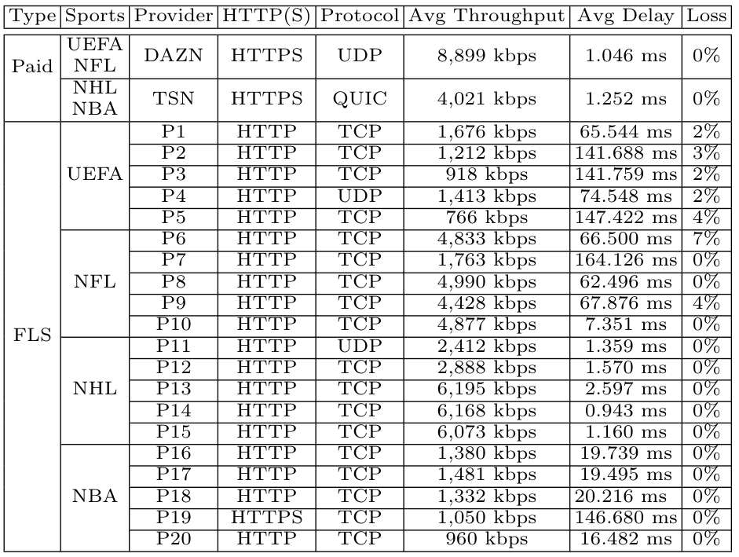
Network QoS Analysis

Slide 8
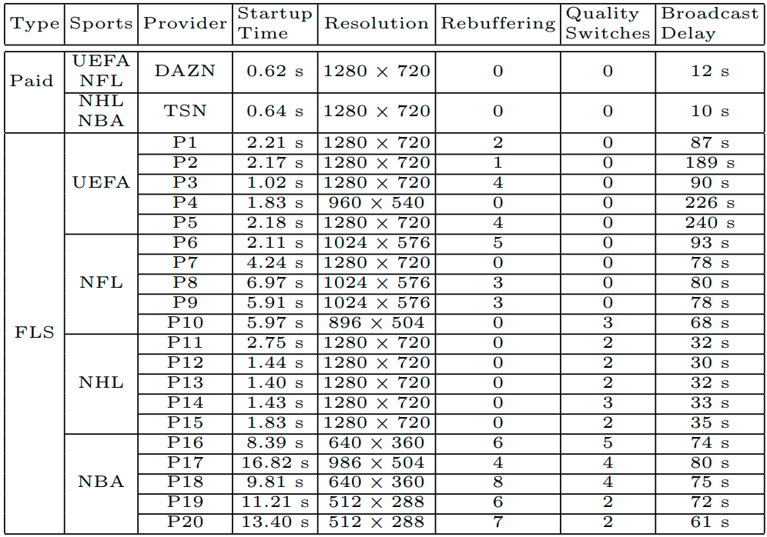
Video QoS Analysis

Slide 9
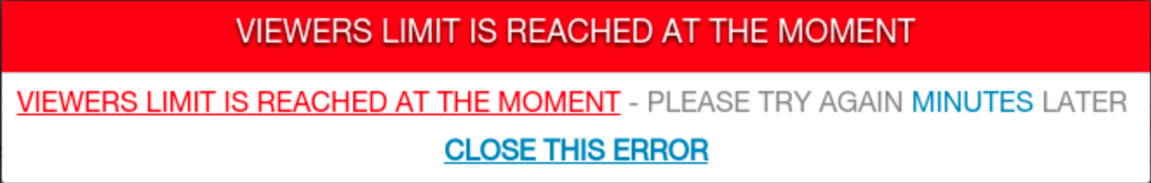
Scalability
The FLS sites had problems during popular games, such as the 2019 NBA Finals.

Slide 10
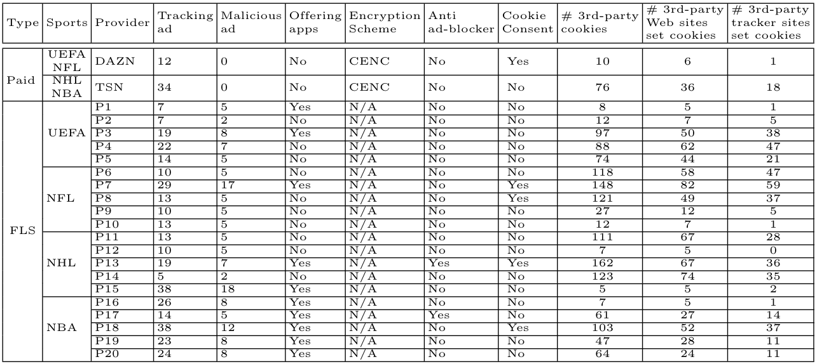
Privacy View

Slide 11
Data Leaks
Some FLS sites send the following information to tracking Web sites:
  Public and private IP addresses
  Internet Service Provider (ISP)
  City and area
  Device name, OS, and browser version
  Graphic card model
  Proxy information
Ad-blocker tools do not prevent this data transmission
Notes:
Add some data leak screanshots

Slide 12
Conclusions
We observed a long broadcasting delay in free live streams
The throughput, streaming quality, and packet loss rate differ greatly across FLS sites
TSN delivers live video streaming using QUIC, which can improve performance in WiFi networks with higher delay and/or loss
There is uncertainty of streaming popular events with FLS services
There are privacy and security risks associated with FLS services

