Slide 1
NetFlix
Traffic Characterization
Michel Laterman
Department of Computer Science
University of Calgary
Supervisors: Carey Williamson and Martin Arlitt

Slide 2
Introduction
Video streaming traffic constitutes a large (and growing!) proportion of modern Internet traffic
Popular video streaming services include:
  YouTube – user-generated content, short-clips (well-studied)
  NetFlix – on-demand video, TV shows, movies (some studies)
  Twitch – live streaming of video game play (few studies)
  Vimeo – video-sharing site with High-Definition videos
  Hulu – on-demand video, not in Canada
  Yahoo Screen – professionally produced content, limited availability in Canada
On the University of Calgary network, the top video streaming sites observed are YouTube, NetFlix, Twitch

Slide 3
Research Objectives
General
  Improve understanding of U of C network traffic
  Identify network performance problems and anomalies
Specific
  Characterize video streaming services on U of C network
  Understand similarities/differences between NetFlix and Twitch

Slide 4
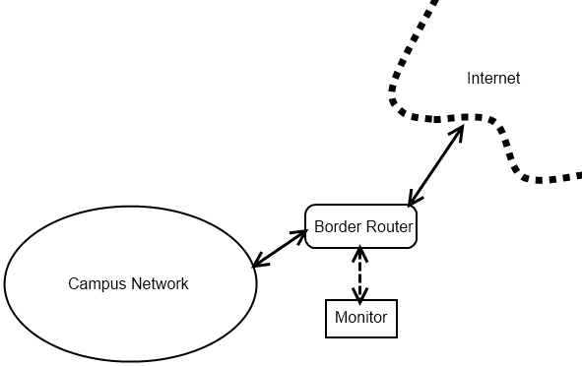
Methodology
Passive network traffic measurement
Hardware: Endace DAG packet capture card
Software: Bro network security monitor
5 months of data (December 1, 2014 to April 29, 2015)
Analysis of TCP connection and HTTP transaction logs

Slide 5
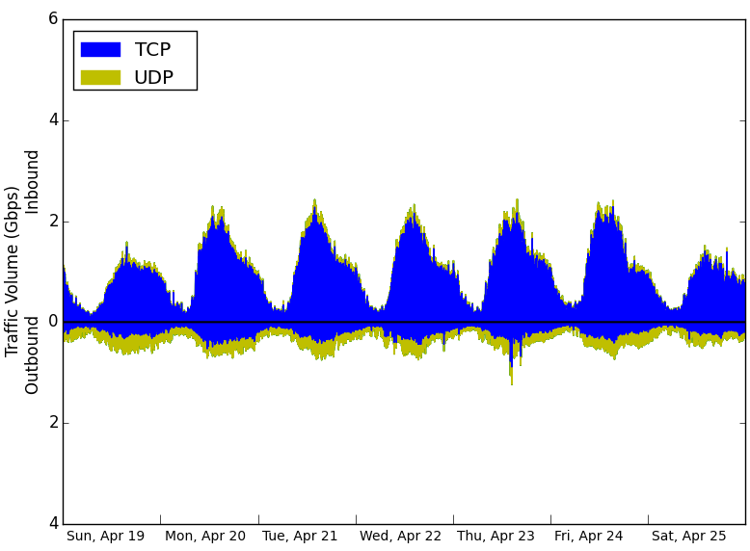
Example: Traffic Overview (April 2015)

Slide 6
HTTP Traffic Overview
Host | Req. Percent | Volume
netflix.com | 33.81% | 217.1 TB
apple.com | 8.37% | 53.75 TB
googlevideo.com | 2.43% | 15.59 TB
steampowered.com | 2.14% | 13.79 TB
twitch.tv | 2.04% | 13.12 TB

Slide 7
HTTPS Traffic Overview
Host | Connections | Percent | Volume
google.com | 314 million | 7.91% | 27.3 TB
apple.com | 179 million | 4.51% | 2.8 TB
majuwe.com | 168 million | 4.23% | 106.7 GB
akamaihd.com | 151 million | 3.80% | 32.7 TB
googlevideo.com | 131 million | 3.30% | 230.1 TB

Slide 8
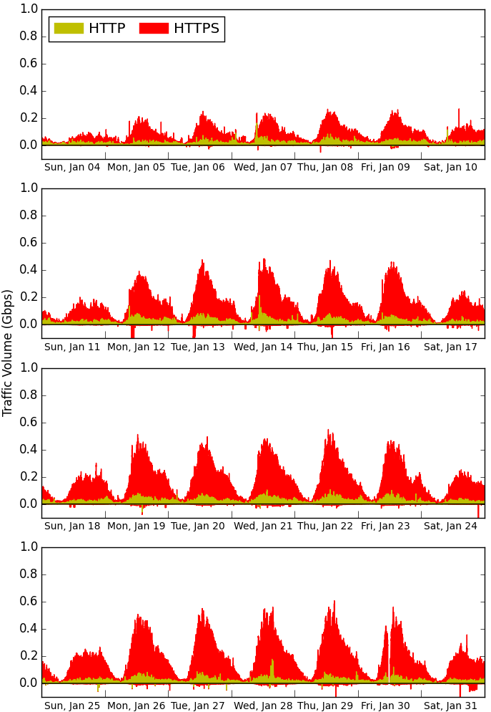
YouTube Traffic
January 2015
Uses HTTPS by default
HTTP for some embedded clips
Outbound traffic is for video uploads

Slide 9
Video Traffic Volume
Outbound traffic to NetFlix and Twitch is negligible.
 | YouTube - HTTP |  | YouTube - HTTPS |  | NetFlix | Twitch
 | Inbound | Outbound | Inbound | Outbound | Inbound | Inbound
December | 1.93 TB | 0.14 TB | 36.22 TB | 0.89 TB | 30.77 TB | 2.82 TB
January | 1.89 TB | 0.12 TB | 36.31 TB | 1.06 TB | 44.41 TB | 3.14 TB
February | 1.79 TB | 0.05 TB | 45.47 TB | 1.14 TB | 43.83 TB | 3.74 TB
March | 2.08 TB | 0.05 TB | 59.63 TB | 1.36 TB | 54.29 TB | 4.79 TB
April | 1.51 TB | 0.05 TB | 52.43 TB | 1.08 TB | 43.85 TB | 3.74 TB

Slide 10
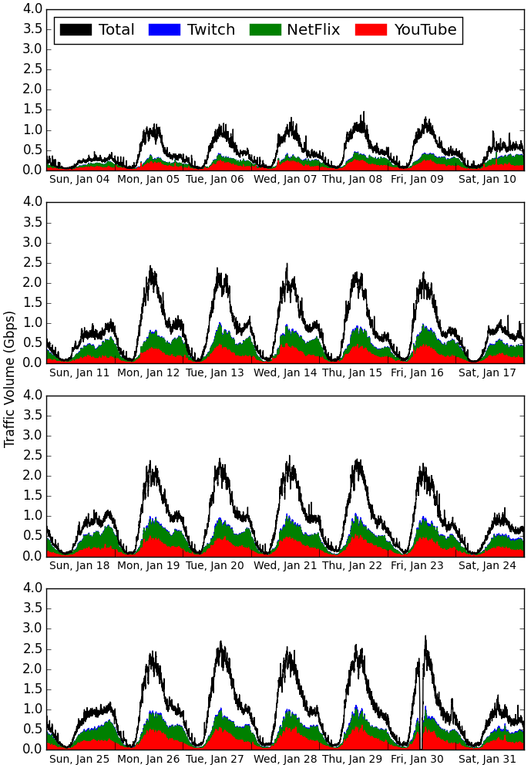
Video Traffic
January 2015
Top line (Total) is HTTP+HTTPS
Red is (HTTPS) YouTube
Green is NetFlix
Blue is Twitch

Slide 11
NetFlix
305 million request-response pairs on 14.3 million connections generating 217.1 TB of volume
62.9% of requests had code 200 (OK), 29.9% had 206 (Partial content), 6.09% had no code.
35 different content-type headers
  Application/octet-stream 216.7 TB
  Text/html 328.8 GB

Slide 12
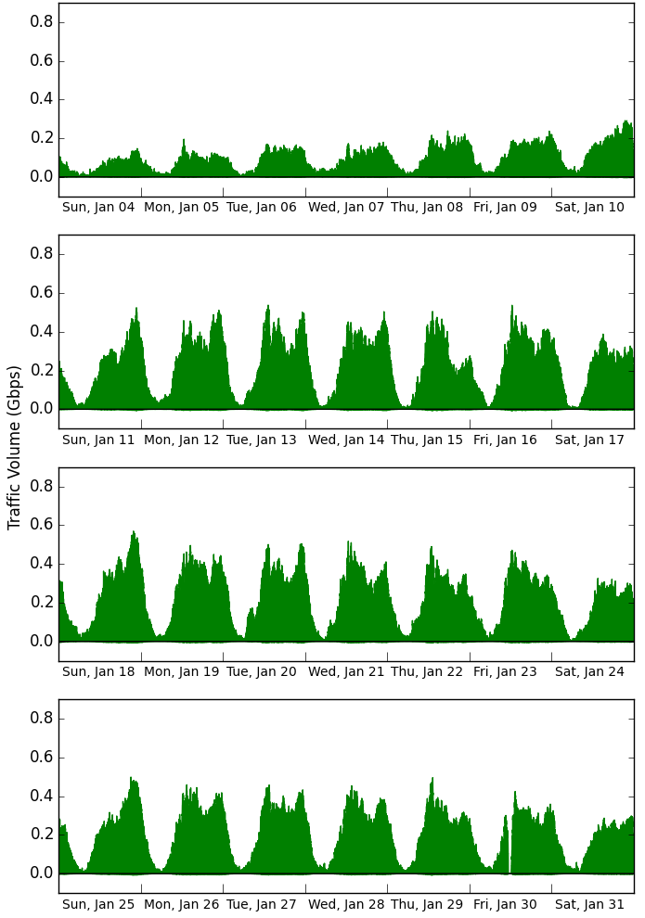
NetFlix Traffic
Video content is served from several unnamed servers with NetFlix IP addresses
217.1 TB total traffic
Connections average 26 MB in, 370 KB out
Average duration 150 seconds

Slide 13
NetFlix – Video Delivery
HTML5 Player (transitioned away from Silverlight)
Requests to the Web interface player include a parameter called movieID
Desktop and Mobile devices use different request paths
  Can’t see movieid from mobile requests
162.6 TB of traffic was responses to content requests from desktop devices, 54.01 TB mobile
Multiple connections are used to transport video (7-9 for a 22 min episode, 14-16 for 42 min)

Slide 14
NetFlix – What are people Watching?
Title | Dec | Jan | Feb | Mar | Apr
Friends | - | 1 | 1 | 1 | 1
2. Grey’s Anatomy | 1 | 2 | 2 | 3 | 2
3. House of Cards | 20 | 16 | 3 | 2 | 9
4. Gilmore Girls | 2 | 4 | 9 | 10 | 5
5. Gossip Girl | 3 | 3 | 7 | 7 | 7
6. That 70’s Show | 42 | 49 | 4 | 4 | 6
…
18. Daredevil | - | - | - | - | 3
Long-term
popularity
Short-term
popularity

Slide 15
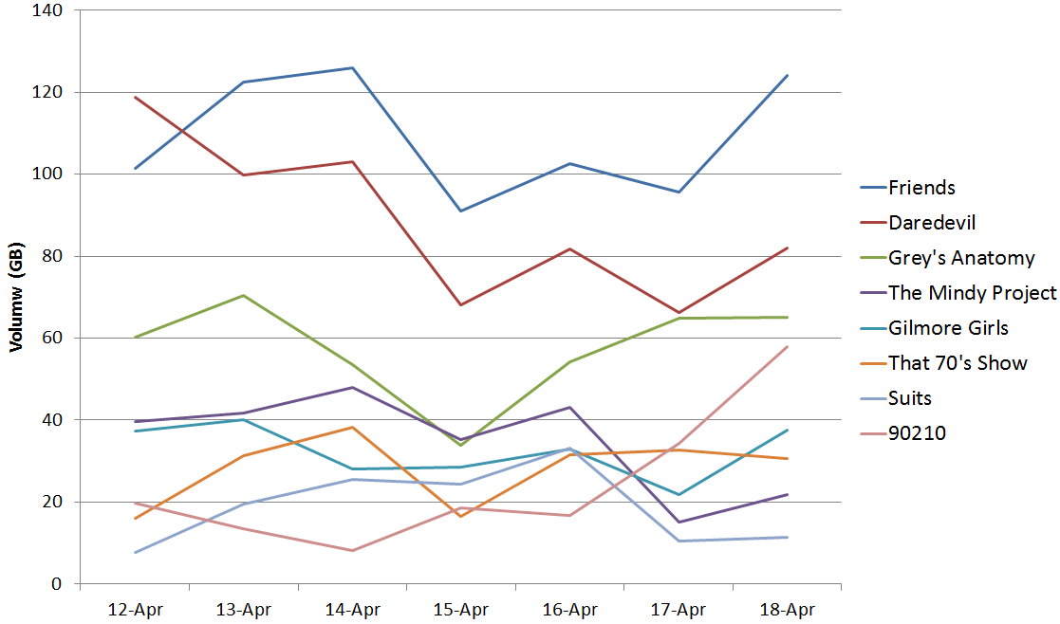
A Week of NetFlix Traffic – Top Content

Slide 16
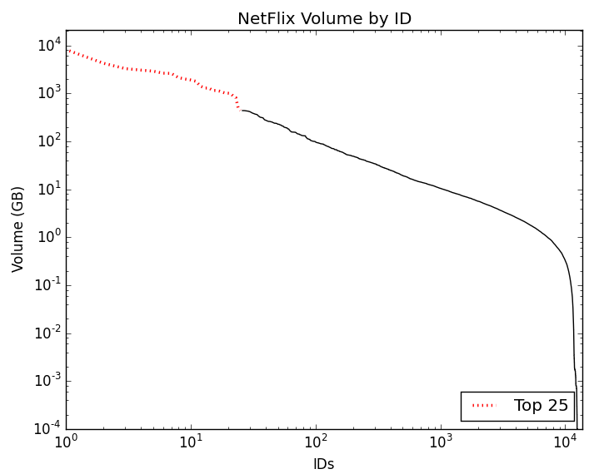
NetFlix movieID Traffic Volumes
Top 25 shows (2,801 IDs)
  50% of traffic volume
Friends: 21 TB
Grey’s Anatomy: 8 TB
House of Cards: 4 TB

Slide 17
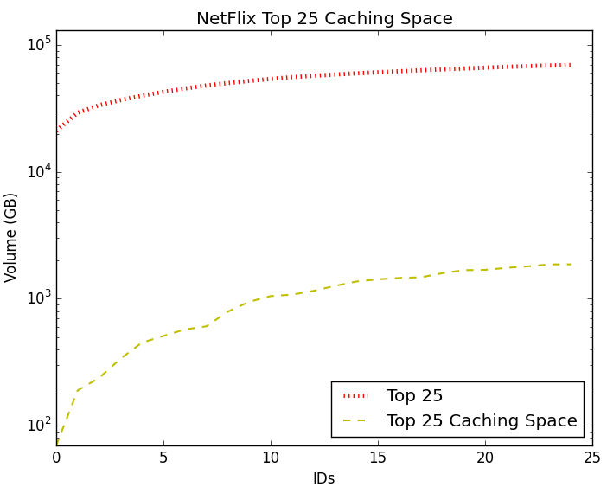
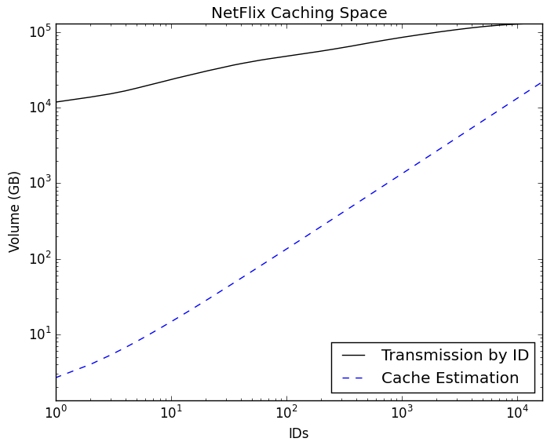
Caching NetFlix
File sizes: 13.23 MB/minute (SD) or 22.58 MB/min (HD)
70 GB to cache Friends (21 TB transmission)
120 GB to cache Grey’s Anatomy (8.2 TB)
40 GB to cache House of Cards (4.25 TB)

Slide 18
Conclusions (Netflix)
Video streaming services constitute a large proportion of inbound traffic on the U of C network
YouTube and NetFlix are the most popular currently
Caching NetFlix could greatly reduce network traffic
  Caching “Friends” (70 GB) would reduce traffic by 20 TB
Studies like this will be much more difficult once Netflix moves to HTTPS for all content delivery (mid-2015)

