Slide 1
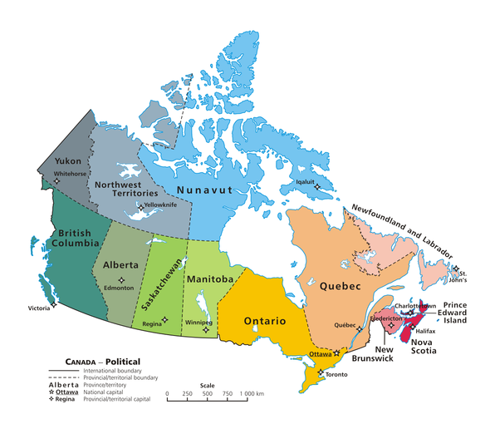
An Empirical Study of
Campus-Level Instagram Traffic
Carey Williamson
Visiting Professor, DAIS, Università Ca’ Foscari Venezia
Department of Computer Science
University of Calgary
Calgary, Alberta, Canada
November 27, 2019
[ Joint work with S. Klenow, S. Keshvadi, and M. Arlitt ]

Slide 2
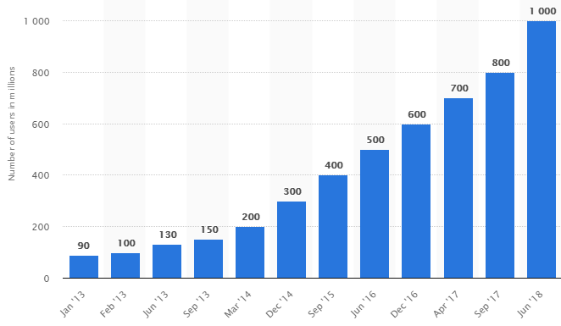
Instagram
A photo and video sharing service
Features:
Instagram Explorer
Instagram Direct
Instagram Stories
Instagram TV (IGTV)
Live Streaming
Monthly Active Users from 2013 to 2018 (in millions)

Slide 3
Research Questions
What are the key characteristics of Instagram traffic?
What are its network performance implications?
How can this better inform our network simulation models?

Slide 4
Case Study
University of Calgary in Calgary, Alberta, Canada
  35,000 students (ugrad/grad)
  3,000 faculty/staff
One week: Sunday March 3, 2019 to Saturday March 9, 2019

Slide 5
Methodology 1 of 2: Active Measurement
Objective:
Study Instagram traffic for 1 user from a single device under test (Android smartphone+Charles)
Challenges:
Different domain names (e.g., Instagram vs Facebook)
Encrypted data (HTTPS)
Certificate pinning required (rooted device)
App security policies
Rationale:
Detect IP destinations
Identify effects of user interactions
Identify app features
[ This part of the work was done by PhD student Sina Keshvadi ]

Slide 6
Active Measurement Results
Over 90% of the Instagram-related requests go to a single IP: 157.240.3.63
All main features use the same IP address
Monitoring this single IP address gives a good estimate (but slight underestimate) of the campus-level Instagram traffic!
Observed DNS host names:
i.instagram.com
platform.instagram.com
instagram.c10r.facebook.com
scontent-sea1-1.cdninstagram.com
graph.instagram.com

Slide 7
Methodology 2 of 2: Passive Measurement
Objective:
Study network traffic at scale
Challenges:
Complexity of campus network (DHCP, NAT, VPN, BYOD)
Traffic capturing process
Storage/processing of traces
Analysis of large datasets
Encrypted traffic (HTTPS)
Ethical considerations
Rationale:
Campus-level traffic characterization
Identify traffic behaviour
Identify any network anomalies
Network performance implications
[ This part of the work was done by visiting MSc student Steffen Berg Klenow ]

Slide 8
Example of Raw Data Format (Bro Conn Logs)
Epoch_Timestamp UID Src_IP SPort Dest_IP DPort Prot Svc Duration TCPout TCPin State IPout B_out IPin B_in
1551596628.248886 u29N3fRWgQZb 1.2.3.4 50468 157.240.3.63 443 tcp ssl 165.901378 9053 86515 S3 100 14297 98 90892
1551596628.250997 CThhn41IttYm27 1.2.3.4 50470 157.240.3.63 443 tcp ssl 3.334059 489 447 RSTO 11 1093 7 1133
1551596628.301082 z1RCa3W19Ralf 1.2.3.5 50040 157.240.3.63 443 tcp ssl 329.763400 425964 45413 SF 737 468313 538 73893
1551596628.307782 GcdG3L8hgX7e 1.2.3.6 62558 157.240.3.63 443 tcp ssl 0.004667 39 39 SF 4 247 5 263
1551596628.316061 CLkeo71KeeiHx1 1.2.3.7 57396 157.240.3.63 443 tcp ssl 209.412519 5239 91968 SF 67 9983 83 94918
1551596628.348089 OhKpI2eBASJOg 1.2.3.7 57397 157.240.3.63 443 tcp ssl 209.388824 7489 914542 S3 454 31736 682 933553
1551596628.502214 Vh9Ev3gHpUSga 1.2.4.1 52990 157.240.3.63 443 tcp ssl 8.459407 1703 126326 SF 83 6031 99 131482
1551596628.504240 pDJJC43UXfYE8 1.2.4.1 52991 157.240.3.63 443 tcp ssl 8.457381 2222 962556 SF 431 24646 719 998714
Hardware: Endace DAG packet capture card (10 Gbps); headers only (not payloads)
Software: Bro Intrusion Detection System (IDS) (now called Zeek)
We analyze the logs using Vertica (a big data analytics framework available from HP)
[ This data collection/analysis infrastructure was designed by Martin Arlitt ]

Slide 9
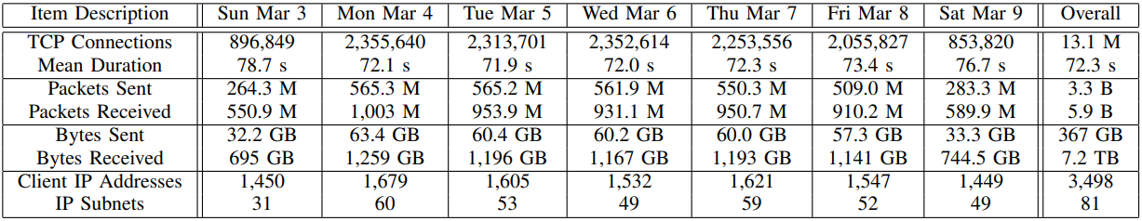
Overview of UCalgary Instagram Traffic (1 Week)
Notes:
High data volumes generated by Instagram traffic (about 1 TB per day)
Asymmetry of this traffic (e.g., received bytes exceed sent bytes by about a factor of 20)
Large client base (e.g., several thousand distinct IP addresses observed, many of which are NAT addresses with multiple users behind them).
Remarkable consistency in the traffic from one day to the next
Typical weekday: 2 million TCP connections from 1,600 different IP addresses across about fifty /24 subnets, and over 1 TB of data

Slide 10
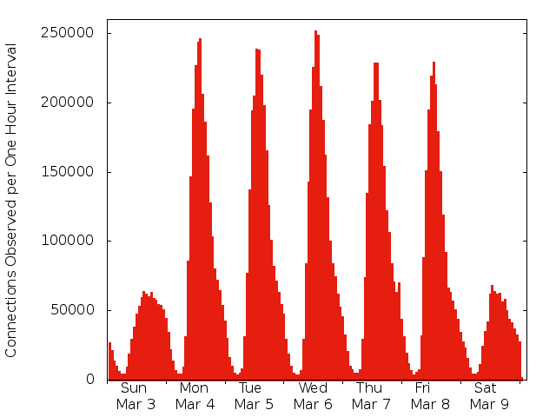
U of C Instagram Traffic Profile

Slide 11
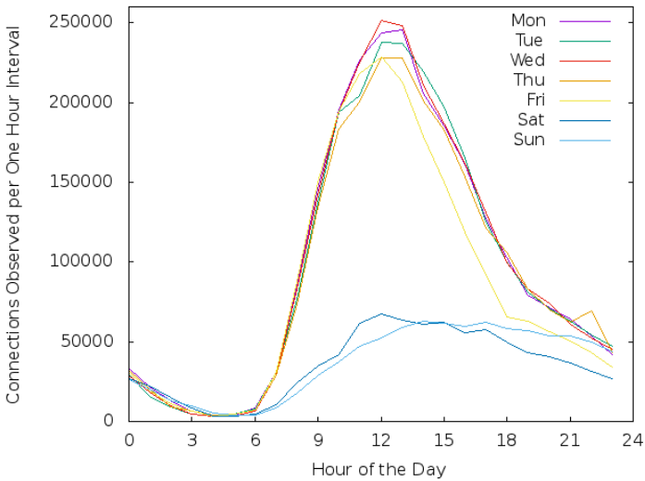
Daily Instagram Traffic
Notes:
Strong diurnal pattern: traffic rises quickly each morning, peaks near mid-day, and then declines gradually in the mid-to-late afternoon and evenings.
Declines by about 60% on the weekends.
Consistency of the weekday traffic from Monday to Thursday, despite the varying class lecture schedule (e.g., MWF versus TTh). There is a slight decline on the Friday afternoon (yellow), and lower activity levels on weekends (since no lectures take place, and fewer people are on campus).

Slide 12
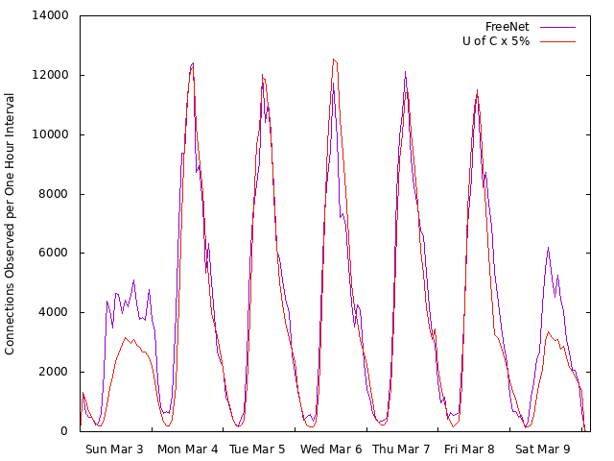
Freenet Instagram Traffic Profile

Slide 13
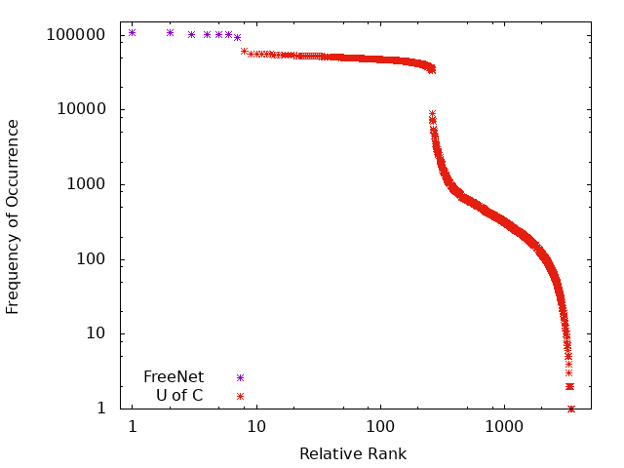
IP Address Frequency-Rank Profile

Slide 14
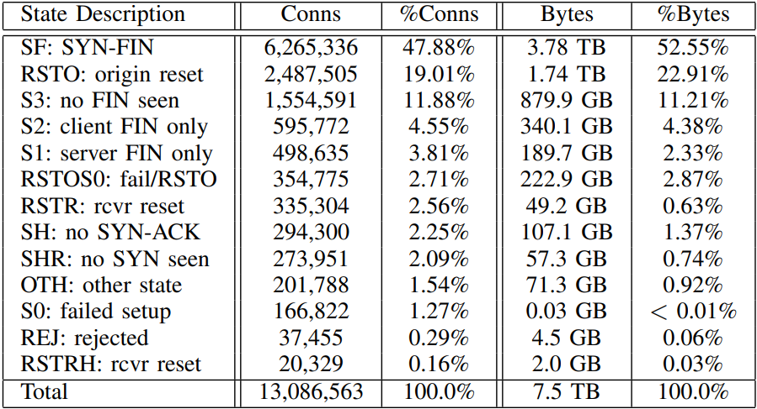
Observed TCP Connection States
Notes:
Approximately half (47.9%) of the TCP connections have the normal SF state, while the other half do not.
Among the latter, the most prevalent is a reset of a successful connection by the originating client (RSTO).
Next most prevalent are partial connections (S1, S2, or S3), many of which are long lasting and exchange a lot of data.
Two other reset types are also seen, either for unsuccessful connections (RSTS0), or for successful connections reset by the server (RSTR).
S0 represents unsuccessful TCP connection attempts.
A few other unusual states (e.g., half-open connections, REJECT, etc) account for a very small proportion of the total connections and bytes.

Slide 15
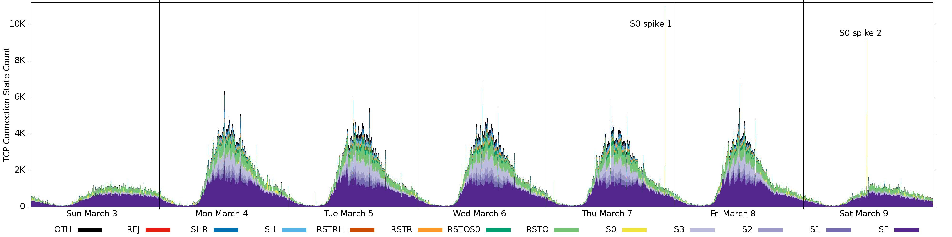
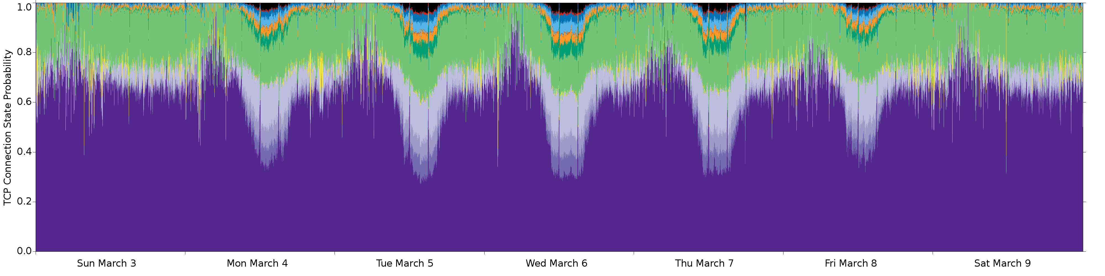
Additional Results
Time Series Illustration of TCP Connection State
Notes:
SF state dominates at night time, but when the traffic load is higher during the day, many other TCP states are observed.
When the traffic load is near its peak, there are more unsuccessful connections (RSTOS0 in dark green) and server-side resets (RSTR in orange).

Slide 16
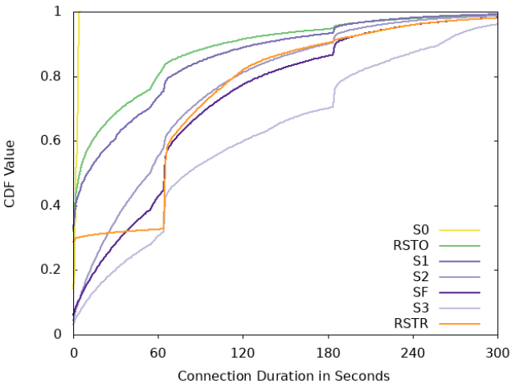
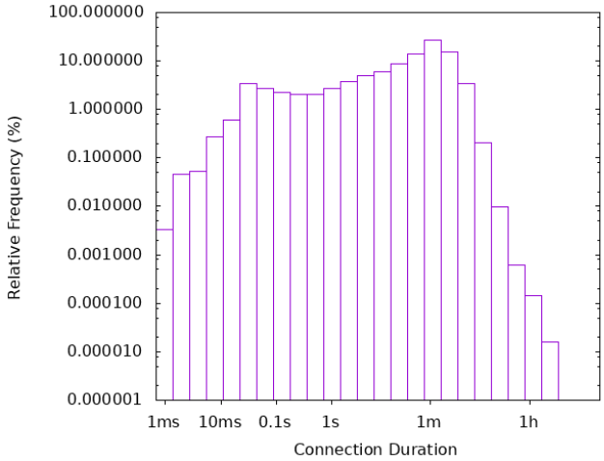
Distribution of TCP Connection Duration
Notes:
12% of the connections consist of only a single packet, and are shown as a duration of zero.
There is a small peak near 4 seconds, since many of the failed (S0) connections give up after several unsuccessful retransmission attempts.
The large peak at 65 seconds represents the default persistent connection timeout value for an idle TCP connection when Instagram app is closed.
The large peak at 185 seconds represents the persistent connection timeout value when the app is running in the background.

Slide 17
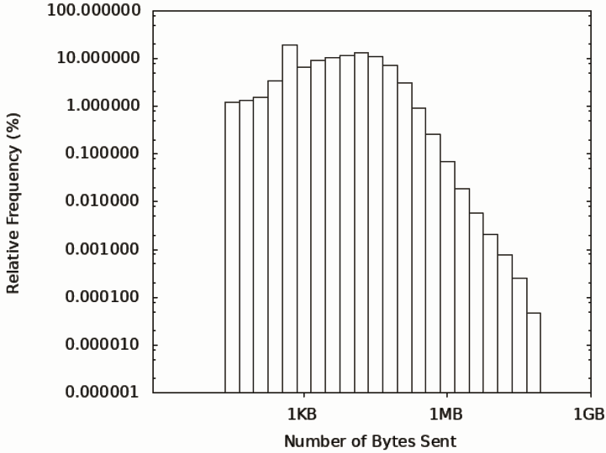
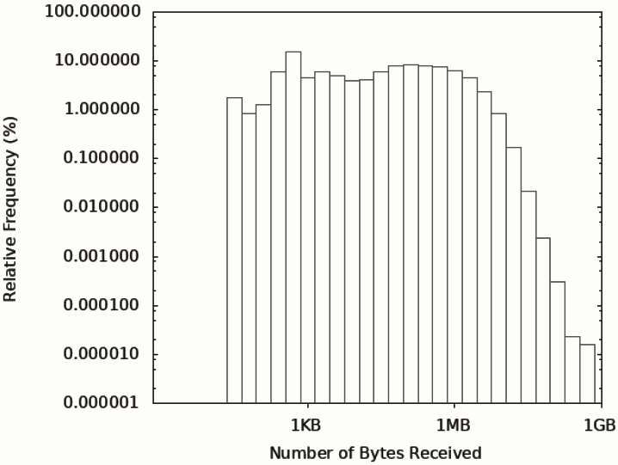
Transfer Sizes in Bytes

Slide 18
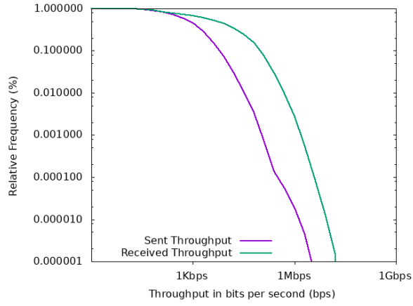
TCP Connection Throughput

Slide 19
Conclusions
On our campus network, a typical weekday of Instagram traffic has:
  1 TB of data downloaded
  60 GB of data uploaded
Third highest bandwidth consumption behind Netflix (6 TB per day) and YouTube (3 TB per day)
Highly skewed distributions:
  high variability (e.g., transfer sizes, throughputs)
  heavy-tails (e.g., connection durations, transfer sizes)
This traffic can have a large impact on a campus edge network!

Slide 20
Acknowledgements
Financial support for this work was provided by Canada’s Natural Sciences and Engineering Research Council (NSERC).
A big thanks to University of Calgary Information Technologies (UCIT) for enabling the collection of our network traffic measurement data.

Slide 21


Slide 22
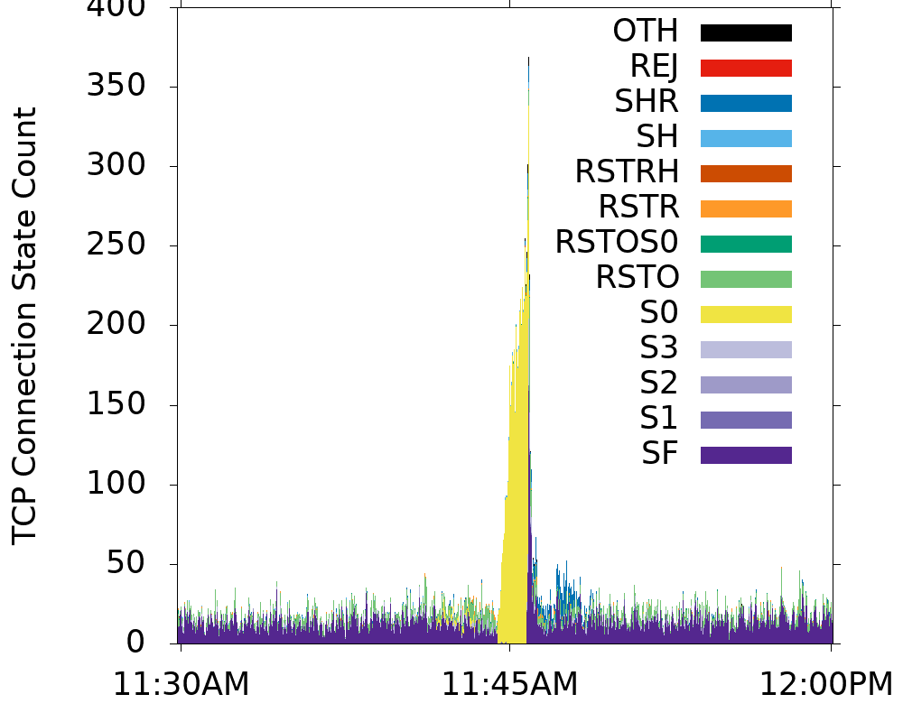
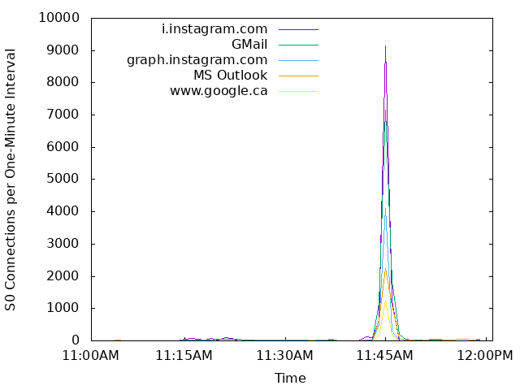
Instagram Traffic Anomaly (1 of 3)
A brief network router outage for about 80 seconds on Saturday March 9, which affected Instagram traffic, and
other network services

Slide 23
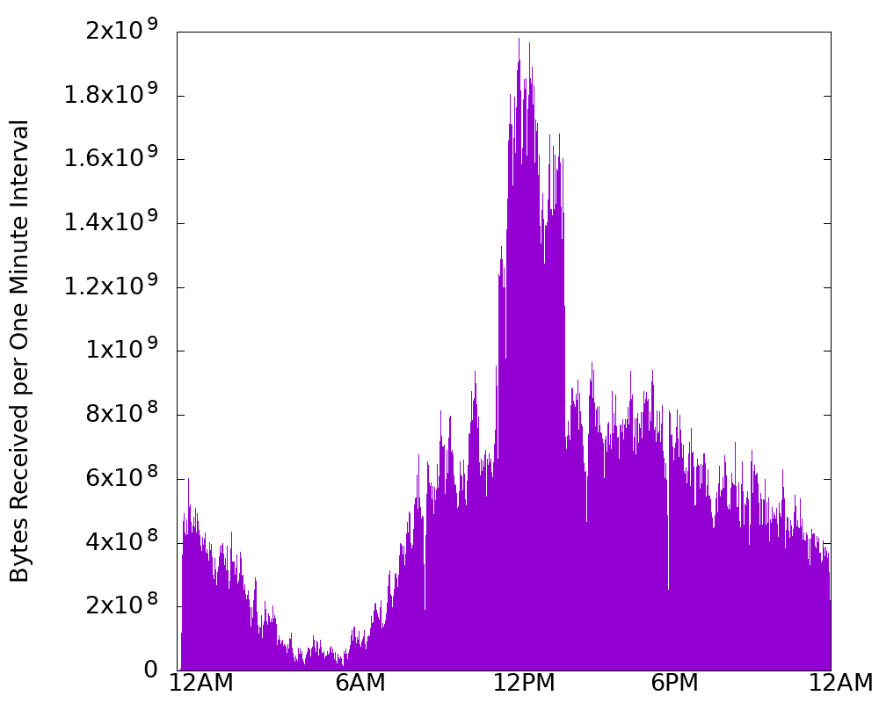
Instagram Traffic Anomaly (2 of 3)
Multiple UCalgary
IP addresses partaking in some Instagram video streaming event for about 2 hours on Sat March 9

Slide 24
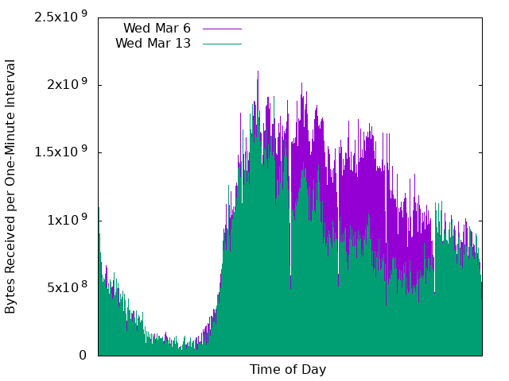
Instagram Traffic Anomaly (3 of 3)
Partial outage for
Facebook,
WhatsApp, and
Instagram for
several hours on
Wed March 13/19

