Slide 1
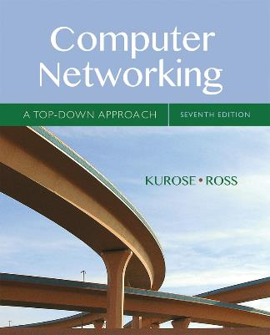
Chapter 6
The Link Layer
and LANs
A note on the use of these Powerpoint slides:
We’re making these slides freely available to all (faculty, students, readers). They’re in PowerPoint form so you see the animations; and can add, modify, and delete slides (including this one) and slide content to suit your needs. They obviously represent a lot of work on our part. In return for use, we only ask the following:
Computer Networking: A Top Down Approach
If you use these slides (e.g., in a class) that you mention their source (after all, we’d like people to use our book!)
If you post any slides on a www site, that you note that they are adapted from (or perhaps identical to) our slides, and note our copyright of this material.
Thanks and enjoy! JFK/KWR
All material copyright 1996-2016
J.F Kurose and K.W. Ross, All Rights Reserved
7th edition
Jim Kurose, Keith Ross
Pearson/Addison Wesley
April 2016

Slide 2
Link layer, LANs: outline
6.1 introduction, services
6.2 error detection, correction
6.3 multiple access protocols
6.4 LANs
  addressing, ARP
  Ethernet
  switches
  VLANS
6.5 link virtualization: MPLS
6.6 data center networking
6.7 a day in the life of a web request

Slide 3
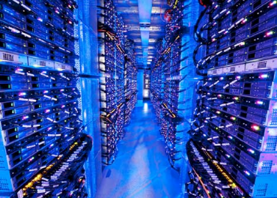
Data center networks
10’s to 100’s of thousands of hosts, often closely coupled, in close proximity:
  e-business (e.g. Amazon)
  content-servers (e.g., YouTube, Akamai, Apple, Microsoft)
  search engines, data mining (e.g., Google)
challenges:
  multiple applications, each serving massive numbers of clients
  managing/balancing load, avoiding processing, networking, data bottlenecks
Inside a 40-ft Microsoft container,
Chicago data center

Slide 4
Data center networks
load balancer: application-layer routing
receives external client requests
directs workload within data center
returns results to external client (hiding data center internals from client)
Internet
Border router
Load
balancer
Load
balancer
Access router
B
Tier-1 switches
A
C
Tier-2 switches
TOR switches
Server racks
1
2
3
4
5
6
7
8

Slide 5
Data center networks
rich interconnection among switches, racks:
  increased throughput between racks (multiple routing paths possible)
  increased reliability via redundancy
Tier-1 switches
Tier-2 switches
TOR switches
Server racks
1
2
3
4
5
6
7
8

