Slide 1

Enterprise-Level
Network Traffic Analysis and Security Monitoring
Martin Arlitt and Carey Williamson
Department of Computer Science
University of Calgary

Slide 2
Outline
Introduction (Carey: 20 minutes)
  Internet TCP/IP protocol stack
  Network traffic measurement
  Basic tools: tcpdump, wireshark
Network Security Analysis (Martin: 20 minutes)
  Principles and approaches
  Advanced tools: Endace DAG, Bro (Zeek) IDS, Vertica
  U of C network traffic overview and challenges
U of C Case Study: Part 1 (Carey: 20 minutes)
  Examples of normal and abnormal (malicious) traffic
U of C Case Study: Part 2 (Martin: 20 minutes)
  More examples of malicious traffic
Q&A
2

Slide 3
Background Review: Internet Protocol Stack (see [5])
Application: supports end-user services and network applications
  HTTP, SMTP, DNS, FTP, NTP
Transport: end to end data transfer
  TCP, UDP
Network: routing of datagrams from source to destination
  IPv4, IPv6, BGP, RIP
Data Link: channel access, framing, flow/error control, hop by hop basis
  PPP, Ethernet, IEEE 802.11b WiFi
Physical: transmission of bits
Application
Transport
Network
Data Link
Physical
001101011...

Slide 4
Network Traffic Measurement (see [2][7][8])
A focus of networking research for 30+ years
Collect datasets or traces showing packet-level activity on the network for different applications
Why?
  Understand the traffic on existing networks (see [9])
  Workload characterization and modeling
  Develop models of traffic for future networks
  Performance evaluation of protocols and applications
  Protocol debugging
  Network security monitoring (see [6])
4

Slide 5
Requirements
Network traffic measurement requires hardware or software measurement tools that attach directly to network
Allows you to observe all packet traffic on the network (or a filtered subset for traffic of interest)
Assumes broadcast-based network technology, superuser permission
101101
5

Slide 6
Network Packet Structure
Protocol Headers
(Control Information)
Payload
Src
12:BD:07:
AF:B0:6E
Dst
37:F9:14:
FD:C1:08
CRC
0xFC147E
SrcIP
372.19.44.108
DstIP
136.159.99.114
Length 1500
SrcPort 80
DstPort 2579
SeqNum 61842
ACK 3756812
Window 8192
Flags: PA
HTTP/1.0 200 OK
Content-Type: text
Content-Length: 4732
<html>
Welcome to Sponge Bob’s home page! <br>
On this site, there are lots of fun activities for you: colouring pages, bath time singalongs, and more.
<p>
Please click <a> <href=“./signup.html”> here </a>
to learn more about membership accounts and...
DataLink
Layer
Header
(e.g., WiFi,
Ethernet)
Network
Layer
Header
(e.g., IP)
Transport
Layer
Header
(e.g., TCP)
Payload (User Level Data)

Slide 7
Measurement Approaches (1 of 3)
Can be classified into hardware and software measurement tools (see [4][8])
Hardware: specialized equipment
  Examples: HP 4972 LAN Analyzer, DataGeneral Network Sniffer, NavTel InterWatch 95000, Endace DAG, others...
  These are faster, but more expensive ($$$)
Software: special software tools
  Examples: tcpdump, ethereal, wireshark, SNMP, others...
  These are cheaper (free!), but also slower (miss packets)
7

Slide 8
Measurement Approaches (2 of 3)
Measurement tools can also be classified as active or passive
Active: the monitoring tool generates traffic of its own during data collection (e.g., ping, traceroute)
Passive: the monitoring tool is passive, observing and recording traffic info, while generating none of its own (e.g., tcpdump, wireshark, airopeek)
8

Slide 9
Measurement Approaches (3 of 3)
Measurement tools can also be classified as real-time or non-real-time
Real-time: collects traffic data as it happens, and may even be able to display traffic info as it happens, for real-time traffic management
Non-real-time: collected traffic data may only be a subset (sample) of the total traffic, and is analyzed off-line (later), for detailed analysis
9

Slide 10
Basic Tools for Network Traffic Measurement
tcpdump https://www.tcpdump.org
  Unix-based tool from mid-to-late 1980’s
  Distributed with BSD Unix (Berkeley Software Distribution)
  Command-line interface; must be root to run it
  Uses the Berkeley Packet Filter (BPF) in operating system
  Writes to a PCAP file format; uses libpcap library
Wireshark https://www.wireshark.org
  PC-based tool from the early 2000’s
  Formerly called Ethereal (name change in May 2006)
  Free and open-source tool
  Multi-layer visualization and analysis of packet traces
  Also supports PCAP file format
10

Slide 11
Example: tcpdump
Time IP Source Addr IP Dest Addr Size Prot SPort DPort TCP Data SeqNumber TCP AckNum Window Flags
0.000000 192.168.1.201 -> 192.168.1.200 60 TCP 4105 80 1315338075 : 1315338075 0 win: 5840 S
0.003362 192.168.1.200 -> 192.168.1.201 60 TCP 80 4105 1417888236 : 1417888236 1315338076 win: 5792 SA
0.009183 192.168.1.201 -> 192.168.1.200 52 TCP 4105 80 1315338076 : 1315338076 1417888237 win: 5840 A
0.010854 192.168.1.201 -> 192.168.1.200 127 TCP 4105 80 1315338076 : 1315338151 1417888237 win: 5840 PA
0.014309 192.168.1.200 -> 192.168.1.201 52 TCP 80 4105 1417888237 : 1417888237 1315338151 win: 5792 A
0.049848 192.168.1.200 -> 192.168.1.201 1500 TCP 80 4105 1417888237 : 1417889685 1315338151 win: 5792 A
0.056902 192.168.1.200 -> 192.168.1.201 1500 TCP 80 4105 1417889685 : 1417891133 1315338151 win: 5792 A
0.057284 192.168.1.201 -> 192.168.1.200 52 TCP 4105 80 1315338151 : 1315338151 1417889685 win: 8688 A
0.060120 192.168.1.201 -> 192.168.1.200 52 TCP 4105 80 1315338151 : 1315338151 1417891133 win: 11584 A
0.068579 192.168.1.200 -> 192.168.1.201 1500 TCP 80 4105 1417891133 : 1417892581 1315338151 win: 5792 PA
0.075673 192.168.1.200 -> 192.168.1.201 1500 TCP 80 4105 1417892581 : 1417894029 1315338151 win: 5792 A
0.076055 192.168.1.201 -> 192.168.1.200 52 TCP 4105 80 1315338151 : 1315338151 1417892581 win: 14480 A
0.083233 192.168.1.200 -> 192.168.1.201 1500 TCP 80 4105 1417894029 : 1417895477 1315338151 win: 5792 A
0.096728 192.168.1.200 -> 192.168.1.201 1500 TCP 80 4105 1417896925 : 1417898373 1315338151 win: 5792 A
0.103439 192.168.1.200 -> 192.168.1.201 1500 TCP 80 4105 1417898373 : 1417899821 1315338151 win: 5792 A
0.103780 192.168.1.201 -> 192.168.1.200 52 TCP 4105 80 1315338151 : 1315338151 1417894029 win: 17376 A
0.106534 192.168.1.201 -> 192.168.1.200 52 TCP 4105 80 1315338151 : 1315338151 1417898373 win: 21720 A
0.133408 192.168.1.200 -> 192.168.1.201 776 TCP 80 4105 1417904165 : 1417904889 1315338151 win: 5792 FPA
0.139200 192.168.1.201 -> 192.168.1.200 52 TCP 4105 80 1315338151 : 1315338151 1417904165 win: 21720 A
0.140447 192.168.1.201 -> 192.168.1.200 52 TCP 4105 80 1315338151 : 1315338151 1417904890 win: 21720 FA
0.144254 192.168.1.200 -> 192.168.1.201 52 TCP 80 4105 1417904890 : 1417904890 1315338152 win: 5792 A
Flow summary (e.g., NetFlow record or Bro connection log entry):
0.000000 192.168.1.201 4105 192.168.1.200 80 0.144254 10 77 11 16654 SF

Slide 12
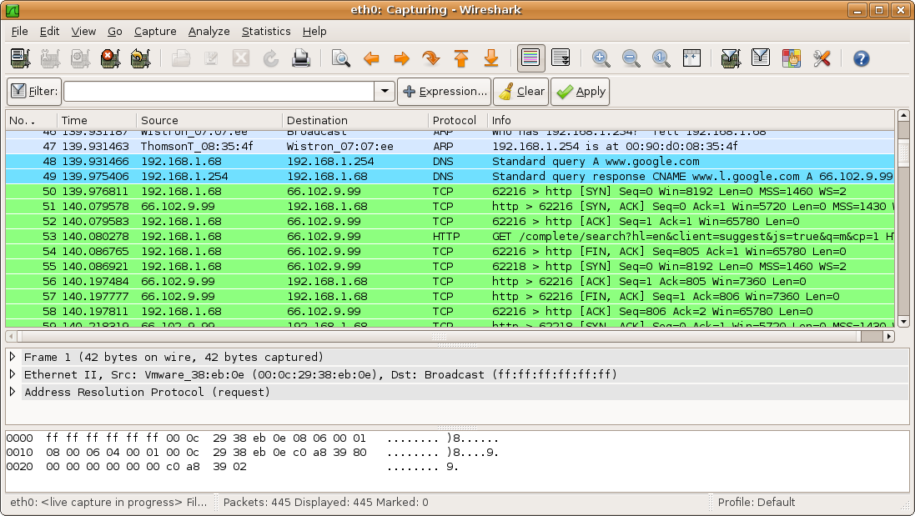

Example: wireshark
12

Slide 13
Some Technical Challenges
Speed:
  Real-time collection/analysis at network link speeds
  Sheer volume of traffic on an enterprise-level network
Information collection:
  Headers only versus full payloads
  Flow-level versus packet-level analysis
Storage:
  Short-term versus long-term data collection
Miscellaneous:
  Middleboxes (NAT, DHCP, VPN, firewalls); WiFi; IP subnets
  End-to-end encryption (HTTPS, TLS, SSL) (see [1])
13

Slide 14
Outline
Introduction (Carey: 20 minutes)
  Internet TCP/IP protocol stack
  Network traffic measurement
  Basic tools: tcpdump, wireshark
Network Security Analysis (Martin: 20 minutes)
  Principles and approaches
  Advanced tools: Endace DAG, Bro (Zeek) IDS, Vertica
  U of C network traffic overview and challenges
U of C Case Study: Part 1 (Carey: 20 minutes)
  Examples of normal and abnormal (malicious) traffic
U of C Case Study: Part 2 (Martin: 20 minutes)
  More examples of malicious traffic
Q&A
14

Slide 15

Guiding Principle #1
“Know your enemy and yourself.”
Sun Tzu
  General and Military Strategist
  (Ancient China)
“Organizations know which technologies they intended to use on their network;
hackers/nation states know which technologies are actually in use on that network.”
Rob Joyce
Tailored Access Operations
National Security Agency
(USENIX Enigma Conference 2016)
15

Slide 16

Guiding Principle #2
“All models are wrong, but some are useful.”
-George Box, Statistician (1919-2013)
1. Acquire
5. Act
2. Deliver
4. Interpret
3. Accept
“Sequence of effective intelligence operations”
(or “Intelligence lifecycle”)
16

Slide 17

Guiding Principle #3
“Anything that can go wrong will go wrong.”
-Murphy’s Law
This applies to all stages of the intelligence lifecycle, but it is especially applicable to data collection.
17

Slide 18

Guiding Principle #4
“A small leak will sink a great ship.”
-Benjamin Franklin
Security analytics is like searching for needles in a giant haystack.
(Vertica is a great tool for doing this)
18
Notes:
Author Clifford Stoll, PhD, an astronomer by training, managed computers at Lawrence Berkeley National Laboratory in California. One day in 1986 his supervisor, Dave Cleveland, asked him to resolve a US$0.75 accounting error in the computer usage accounts. Stoll traced the error to an unauthorized user who had apparently used 9 seconds of computer time and not paid for it. Stoll eventually realized that the unauthorized user was a hacker who had acquired Superuser access to the LBNL system by exploiting a vulnerability in the movemail function of the original GNU Emacs.

Slide 19
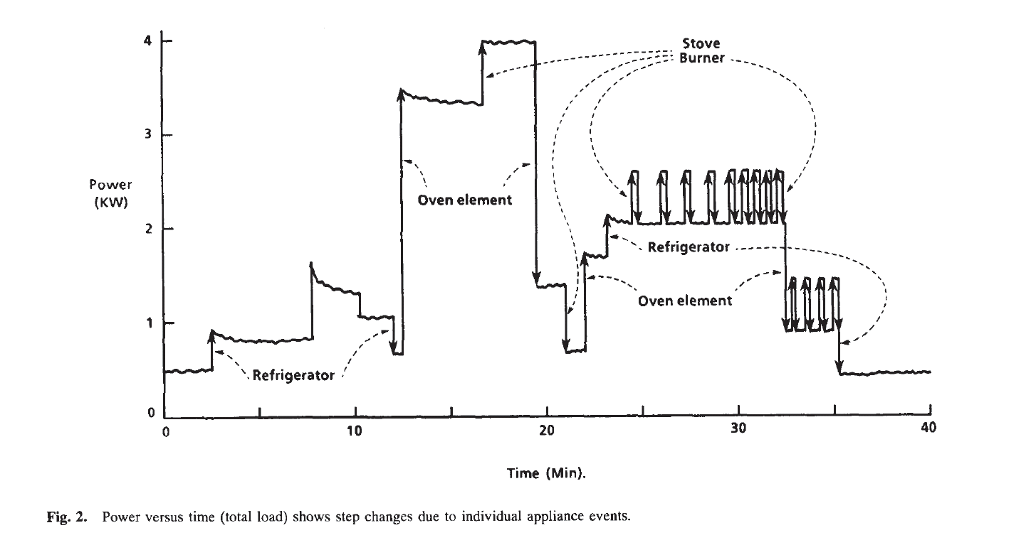
An Analogy: Power Signals
Disaggregating an aggregation of signals
G. Hart, “Nonintrusive Application Load Monitoring”, Proceedings of the IEEE, 1992.
19

Slide 20
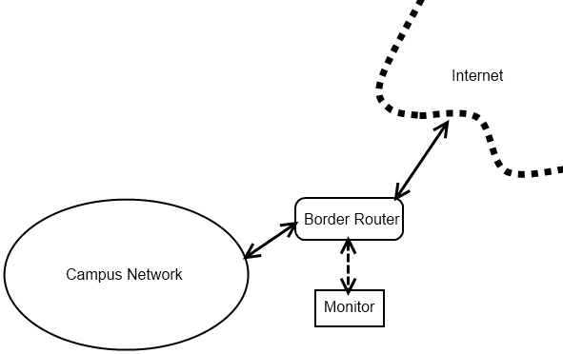
U of C Monitoring & Analysis Infrastructure
orgMappings
Endace
Vertica
Bro/Zeek
UofCMappings
orgMappings
Threat Intel
conn
dns
http
etc
20

Slide 21
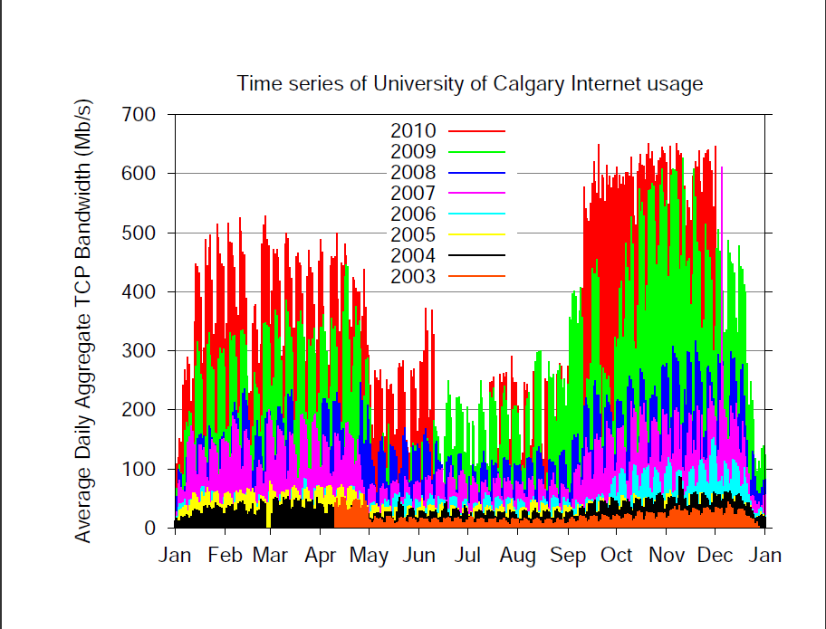
Data Acquisition (2003-2010)
21

Slide 22
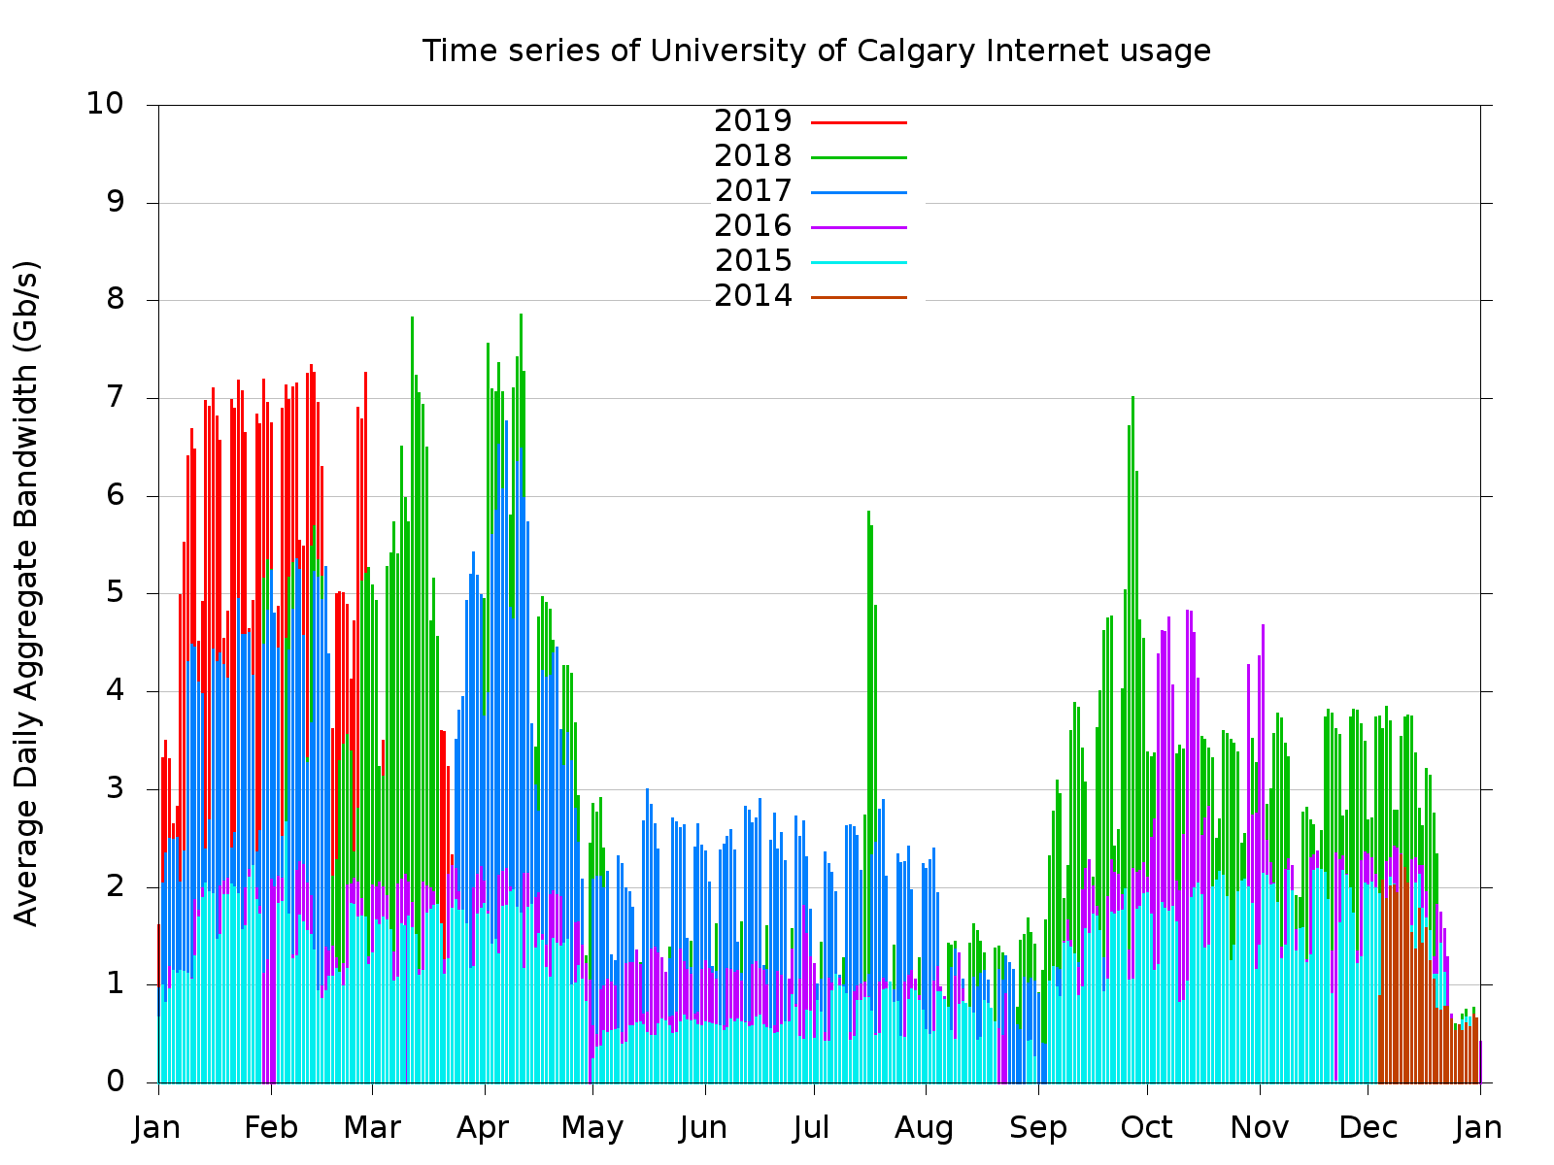
Data Acquisition (2014-present)
22

Slide 23
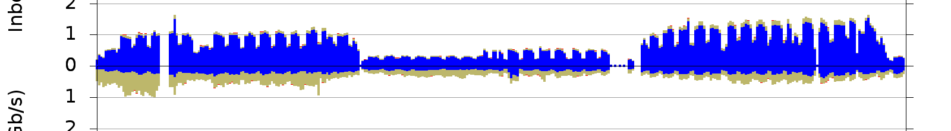
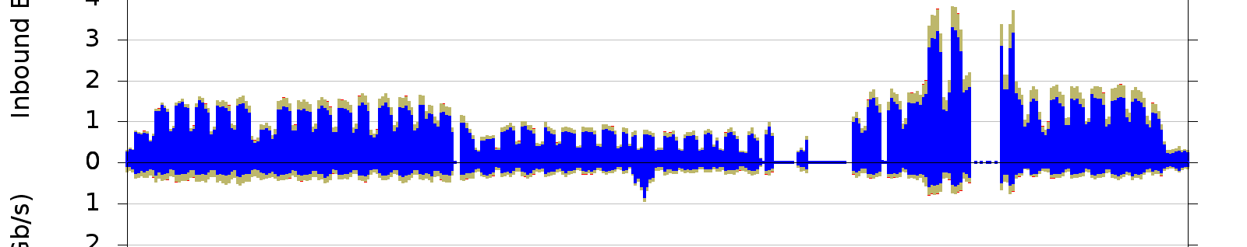
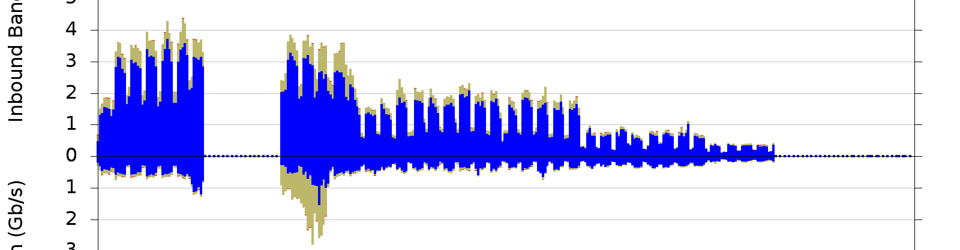
Data Acquisition (2015-2017)
2015
2016
2017
23

Slide 24
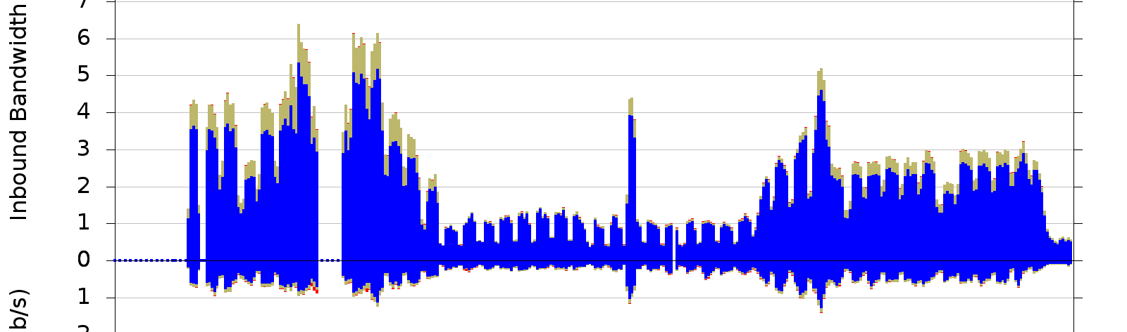
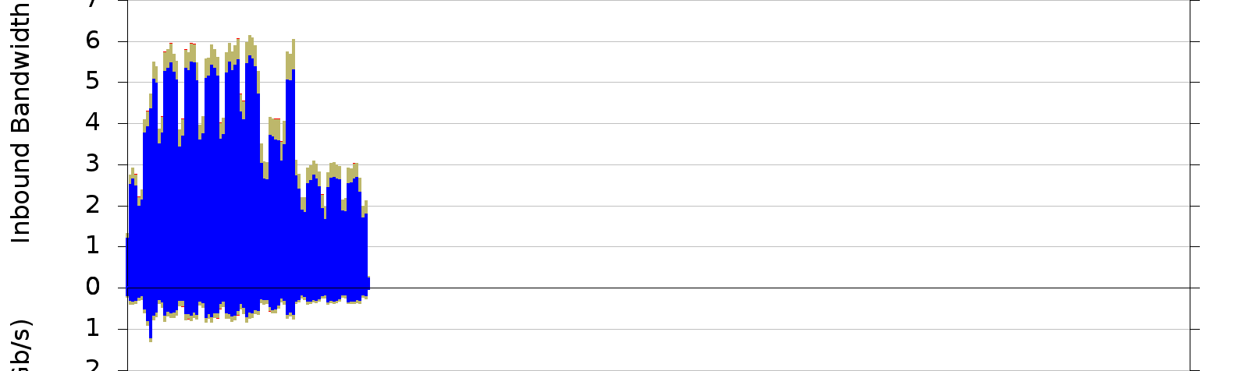
Data Acquisition (2018-2019)
2018
2019
24

Slide 25
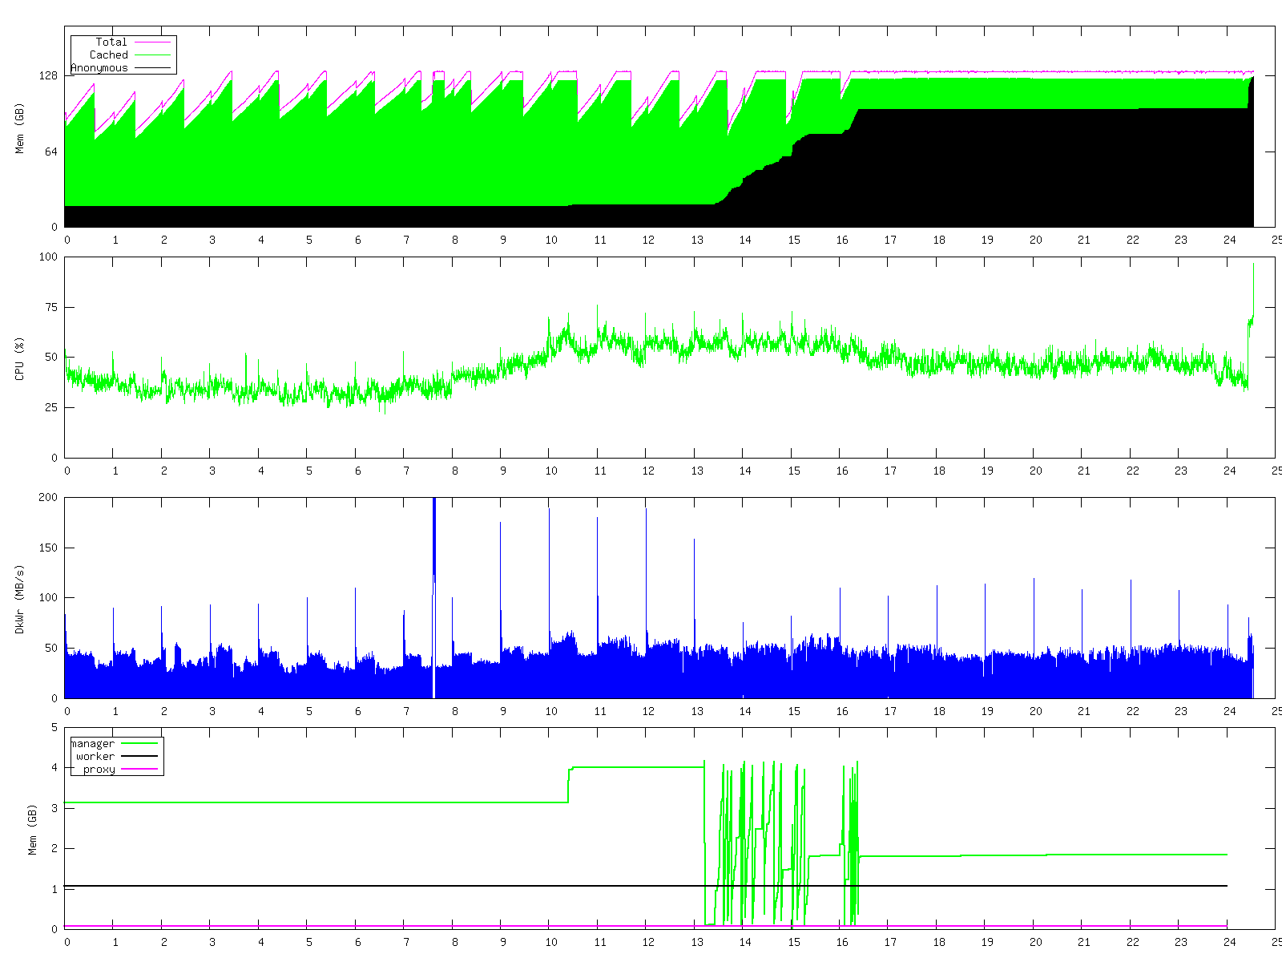
(Another) Data Acquisition Challenge
25

Slide 26
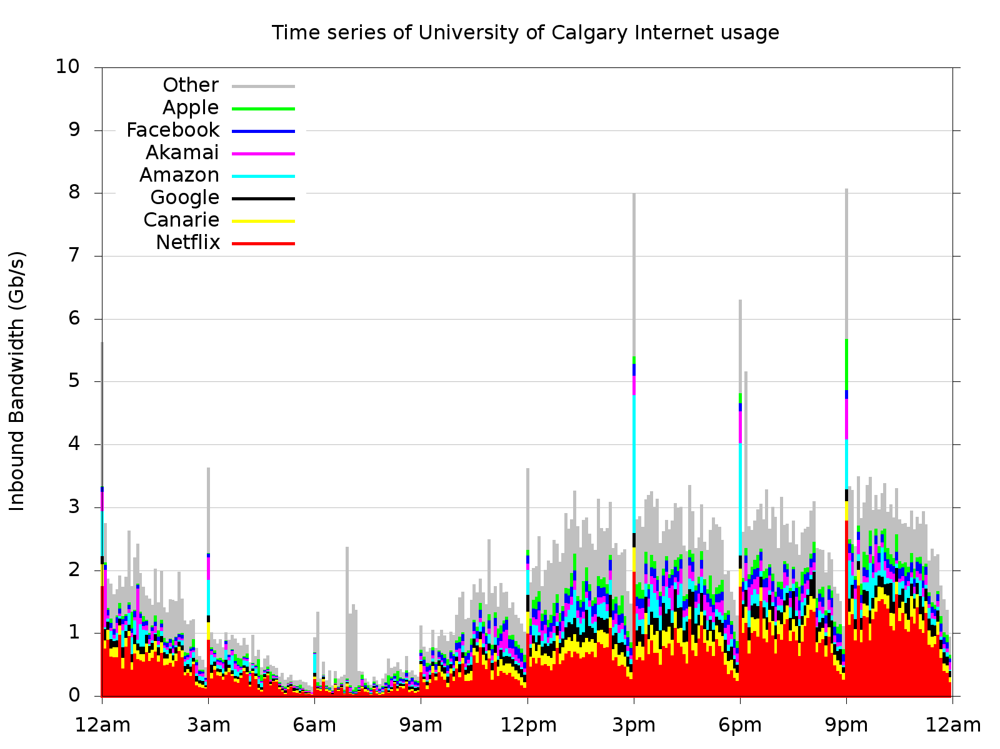
Data Acceptance & Interpretation
26

Slide 27
Outline
Introduction (Carey: 20 minutes)
  Internet TCP/IP protocol stack
  Network traffic measurement
  Basic tools: tcpdump, wireshark
Network Security Analysis (Martin: 20 minutes)
  Principles and approaches
  Advanced tools: Endace DAG, Bro (Zeek) IDS, Vertica
  U of C network traffic overview and challenges
U of C Case Study: Part 1 (Carey: 20 minutes)
  Examples of normal and abnormal (malicious) traffic
U of C Case Study: Part 2 (Martin: 20 minutes)
  More examples of malicious traffic
Q&A
27

Slide 28
Methodology
Passive network traffic measurement
Hardware: Endace DAG packet capture card
Software: Bro IDS network security monitor (see [6])
About 15 years of data
Analysis of TCP connection and HTTP transaction logs
28

Slide 29
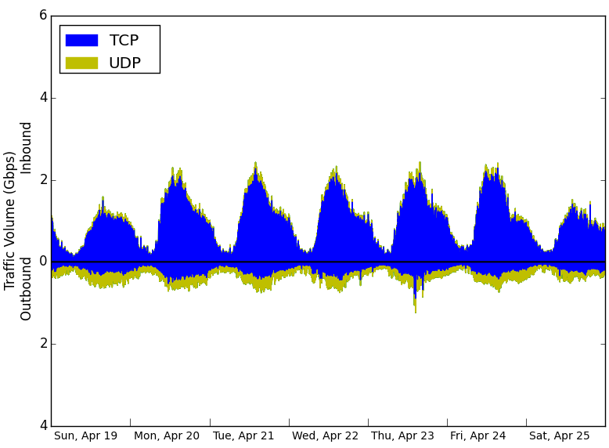
Overview of Traffic Volume (April 2015)
29

Slide 30
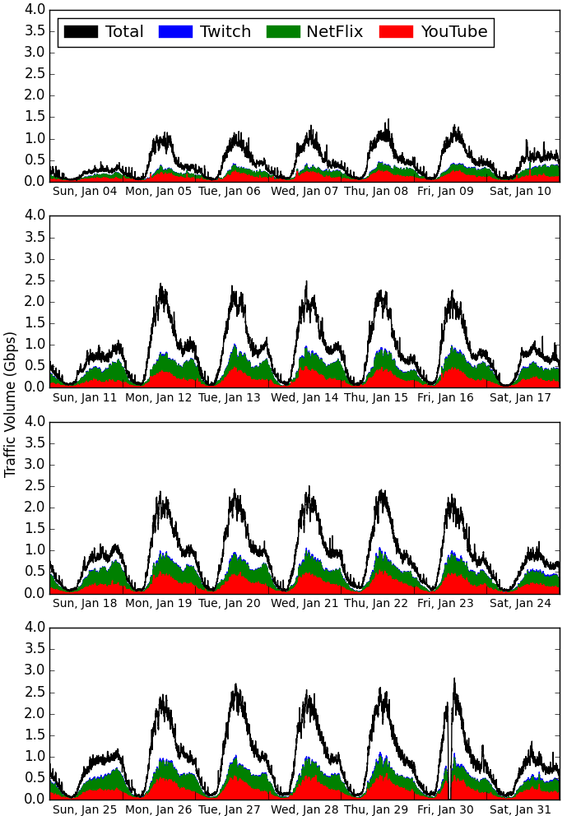
Video Streaming
January 2015
Top line (Total) is HTTP+HTTPS
Blue is Twitch
Green is Netflix (HTTP)
Red is YouTube (HTTPS)

Slide 31
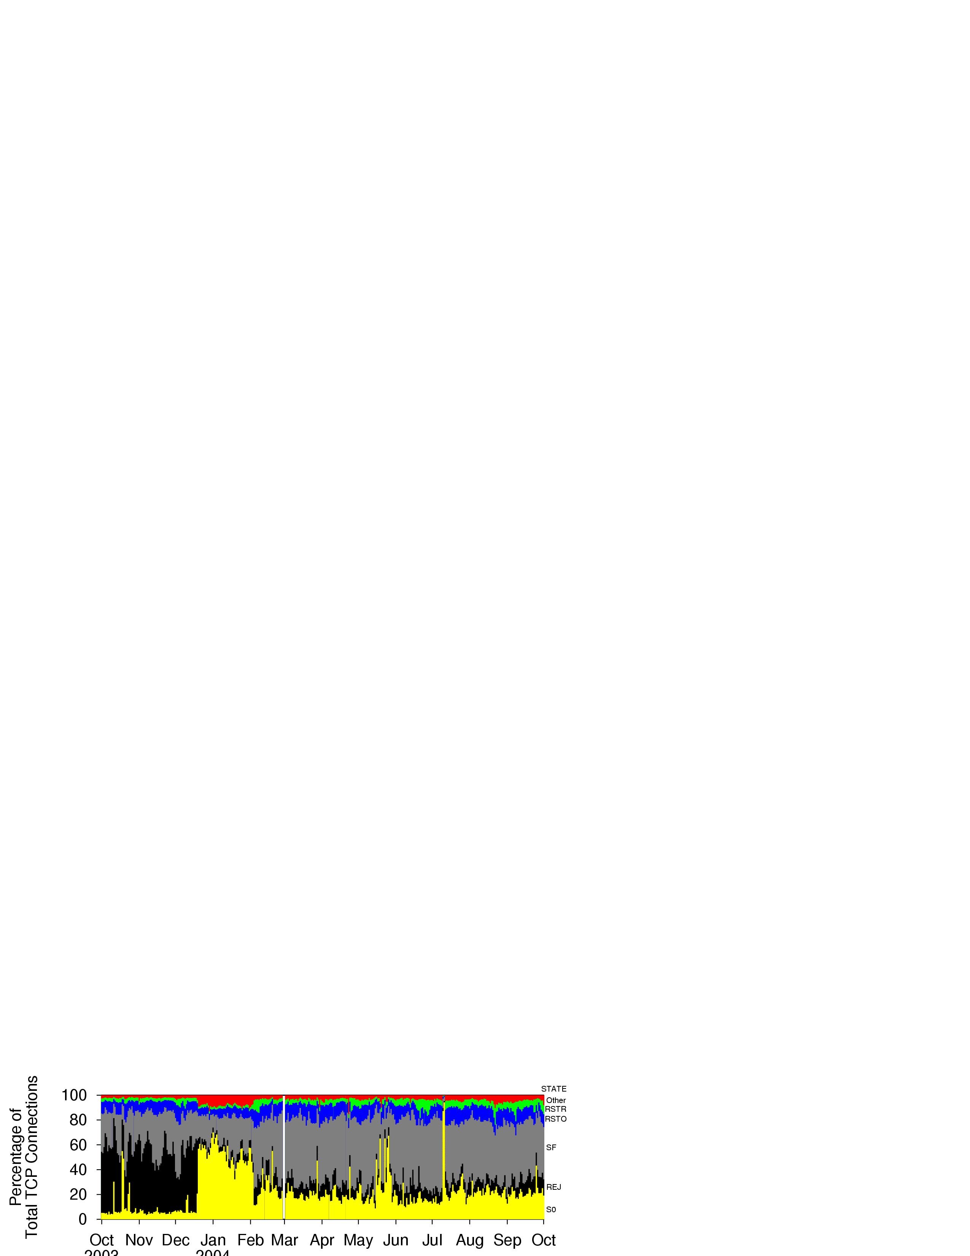
Example 1: TCP Connection State Analysis (1 yr)
2003
2004
M. Arlitt and C. Williamson, “An Analysis of TCP Reset Behaviour on the Internet”,
ACM Computer Communication Review, Vol. 35, No. 1, pp. 37-44, January 2005

Slide 32
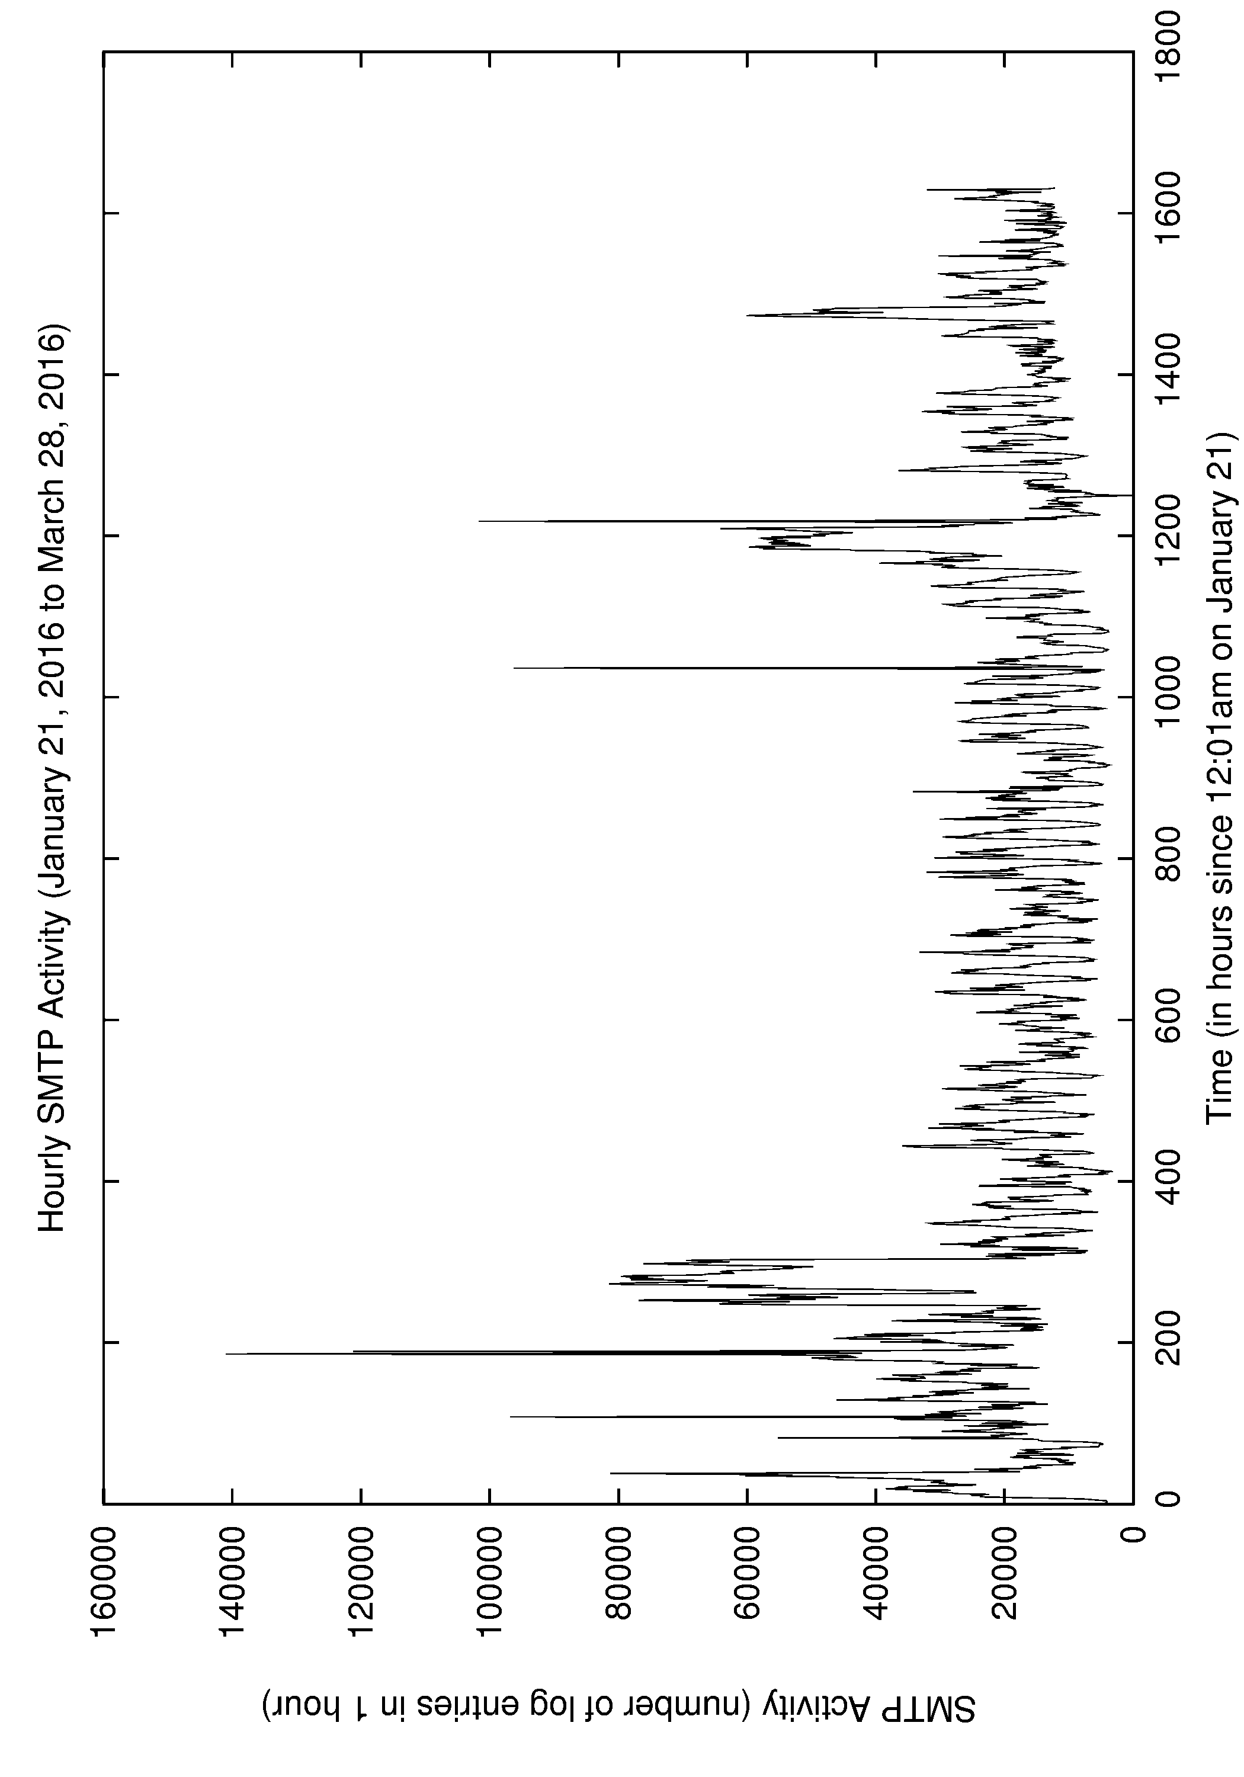
Example 2: SMTP (email) Traffic Activity
Spambot-generated email traffic (mostly)
Human-generated email traffic (mostly)
32

Slide 33
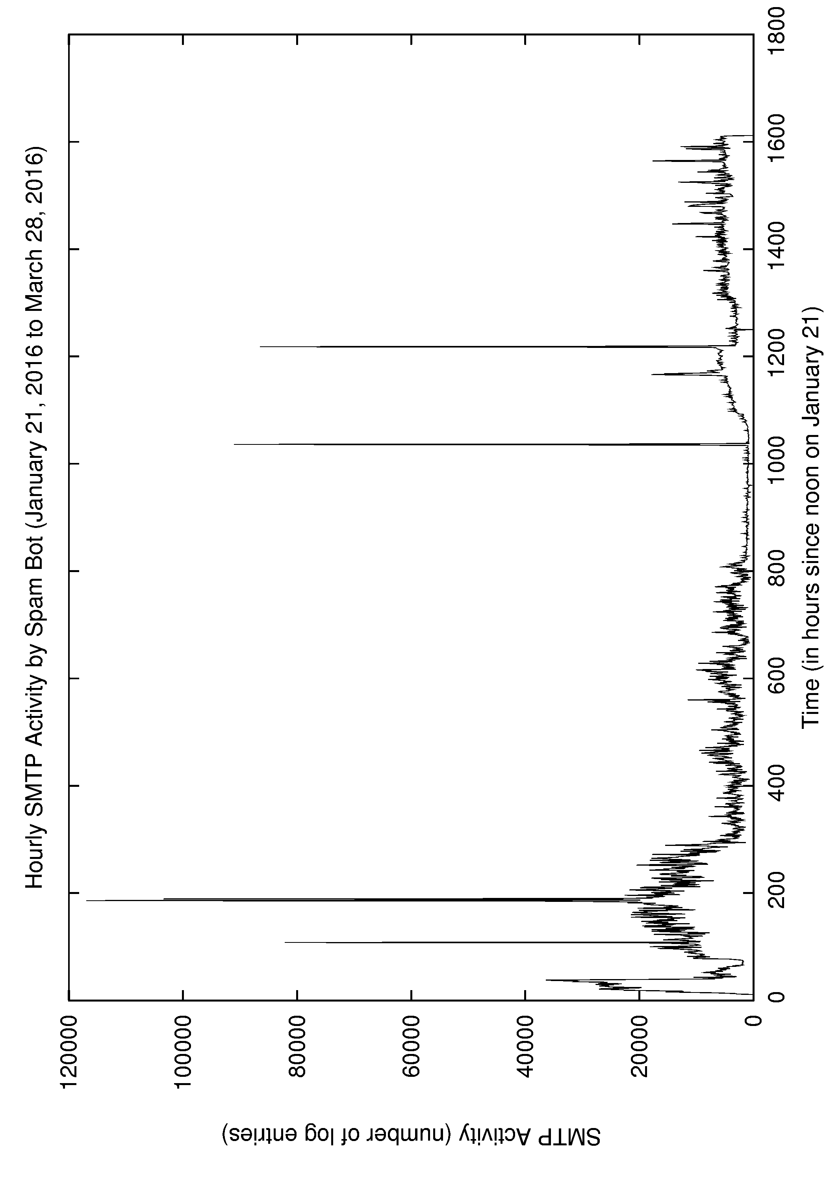
Example 3: Email Spam Bot Activity
Jan 25
(noon)
Mar 4
(4am)
Mar 11
(6pm)
Jan 28
(6-9pm)
March 28
Jan 21
(noon)
33

Slide 34
Example 4: Periodic Traffic Analysis (1 of 3)
Time IP Source Addr Port IP Dest Addr Port Duration PS PR BS BR State
0.000000 192.168.1.201 4105 192.168.1.200 80 0.144254 10 77 11 16654 SF
0.237814 192.168.1.285 7336 192.168.1.200 80 2.765018 32 105 937 87932 SF
0.589206 192.168.1.141 1060 192.168.1.200 80 0.842541 15 26 361 37850 SF
0.837142 192.168.1.251 8109 192.168.1.200 80 0.713306 12 54 110 32768 RST
1.249788 192.168.1.281 7206 192.168.1.200 80 1.517842 81 340 1096 181654 SF
1.742355 192.168.1.271 4812 192.168.1.200 80 0.642311 15 71 82 3784 SF
2.168283 192.168.1.146 1090 192.168.1.200 80 5.254088 10 385 36 20176 SF
2.577825 192.168.1.285 7339 192.168.1.200 80 0.034217 7 46 18 9184 SF
3.492006 192.168.1.236 3607 192.168.1.200 80 0.594426 18 61 105 5408 SF
4.587426 192.168.1.141 1061 192.168.1.200 80 0.331344 11 20 28 12716 SF
5.824413 192.168.1.231 6022 192.168.1.200 80 0.680049 24 75 31 18533 SF
6.073508 192.168.1.104 8704 192.168.1.200 80 0.913426 27 37 88 14236 SF
7.198741 192.168.1.251 8122 192.168.1.200 80 1.744125 52 128 238 75890 SF
7.363601 192.168.1.281 7218 192.168.1.200 80 0.164425 12 8 22 6654 RST
8.597769 192.168.1.141 1063 192.168.1.200 80 0.517756 18 119 310 15024 SF
8.370944 192.168.1.271 4818 192.168.1.200 80 0.027399 6 30 45 18324 SF
9.127458 192.168.1.235 4093 192.168.1.200 80 2.044254 35 264 212 172654 SF
9.627145 192.168.1.281 7225 192.168.1.200 80 0.283158 15 46 53 18498 SF
[3] M. Haffey, M. Arlitt, and C. Williamson, "Modeling, Analysis, and Characterization
Of Periodic Network Traffic", IEEE MASCOTS 2018, Milwaukee, WI, September 2018.

Slide 35
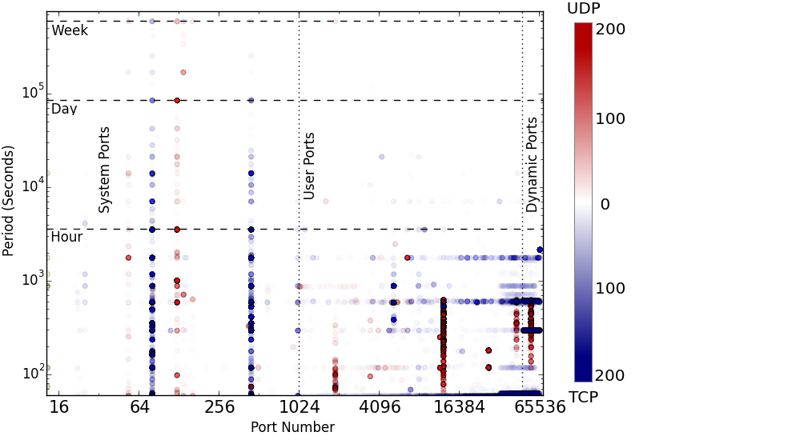
Example 4: Periodic Traffic Analysis (2 of 3)
HTTP
NTP
HTTPS
Apple’s Push
Notification Service
Google Hangouts
Akamai
SSDP
35

Slide 36
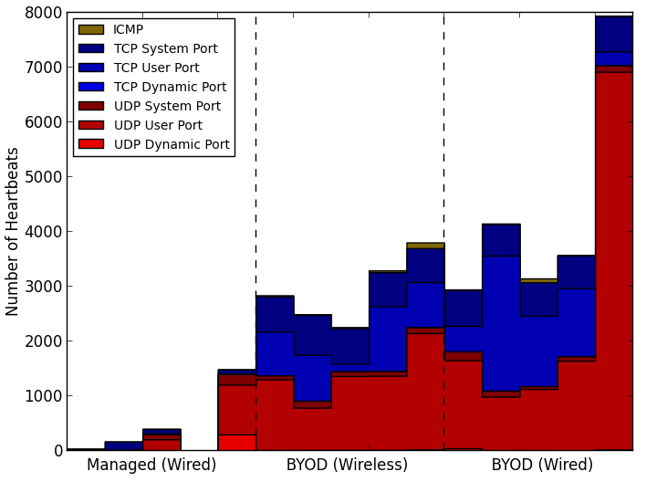
Example 4: Periodic Traffic Analysis (3 of 3)

Slide 37
Outline
Introduction (Carey: 20 minutes)
  Internet TCP/IP protocol stack
  Network traffic measurement
  Basic tools: tcpdump, wireshark
Network Security Analysis (Martin: 20 minutes)
  Principles and approaches
  Advanced tools: Endace DAG, Bro (Zeek) IDS, Vertica
  U of C network traffic overview and challenges
U of C Case Study: Part 1 (Carey: 20 minutes)
  Examples of normal and abnormal (malicious) traffic
U of C Case Study: Part 2 (Martin: 20 minutes)
  More examples of malicious traffic
Q&A
37

Slide 38
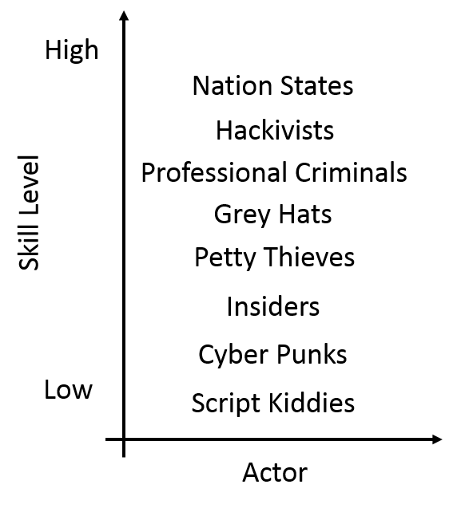
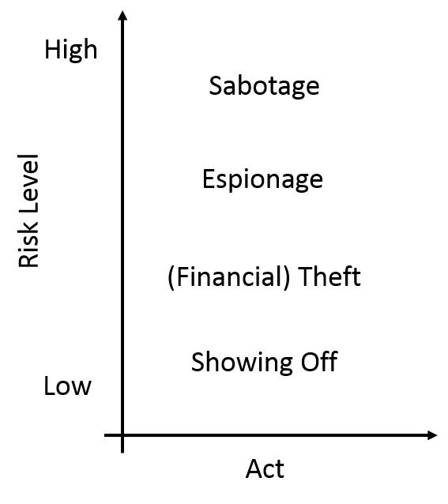
Who and what we are up against
38

Slide 39
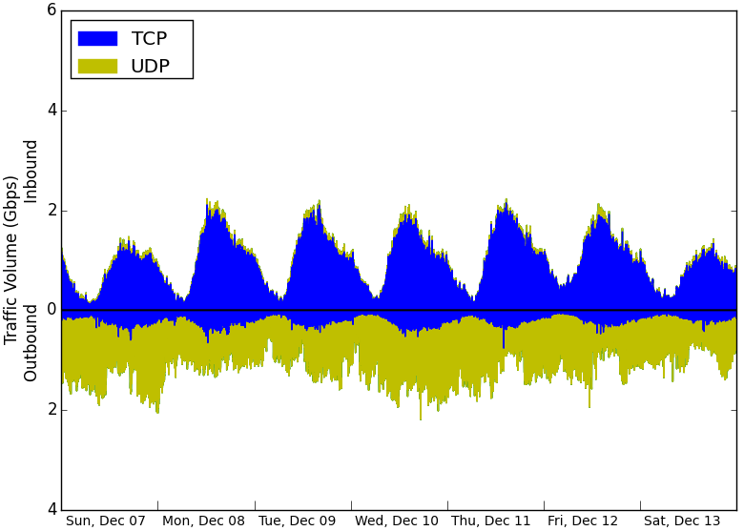
Example 5: NTP Amplification Attack (Dec 2014)
39

Slide 40
Example 5B: HTTP DDoS participation (2019)
DstOrg | proto | resp_p | Srcs | Conns | OGB | RGB |
---------------------------------+-------+--------+-------+--------+----------+----------+
OVH SAS | tcp | 80 | 65306 | 390355 | .0 | .0 |
No.31,Jin-rong Street | tcp | 80 | 58392 | 146205 | .0 | .0 |
Zhejiang Taobao Network Co.,Ltd | tcp | 80 | 53471 | 111031 | .0 | .0 |
CHINA UNICOM China169 Backbone | tcp | 80 | 49040 | 99313 | .0 | .0 |
Guangdong | tcp | 80 | 34067 | 48080 | .0 | .0 |
(5 rows)
Activity from a known, unused local IP address:
ts | orig_p | DstOrg | resp_p | proto |
----------------------------+--------+----------------------------------+--------+-------+
2019-03-24 00:07:28.770651 | 42254 | Zhejiang Taobao Network Co.,Ltd | 80 | tcp |
2019-03-24 00:36:39.219374 | 52671 | No.31,Jin-rong Street | 80 | tcp |
2019-03-24 00:37:00.251778 | 42058 | No.31,Jin-rong Street | 80 | tcp |
2019-03-24 00:42:14.622743 | 57970 | No.31,Jin-rong Street | 80 | tcp |
2019-03-24 00:52:27.775738 | 2957 | CHINA UNICOM China169 Backbone | 80 | tcp |
2019-03-24 00:53:16.424589 | 39247 | China Mobile communications corp | 80 | tcp |
2019-03-24 00:54:22.264719 | 46864 | CHINANET Guangdong province | 80 | tcp |
2019-03-24 00:58:41.612098 | 18470 | No.31,Jin-rong Street | 80 | tcp |
<snip>
2019-03-24 22:47:44.014437 | 28985 | OVH SAS | 80 | tcp |
2019-03-24 22:47:54.384277 | 51532 | OVH SAS | 80 | tcp |
(10 rows)
40

Slide 41
Example 6: Data Exfiltration (2019)
DstOrg | Srcs | Dsts | Services | Conns | OGB | RGB
--------------------------------------+-------+-------+----------+---------+----------+----------
Apple Inc. | 3129 | 2705 | 52 | 3087969 | 181.4 | 972.9
Google LLC | 3336 | 8413 | 250 | 7433788 | 170.2 | 1,547.0
Microsoft Corporation | 3498 | 3916 | 264 | 4354021 | 136.9 | 165.9
Amazon.com, Inc. | 27610 | 54749 | 1578 | 6904241 | 128.2 | 717.3
Dropbox, Inc. | 1103 | 68 | 9 | 485147 | 90.6 | 119.0
Facebook, Inc. | 29177 | 602 | 604 | 2217479 | 61.1 | 1,072.4
Netflix Streaming Services Inc. | 906 | 310 | 4 | 266308 | 59.3 | 6,089.6
Shaw Communications Inc. | 758 | 2410 | 2828 | 221592 | 55.1 | 147.0
TELUS Communications Inc. | 1099 | 2144 | 2048 | 311961 | 36.7 | 76.4
Akamai Technologies, Inc. | 6295 | 9468 | 102 | 2603508 | 28.8 | 449.5
Tencent Building, Kejizhongyi Avenue | 1077 | 1850 | 548 | 918944 | 21.7 | 127.4
Twitch Interactive Inc. | 224 | 96 | 3 | 27215 | 19.1 | 693.2
Bell Canada | 16604 | 1880 | 1437 | 36086 | 15.7 | 34.3
No.31,Jin-rong Street | 58861 | 48437 | 33480 | 811287 | 14.3 | 82.9
Canarie Inc | 1941 | 22 | 8 | 449694 | 13.4 | 1,551.8
PlusServer GmbH | 125 | 136 | 6 | 1527 | 13.0 | .3
Comcast Cable Communications, LLC | 873 | 5992 | 3086 | 34203 | 12.8 | 5.5
Unwired | 23 | 245 | 4 | 6434 | 12.7 | .2
Fastly | 3055 | 728 | 9 | 822142 | 12.3 | 494.4
Rogers Communications Canada Inc. | 626 | 1637 | 1570 | 87703 | 9.8 | 23.3
(20 rows)
41

Slide 42
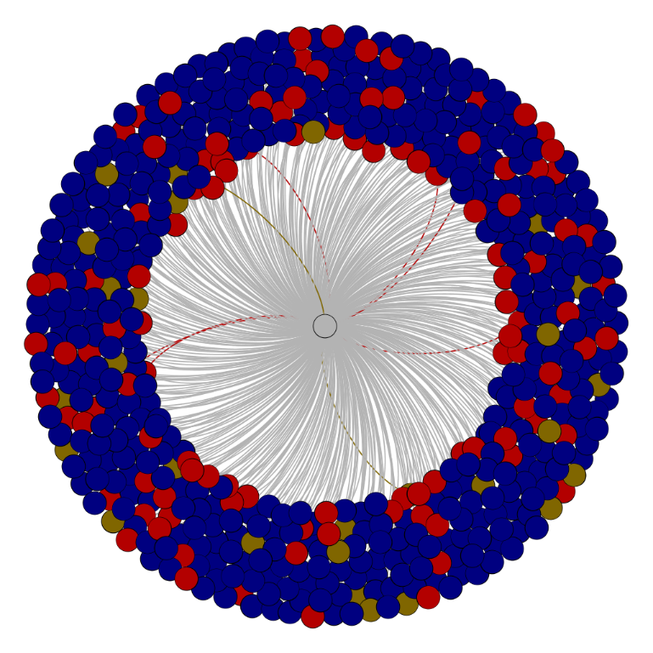
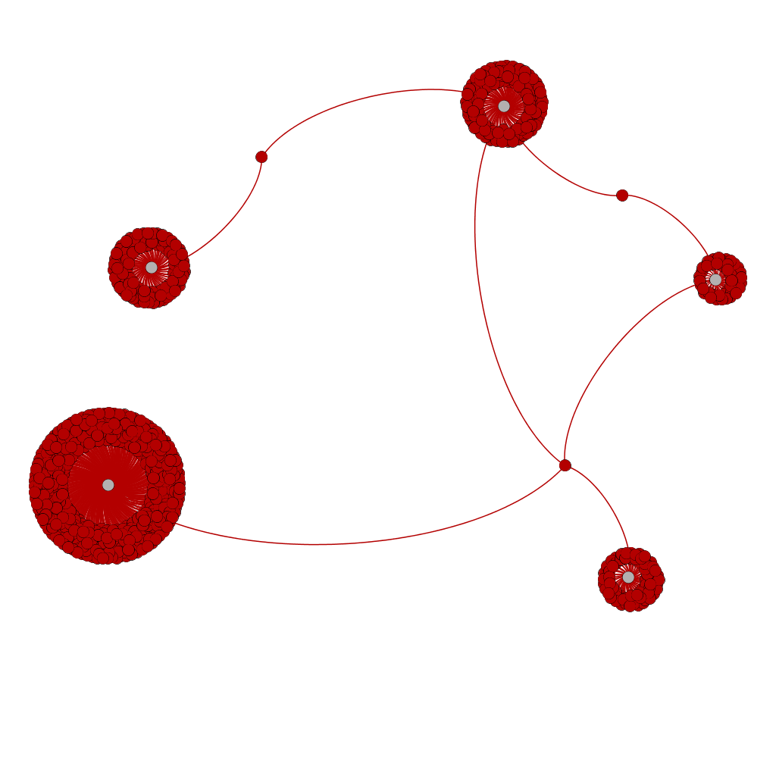

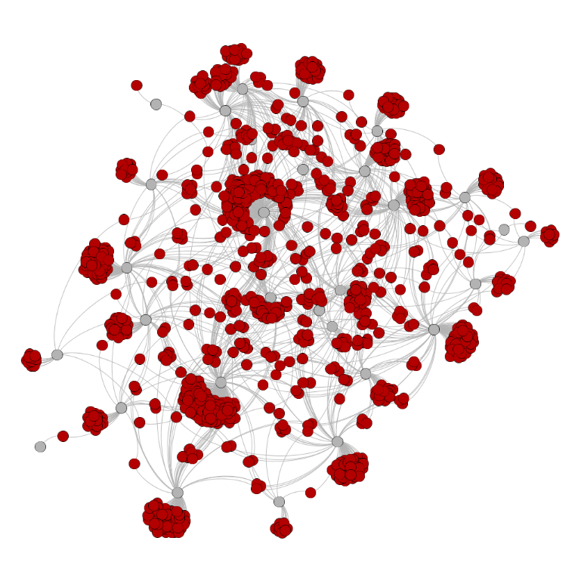
Example 7: Botnets (see [3]) (2017)
Akamai CDN node
BitTorrent
ZeroAccess
Botnet
Sality Botnet
42

Slide 43
Example 8: Advanced Persistent Threats (2019)
Threat Intelligence
threatName | intelSource | date | BadAddress | startAddress | endAddress
------------+-------------+---------------------+-----------------+---------------+-----------------
APT28 | Fortinet | 2018-10-12 00:00:00 | 179.43.158.20 | 179.43.158.0 | 179.43.158.255
APT28 | Fortinet | 2018-10-12 00:00:00 | 185.181.102.201 | 185.181.102.0 | 185.181.102.255
APT28 | Fortinet | 2018-10-12 00:00:00 | 185.183.107.40 | 185.183.107.0 | 185.183.107.255
APT28 | Fortinet | 2018-10-12 00:00:00 | 85.204.124.77 | 85.204.124.0 | 85.204.124.255
Gallmaker | Fortinet | 2018-10-12 00:00:00 | 111.90.149.99 | 111.90.149.0 | 111.90.149.255
Gallmaker | Fortinet | 2018-10-12 00:00:00 | 45.55.154.23 | 45.55.154.0 | 45.55.154.255
Gallmaker | Fortinet | 2018-10-12 00:00:00 | 5.223.98.157 | 5.223.98.0 | 5.223.98.255
Gallmaker | Fortinet | 2018-10-12 00:00:00 | 82.202.120.156 | 82.202.120.0 | 82.202.120.255
Gallmaker | Fortinet | 2018-10-12 00:00:00 | 87.17.148.117 | 87.17.148.0 | 87.17.148.255
Gallmaker | Fortinet | 2018-10-12 00:00:00 | 87.17.148.76 | 87.17.148.0 | 87.17.148.255
Gallmaker | Fortinet | 2018-10-12 00:00:00 | 93.109.241.154 | 93.109.241.0 | 93.109.241.255
(11 rows)
43

Slide 44
Example 8: Advanced Persistent Threats (2019)
https://www.fireeye.com/current-threats/apt-groups.html
APT28 (aka “Tsar Team”)
Suspected attribution: Russian government
ts | Threat | Dst | proto | resp_p
----------------------------+--------+----------------+-------+--------
2019-03-24 00:04:00.346623 | APT28 | 85.204.124.82 | tcp | 443
2019-03-24 00:21:08.846368 | APT28 | 185.181.102.60 | tcp | 443
2019-03-24 00:21:10.716686 | APT28 | 185.181.102.60 | tcp | 443
2019-03-24 00:27:23.543676 | APT28 | 185.181.102.18 | icmp | 1
2019-03-24 00:30:28.963384 | APT28 | 85.204.124.38 | tcp | 443
2019-03-24 00:30:28.963413 | APT28 | 85.204.124.38 | tcp | 443
2019-03-24 00:32:35.505192 | APT28 | 185.181.102.18 | icmp | 3
2019-03-24 00:43:41.516986 | APT28 | 85.204.124.82 | tcp | 443
2019-03-24 00:48:42.523358 | APT28 | 185.181.102.18 | icmp | 3
2019-03-24 00:58:24.492231 | APT28 | 185.181.102.18 | icmp | 0
2019-03-24 01:03:05.507413 | APT28 | 185.181.102.18 | icmp | 3
2019-03-24 01:15:58.521104 | APT28 | 185.181.102.18 | icmp | 3
2019-03-24 01:16:22.528087 | APT28 | 185.181.102.18 | icmp | 3
2019-03-24 01:18:56.491637 | APT28 | 185.181.102.18 | icmp | 3
2019-03-24 01:33:07.52546 | APT28 | 185.181.102.18 | icmp | 3
2019-03-24 01:34:16.511177 | APT28 | 185.181.102.18 | icmp | 10
2019-03-24 01:35:36.51376 | APT28 | 185.181.102.18 | icmp | 3
2019-03-24 01:38:30.497508 | APT28 | 185.181.102.18 | icmp | 3
2019-03-24 01:39:54.510276 | APT28 | 185.181.102.18 | icmp | 0
2019-03-24 01:42:06.528017 | APT28 | 185.181.102.18 | icmp | 3
(20 rows)
44

Slide 45
Example 9: Inbound Reconnaissance Traffic (2019)
Org | Probes | Sources | Services | Destinations
-------------------------------------------+----------+---------+----------+--------------
4Media | 55197769 | 1 | 7747 | 65535
OOO Network of data-centers Selectel | 27950860 | 68 | 5163 | 65536
45.227.254.0 | 27225683 | 1 | 19630 | 65535
IP Volume inc | 25879374 | 29 | 11210 | 65536
SS-Net | 16155185 | 23 | 1848 | 65536
Infium, UAB | 13244314 | 5 | 1557 | 65536
92.118.37.0 | 10507608 | 14 | 204 | 65535
ERA LLC | 10405141 | 2 | 6001 | 65535
DigitalOcean, LLC | 9926509 | 1965 | 1219 | 65536
FutureNow Incorporated | 5389151 | 8 | 1137 | 65536
Novogara LTD | 4417903 | 3 | 3495 | 65535
No.31,Jin-rong Street | 4102569 | 66658 | 12693 | 65535
BitWeb LLC | 3940653 | 11 | 136 | 65536
Chernyshov Aleksandr Aleksandrovich | 3825759 | 4 | 70 | 65535
CHINA UNICOM China169 Backbone | 3573076 | 19561 | 5887 | 65535
ColoCrossing | 3166543 | 224 | 380 | 65536
Hurricane Electric LLC | 2852790 | 353 | 92 | 65536
TELUS Communications Inc. | 2512320 | 2743 | 1028 | 11579
Access2.IT Group B.V. | 2300727 | 10 | 104 | 65535
ESTOXY OU | 2216136 | 51 | 23 | 65536
(20 rows)
45

Slide 46
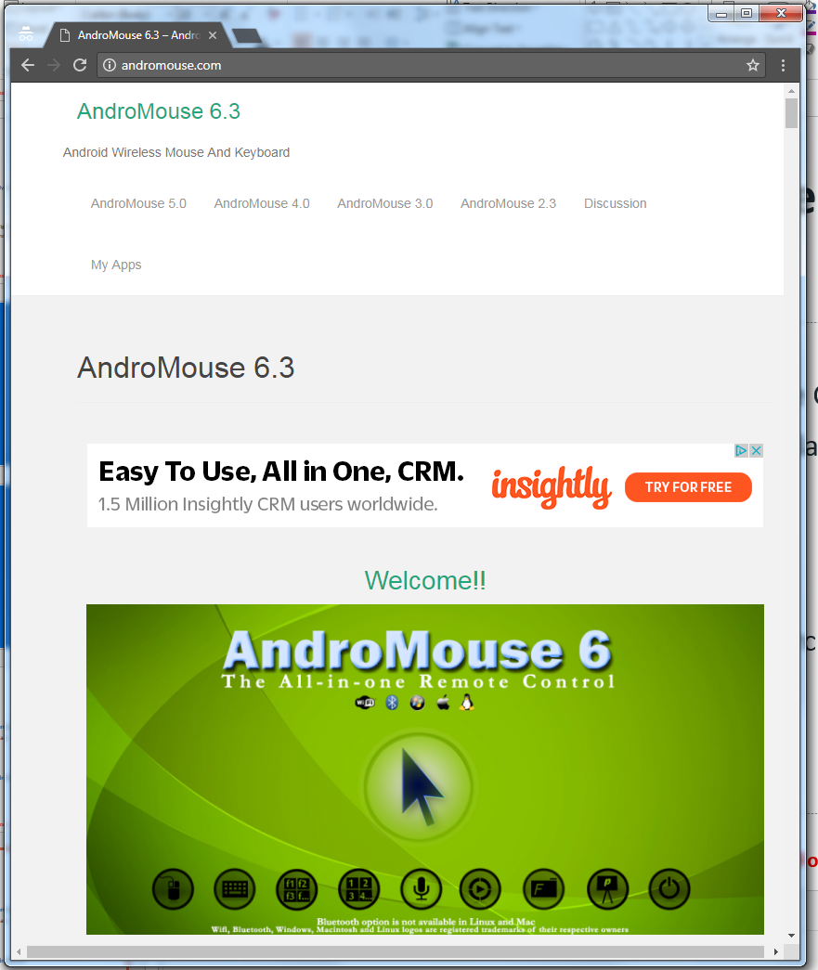
Example 9: Inbound Reconnaissance Traffic (2017)
46

Slide 47
Outline
Introduction (Carey: 20 minutes)
  Internet TCP/IP protocol stack
  Network traffic measurement
  Basic tools: tcpdump, wireshark
Network Security Analysis (Martin: 20 minutes)
  Principles and approaches
  Advanced tools: Endace DAG, Bro (Zeek) IDS, Vertica
  U of C network traffic overview and challenges
U of C Case Study: Part 1 (Carey: 20 minutes)
  Examples of normal and abnormal (malicious) traffic
U of C Case Study: Part 2 (Martin: 20 minutes)
  More examples of malicious traffic
Q&A
47

Slide 48
References
[1] A. Cortesi, M. Hils, T. Kriechbaumer, et al., "mitmproxy: A Free and Open Source Interactive HTTPS Proxy", 2010-2018. https://mitmproxy.org
[2] M. Crovella and B. Krishnamurthy, Internet Measurement: Infrastructure, Traffic, and Applications, Wiley, 2006.
[3] M. Haffey, M. Arlitt, and C. Williamson, "Modeling, Analysis, and Characterization of Periodic Network Traffic", Proceedings of IEEE MASCOTS 2018, Milwaukee, WI, September 2018.
[4] R. Jain, "A Survey of Network Traffic Monitoring and Analysis Tools", https://www.cse.wustl.edu/~jain/cse567-06/ftp/net_traffic_monitors3
[5] J. Kurose and K. Ross, Computer Networking: A Top-Down Approach, 7th edition, Pearson, 2017.
[6] V. Paxson, "Bro: A System for Detecting Network Intruders in Real-time", Computer Networks, Vol. 31, No. 23, pp. 2435-2463, December 1999.
[7] V. Paxson, "Strategies for Sound Internet Measurement", Proceedings of ACM Internet Measurement Conference (IMC), Toarmina, Italy, October 2004.
[8] C. Williamson, "A Tutorial on Internet Traffic Measurement", IEEE Internet Computing, Vol. 5, No. 6, pp. 70-74, November/December 2001.
[9] Z. Zhang and C. Williamson, "A Campus-Level View of Outlook Email Traffic", Proceedings of the 7th International Conference on Network, Communication, and Computing (ICNCC 2018), Taipei, Taiwan, December 2018.
48

