Slide 1
An Empirical Analysis of
Email Delivery Security
Zakir Durumeric et al.
ACM IMC 2015
Slides Credit: Sogand Sadrhaghighi

Slide 2

Motivation
How is your everyday email protected?

Slide 3
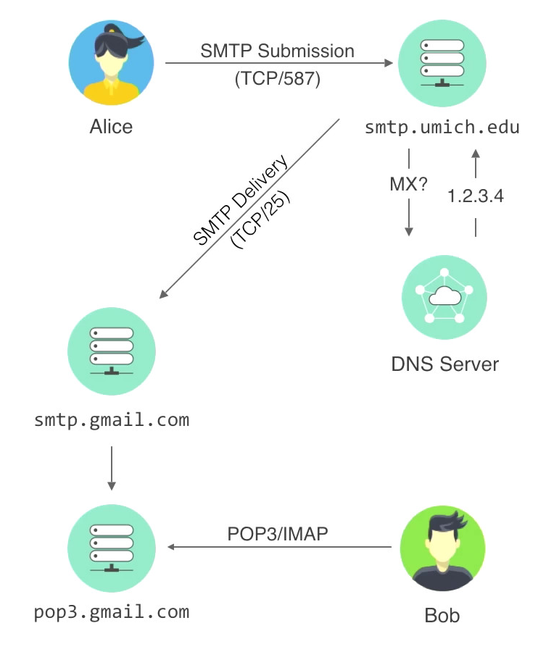
SMTP (Simple Mail Transfer Protocol)
SMTP is the Internet standard for sending and relaying email.

Slide 4

SMTP Security
The original SMTP (RFC 821) had no built-in security at all.
There have been several security extensions over the years:
Confidentiality (encrypt email in transit)
1
STARTTLS
Authenticate email on receipt
1
DKIM (Domain Keys Identified Mail)
2
SPF (Sender Policy Framework)
3
DMARC (Domain-based Message Authentication, Reporting + Conformance)
Deployment is voluntary and (usually) invisible to end users!

Slide 5
Two Empirical Datasets
16 months of gmail inbound/outbound messages
  Longitudinal view: January 2014 to April 2015
  Used Google’s “Transparency Report” for message stats
  Also: analysis of ciphers negotiated with SMTP servers
Mail servers from the top 1 million Alexa domains
  Snapshot view: current state as of April 2015
  Performed MX lookups in DNS for popular domains
  For domains with mail servers (79%), a DNS query was used to identify security extensions supported (if any)
  Attempted SMTP/STARTTLS handshake using Zmap

Slide 6
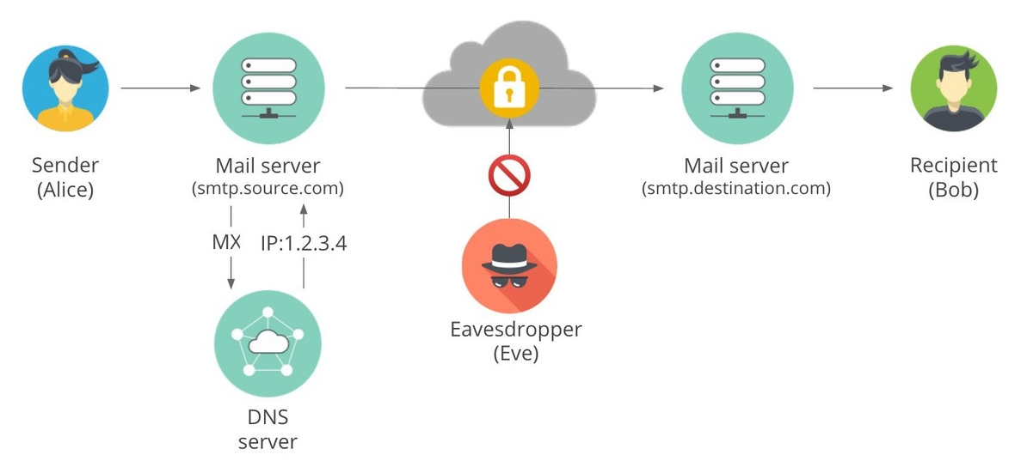
STARTTLS: TLS for SMTP
Allows TLS session to be started during an SMTP connection
Mail is transferred over an encrypted session
Protection against passive eavesdroppers

Slide 7
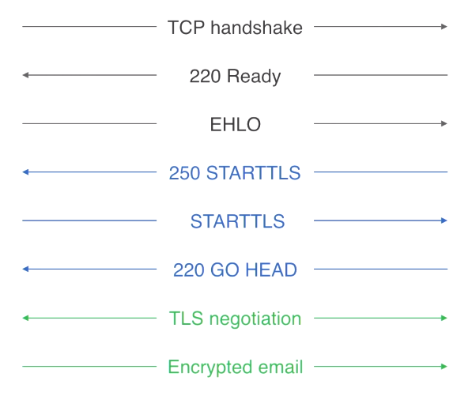
STARTTLS: TLS for SMTP
Source mail server
Destination mail server

Slide 8
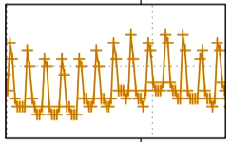
Empirical Measurements of STARTTLS
Based on the volume of messages protected by STARTTLS
As of April 26, 2015
 | STARTTLS Initiation | Increase from January 2014
Outgoing messages | 80% | 54%
Incoming messages | 60% | 82%
Poodle vulnerability
Yahoo and Hotmail deploying STARTTLS
Weekends 10% more than weekdays

Slide 9
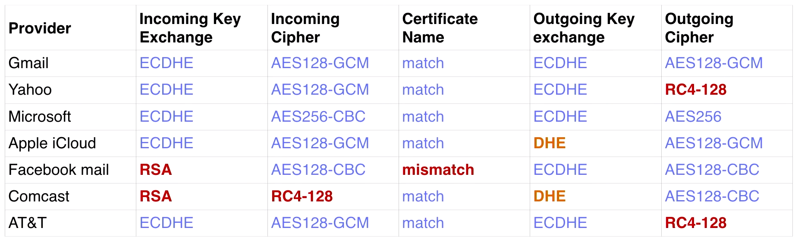
Cipher Suite Analysis
Findings:
80% of outbound connections are protected by TLS
About half of all incoming connections chose a strong cipher suite
About 45% of clients use RC4 despite its known weaknesses

Slide 10

Security Threats
STARTTLS provides protection against passive eavesdroppers, but not against active attackers who can tamper with packets
STARTTLS is designed to “fail open” rather than “fail closed” (i.e., defaults to plain text if TLS negotiation fails)
An active attacker can manipulate the packets containing STARTTLS to prevent servers from establishing a secure channel!
TCP handshake
Client
Server
220 Ready
EHLO
XXXX
Plain text

Slide 11
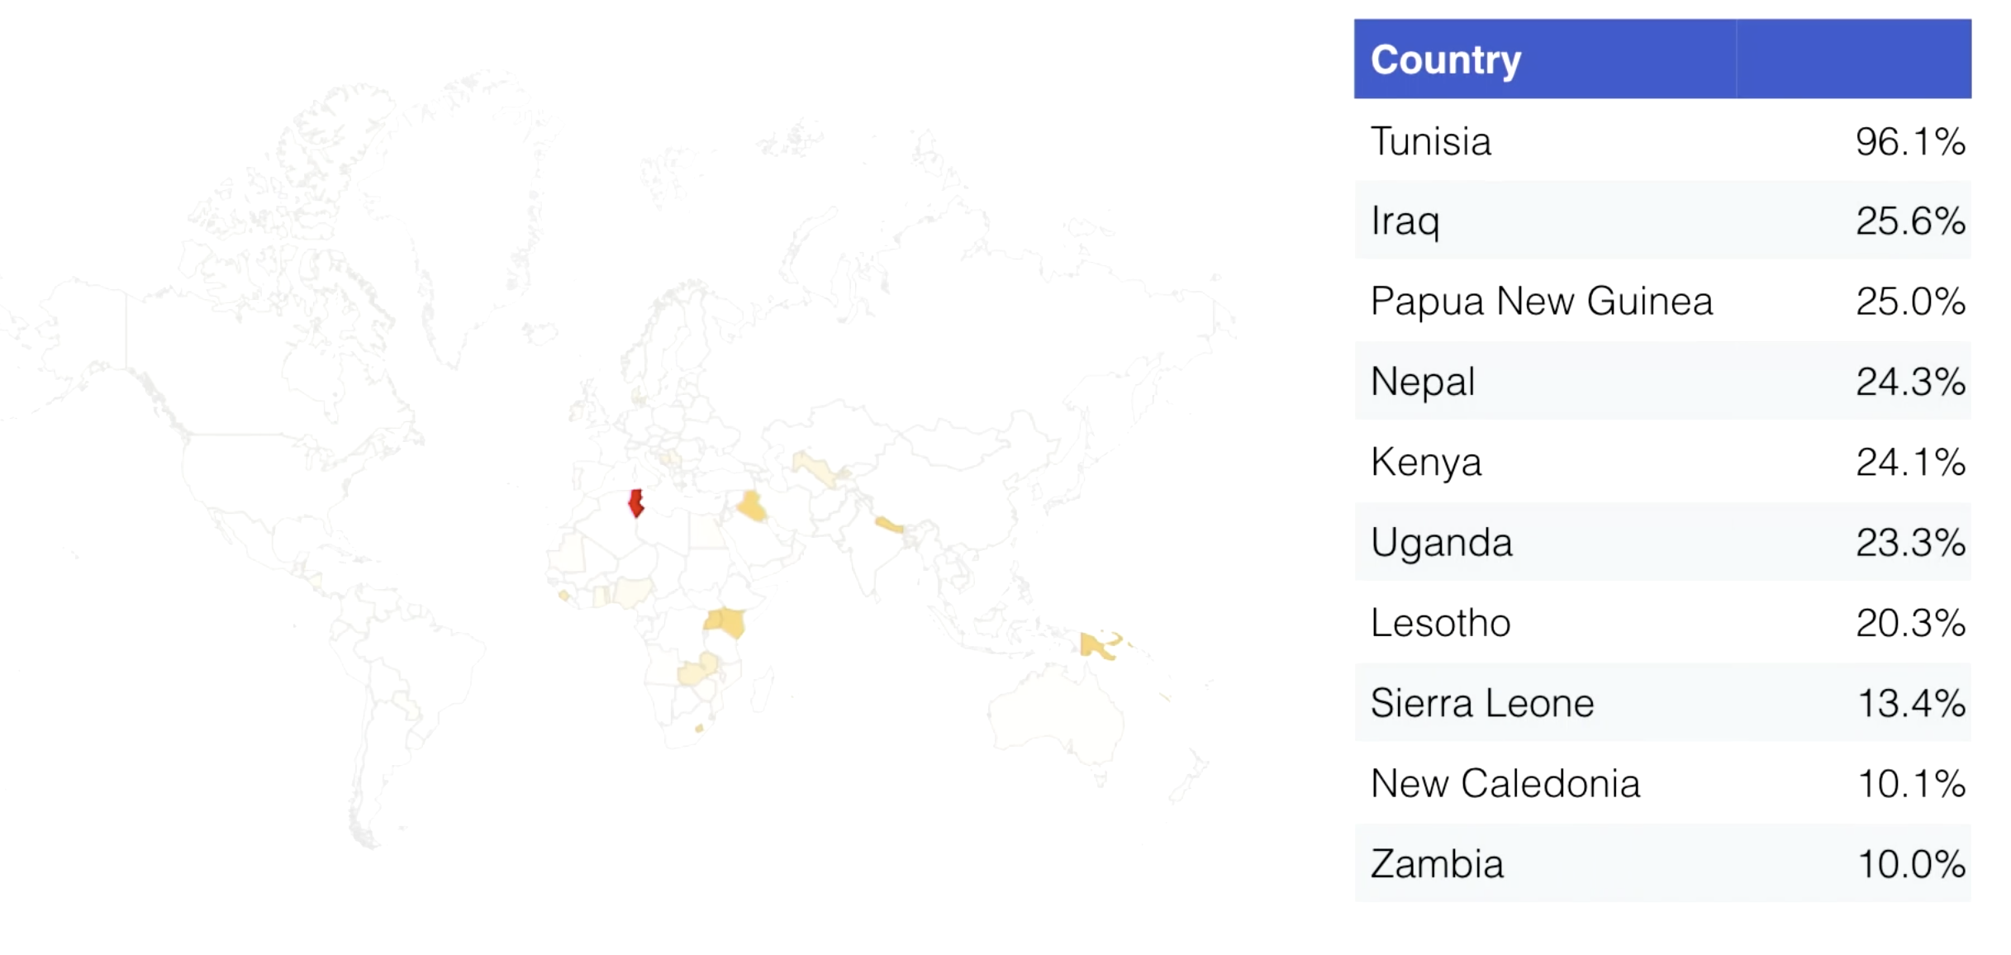
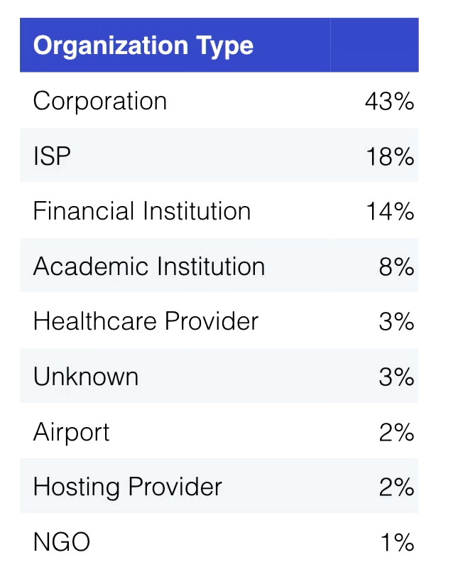
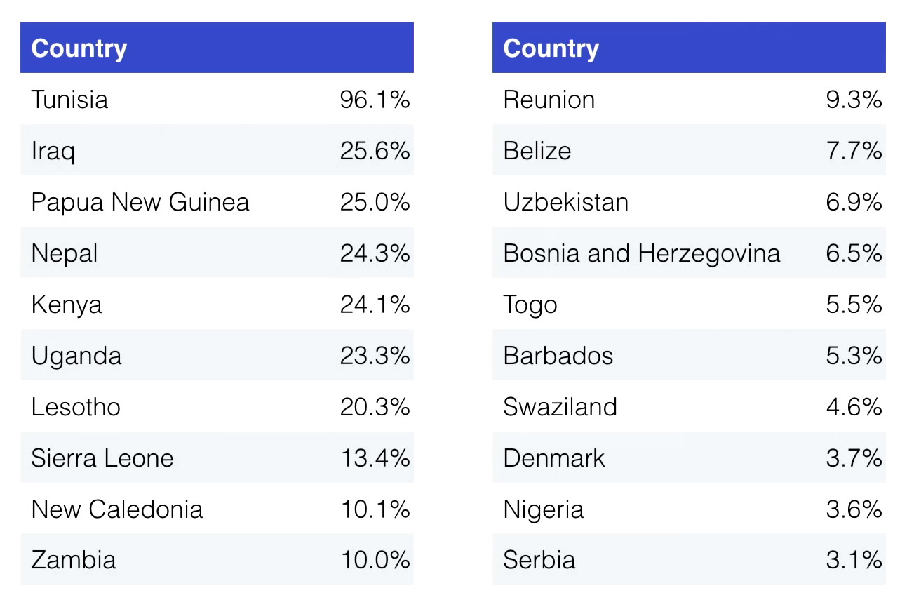
Geographical Analysis of Active Attacks
Cisco exploits this feature to detect spammers and prevent attacks.
Downfall: Every email from your country will be in plain text!

Slide 12

Authentication
When we receive a message, we want to see if it is sent from someone authorized in the source domain.
Detecting spams
Allows a domain to put a DNS TXT record that lists the IP addresses of their legitimate mail servers
Example: <spf-mail.example.com> “v=sfp1 ip4:64.18.0.0/20 -all”
SPF (Sender Policy Framework)

Slide 13
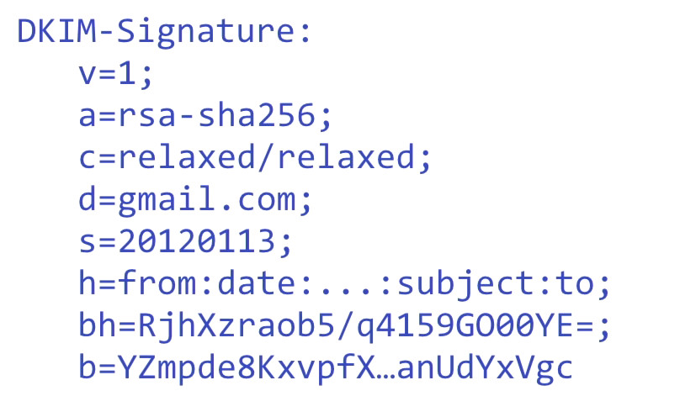
DKIM
DKIM (Domain Keys Identified Mail )
The sender publishes its public key in a DNS record
Sender attaches cryptographic signature in a message’s header
Recipient checks the signature, using the public key p
Signing domain
Body hash
Digital signature of the content

Slide 14
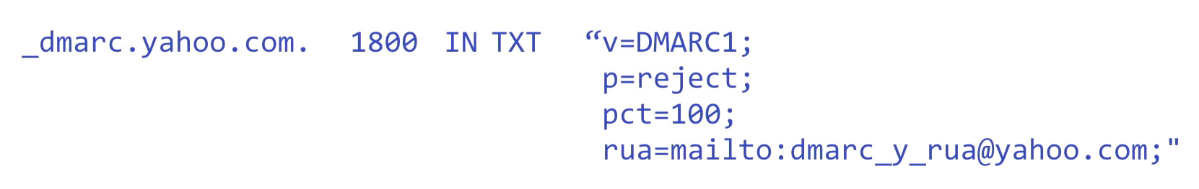
DMARC
DMARC: Domain-based Message Authentication, Reporting, and Conformance
Builds upon DKIM and SPF
Allows a sender to publishes a mail policy in a DNS record.
Recipient checks for the sender’s policy

Slide 15
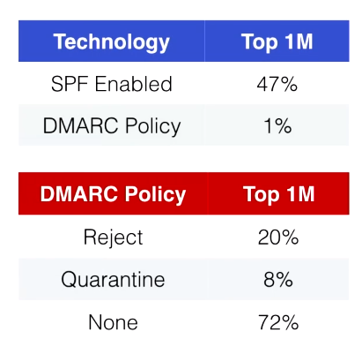
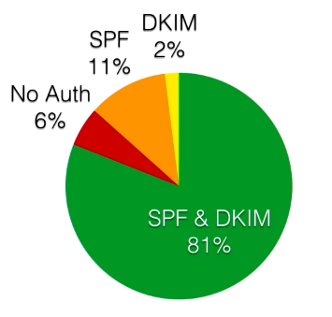
Empirical Measurements
Delivered Gmail Messages
Top Million Domains
April 2015

Slide 16
Conclusions
SMTP by itself is NOT secure
Mail community has started to deploy new security extensions, but progress is slow for small organizations
STARTTLS is not a long-term solution, since active attacks are prevalent and potentially very serious

