Slide 1
Autoscaling Effects in Speed Scaling Systems
CORS 2016
Carey Williamson
Department of Computer Science
(joint work with Maryam Elahi and Philipp Woelfel)

Slide 2
Introduction
Dynamic CPU speed scaling systems
Service rate adjusted based on offered load
Classic tradeoff:
Faster speed → lower response time, higher energy usage
Two key design choices:
Speed scaler: how fast to run? (static, coupled, decoupled)
Scheduler: which job to run? (FCFS, PS, FSP, SRPT, LRPT)
Research questions:
What are the “autoscaling” properties of coupled (i.e., job-count based) speed scaling systems under heavy load?
In what ways are PS and SRPT similar or different?

Slide 3
Related Work
[Albers 2010] “Energy-Efficient Algorthms”, CACM
[Andrew et al. 2010] “Optimality, Fairness, and Robustness in Speed Scaling Designs”, ACM SIGMETRICS
[Bansal et al. 2007] “Speed Scaling to Manage Energy and Temperature”, JACM
[Elahi et al. 2012] “Decoupled Speed Scaling”, QEST, PEVA
[Wierman et al. 2009] “Power-Aware Speed Scaling in Processor Sharing Systems”, IEEE INFOCOM, PEVA 2012
[Weiser et al. 1994] “Scheduling for Reduced CPU Energy”, USENIX OSDI
[Yao et al. 1995] “A Scheduling Model for Reduced CPU Engergy”, ACM FOCS

Slide 4
System Model (1 of 4)
Review: Birth-death Markov chain model of classic M/M/1 queue
Fixed arrival rate λ
Fixed service rate μ
λ
λ
λ
λ
λ
…
0
1
2
3
4
μ
μ
μ
μ
μ
Mean system occupancy: N = ρ / (1 – ρ)
Ergodicity requirement: ρ = λ/μ < 1
p_{n} = p₀ (λ/μ)^{n}
U = 1 – p₀ = ρ

Slide 5
System Model (2 of 4)
Birth-death Markov chain model of classic M/M/∞ queue
Fixed arrival rate λ
Service rate scales linearly with system occupancy (α = 1)
λ
λ
λ
λ
λ
…
0
1
2
3
4
μ
2μ
3μ
4μ
5μ
Mean system occupancy: N = ρ = λ/μ
System occupancy has Poisson distribution
Ergodicity requirement: ρ = λ/μ < ∞
n-1
p_{n} = p₀ ∏ (λ/(i+1)μ)
i=0
U = 1 – p₀ ≠ ρ
FCFS = PS ≠ SRPT

Slide 6
System Model (3 of 4)
Birth-death Markov chain model of dynamic speed scaling system
Fixed arrival rate λ
Service rate scales sub-linearly with system occupancy (α = 2)
λ
λ
λ
λ
λ
…
0
1
2
3
4
μ
√
2μ
√
3μ
√
4μ
√
5μ
n-1
√
Mean system occupancy: N = ρ² = (λ/μ)²
System occupancy has higher variance than Poisson distribution
Ergodicity requirement: ρ = λ/μ < ∞
p_{n} = p₀ ∏ (λ/( i+1)μ)
i=0

Slide 7
System Model (4 of 4)
Birth-death Markov chain model of dynamic speed scaling system
Fixed arrival rate λ
Service rate scales sub-linearly with system occupancy (α > 1)
λ
λ
λ
λ
λ
…
0
1
2
3
4
α
α
α
α
μ
√
2μ
√
3μ
√
4μ
√
5μ
n-1
α
√
Mean system occupancy: N = ρ^{α} = (λ/μ)^{α}
System occupancy has higher variance than Poisson distribution
Ergodicity requirement: ρ = λ/μ < ∞
p_{n} = p₀ ∏ (λ/( i+1)μ)
i=0

Slide 8
Analytical Insights and Observations
In speed scaling systems, ρ and U differ
Speed scaling systems stabilize even when ρ > 1
In stable speed scaling systems, s = ρ (an invariant)
PS is amenable to analysis; SRPT is not
PS with linear speed scaling behaves like M/M/∞, which has Poisson distribution for system occupancy
Increasing α changes the Poisson structure of PS
At high load, N → ρ^{α} (another invariant property)

Slide 9
PS Modeling Results

Slide 10
SRPT Simulation Results

Slide 11
Comparing PS and SRPT
Similarities:
Mean system speed (invariant property)
Mean system occupancy (invariant property)
Effect of α (i.e., the shift, the squish, and the squeeze)
Differences:
Variance of system occupancy (SRPT is lower)
Mean response time (SRPT is lower)
Variance of response time (SRPT is higher)
PS is always fair; SRPT is unfair (esp. with speed scaling!)
Compensation effect in PS
Procrastination/starvation effect in SRPT

Slide 12
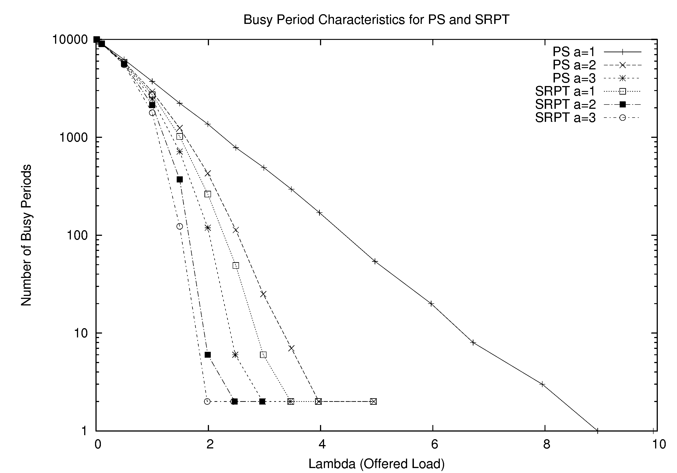
Busy Period Structure for PS and SRPT (simulation)

Slide 13
Simulation Insights and Observations
Under heavy load, busy periods coalesce and U → 1
Saturation points for PS and SRPT are different
Different “overload regimes” for PS and SRPT
Gap always exists between them
Gap shrinks as α increases
Limiting case (α = ∞) requires ρ < 1 (i.e., fixed rate)
SRPT suffers from starvation under very high load
“Job count” stability and “work” stability differ

Slide 14
Conclusions
The autoscaling properties of dynamic speed scaling systems are many, varied, and interesting!
Autoscaling effect: stable even at very high offered load (s = ρ)
Saturation effect: U → 1 at heavy load, with N → ρ^{α}
The α effect: the shift, the squish, and the squeeze
Invariant properties are helpful for analysis
Differences exist between PS and SRPT
Variance of system occupancy; mean/variance of response time
Saturation points for PS and SRPT are different
SRPT suffers from starvation under very high load
Our results suggest that PS becomes superior to SRPT for coupled speed scaling, if the load is high enough

