Slide 1

CPSC 641:
Performance Issues in
High Speed Networks
Carey Williamson
Department of Computer Science
University of Calgary

Slide 2
Agenda
Welcome!
Course Overview
Administrative Details
Expectations
Q&A
Today’s Lecture Material:
  Network Performance Issues
  Networking Terminology Review
  Examples: U of C Networking Research

Slide 3
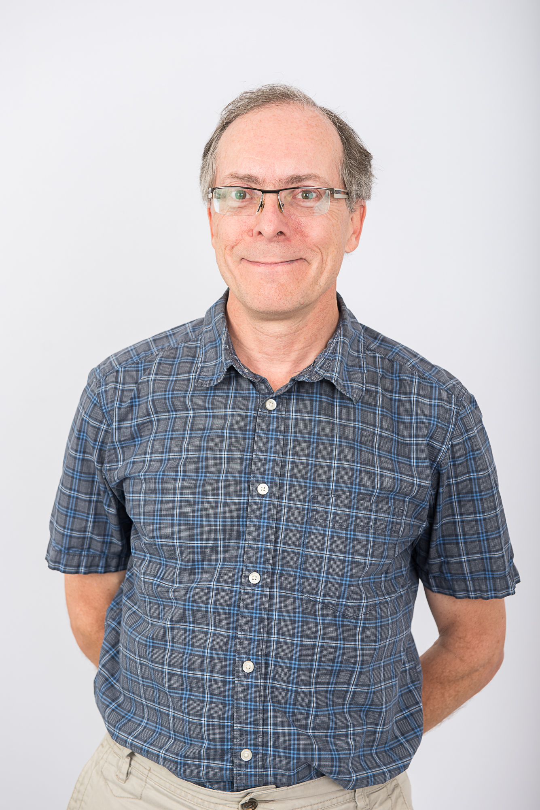
Overview
CPSC 641
  Performance Issues in High Speed Networks
Introductory-level graduate course on the basic methods and current topics in networking research
Professor:
  Carey Williamson
  http://www.cpsc.ucalgary.ca/~carey
Course Web site:
  http://www.cpsc.ucalgary.ca/~carey/CPSC641

Slide 4

Motivation
“Opening a highway does not by itself
drastically change the speed of the bicycles”
- Ancient Proverb

Slide 5
High Speed Networks: A Layered View
Application Designers
Web, Video, P2P, Email
Linux, Mac OS, Windows
PC, Intel, Grid, NAS
TCP, UDP, IP, IPv6
LAN Adapters, NICs
GigE, ATM, WiFi, MPLS
Fiber, SONET, LTE, OFDM
OS Architects
CPU, Memory,Disk
Protocol Architects
LAN Interfaces
Media Access
Physical Devices

Slide 6
Layering Considered Harmful?
Faster media does not necessarily imply faster network applications
New environments, platforms, applications
Interdependence between layers
Interactions between protocols
Need to consider trends of all layers!

Slide 7
CPSC 641: Course Overview
Main focus: Internet technologies, protocols, and applications
Secondary focus: Performance issues
Textbook: None (notes+current literature)
Goal: Understanding the current state of the art for high speed networking research and network performance issues

Slide 8
Contact Information
Professor: Carey Williamson
Email: carey@cpsc.ucalgary.ca
Office: ICT 736
Office hours: Mon 1:00pm-3:00pm
Phone: (403) 220-6780
Web site: http://www.cpsc.ucalgary/~carey
CPSC 641 Web site for info, slides, assignments: http://www.cpsc.ucalgary.ca/~carey/CPSC641

