Slide 1

Understanding and Exploiting Amazon EC2 Spot Instances
Carey Williamson
Department of Computer Science
University of Calgary

Slide 2
Introduction and Motivation
Within Amazon’s Elastic Compute Cloud (EC2) offerings, clients have a choice between services:
  On-demand instances: reserve for given price and duration
  Spot instances: cheaper price; unpredictable duration
Challenges:
  Spot instance prices fluctuate a lot!
  Duration of instance availability unknown
  Bid failures and revocations adversely impact QoS
  How to “optimize” cost and performance in EC2 markets?

Slide 3
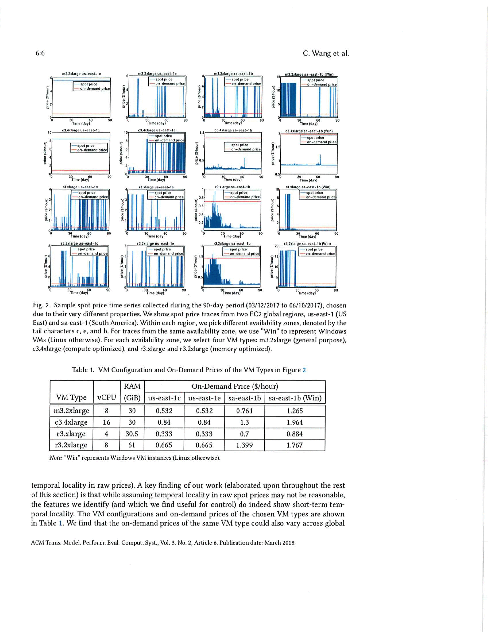
Example: On-Demand Prices in Amazon EC2

Slide 4
An Example of Spot Instance Dynamics

Slide 5
More Examples of Spot Instance Dynamics

Slide 6
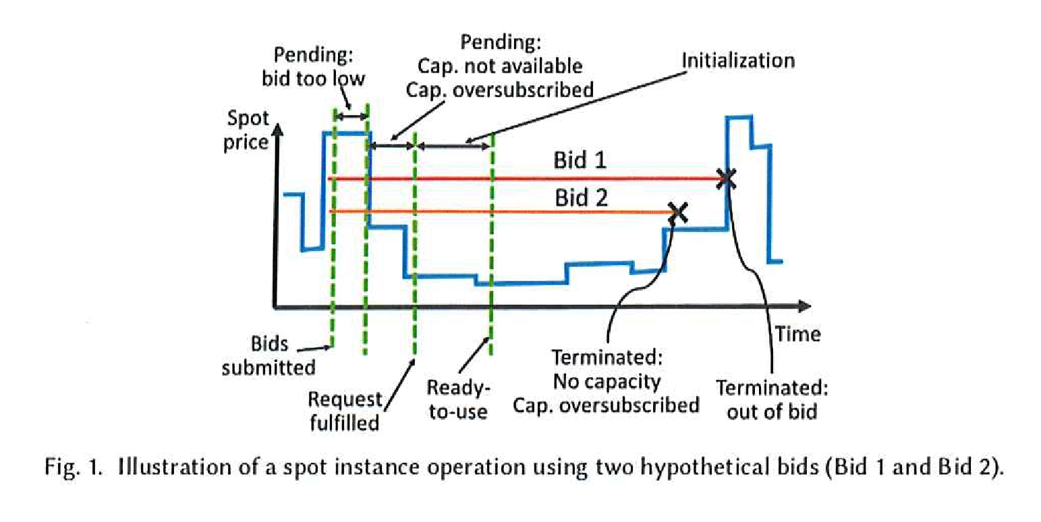
Spot Instance Terminology

Slide 7
This Paper
Research Questions:
  After bidding, how long does it take to get an instance?
  What is the expected lifetime of an instance?
  What is the average cost incurred for an instance?
  What is the probability of instance revocations?
  How can spot instance features be exploited to devise efficient and cost-effective procurement algorithms?
Two main contributions:
  Empirical study of Amazon EC2 instances (2015 and 2017)
  Two case studies to evaluate effectiveness of models
C. Wang, Q. Liang, and B. Urgaonkar, “An Empirical Analysis of Amazon EC2 Spot Instance
Features Affecting Cost-Effective Resource Procurement”, ACM ToMPECS, Vol. 3, No. 2,
Article 6, pp. 1-24, March 2018. (Extended journal version of earlier ICPE 2017 paper)

Slide 8
Empirical Analysis (preview)
Feature 1: Lifetime of spot instances
  Exhibits sufficient temporal dependence for prediction
Feature 2: Average cost during lifetime
  Exhibits sufficient temporal dependence for prediction
Feature 3: Simultaneous revocations
  Some spatial dependence; weaker temporal dependence
Feature 4: Time to start a spot instance
  No obvious structural properties that can be exploited

Slide 9
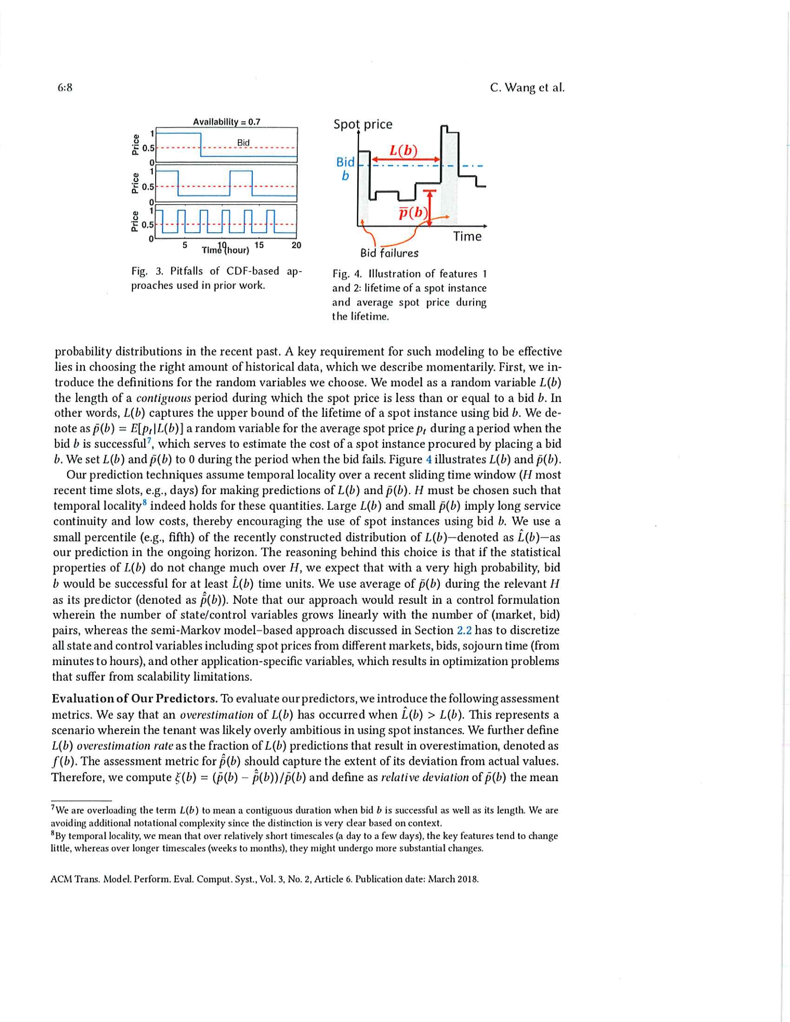
Figure 3
Simple CDF-based approaches from the literature are not sufficient for this problem , since they do not distinguish the following three (synthetic) scenarios
Need to explicitly consider “lifetimes” of instances

Slide 10
Figure 4
Illustration of “lifetime” for a successful bid
Illustration of “average cost” for a successful bid

Slide 11
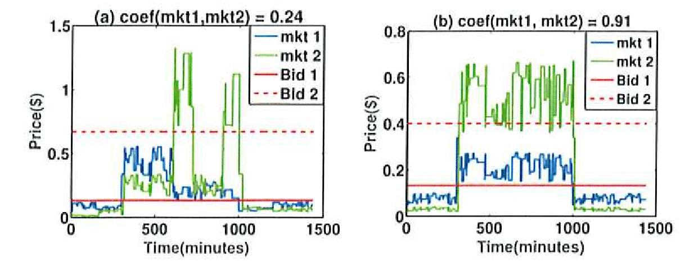
Figure 5
Some markets may be strongly correlated (right), while others may only be weakly correlated (left)
Correlated markets might have correlated bid failures (i.e., multiple spot instances revoked at similar time)
Results are conditional upon bid values though!

Slide 12
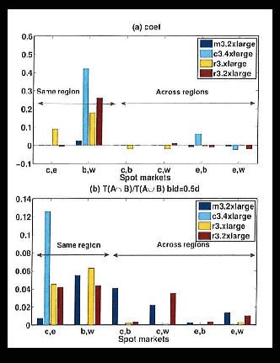
Figure 6
Empirical correlation results
Observations:
  Stronger spatial relationship
  within regions than across
  Detected by both metrics
  Proposed approach detects
  some spatial corr across regions
  Weak spatial correlation
  observed for instance types

Slide 13
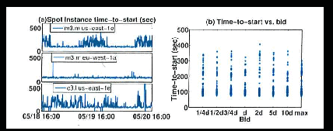
Figure 7
Some temporal correlation in start up times
No obvious correlation structure based on bids

Slide 14
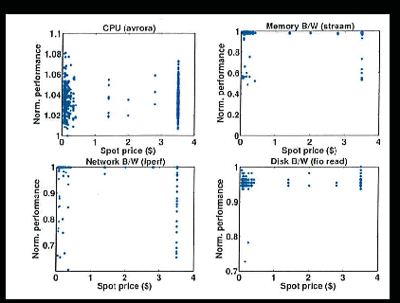
Figure 8
Empirical measurements of “effective capacity”
Relatively small variation for any of the metrics

Slide 15
Empirical Analysis (review)
Feature 1: Lifetime of spot instances
  Exhibits sufficient temporal dependence for prediction
  Using 7-14 days of recent past history gives best results
Feature 2: Average cost during lifetime
  Exhibits sufficient temporal dependence for prediction
  Using 7-14 days of recent past history gives best results
Feature 3: Simultaneous revocations
  Some spatial dependence; weaker temporal dependence
  Suggests splitting jobs across regions and instance types
Feature 4: Time to start a spot instance
  No obvious structural properties that can be exploited

Slide 16
Case Studies (preview)
Application 1: Latency-sensitive data processing
  In-memory key-value store (memcached)
Application 2: Delay-tolerant batch computing
  Primary spot instances with backup on-demand instances
For each application, two types of evaluation:
  Trace-driven simulation (90 days of spot instance pricing)
  System prototyping (24-hour EC2 expt, real-time control)

Slide 17
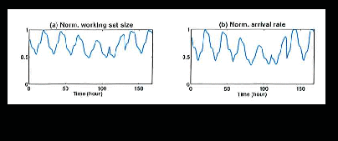
Figure 9
Wikipedia workload characteristics
Clear diurnal patterns
Time-varying working set size

Slide 18
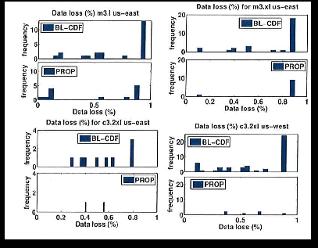
Figure 10
Trace-driven simulation evaluation of approaches
Data loss performance for Application 1

Slide 19
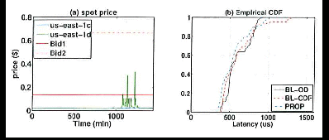
Figure 11
Experimental evaluation/comparison of approaches
Application 1: memcached

Slide 20
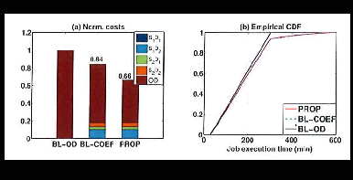
Figure 12
Trace-driven simulation evaluation of approaches
Application 2: batch computing

Slide 21
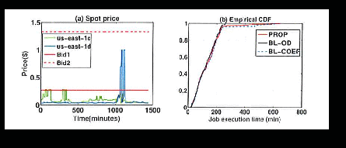
Figure 13
Experimental evaluation/comparison of approaches
Application 2: batch computing

Slide 22
Case Studies (review)
Application 1: Latency-sensitive data processing
  In-memory key-value store (memcached)
  Comparable cost but much better performance
Application 2: Delay-tolerant batch computing
  Primary spot instances with backup on-demand instances
  Comparable performance with 18% lower costs
For each application, two types of evaluation:
  Trace-driven simulation (90 days of spot instance pricing)
  System prototyping (24-hour EC2 expt, real-time control)

Slide 23
Summary and Conclusions
There are four key features of Amazon EC2 instances that need to be considered (i.e., spot instance lifetime; average price during lifetime; simultaneous revocations; time to start)
Temporal and spatial dependence in some features can be exploited to improve predictions
Need to consider impacts of (simultaneous) revocations
Need to condition results based on bid price
Two real-world case studies demonstrate the effectiveness of the proposed approach in practice
  Can save 20-70% on costs versus on-demand instances
  Can provide flexible tradeoffs between cost and performance

