Slide 1
Peer-assisted On-demand Streaming of Stored Media using BitTorrent-like Protocols
Authors:
Niklas Carlsson & Derek L. Eager
Published in:
Proc. IFIP/TC6 Networking ’07, Atlanta, GA, May 2007
Presenter:
Md. Tauhiduzzaman
M.Sc. Student, University of Calgary

Slide 2
Outline
Goals of the paper
Previous works
Overview on BitTorrent
On-demand streaming in BitTorrent-like systems
Proposed technique
Simulation
Summary
Acknowledgement

Slide 3
Goal
Simple and flexible BitTorrent-like approach ensuring
On-demand delivery of stored media
“Streaming” delivery

Slide 4
Previous works Live Streaming (e.g. CoolStreaming)
Internet
Does not accept pieces outside the window
Playback buffer
Sliding window
Problems
All peers are roughly at the same playback position
Sliding window constraint

Slide 5
Previous works Sub-files (e.g. Annapureddy et al.))
Statistically split files into sub-files
Download sub-files near-sequentially in BitTorrent fashion
Use pre-fetching and network coding
Start playback after the first sub-file is downloaded
Large sub-file: large start-up delay
Small sub-file: Sequential download
How to dynamically adjust file size?
When is the safe playback start time?
Notes:
This paper proposes a similar technique that allows the peers to download any piece it need if it is available

Slide 6
BitTorrent Download
Peer-to-Peer Delivery
Use BitTorrent-like system
File split into many smaller pieces
Pieces are downloaded whenever available from both
Seeds: having the entire file
Leechers: other peers currently downloading the same file
Mesh-based approach
Tit-for-tat incentive mechanism
Notes:
More dynamic than tree-based, Connections may be heterogeneous, Better able to support high peer churn

Slide 7
BitTorrent Download
…
…
Peer 1 (leecher):
1
2
3
k
K
Peer 2 (seed):
…
…
1
2
3
k
K
…
…
Peer N (leecher):
1
2
3
k
K
Pieces in neighbor set:
(1)
(2)
(1)
(2)
(2)
(3)
(2)
…
…
1
2
3
k
K
Rarest-first download policy
Request for the rarest piece in the neighbourhood
Ensures high piece diversity

Slide 8
On-demand Streaming in BitTorrent-like Systems
Trade-off
Piece-diversity
Downloading rarest piece first
In-order download
Ensure “streaming”
Proposed streaming protocol
Efficient piece selection policy
Start-up rule to decide on safe playback start time

Slide 9
Piece Selection Policy Candidate Policies
Basic policies
Rarest
Request piece that is the rarest in the neighborhood
In-order
Request pieces sequentially
Probabilistic
Portion(p)
Pieces with probability p downloaded in-order
(1-p) rarest
Probability distribution
Used to bias towards selection of earlier pieces
Zipsf distribution works well for on-demand streaming

Slide 10
Start-up rule
Start playback after a minimum amount of pieces are received
High possibility for playback interruption
Maintain in-order buffer

Slide 11
Start-up rule
The total amount of data received
The amount of in-order
data received
data
x
T
time
In-order buffer
Contains pieces up to the first missing piece
The rate (d_{seq}) of increasing in-order buffer size is expected to increase with time
Wait for at least b pieces to be downloaded sequentially
May cause bad playback at later time
Estimate optimum d_{seq} using long term average (LTA)

Slide 12
Start-up rule
The total amount of data received
The amount of in-order
data received
data
Required amount of in-order data, if received at constant rate
x
The amount of data played out if
playback starts at time T
T
time
In-order buffer
Contains pieces up to the first missing piece
The rate (d_{seq}) of increasing in-order buffer size is expected to increase with time
Wait for at least b pieces to be downloaded sequentially
May cause bad playback at later time
Estimate optimum d_{seq} using long term average (LTA)

Slide 13
Simulation
Single seed, multiple leechers
Connection bottlenecks locate at the end points
Max-min fair share of bandwidth (TCP)
Scenarios:
Steady state
Early departure
Exponentially decaying arrival rate
Client heterogeneity

Slide 14
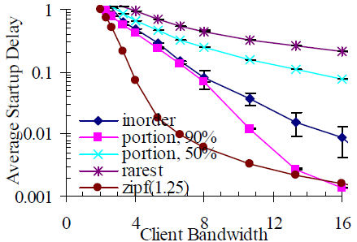
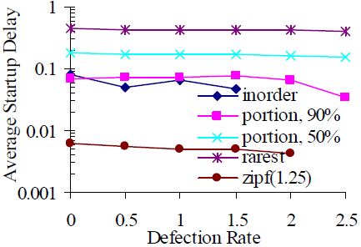
Scenario Results
Steady state scenario
Early departure scenario

Slide 15
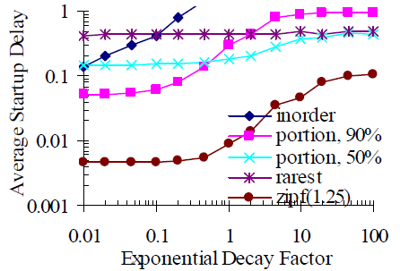
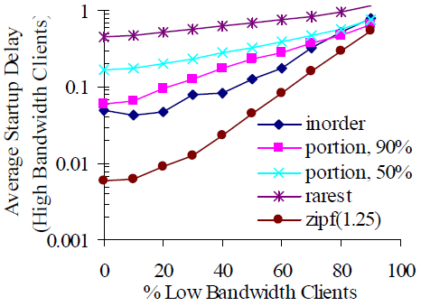
Scenario Results
Exponentially decaying scenario
Client heterogeneity scenario

Slide 16
Start-up rule implementation results
The technique using rate condition adjusts start-up delay base on network conditions.
Number of late piece information is lower
Notes:
All scenarios have been implemented. All of them provide evidence of proper adjustment of LTA with network conditions

Slide 17
Comments
The piece selection policy
Efficient, but did not find out the optimum value of the Zipf distribution parameter
Start-up rule
Works fine for VoD
Not efficient for live streaming where there is time constraints

Slide 18
Summary
Piece selection
Trade-off
Piece diversity
In-order requirement
Probabilistic approach using Zipf distribution to select pieces provides the best performance
Start-up rule
Determines safe commencing time of playback
No significant chance of playback interruption
Promising approaches
Start playback after a minimum number of pieces downloaded
Determine optimum in-order buffer occupancy rate using LTA

Slide 19
Acknowledgement
4 slides taken from the author’s presentation slides
Authors’ slides provided by Niklas Carlsson, Postdoctoral Research Associate, University of Calgary

Slide 20
Questions
???

