Slide 1
An Energy Efficient Hierarchical Clustering Algorithm for Wireless Sensor Networks
Seema Bandyopadhyay and Edward J. Coyle
Prepared by
Mohamed Elsersy
March 2010

Slide 2
About the paper
Appeared in INFOCOM 2003
11 pages
30 references
Cited by 673 papers

Slide 3
Topic classification
WSN
Deployment
Routing
Flat
Network Type
Issues
Algorithms
Location-based
Hierarchical
Sensing
Decision
Making

Slide 4
Paper Structure
EEHCA paper
Introduction
Related Work
Algorithm
Single-level Clustering Alg.
Optimal parameters
Simulation Results
Hierarchical clustering Alg.
CH Probability
Maximum hops
Algorithm
Optimal parameters
Numeric Results
Additional Consideration
Conclusion & Future Work
CH Probability
Maximum hops

Slide 5
Related Work
LCA
LCA2
WCA
DCA
DMAC
LEACH
non-purely hierarchical models

Slide 6
Assumptions (1/2)
a) The sensors are distributed as per a homogeneous spatial Poisson process of intensity λ in 2-D space.
b) All sensors transmit at the same power level so have the same radio ranger.
c)Data exchanged between two communicating sensors not within each others’ radio range is forwarded by other sensors.

Slide 7
Assumptions (2/2)
d) A distance of d between any sensor and its cluster head is equivalent to d / r hops.
e) Each sensor uses one unit of energy to transmit or receive one unit of data.
f) A routing infrastructure is in place;
so, only the sensors on the routing path forward the data.
g) The communication environment is contention- and error-free. (No retransmit)

Slide 8
Single-level Clustering Algorithm
Each sensor becomes a cluster-head (CH) with probability p and advertises itself as a CH to the sensors within its radio range.
The advertisement is forwarded to all the sensors that are no more than k hops away from CH. Any sensor that receives such advertisements and is not itself a CH joins the cluster of the closest CH.
Any sensor that is neither a CH nor has joined any cluster itself becomes a CH.

Slide 9
Optimal parameters

Slide 10
Results (1/4)

Slide 11
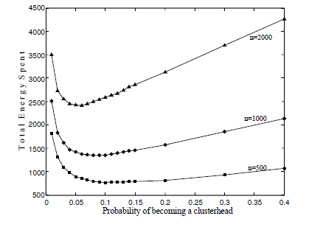
Results (2/4)

Slide 12
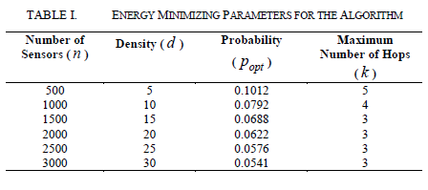
Results (3/4)

Slide 13
Results (4/4)

Slide 14
Hierarchical Clustering Alg. (1/2)
Each sensor decides to become a level-1 CH with p₁ and advertises itself as a CH to the sensors within its radio range.
This advertisement is forwarded to all the sensors within k₁ hops of the advertising. Each sensor that receives an advertisement joins the cluster of the closest level-1 CH; the remaining sensors become forced level-1 CHs.

Slide 15
Hierarchical Clustering Alg. (2/2)
Level-1 CHs then elect themselves as level-2 CHs with a certain probability p₂ and broadcast their decision of becoming a level-2 CH. This decision is forwarded to all the sensors within k₂ hops.
The level-1 CHs that receive the advertisements from level-2 CHs joins the cluster of the closest level-2 CH. All other level-1 CHs become forced level-2 CHs.
CH at level 3,4,…,h are chosen in similar fashion, with probabilities p₃, p₄,…, p_{h} respectively

Slide 16
Optimal parameters

Slide 17
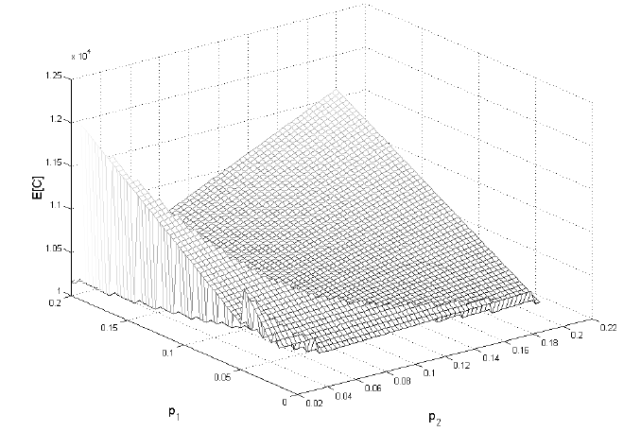
Results (1/4)

Slide 18
Results (2/4)

Slide 19
Results (3/4)

Slide 20
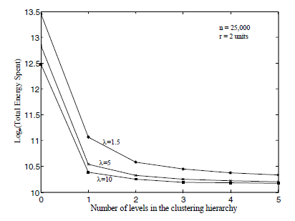
Results (4/4)

Slide 21
Q&A

Slide 22
Conclusion (1/2)
A distributed algorithm proposed for organizing sensors into a hierarchy of clusters.
Objective is minimizing the total energy spent in the system to communicate the information gathered by these sensors to the information-processing center.
The optimal parameter values found for these algorithms that minimize the energy spent in the network.

Slide 23
Conclusion (2/2)
Assumed that the communication environment is contention and error free.
In a contention-free environment, the algorithm has a time complexity of O(k₁ + k₂ + ... + k_{h} ), a significant improvement over the many O(n) clustering algorithms in the literature.
The algorithm is suitable for networks of large number of nodes.

Slide 24
Future Work
Consider an underlying medium access protocol and investigate how that would affect the optimal probabilities of becoming a CH and the run-time of the algorithm.

Slide 25
Thank You
WSN
Deployment
Routing
Flat
Network Type
Issues
Algorithms
Location-based
Hierarchical
Sensing
Decision
Making

