Slide 1

CPSC 531:
System Modeling and Simulation
Carey Williamson
Department of Computer Science
University of Calgary
Fall 2017

Slide 2
Recap and Terminology
(Pseudo-) Random Number Generation (RNG)
A fundamental primitive required for simulations
Goal: Uniform(0,1)
Uniformity
Independence
Computational efficiency
Long period
Multiple streams
Common approach: LCG
Careful design and seeding
Never generates 0.0 or 1.0
Covered in guest lecture (JH)
Readings: 2.1, 2.2
Random Variate Generation (RVG)
Builds upon Uniform(0,1)
Goal: any distribution
Discrete distributions
Continuous distributions
Independence (usually)
Correlation (if desired)
Computational efficiency
Common approach: the inverse transform method
Straightforward math (usually)
Might generate 0.0 or 1.0
Covered in today’s lecture
Readings: 6.1, 6.2

Slide 3
Outline
Random variate generation
  Inverse transform method
  Convolution method
  Empirical distribution
  Other techniques

Slide 4
Discrete-Event Simulation
Input parameters such as inter-arrival times and service times are often modeled by random variables with some given distributions
A mechanism is needed to generate variates for a wide class of distributions
  This can be done using a sequence of random numbers that are independent of each other and are uniformly distributed between 0 and 1

Slide 5
Uniform Random Numbers
Uniformly distributed between 0 and 1
  Consider a sequence of random numbers u₁,u₂,…,u_{N}
  Uniformity: expected number of random numbers in each sub-interval is N/n
  Independence: value of each random number is not affected by any other numbers
n equal
sub-intervals
• • •
0
1

Slide 6
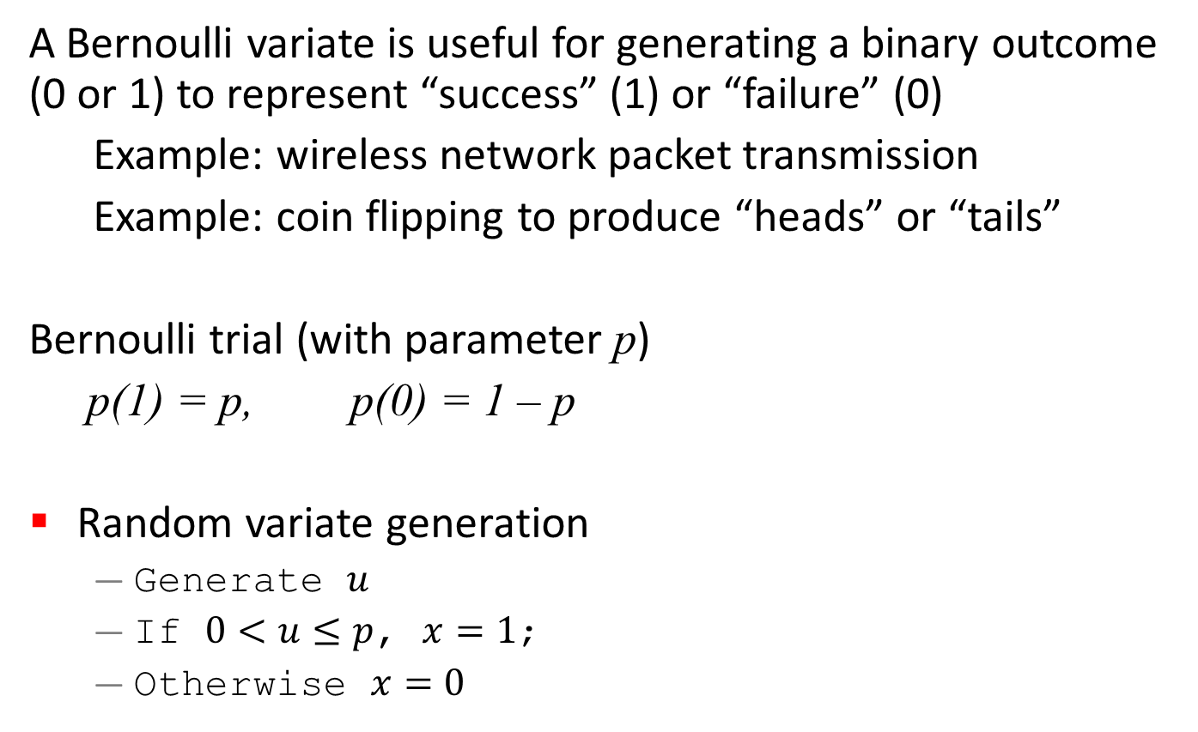
Bernoulli Variate
A Bernoulli variate is useful for generating a binary outcome (0 or 1) to represent “success” (1) or “failure” (0)
Example: wireless network packet transmission
Example: coin flipping to produce “heads” or “tails”
Bernoulli trial (with parameter p)
p(1) = p, p(0) = 1 – p
Random variate generation
  Generate $u$
  If $0<u≤p$, $x=1$;
  Otherwise $x=0$

Slide 7
Inverse Transformation Method:
Discrete Distributions
Consider a tri-modal discrete distribution
  Example: size of an email message (in paragraphs, or KB)
  Example: p(1) = 0.5, p(2) = 0.3, p(3) = 0.2
Cumulative distribution function, F(x)
1.0
0.8
F(x)
0.5
0
1
2
3
x

Slide 8
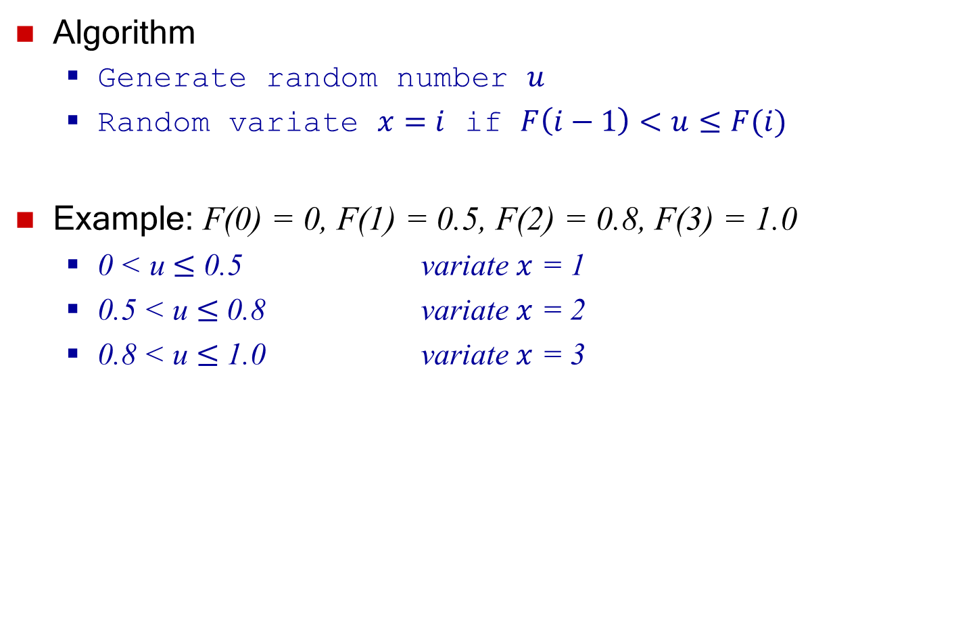
Inverse Transformation Method:
Discrete Distributions
Algorithm
  Generate random number $u$
  Random variate $x=i$ if $F\left(i−1\right)<u≤F(i)$
Example: F(0) = 0, F(1) = 0.5, F(2) = 0.8, F(3) = 1.0
  0 < u $≤$ 0.5 variate $x$ = 1
  0.5 < u $≤$ 0.8 variate $x$ = 2
  0.8 < u $≤$ 1.0 variate $x$ = 3

Slide 9
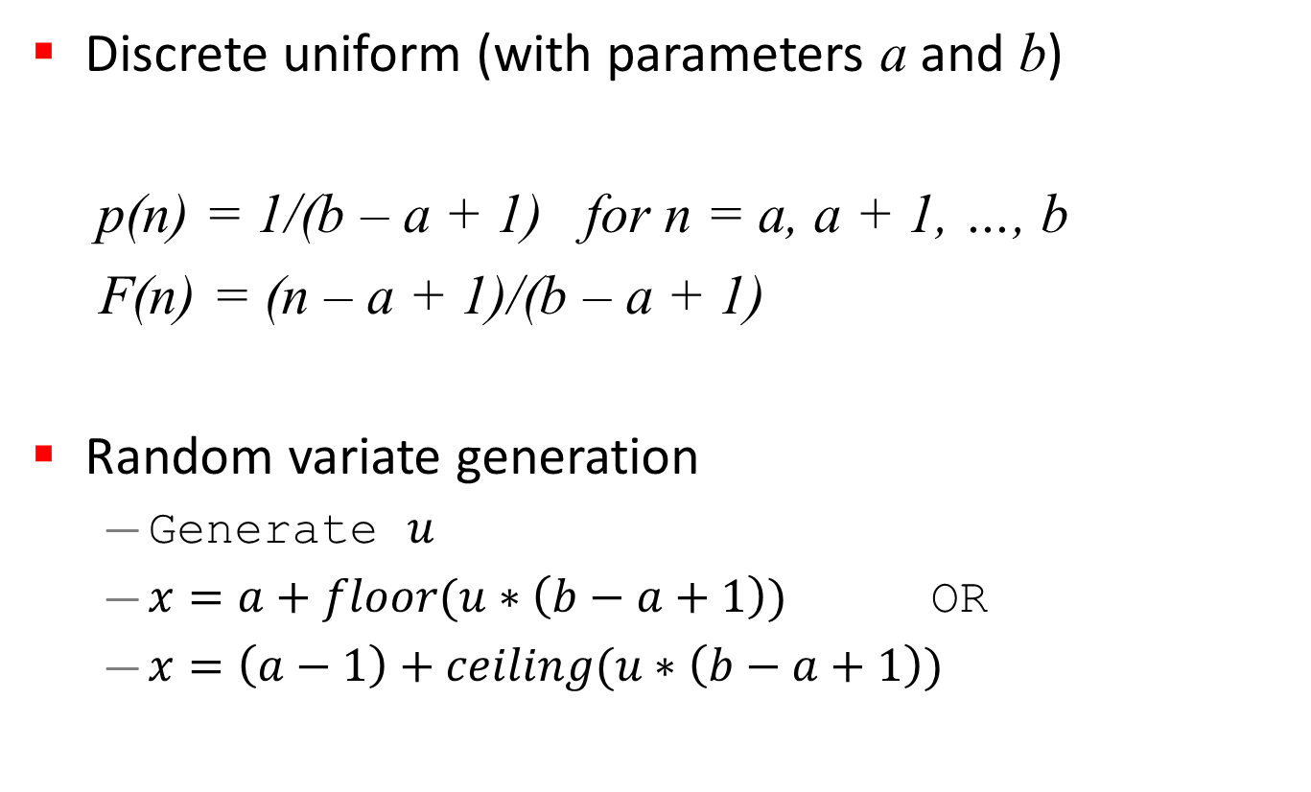
Discrete Uniform Variate
Discrete uniform (with parameters a and b)
p(n) = 1/(b – a + 1) for n = a, a + 1, …, b
F(n) = (n – a + 1)/(b – a + 1)
Random variate generation
  Generate $u$
  $x=a+floor(u∗\left(b−a+1\right))$ OR
  $x=\left(a−1\right)+ceiling(u∗\left(b−a+1\right))$

Slide 10
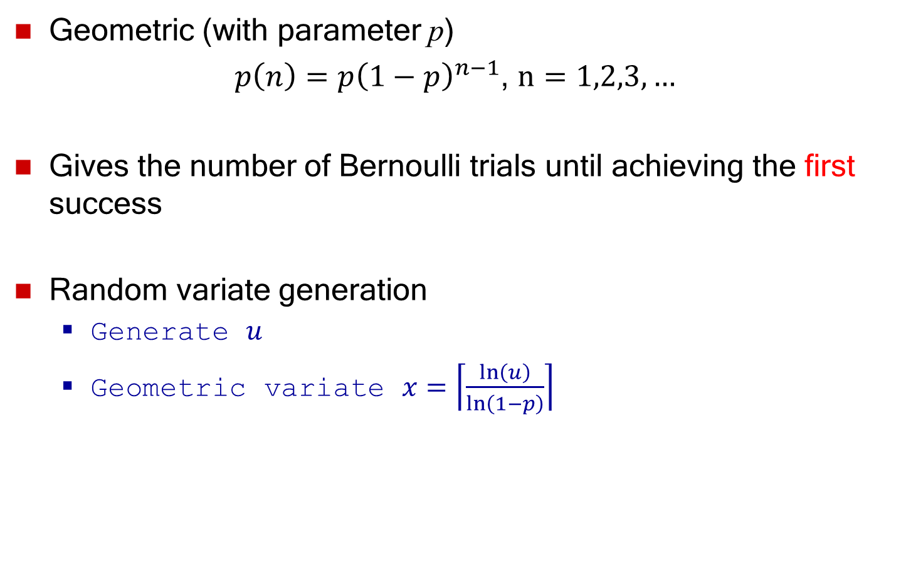
Geometric Variate
Geometric (with parameter p)
$p\left(n\right)={p\left(1−p\right)}^{n−1}$, $n=1,2,3,…$
Gives the number of Bernoulli trials until achieving the first success
Random variate generation
  Generate $u$
  Geometric variate $x=\left\lceil \frac{\ln\left(u\right)}{\ln\left(1−p\right)}\right\rceil$

Slide 11
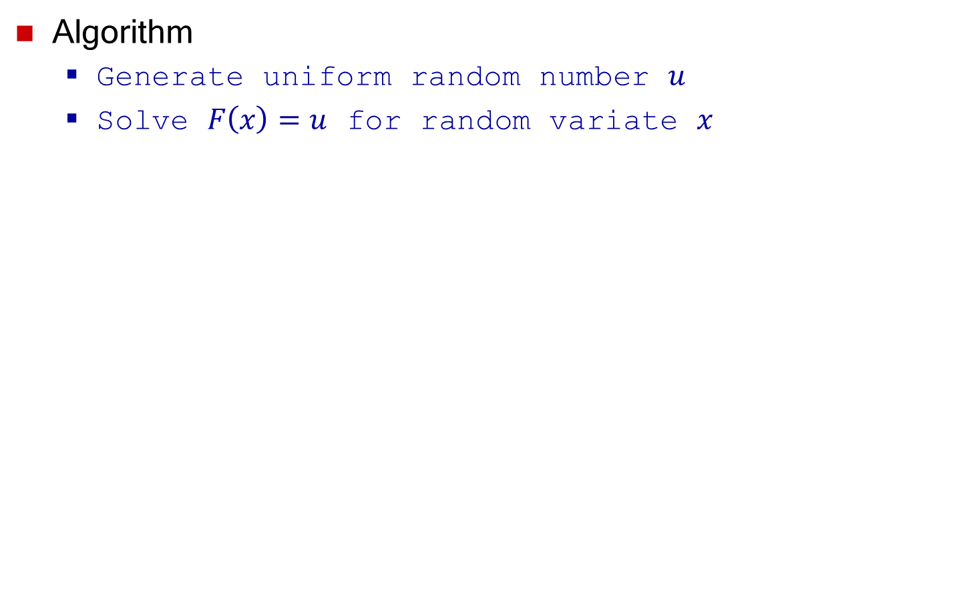
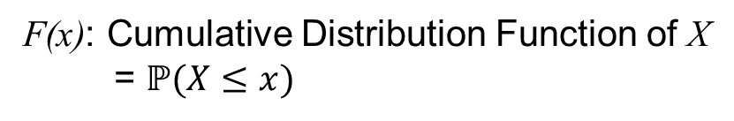

Inverse Transformation Method:
Continuous Distributions
Algorithm
  Generate uniform random number $u$
  Solve $F\left(x\right)=u$ for random variate $x$
1
F(x)
u
F(x): Cumulative Distribution Function of X
= $ℙ(X≤x)$
0
Variate $x$
x

Slide 12


Proof
Define the random variable $Y$ as:
$$Y=F(X)$$
$$ℙ\left(Y≤y\right)=ℙ\left(X≤x\right)=y$$
Therefore,
$$Y\sim U(0, 1)$$
1
$$F(x)$$
y
x

Slide 13
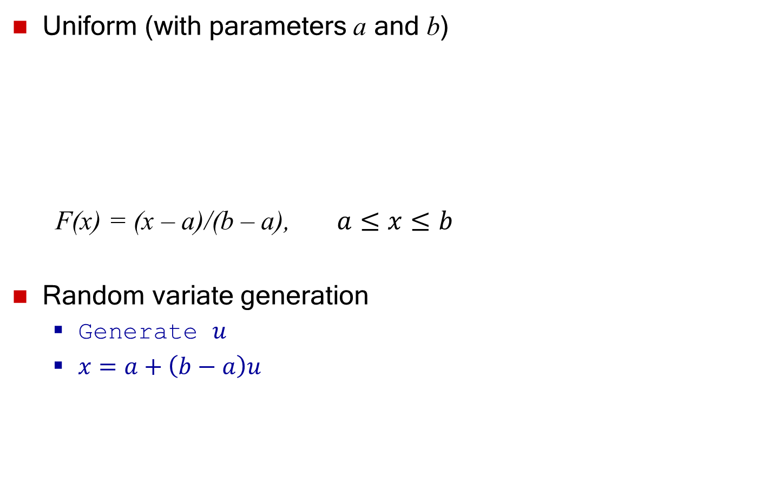
Continuous Uniform Variate
Uniform (with parameters a and b)
F(x) = (x – a)/(b – a), $a≤x≤b$
Random variate generation
  Generate $u$
  $x=a+\left(b−a\right)u$

Slide 14
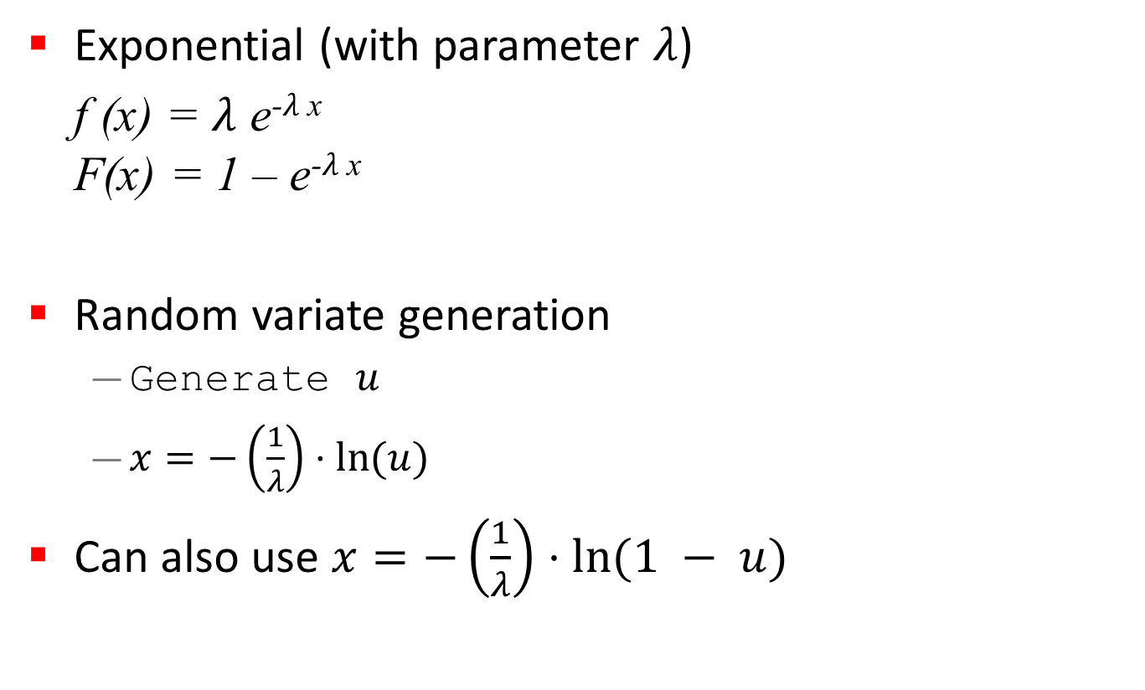
Exponential Variate
Exponential (with parameter $λ$)
f (x) = $λ$ e⁻$λ$ ^{x}
F(x) = 1 – e⁻$λ$ ^{x}
Random variate generation
  Generate $u$
  $x=−\left(\frac{1}{λ}\right)⋅\ln{(u)}$
Can also use $x=−\left(\frac{1}{λ}\right)⋅\ln{(1 − u)}$
  Note: If $u$ is Uniform(0,1), then $1−u$ is Uniform(0,1) too!

Slide 15
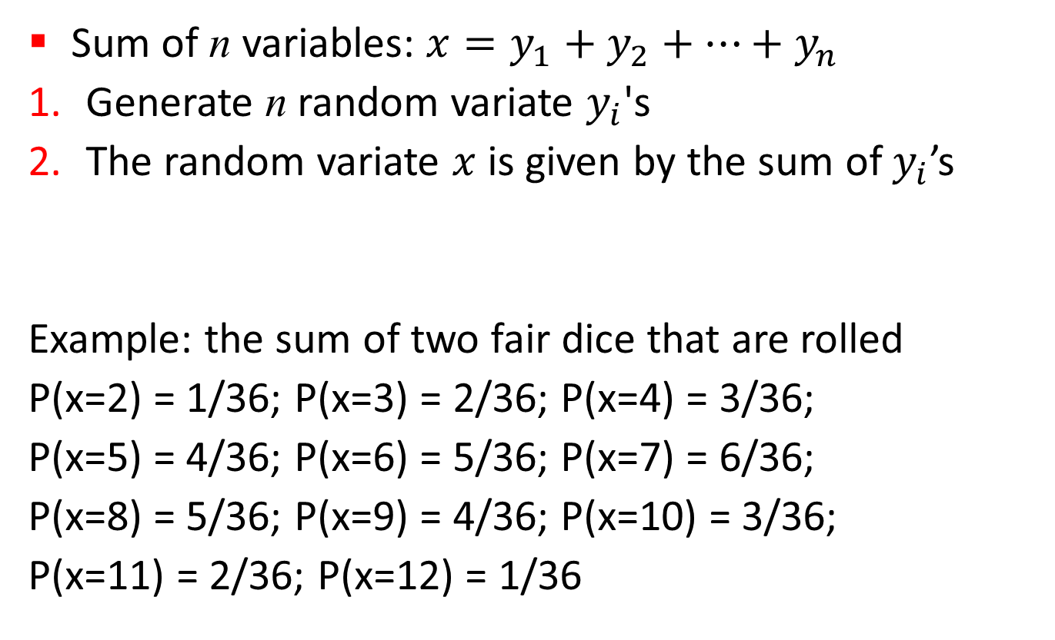
Convolution Method
Sum of n variables: $x=y_{1}+y_{2}+…+y_{n}$
Generate n random variate $y_{i}$'s
The random variate $x$ is given by the sum of $y_{i}$’s
Example: the sum of two fair dice that are rolled
P(x=2) = 1/36; P(x=3) = 2/36; P(x=4) = 3/36;
P(x=5) = 4/36; P(x=6) = 5/36; P(x=7) = 6/36;
P(x=8) = 5/36; P(x=9) = 4/36; P(x=10) = 3/36;
P(x=11) = 2/36; P(x=12) = 1/36

Slide 16
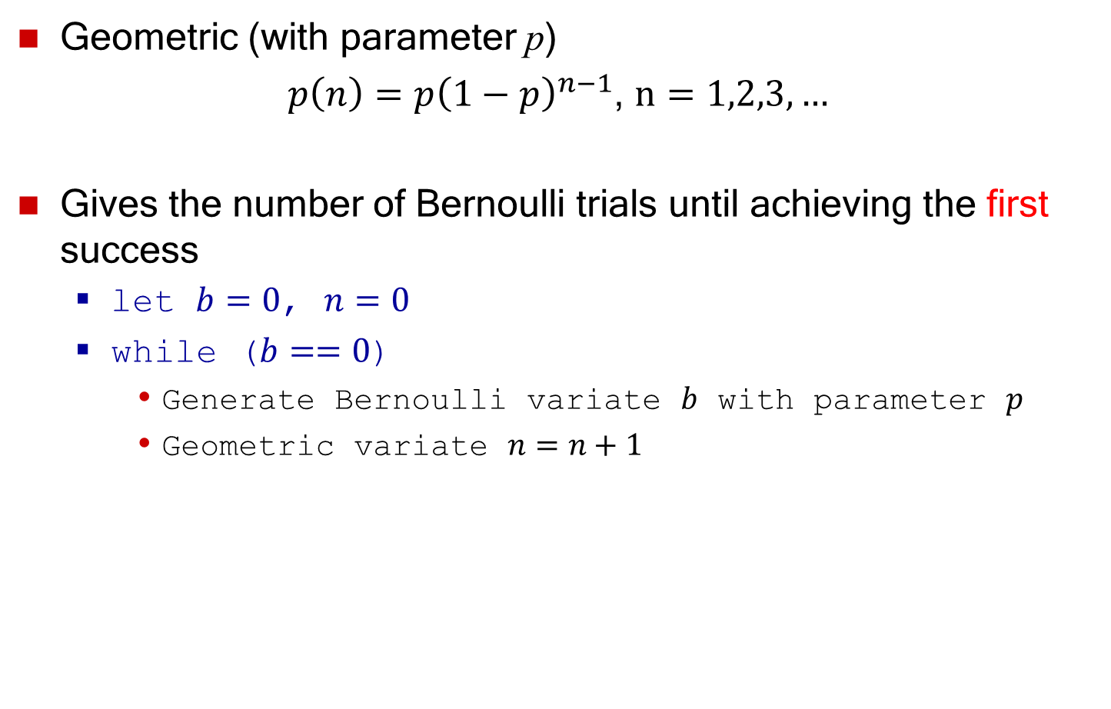
Geometric Variate
Geometric (with parameter p)
$p\left(n\right)={p\left(1−p\right)}^{n−1}$, $n=1,2,3,…$
Gives the number of Bernoulli trials until achieving the first success
  let $b=0$, $n=0$
  while ($b==0$)
    Generate Bernoulli variate $b$ with parameter $p$
    Geometric variate $n=n+1$
  Inefficient!!

Slide 17
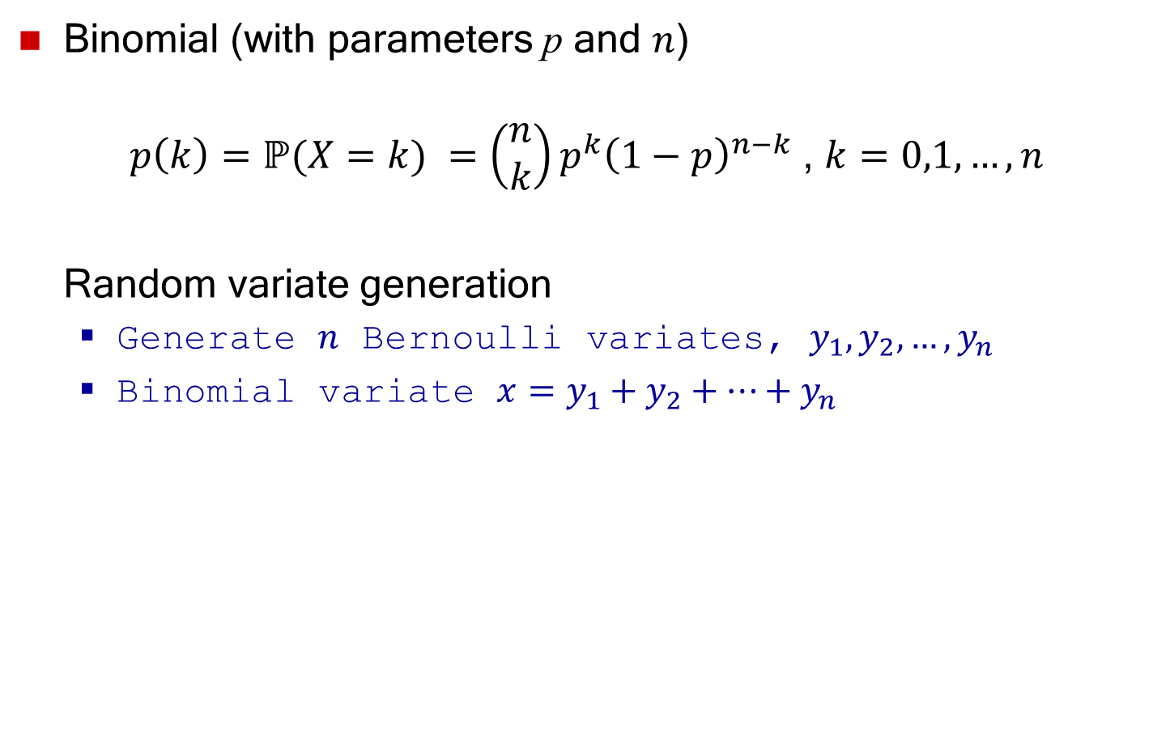
Binomial Variate
Binomial (with parameters p and $n$)
$p\left(k\right)=ℙ(X=k) =\left(\begin{matrix}n \\ k\end{matrix}\right)p^{k}{\left(1−p\right)}^{n−k}$ , $k=0,1,…,n$
Random variate generation
  Generate $n$ Bernoulli variates, $y_{1},y_{2},…,y_{n}$
  Binomial variate $x=y_{1}+y_{2}+⋯+y_{n}$

Slide 18
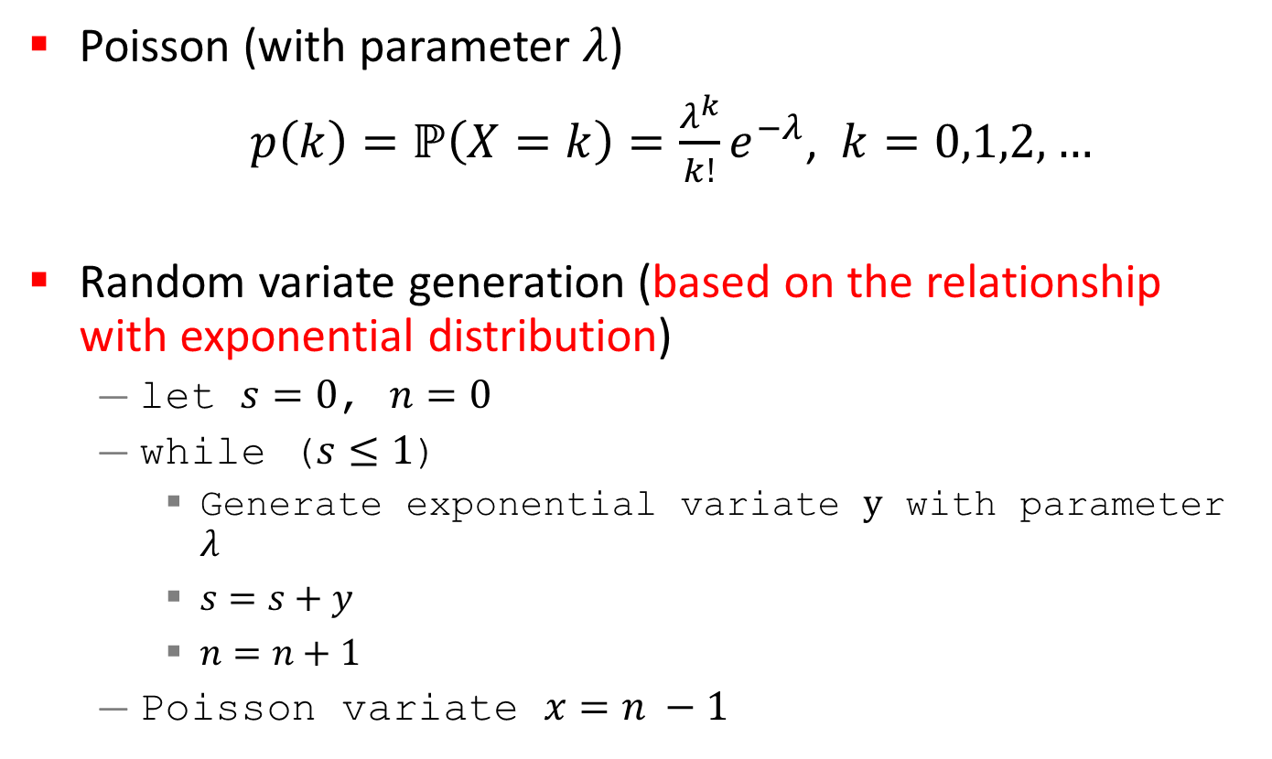
Poisson Variate
Poisson (with parameter $λ$)
$p\left(k\right)=ℙ\left(X=k\right)=\frac{λ^{k}}{k!}e^{−λ}$, $k=0,1,2,…$
Random variate generation (based on the relationship with exponential distribution)
  let $s=0$, $n=0$
  while ($s≤1$)
    Generate exponential variate $y$ with parameter $λ$
    $s=s+y$
    $n=n+1$
  Poisson variate $x=n −1$

Slide 19
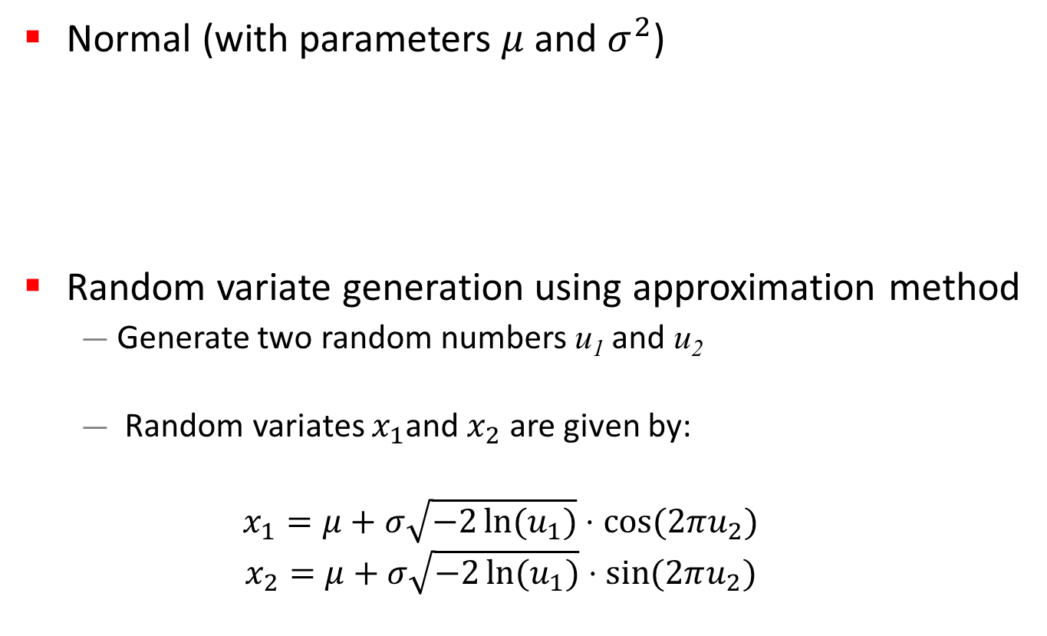
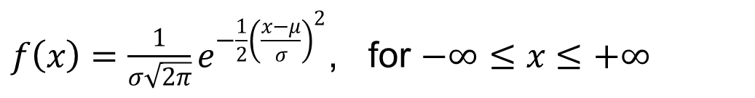
Other Techniques: Normal Variate
Normal (with parameters $μ$ and $σ^{2}$)
Random variate generation using approximation method
  Generate two random numbers u₁ and u₂
  Random variates $x_{1}$and $x_{2}$ are given by:
  $$x_{1}=μ+σ\sqrt{−2\ln{(u_{1})}}⋅\cos{(2πu_{2})}$$
  $$x_{2}=μ+σ\sqrt{−2\ln{(u_{1})}}⋅\sin{(2πu_{2})}$$
$f\left(x\right)=\frac{1}{σ\sqrt{2π}}e^{−\frac{1}{2}{\left(\frac{x−μ}{σ}\right)}^{2}}$, for $−∞≤x≤+∞$

Slide 20
Empirical Distribution
Could be used if no theoretical distributions
fit the data adequately
Example: Piecewise Linear empirical distribution
  Used for continuous data
  Appropriate when a large
  sample data is available
  Empirical CDF is approximated
  by a piecewise linear function:
    the ‘jump points’ connected
    by linear functions
Piecewise Linear
Empirical CDF

Slide 21


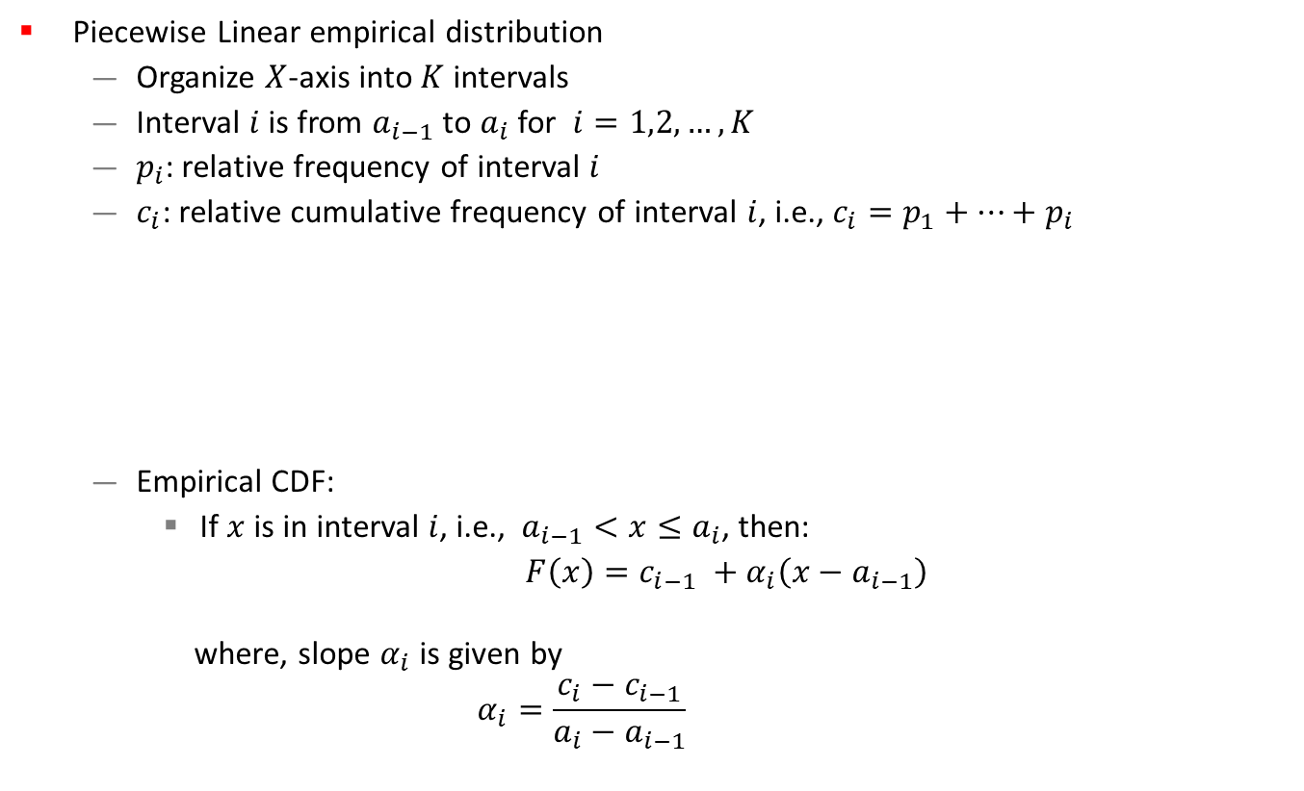



Empirical Distribution
Piecewise Linear empirical distribution
  Organize $X$-axis into $K$ intervals
  Interval $i$ is from $a_{i−1}$ to $a_{i}$ for $i=1,2,…, K$
  $p_{i}$: relative frequency of interval $i$
  $c_{i}$: relative cumulative frequency of interval $i$, i.e., $c_{i}=p_{1}+⋯+p_{i}$
  Empirical CDF:
    If $x$ is in interval $i$, i.e., $a_{i−1}<x≤a_{i}$, then:
    $F\left(x\right)=c_{i−1} +α_{i}\left(x−a_{i−1}\right)$
    where, slope $α_{i}$ is given by
    $$α_{i}=\frac{c_{i}−c_{i−1}}{a_{i}−a_{i−1}}$$
interval $i$
• • •
$$a_{0}$$
$$a_{i−1}$$
$$a_{i}$$
$$a_{K}$$
$K$ intervals

Slide 22






Example Empirical Distribution
Suppose the data collected for 100 broken machine repair times are:
Piecewise Linear
Empirical CDF
Slope $α_{3}=\frac{c_{3}−c_{2}}{a_{3}−a_{2}}=0.5$
$$a_{0}$$
$$a_{1}$$
$$a_{2}$$
$$a_{3}$$
$$a_{4}$$

Slide 23
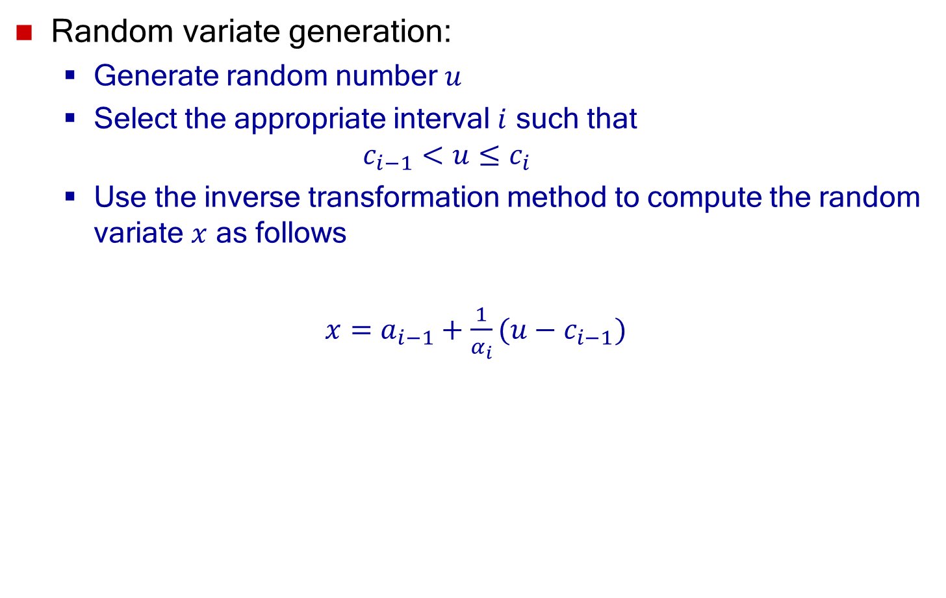
Empirical Distribution
Random variate generation:
  Generate random number $u$
  Select the appropriate interval $i$ such that
  $$c_{i−1}<u≤c_{i}$$
  Use the inverse transformation method to compute the random variate $x$ as follows
  $x=a_{i−1}+\frac{1}{α_{i}}(u−c_{i−1})$

Slide 24

Example Empirical Distribution
Suppose the data collected for 100 broken machine repair times are:
Suppose: $u=0.83$
  $$c_{3}=0.66<u≤c_{4}=1.00⇒i=4$$
  $$x=a_{3}+\frac{1}{α_{4}}\left(u−c_{3}\right) \\ =1.5+\frac{1}{0.68} \left(0.83−0.66\right) \\ =1.75$$

