Slide 1
Experimental
Calibration and Validation of a Speed Scaling Simulator
IEEE MASCOTS 2016
Arsham Skrenes
Carey Williamson
Department of Computer Science
University of Calgary

Slide 2
Speed Scaling: Inherent Tradeoffs
Dynamic Speed Scaling: adapt service rate to the current state of the system to balance energy consumption and performance.
Run slower:
less energy
Run faster: less delay
Minimize power consumption P
  Minimize energy cost ε
  Minimize heat, wear, etc.
Minimize response time T
  Minimize delay
Maximize job throughput
Notes:
Need update in emphasizing the motivation

Slide 3
Background: Theory and Systems
Theoretical Research
Systems Research
Goal: optimality
Domains: CPU, parallel systems
Methods: proofs, complexity, competitive analysis, queueing theory, Markov chains, worst case, asymptotics, simulation
Metrics: E[T], E[ε], combo, slowdown, competitive ratio
Power: P = s^{α} (2 ≤ α ≤ 3)
Schedulers: PS, SRPT, FSP, YDS
Speed scalers: job-count-based, continuous and unbounded speeds
Venues: SIGMETRICS, PEVA, Performance, INFOCOM, OR
Goal: practicality
Domains: CPU, disk, network
Methods: DVFS, power meter, measurement, benchmarking, simulation, power gating, over-clocking, simulation
Metrics: response time, energy, heat, utilization
Power: P = a C_{eff} V² f
Schedulers: FCFS, RR, FB
Speed scalers: threshold-based, discrete and finite speeds
Venues: SIGMETRICS, SOSP, OSDI, ISCA, MASCOTS, TOCS

Slide 4
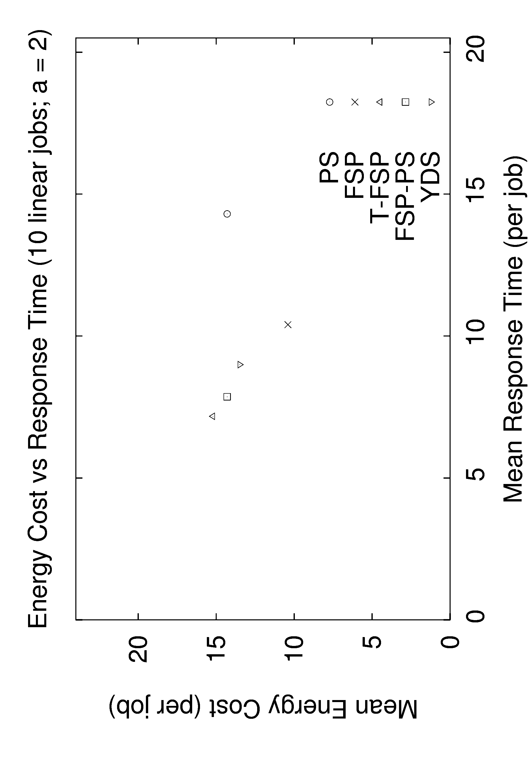
Example Simulation Results: IEEE MASCOTS 2014
α
T-FSP
FSP-PS
PS
YDS
FSP

Slide 5
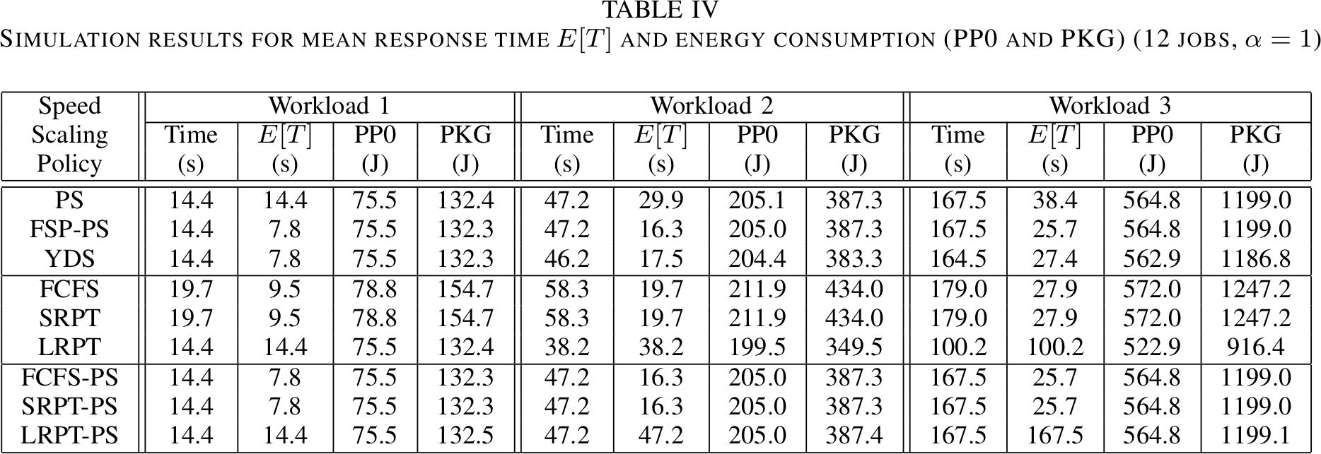
Simulation Results
Notes:
We can see that the simulation values closely model the empirical results.
With validated simulator, can evaluate response time, energy, and fairness characteristics for other scheduling policies and speed scalers even faster
SRPT-PS consistently provides best response time, though it does not have fairness properties of FSP-PS.
FCFS identical to SRPT since they’re batch workloads, and jobs are in non-decreasing order of size.
LRPT has worst response time amongst policies evaluated. However, it does not always have highest energy consumption, since in some cases it completes entire batch workload up to 40% sooner than other policies, such as PS. This is a theme around race-to-idle.
Results in table provide further evidence of many tradeoffs between response time, fairness, and energy consumption in dynamic speed scaling systems.

Slide 6
Typical Modeling Assumptions
Single-server queue for CPU service
Single batch of n jobs arrive at time 0
Job sizes known in advance
Dynamic speed scaling with s = f(n)
Power consumption P = s^{α} where 1 ≤ α ≤ 3
Maximum system speed is unbounded
System speeds are continuous (not discrete)
Context switches are free (i.e., zero cost)
Speed changes are free (i.e., zero cost)
Question: How would they perform on real systems?

Slide 7
Profilo Design [Skrenes 2016]
7
Flexible framework for the experimental evaluation of arbitrary scheduling and speed scaling policies
Hybrid user-mode and kernel-mode implementation
User space: CSV file input to specify workload
Kernel space: carefully-controlled job execution, timing, and energy measurement using RAPL MSRs
P1 5 20
P2 7 12
P3 2 50
P1 1 10
P4 10 8
P2 5 30
…
Process args
Set up environment
Profiling
Summarize results
User space
sysfs API
Work unit (primes)
Do work (loops)
Sleep busy
Sleep deep
Kernel space

Slide 8
Running Average Power Limit (RAPL)
Non-architectural model-specific registers (MSRs)
Four domains (but only three for any given CPU):
  PP0: Power Plane 0 for the CPU cores
  PP1: Power Plane 1 for GPU (consumer machines only)
  DRAM: Memory energy (server-class machines only)
  PKG: Energy usage by rest of the CPU chip package
Highly accurate power meters for each domain (matches well with external power measurements)
Experiments conducted on Macbook Pro Retina laptop (2012): 2.3 GHz quad-core Intel i7-3615 QM Ivy Bridge processor; Ubuntu Linux 14.04 LTS; compute-intensive workload with no I/O, memory, or networking involved
Notes:
RAPL MSR’s allow policies for domains that manage thermal output and energy consumption of the processor and memory to keep it within defined envelope(s).
Intel Sandy Bridge microarchitecture (2011) debuted the RAPL interface.
For maximum compatibility use PPO & PKG.
Intel says “PP1 may reflect to uncore devices”. It’s the GPU.
Uncore is term used by Intel to describe functions of microprocessor not in core, but which must be closely connected to core to achieve high performance. L3 is not part of uncore.

Slide 9
Measurement Results
9
Frequency (MHz) | PP0 (W) | PKG (W) | Context Switch (us) | Speed Switch (us) | Mode Switch (ns)
2301 (3300) | 11.5 | 15.3 | 1.140 | 0.76 | 44.8
2300 | 5.4 | 9.2 | 1.634 | 1.09 | 64.2
2200 | 5.0 | 8.9 | 1.708 | 1.14 | 67.0
2100 | 4.8 | 8.6 | 1.808 | 1.20 | 70.2
2000 | 4.6 | 8.4 | 1.898 | 1.26 | 73.7
1900 | 4.5 | 8.3 | 1.999 | 1.32 | 78.3
1800 | 4.3 | 8.0 | 2.118 | 1.38 | 81.9
1700 | 4.1 | 7.9 | 2.213 | 1.47 | 86.7
1600 | 3.9 | 7.6 | 2.369 | 1.56 | 92.1
1500 | 3.7 | 7.5 | 2.526 | 1.67 | 98.6
1400 | 3.5 | 7.3 | 2.709 | 1.81 | 105.3
1300 | 3.3 | 7.1 | 2.886 | 1.93 | 113.4
1200 | 3.1 | 6.9 | 3.167 | 2.09 | 123.1

Slide 10
Experimental Evaluation Setup
Three workloads (each with batch of 12 jobs):
  Homogenous
  Additive (arithmetic progression)
  Multiplicative (factors of 2)
Three algorithms (all with α=1):
  PS (epitomizes fairness)
  FSP-PS (decoupled speed scaling; improves mean response time while retaining fairness)
  YDS (minimizes power consumption)
Notes:
MULTI – PLICK – ATIV
Workload with jobs sizes that have no variability, medium variability, and high variability
YDS = Yao / Demers / Shenker

Slide 11
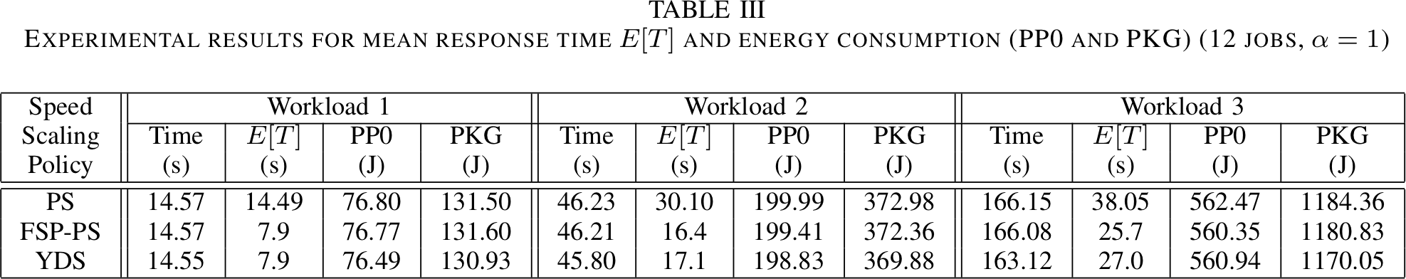
Experimental Evaluation Results
Observation 1: Decoupled speed scaling (FSP-PS) provides a significant response time advantage over PS, for the “same” energy costs
Observation 2: The response time advantage of FSP-PS decreases as job size variability increases
Observation 3: FSP-PS has a slight energy advantage over PS because of fewer context switches between jobs
Observation 4: YDS has the lowest energy consumption among these policies (even better than expected due to discretization effect, and no speed changes)
Notes:
Discretization effect would be even larger if voltage step for each frequency
FSP-PS dramatically reduces mean response time
Reduced 33% to 46% compared to PS (small but measurable reduction in batch execution & energy)
Reduced up to 5% compared to YDS
To lesser degree, YDS instead improves overall execution time (2%) and power efficiency (1%) compared to FSP-PS
There’s workloads with less variability than 2&3 that show much greater differences between FSP-PS/YDS
FSP-PS reduces mean response time by 10%
YDS reduces overall execution time by 5%
YDS reduces overall energy consumption by 3-4%
Fusion of high/low service rates (with PS speed scaling policy) drives differences between two policies.
FSP-PS favors smallest jobs.
YDS blends the service rate and has fewer context switches.

Slide 12
Simulation Results
Notes:
We can see that the simulation values closely model the empirical results.
With validated simulator, can evaluate response time, energy, and fairness characteristics for other scheduling policies and speed scalers even faster
SRPT-PS consistently provides best response time, though it does not have fairness properties of FSP-PS.
FCFS identical to SRPT since they’re batch workloads, and jobs are in non-decreasing order of size.
LRPT has worst response time amongst policies evaluated. However, it does not always have highest energy consumption, since in some cases it completes entire batch workload up to 40% sooner than other policies, such as PS. This is a theme around race-to-idle.
Results in table provide further evidence of many tradeoffs between response time, fairness, and energy consumption in dynamic speed scaling systems.

