Slide 1

CPSC 531:
System Modeling and Simulation
Carey Williamson
Department of Computer Science
University of Calgary
Fall 2017

Slide 2
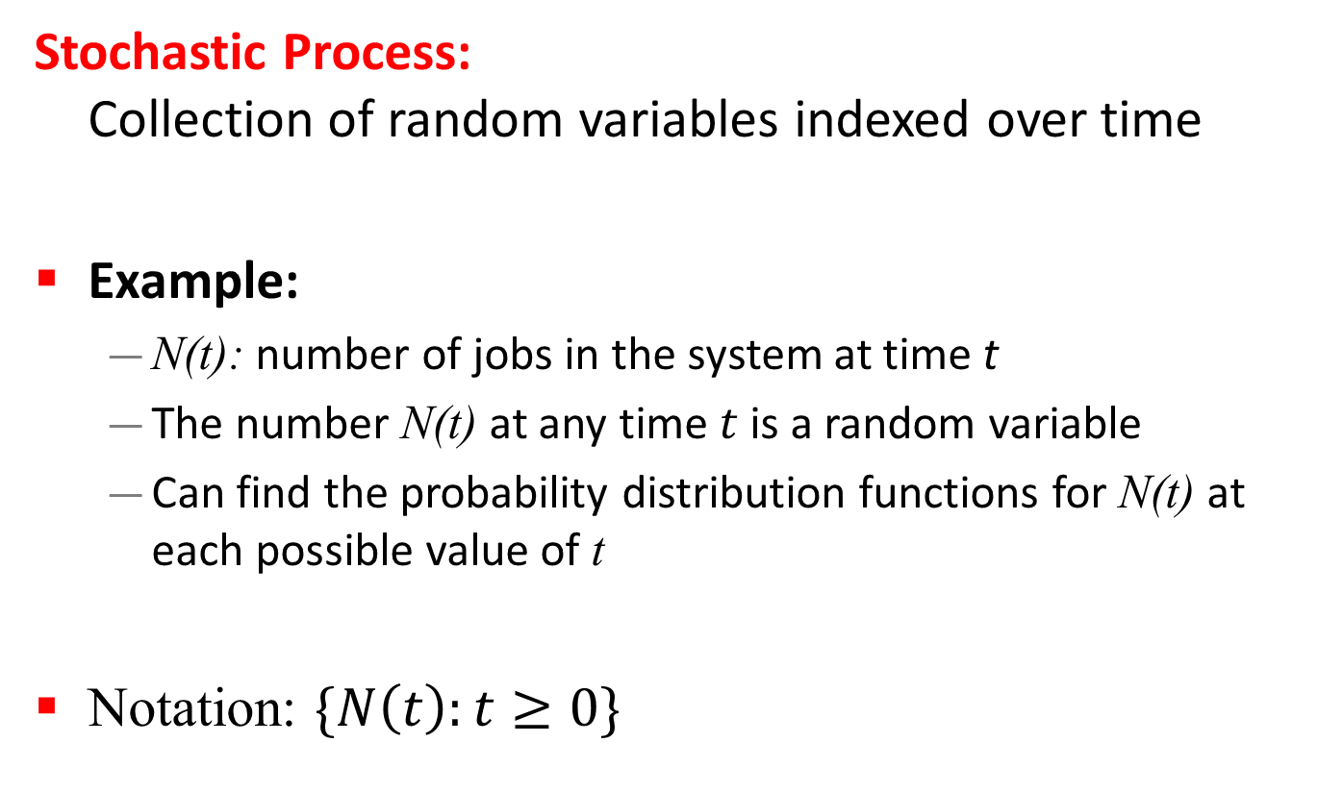
Stochastic Processes
Stochastic Process:
Collection of random variables indexed over time
Example:
  N(t): number of jobs in the system at time t
  The number N(t) at any time $t$ is a random variable
  Can find the probability distribution functions for N(t) at each possible value of t
Notation: $\{N\left(t\right):t≥0\}$

Slide 3
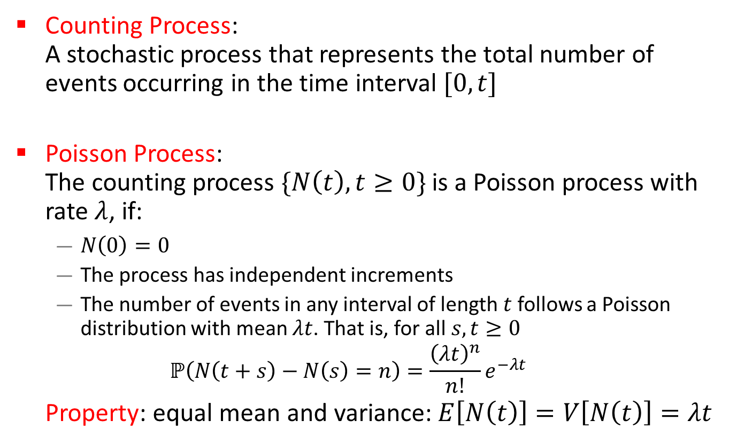
Poisson Process
Counting Process:
A stochastic process that represents the total number of events occurring in the time interval $[0, t]$
Poisson Process:
The counting process $\{N\left(t\right), t≥0\}$ is a Poisson process with rate $λ$, if:
  $N\left(0\right)=0$
  The process has independent increments
  The number of events in any interval of length $t$ follows a Poisson distribution with mean $λt$. That is, for all $s, t≥0$
  $$ℙ\left(N\left(t+s\right)−N\left(s\right)=n\right)=\frac{{\left(λt\right)}^{n}}{n!}e^{−λt}$$
Property: equal mean and variance:$E\left[N\left(t\right)\right]=V\left[N\left(t\right)\right]=λt$

Slide 4
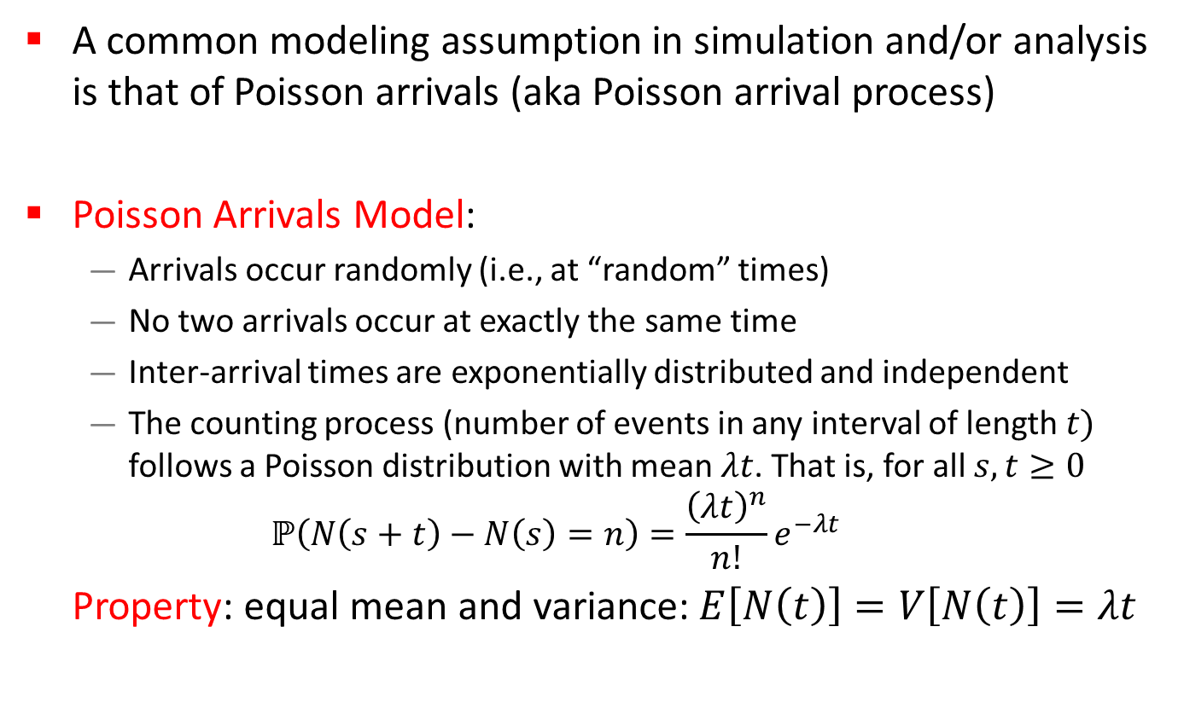
Poisson Arrival Process
A common modeling assumption in simulation and/or analysis is that of Poisson arrivals (aka Poisson arrival process)
Poisson Arrivals Model:
  Arrivals occur randomly (i.e., at “random” times)
  No two arrivals occur at exactly the same time
  Inter-arrival times are exponentially distributed and independent
  The counting process (number of events in any interval of length $t)$ follows a Poisson distribution with mean $λt$. That is, for all $s, t≥0$
  $$ℙ\left(N\left(s+t\right)−N\left(s\right)=n\right)=\frac{{\left(λt\right)}^{n}}{n!}e^{−λt}$$
Property: equal mean and variance:$E\left[N\left(t\right)\right]=V\left[N\left(t\right)\right]=λt$

Slide 5
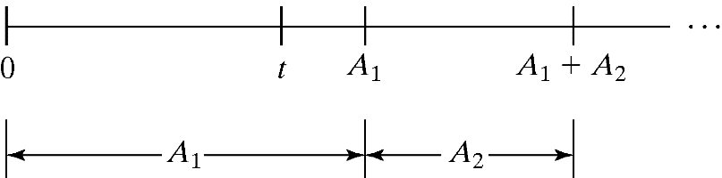
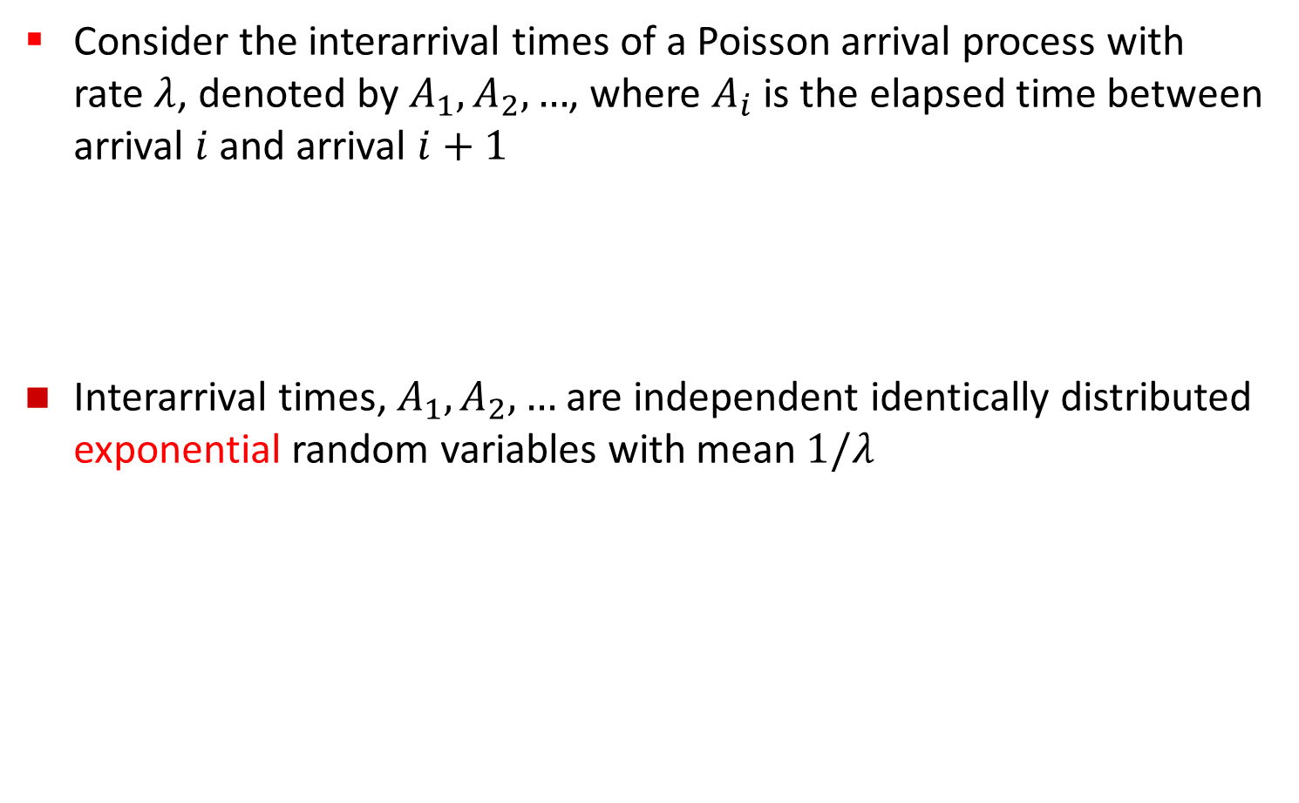
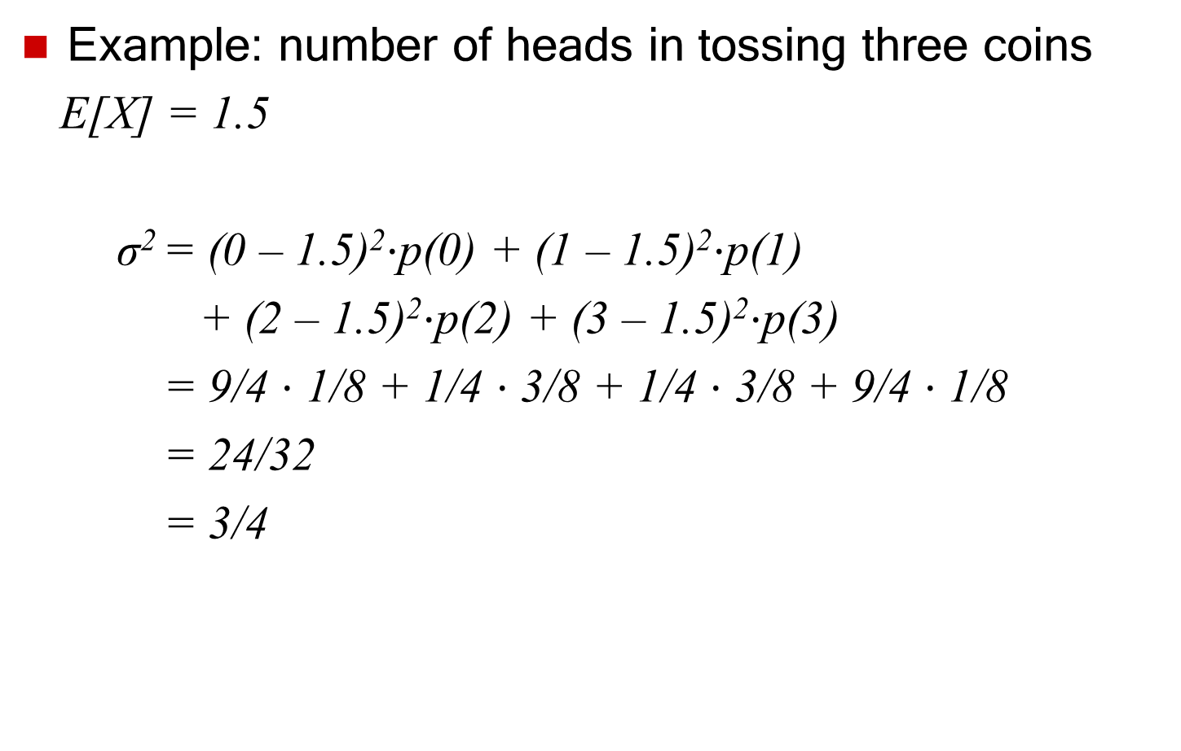

Interarrival Times
Consider the interarrival times of a Poisson arrival process with
rate $λ$, denoted by $A_{1},A_{2},…$, where $A_{i}$ is the elapsed time between arrival $i$ and arrival $i+1$
  Interarrival times, $A_{1},A_{2},…$ are independent identically distributed exponential random variables with mean $1/λ$
Arrival counts ~ Poisson($λ$)
Interarrival times
~ Exponential($λ$)

Slide 6
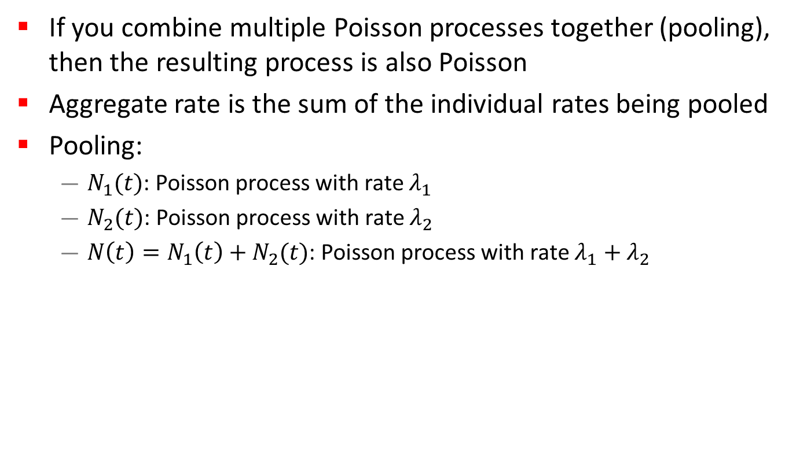
Pooling Property
If you combine multiple Poisson processes together (pooling), then the resulting process is also Poisson
Aggregate rate is the sum of the individual rates being pooled
Pooling:
  $N_{1}(t)$: Poisson process with rate $λ_{1}$
  $N_{2}(t)$: Poisson process with rate $λ_{2}$
  $N\left(t\right)=N_{1}\left(t\right)+N_{2}(t)$: Poisson process with rate $λ_{1}+λ_{2}$
N1(t) ~ Poisson(λ₁)
λ₁
λ₁ + λ₂
N(t) ~ Poisson(λ₁ + λ₂)
N2(t) ~ Poisson(λ₂)
λ₂

Slide 7
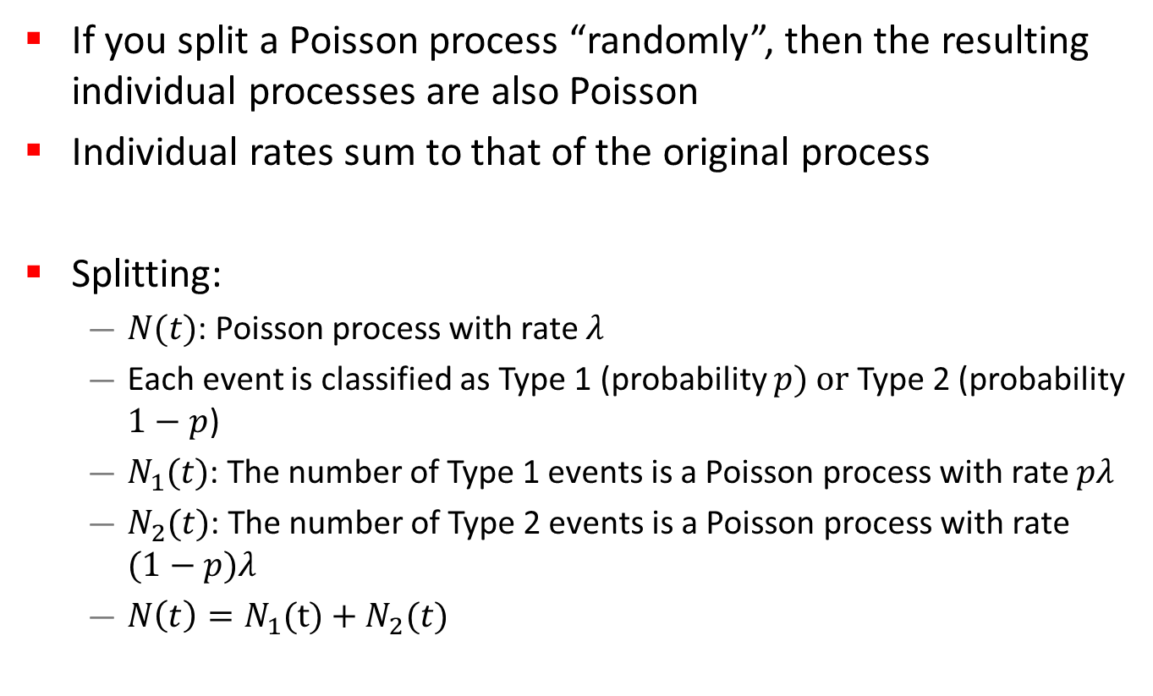
Splitting Property
If you split a Poisson process “randomly”, then the resulting individual processes are also Poisson
Individual rates sum to that of the original process
Splitting:
  $N(t)$: Poisson process with rate $λ$
  Each event is classified as Type 1 (probability $p) or$ Type 2 (probability $1−p$)
  $N_{1}(t)$: The number of Type 1 events is a Poisson process with rate $pλ$
  $N_{2}(t)$: The number of Type 2 events is a Poisson process with rate $(1−p)λ$
  $N\left(t\right)=N_{1}(t)+N_{2}(t)$
λp
N1(t) ~ Poisson(λp)
N(t) ~ Poisson(λ)
λ
λ(1-p)
N2(t) ~ Poisson(λ(1-p))

Slide 8
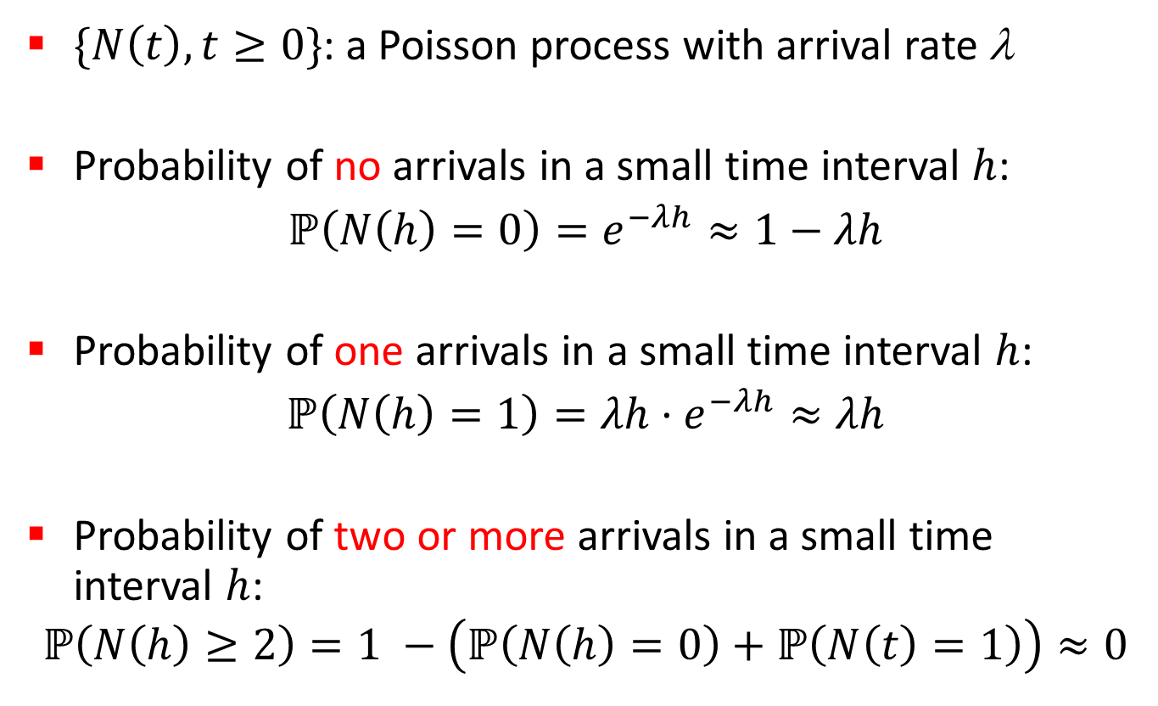
More on Poisson Distribution
$\{N\left(t\right), t≥0\}$: a Poisson process with arrival rate λ
Probability of no arrivals in a small time interval $h$:
$ℙ\left(N\left(h\right)=0\right)=e^{−λh}≈1−λh$
Probability of one arrivals in a small time interval $h$:
$ℙ\left(N\left(h\right)=1\right)={λh⋅e}^{−λh}≈λh$
Probability of two or more arrivals in a small time interval $h$:
$$ℙ\left(N\left(h\right)≥2\right)=1 −\left(ℙ\left(N\left(h\right)=0\right)+ℙ\left(N\left(t\right)=1\right)\right)≈0$$

Slide 9
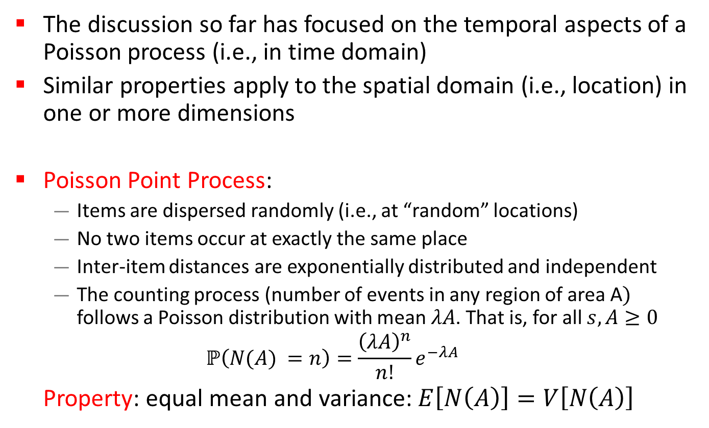
Aside: Poisson Point Process
The discussion so far has focused on the temporal aspects of a Poisson process (i.e., in time domain)
Similar properties apply to the spatial domain (i.e., location) in one or more dimensions
Poisson Point Process:
  Items are dispersed randomly (i.e., at “random” locations)
  No two items occur at exactly the same place
  Inter-item distances are exponentially distributed and independent
  The counting process (number of events in any region of area A$)$ follows a Poisson distribution with mean $λA$. That is, for all $s, A≥0$
  $$ℙ\left(N(A) =n\right)=\frac{{\left(λA\right)}^{n}}{n!}e^{−λA}$$
Property: equal mean and variance:$E\left[N\left(A\right)\right]=V\left[N\left(A\right)\right]$

Slide 10
Bonus Material: Queueing Theory Basics
Queueing theory is a well-established area of performance modeling that studies the behaviour of queues
Classic textbook: Queueing Systems: Vol 1, by L. Kleinrock
The foundation of queueing theory is built using the types of probability models that we have just been studying
The goal in this short presentation is to show you the basics of the M/M/1 queuing model, for which N = ρ/(1-ρ)
This is only a preview; we will revisit this material in much more depth in late November and/or early December

Slide 11
Notation
λ: The average arrival rate (in customers per time unit)
  The mean inter-arrival time is 1/λ
μ: The average service rate (in customers per time unit)
  The mean service time requirement is 1/μ
ρ: The average load offered to the system
  ρ = λ/μ < 1.0
Kendall notation for queueing systems:
  Arrival process: either M (for Markovian) or G (for General)
  Service time process: either D (for Deterministic), M, or G
  N: The number of servers
Example: M/M/1 is a single-server queue with a Poisson arrival process and exponential service times for customers

Slide 12
M/M/1 System Model
Markov chain model of classic M/M/1 queue
Birth-death process representing system occupancy
Fixed arrival rate λ
Fixed service rate μ
λ
λ
λ
λ
λ
…
0
1
2
3
4
μ
μ
μ
μ
μ
Mean system occupancy: N = ρ / (1 – ρ)
Ergodicity requirement: ρ = λ/μ < 1
p_{n} = p₀ (λ/μ)^{n}
U = 1 – p₀ = ρ

