Slide 1

CPSC 531:
System Modeling and Simulation
Carey Williamson
Department of Computer Science
University of Calgary
Fall 2017

Slide 2
Recap: Performance Evaluation
Performance Evaluation
Performance Measurement
Performance Modeling
Analytic Modeling
Simulation

Slide 3
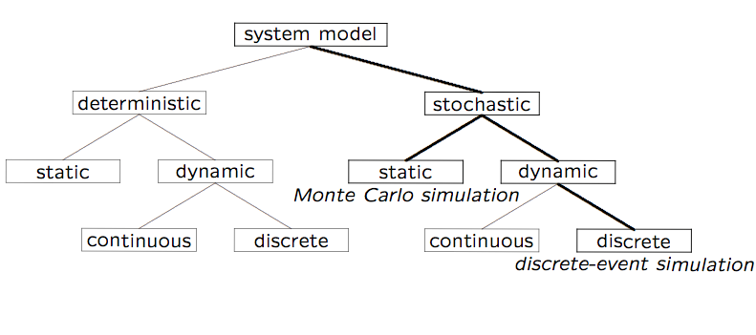
Simulation Model Taxonomy (preview)

Slide 4
Terminology (1 of 2)
A system is defined as a group of objects that interact with each other to accomplish some purpose
  A computer system: CPU, memory, disk, bus, NIC
  An automobile factory: Machines, components parts and workers operate jointly along assembly line
A system is often affected by changes occurring outside the system: system environment
  Hair salon: arrival of customers
  Warehouse: arrival of shipments, fulfilling of orders
    Effect of supply on demand: relationship between factory output from supplier and consumption by customers

Slide 5
Terminology (2 of 2)
Entity
  An object of interest in the system: Machines in factory
Attribute
  The property of an entity: speed, capacity, failure rate
State
  A collection of variables that describe the system in any time: status of machine (busy, idle, down,…)
Event
  An instantaneous occurrence that might change the state of the system: breakdown

Slide 6
Simulation Modeling
Develop a simulation program that implements a computational model of the system of interest
Run the simulation program and use the data collected to estimate the performance measures of interest (often involves the use of randomization)
A system can be studied at an arbitrary level of detail
Quote of the day:
“The hardest part about simulation is deciding what NOT to model.” - Moe Lavigne, Stentor, Summer 1995

Slide 7
Advantages of Simulation
New policies and procedures can be explored without disrupting the ongoing operation of the real system
New designs can be tested without committing resources for their acquisition
Time can be compressed or expanded to allow for a speed-up or slow-down of the phenomenon under study
Insight can be obtained about the interactions of variables, and which ones have the most impact on system performance
Can obtain answers to “What if…” questions

Slide 8
Disadvantages of Simulation
Model building requires special training
  An important role for courses like CPSC 531!!
  Vendors of simulation software have been actively developing packages that contain models that only need input (templates), which simplifies things for users
Simulation results can be difficult to interpret
  Need proper statistical interpretation for output analysis
Simulation modeling and analysis can be time- consuming and expensive, both for the modeler, as well as in compute time (if not done judiciously)

Slide 9
When Simulation Is Not Appropriate
When the problem can be solved by common sense
When the problem can be solved analytically
When it is easier to perform direct experiments
When cost of simulations exceeds (expected) savings for the real system
When system behavior is too complex (e.g., humans)

Slide 10
Common Mistakes in Simulation
Poor (pseudo) random number generators
  Best to use well-known or well-understood generator
Improper selection of seeds for PRNG
  Short periods; same seeds for all streams
Inappropriate level of detail:
  More detail ➔ more time ➔ more bugs
  More parameters ≠ more accurate
Improperly handled initial conditions (warmup)
Improperly handled ending conditions (cooldown)
Run-length too short to achieve steady-state
  Need proper output analysis, confidence intervals
Notes:
* Move to later slides

Slide 11
Types of Simulations
Monte Carlo simulation
Time-stepped simulation
Trace-driven simulation
Discrete-event simulation
Continuous simulation

Slide 12
Simulation Model Taxonomy

Slide 13
Simulation Examples
Monte Carlo simulation (see Assignment 1)
  Estimating π
  Craps (dice game)
Time-stepped simulation
  Mortgage scenarios
Trace-driven simulation (see Assignment 2)
  Single-server queue (ssq1.c)
Discrete-event simulation (see Assignments 3 and 4)
  Witchcraft hair salon

Slide 14
Monte Carlo Simulation
Static simulation (no time dependency)
To model probabilistic phenomenon
Can be used for evaluating non-probabilistic expressions using probabilistic methods
Can be used for estimating quantities that are “hard” to determine analytically or experimentally
Named after Count Montgomery de Carlo, who was a famous Italian gambler and random-number generator (1792-1838).

Slide 15
Trace-Driven Simulation
Trace = time-ordered record of events in system
Trace-driven simulation = Trace input
Often used in evaluating or tuning resource management algorithms (based on real workloads):
  Paging, cache analysis, CPU scheduling, deadlock prevention, dynamic storage allocation
Example: Trace = start time + duration of processes
Example: Trace = size in bytes of file written to disk
Example: Trace = mobile device ID and call duration

Slide 16
Advantages of Trace-Driven Simulations
Credibility
Easy validation: compare simulation with measurement
Accurate workload: models correlation and interference
Fair comparison: better than random input
Similarity to the actual implementation:
  trace-driven model is similar to the system
  can understand complexity of implementation

Slide 17
Disadvantages of Trace-Driven Simulations
Complexity: more detailed
Representativeness: workload changes with time, equipment
Data Collection: few minutes fill up a disk
Instrumentation: granularity; intrusiveness
Single Point of Validation: one trace = one point
Difficult to change workload

Slide 18
Discrete-Event Simulation
A simulation model with three features:
  Stochastic:
  some variables in the simulation model are random
  Dynamic:
  system state evolves over time
  Discrete-Event:
  changes in system state occur at discrete time instances

Slide 19
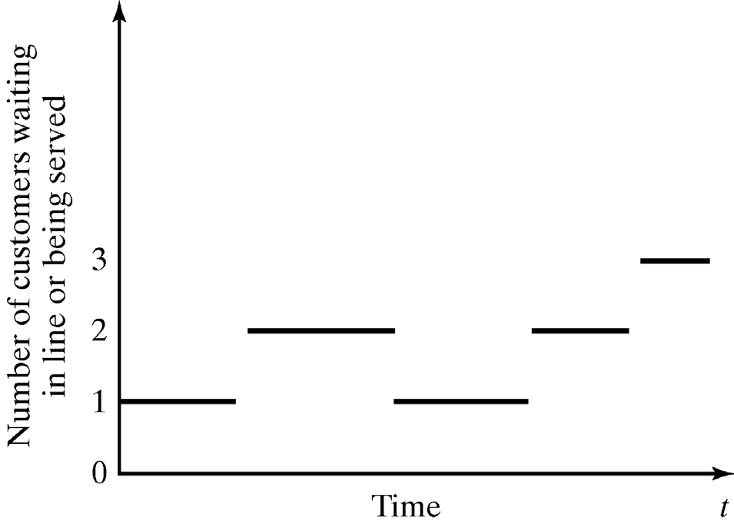
Discrete and Continuous Systems
A discrete system is one in which the system state changes only at a discrete set of points in time
  Example: A restaurant

Slide 20
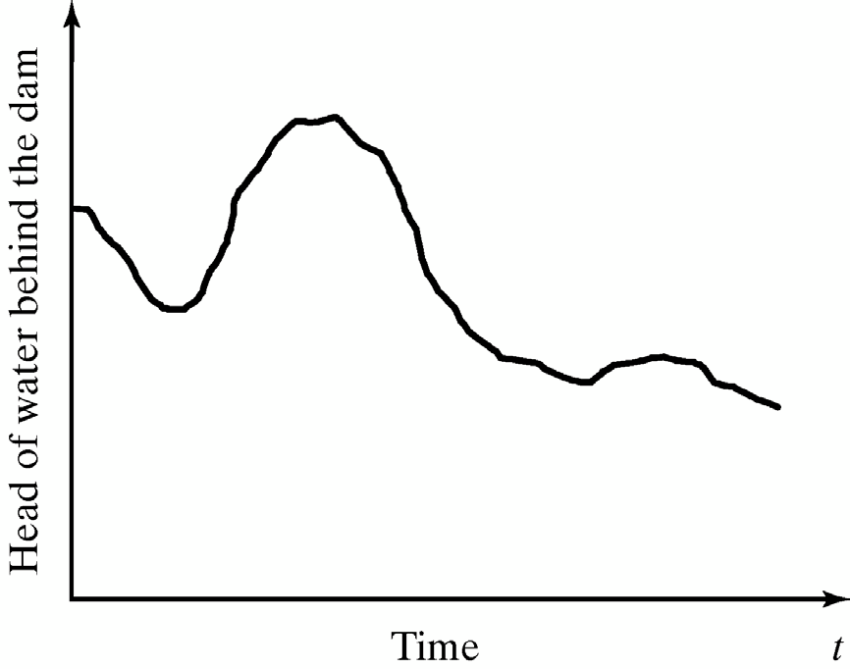
Discrete and Continuous Systems
A continuous system is one in which the system state changes continuously over time
  Example: Water level in Bow River (or Bearspaw dam)

Slide 21
Discrete-Event Simulation
A simulation model in which system state evolves over a discrete sequence of events in time
  System state changes only when an event occurs
  System state does not change between the events
Arrival
Departure
Arrival
Arrival
Restaurant Example

Slide 22
Continuous Simulation
A simulation model in which system state evolves continuously over time
  Time is divided to small time slices
  System state changes in every time slice
Dam Example

Slide 23
Characterizing a Simulation Model
Deterministic or Stochastic
  Does the model contain stochastic components?
Static or Dynamic
  Is time a significant variable?
Continuous or Discrete
  Does the system state evolve continuously or only at discrete points in time?

Slide 24
Simulation Model Taxonomy

Slide 25
DES Model Development
How to develop a simulation model:
  Determine the goals and objectives
  Build a conceptual model
  Convert into a specification model
  Convert into a computational model
  Verify the model
  Validate the model
Typically an iterative process

Slide 26
Three Model Levels
Conceptual Model
  Very high level (perhaps schematic diagram)
  How comprehensive should the model be?
  What are the state variables?
  Which ones are dynamic, and which are most important?
Specification Model
  On paper: entitites, interactions, requirements, rules, etc.
  May involve equations, pseudocode, etc.
  How will the model receive input?
Computational Model
  A computer program
  General-purpose programming language or simulation language?

Slide 27
Simulation Software
General purpose programming languages
  Flexible and familiar
  Well suited for learning DES principles and techniques
  E.g., C++, Java
Simulation programming languages
  Good for building models quickly
  Provide built-in features (e.g., queue structures)
  Graphics and animation provided
  Domain specific
    Network protocol simulation: ns2, Opnet
    Electrical power simulation: ETAP
    Design and engineering: Ansys, Autodesk
    Process simulation: Simul8

Slide 28
Verification and Validation
Verification
  Computational model should be consistent with specification model
  Did we build the model right?
Validation
  Computational model should be consistent with the system being analyzed
  Did we build the right model?
  Can an expert distinguish simulation output from system output?

