Slide 1

CPSC 531:
System Modeling and Simulation
Carey Williamson
Department of Computer Science
University of Calgary
Fall 2017

Slide 2
Outline
Random number generation
  Properties of random numbers
  Linear Congruential Generator
  Seed selection and random streams

Slide 3
Random Number Generators (RNG’s)
Requirements
  Sequence generated has uniform distribution (continuous) between 0 and 1
  The numbers in the sequence are independent of each other
RNG’s in computer simulation are pseudorandom
  Each number in the sequence is determined by one or several of its predecessors
  Statistical tests can be used to determine how well the requirements of uniformity and independence are met

Slide 4
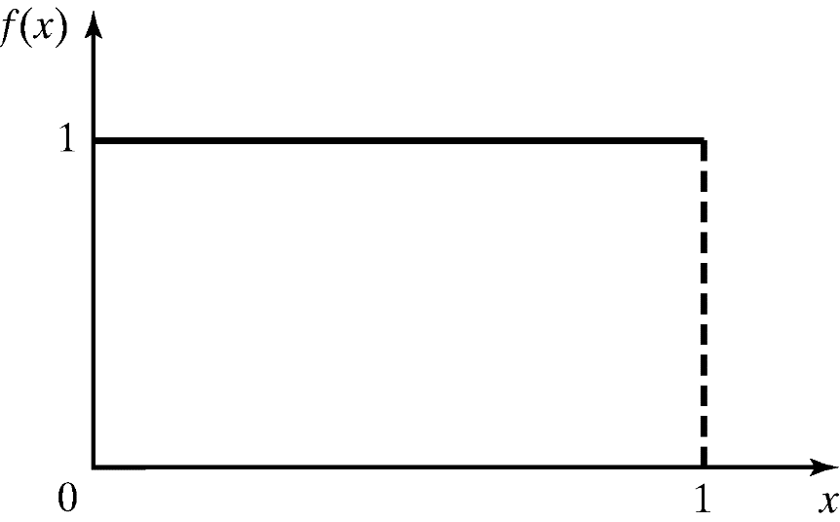

Properties of Random Numbers
Two important statistical properties:
  Uniformity
  Independence
Random numbers, $x_{1}, x_{2},x_{3},…$, must be independently drawn from a uniform distribution with PDF:

Slide 5
Desirable Properties
Uniformity and independence
Should be able to reproduce a given sequence of random numbers
  Helps program debugging
  Helpful when comparing alternative system design
Should have provision to generate several streams of random numbers
Computationally efficient

Slide 6
A Sample Generator
Starting with x₀ = 5:
The first 32 numbers obtained by the above procedure
10, 3, 0, 1, 6, 15, 12, 13, 2, 11, 8, 9, 14, 7, 4, 5, 10, 3, 0, 1, 6, 15, 12, 13, 2, 11, 8, 9, 14, 7, 4, 5.
By dividing x's by 16:
0.6250, 0.1875, 0.0000, 0.0625, 0.3750, 0.9375, 0.7500, 0.8125, 0.1250, 0.6875, 0.5000, 0.5625, 0.8750, 0.4375, 0.2500, 0.3125, 0.6250, 0.1875, 0.0000, 0.0625, 0.3750, 0.9375, 0.7500, 0.8125, 0.1250, 0.6875, 0.5000, 0.5625, 0.8750, 0.4375, 0.2500, 0.3125.

Slide 7
Linear Congruential Generator (LCG)
Commonly used algorithm
A sequence of integers x₁,x₂,… between 0 and m-1 is generated according to
    x_{i} = (a x_{i-1} + c) mod m
    where a and c are constants, m is the modulus and x₀ is the seed (or starting value)
Random numbers u₁,u₂,… are given by u_{i} = x_{i}/m
The sequence can be reproduced if the seed is known

Slide 8
Linear Congruential Generator (LCG)
Example
  x_{n} = 7 x_{n-1} + 3 mod 10, x₀ = 3
  sequence: 3, 4, 1, 0, 3, 4, 1, …
Example
  x_{n} = 4 x_{n-1} + 2 mod 9, x₀ = 3
  sequence: 3, 5, 4, 0, 2, 1, 6, 8, 7, 3, 5, 4, …

Slide 9
Properties of LCG
Can have at most m distinct integers in the sequence
  As soon as any number in the sequence is repeated, the whole sequence is repeated
  Period: number of distinct integers generated before repetition occurs
Problem: Instead of continuous, the u_{i}’s can only take on discrete values 0, 1/m, 2/m,…, (m-1)/m
  Solution: m should be selected to be very large in order to achieve the effect of a continuous distribution
  (typically, m > 10⁹)
  Approximation appears to be of little consequence

Slide 10
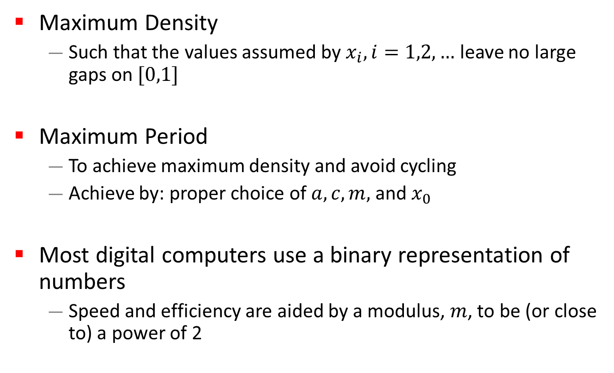
Characteristics of a Good Generator
Maximum Density
  Such that the values assumed by $x_{i}, i=1,2,…$ leave no large gaps on $[0,1]$
Maximum Period
  To achieve maximum density and avoid cycling
  Achieve by: proper choice of $a, c, m,$ and $x_{0}$
Most digital computers use a binary representation of numbers
  Speed and efficiency are aided by a modulus, $m$, to be (or close to) a power of 2

Slide 11
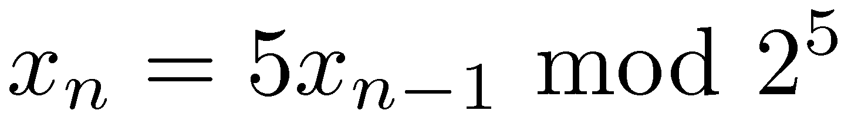
Types of LCG
Mixed LCG
  c > 0
  Example:
Multiplicative LCG
  c = 0
  Example:
  Generally performs as well as mixed LCG

Slide 12
Example
Using a seed of x₀ = 1:
5, 25, 29, 17, 21, 9, 13, 1, 5,…
Period = 8
With x₀ = 2:
10, 18, 26, 2, 10,…
Period is only 4
Note: Full period is a nice property but uniformity and independence are more important

Slide 13
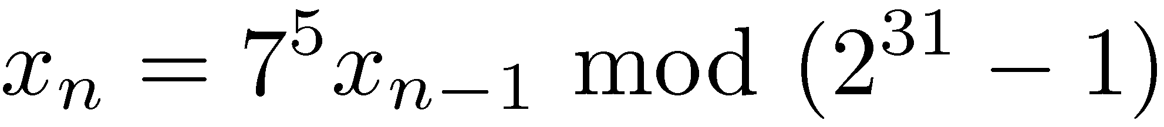
Example RNGs
A currently popular multiplicative LCG is:
  2³¹-1 is a prime number and 7⁵ is a primitive root of it
  → Full period of 2³¹-2.
This generator has been extensively analyzed and shown to be good
See the following book for advanced RNGs:
Numerical Recipes: The Art of Scientific Computing
http://www.nr.com/

Slide 14
Tips for Seed Selection
Seed selection
  Any value in the sequence can be used to “seed” the generator
Do not use random seeds: such as the time of day
  Cannot reproduce. Cannot guarantee non-overlap.
Do not use zero:
  Fine for mixed LCGs
  But multiplicative LCGs will be stuck at zero
Avoid even values:
  For multiplicative LCG with modulus m=2^{k}, the seed should be odd
Do not use successive seeds
  May result in strong correlation
Better to avoid generators that have too many conditions on seed values or whose performance (period and randomness) depends upon the seed value.

Slide 15

Random-Number Streams
Multi-stream simulations: need more than one random stream
  Do not subdivide one stream: the sub-streams may be correlated
  Use non-overlapping streams
A random-number stream:
  Refers to a starting seed taken from the sequence of random numbers $x_{0},x_{1},…$
A single random-number generator with $k$ streams can act like $k$ distinct virtual random-number generators
  Choose the seeds for each stream to be far apart
  To have streams that are $b$ values apart, stream $i$ could be defined by starting seed:
  $$S_{i}=x_{b\left(i−1\right)}$$
  Older generators: $b={10}^{5}$; Newer generators: $b={10}^{37}$

Slide 16
Myths About Random-Number Generation (1 of 3)
A complex set of operations leads to random results.
It is better to use simple operations that can be analytically evaluated for randomness.
Random numbers are unpredictable.
Easy to compute the parameters, a, c, and m from a few numbers => LCGs are unsuitable for cryptographic applications

Slide 17
Myths (2 of 3)
Some seeds are better than others. May be true for some generators.
  Works correctly for all seeds except x₀ = 37911
  Stuck at x_{n}= 37911 forever
  Such generators should be avoided
  Any non-zero seed in the valid range should produce an equally good sequence
  Generators whose period or randomness depends upon the seed should not be used, since an unsuspecting user may not remember to follow all the guidelines

Slide 18
Myths (3 of 3)
Accurate implementation is not important.
  RNGs must be implemented without any overflow or truncation
  For example:
  Straightforward multiplication above may produce overflow.

