Slide 1

CPSC 531:
System Modeling and Simulation
Carey Williamson
Department of Computer Science
University of Calgary
Fall 2017

Slide 2
Overview
The world a model-builder sees is probabilistic rather than deterministic:
  Some probability model might well describe the variations
Goals:
Review the fundamental concepts of probability
Understand the difference between discrete and continuous random variable
Review the most common probability models

Slide 3
Outline
Probability and random variables
  Random experiment and random variable
  Probability mass/density functions
  Expectation, variance, covariance, correlation
Probability distributions
  Discrete probability distributions
  Continuous probability distributions
  Empirical probability distributions

Slide 4
Outline
Probability and random variables
  Random experiment and random variable
  Probability mass/density functions
  Expectation, variance, covariance, correlation
Probability distributions
  Discrete probability distributions
  Continuous probability distributions
  Empirical probability distribution

Slide 5
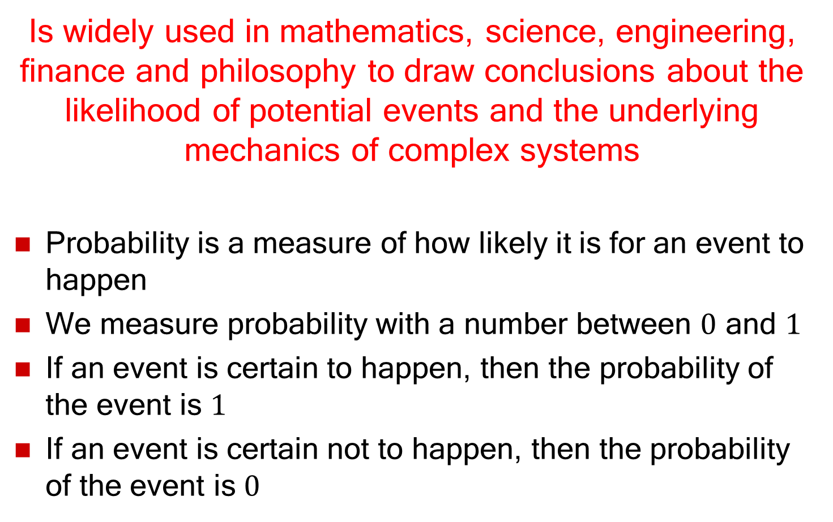
Probability
Is widely used in mathematics, science, engineering, finance and philosophy to draw conclusions about the likelihood of potential events and the underlying mechanics of complex systems
Probability is a measure of how likely it is for an event to happen
We measure probability with a number between $0$ and $1$
If an event is certain to happen, then the probability of the event is $1$
If an event is certain not to happen, then the probability of the event is $0$

Slide 6
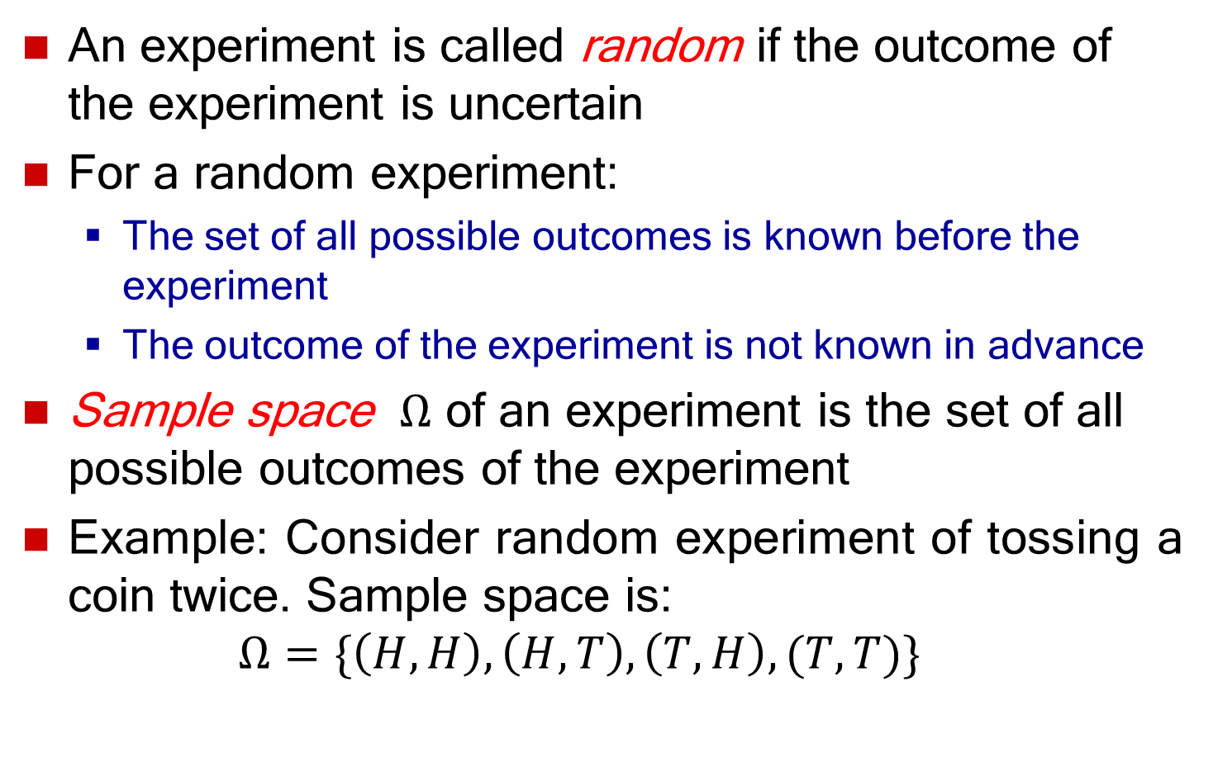
Random Experiment
An experiment is called random if the outcome of the experiment is uncertain
For a random experiment:
  The set of all possible outcomes is known before the experiment
  The outcome of the experiment is not known in advance
Sample space $Ω$ of an experiment is the set of all possible outcomes of the experiment
Example: Consider random experiment of tossing a coin twice. Sample space is:
$$Ω=\{\left(H,H\right), \left(H, T\right), \left(T,H\right), (T,T)\}$$

Slide 7
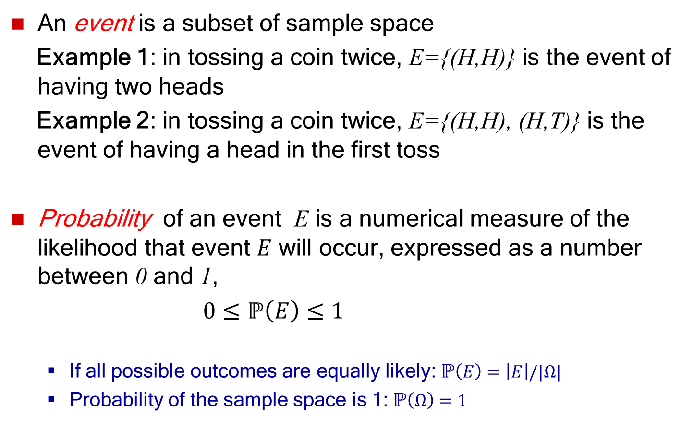
Probability of Events
An event is a subset of sample space
Example 1: in tossing a coin twice, E={(H,H)} is the event of having two heads
Example 2: in tossing a coin twice, E={(H,H), (H,T)} is the event of having a head in the first toss
Probability of an event E is a numerical measure of the likelihood that event $E$ will occur, expressed as a number between 0 and 1,
$0≤ℙ\left(E\right)≤1$
  If all possible outcomes are equally likely: $ℙ\left(E\right)=\left|E\right|/|Ω|$
  Probability of the sample space is 1:$ℙ\left(Ω\right)=1$

Slide 8
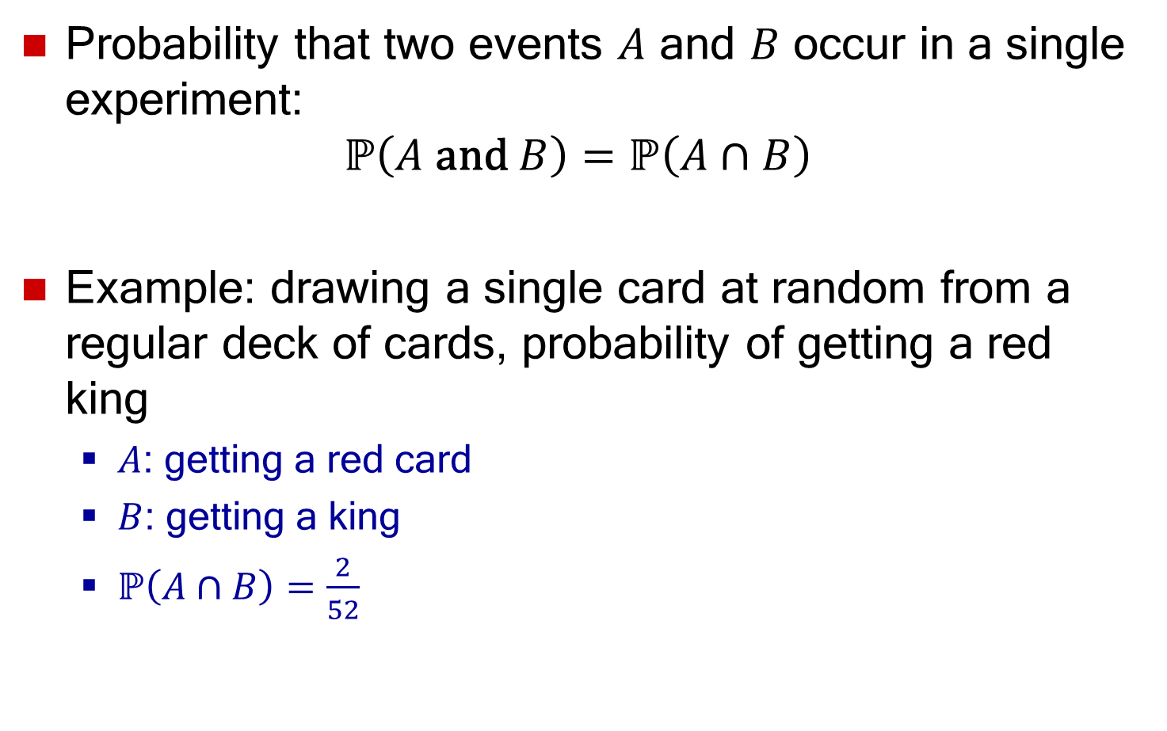
Joint Probability
Probability that two events $A$ and $B$ occur in a single experiment:
$$ℙ\left(A \text{and} B\right)=ℙ\left(A∩B\right)$$
Example: drawing a single card at random from a regular deck of cards, probability of getting a red king
  $A$: getting a red card
  $B$: getting a king
  $ℙ\left(A∩B\right)=\frac{2}{52}$

Slide 9
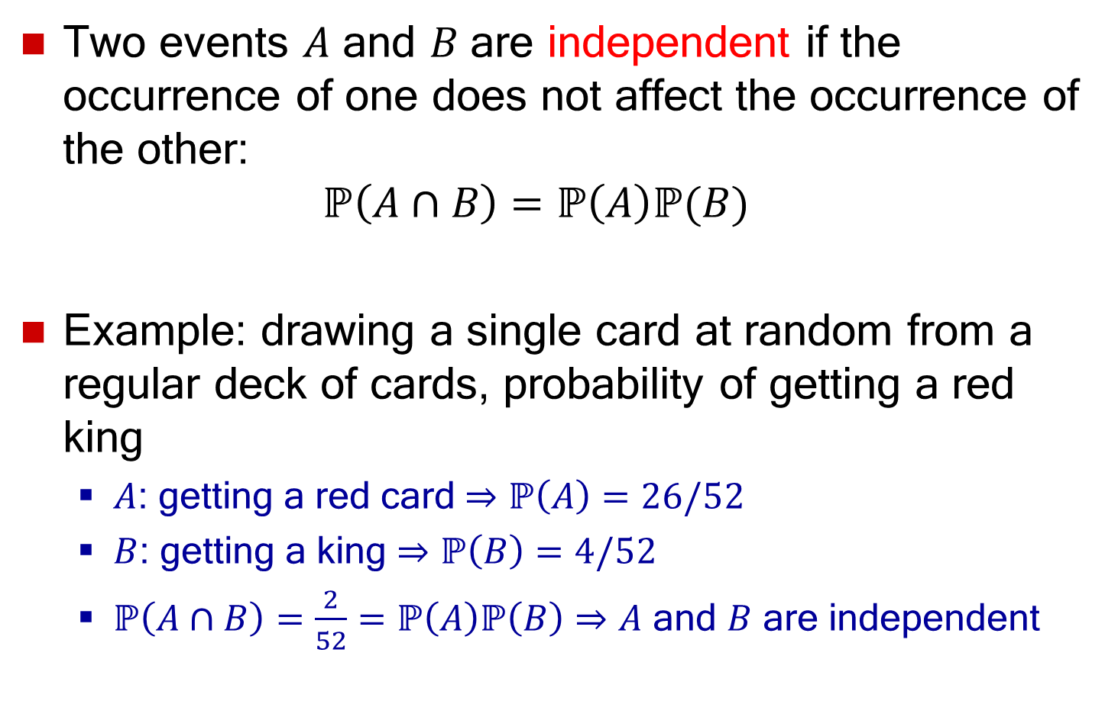
Independent Events
Two events $A$ and $B$ are independent if the occurrence of one does not affect the occurrence of the other:
$ℙ\left(A∩B\right)=ℙ\left(A\right)ℙ(B)$
Example: drawing a single card at random from a regular deck of cards, probability of getting a red king
  $A$: getting a red card $⇒$ $ℙ\left(A\right)=26/52$
  $B$: getting a king $⇒$ $ℙ\left(B\right)=4/52$
  $ℙ\left(A∩B\right)=\frac{2}{52}=ℙ\left(A\right)ℙ\left(B\right)⇒A$ and $B$ are independent

Slide 10
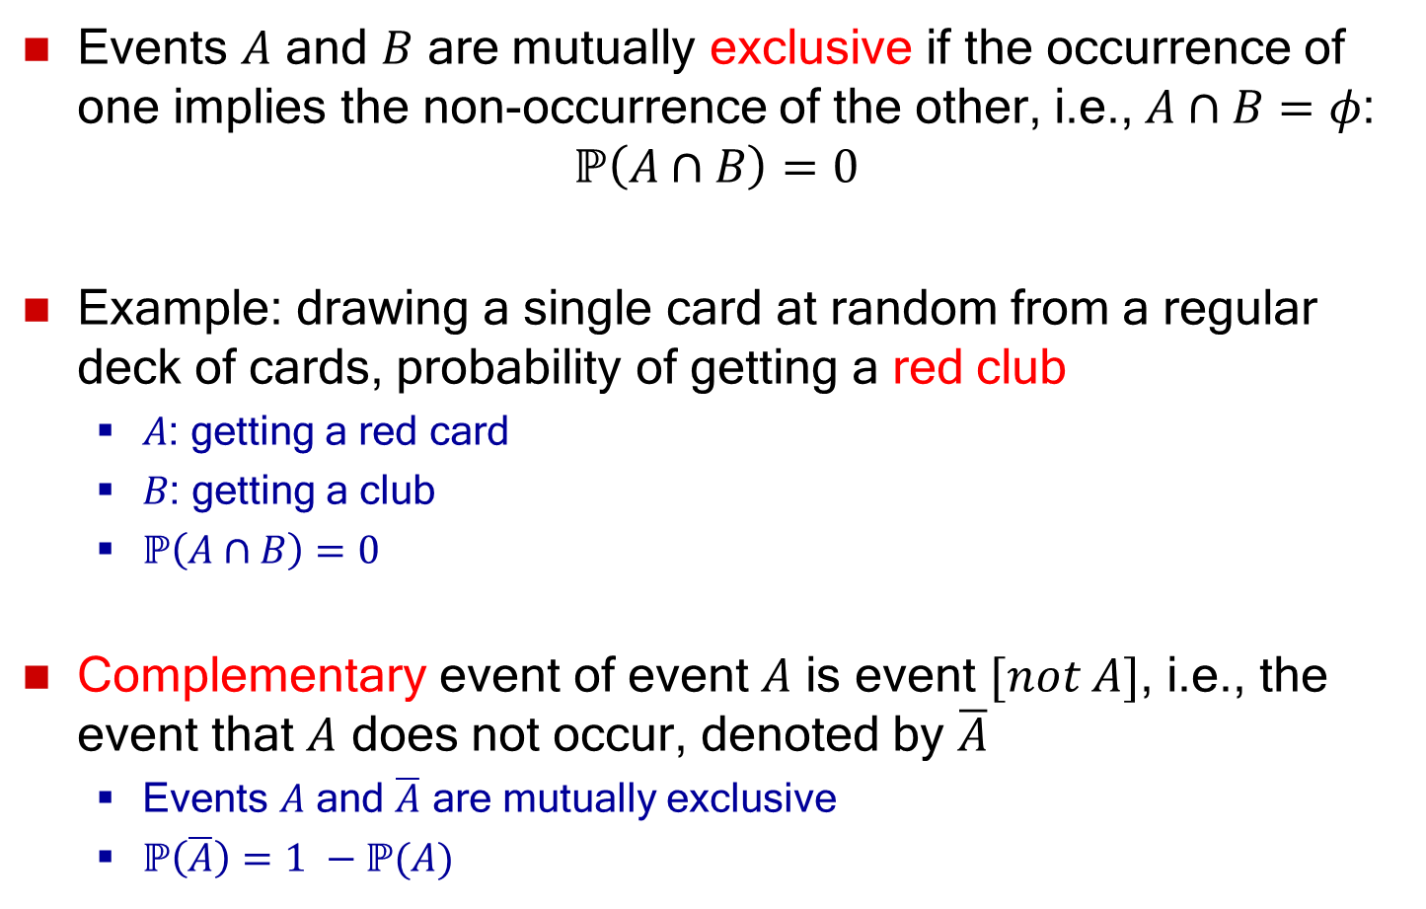
Mutually Exclusive Events
Events $A$ and $B$ are mutually exclusive if the occurrence of one implies the non-occurrence of the other, i.e.,$A∩B=φ$:
$$ℙ\left(A∩B\right)=0$$
Example: drawing a single card at random from a regular deck of cards, probability of getting a red club
  $A$: getting a red card
  $B$: getting a club
  $ℙ\left(A∩B\right)=0$
Complementary event of event $A$ is event $[not A]$, i.e., the event that $A$ does not occur, denoted by $\overline{A}$
  Events $A$ and $\overline{A}$ are mutually exclusive
  $ℙ\left(\overline{A}\right)=1 −ℙ(A)$

Slide 11
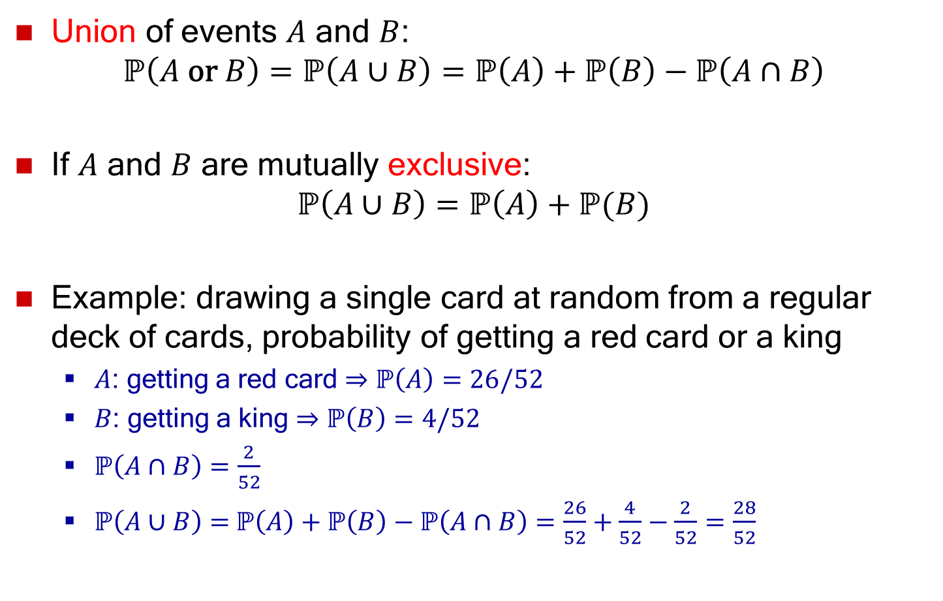
Union Probability
Union of events $A$ and $B$:
$$ℙ\left(A \text{or} B\right)=ℙ\left(A∪B\right)=ℙ\left(A\right)+ℙ\left(B\right)−ℙ\left(A∩B\right)$$
If $A$ and $B$ are mutually exclusive:
$$ℙ\left(A∪B\right)=ℙ\left(A\right)+ℙ(B)$$
Example: drawing a single card at random from a regular deck of cards, probability of getting a red card or a king
  $A$: getting a red card $⇒$ $ℙ\left(A\right)=26/52$
  $B$: getting a king $⇒$ $ℙ\left(B\right)=4/52$
  $ℙ\left(A∩B\right)=\frac{2}{52}$
  $ℙ\left(A∪B\right)=$ $ℙ\left(A\right)+ℙ\left(B\right)−ℙ\left(A∩B\right)=\frac{26}{52}+\frac{4}{52}−\frac{2}{52}=\frac{28}{52}$

Slide 12
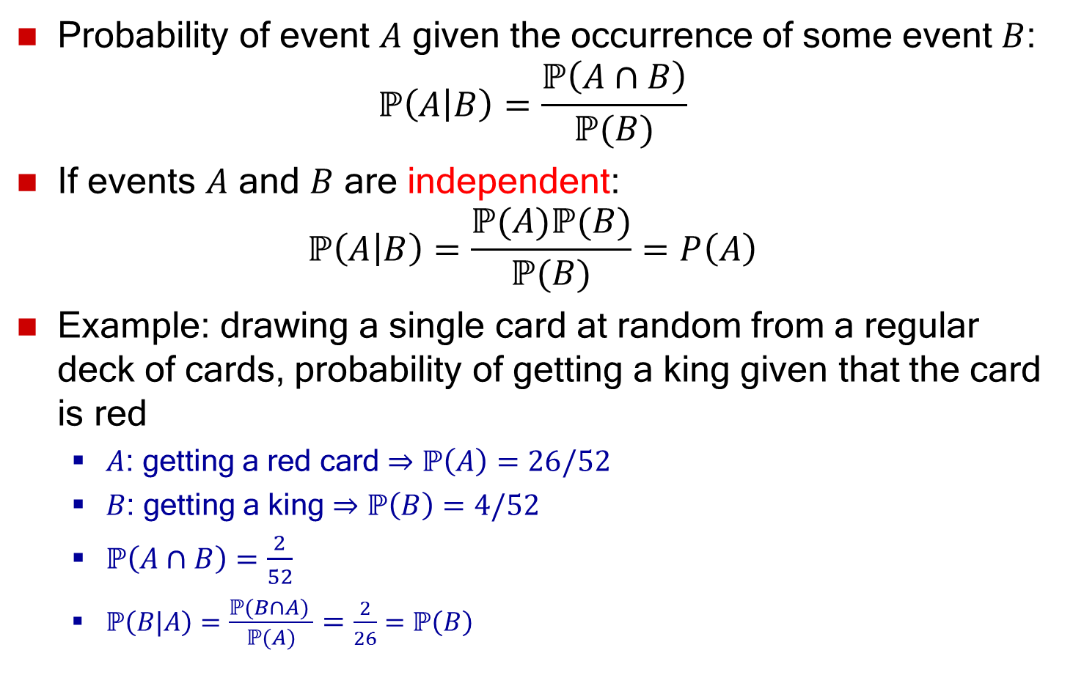
Conditional Probability
Probability of event $A$ given the occurrence of some event $B$:
$ℙ\left(A | B\right)=\frac{ℙ\left(A∩B\right)}{ℙ(B)}$
If events $A$ and $B$ are independent:
$$ℙ\left(A | B\right)=\frac{ℙ(A)ℙ(B)}{ℙ(B)}=P\left(A\right)$$
Example: drawing a single card at random from a regular deck of cards, probability of getting a king given that the card is red
  $A$: getting a red card $⇒$ $ℙ\left(A\right)=26/52$
  $B$: getting a king $⇒$ $ℙ\left(B\right)=4/52$
  $ℙ\left(A∩B\right)=\frac{2}{52}$
  $ℙ\left(B|A\right)=\frac{ℙ(B∩A) }{ℙ(A)}=\frac{2}{26}=ℙ\left(B\right)$

Slide 13
Random Variable
A numerical value can be associated with each outcome of an experiment
A random variable X is a function from the sample space Ω to the real line that assigns a real number X(s) to each element s of Ω
X: Ω → R
Random variable takes on its values with some probability

Slide 14
Random Variable
Example: Consider random experiment of tossing a coin twice. Sample space is:
Ω = {(H,H), (H,T), (T,H), (T,T)}
Define random variable X as the number of heads in the experiment:
X((T,T)) = 0, X((H,T))=1,
X((T,H)) = 1, X((H,H))=2
Example: Rolling a die.
Sample space Ω = {1,2,3,4,5,6).
Define random variable X as the number rolled:
X(j) = j, 1 ≤ j ≤ 6

Slide 15
Random Variable
Example: roll two fair dice and observe the outcome
Sample space = {(i,j) | 1 ≤ i ≤ 6, 1 ≤ j ≤ 6}
i: integer from the first die
j: integer from the second die
(1,1) | (1,2) | (1,3) | (1,4) | (1,5) | (1,6)
(2,1) | (2,2) | (2,3) | (2,4) | (2,5) | (2,6)
(3,1) | (3,2) | (3,3) | (3,4) | (3,5) | (3,6)
(4,1) | (4,2) | (4,3) | (4,4) | (4,5) | (4,6)
(5,1) | (5,2) | (5,3) | (5,4) | (5,5) | (5,6)
(6,1) | (6,2) | (6,3) | (6,4) | (6,5) | (6,6)
Possible outcomes

Slide 16
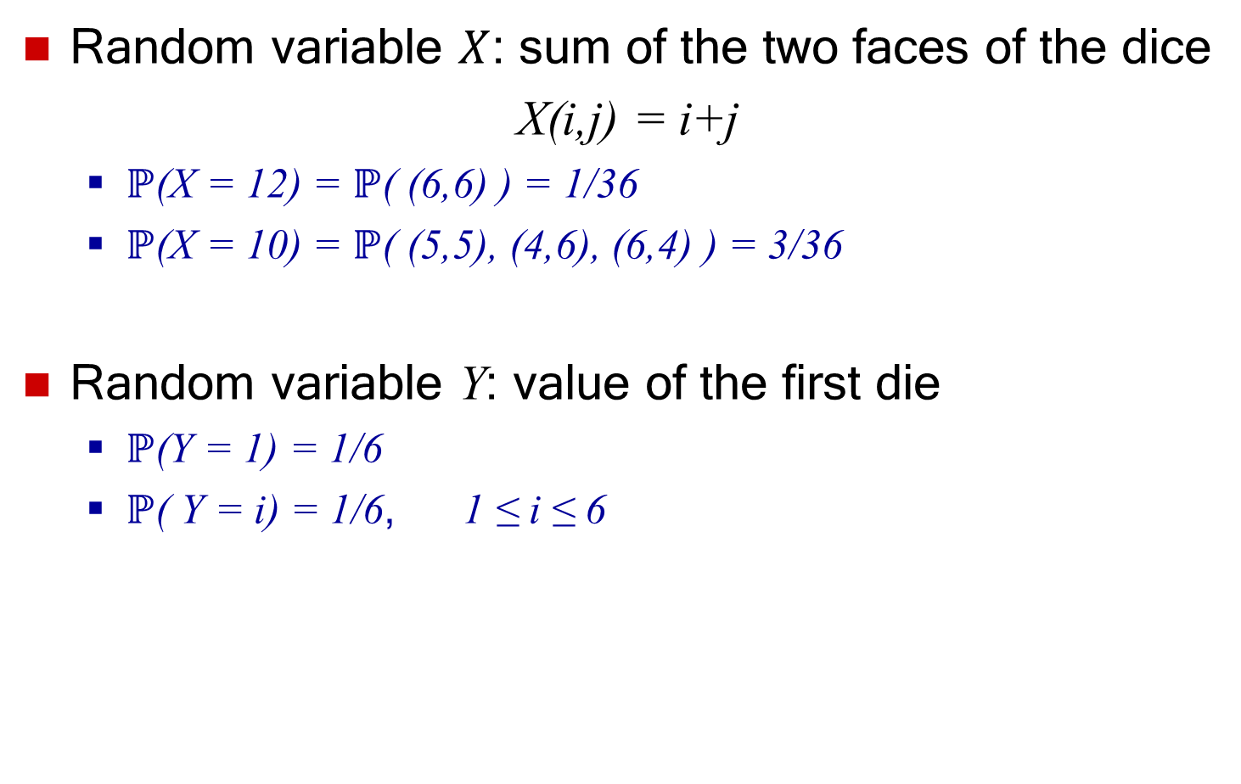
Random Variable
Random variable $X$: sum of the two faces of the dice
X(i,j) = i+j
  $ℙ$(X = 12) = $ℙ$( (6,6) ) = 1/36
  $ℙ$(X = 10) = $ℙ$( (5,5), (4,6), (6,4) ) = 3/36
Random variable Y: value of the first die
  $ℙ$(Y = 1) = 1/6
  $ℙ$( Y = i) = 1/6, 1 ≤ i ≤ 6

Slide 17
Types of Random Variables
Discrete
  Random variables whose set of possible values can be written as a finite or infinite sequence
  Example: number of requests sent to a web server
Continuous
  Random variables that take a continuum of possible values
  Example: time between requests sent to a web server

Slide 18
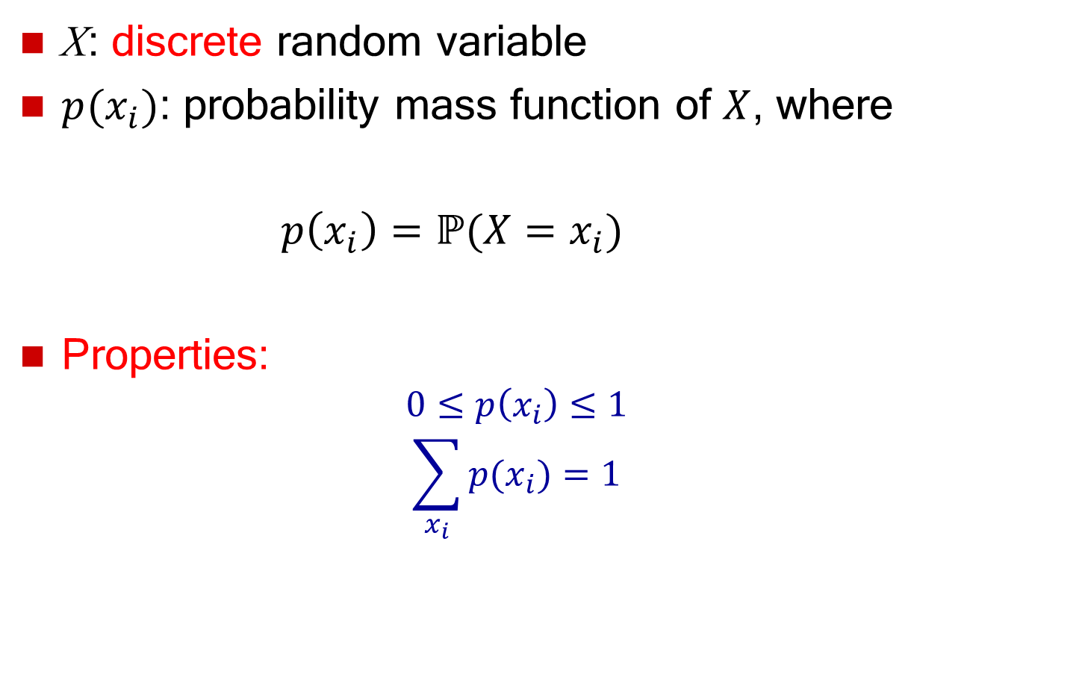
Probability Mass Function (PMF)
X: discrete random variable
$p(x_{i})$: probability mass function of $X$, where
$p\left(x_{i}\right)=ℙ⁡(X=x_{i})$
Properties:
  $$0≤p\left(x_{i}\right)≤1$$
  $$\sum_{x_{i}}{p(x_{i})}=1$$

Slide 19
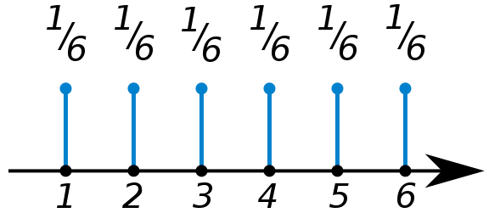
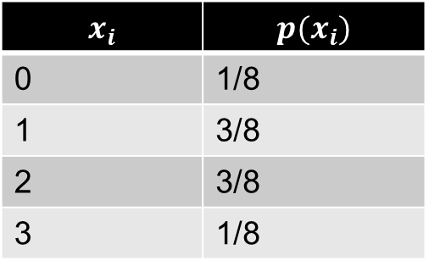


PMF Examples
Number of heads in tossing three coins
$$\sum_{x_{i}}{p\left(x_{i}\right)=\frac{1}{8}+\frac{3}{8}+\frac{3}{8}+\frac{1}{8}=1}$$
Number rolled in rolling a fair die
$$\sum_{x_{i}}{p\left(x_{i}\right)=\frac{1}{6}+\frac{1}{6}+\frac{1}{6}+\frac{1}{6}+\frac{1}{6}+\frac{1}{6}=1}$$
$$x_{i}$$ | $$p(x_{i})$$
0 | 1/8
1 | 3/8
2 | 3/8
3 | 1/8

Slide 20
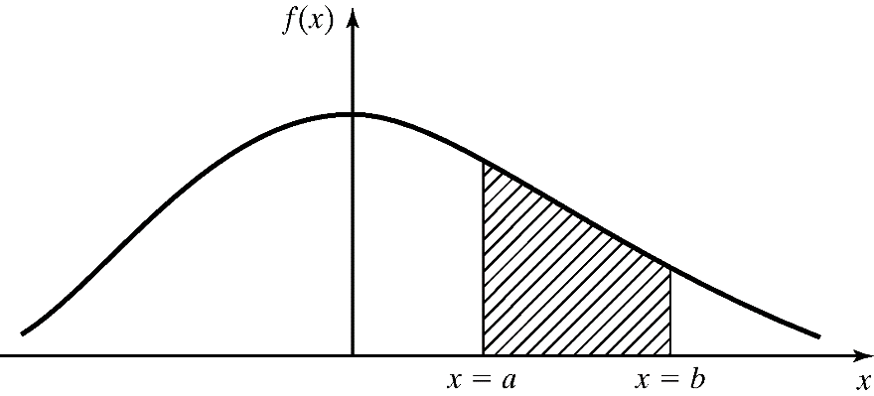

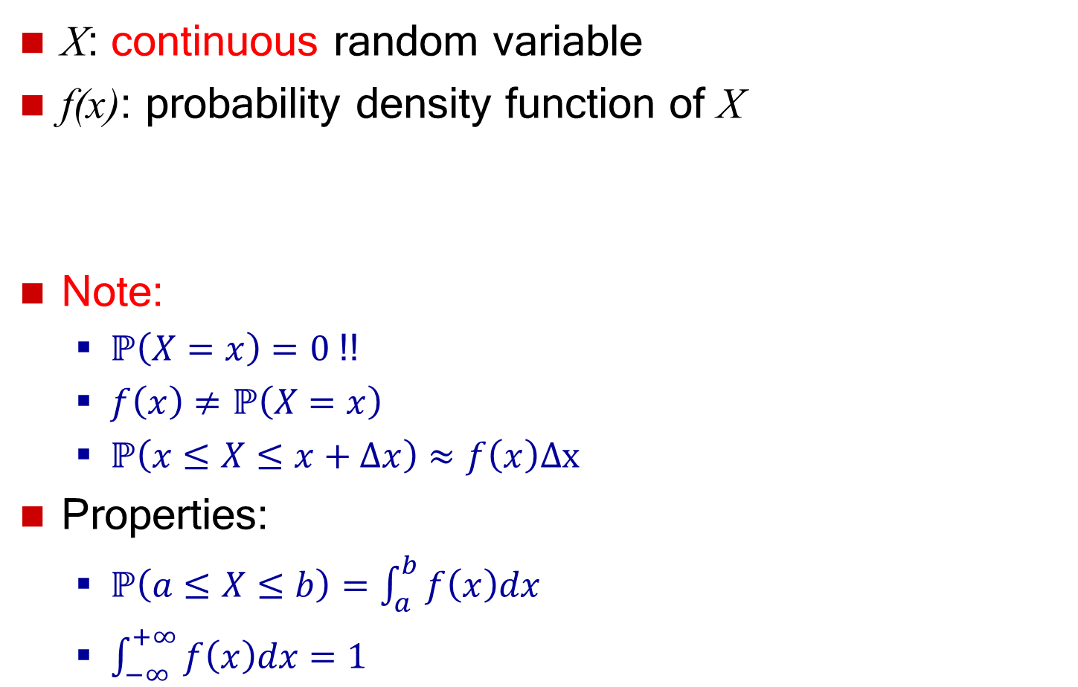
Probability Density Function (PDF)
X: continuous random variable
f(x): probability density function of X
Note:
  $ℙ\left(X=x\right)=0$ !!
  $f\left(x\right)≠ℙ\left(X=x\right)$
  $ℙ\left(x≤X≤x+Δx\right)≈f\left(x\right)Δx$
Properties:
  $ℙ\left(a≤X≤b\right)=\int_{a}^{b}{f\left(x\right)dx}$
  $\int_{−∞}^{+∞}{f\left(x\right)dx}=1$
CDF of $X$

Slide 21
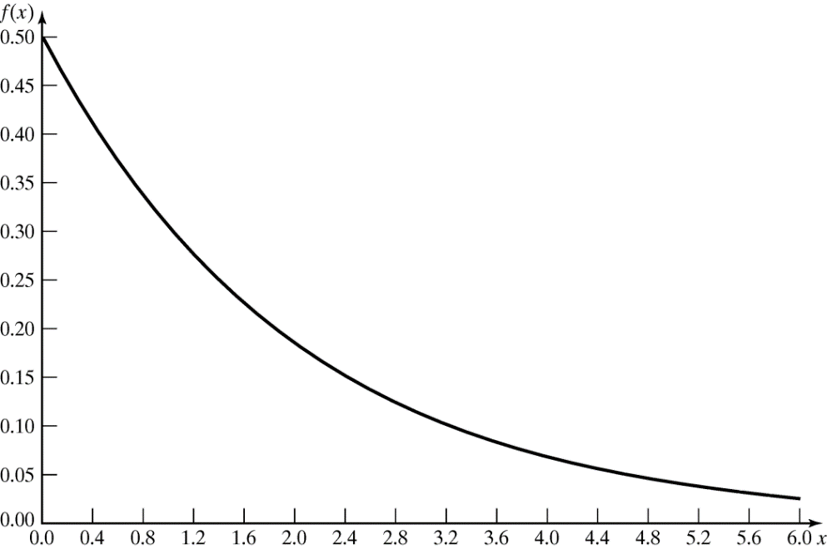
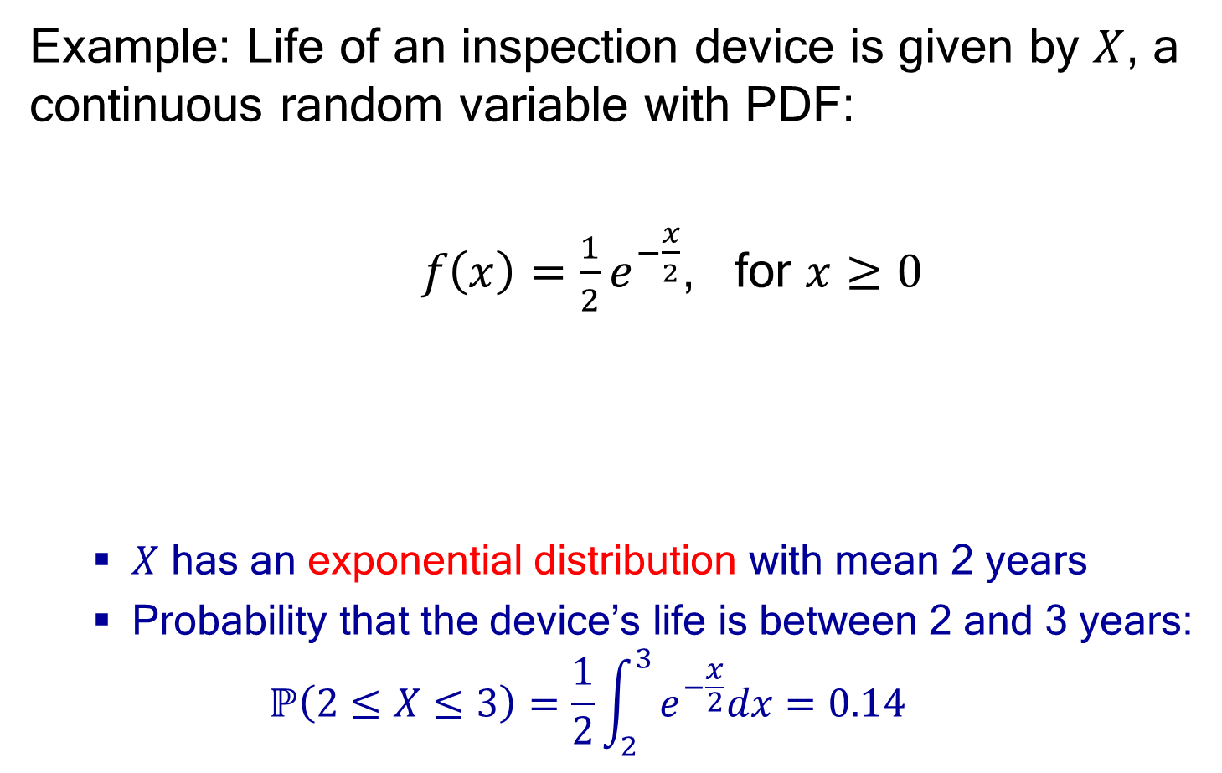
Probability Density Function
Example: Life of an inspection device is given by $X$, a continuous random variable with PDF:
$f\left(x\right)=\frac{1}{2}e^{−\frac{x}{2}}$, for $x≥0$
  $X$ has an exponential distribution with mean 2 years
  Probability that the device’s life is between 2 and 3 years:
  $$ℙ\left(2≤X≤3\right)=\frac{1}{2}\int_{2}^{3}{e^{−\frac{x}{2}}dx=0.14}$$

Slide 22
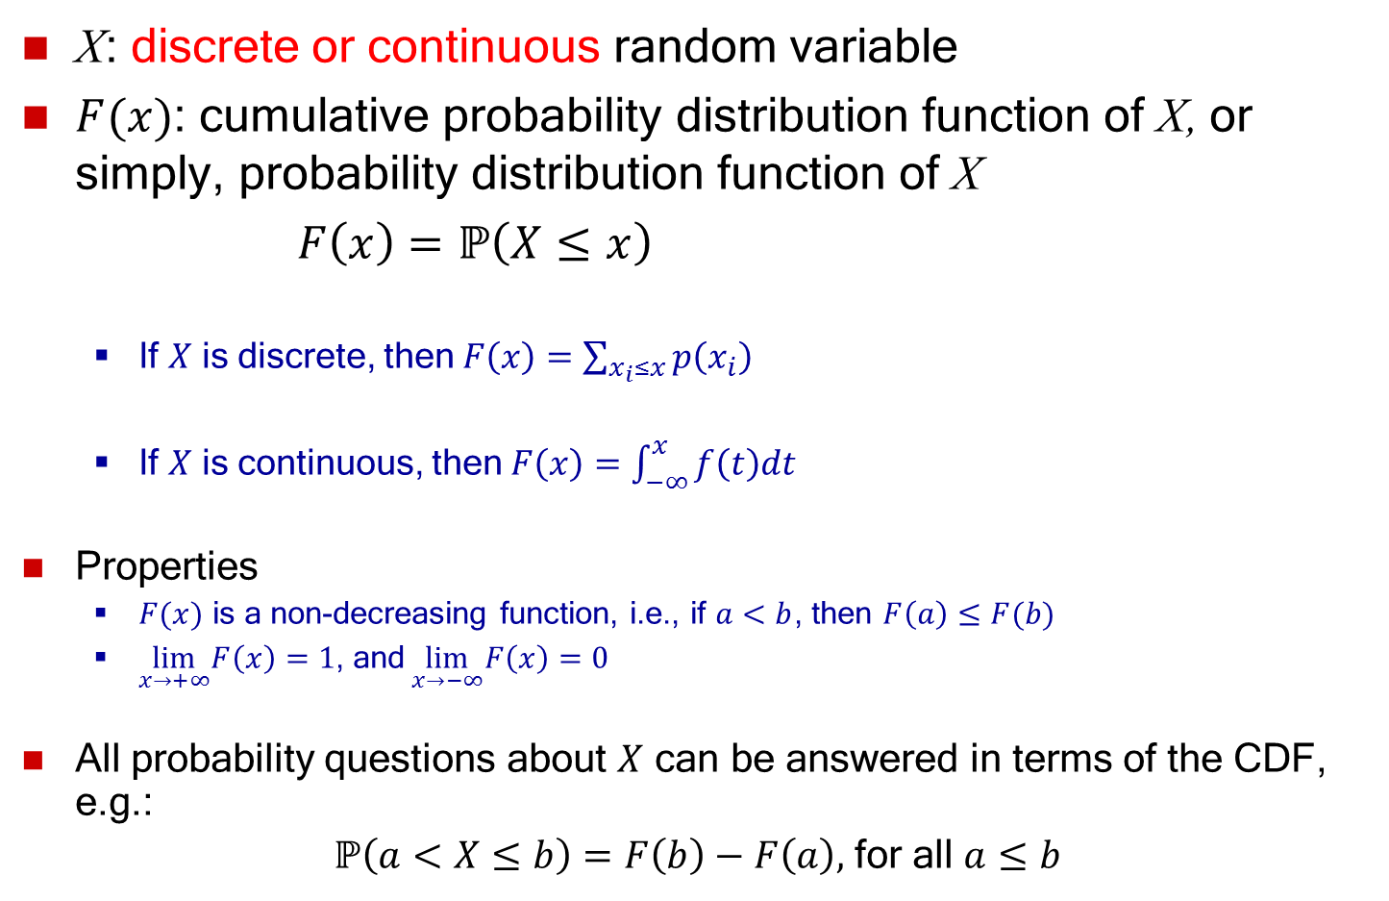
Cumulative Distribution Function (CDF)
X: discrete or continuous random variable
$F(x)$: cumulative probability distribution function of X, or simply, probability distribution function of X
$F\left(x\right)=ℙ\left(X≤x\right)$
  If $X$ is discrete, then $F\left(x\right)=\sum_{x_{i}≤x}{p\left(x_{i}\right)}$
  If $X$ is continuous, then $F\left(x\right)=\int_{−∞}^{x}{f\left(t\right)dt }$
Properties
  $F(x)$ is a non-decreasing function, i.e., if $a<b$, then $F\left(a\right)≤F(b)$
  $\lim_{x→+∞}F\left(x\right)=1$, and$\lim_{x→−∞}F\left(x\right)=0$
All probability questions about $X$ can be answered in terms of the CDF, e.g.:
$ℙ\left(a<X≤b\right)=F\left(b\right)−F\left(a\right),$ for all $a≤b$

Slide 23
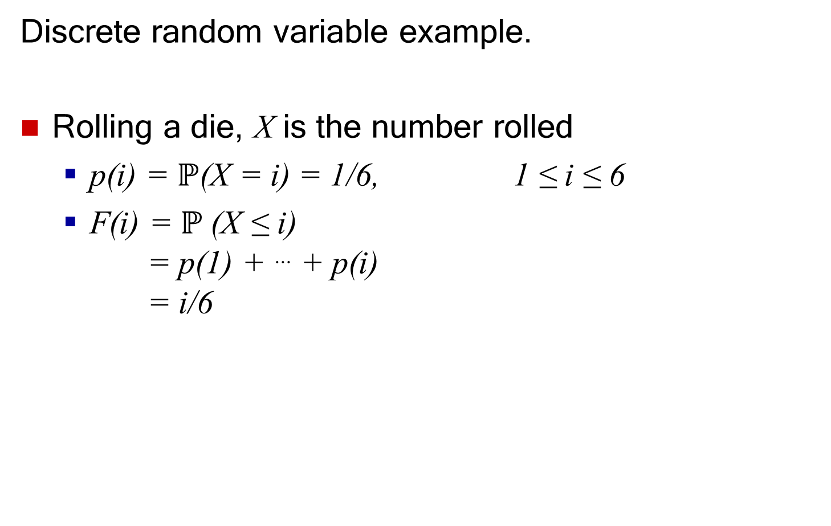
Cumulative Distribution Function
Discrete random variable example.
Rolling a die, X is the number rolled
  p(i) = $ℙ$(X = i) = 1/6, 1 ≤ i ≤ 6
  F(i) = $ℙ$(X ≤ i)
  = p(1) + … + p(i)
  = i/6

Slide 24
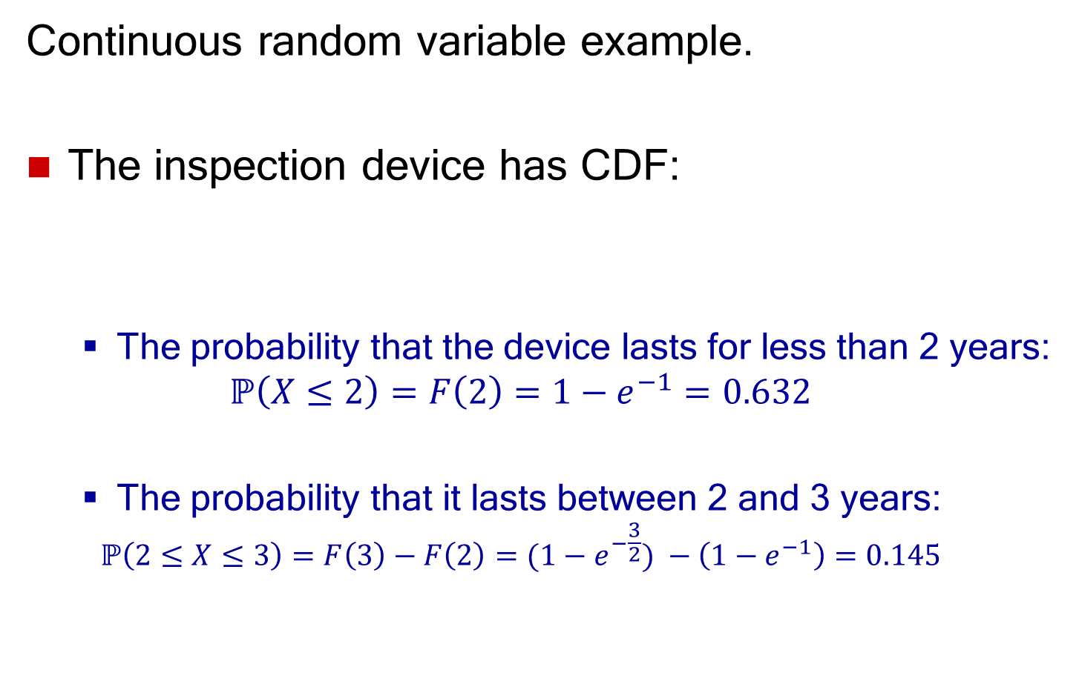
Cumulative Distribution Function
Continuous random variable example.
The inspection device has CDF:
  The probability that the device lasts for less than 2 years:
  $$ℙ\left(X≤2\right)=F\left(2\right)=1−e^{−1}=0.632$$
  The probability that it lasts between 2 and 3 years:
  $$ℙ\left(2≤X≤3\right)=F\left(3\right)−F\left(2\right)=(1−e^{−\frac{3}{2}}) −\left(1−e^{−1}\right)=0.145$$

Slide 25
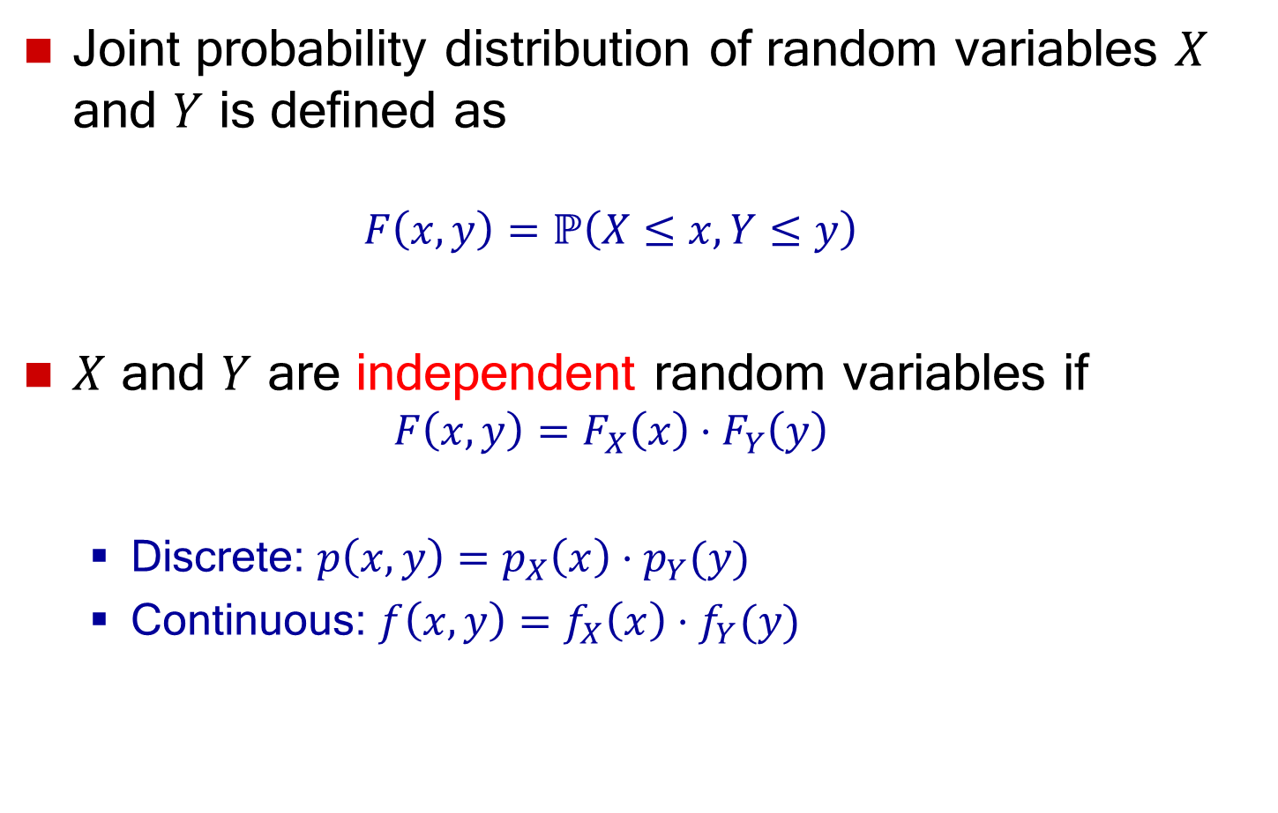
Joint Probability Distribution
Joint probability distribution of random variables $X$ and $Y$ is defined as
  $$F\left(x,y\right)=ℙ\left(X≤x, Y≤y\right)$$
$X$ and $Y$ are independent random variables if
  $$F\left(x,y\right)=F_{X}\left(x\right)⋅F_{Y}\left(y\right)$$
  Discrete: $p\left(x, y\right)=p_{X}\left(x\right)⋅p_{Y}(y)$
  Continuous: $f\left(x,y\right)=f_{X}\left(x\right)⋅f_{Y}(y)$

Slide 26
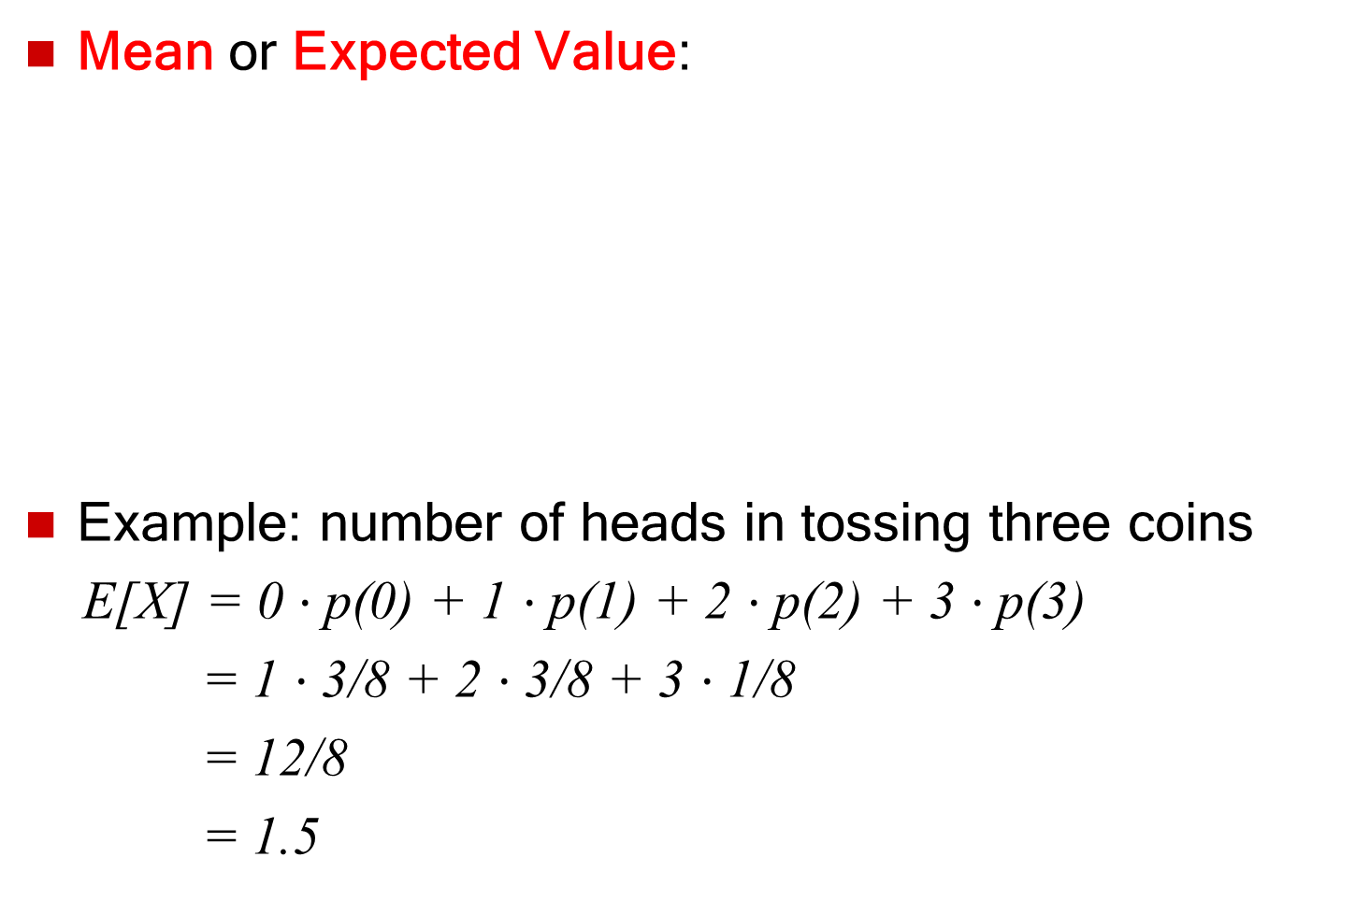
Expectation of a Random Variable
Mean or Expected Value:
Example: number of heads in tossing three coins
E[X] = 0 $⋅$p(0) + 1 $⋅$p(1) + 2 $⋅$p(2) + 3 $⋅$p(3)
= 1 $⋅$3/8 + 2 $⋅$3/8 + 3 $⋅$1/8
= 12/8
= 1.5

Slide 27
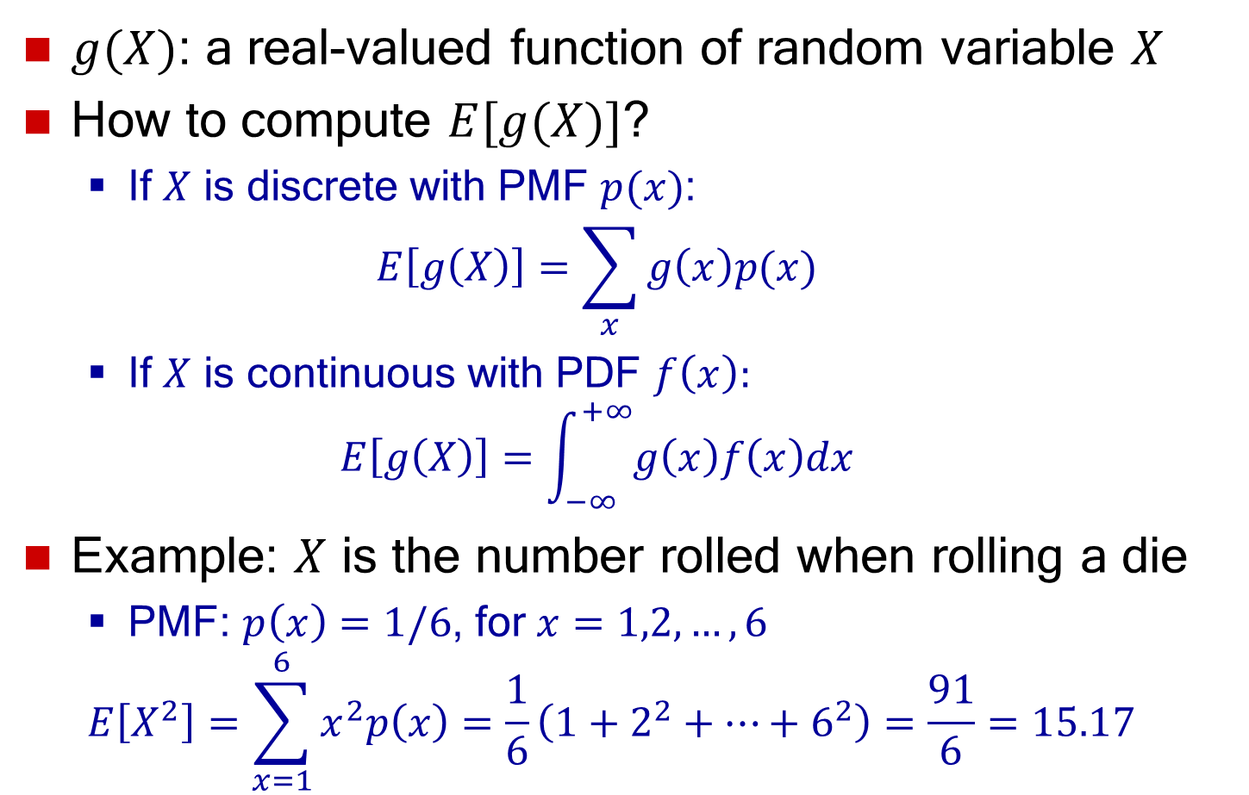
Expectation of a Function
$g(X)$: a real-valued function of random variable $X$
How to compute $E[g(X)]$?
  If $X$ is discrete with PMF $p(x)$:
  $E\left[g\left(X\right)\right]=\sum_{x}{g\left(x\right)p(x)}$
  If $X$ is continuous with PDF $f\left(x\right):$
  $E\left[g\left(X\right)\right]=\int_{−∞}^{+∞}{g\left(x\right)f\left(x\right)dx}$
Example: $X$ is the number rolled when rolling a die
  PMF: $p\left(x\right)=1/6$, for $x=1,2,…,6$
  $$E\left[X^{2}\right]=\sum_{x=1}^{6}{x^{2}p\left(x\right)}=\frac{1}{6}\left(1+2^{2}+⋯+6^{2}\right)=\frac{91}{6}=15.17$$

Slide 28
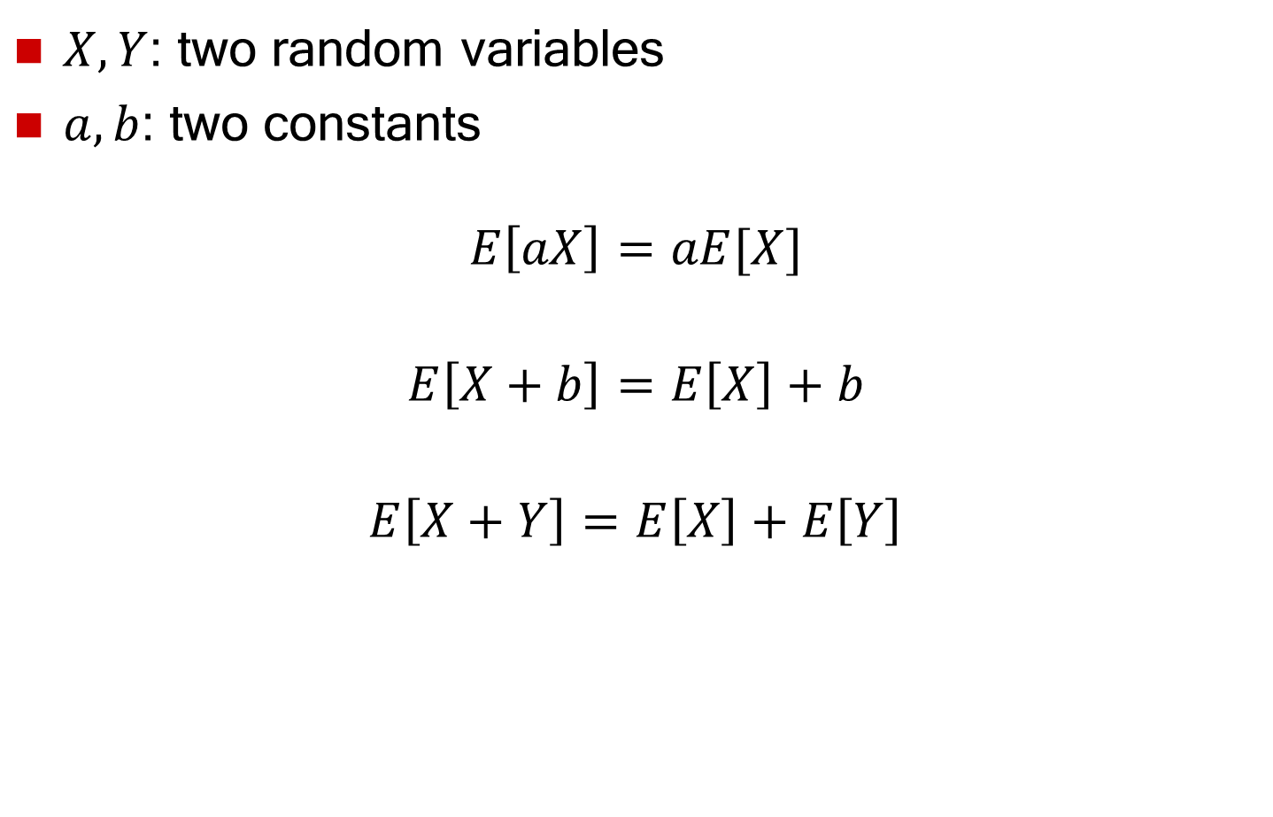
Properties of Expectation
$X, Y$: two random variables
$a, b$: two constants
$$E\left[aX\right]=aE[X]$$
$$E\left[X+b\right]=E\left[X\right]+b$$
$$E\left[X+Y\right]=E\left[X\right]+E\left[Y\right]$$

Slide 29
Misuses of Expectations
Multiplying means to get the mean of a product
Example: tossing three coins
  X: number of heads
  Y: number of tails
  E[X] = E[Y] = 3/2 ⇒ E[X]E[Y] = 9/4
  E[XY] = 3/2
  ⇒ E[XY] ≠ E[X]E[Y]
Dividing means to get the mean of a ratio

Slide 30
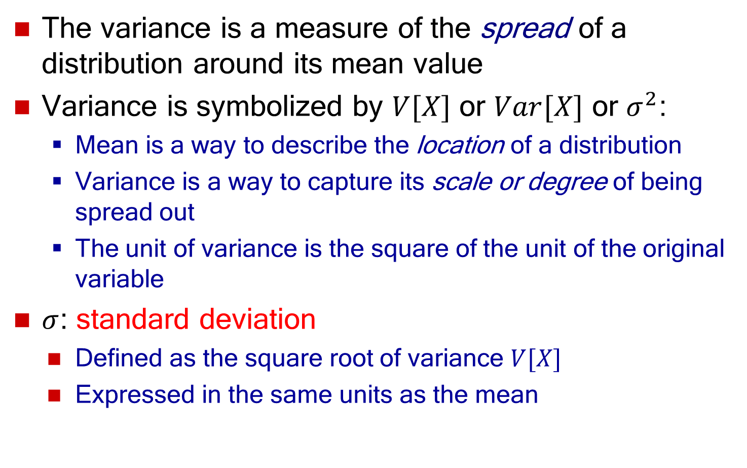
Variance of a Random Variable
The variance is a measure of the spread of a distribution around its mean value
Variance is symbolized by $V[X]$ or $Var[X]$ or $σ^{2}$:
  Mean is a way to describe the location of a distribution
  Variance is a way to capture its scale or degree of being spread out
  The unit of variance is the square of the unit of the original variable
  $σ$: standard deviation
    Defined as the square root of variance $V[X]$
    Expressed in the same units as the mean

Slide 31
Variance of a Random Variable
Variance: The expected value of the square of distance between a random variable and its mean
where, μ= E[X]
Equivalently:
σ² = E[X²] – (E[X])²

Slide 32
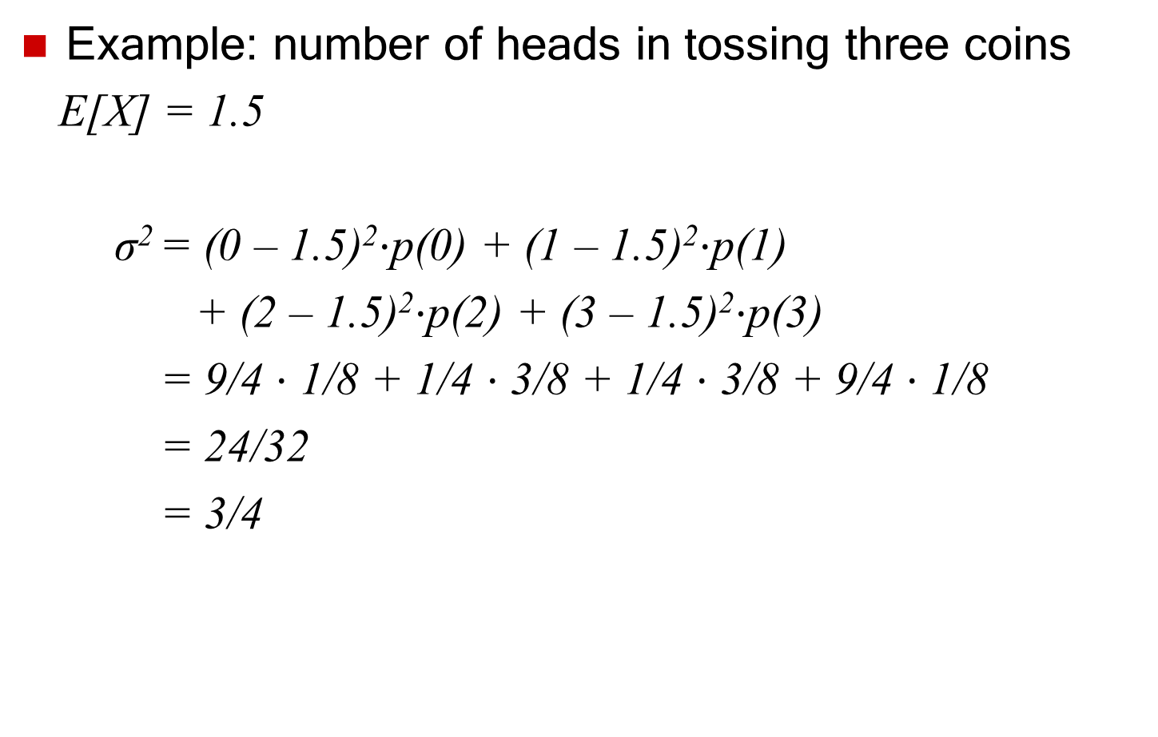
Variance of a Random Variable
Example: number of heads in tossing three coins
E[X] = 1.5
σ² = (0 – 1.5)²$⋅$p(0) + (1 – 1.5)²$⋅$p(1)
+ (2 – 1.5)²$⋅$p(2) + (3 – 1.5)²$⋅$p(3)
= 9/4 $⋅$ 1/8 + 1/4 $⋅$ 3/8 + 1/4 $⋅$ 3/8 + 9/4 $⋅$ 1/8
= 24/32
= 3/4

Slide 33
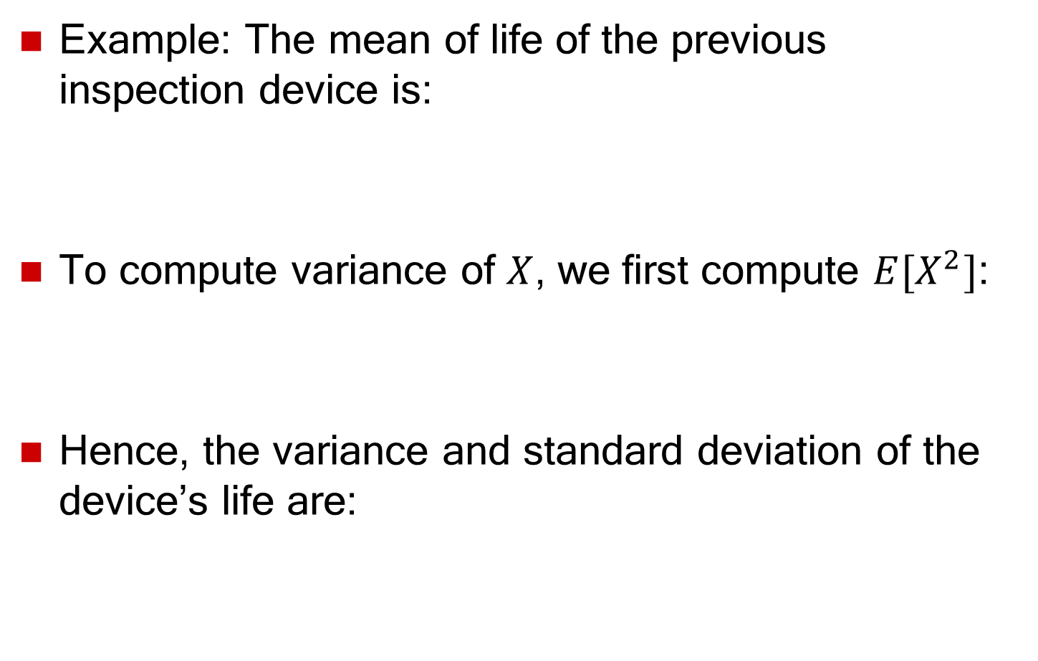
Variance of a Random Variable
Example: The mean of life of the previous inspection device is:
To compute variance of $X$, we first compute $E[X^{2}]$:
Hence, the variance and standard deviation of the device’s life are:

Slide 34
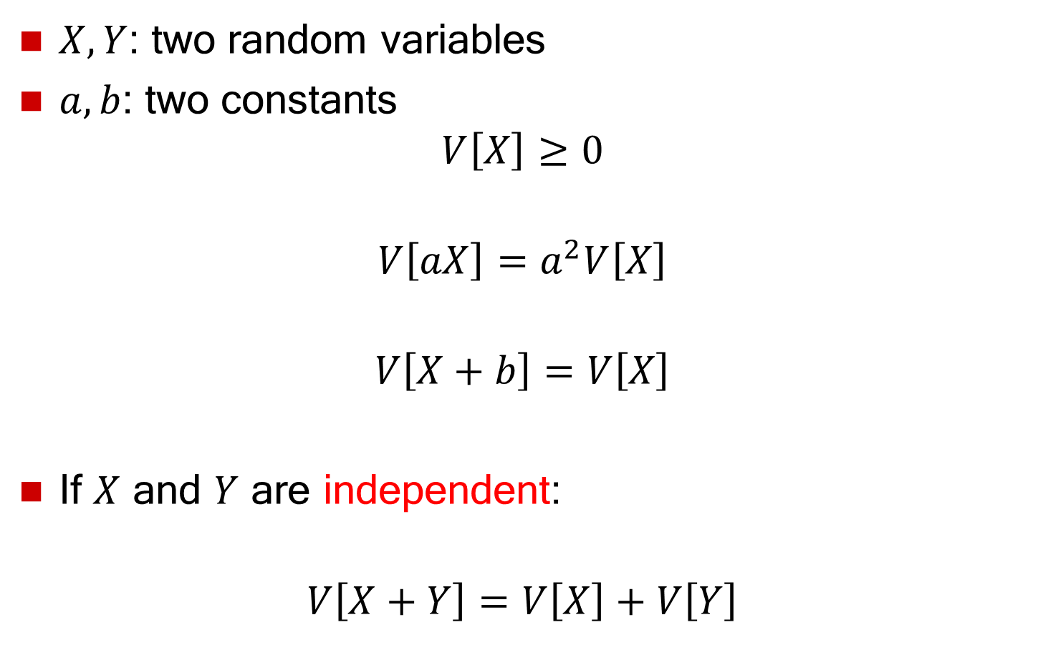
Properties of Variance
$X, Y$: two random variables
$a, b$: two constants
$V\left[X\right]≥0$
$$V\left[aX\right]=a^{2}V\left[X\right]$$
$$V\left[X+b\right]=V\left[X\right]$$
If $X$ and $Y$ are independent:
$$V\left[X+Y\right]=V\left[X\right]+V\left[Y\right]$$

Slide 35
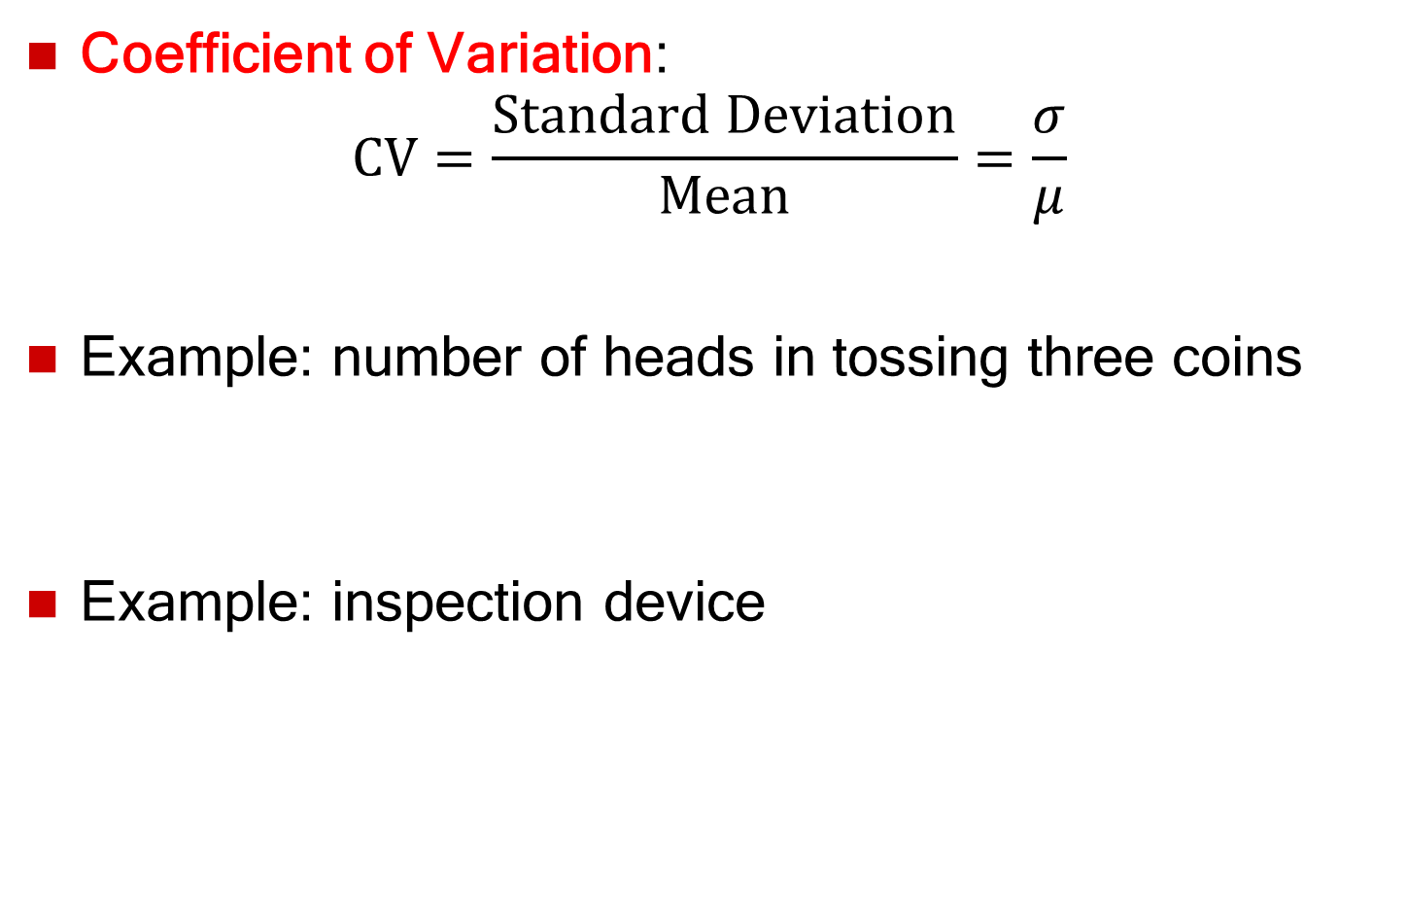
Coefficient of Variation
Coefficient of Variation:
$$\text{CV}=\frac{\text{Standard} \text{Deviation}}{\text{Mean}}=\frac{σ}{μ}$$
Example: number of heads in tossing three coins
Example: inspection device

Slide 36
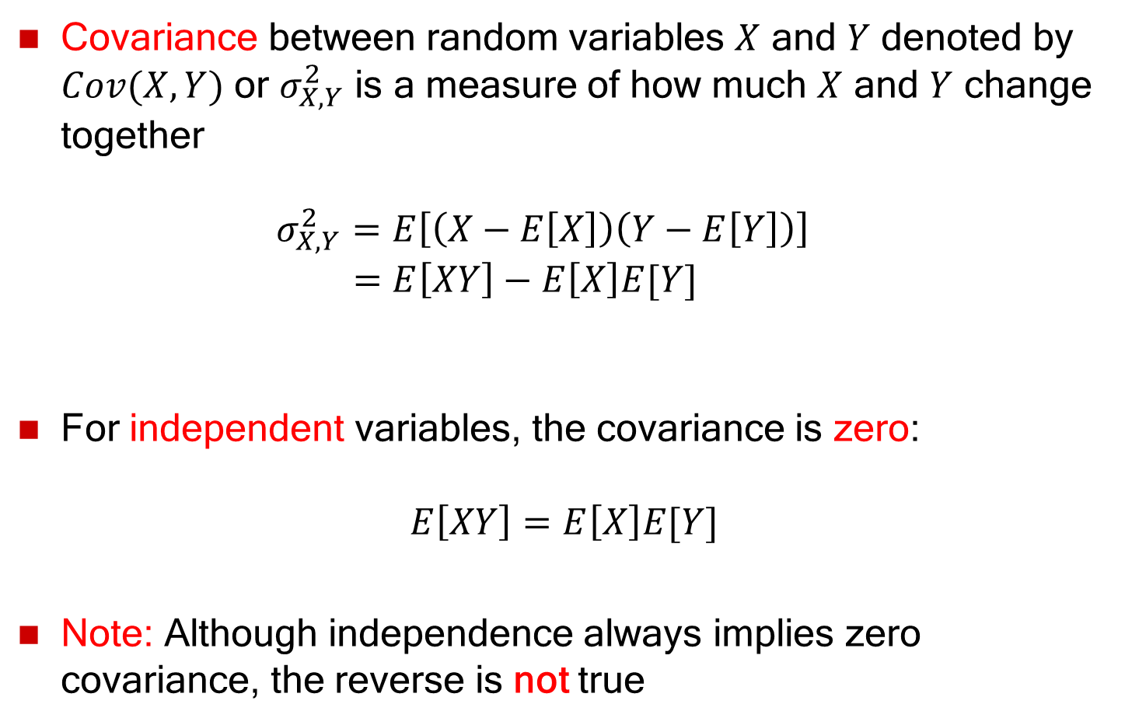
Covariance
Covariance between random variables $X$ and $Y$ denoted by $Cov(X,Y)$ or $σ_{X,Y}^{2}$ is a measure of how much $X$ and $Y$ change together
$σ_{X,Y}^{2}=E\left[\left(X−E\left[X\right]\right)\left(Y−E\left[Y\right]\right)\right]$
$=E\left[XY\right]−E\left[X\right]E[Y]$
For independent variables, the covariance is zero:
$$E\left[XY\right]=E\left[X\right]E[Y]$$
Note: Although independence always implies zero covariance, the reverse is not true

Slide 37
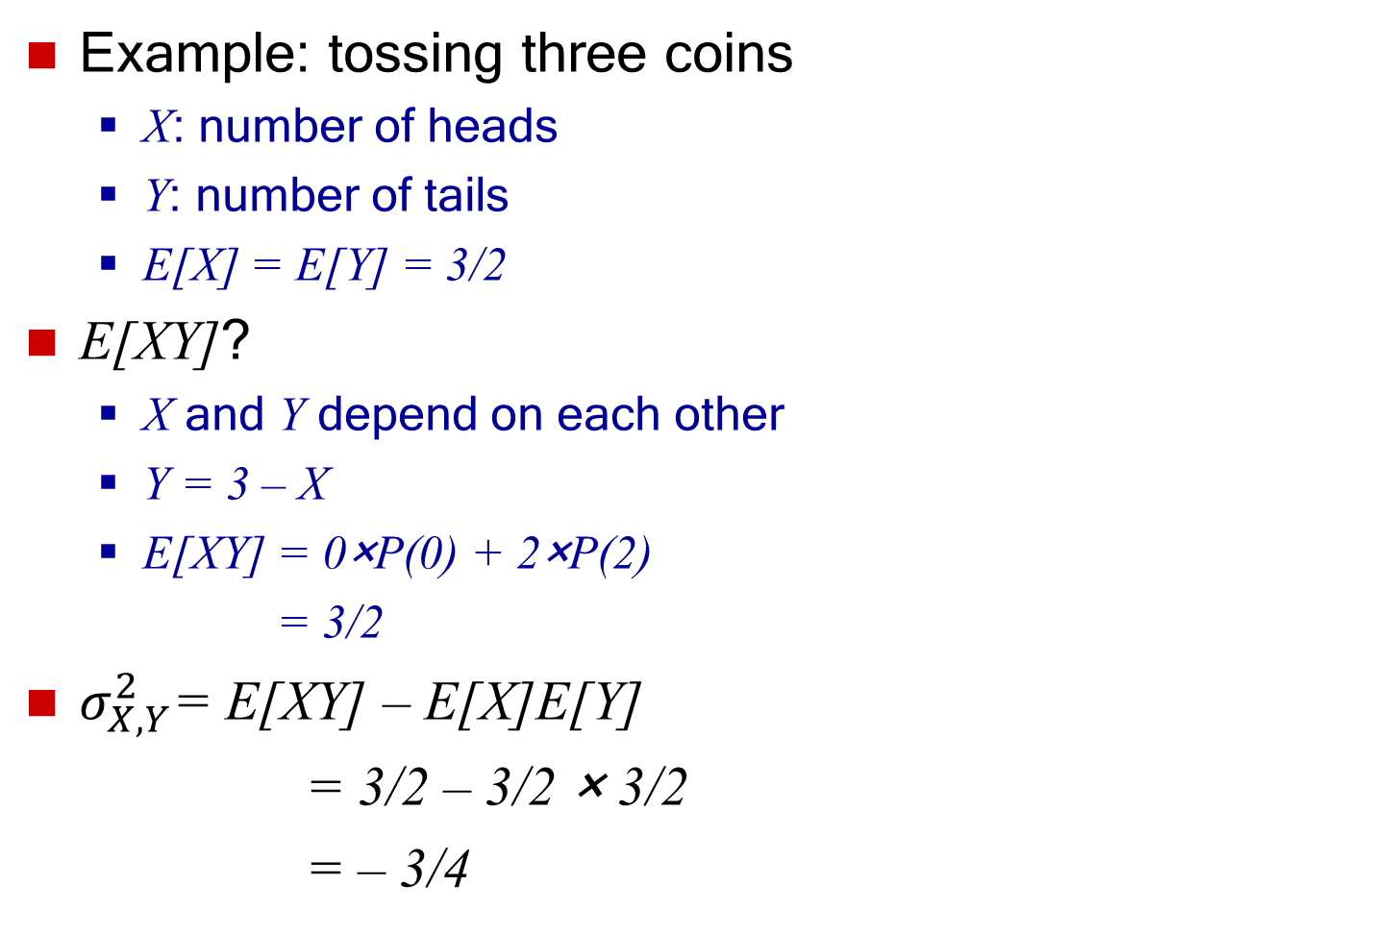
Covariance
Example: tossing three coins
  X: number of heads
  Y: number of tails
  E[X] = E[Y] = 3/2
E[XY]?
  X and Y depend on each other
  Y = 3 – X
  E[XY] = 0×P(0) + 2×P(2)
  = 3/2
$σ_{X,Y}^{2}$= E[XY] – E[X]E[Y]
= 3/2 – 3/2 × 3/2
= – 3/4
x | y | xy | p(x)
0 | 3 | 0 | 1/8
1 | 2 | 2 | 3/8
2 | 1 | 2 | 3/8
3 | 0 | 0 | 1/8
xy | p(xy)
0 | 2/8
2 | 6/8

Slide 38
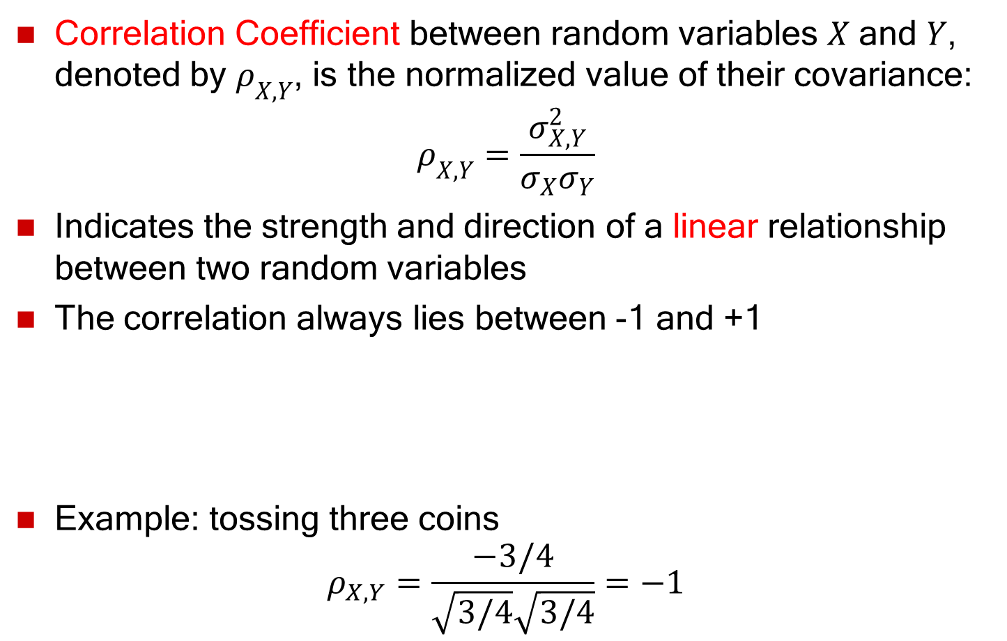
Correlation
Correlation Coefficient between random variables $X$ and $Y$, denoted by $ρ_{X,Y}$, is the normalized value of their covariance:
$$ρ_{X,Y}=\frac{σ_{X,Y}^{2}}{σ_{X}σ_{Y}}$$
Indicates the strength and direction of a linear relationship between two random variables
The correlation always lies between -1 and +1
Example: tossing three coins
$$ρ_{X,Y}=\frac{−3/4}{\sqrt{3/4}\sqrt{3/4}}=−1$$
Negative linear
correlation
Positive linear
correlation
No correlation
-1
0
+1

Slide 39
Outline
Probability and random variables
  Random experiment and random variable
  Probability mass/density functions
  Expectation, variance, covariance, correlation
Probability distributions
  Discrete probability distributions
  Continuous probability distributions
  Empirical probability distribution

Slide 40
Outline
Probability and random variables
  Random experiment and random variable
  Probability mass/density functions
  Expectation, variance, covariance, correlation
Probability distributions
  Discrete probability distributions
  Continuous probability distributions
  Empirical probability distribution

Slide 41



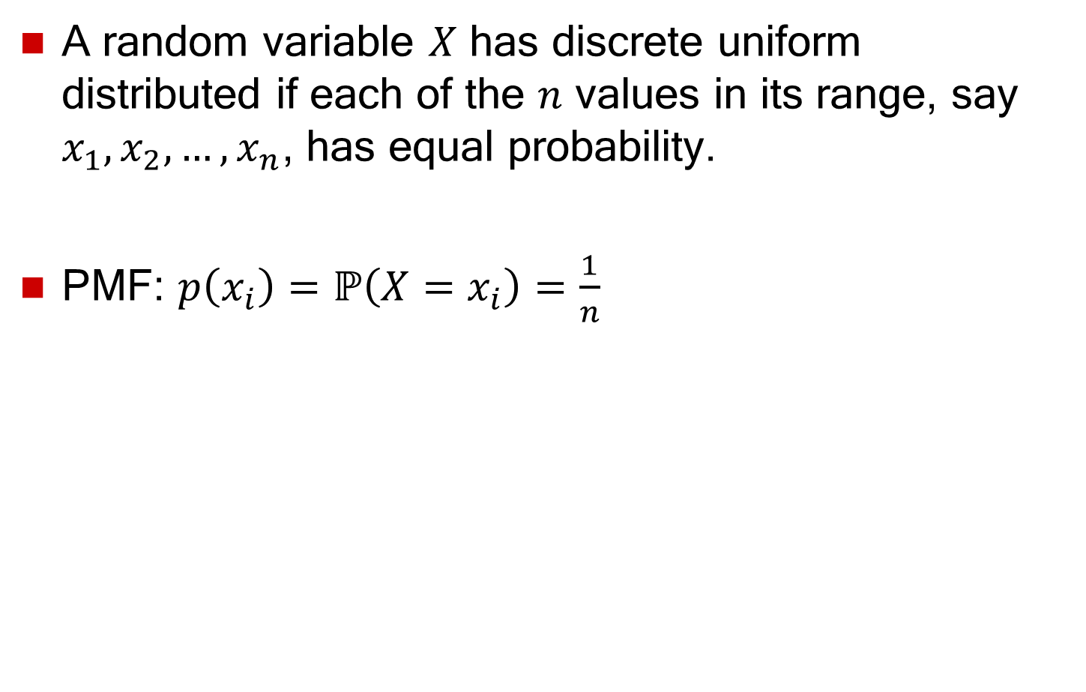



Discrete Uniform Distribution
A random variable $X$ has discrete uniform distributed if each of the $n$ values in its range, say $x_{1}, x_{2}, …, x_{n}$, has equal probability.
PMF: $p\left(x_{i}\right)=ℙ\left(X=x_{i}\right)=\frac{1}{n}$
$$p(x_{i})$$
$$\frac{1}{4}$$
$$1$$
$$2$$
$$3$$
$$4$$

Slide 42
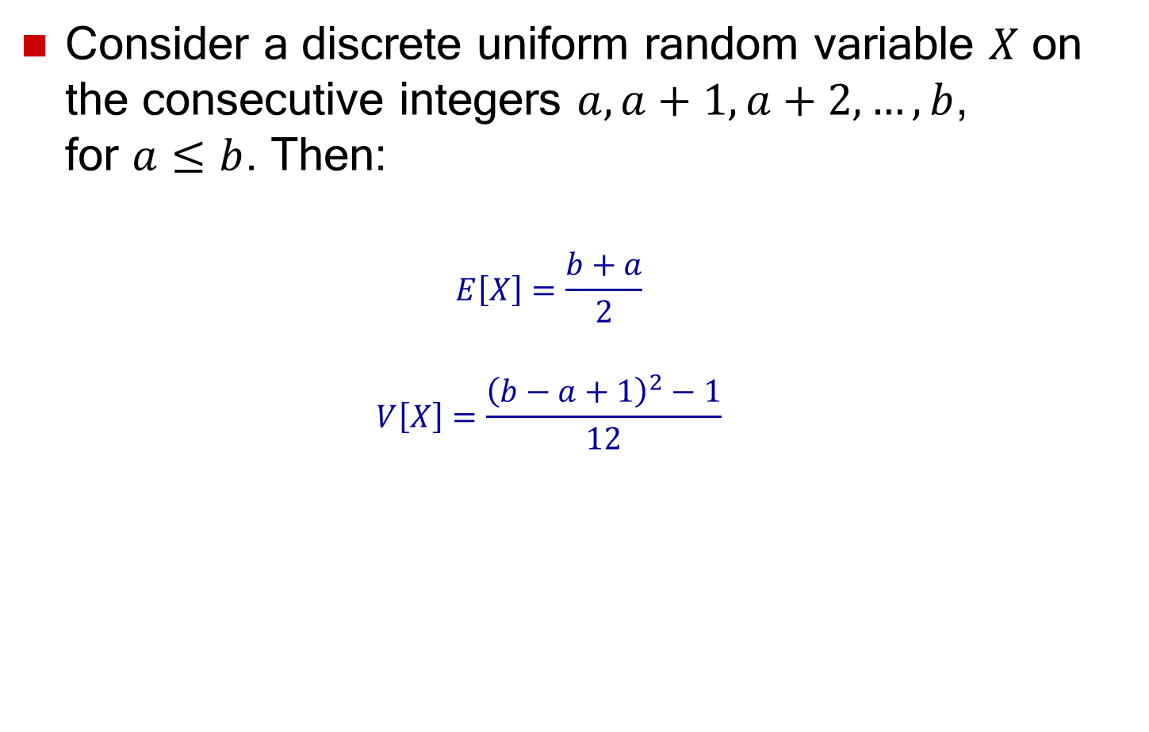
Discrete Uniform Distribution
Consider a discrete uniform random variable $X$ on the consecutive integers $a, a+1, a+2, …, b$,
for $a≤b$. Then:
  $$E\left[X\right]=\frac{b+a}{2}$$
  $$V\left[X\right]=\frac{{\left(b−a+1\right)}^{2}−1}{12}$$

Slide 43
Bernoulli Trial
Consider an experiment whose outcome can be a success with probability $p$ or a failure with probability $1−p$:
  $X=1$ if the outcome is a success
  $X=0$ if the outcome is a failure
$X$ is a Bernoulli random variable with parameter $p$
  where $0≤p≤1$ is the success probability
PMF:
$$p\left(1\right)=ℙ(X=1) =p$$
$$p\left(0\right)=ℙ(X=0) =1−p$$
Properties:
  $E\left[X\right]=p$ and $V\left[X\right]=p(1−p)$

Slide 44
Binomial Distribution
$X$: number of successes in $n (n=1,2,…)$ independent Bernoulli trials with success probability $p$
$X$ is a binomial random variable with parameters $\left(n,p\right)$
PMF: Probability of having $k$ ($k=0,1,2,…,n$) successes in $n$ trials
  $p\left(k\right)=ℙ(X=k) =\left(\begin{matrix}n \\ k\end{matrix}\right)p^{k}{\left(1−p\right)}^{n−k}$
  where, $\left(\begin{matrix}n \\ k\end{matrix}\right)=\frac{n!}{k!\left(n−k\right)!}$
Properties:
  $E\left[X\right]=np$ and $V\left[X\right]=np(1−p)$

Slide 45


Example: Binomial Distribution
Binomial distribution PMF
$$(n=10)$$
Binomial distribution CDF
$$(n=10)$$

Slide 46
Geometric Distribution
$X$: number of Bernoulli trials until achieving the first success
$X$ is a geometric random variable with success probability $p$
PMF: probability of $k (k=1,2,3,…)$ trials until the first success
$p\left(k\right)={p\left(1−p\right)}^{k−1}$
CDF: $F\left(k\right)=1−{\left(1−p\right)}^{k}$
Properties:
$E\left[X\right]=\frac{1}{p}$, and $V\left[X\right]=\frac{1−p}{p^{2}}$

Slide 47
Example: Geometric Distribution
Geometric distribution PMF
Geometric distribution CDF

Slide 48
Poisson Distribution
Number of events occurring in a fixed time interval
  Events occur with a known rate and are independent
Poisson distribution is characterized by the rate λ
  Rate: the average number of event occurrences in a fixed time interval
Examples
  The number of calls received by a switchboard per minute
  The number of packets coming to a router per second
  The number of travelers arriving to the airport for flight registration per hour
Notes:
48

Slide 49
Poisson Distribution
Random variable $X$ is Poisson distributed with rate parameter $λ$
PMF: the probability that there are exactly $k$ events in a time interval
$p\left(k\right)=ℙ\left(X=k\right)=\frac{λ^{k}}{k!}e^{−λ}$, $k=0,1,2,…$
CDF: the probability of at least $k$ events in a time interval
$$F\left(k\right)=ℙ\left(X≤k\right)=\sum_{i=0}^{k}{\frac{λ^{i}}{i!}e^{−λ}}$$
Properties:
$E\left[X\right]=λ$
$$V\left[X\right]=λ$$

Slide 50
Example: Poisson Distribution
Poisson distribution PMF
Poisson distribution CDF

Slide 51
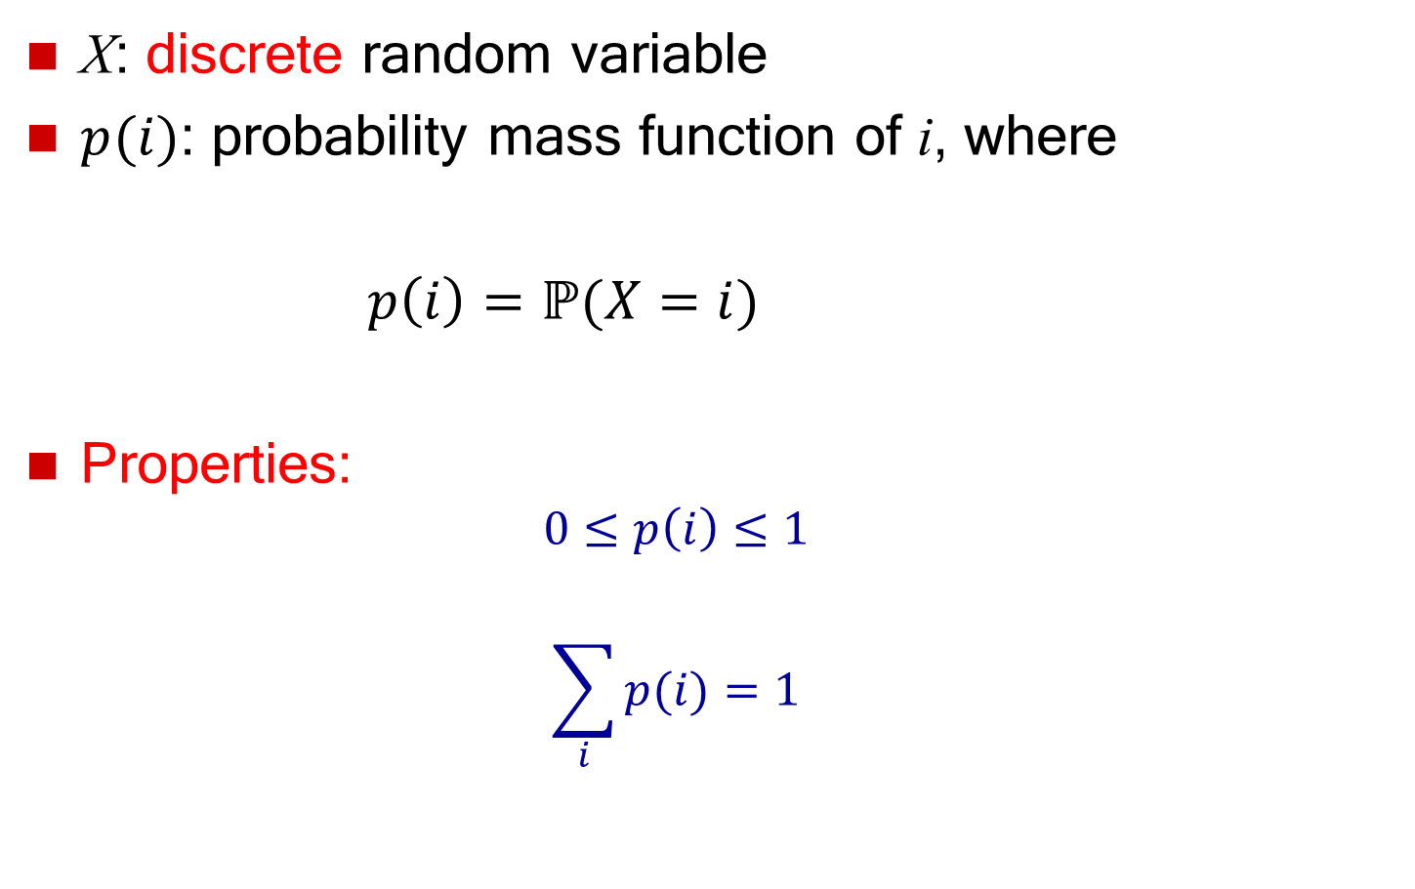
Example: Poisson Distribution
The number of cars that enter a parking lot follows a Poisson distribution with a rate equal to $λ=20$ cars/hour
  The probability of having exactly 15 cars entering the parking lot in one hour:
  $p\left(15\right)=\frac{{20}^{15}}{15!}e^{−20}=0.051649$
  The probability of having more than 3 cars entering the parking lot in one hour:
  $ℙ\left(X>3\right)=1−ℙ\left(X≤3\right)$
  $=1−\left[P\left(0\right)+P\left(1\right)+P\left(2\right)+P\left(3\right)\right]$
  $=0.9999967$

Slide 52
Outline
Probability and random variables
  Random experiment and random variable
  Probability mass/density functions
  Expectation, variance, covariance, correlation
Probability distributions
  Discrete probability distributions
  Continuous probability distributions
  Empirical probability distribution

Slide 53
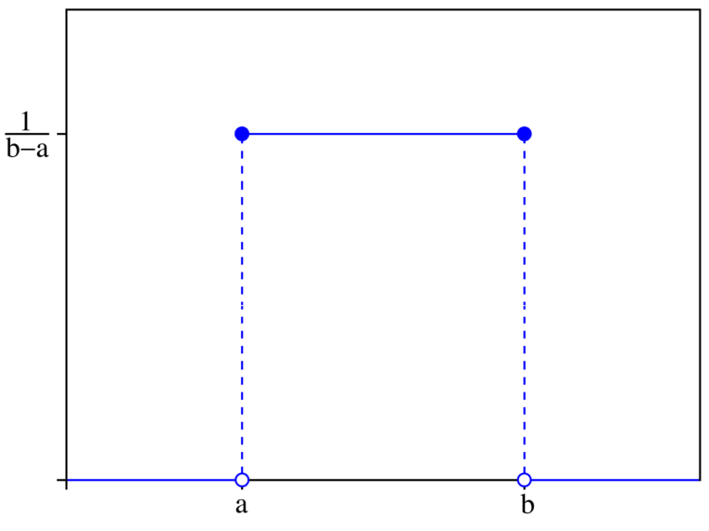
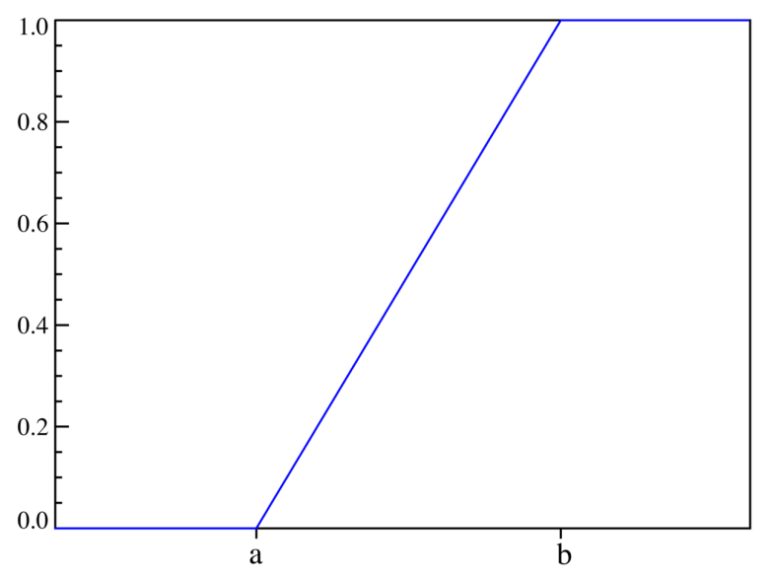
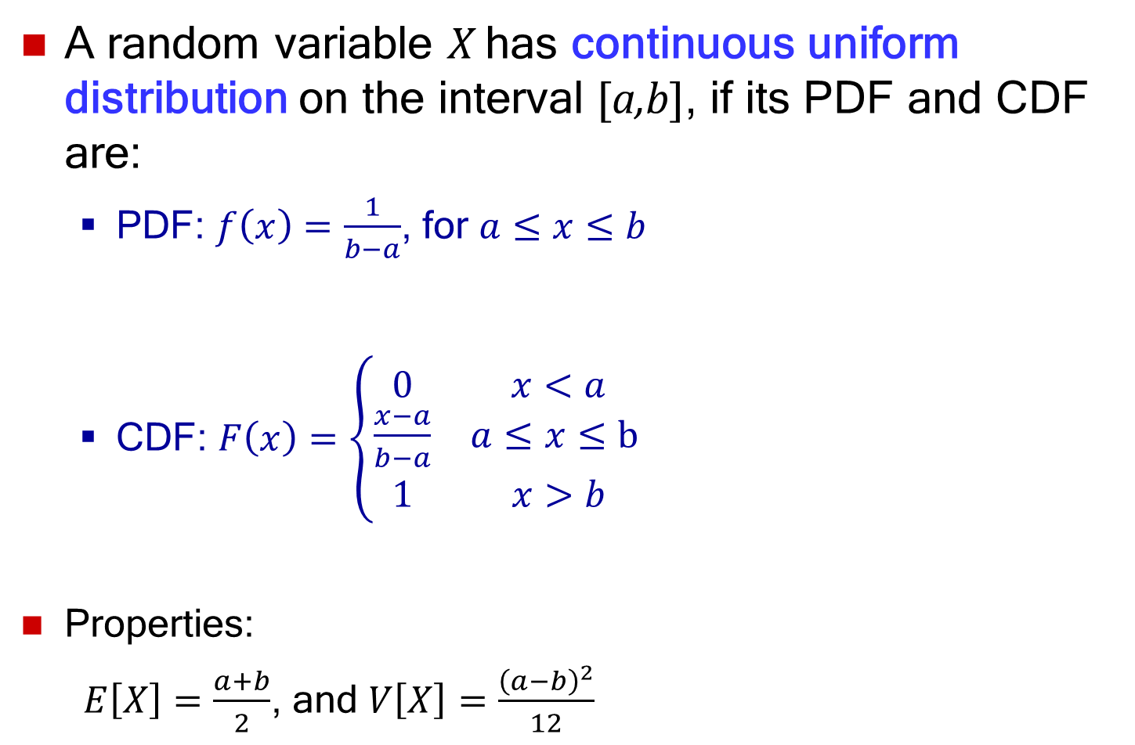
Uniform Distribution
A random variable X has continuous uniform distribution on the interval [a,b], if its PDF and CDF are:
  PDF: $f\left(x\right)=\frac{1}{b−a}$, for $a≤x≤b$
  CDF: $F\left(x\right)=\left\{\begin{matrix}0 & x<a \\ \frac{x−a}{b−a} & a≤x≤b \\ 1 & x>b\end{matrix}\right.$
Properties:
$E\left[X\right]=\frac{a+b}{2}$, and $V\left[X\right]=\frac{{\left(a−b\right)}^{2}}{12}$
PDF
CDF

Slide 54
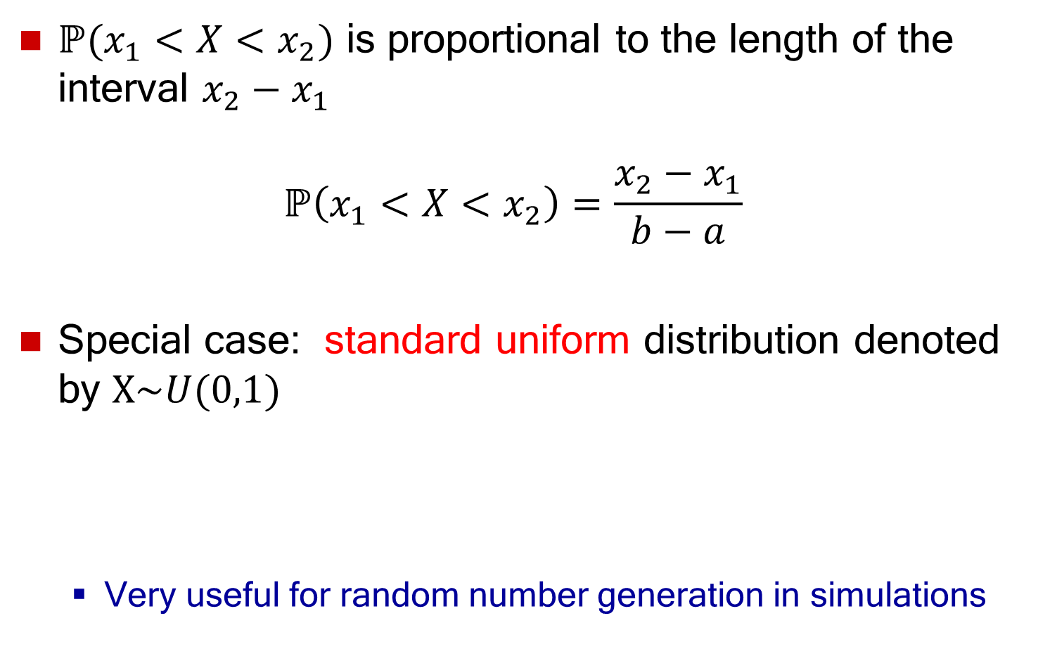

Uniform Distribution Properties
$ℙ(x_{1}<X<x_{2})$ is proportional to the length of the interval $x_{2}−x_{1}$
$$ℙ\left(x_{1}<X<x_{2}\right)=\frac{x_{2}−x_{1}}{b−a}$$
Special case: standard uniform distribution denoted by $X\sim U(0,1)$
  Very useful for random number generation in simulations
$$f\left(x\right)=\left\{\begin{matrix}1, 0≤x≤1 \\ 0, \text{otherwise} \end{matrix}\right.$$

Slide 55
Exponential Distribution
A random variable $X$ is exponentially distributed with parameter $λ$ if its PDF and CDF are:
  PDF: $f\left(x\right)=λ e^{−λx}$, for $x≥0$
  CDF: $F\left(x\right)=1−e^{−λx}$, for $x≥0$
Properties:
  $E\left[X\right]=\frac{1}{λ}$, and $V\left[X\right]=\frac{1}{λ^{2}}$
The exponential distribution describes the time between consecutive events in a Poisson process of rate $λ$

Slide 56
Example: Exponential Distribution
Exponential distribution PDF
Exponential distribution CDF

Slide 57
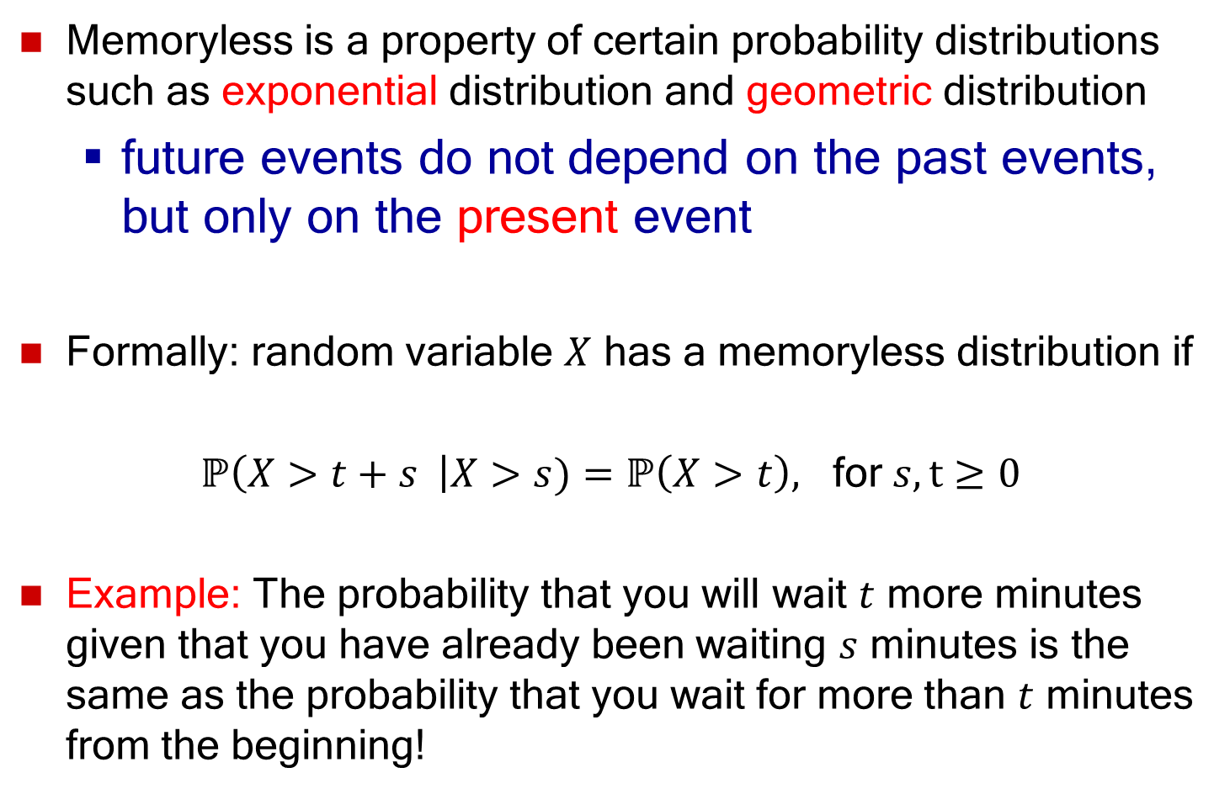
Memoryless Property
Memoryless is a property of certain probability distributions such as exponential distribution and geometric distribution
  future events do not depend on the past events, but only on the present event
Formally: random variable $X$ has a memoryless distribution if
$ℙ\left(X>t+s \right|X>s)=ℙ\left(X>t\right),$ for $s,t≥0$
Example: The probability that you will wait $t$ more minutes given that you have already been waiting $s$ minutes is the same as the probability that you wait for more than $t$ minutes from the beginning!

Slide 58

Example: Exponential Distribution
The time needed to repair the engine of a car is exponentially distributed with a mean time equal to 3 hours.
  The probability that the car spends more than the average wait time in repair:
  $ℙ\left(X>3\right)=1−F\left(3\right)=e^{−\frac{3}{3}}=0.368$
  The probability that the car repair time lasts between 2 to 3 hours is:
  $$ℙ\left(2≤X≤3\right)=F\left(3\right)−F\left(2\right)=0.145$$
  The probability that the repair time lasts for another hour given that it has already lasted for 2.5 hours:
  Using the memoryless property of the exponential distribution,
  $$ℙ\left(X>\left(1+2.5\right)|X>2.5\right)=ℙ\left(X>1\right)=1−F\left(1\right)=e^{−\frac{1}{3}}=0.717$$

Slide 59
Normal Distribution
The Normal distribution, also called the Gaussian distribution, is an important continuous probability distribution applicable in many fields
It is specified by two parameters: mean (μ) and variance ($σ^{2}$)
The importance of the normal distribution as a statistical model in natural and behavioral sciences is due in part to the Central Limit Theorem
It is usually used to model system error (e.g. channel error), the distribution of natural phenomena, height, weight, etc.

Slide 60
Why Normal?
There are two main reasons for the popularity of the normal distribution:
The sum of n independent normal variables is a normal variable. If,
then has a normal distribution with
mean and variance
The mean of a large number of independent observations from any distribution tends to have a normal distribution. This result, which is called central limit theorem, is true for observations from all distributions
=> Experimental errors caused by many factors are normal

Slide 61
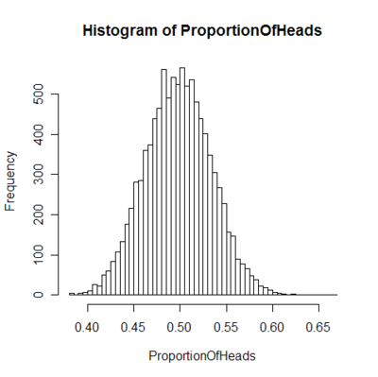
Central Limit Theorem
Histogram plot of average proportion of heads in a fair coin
toss, over a large number of sequences of coin tosses.

Slide 62
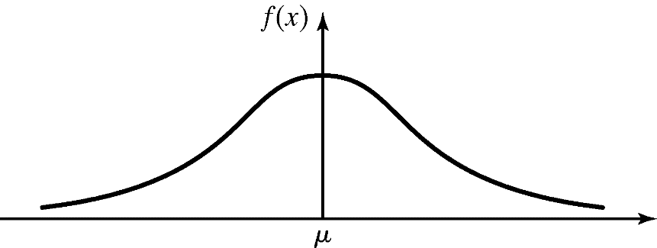
Normal Distribution
Random variable X is normally distribution with
parameters $\left(μ, σ^{2}\right)$, i.e., $X\sim N(μ, σ^{2})$:
  PDF: $f\left(x\right)=\frac{1}{σ\sqrt{2π}}e^{−\frac{1}{2}{\left(\frac{x−μ}{σ}\right)}^{2}}$, for $−∞≤x≤+∞$
  CDF: does not have any closed form!
  $E\left[X\right]=μ$, and $V\left[X\right]=σ^{2}$
Properties:
  $\lim_{x→±∞}f\left(x\right)=0⁡$
  Normal PDF is a symmetrical, bell-shaped curve
  centered at its expected value $μ$
  Maximum value of PDF occurs at $x=μ$

Slide 63
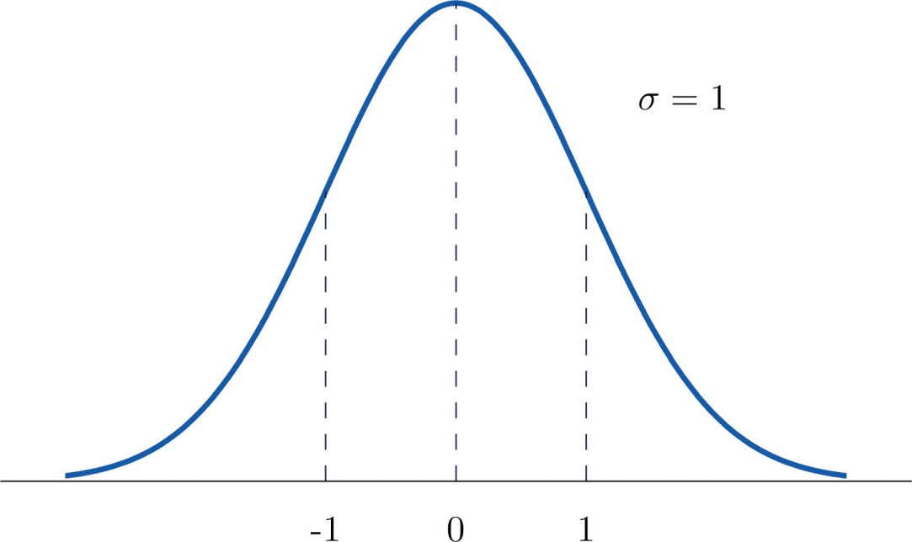
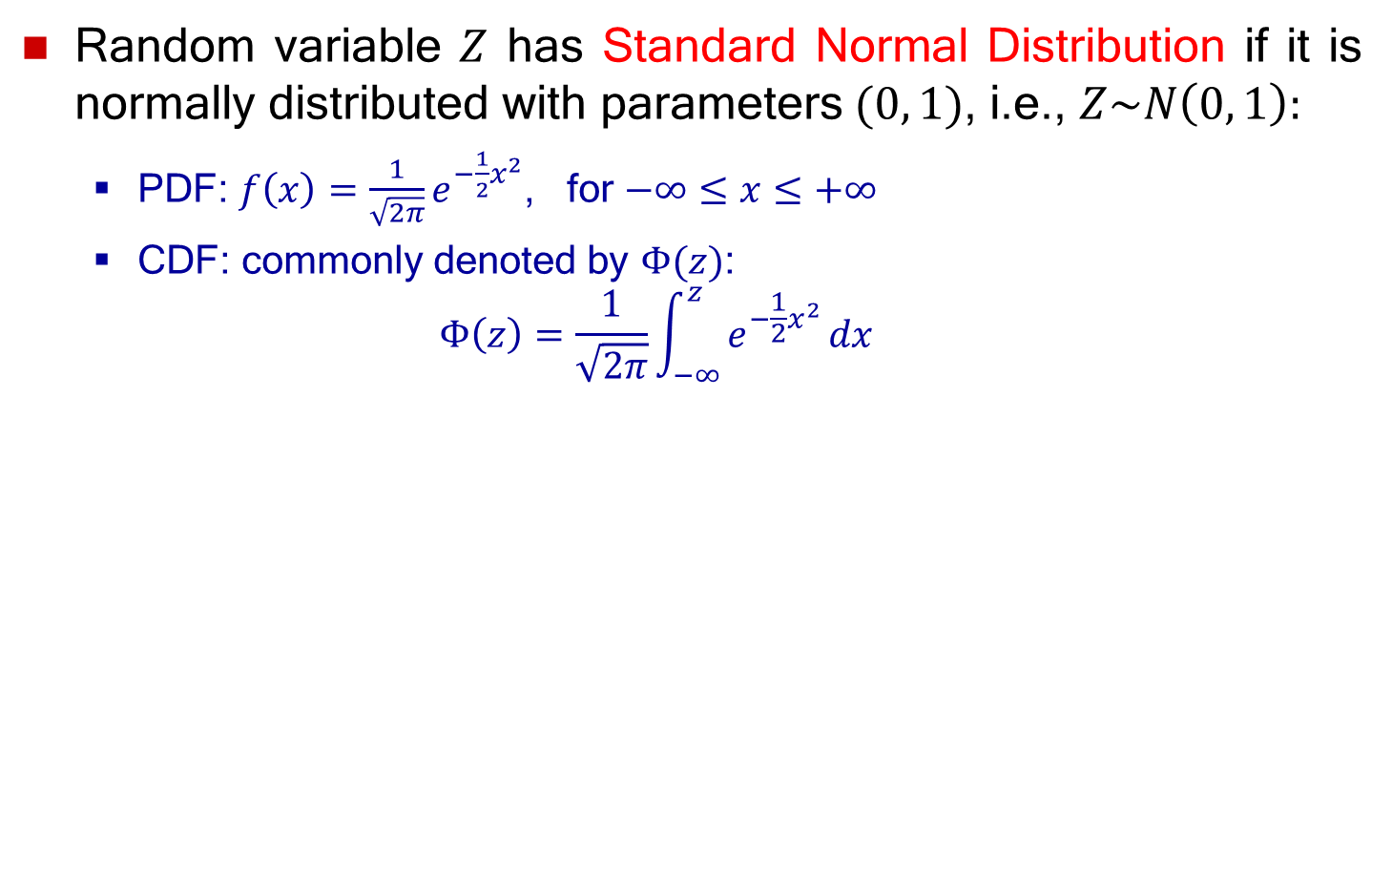
Standard Normal Distribution
Random variable $Z$ has Standard Normal Distribution if it is normally distributed with parameters $(0, 1)$, i.e., $Z\sim N\left(0, 1\right):$
  PDF: $f\left(x\right)=\frac{1}{\sqrt{2π}}e^{−\frac{1}{2}x^{2}}$, for $−∞≤x≤+∞$
  CDF: commonly denoted by $Φ(z)$:
  $$Φ\left(z\right)=\frac{1}{\sqrt{2π}}\int_{−∞}^{z}{e^{−\frac{1}{2}x^{2}}}dx$$

Slide 64
Normal Distribution
Evaluating the distribution $X\sim N\left(μ, σ^{2}\right)$:
  $F\left(x\right)=ℙ\left(X≤x\right)?$
Two techniques:
Use numerical methods (no closed form)
Use the standard normal distribution
  $Φ(z)$ is widely tabulated
  Use the transformation $Z=\frac{X−μ}{σ}$
  If $X\sim N(μ, σ^{2})$ then $Z\sim N(0, 1)$, i.e., standard normal distribution:
  $$F\left(x\right)=ℙ\left(X≤x\right)=ℙ\left(\frac{X−μ}{σ}≤\frac{x−μ}{σ}\right)$$
  $$=ℙ\left(Z≤\frac{x−μ}{σ}\right)=Φ\left(\frac{x−μ}{σ}\right)$$

Slide 65
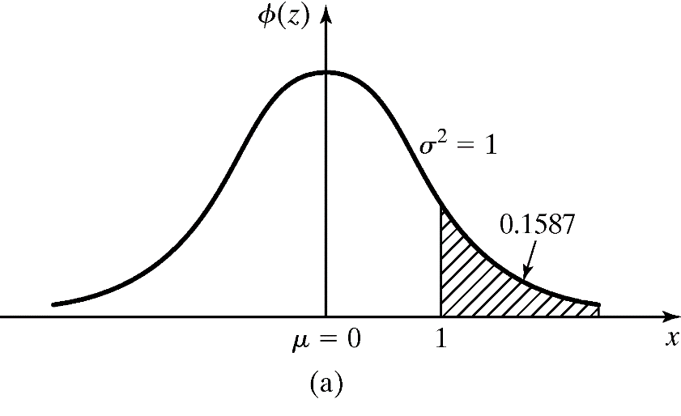
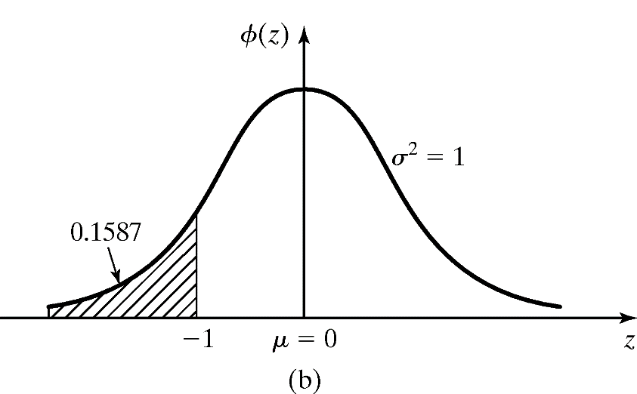
Normal Distribution
Example: The time required to load an oceangoing vessel, $X$, is distributed as $N(12, 4)$
  The probability that the vessel is loaded in less than 10 hours:
  $$F\left(10\right)=Φ\left(\frac{10−12}{2}\right)=Φ\left(−1\right)=0.1587$$
  Using the symmetry property, Φ(1) is the complement of Φ (-1)

Slide 66
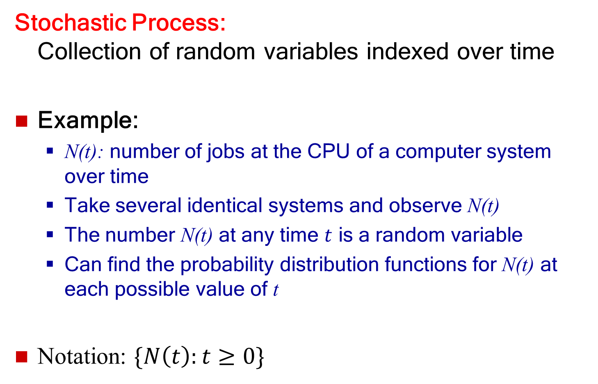
Stochastic Process
Stochastic Process:
Collection of random variables indexed over time
Example:
  N(t): number of jobs at the CPU of a computer system over time
  Take several identical systems and observe N(t)
  The number N(t) at any time $t$ is a random variable
  Can find the probability distribution functions for N(t) at each possible value of t
Notation: $\{N\left(t\right):t≥0\}$

Slide 67
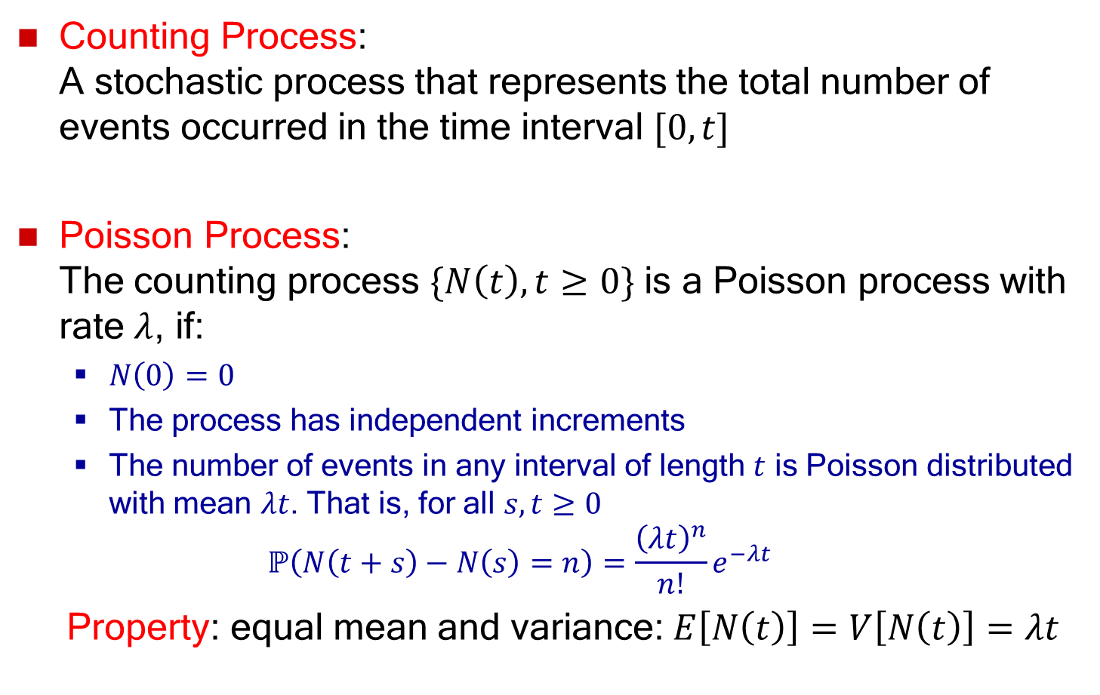
Poisson Process
Counting Process:
A stochastic process that represents the total number of events occurred in the time interval $[0, t]$
Poisson Process:
The counting process $\{N\left(t\right), t≥0\}$ is a Poisson process with rate $λ$, if:
  $N\left(0\right)=0$
  The process has independent increments
  The number of events in any interval of length $t$ is Poisson distributed with mean $λt$. That is, for all $s, t≥0$
  $$ℙ\left(N\left(t+s\right)−N\left(s\right)=n\right)=\frac{{\left(λt\right)}^{n}}{n!}e^{−λt}$$
Property: equal mean and variance:$E\left[N\left(t\right)\right]=V\left[N\left(t\right)\right]=λt$

Slide 68
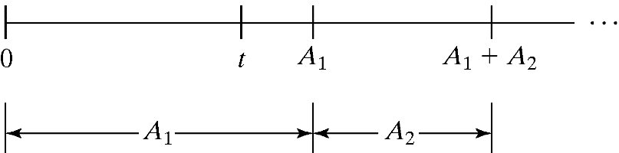

Interarrival Times
Consider the interarrival times of a Poisson process with
rate $λ$, denoted by $A_{1},A_{2},…$, where $A_{i}$ is the elapsed time between arrival $i$ and arrival $i+1$
  Interarrival times, $A_{1},A_{2},…$ are independent identically distributed exponential random variables having the mean $1/λ$
Proof?
Arrival counts ~ Poisson($λ$)
Interarrival times
~ Exponential($λ$)

Slide 69
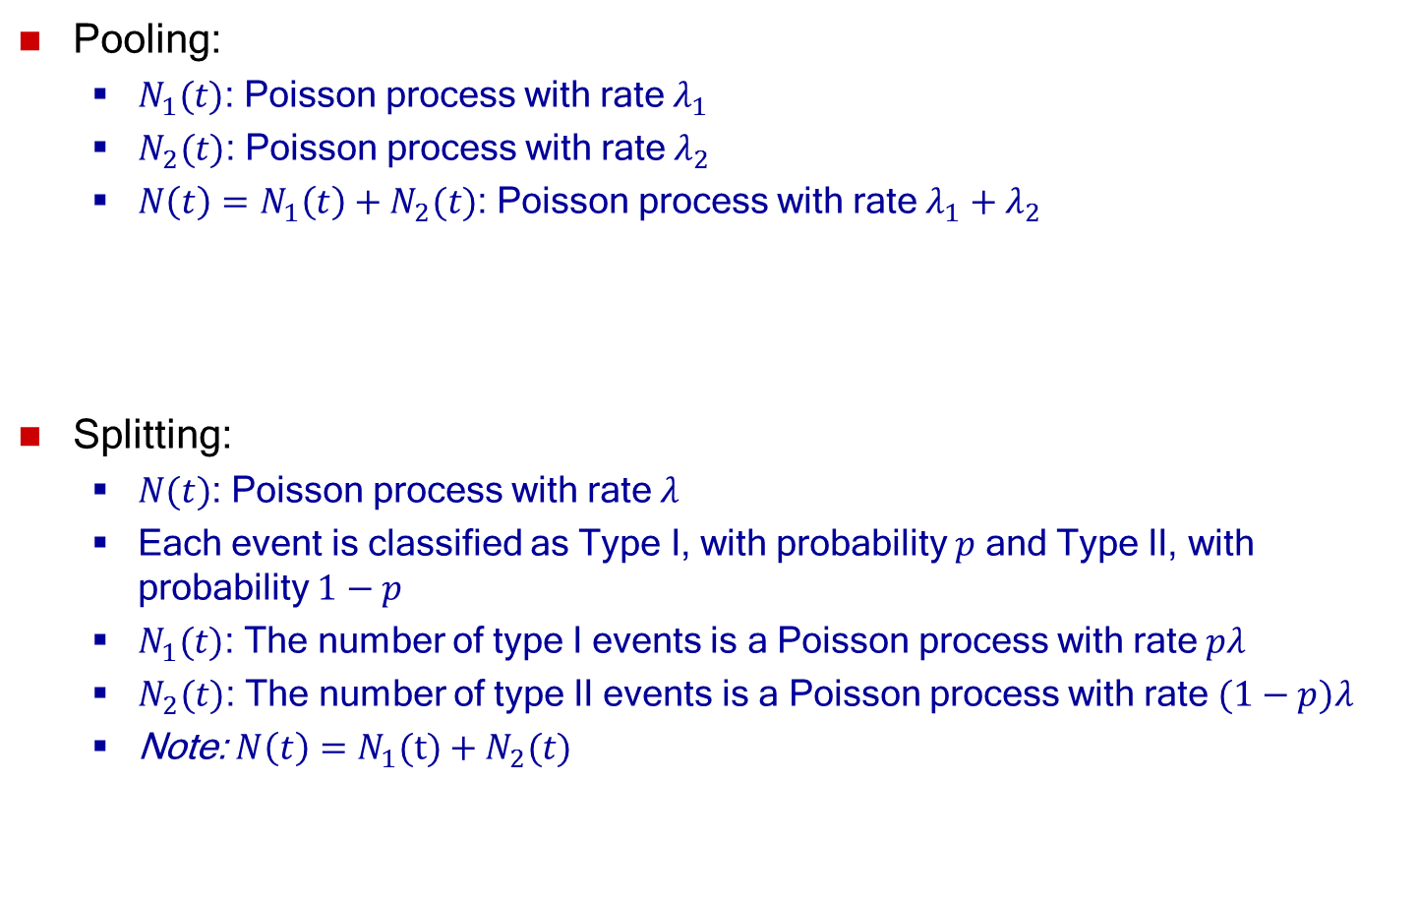
Splitting and Pooling
Pooling:
  $N_{1}(t)$: Poisson process with rate $λ_{1}$
  $N_{2}(t)$: Poisson process with rate $λ_{2}$
  $N\left(t\right)=N_{1}\left(t\right)+N_{2}(t)$: Poisson process with rate $λ_{1}+λ_{2}$
Splitting:
  $N(t)$: Poisson process with rate $λ$
  Each event is classified as Type I, with probability $p$ and Type II, with probability $1−p$
  $N_{1}(t)$: The number of type I events is a Poisson process with rate $pλ$
  $N_{2}(t)$: The number of type II events is a Poisson process with rate $(1−p)λ$
  Note: $N\left(t\right)=N_{1}(t)+N_{2}(t)$
N1(t) ~ Poisson(λ₁)
λ₁
λ₁ + λ₂
N(t) ~ Poisson(λ₁ + λ₂)
N2(t) ~ Poisson(λ₂)
λ₂
λp
N1(t) ~ Poisson(λp)
N(t) ~ Poisson(λ)
λ
λ(1-p)
N2(t) ~ Poisson(λ(1-p))

Slide 70

More on Poisson Distribution
$\{N\left(t\right), t≥0\}$: a Poisson process with arrival rate λ
Probability of no arrivals in a small time interval $h$:
$ℙ\left(N\left(h\right)=0\right)=e^{−λh}≈1−λh$
Probability of one arrivals in a small time interval $h$:
$ℙ\left(N\left(h\right)=1\right)={λh⋅e}^{−λh}≈λh$
Probability of two or more arrivals in a small time interval $h$:
$$ℙ\left(N\left(h\right)≥2\right)=1 −\left(ℙ\left(N\left(h\right)=0\right)+ℙ\left(N\left(t\right)=1\right)\right)≈0$$

Slide 71
Outline
Probability and random variables
  Random experiment and random variable
  Probability mass/density functions
  Expectation, variance, covariance, correlation
Probability distributions
  Discrete probability distributions
  Continuous probability distributions
  Empirical probability distribution

Slide 72
Empirical Distribution
A distribution whose parameters are the observed values in a sample of data:
  Could be used if no theoretical distributions fit the data adequately
  Advantage: no assumption beyond the observed values in the sample
  Disadvantage: sample might not cover the entire range of possible values

Slide 73
Empirical Distribution
“Piecewise Linear” empirical distribution
  Used for continuous data
  Appropriate when a large
  sample data is available
  Empirical CDF is approximated
  by a piecewise linear function:
    the ‘jump points’ connected
    by linear functions
Piecewise Linear
Empirical CDF

Slide 74


Empirical Distribution
Piecewise Linear empirical distribution
  Organize $X$-axis into $K$ intervals
  Interval $i$ is from $a_{i−1}$ to $a_{i}$ for $i=1,2,…, K$
  $p_{i}$: relative frequency of interval $i$
  $c_{i}$: relative cumulative frequency of interval $i$, i.e., $c_{i}=p_{1}+⋯+p_{i}$
  Empirical CDF:
    If $x$ is in interval $i$, i.e., $a_{i−1}<x≤a_{i}$, then:
    $F\left(x\right)=c_{i−1} +α_{i}\left(x−a_{i−1}\right)$
    where, slope $α_{i}$ is given by
    $$α_{i}=\frac{c_{i}−c_{i−1}}{a_{i}−a_{i−1}}$$
interval $i$
• • •
$$a_{0}$$
$$a_{i−1}$$
$$a_{i}$$
$$a_{K}$$
$K$ intervals

Slide 75

Example Empirical Distribution
Suppose the data collected for 100 broken machine repair times are:
Piecewise Linear
Empirical CDF
Slope $α_{3}=\frac{c_{3}−c_{2}}{a_{3}−a_{2}}=0.5$
$$a_{0}$$
$$a_{1}$$
$$a_{2}$$
$$a_{3}$$
$$a_{4}$$

