Slide 1

CPSC 531:
System Modeling and Simulation
Carey Williamson
Department of Computer Science
University of Calgary
Fall 2017

Slide 2
Outline
Probability and random variables
  Random experiment and random variable
  Probability mass/density functions
  Expectation, variance, covariance, correlation
Probability distributions
  Discrete probability distributions
  Continuous probability distributions
  Empirical probability distributions

Slide 3
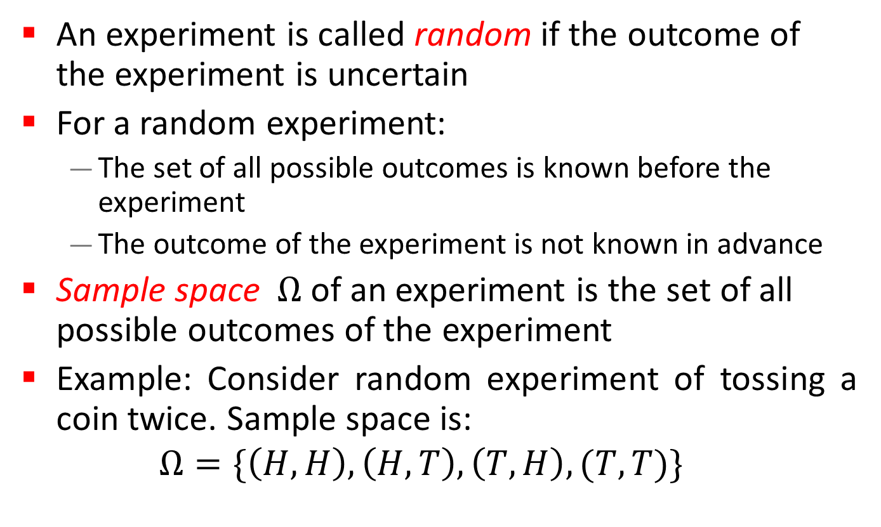
Random Experiment
An experiment is called random if the outcome of the experiment is uncertain
For a random experiment:
  The set of all possible outcomes is known before the experiment
  The outcome of the experiment is not known in advance
Sample space $Ω$ of an experiment is the set of all possible outcomes of the experiment
Example: Consider random experiment of tossing a coin twice. Sample space is:
$$Ω=\{\left(H,H\right), \left(H, T\right), \left(T,H\right), (T,T)\}$$

Slide 4
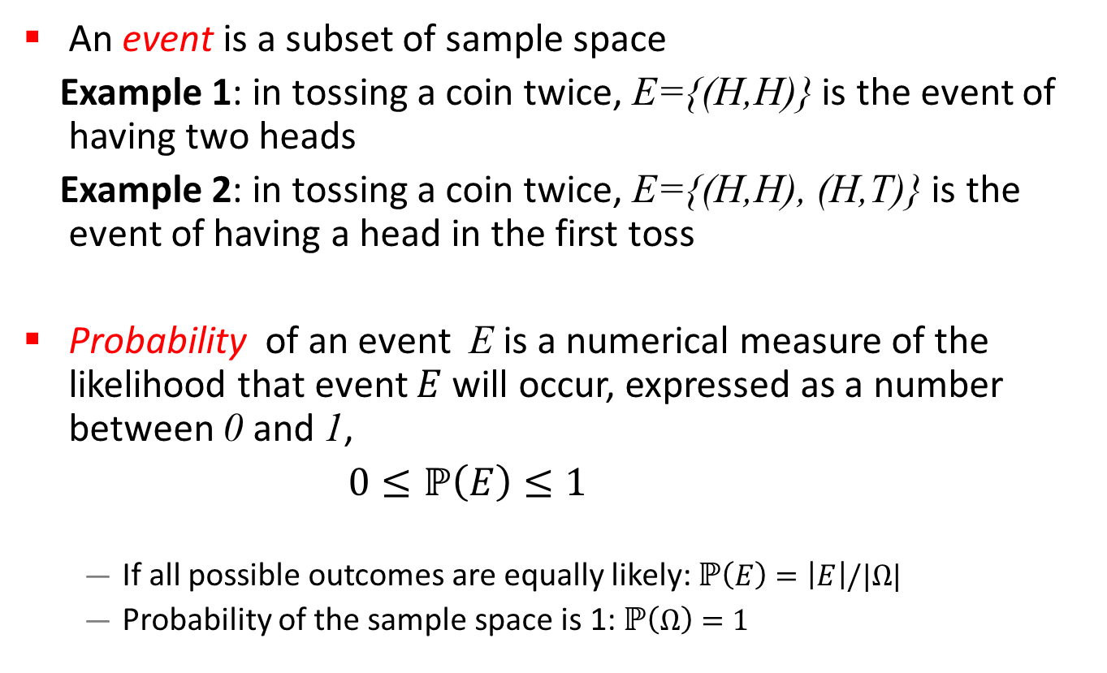
Probability of Events
An event is a subset of sample space
Example 1: in tossing a coin twice, E={(H,H)} is the event of having two heads
Example 2: in tossing a coin twice, E={(H,H), (H,T)} is the event of having a head in the first toss
Probability of an event E is a numerical measure of the likelihood that event $E$ will occur, expressed as a number between 0 and 1,
$0≤ℙ\left(E\right)≤1$
  If all possible outcomes are equally likely: $ℙ\left(E\right)=\left|E\right|/|Ω|$
  Probability of the sample space is 1:$ℙ\left(Ω\right)=1$

Slide 5
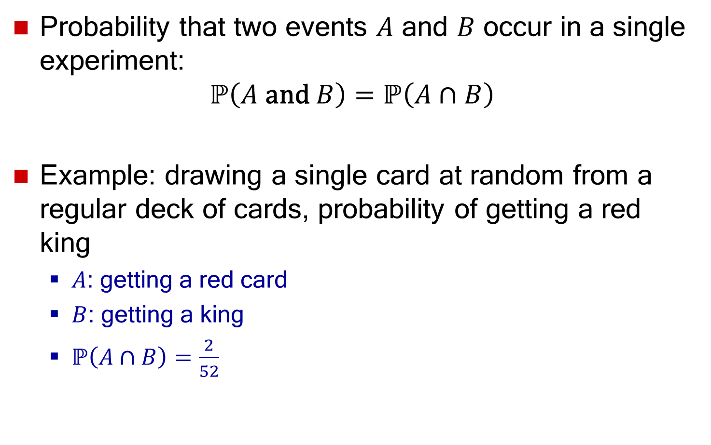
Joint Probability
Probability that two events $A$ and $B$ occur in a single experiment:
$$ℙ\left(A \text{and} B\right)=ℙ\left(A∩B\right)$$
Example: drawing a single card at random from a regular deck of cards, probability of getting a red king
  $A$: getting a red card
  $B$: getting a king
  $ℙ\left(A∩B\right)=\frac{2}{52}$

Slide 6
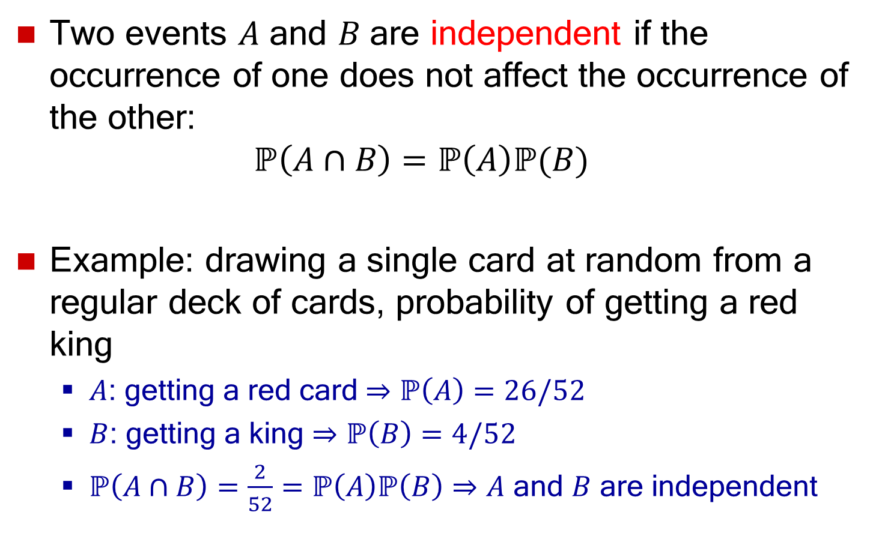
Independent Events
Two events $A$ and $B$ are independent if the occurrence of one does not affect the occurrence of the other:
$ℙ\left(A∩B\right)=ℙ\left(A\right)ℙ(B)$
Example: drawing a single card at random from a regular deck of cards, probability of getting a red king
  $A$: getting a red card $⇒$ $ℙ\left(A\right)=26/52$
  $B$: getting a king $⇒$ $ℙ\left(B\right)=4/52$
  $ℙ\left(A∩B\right)=\frac{2}{52}=ℙ\left(A\right)ℙ\left(B\right)⇒A$ and $B$ are independent

Slide 7
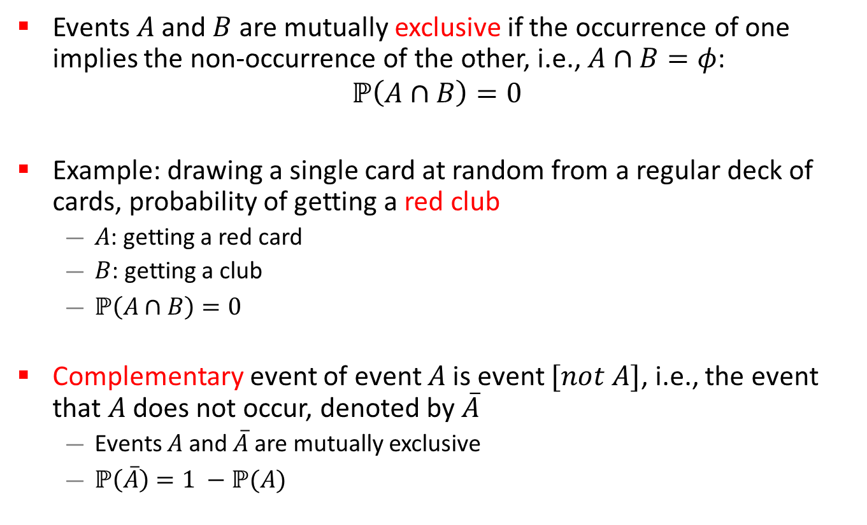
Mutually Exclusive Events
Events $A$ and $B$ are mutually exclusive if the occurrence of one implies the non-occurrence of the other, i.e.,$A∩B=φ$:
$$ℙ\left(A∩B\right)=0$$
Example: drawing a single card at random from a regular deck of cards, probability of getting a red club
  $A$: getting a red card
  $B$: getting a club
  $ℙ\left(A∩B\right)=0$
Complementary event of event $A$ is event $[not A]$, i.e., the event that $A$ does not occur, denoted by $\overline{A}$
  Events $A$ and $\overline{A}$ are mutually exclusive
  $ℙ\left(\overline{A}\right)=1 −ℙ(A)$

Slide 8
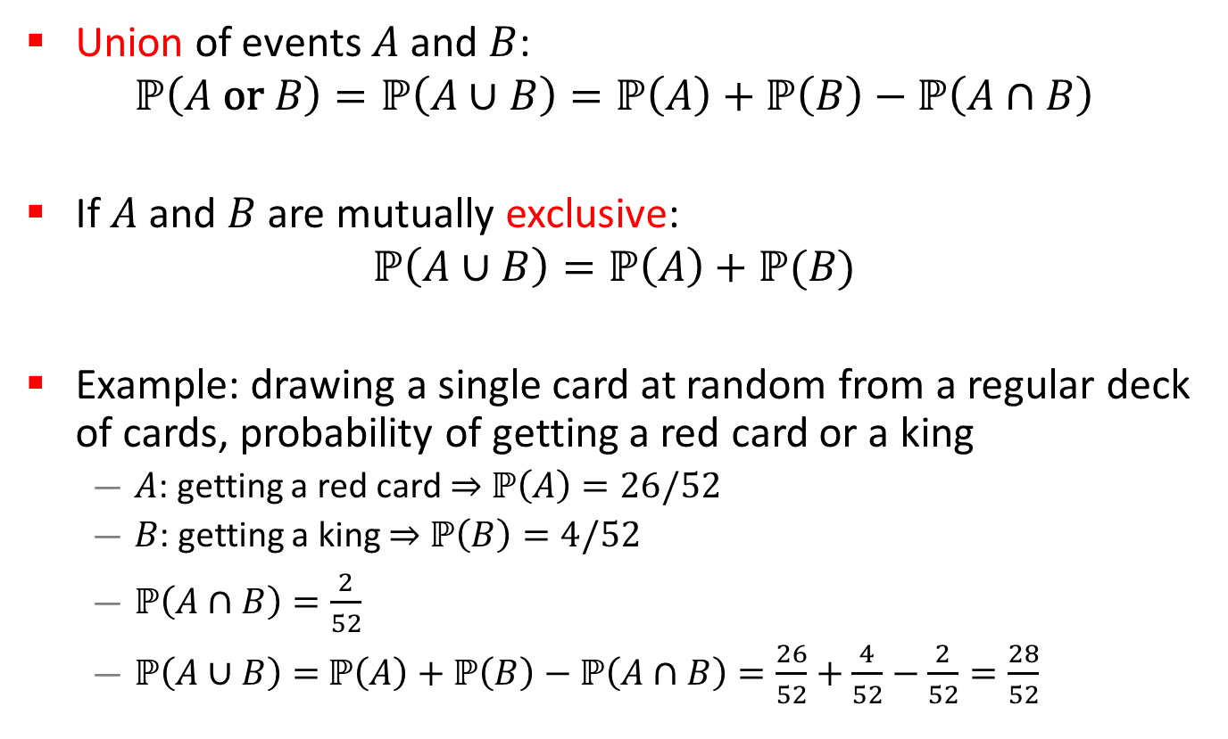
Union Probability
Union of events $A$ and $B$:
$$ℙ\left(A \text{or} B\right)=ℙ\left(A∪B\right)=ℙ\left(A\right)+ℙ\left(B\right)−ℙ\left(A∩B\right)$$
If $A$ and $B$ are mutually exclusive:
$$ℙ\left(A∪B\right)=ℙ\left(A\right)+ℙ(B)$$
Example: drawing a single card at random from a regular deck of cards, probability of getting a red card or a king
  $A$: getting a red card $⇒$ $ℙ\left(A\right)=26/52$
  $B$: getting a king $⇒$ $ℙ\left(B\right)=4/52$
  $ℙ\left(A∩B\right)=\frac{2}{52}$
  $ℙ\left(A∪B\right)=$ $ℙ\left(A\right)+ℙ\left(B\right)−ℙ\left(A∩B\right)=\frac{26}{52}+\frac{4}{52}−\frac{2}{52}=\frac{28}{52}$

Slide 9
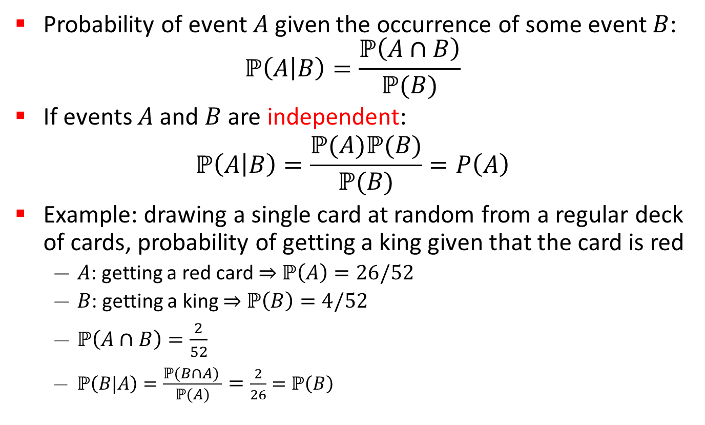
Conditional Probability
Probability of event $A$ given the occurrence of some event $B$:
$ℙ\left(A | B\right)=\frac{ℙ\left(A∩B\right)}{ℙ(B)}$
If events $A$ and $B$ are independent:
$$ℙ\left(A | B\right)=\frac{ℙ(A)ℙ(B)}{ℙ(B)}=P\left(A\right)$$
Example: drawing a single card at random from a regular deck of cards, probability of getting a king given that the card is red
  $A$: getting a red card $⇒$ $ℙ\left(A\right)=26/52$
  $B$: getting a king $⇒$ $ℙ\left(B\right)=4/52$
  $ℙ\left(A∩B\right)=\frac{2}{52}$
  $ℙ\left(B|A\right)=\frac{ℙ(B∩A) }{ℙ(A)}=\frac{2}{26}=ℙ\left(B\right)$

Slide 10
Types of Random Variables
Discrete
  Random variables whose set of possible values can be written as a finite or infinite sequence
  Example: number of requests sent to a web server
Continuous
  Random variables that take a continuum of possible values
  Example: time between requests sent to a web server

Slide 11
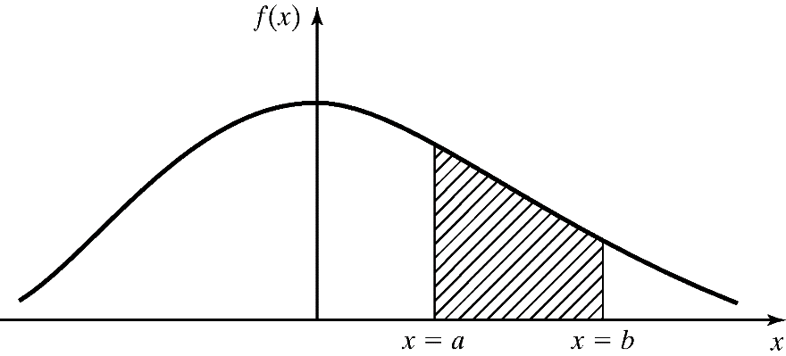

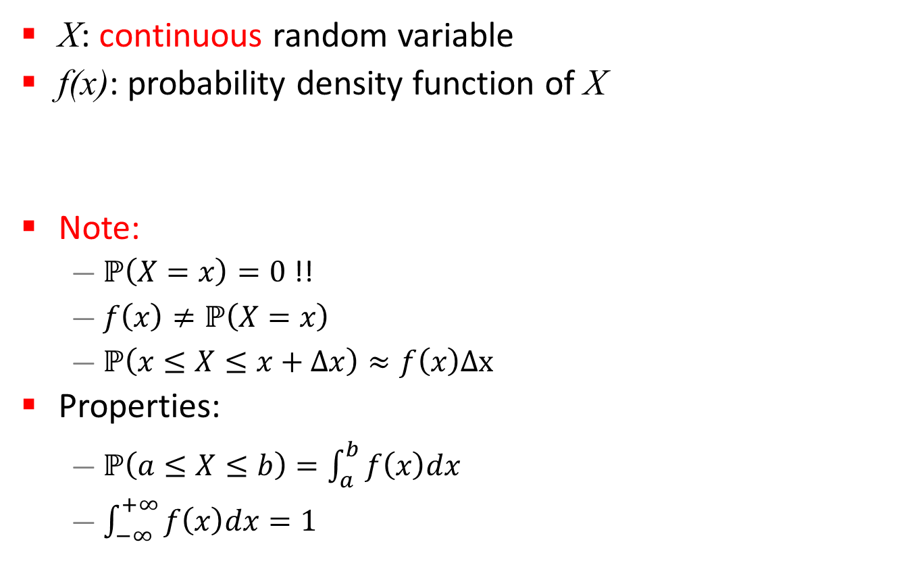
Probability Density Function (PDF)
X: continuous random variable
f(x): probability density function of X
Note:
  $ℙ\left(X=x\right)=0$ !!
  $f\left(x\right)≠ℙ\left(X=x\right)$
  $ℙ\left(x≤X≤x+Δx\right)≈f\left(x\right)Δx$
Properties:
  $ℙ\left(a≤X≤b\right)=\int_{a}^{b}{f\left(x\right)dx}$
  $\int_{−∞}^{+∞}{f\left(x\right)dx}=1$
CDF of $X$

Slide 12
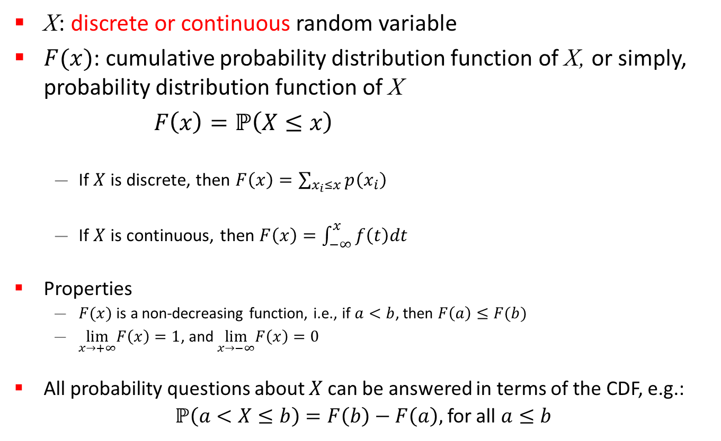
Cumulative Distribution Function (CDF)
X: discrete or continuous random variable
$F(x)$: cumulative probability distribution function of X, or simply, probability distribution function of X
$F\left(x\right)=ℙ\left(X≤x\right)$
  If $X$ is discrete, then $F\left(x\right)=\sum_{x_{i}≤x}{p\left(x_{i}\right)}$
  If $X$ is continuous, then $F\left(x\right)=\int_{−∞}^{x}{f\left(t\right)dt }$
Properties
  $F(x)$ is a non-decreasing function, i.e., if $a<b$, then $F\left(a\right)≤F(b)$
  $\lim_{x→+∞}F\left(x\right)=1$, and$\lim_{x→−∞}F\left(x\right)=0$
All probability questions about $X$ can be answered in terms of the CDF, e.g.:
$ℙ\left(a<X≤b\right)=F\left(b\right)−F\left(a\right),$ for all $a≤b$

Slide 13
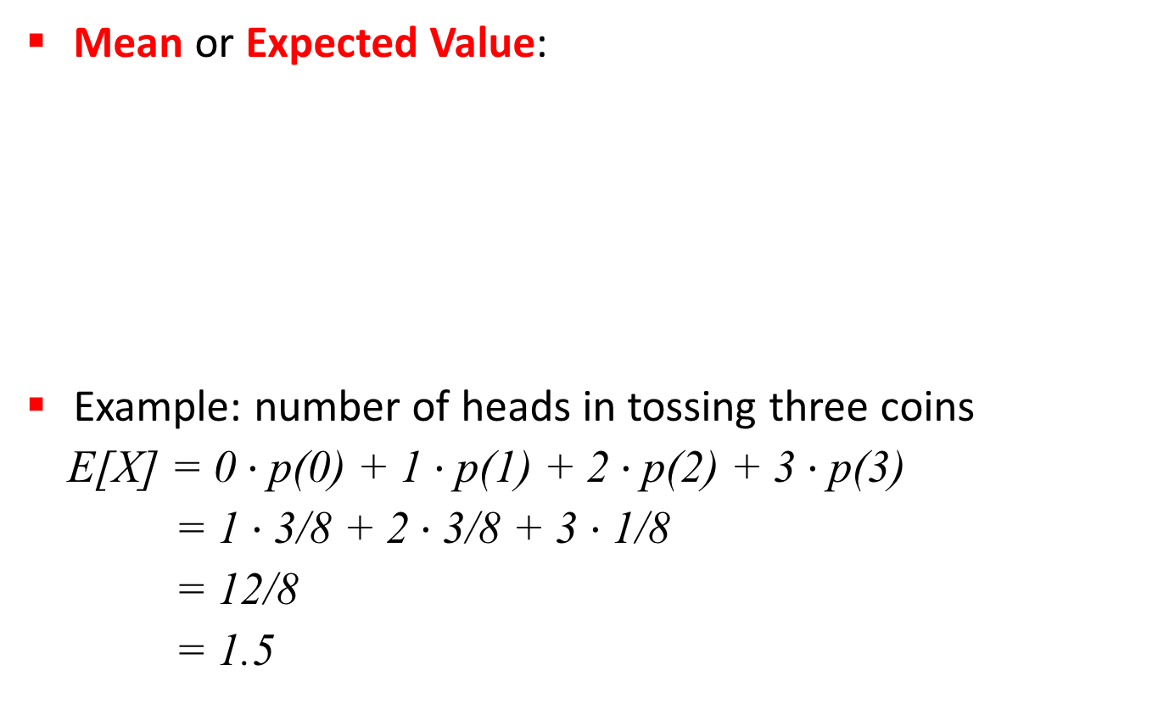
Expectation of a Random Variable
Mean or Expected Value:
Example: number of heads in tossing three coins
E[X] = 0 $⋅$p(0) + 1 $⋅$p(1) + 2 $⋅$p(2) + 3 $⋅$p(3)
= 1 $⋅$3/8 + 2 $⋅$3/8 + 3 $⋅$1/8
= 12/8
= 1.5

Slide 14
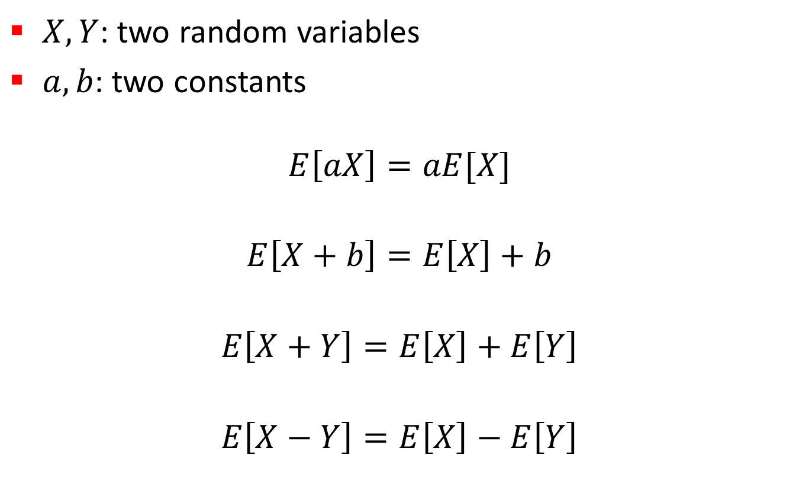
Properties of Expectation
$X, Y$: two random variables
$a, b$: two constants
$$E\left[aX\right]=aE[X]$$
$$E\left[X+b\right]=E\left[X\right]+b$$
$$E\left[X+Y\right]=E\left[X\right]+E\left[Y\right]$$
$$E\left[X−Y\right]=E\left[X\right]−E\left[Y\right]$$

Slide 15
Misuses of Expectations
Multiplying means to get the mean of a product
Example: tossing three coins
  X: number of heads
  Y: number of tails
  E[X] = E[Y] = 3/2 ⇒ E[X]E[Y] = 9/4
  E[XY] = 3/2
  ⇒ E[XY] ≠ E[X]E[Y]
Dividing means to get the mean of a ratio

Slide 16
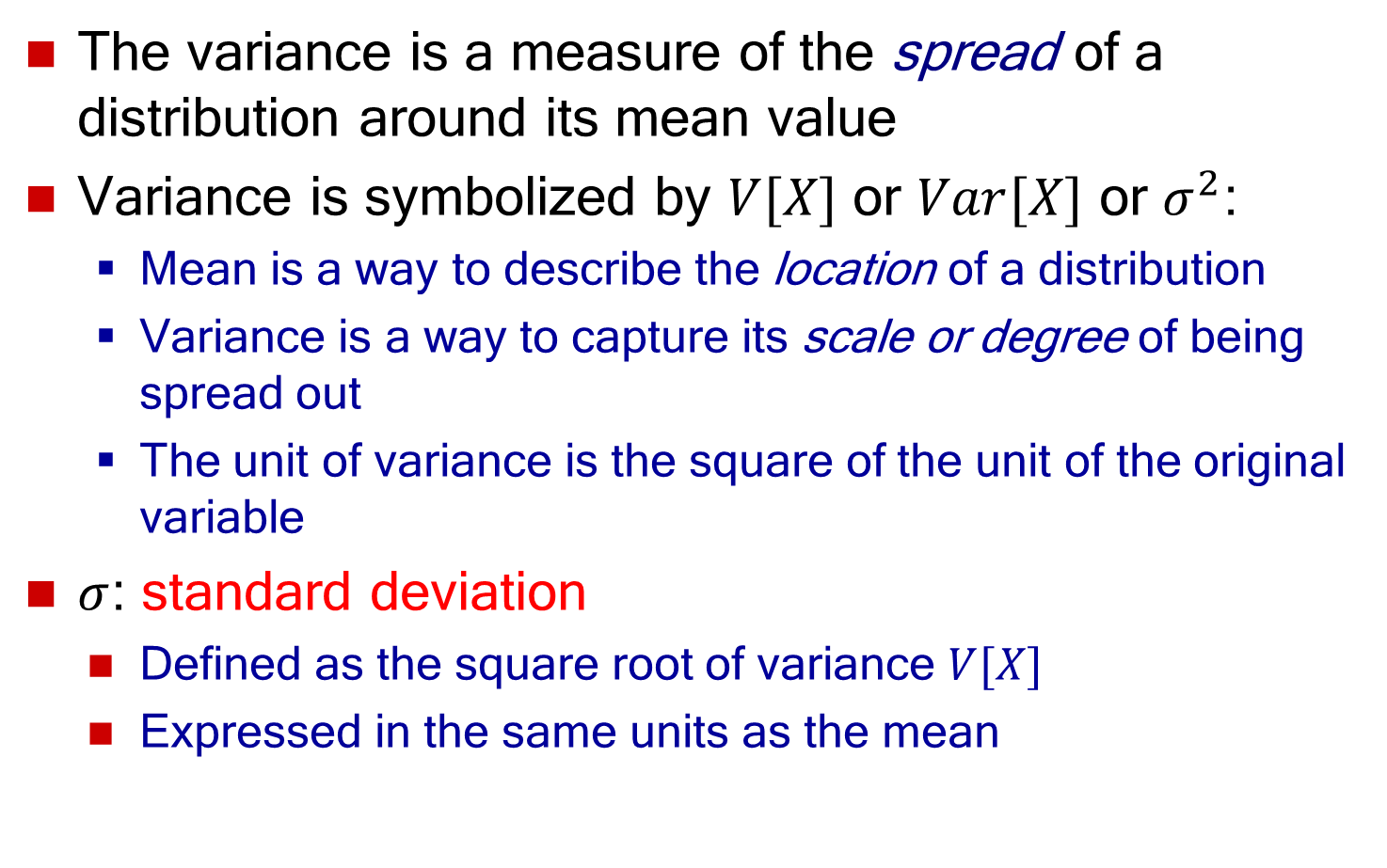
Variance of a Random Variable
The variance is a measure of the spread of a distribution around its mean value
Variance is symbolized by $V[X]$ or $Var[X]$ or $σ^{2}$:
  Mean is a way to describe the location of a distribution
  Variance is a way to capture its scale or degree of being spread out
  The unit of variance is the square of the unit of the original variable
  $σ$: standard deviation
    Defined as the square root of variance $V[X]$
    Expressed in the same units as the mean

Slide 17
Variance of a Random Variable
Variance: The expected value of the square of distance between a random variable and its mean
where, μ= E[X]
Equivalently:
σ² = E[X²] – (E[X])²

Slide 18
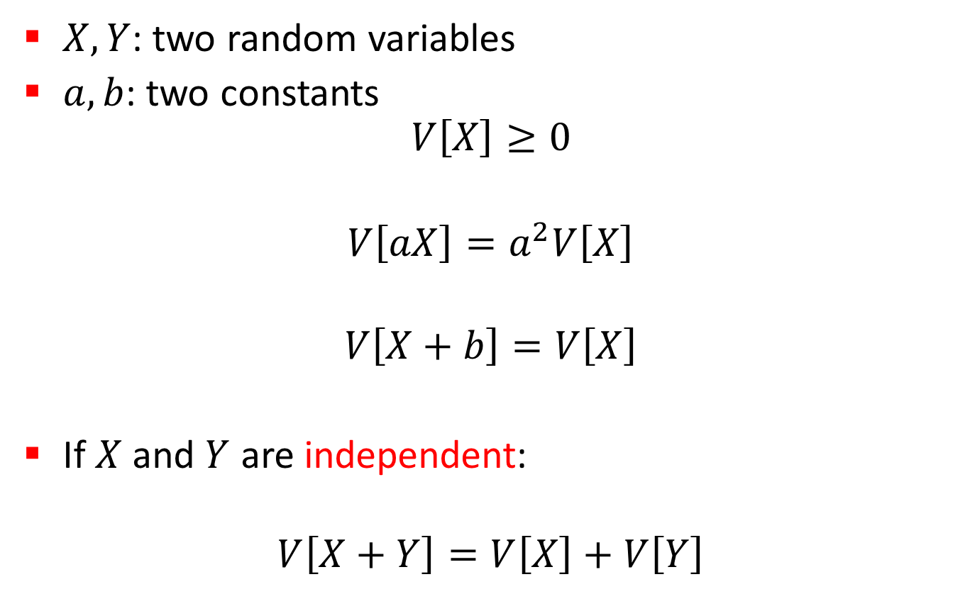
Properties of Variance
$X, Y$: two random variables
$a, b$: two constants
$V\left[X\right]≥0$
$$V\left[aX\right]=a^{2}V\left[X\right]$$
$$V\left[X+b\right]=V\left[X\right]$$
If $X$ and $Y$ are independent:
$$V\left[X+Y\right]=V\left[X\right]+V\left[Y\right]$$

Slide 19

Coefficient of Variation
Coefficient of Variation:
$$\text{CV}=\frac{\text{Standard} \text{Deviation}}{\text{Mean}}=\frac{σ}{μ}$$
Example: number of heads in tossing three coins

Slide 20
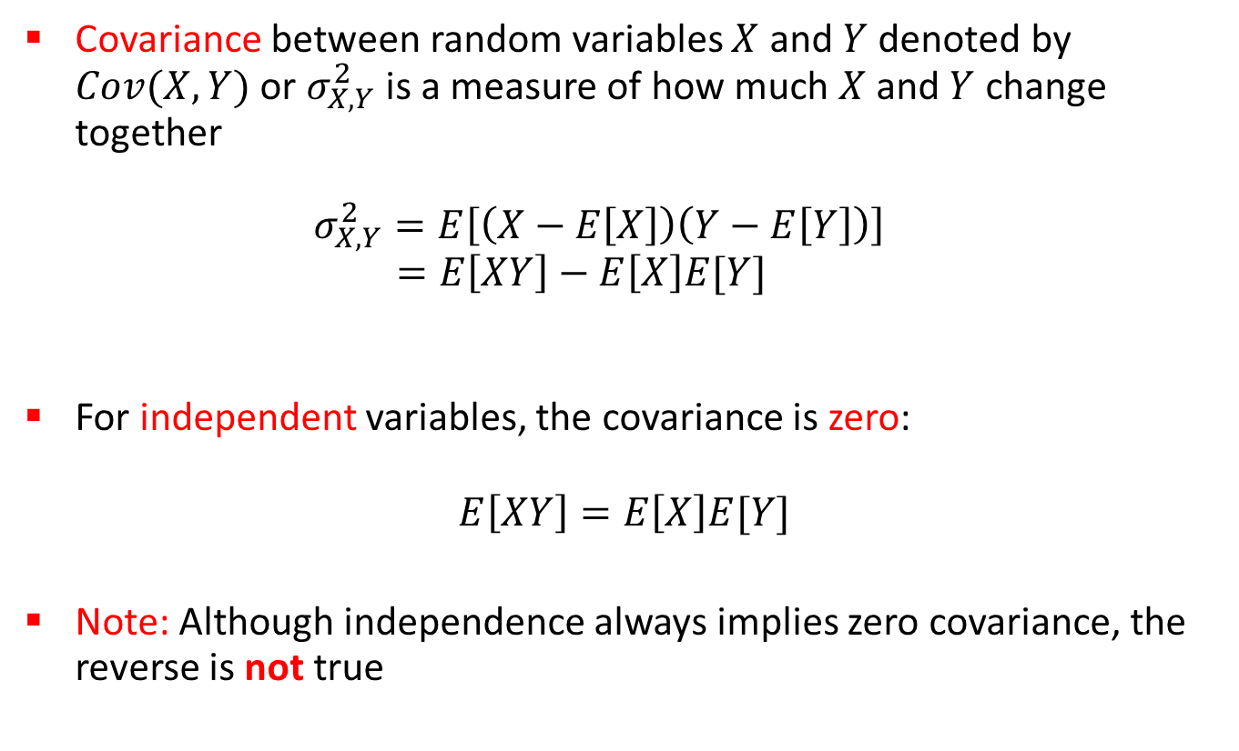
Covariance
Covariance between random variables $X$ and $Y$ denoted by $Cov(X,Y)$ or $σ_{X,Y}^{2}$ is a measure of how much $X$ and $Y$ change together
$σ_{X,Y}^{2}=E\left[\left(X−E\left[X\right]\right)\left(Y−E\left[Y\right]\right)\right]$
$=E\left[XY\right]−E\left[X\right]E[Y]$
For independent variables, the covariance is zero:
$$E\left[XY\right]=E\left[X\right]E[Y]$$
Note: Although independence always implies zero covariance, the reverse is not true

Slide 21
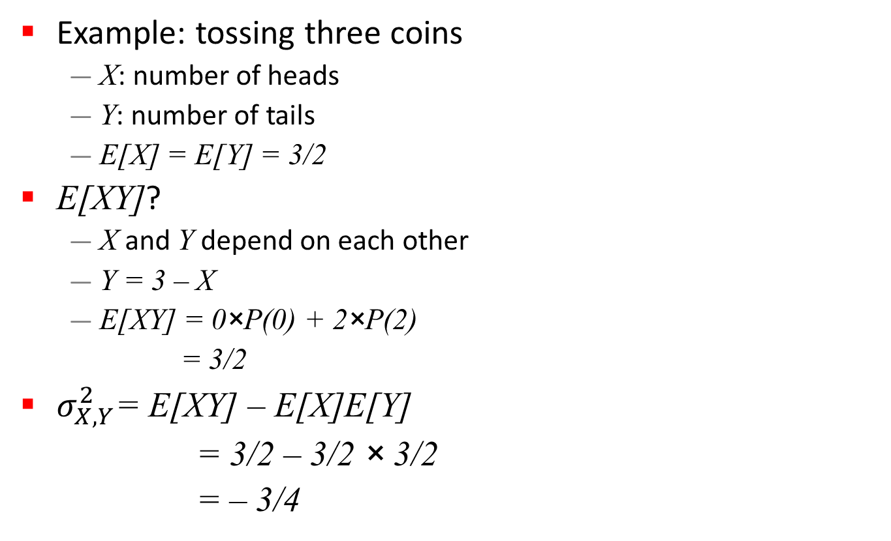
Covariance
Example: tossing three coins
  X: number of heads
  Y: number of tails
  E[X] = E[Y] = 3/2
E[XY]?
  X and Y depend on each other
  Y = 3 – X
  E[XY] = 0×P(0) + 2×P(2)
  = 3/2
$σ_{X,Y}^{2}$= E[XY] – E[X]E[Y]
= 3/2 – 3/2 × 3/2
= – 3/4
x | y | xy | p(x)
0 | 3 | 0 | 1/8
1 | 2 | 2 | 3/8
2 | 1 | 2 | 3/8
3 | 0 | 0 | 1/8
xy | p(xy)
0 | 2/8
2 | 6/8

Slide 22
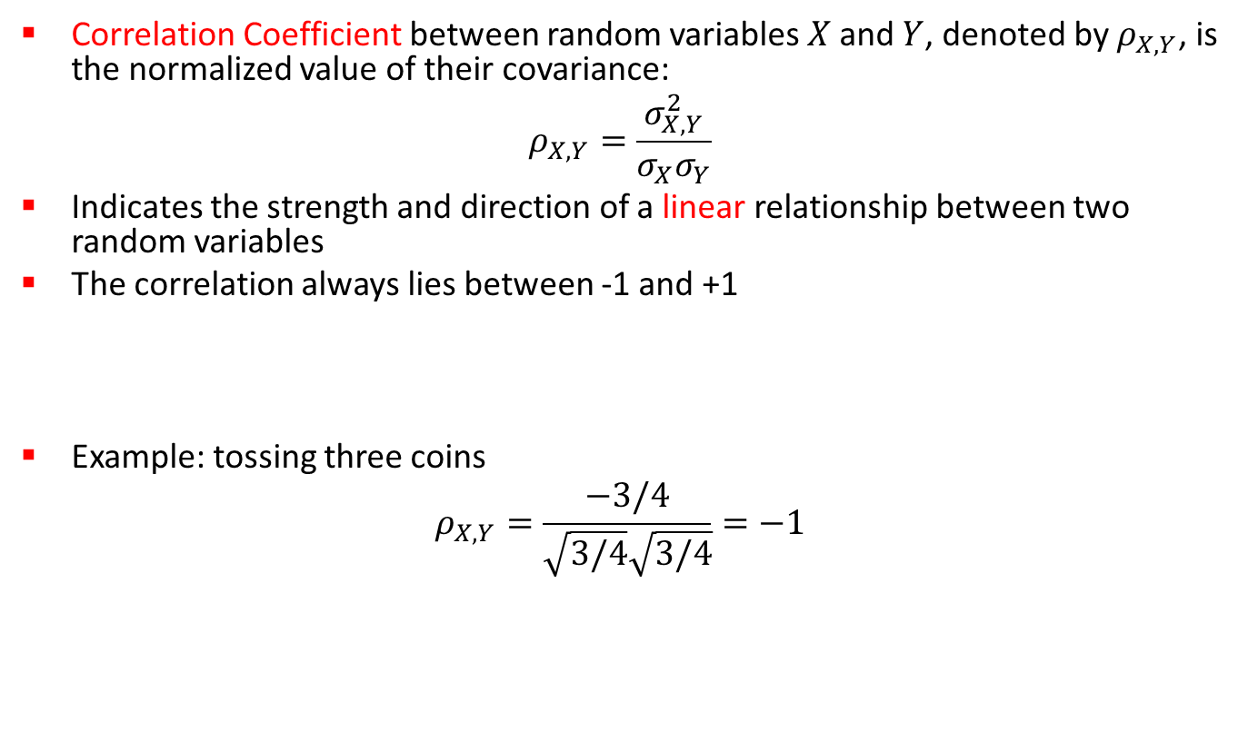
Correlation
Correlation Coefficient between random variables $X$ and $Y$, denoted by $ρ_{X,Y}$, is the normalized value of their covariance:
$$ρ_{X,Y}=\frac{σ_{X,Y}^{2}}{σ_{X}σ_{Y}}$$
Indicates the strength and direction of a linear relationship between two random variables
The correlation always lies between -1 and +1
Example: tossing three coins
$$ρ_{X,Y}=\frac{−3/4}{\sqrt{3/4}\sqrt{3/4}}=−1$$
Negative linear
correlation
Positive linear
correlation
No correlation
-1
0
+1

Slide 23
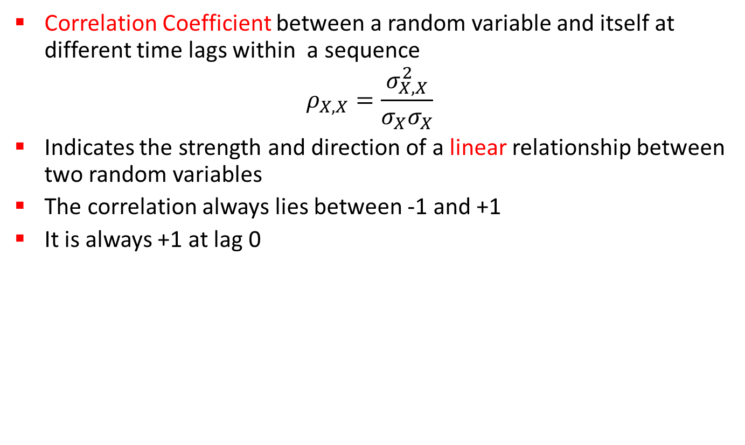
Autocorrelation
Correlation Coefficient between a random variable and itself at different time lags within a sequence
$$ρ_{X,X}=\frac{σ_{X,X}^{2}}{σ_{X}σ_{X}}$$
Indicates the strength and direction of a linear relationship between two random variables
The correlation always lies between -1 and +1
It is always +1 at lag 0
Negative linear
correlation
Positive linear
correlation
No correlation
-1
0
+1

Slide 24
Demo: Correlation and Autocorrelation
Correlation (if desired) can be induced by sharing or re-using random numbers between two (or more) random variables
Example: height and weight of medical patients
Example: a coin that remembers some of its recent history
Negative linear
correlation
Positive linear
correlation
No correlation
-1
0
+1

Slide 25
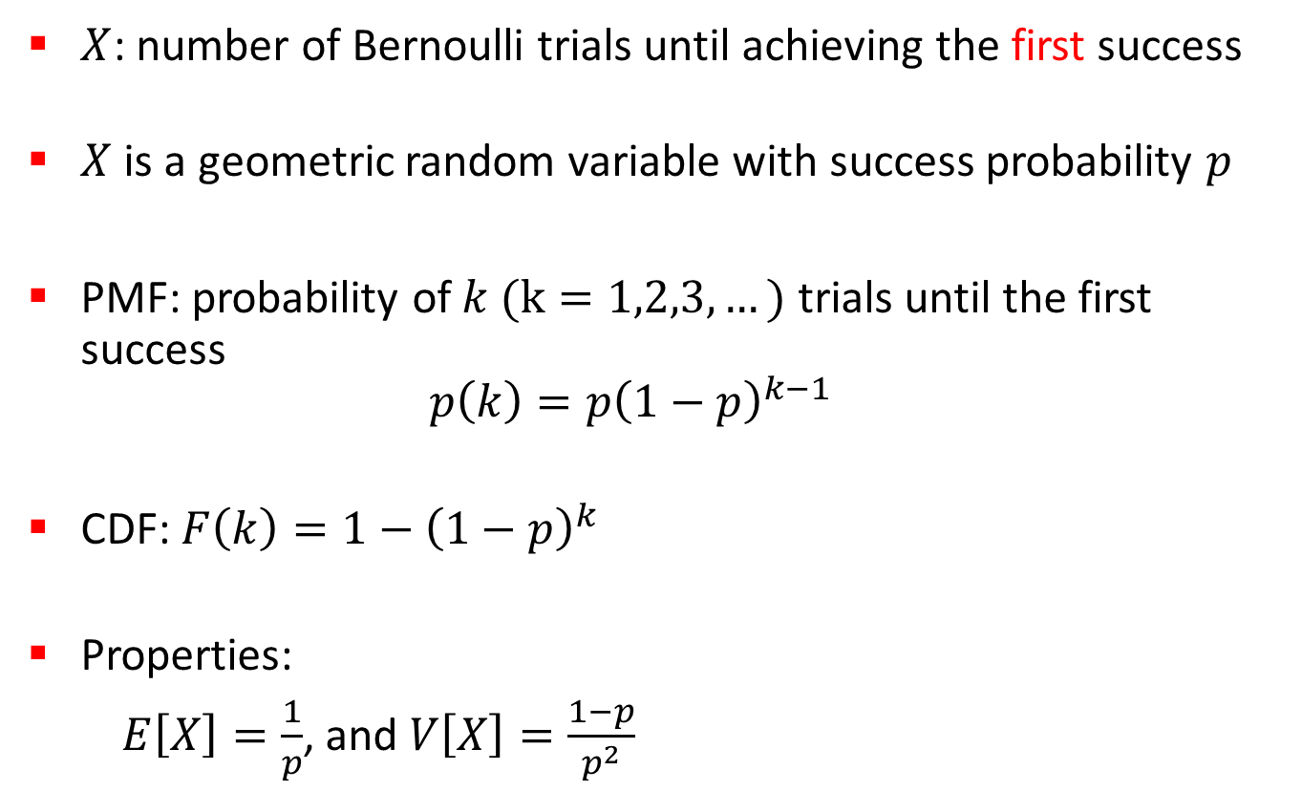
Geometric Distribution
$X$: number of Bernoulli trials until achieving the first success
$X$ is a geometric random variable with success probability $p$
PMF: probability of $k (k=1,2,3,…)$ trials until the first success
$p\left(k\right)={p\left(1−p\right)}^{k−1}$
CDF: $F\left(k\right)=1−{\left(1−p\right)}^{k}$
Properties:
$E\left[X\right]=\frac{1}{p}$, and $V\left[X\right]=\frac{1−p}{p^{2}}$

Slide 26
Example: Geometric Distribution
Geometric distribution PMF
Geometric distribution CDF

Slide 27
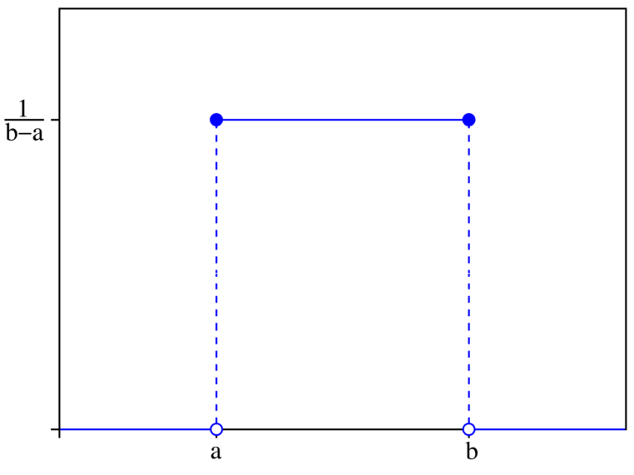
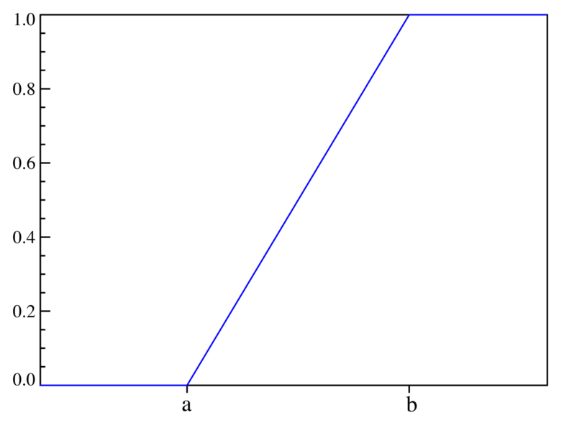
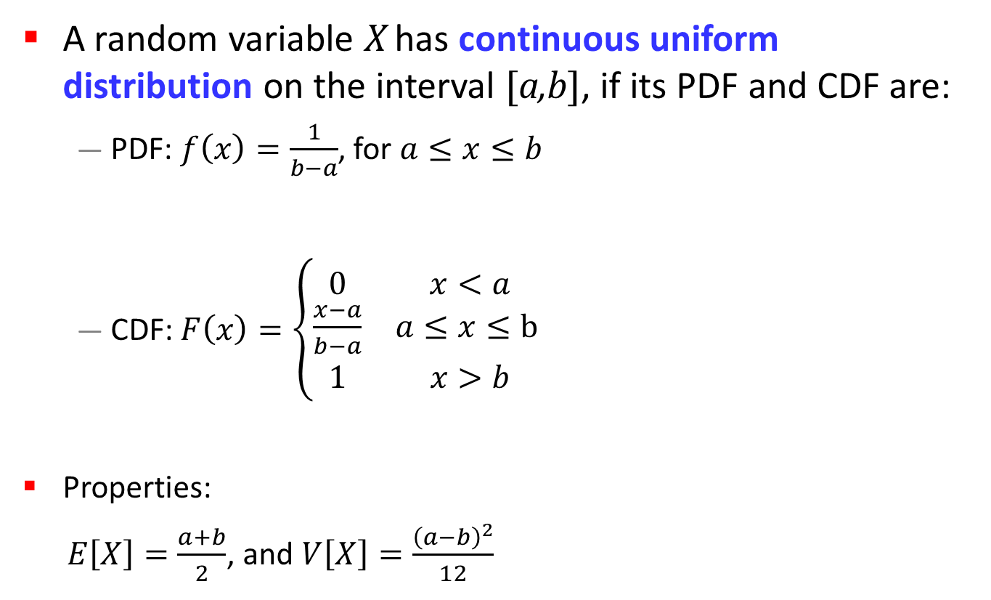
Uniform Distribution
A random variable X has continuous uniform distribution on the interval [a,b], if its PDF and CDF are:
  PDF: $f\left(x\right)=\frac{1}{b−a}$, for $a≤x≤b$
  CDF: $F\left(x\right)=\left\{\begin{matrix}0 & x<a \\ \frac{x−a}{b−a} & a≤x≤b \\ 1 & x>b\end{matrix}\right.$
Properties:
$E\left[X\right]=\frac{a+b}{2}$, and $V\left[X\right]=\frac{{\left(a−b\right)}^{2}}{12}$
PDF
CDF

Slide 28
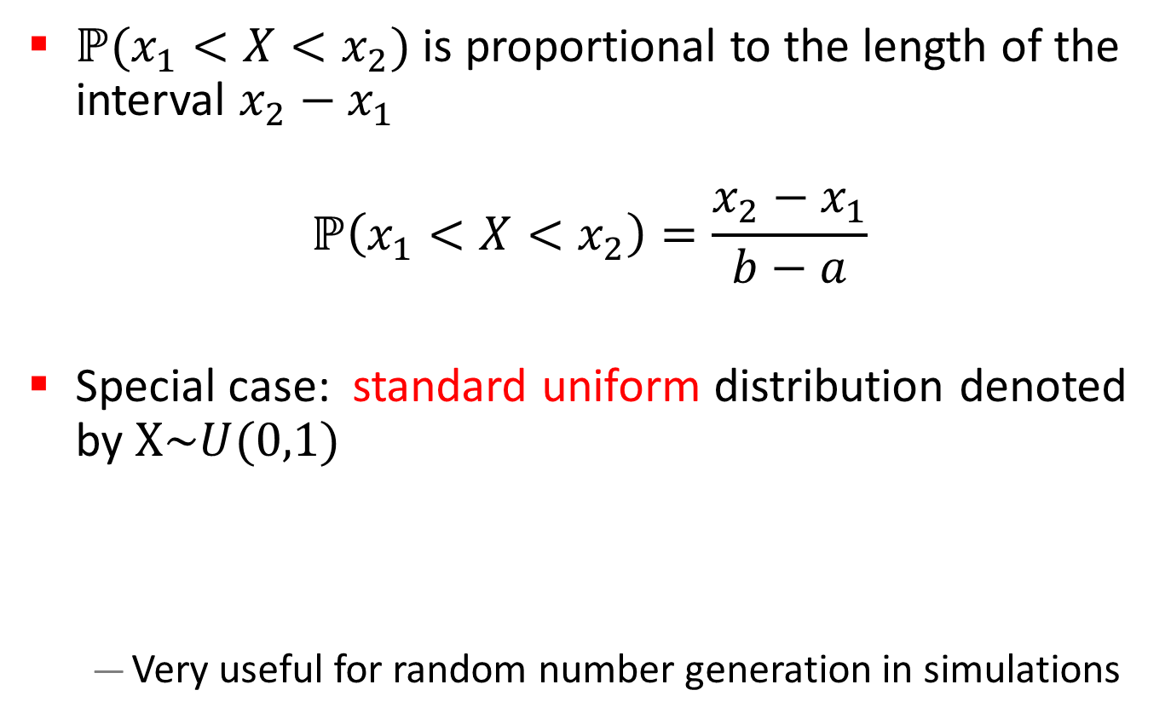
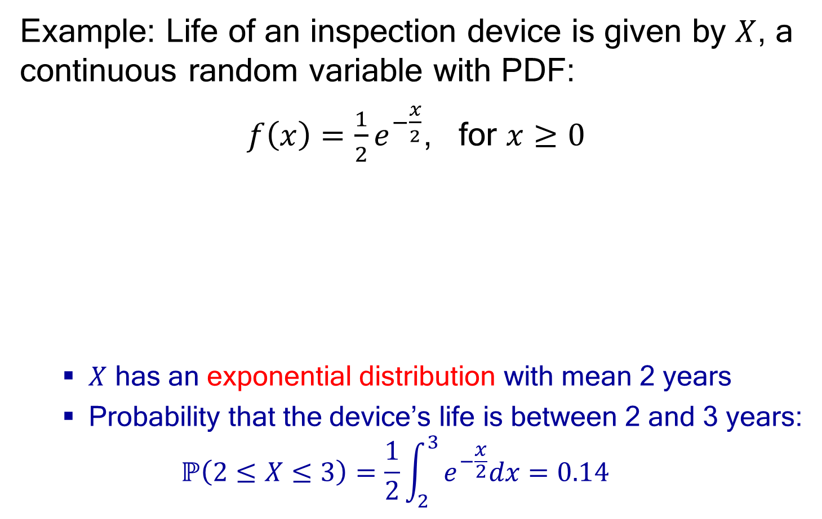
Uniform Distribution Properties
$ℙ(x_{1}<X<x_{2})$ is proportional to the length of the interval $x_{2}−x_{1}$
$$ℙ\left(x_{1}<X<x_{2}\right)=\frac{x_{2}−x_{1}}{b−a}$$
Special case: standard uniform distribution denoted by $X\sim U(0,1)$
  Very useful for random number generation in simulations
$$f\left(x\right)=\left\{\begin{matrix}1, 0≤x≤1 \\ 0, \text{otherwise} \end{matrix}\right.$$

Slide 29
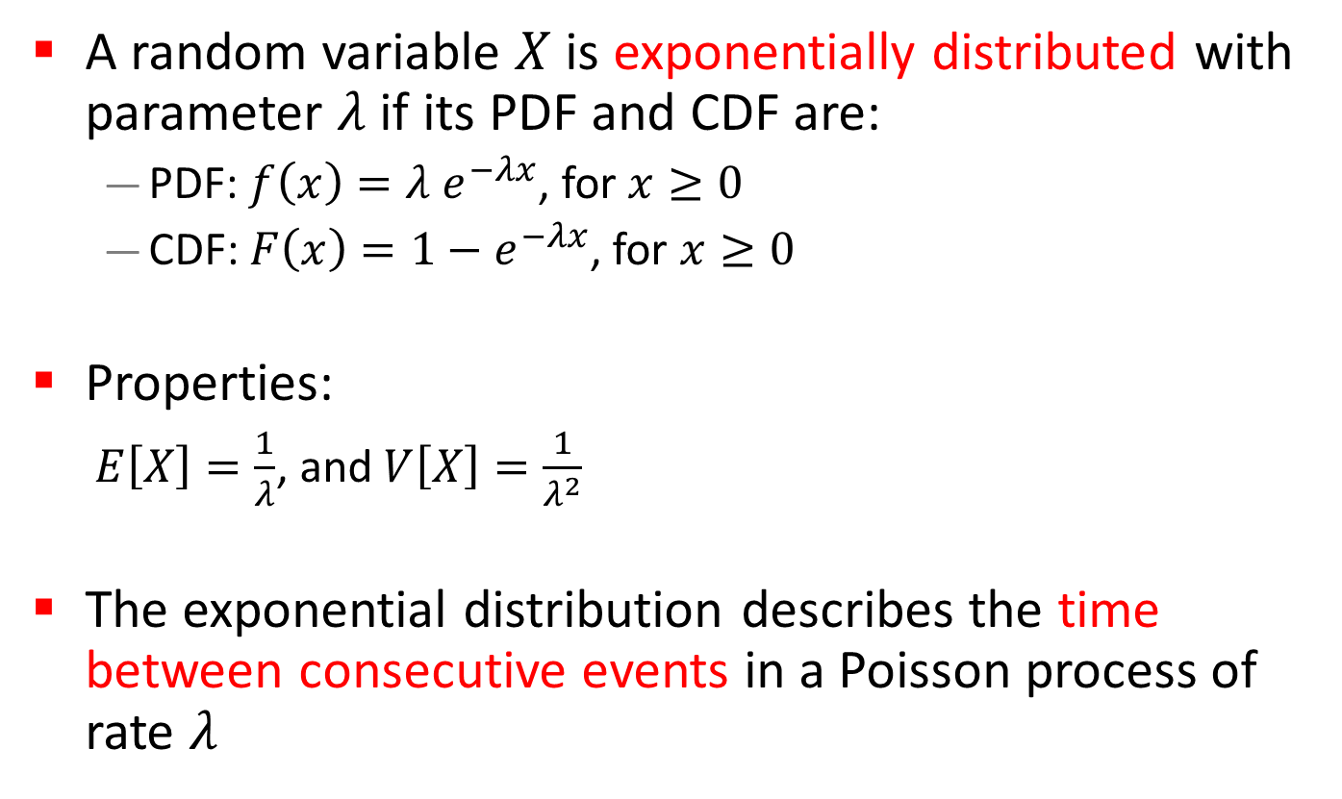
Exponential Distribution
A random variable $X$ is exponentially distributed with parameter $λ$ if its PDF and CDF are:
  PDF: $f\left(x\right)=λ e^{−λx}$, for $x≥0$
  CDF: $F\left(x\right)=1−e^{−λx}$, for $x≥0$
Properties:
  $E\left[X\right]=\frac{1}{λ}$, and $V\left[X\right]=\frac{1}{λ^{2}}$
The exponential distribution describes the time between consecutive events in a Poisson process of rate $λ$

Slide 30
Example: Exponential Distribution
Exponential distribution PDF
Exponential distribution CDF

Slide 31
Light Bulb Testing (1 of 5)
Scenario: Walmart has a giant bin of lightbulbs on sale. You buy one and bring it home for testing and observation.
Assume: All light bulbs last exactly 100 hours.
Observation: Your light bulb has worked for 70 hours.
Question: How much longer is it expected to last?
Answer:
30 hours

Slide 32
Light Bulb Testing (2 of 5)
Scenario: Walmart has a giant bin of lightbulbs on sale. You buy one and bring it home for testing and observation.
Assume: Half of the light bulbs last exactly 50 hours, while the other half last exactly 150 hours. The mean is 100 hours.
Observation: Your light bulb has worked for 70 hours.
Question: How much longer is it expected to last?
Answer:
80 hours

Slide 33
Light Bulb Testing (3 of 5)
Scenario: Walmart has a giant bin of lightbulbs on sale. You buy one and bring it home for testing and observation.
Assume: Half of the light bulbs last exactly 50 hours, while the other half last exactly 150 hours. The mean is 100 hours.
Observation: Your light bulb has worked for 40 hours.
Question: How much longer is it expected to last?
Answer:
60 hours

Slide 34
Light Bulb Testing (4 of 5)
Scenario: Walmart has a giant bin of lightbulbs on sale. You buy one and bring it home for testing and observation.
Assume: Light bulbs have a working duration that is uniformly distributed (continuous) between 50 hours and 150 hours. The mean is 100 hours.
Observation: Your light bulb has worked for 70 hours.
Question: How much longer is it expected to last?
Answer:
40 hours

Slide 35
Light Bulb Testing (5 of 5)
Scenario: Walmart has a giant bin of lightbulbs on sale. You buy one and bring it home for testing and observation.
Assume: Light bulbs have a working duration that is exponentially distributed with a mean of 100 hours.
Observation: Your light bulb has worked for 70 hours.
Question: How much longer is it expected to last?
Answer:
100 hours

Slide 36
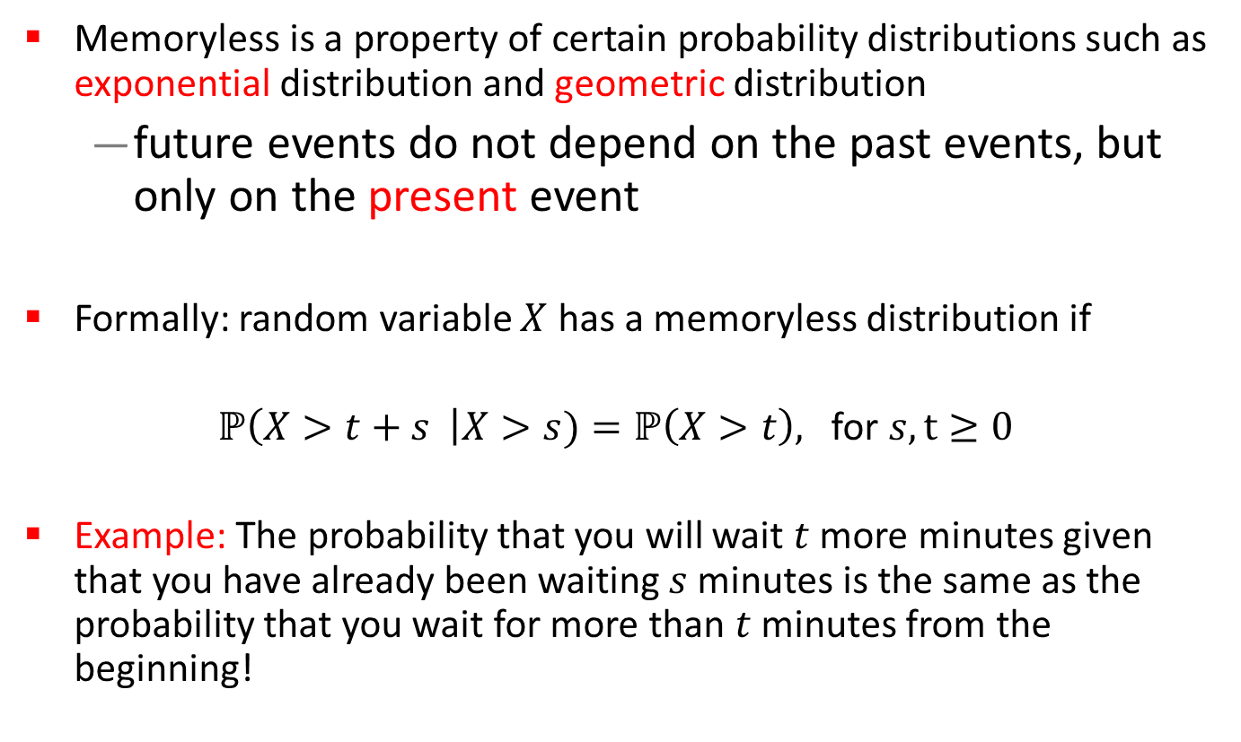
Memoryless Property
Memoryless is a property of certain probability distributions such as exponential distribution and geometric distribution
  future events do not depend on the past events, but only on the present event
Formally: random variable $X$ has a memoryless distribution if
$ℙ\left(X>t+s \right|X>s)=ℙ\left(X>t\right),$ for $s,t≥0$
Example: The probability that you will wait $t$ more minutes given that you have already been waiting $s$ minutes is the same as the probability that you wait for more than $t$ minutes from the beginning!

Slide 37
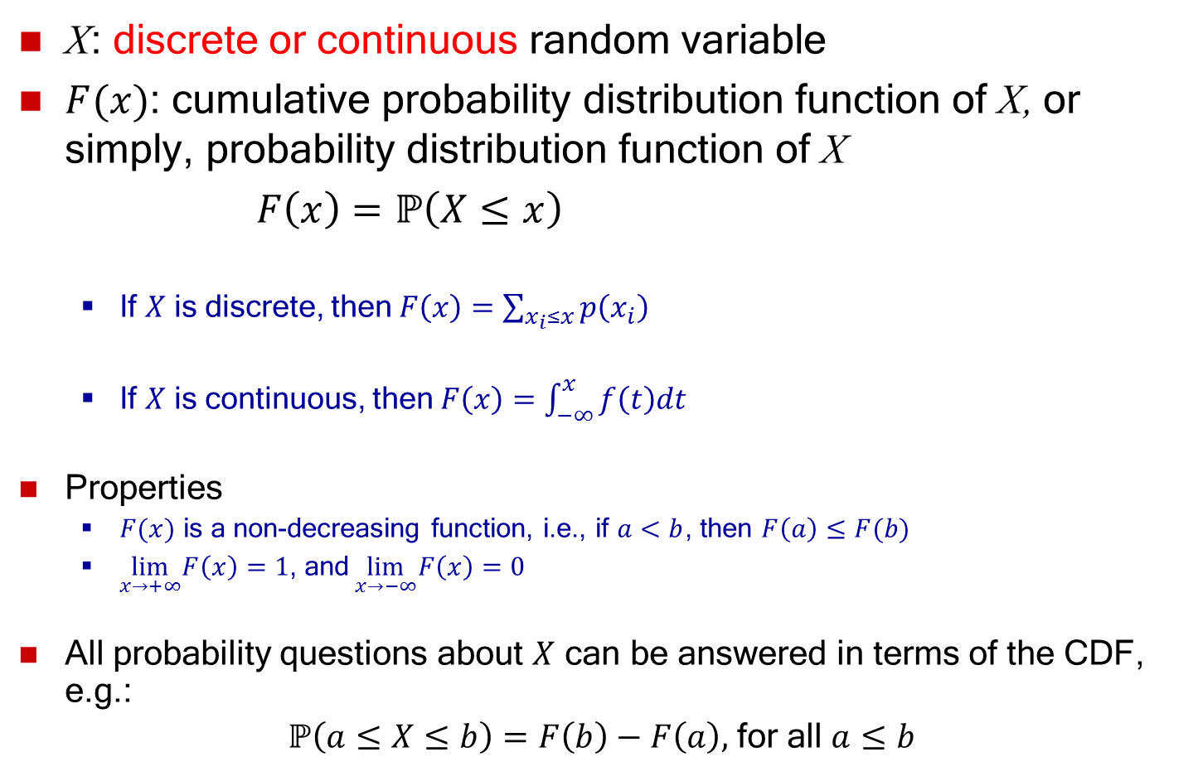
Example: Exponential Distribution
The time needed to repair the engine of a car is exponentially distributed with a mean time equal to 3 hours.
  The probability that the car spends more than the average wait time in repair:
  $ℙ\left(X>3\right)=1−F\left(3\right)=e^{−\frac{3}{3}}=0.368$
  The probability that the car repair time lasts between 2 to 3 hours is:
  $$ℙ\left(2≤X≤3\right)=F\left(3\right)−F\left(2\right)=0.145$$
  The probability that the repair time lasts for another hour given that it has already lasted for 2.5 hours:
  Using the memoryless property of the exponential distribution,
  $$ℙ\left(X>\left(1+2.5\right)|X>2.5\right)=ℙ\left(X>1\right)=1−F\left(1\right)=e^{−\frac{1}{3}}=0.717$$

