Slide 1

CPSC 531:
System Modeling and Simulation
Carey Williamson
Department of Computer Science
University of Calgary
Fall 2017

Slide 2

Quote of the Day
“A person with one watch knows what time it is.
A person with two watches is never quite sure.”
-Segal’s Law

Slide 3
Simulation Output Analysis
Purpose: estimate system performance from simulation output
Understand:
  Terminating and non-terminating simulations
  Transient and steady-state behavior
Learn about statistical data analysis:
  Computing confidence intervals
  Determining the number of observations required to achieve a desired confidence interval

Slide 4
Outline
Measure of performance and error
Transient and steady state
  Types of simulations
  Steady-state analysis
  Initial data deletion
  Length of simulation run
Confidence interval
  Estimating mean and variance
  Confidence interval for small and large samples
  Width of confidence interval

Slide 5
Outline
Measure of performance and error
Transient and steady state
  Types of simulations
  Steady-state analysis
  Initial data deletion
  Length of simulation run
Confidence interval
  Estimating mean and variance
  Confidence interval for small and large samples
  Width of confidence interval

Slide 6
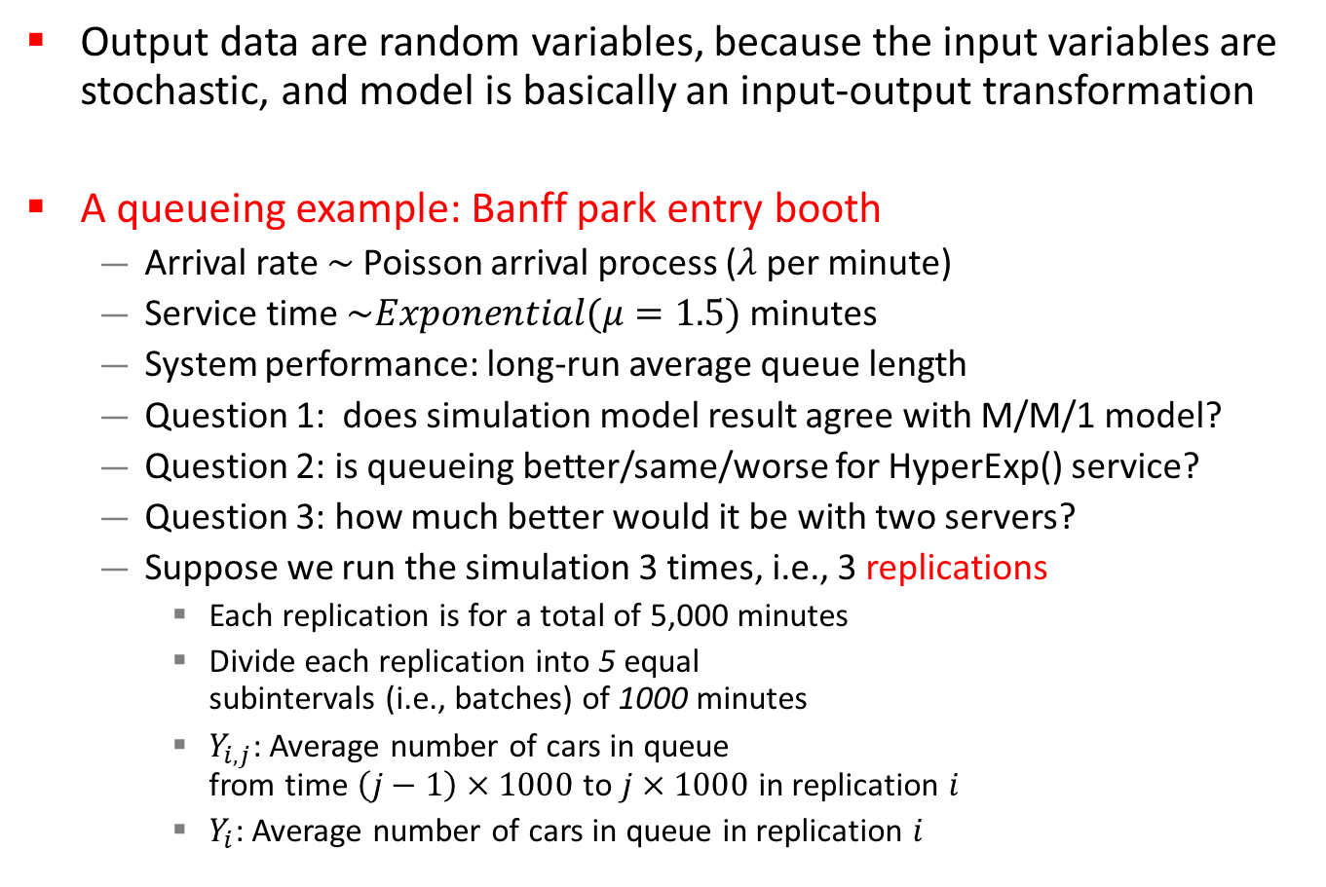
Stochastic Nature of Simulation Output
Output data are random variables, because the input variables are stochastic, and model is basically an input-output transformation
A queueing example: Banff park entry booth
  Arrival rate $\sim$ Poisson arrival process ($λ$ per minute)
  Service time $\sim Exponential(μ=1.5)$ minutes
  System performance: long-run average queue length
  Question 1: does simulation model result agree with M/M/1 model?
  Question 2: is queueing better/same/worse for HyperExp() service?
  Question 3: how much better would it be with two servers?
  Suppose we run the simulation 3 times, i.e., 3 replications
    Each replication is for a total of 5,000 minutes
    Divide each replication into 5 equal
    subintervals (i.e., batches) of 1000 minutes
    $Y_{i,j}$: Average number of cars in queue
    from time $\left(j−1\right)×1000$ to $j×1000$ in replication $i$
    $Y_{i}$: Average number of cars in queue in replication $i$

Slide 7
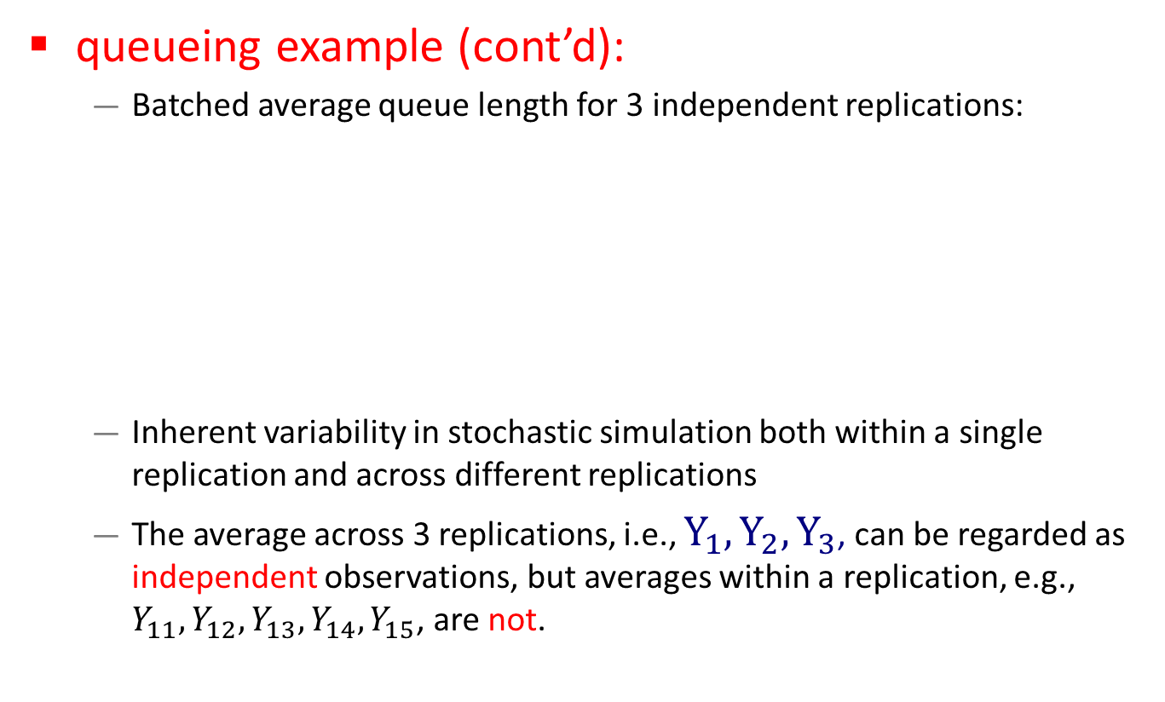
Stochastic Nature of Simulation Output
queueing example (cont’d):
  Batched average queue length for 3 independent replications:
  Inherent variability in stochastic simulation both within a single replication and across different replications
  The average across 3 replications, i.e., $Y_{1}, Y_{2}, Y_{3}$, can be regarded as independent observations, but averages within a replication, e.g., $Y_{11}, Y_{12}, Y_{13}, Y_{14}, Y_{15}$, are not.

Slide 8
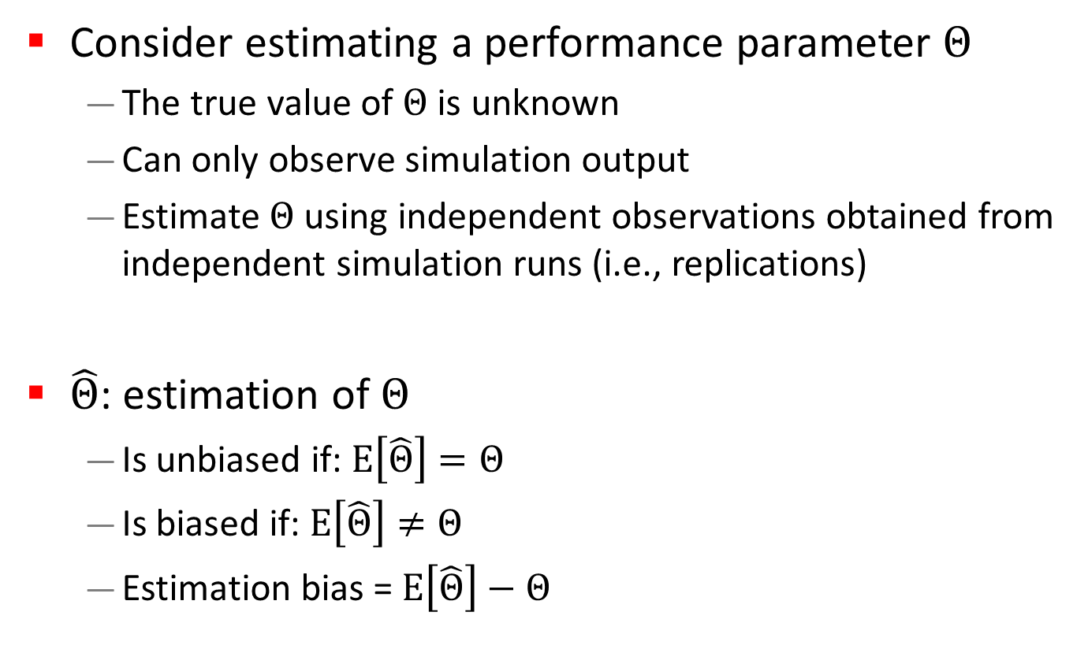
Measure of Performance
Consider estimating a performance parameter $Θ$
  The true value of $Θ$ is unknown
  Can only observe simulation output
  Estimate $Θ$ using independent observations obtained from independent simulation runs (i.e., replications)
$\hat{Θ}$: estimation of $Θ$
  Is unbiased if: $E\left[\hat{Θ}\right]=Θ$
  Is biased if: $E\left[\hat{Θ}\right]≠Θ$
  Estimation bias = $E\left[\hat{Θ}\right]−Θ$
Desired

Slide 9
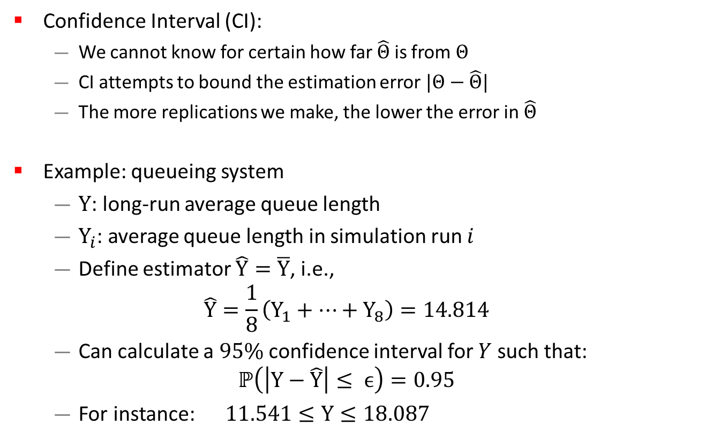
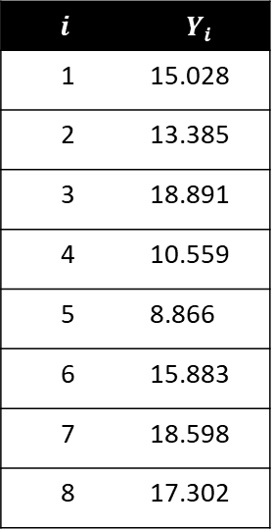
Measure of Error
Confidence Interval (CI):
  We cannot know for certain how far $\hat{Θ}$ is from $Θ$
  CI attempts to bound the estimation error $|Θ−\hat{Θ}|$
  The more replications we make, the lower the error in $\hat{Θ}$
Example: queueing system
  $Y$: long-run average queue length
  $Y_{i}$: average queue length in simulation run $i$
  Define estimator $\hat{Y}=\overline{Y}$, i.e.,
  $$\hat{Y}=\frac{1}{8}\left(Y_{1}+⋯+Y_{8}\right)=14.814$$
  Can calculate a $95\%$ confidence interval for $Y$ such that:
  $ℙ\left(\left|Y−\hat{Y}\right|≤ ϵ\right)=0.95$
  For instance: $11.541≤Y≤18.087$
$$i$$ | $$Y_{i}$$
1 | 15.028
2 | 13.385
3 | 18.891
4 | 10.559
5 | 8.866
6 | 15.883
7 | 18.598
8 | 17.302
Notes:
Example: alpha = 0.05

Slide 10
Outline
Measure of performance and error
Transient and steady state
  Types of simulations
  Steady-state analysis
  Initial data deletion
  Length of simulation run
Confidence interval
  Estimating mean and variance
  Confidence interval for small and large samples
  Width of confidence interval

Slide 11
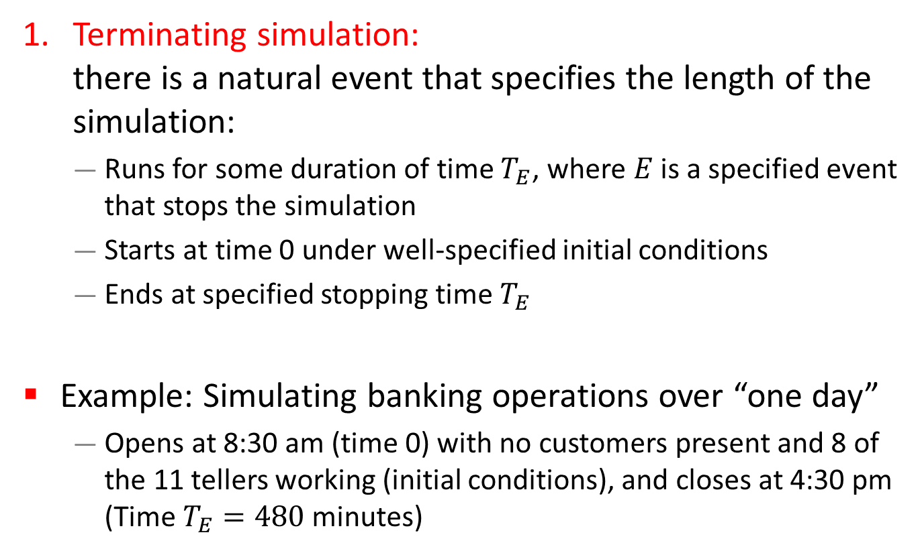
Types of Simulations
Terminating simulation:
there is a natural event that specifies the length of the simulation:
  Runs for some duration of time $T_{E}$, where $E$ is a specified event that stops the simulation
  Starts at time 0 under well-specified initial conditions
  Ends at specified stopping time $T_{E}$
Example: Simulating banking operations over “one day”
  Opens at 8:30 am (time 0) with no customers present and 8 of the 11 tellers working (initial conditions), and closes at 4:30 pm (Time $T_{E}=480$ minutes)

Slide 12
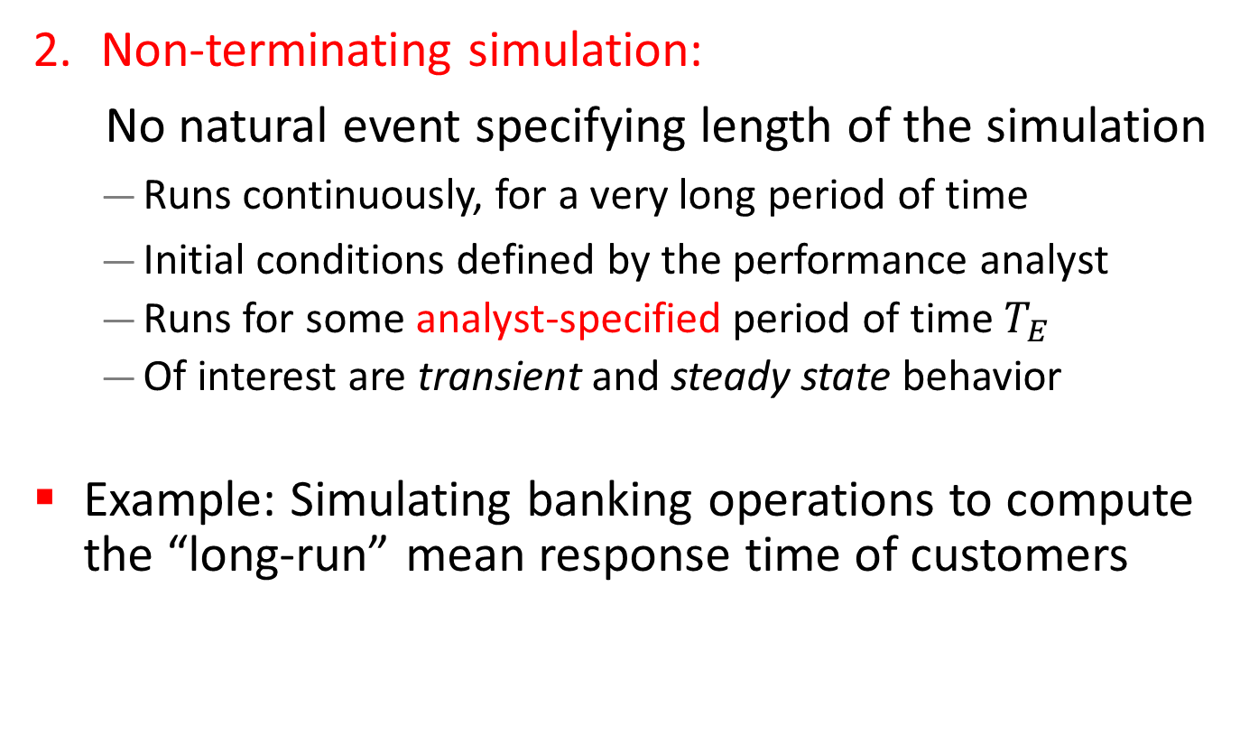
Types of Simulations
Non-terminating simulation:
No natural event specifying length of the simulation
  Runs continuously, for a very long period of time
  Initial conditions defined by the performance analyst
  Runs for some analyst-specified period of time $T_{E}$
  Of interest are transient and steady state behavior
Example: Simulating banking operations to compute the “long-run” mean response time of customers

Slide 13
Types of Simulations
Whether a simulation is considered to be terminating or non-terminating depends on both
  The objectives of the simulation study, and
  The nature of the system.
Similar statistical techniques applied to both types of simulations to estimate performance and error
For non-terminating simulations:
  Transient and steady-state behavior are different
  Generally, steady-state performance is of interest

Slide 14
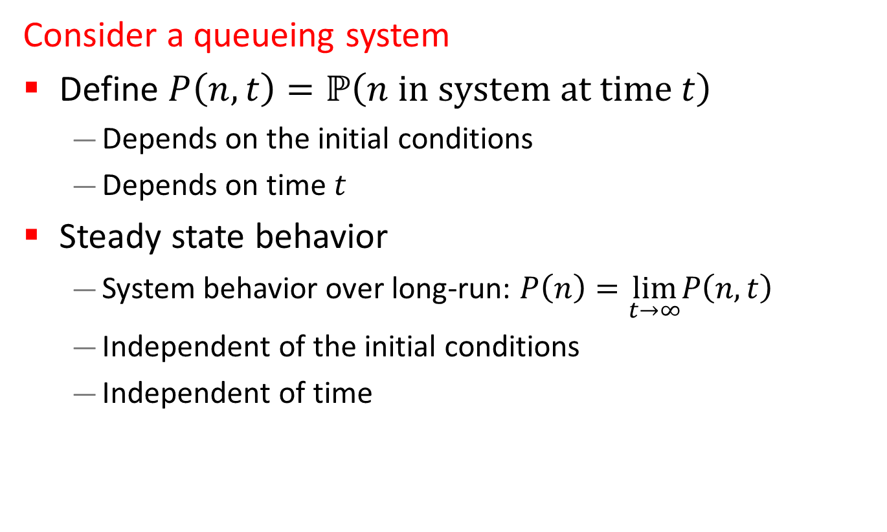
Transient and Steady-State Behavior
Consider a queueing system
Define $P\left(n, t\right)=ℙ\left(n \text{in} \text{system} \text{at} \text{time} t\right)$
  Depends on the initial conditions
  Depends on time $t$
Steady state behavior
  System behavior over long-run: $P\left(n\right)=\lim_{t→∞}P\left(n, t\right)$
  Independent of the initial conditions
  Independent of time

Slide 15
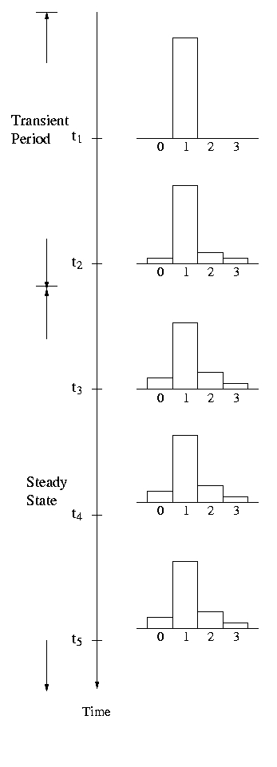
Transient and Steady-State Behavior

Slide 16
Steady-State Output Analysis
General approach based on independent replications:
  Choose the initial conditions
  Determine the length of simulation run
  Run the simulation and collect data
Problem: steady-state results are affected by using artificial and potentially unrealistic initial conditions
Solutions:
  Intelligent initialization
  Simulation warmup (initial data deletion)

Slide 17
Intelligent Initialization
Initialize the simulation in a state that is more representative of long-run conditions
If the system exists, collect data on it and use these data to specify typical initial conditions
If the system can be simplified enough to make it mathematically solvable (e.g. queueing models), then solve the simplified model to find long-run expected or most likely conditions, and use that to initialize the simulation

Slide 18
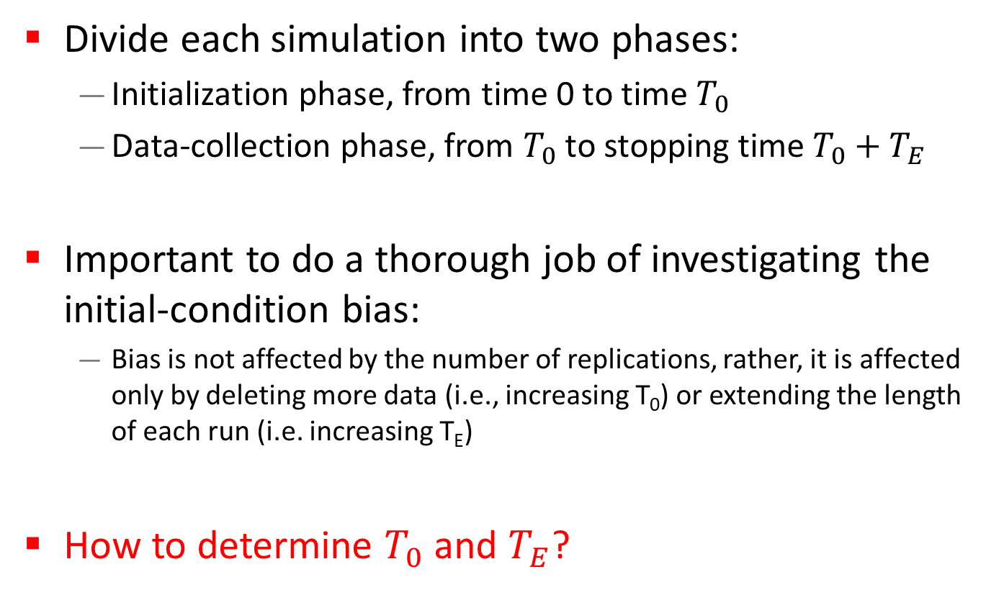
Simulation Warmup: Initial Data Deletion
Divide each simulation into two phases:
  Initialization phase, from time 0 to time $T_{0}$
  Data-collection phase, from $T_{0}$ to stopping time $T_{0}+T_{E}$
Important to do a thorough job of investigating the initial-condition bias:
  Bias is not affected by the number of replications, rather, it is affected only by deleting more data (i.e., increasing T₀) or extending the length of each run (i.e. increasing T_{E})
How to determine $T_{0}$ and $T_{E}$?

Slide 19
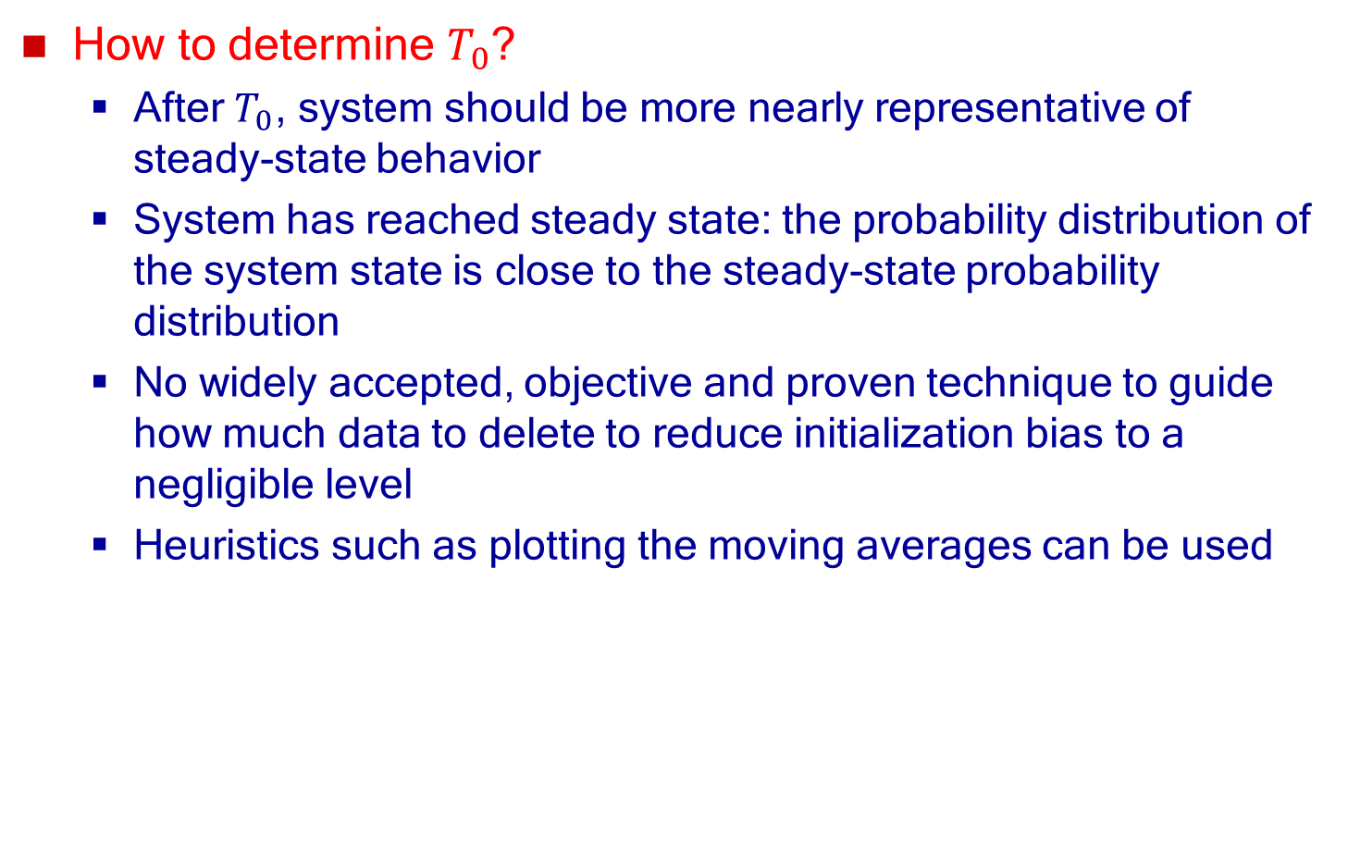
Simulation Warmup: Initial Data Deletion
How to determine $T_{0}$?
  After $T_{0}$, system should be more nearly representative of steady-state behavior
  System has reached steady state: the probability distribution of the system state is close to the steady-state probability distribution
  No widely accepted, objective and proven technique to guide how much data to delete to reduce initialization bias to a negligible level
  Heuristics such as plotting the moving averages can be used

Slide 20
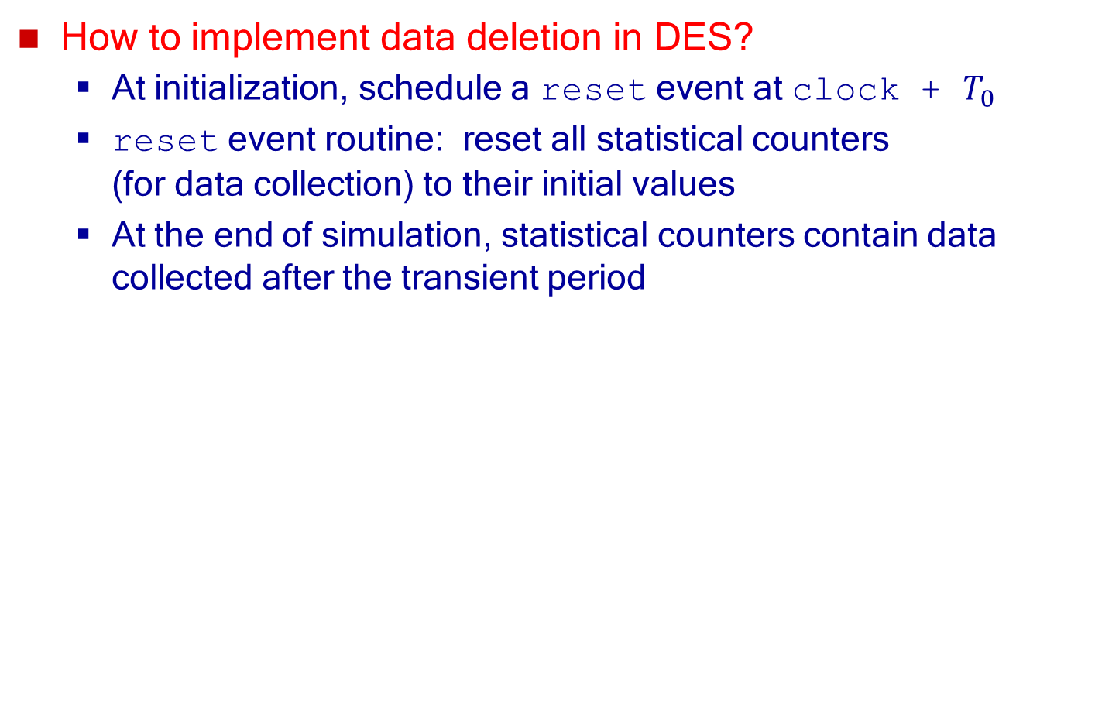
Initial Data Deletion
How to implement data deletion in DES?
  At initialization, schedule a reset event at clock + $T_{0}$
  reset event routine: reset all statistical counters
  (for data collection) to their initial values
  At the end of simulation, statistical counters contain data collected after the transient period

Slide 21
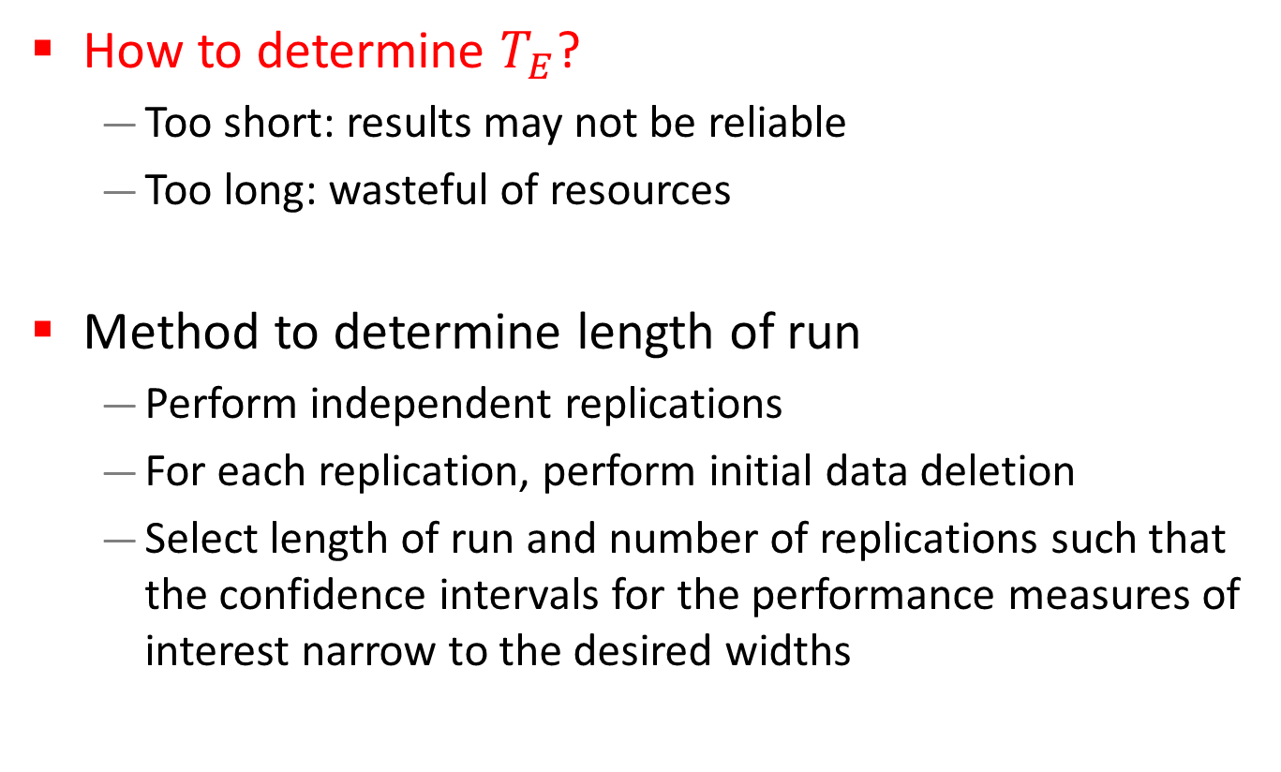
Length of Simulation Run
How to determine $T_{E}$?
  Too short: results may not be reliable
  Too long: wasteful of resources
Method to determine length of run
  Perform independent replications
  For each replication, perform initial data deletion
  Select length of run and number of replications such that the confidence intervals for the performance measures of interest narrow to the desired widths

Slide 22
Outline
Measure of performance and error
Transient and steady state
  Types of simulations
  Steady-state analysis
  Initial data deletion
  Length of simulation run
Confidence interval
  Estimating mean and variance
  Confidence interval for small and large samples
  Width of confidence interval

Slide 23
Confidence Interval
Terminology
Observation: a single value of a performance measure from an experiment
Example: mean response time of a web server
Sample: the set of observations of a performance measure from an experiment

Slide 24
Sample Versus Population
Generate several million random numbers with a given distribution and draw a sample of m observations
Sample mean ≠ population mean
In discrete-event simulation, population characteristics such as mean and variance are unknown
  Need to estimate them using simulation output

Slide 25
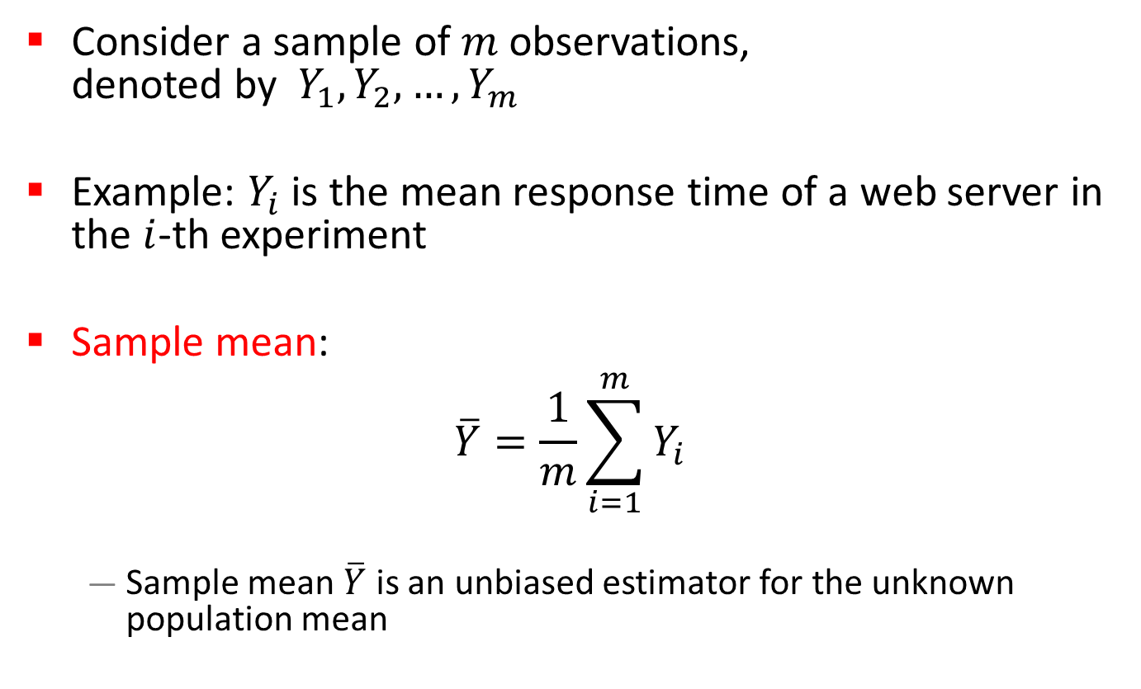
Estimating Mean
Consider a sample of $m$ observations,
denoted by $Y_{1},Y_{2},…,Y_{m}$
Example: $Y_{i}$ is the mean response time of a web server in the $i$-th experiment
Sample mean:
$$\overline{Y}=\frac{1}{m}\sum_{i=1}^{m}{Y_{i}}$$
  Sample mean $\overline{Y}$ is an unbiased estimator for the unknown population mean

Slide 26
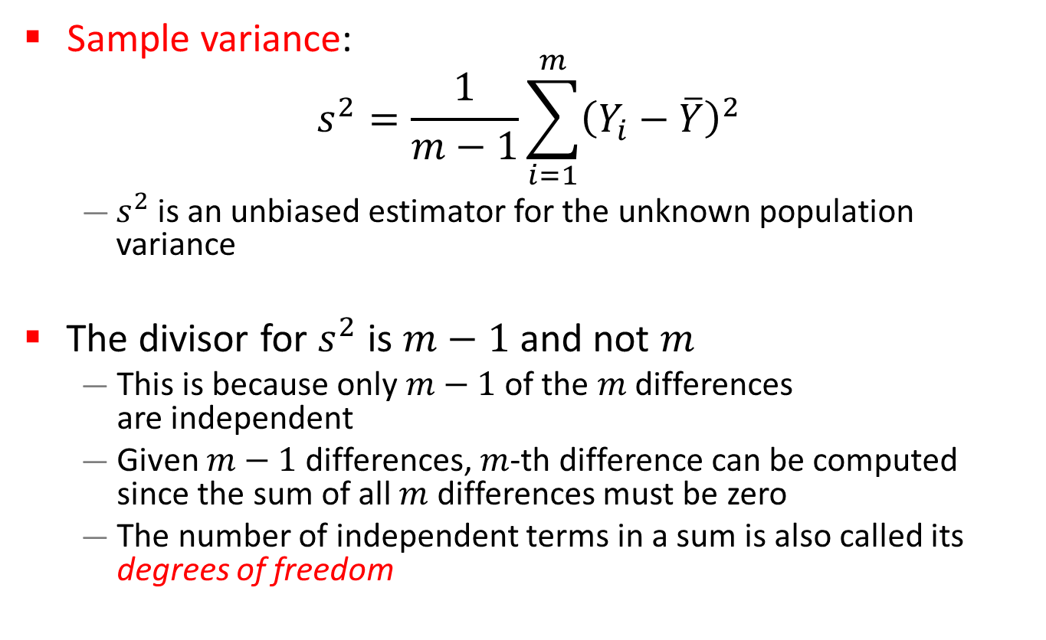
Estimating Variance
Sample variance:
$$s^{2}=\frac{1}{m−1}\sum_{i=1}^{m}{{\left(Y_{i}−\overline{Y}\right)}^{2}}$$
  $s^{2}$ is an unbiased estimator for the unknown population variance
The divisor for $s^{2}$ is $m−1$ and not $m$
  This is because only $m−1$of the $m$ differences
  are independent
  Given $m−1$ differences, $m$-th difference can be computed since the sum of all $m$ differences must be zero
  The number of independent terms in a sum is also called its degrees of freedom

Slide 27
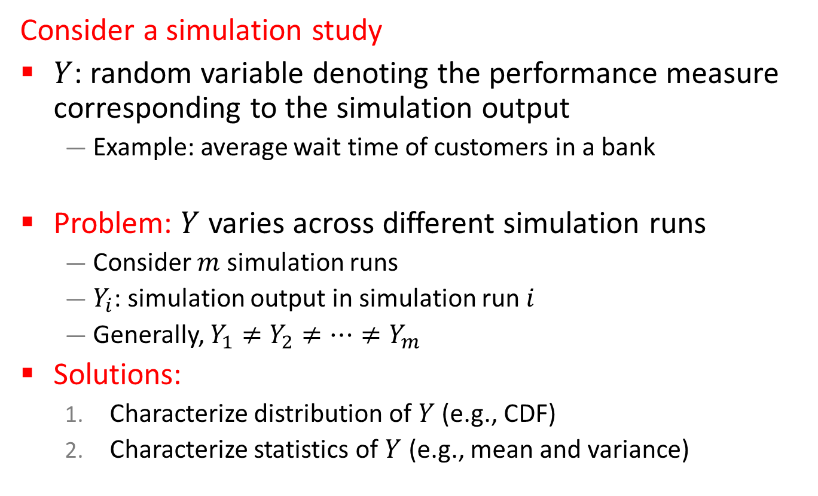
Confidence Interval for Mean
Consider a simulation study
$Y$: random variable denoting the performance measure corresponding to the simulation output
  Example: average wait time of customers in a bank
Problem: $Y$ varies across different simulation runs
  Consider $m$ simulation runs
  $Y_{i}$: simulation output in simulation run $i$
  Generally, $Y_{1}≠Y_{2}≠⋯≠Y_{m}$
Solutions:
  Characterize distribution of $Y$ (e.g., CDF)
  Characterize statistics of $Y$ (e.g., mean and variance)
Notes:
Example: alpha = 0.05

Slide 28
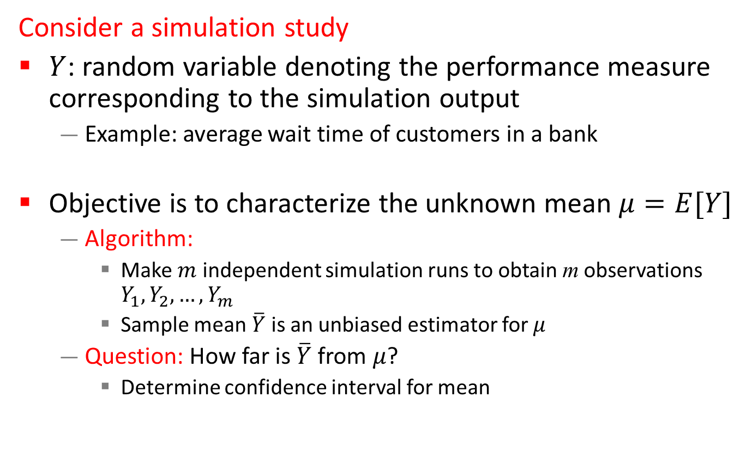
Confidence Interval for Mean
Consider a simulation study
$Y$: random variable denoting the performance measure corresponding to the simulation output
  Example: average wait time of customers in a bank
Objective is to characterize the unknown mean $μ=E[Y]$
  Algorithm:
    Make $m$ independent simulation runs to obtain m observations $Y_{1},Y_{2},…,Y_{m}$
    Sample mean $\overline{Y}$ is an unbiased estimator for $μ$
  Question: How far is $\overline{Y}$ from $μ$?
    Determine confidence interval for mean
Notes:
Example: alpha = 0.05

Slide 29

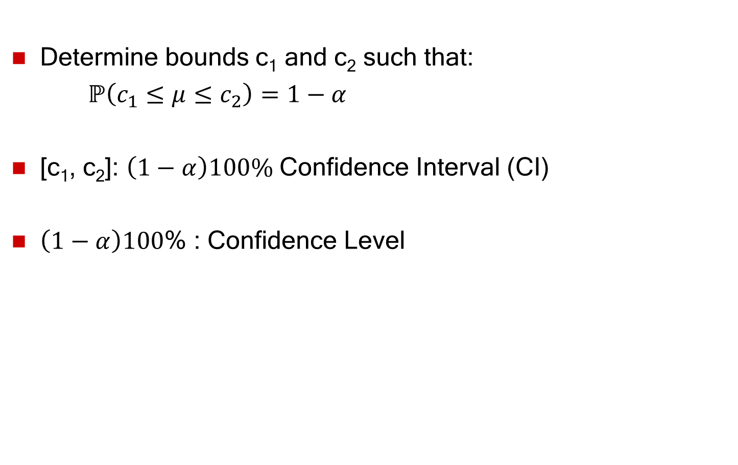
Confidence Interval for Mean
Determine bounds c₁ and c₂ such that:
$ℙ\left(c_{1}≤μ≤c_{2}\right)=1−α$
[c₁, c₂]: $\left(1−α\right)100\%$ Confidence Interval (CI)
$\left(1−α\right)100$% : Confidence Level
c₁
c₂
$$μ$$
Notes:
Example: alpha = 0.05

Slide 30
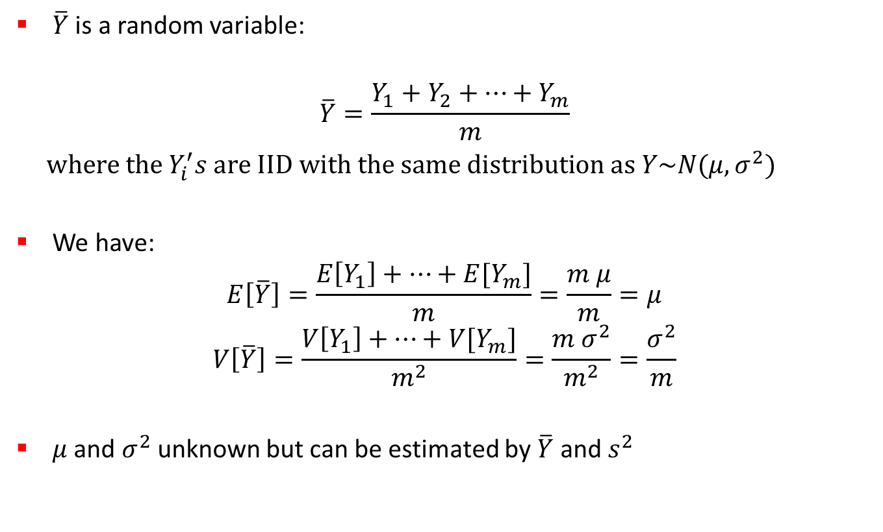
Determining Confidence Interval
$\overline{Y}$ is a random variable:
$$\overline{Y}=\frac{Y_{1}+Y_{2}+⋯+Y_{m}}{m}$$
$\text{wher}e the Y_{i}^{′}s \text{are} \text{IID} \text{with} \text{the} \text{same} \text{distribution} \text{as} Y\sim N(μ, σ^{2})$
We have:
$$E\left[\overline{Y}\right]=\frac{E\left[Y_{1}\right]+⋯+E[Y_{m}]}{m}=\frac{m μ}{m}=μ$$
$$V\left[\overline{Y}\right]=\frac{V\left[Y_{1}\right]+⋯+V[Y_{m}]}{m^{2}}=\frac{m σ^{2}}{m^{2}}=\frac{σ^{2}}{m}$$
$μ$ and $σ^{2}$ unknown but can be estimated by $\overline{Y}$ and $s^{2}$

Slide 31
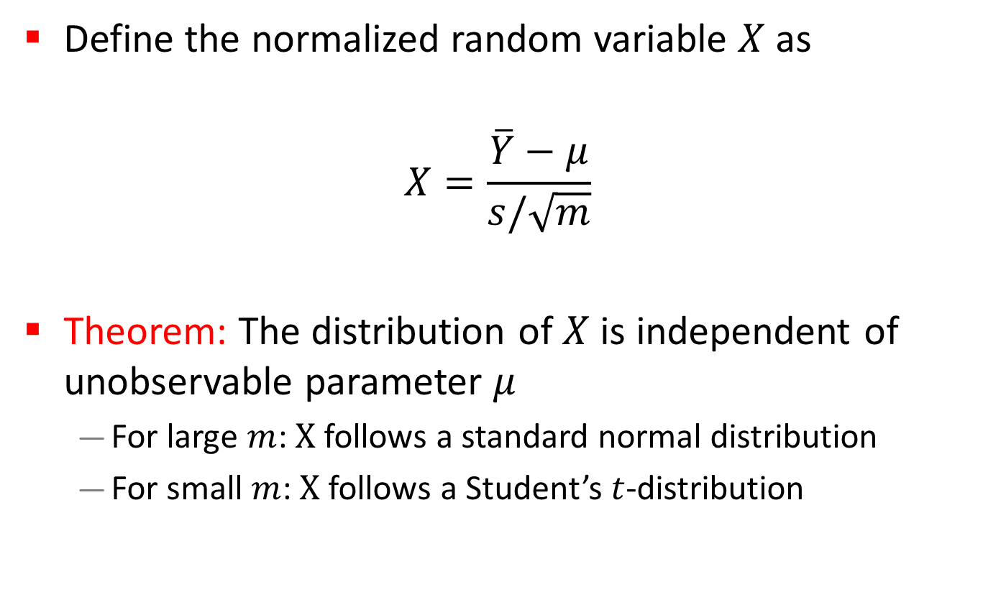
Determining Confidence Interval
Define the normalized random variable $X$ as
$$X=\frac{\overline{Y}−μ}{s/\sqrt{m}}$$
Theorem: The distribution of $X$ is independent of unobservable parameter $μ$
  For large $m$: $X$ follows a standard normal distribution
  For small $m$: $X$ follows a Student’s $t$-distribution

Slide 32
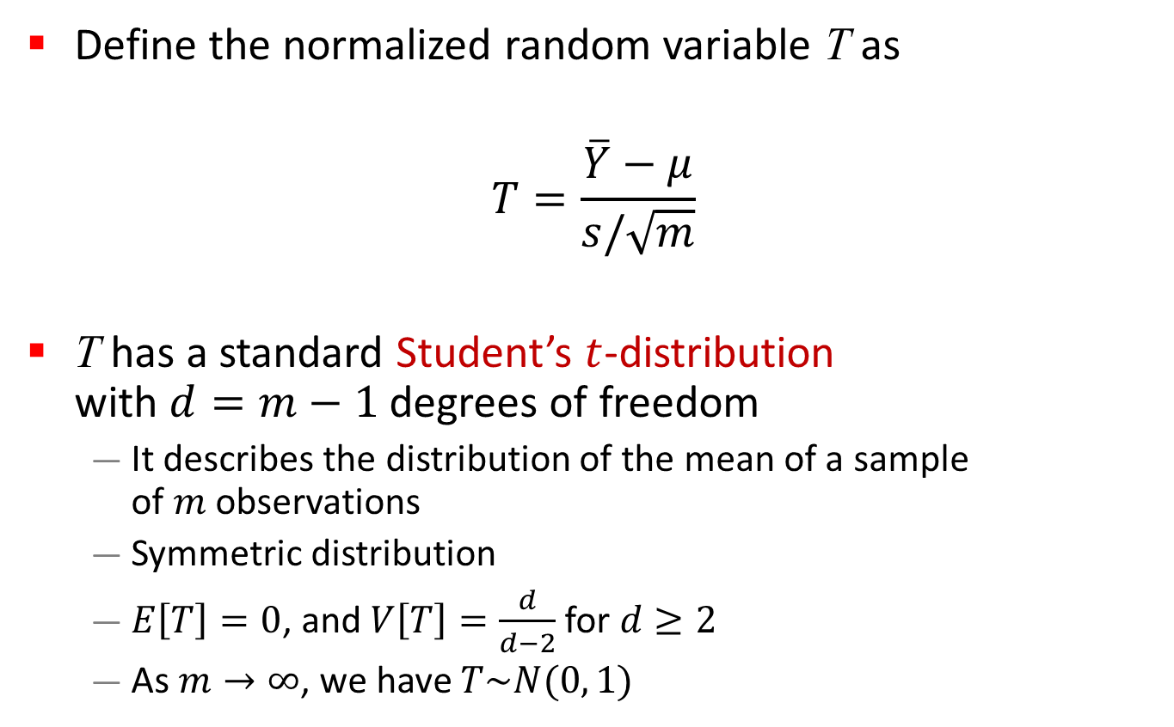
Confidence Interval for Small Samples
Define the normalized random variable T as
$$T=\frac{\overline{Y}−μ}{s/\sqrt{m}}$$
T has a standard Student’s $t$-distribution
with $d=m−1$ degrees of freedom
  It describes the distribution of the mean of a sample
  of $m$ observations
  Symmetric distribution
  $E\left[T\right]=0$, and $V\left[T\right]=\frac{d}{d−2}$ for $d≥2$
  As $m→∞$, we have $T\sim N(0, 1)$

Slide 33
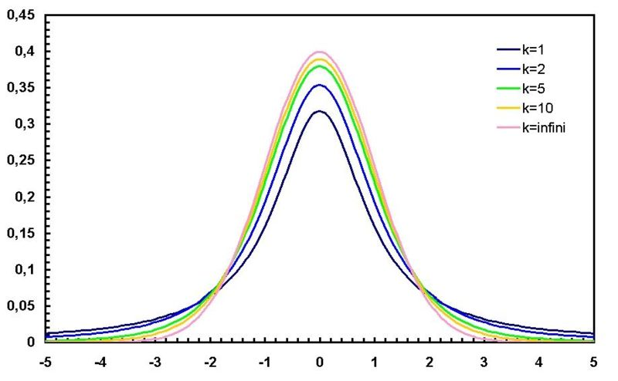
Student’s t-Distribution
d=1
d=2
d=5
d=10
d=infinity
Probability Density Function (PDF)

Slide 34
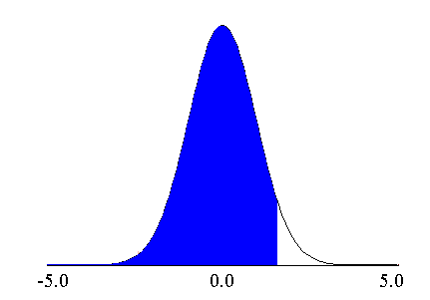
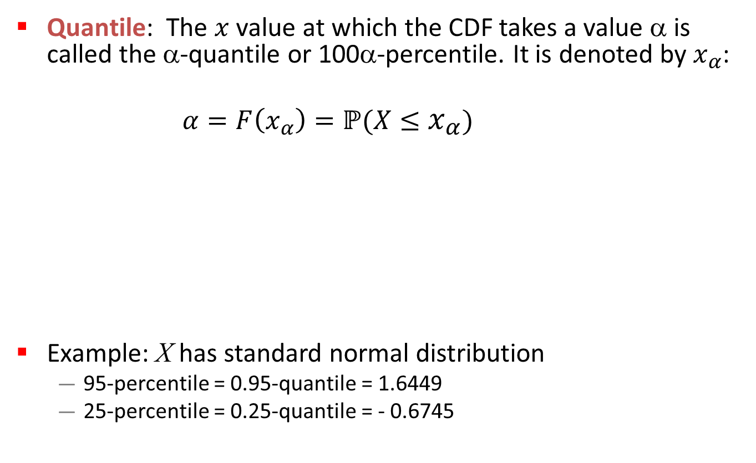

Determining Confidence Interval
Quantile: The $x$ value at which the CDF takes a value α is called the α-quantile or 100α-percentile. It is denoted by $x_{α}$:
$α=F\left(x_{α}\right)=ℙ(X≤x_{α})$
Example: X has standard normal distribution
  95-percentile = 0.95-quantile = 1.6449
  25-percentile = 0.25-quantile = - 0.6745
$$f(x)$$
α
x_{α}

Slide 35

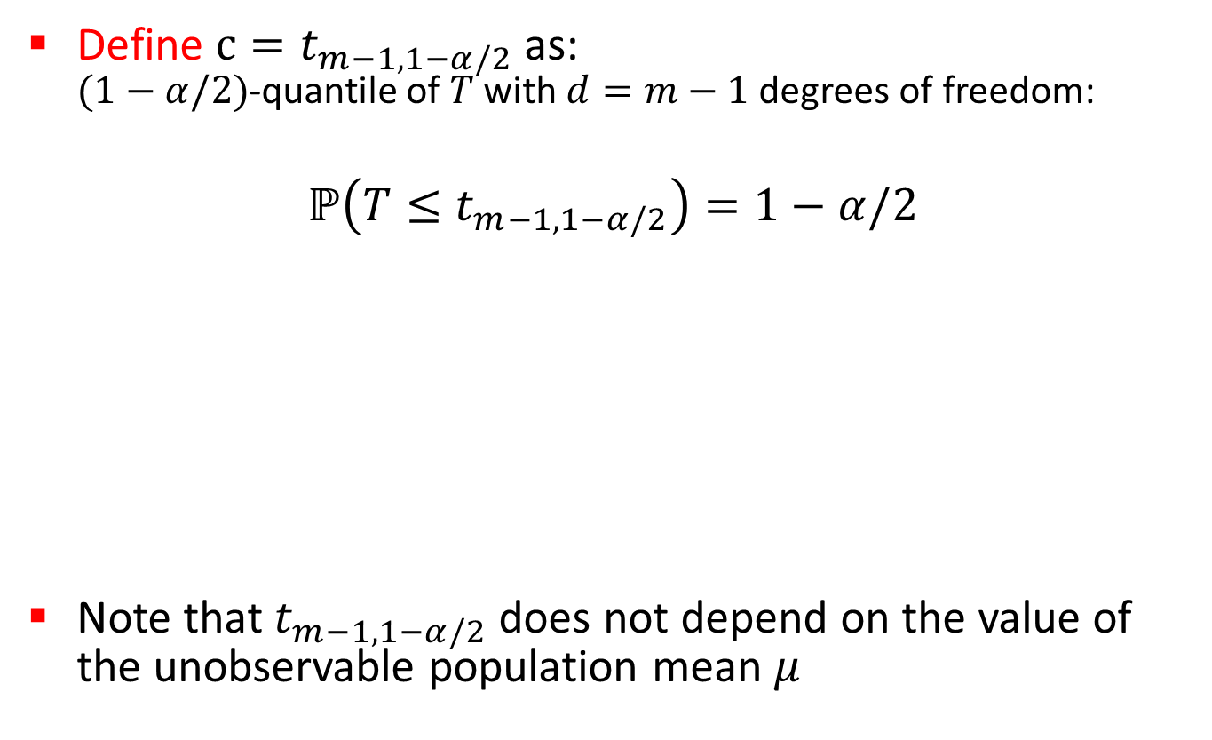

Determining Confidence Interval
Define $c=t_{m−1, 1−α/2}$ as:
$(1−α/2)$-quantile of $T$ with $d=m−1$ degrees of freedom:
$$ℙ\left(T≤t_{m−1, 1−α/2}\right)=1−α/2$$
Note that$t_{m−1, 1−α/2}$does not depend on the value of the unobservable population mean $μ$
$${−t}_{m−1, 1−α/2}$$
0
$$t_{m−1, 1−α/2}$$

Slide 36
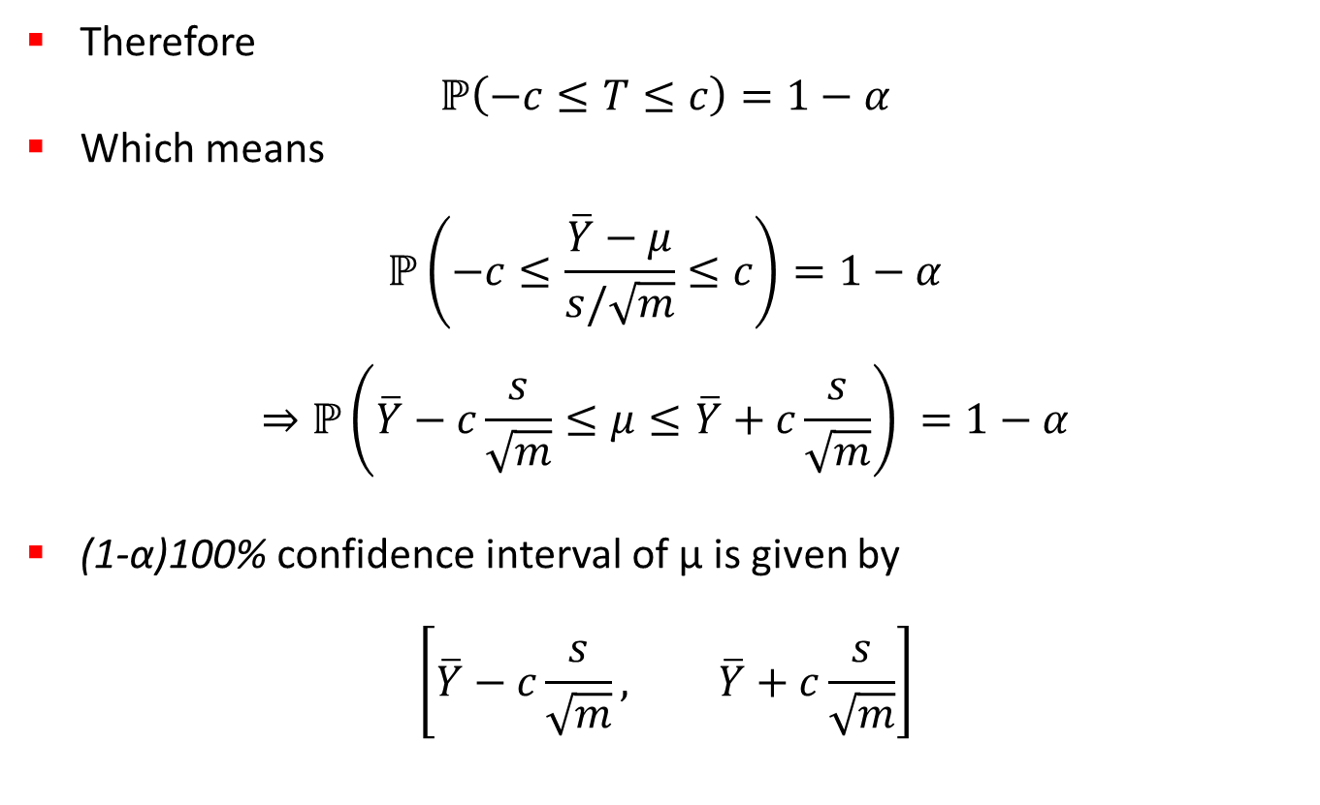
Determining Confidence Interval
Therefore
$$ℙ\left(−c≤T≤c\right)=1−α$$
Which means
$$ℙ\left(−c≤\frac{\overline{Y}−μ}{s/\sqrt{m}}≤c\right)=1−α$$
$$⇒ℙ\left(\overline{Y}−c\frac{s}{\sqrt{m}}≤μ≤\overline{Y}+c\frac{s}{\sqrt{m}}\right) =1−α$$
(1-α)100% confidence interval of µ is given by
$$\left[\overline{Y}−c\frac{s}{\sqrt{m}}, \overline{Y}+c\frac{s}{\sqrt{m}}\right]$$

Slide 37
Example
Sample:
-0.04, -0.19, 0.14, -0.09, -0.14, 0.19, 0.04, and 0.09
Mean = 0, Sample standard deviation = 0.138
For 90% confidence interval: t_{7, 0.95} = 1.895
Confidence interval for the mean

Slide 38
Confidence Interval: Meaning
If we take 100 samples and construct confidence interval for each sample, the interval would include the population mean in 90 cases.
c₁
µ
c₂
Total yes > 100(1-α)

Slide 39
Example: Assignment 2
10 replications of Banff park entry gate simulation
Warmup: 10,000 minutes
Number of cars: 60,000
See graph online for 90% confidence intervals
λ | 1/μ | ρ | Mean Q | Std Dev
0.5 | 1.5 | 0.75 | 3.019 | 0.109
0.55 | 1.5 | 0.825 | 4.715 | 0.174
0.60 | 1.5 | 0.90 | 9.042 | 0.980
0.65 | 1.5 | 0.975 | 39.876 | 12.76

Slide 40
Example: Assignment 2 (cont’d)
10 batches from Banff park entry gate simulation
Warmup: 0 minutes
Number of cars: 500,000
λ | 1/μ | ρ | Mean Q | Std Dev
0.5 | 1.5 | 0.75 | 2.997 | 0.088
0.55 | 1.5 | 0.825 | 4.813 | 0.206
0.60 | 1.5 | 0.90 | 9.033 | 0.608
0.65 | 1.5 | 0.975 | 42.22 | 14.72

Slide 41
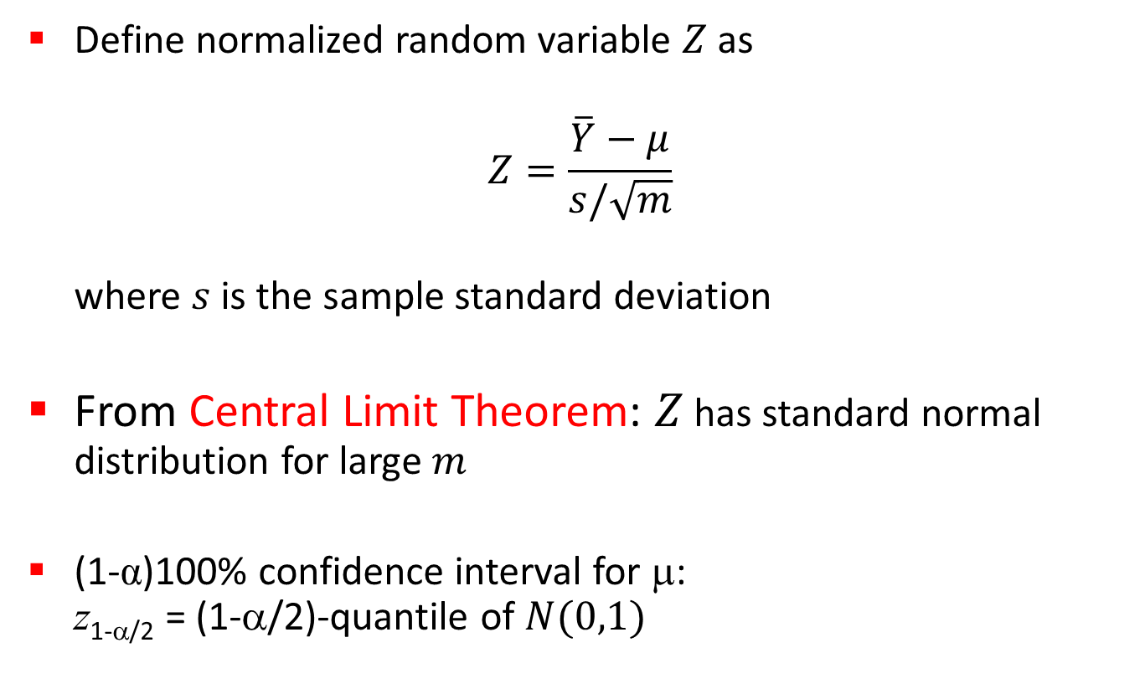
Confidence Interval for Large Samples
Define normalized random variable $Z$ as
$$Z=\frac{\overline{Y}−μ}{s/\sqrt{m}}$$
where $s$ is the sample standard deviation
From Central Limit Theorem: $Z$ has standard normal distribution for large $m$
(1-α)100% confidence interval for μ:
z_{1-α/2} = (1-α/2)-quantile of $N(0,1)$
-z_{1-a/2}
0
z_{1-a/2}

Slide 42
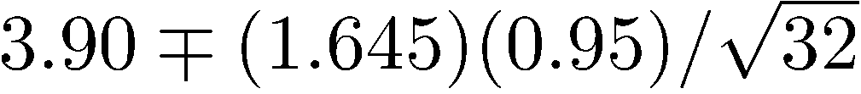
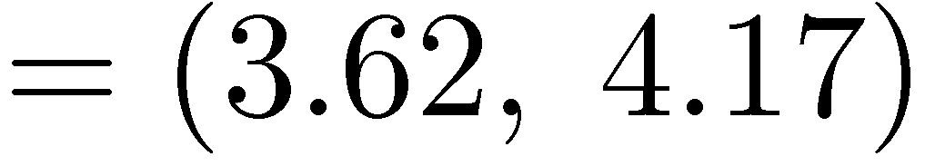

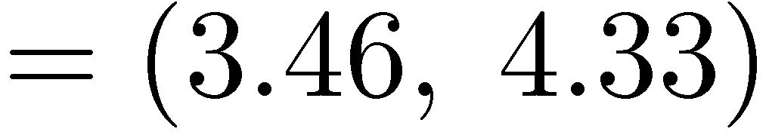
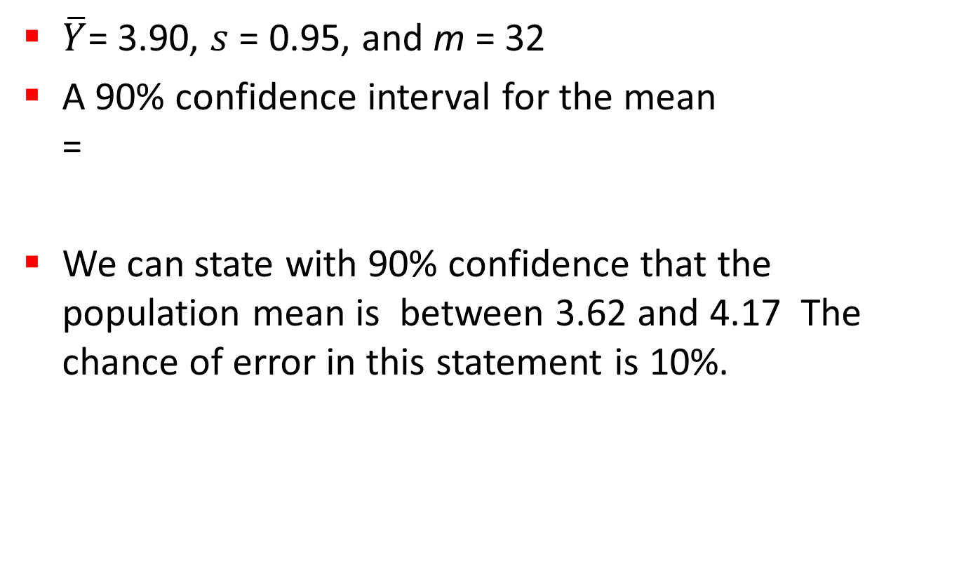
Example
$\overline{Y}$= 3.90, $s$ = 0.95, and m = 32
A 90% confidence interval for the mean
=
We can state with 90% confidence that the population mean is between 3.62 and 4.17 The chance of error in this statement is 10%.

Slide 43
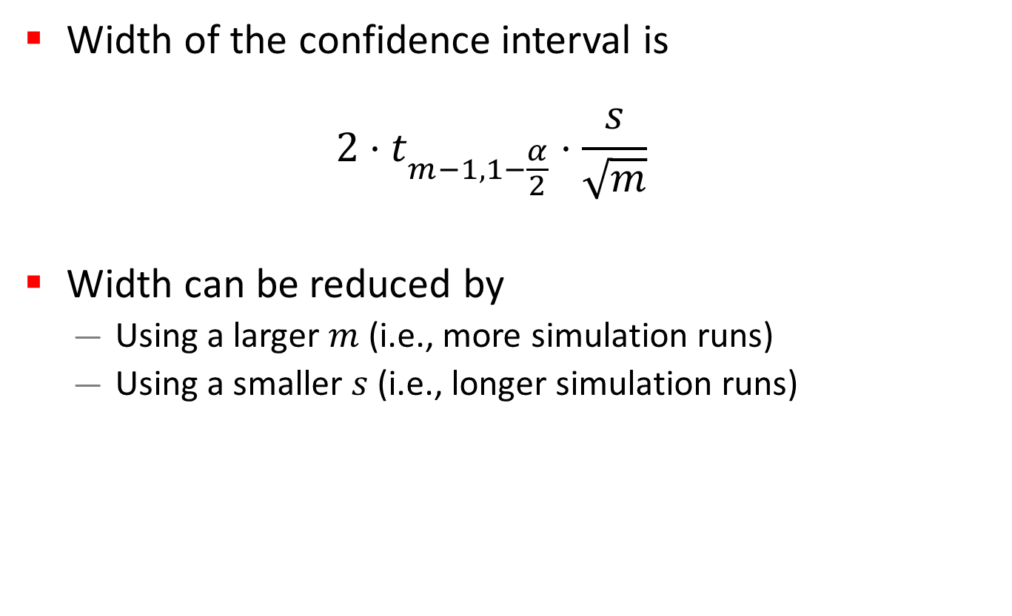
Width of Confidence Interval
Width of the confidence interval is
$$2⋅t_{m−1, 1−\frac{α}{2}}⋅\frac{s}{\sqrt{m}}$$
Width can be reduced by
  Using a larger $m$ (i.e., more simulation runs)
  Using a smaller $s$ (i.e., longer simulation runs)

Slide 44
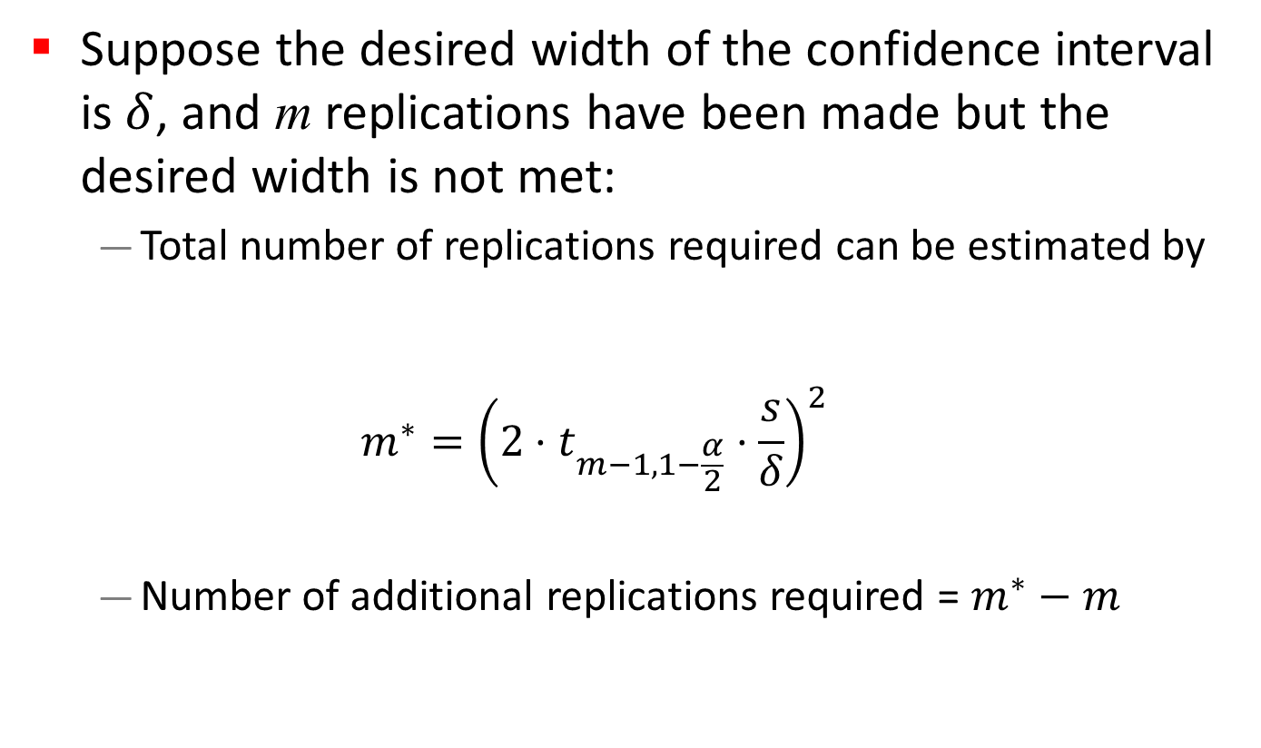
Number of Simulation Runs
Suppose the desired width of the confidence interval is $δ$, and m replications have been made but the desired width is not met:
  Total number of replications required can be estimated by
  $$m^{∗}={\left(2⋅t_{m−1, 1−\frac{α}{2}}⋅\frac{s}{δ}\right)}^{2}$$
  Number of additional replications required = $m^{∗}−m$

Slide 45
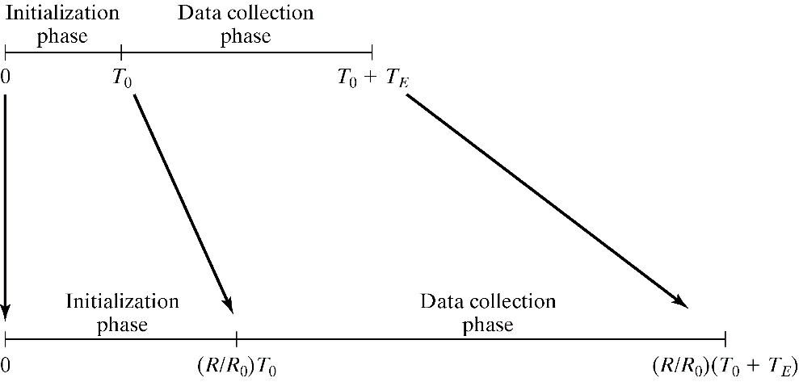
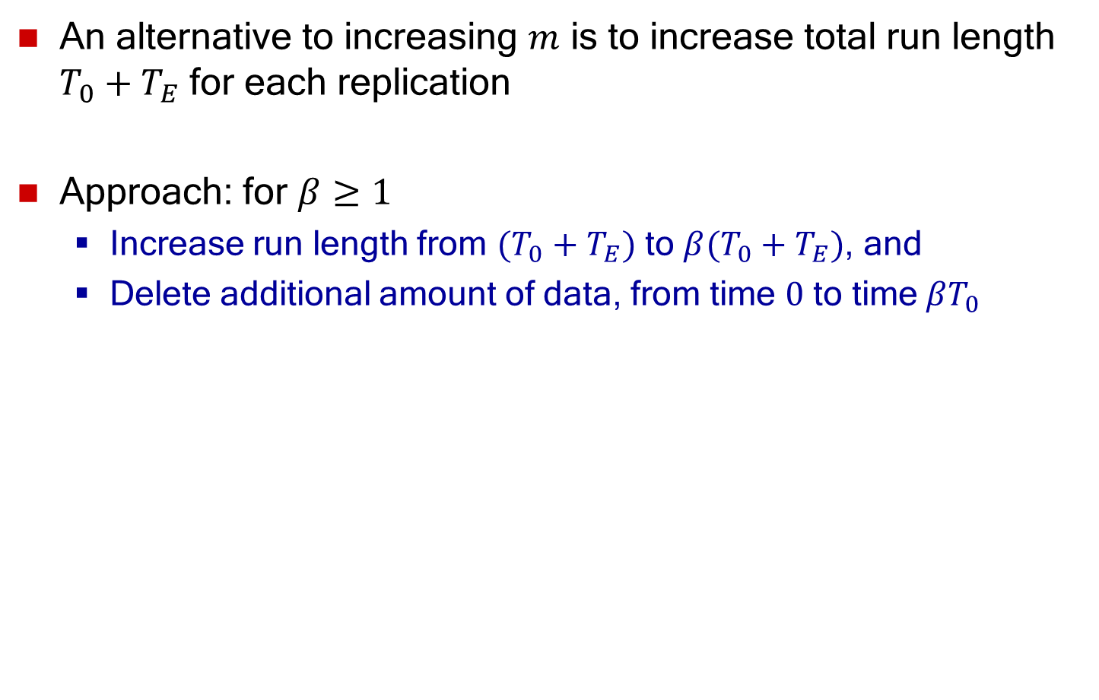


Length of Simulation Runs
An alternative to increasing $m$ is to increase total run length $T_{0}+T_{E}$ for each replication
Approach: for $β≥1$
  Increase run length from $(T_{0}+T_{E})$ to $β(T_{0}+T_{E})$, and
  Delete additional amount of data, from time $0$ to time$βT_{0}$
$$βT_{0}$$
$$β{(T}_{0}+T_{E})$$

