Slide 1

CPSC 531:
System Modeling and Simulation
Carey Williamson
Department of Computer Science
University of Calgary
Fall 2017

Slide 2
Motivational Quote
“If you can’t measure it, you can’t improve it.”
- Peter Drucker

Slide 3
(Slightly Revised) Motivational Quote
model
“If you can’t measure it, you can’t improve it.”
- Peter Drucker

Slide 4
Simulation Input Analysis
Input models are the driving force for many simulations
Quality of the output depends on the quality of inputs
There are four main steps for input model development:
  Collect data from the real system
  Identify a suitable probability distribution to represent the input process
  Choose parameters for the distribution
  Evaluate the goodness-of-fit for the chosen distribution and parameters

Slide 5
Data Collection
Data collection is one of the biggest simulation tasks
Beware of GIGO: Garbage-In-Garbage-Out
Suggestions to facilitate data collection:
  Analyze the data as it is being collected: check adequacy
  Combine homogeneous data sets (e.g. successive time periods, or the same time period on successive days)
  Be aware of inadvertent data censoring: quantities that are only partially observed versus observed in their entirety; gaps; outliers; risk of leaving out long processing times
  Collect input data, not performance data (i.e., output)

Slide 6
Data Analysis Checklist (meta-level)
Where did this data come from?
How was it collected?
What can it tell me?
Do some exploratory data analysis (see next slide)
Does this data make sense?
Is it representative?
What are the key properties?
Does it resemble anything I’ve seen before?
How best to model it?

Slide 7
Data Analysis Checklist (detailed-level)
How much data do I have? (N)
Is it discrete or continuous?
What is the range for the data? (min, max)
What is the central tendency? (mean, median, mode)
How variable is it? (mean, variance, std dev, CV)
What is the shape of the distribution? (histogram)
Are there gaps, outliers, or anomalies? (tails)
Is it time series data? (time series analysis)
Is there correlation structure and/or periodicity?
Other interesting phenomena? (scatter plot)

Slide 8
Identifying the Distribution
Non-Parametric Approach: does not care about the actual distribution or its parameters; simply (re-)generates observations from the empirically observed CDF for the distribution.
- less work for the modeler, but limited generative capability (e.g., variety; length; repetitive; preserves flaws in data)
Parametric Approach: tries to find a compact, concise, and parsimonious model that accurately represents the input data.
- more work, but potentially valuable model (parameterizable)
Histograms (visual/graphical approach)
Selecting families of distributions (logic/statistics)
Parameter estimation (statistical methods)
Goodness-of-fit tests (statistical/graphical methods)

Slide 9
Histograms (1 of 3)
Histogram: A frequency distribution plot useful in determining the shape of a distribution
  Divide the range of data into (typically equal) intervals
  or cells
  Plot the frequency of each cell as a rectangle
For discrete data:
  Corresponds to the
  probability mass function
For continuous data:
  Corresponds to the
  probability density function

Slide 10
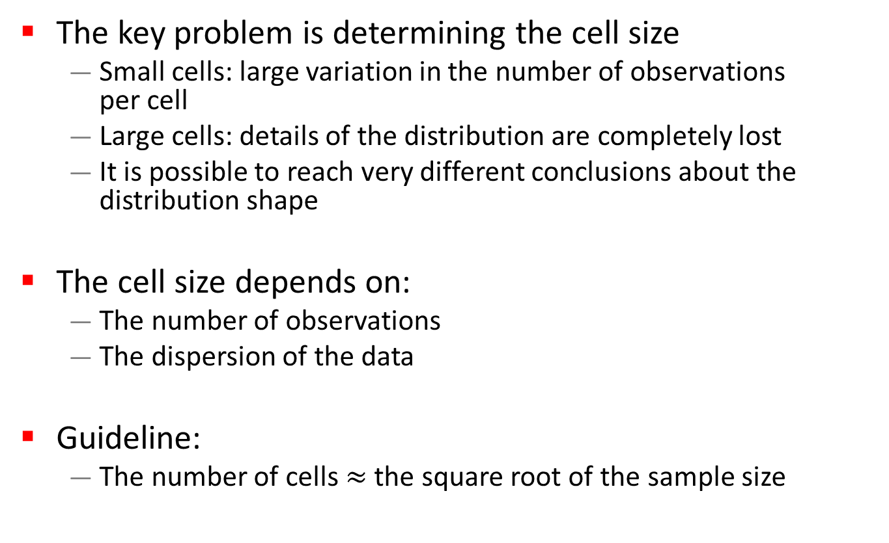
Histograms (2 of 3)
The key problem is determining the cell size
  Small cells: large variation in the number of observations
  per cell
  Large cells: details of the distribution are completely lost
  It is possible to reach very different conclusions about the distribution shape
The cell size depends on:
  The number of observations
  The dispersion of the data
Guideline:
  The number of cells $≈$ the square root of the sample size

Slide 11
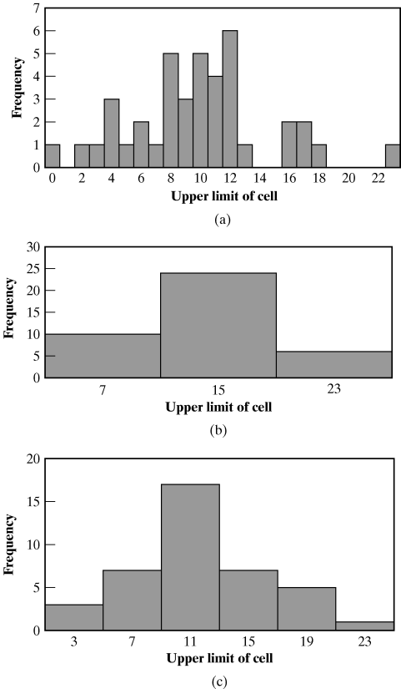
Histograms (3 of 3)
  Example: It is possible to reach very different conclusions about the distribution shape by changing the cell size
Same data with different interval sizes
Notes:
Tutorials

Slide 12
Selecting the Family of Distributions (1 of 4)
A family of distributions is selected based on:
  The context of the input variable
  Shape of the histogram
Frequently encountered distributions:
  Easier to analyze: Exponential, Geometric, Poisson
  Moderate to analyze: Normal, Log-Normal, Uniform
  Harder to analyze: Beta, Gamma, Pareto, Weibull, Zipf

Slide 13
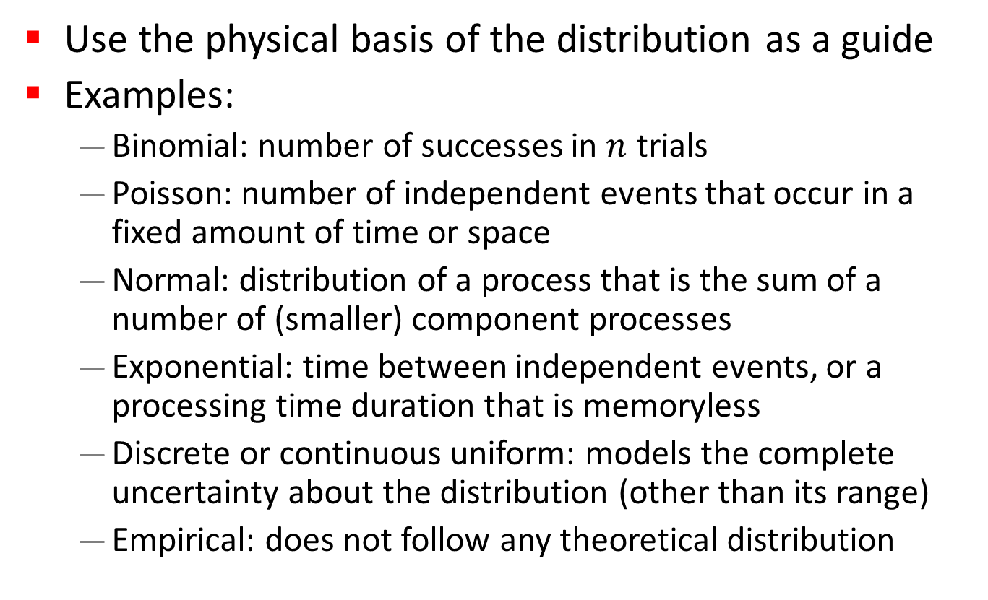
Selecting the Family of Distributions (2 of 4)
Use the physical basis of the distribution as a guide
Examples:
  Binomial: number of successes in $n$ trials
  Poisson: number of independent events that occur in a fixed amount of time or space
  Normal: distribution of a process that is the sum of a number of (smaller) component processes
  Exponential: time between independent events, or a processing time duration that is memoryless
  Discrete or continuous uniform: models the complete uncertainty about the distribution (other than its range)
  Empirical: does not follow any theoretical distribution

Slide 14
Selecting the Family of Distributions (3 of 4)
Remember the physical characteristics of the process
  Is the process naturally discrete or continuous valued?
  Is it bounded?
  Is it symmetric, or is it skewed?
No “true” distribution for any stochastic input process
Goal: obtain a good approximation that captures the salient properties of the process (e.g., range, mean, variance, skew, tail behavior)

Slide 15
Selecting the Family of Distributions (4 of 4)
How to check if the chosen distribution is a good fit?
Compare the shape of the pmf/pdf of the distribution with the histogram:
  Problem: Difficult to visually compare probability curves
  Solution: Use Quantile-Quantile plots
Example: Oil change time at MinitLube
Histogram suggests “exponential” dist.
How well does Exponential fit the data?

Slide 16
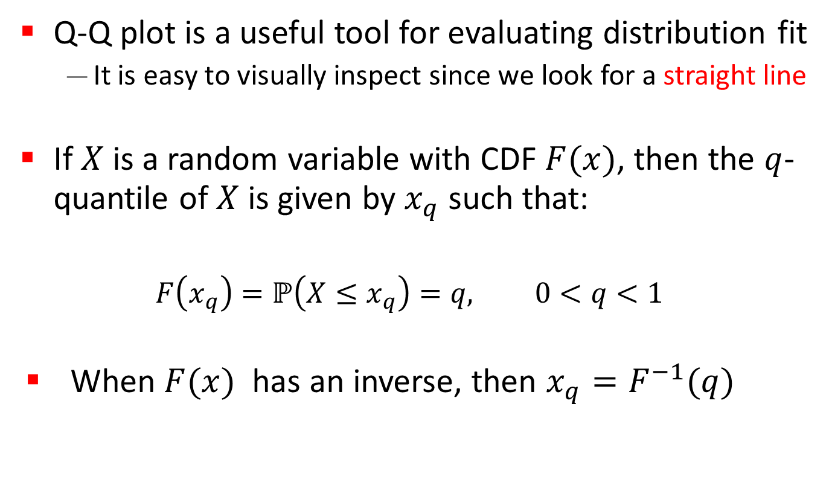
Quantile-Quantile Plots (1 of 8)
Q-Q plot is a useful tool for evaluating distribution fit
  It is easy to visually inspect since we look for a straight line
If $X$ is a random variable with CDF $F(x)$, then the $q$-quantile of $X$ is given by $x_{q}$ such that:
  $F\left(x_{q}\right)=ℙ\left(X≤x_{q}\right)=q, 0<q<1$
When $F(x)$ has an inverse, then $x_{q}=F^{−1}(q)$

Slide 17
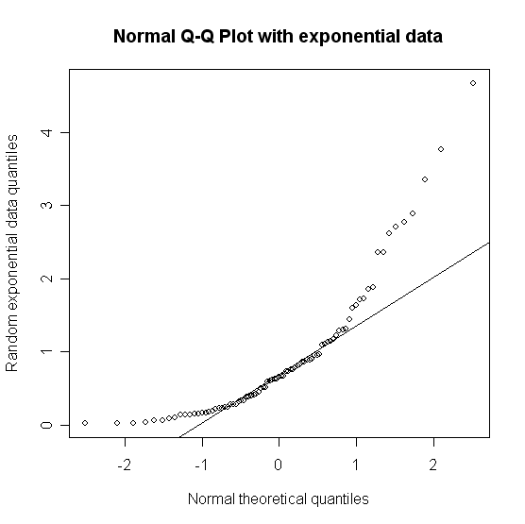
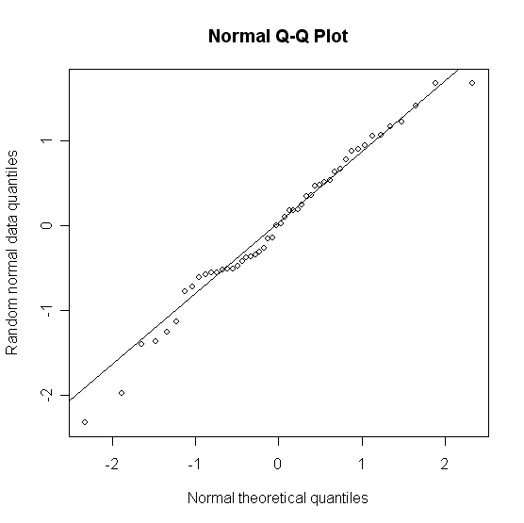

Quantile-Quantile Plots (2 of 8)
$x_{q}^{S}$: empirical $q$-quantile from the sample
$x_{q}^{M}$: theoretical $q$-quantile from the model
Q-Q plot: plot $x_{q}^{S}$ versus $x_{q}^{M}$ as a scatterplot of points

Slide 18
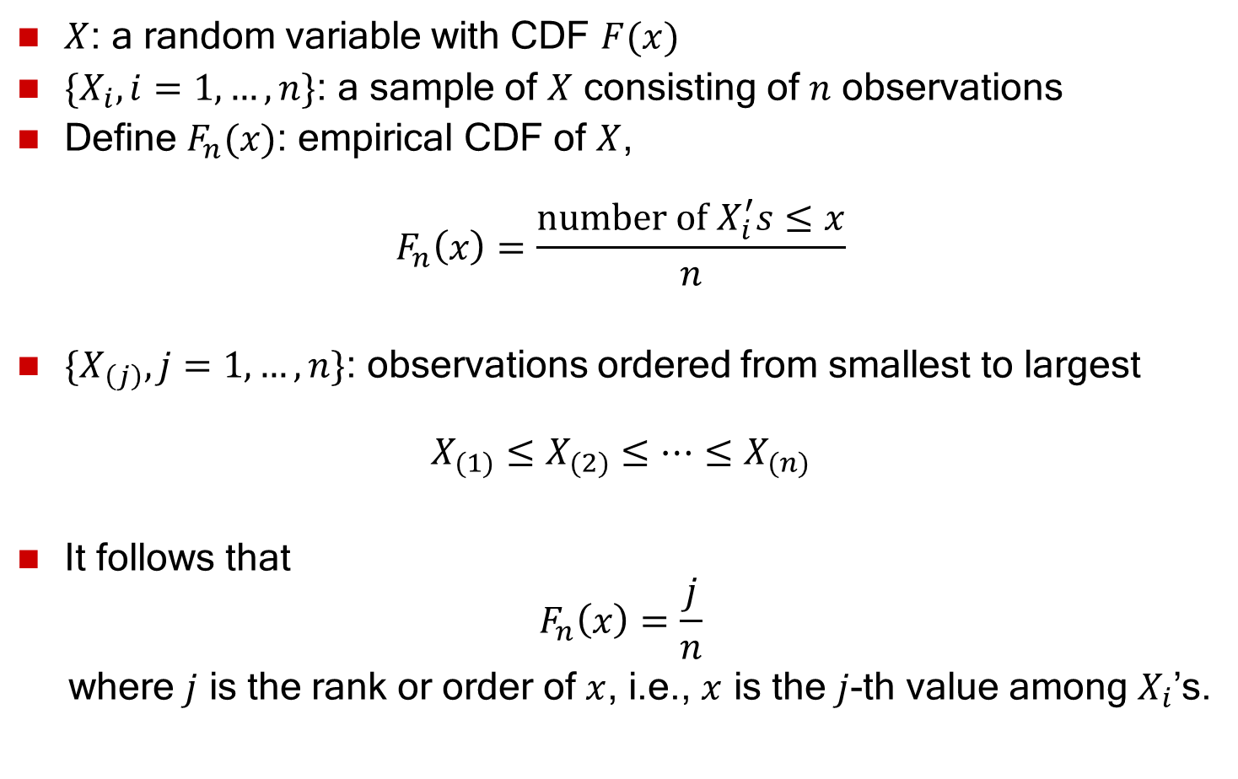
Quantile-Quantile Plots (3 of 8)
$X$: a random variable with CDF $F(x)$
$\{X_{i}, i=1, …, n\}$: a sample of $X$ consisting of $n$ observations
Define $F_{n}(x)$: empirical CDF of $X$,
$$F_{n}\left(x\right)=\frac{\text{number} \text{of} X_{i}^{′}s≤x}{n}$$
$\{X_{\left(j\right)}, j=1,…,n\}$: observations ordered from smallest to largest
$$X_{(1)}≤X_{(2)}≤⋯≤X_{(n)}$$
It follows that
$$F_{n}\left(x\right)=\frac{j}{n}$$
where $j$ is the rank or order of $x$, i.e., $x$ is the $j$-th value among $X_{i}$’s.

Slide 19
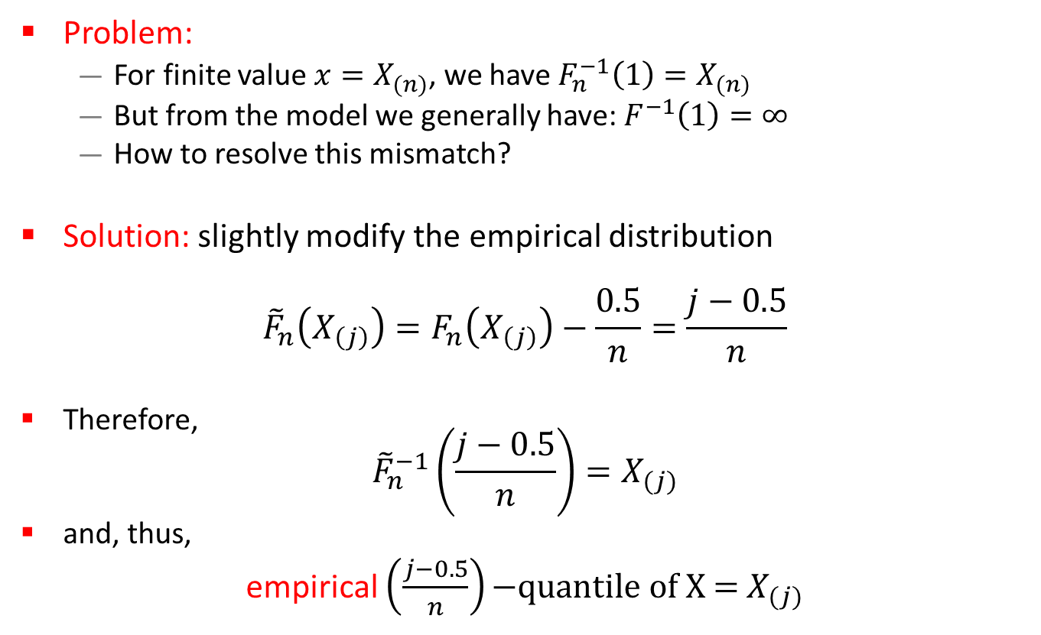
Quantile-Quantile Plots (4 of 8)
Problem:
  For finite value $x=X_{(n)}$, we have $F_{n}^{−1}\left(1\right)=X_{(n)}$
  But from the model we generally have: $F^{−1}\left(1\right)=∞$
  How to resolve this mismatch?
Solution: slightly modify the empirical distribution
$${\tilde{F}}_{n}\left(X_{\left(j\right)}\right)=F_{n}\left(X_{\left(j\right)}\right)−\frac{0.5}{n}=\frac{j−0.5}{n}$$
Therefore,
${\tilde{F}}_{n}^{−1}\left(\frac{j−0.5}{n}\right)=X_{(j)}$
and, thus,
empirical $\left(\frac{j−0.5}{n}\right)\text{−}\text{quantile} \text{of} \text{X}\text{ = }X_{(j)}$

Slide 20
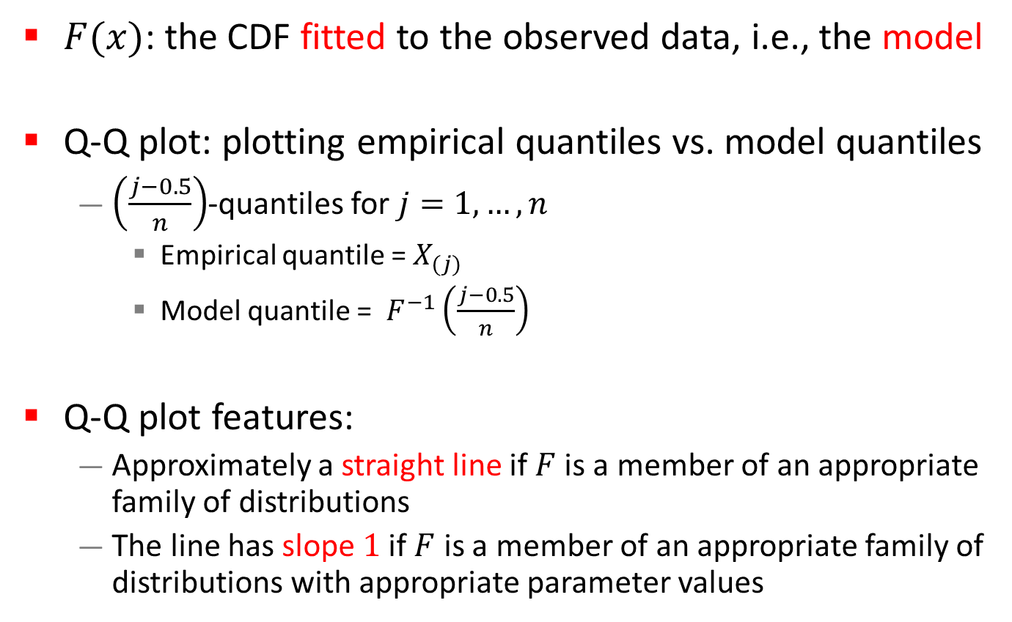
Quantile-Quantile Plots (5 of 8)
$F(x)$: the CDF fitted to the observed data, i.e., the model
Q-Q plot: plotting empirical quantiles vs. model quantiles
  $\left(\frac{j−0.5}{n}\right)$-quantiles for $j=1,…,n$
    Empirical quantile = $X_{(j)}$
    Model quantile = $F^{−1}\left(\frac{j−0.5}{n}\right)$
Q-Q plot features:
  Approximately a straight line if $F$ is a member of an appropriate family of distributions
  The line has slope $1$ if $F$ is a member of an appropriate family of distributions with appropriate parameter values

Slide 21
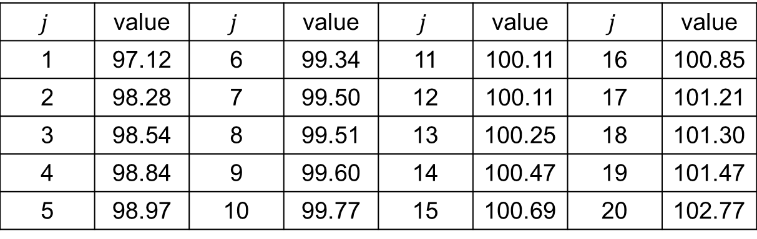
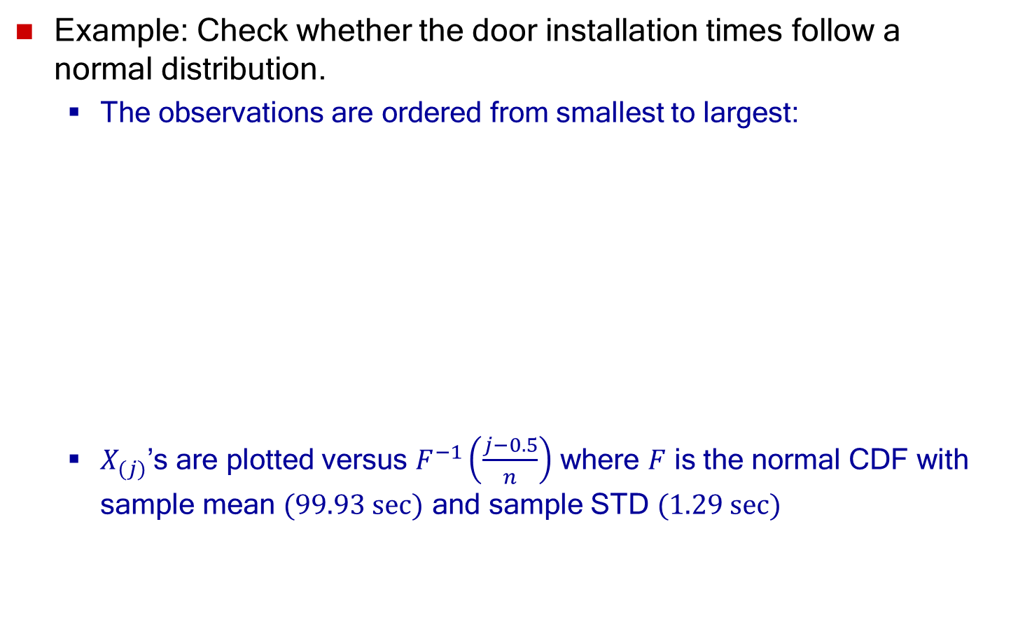
Quantile-Quantile Plots (6 of 8)
Example: Check whether the door installation times follow a normal distribution.
  The observations are ordered from smallest to largest:
  $X_{(j)}$’s are plotted versus $F^{−1}\left(\frac{j−0.5}{n}\right)$ where $F$ is the normal CDF with sample mean $(99.93 sec)$ and sample STD $(1.29 sec)$
$$j$$ | value | $$j$$ | value | $$j$$ | value | $$j$$ | value
1 | 97.12 | 6 | 99.34 | 11 | 100.11 | 16 | 100.85
2 | 98.28 | 7 | 99.50 | 12 | 100.11 | 17 | 101.21
3 | 98.54 | 8 | 99.51 | 13 | 100.25 | 18 | 101.30
4 | 98.84 | 9 | 99.60 | 14 | 100.47 | 19 | 101.47
5 | 98.97 | 10 | 99.77 | 15 | 100.69 | 20 | 102.77

Slide 22
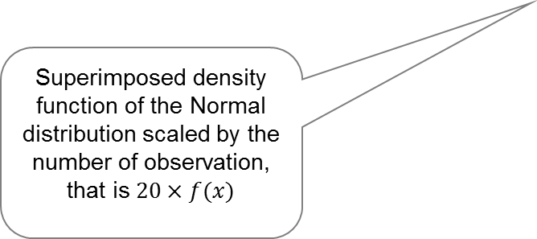
Quantile-Quantile Plots (7 of 8)
Example (continued):
Check whether the door installation
times follow a normal distribution.
Straight line, supporting the hypothesis of a normal distribution
Superimposed density function of the Normal distribution scaled by the number of observation, that is $20×f(x)$

Slide 23
Quantile-Quantile Plots (8 of 8)
Consider the following while evaluating the linearity
of a Q-Q plot:
  The observed values never fall exactly on a straight line
  Variation of the extremes is higher than the middle.
  Linearity of the points in the middle of the plot (the main body of the distribution) is more important.

Slide 24
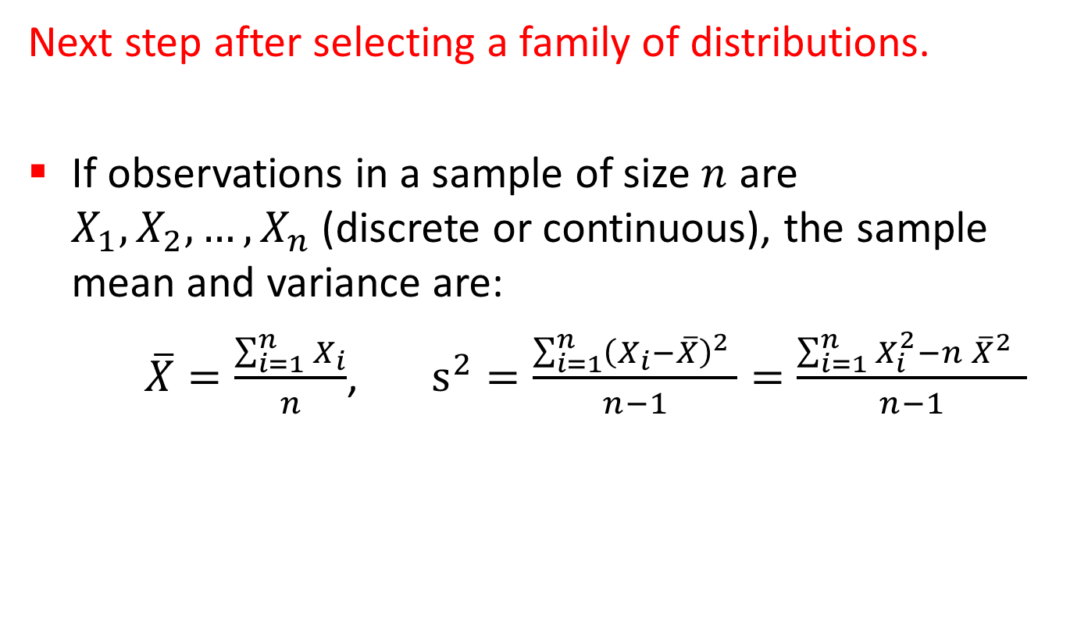
Parameter Estimation (1 of 4)
Next step after selecting a family of distributions.
If observations in a sample of size $n$ are $X_{1},X_{2},…,X_{n}$(discrete or continuous), the sample mean and variance are:
$\overline{X}=\frac{\sum_{i=1}^{n}{X_{i}}}{n}$, $s^{2}=\frac{\sum_{i=1}^{n}{{\left(X_{i}−\overline{X}\right)}^{2}} }{n−1}=\frac{\sum_{i=1}^{n}{X_{i}^{2}−n {\overline{X}}^{2}} }{n−1}$

Slide 25
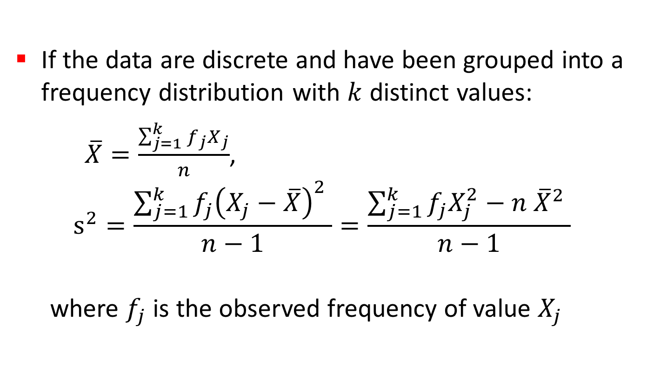
Parameter Estimation (2 of 4)
If the data are discrete and have been grouped into a frequency distribution with $k$ distinct values:
$\overline{X}=\frac{\sum_{j=1}^{k}{{f_{j}X}_{j}}}{n}$,
$$s^{2}=\frac{\sum_{j=1}^{k}{{f_{j}\left(X_{j}−\overline{X}\right)}^{2}} }{n−1}=\frac{\sum_{j=1}^{k}{f_{j}X_{j}^{2}−n {\overline{X}}^{2}} }{n−1}$$
where $f_{j}$ is the observed frequency of value $X_{j}$

Slide 26
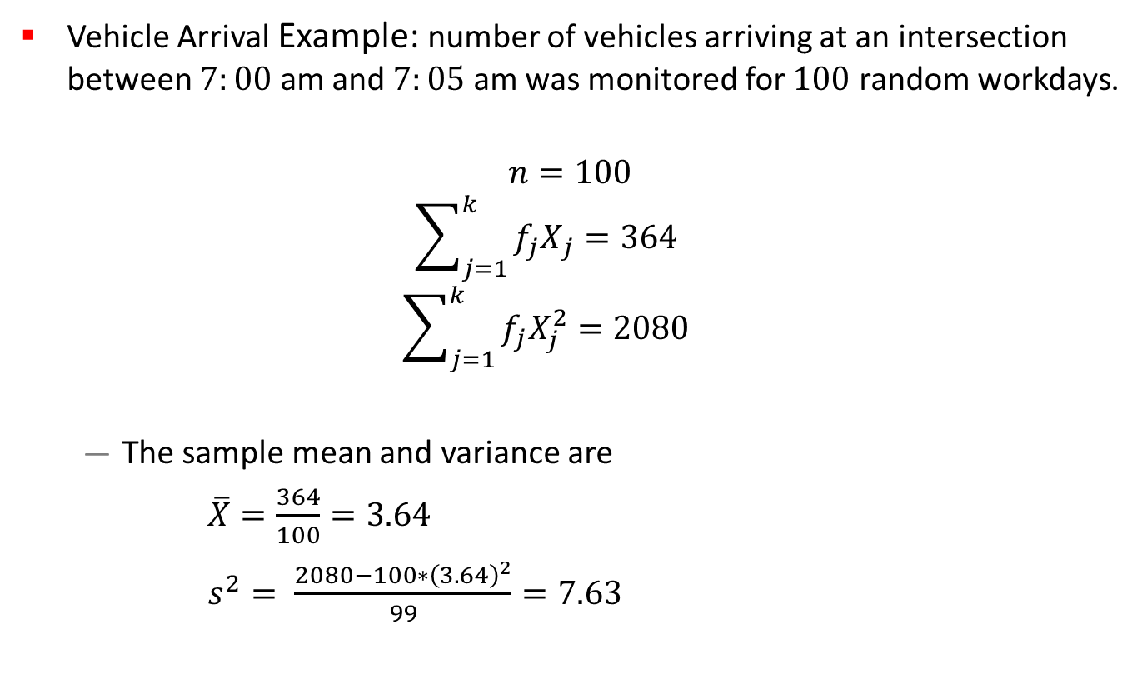
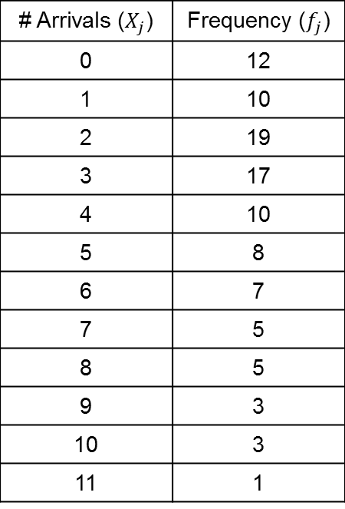
Parameter Estimation (3 of 4)
Vehicle Arrival Example: number of vehicles arriving at an intersection between $7:00$ am and $7:05$ am was monitored for $100$ random workdays.
$$n=100$$
$$\sum_{j=1}^{k}{{f_{j}X}_{j}}=364$$
$$\sum_{j=1}^{k}{f_{j}X_{j}^{2}=2080}$$
  The sample mean and variance are
  $\overline{X}=\frac{364}{100}=3.64$
  $s^{2}= \frac{2080−100∗{\left(3.64\right)}^{2}}{99}=7.63$
# Arrivals ($X_{j}$) | Frequency ($f_{j}$)
0 | 12
1 | 10
2 | 19
3 | 17
4 | 10
5 | 8
6 | 7
7 | 5
8 | 5
9 | 3
10 | 3
11 | 1

Slide 27
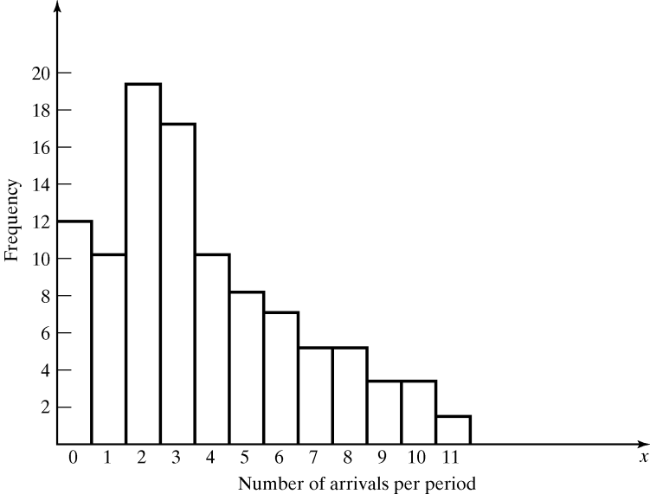

Parameter Estimation (4 of 4)
The histogram suggests $X$ is a Poisson distribution
  However, the sample mean is not equal to sample variance
  Reason: each estimator is a random variable (not perfect)

Slide 28
Goodness-of-Fit Tests (1 of 2)
Conduct hypothesis testing on input data distribution using well-known statistical tests, such as:
  Chi-square test
  Kolmogorov-Smirnov test
Note: you don’t always get a single unique correct distributional result for any real application:
  If very little data are available, it is unlikely to reject any candidate distributions
  If a lot of data are available, it is likely to reject all candidate distributions

Slide 29
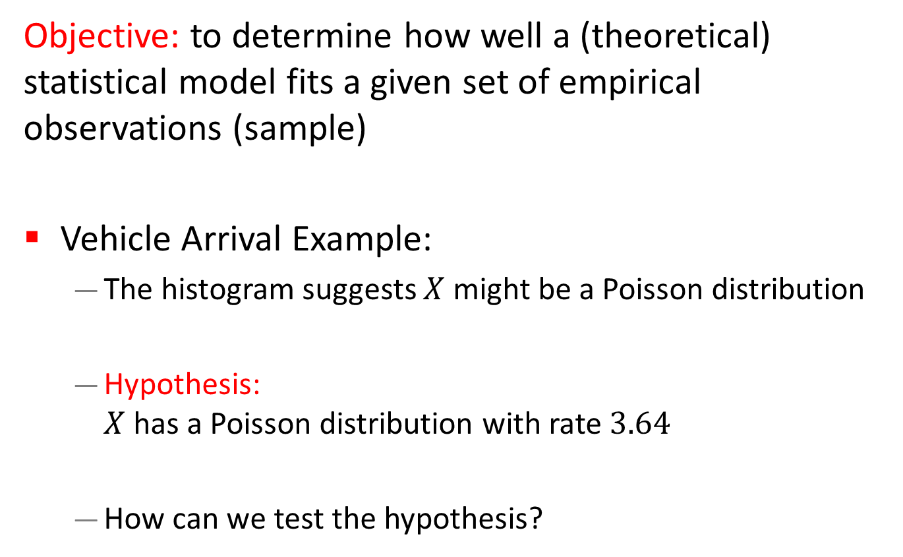
Goodness-of-Fit Tests (2 of 2)
Objective: to determine how well a (theoretical) statistical model fits a given set of empirical observations (sample)
Vehicle Arrival Example:
  The histogram suggests $X$ might be a Poisson distribution
  Hypothesis:
  $X$ has a Poisson distribution with rate $3.64$
  How can we test the hypothesis?

Slide 30
Chi-Square Test (1 of 11)
Intuition:
It establishes whether an observed frequency distribution differs from a model distribution
  Model distribution refers to the hypothesized distribution with the estimated parameters
  Can be used for both discrete and continuous random variables
  Valid for large sample sizes
If the difference between the distributions is smaller than a critical value, the model distribution fits the observed data well, otherwise, it does not.

Slide 31
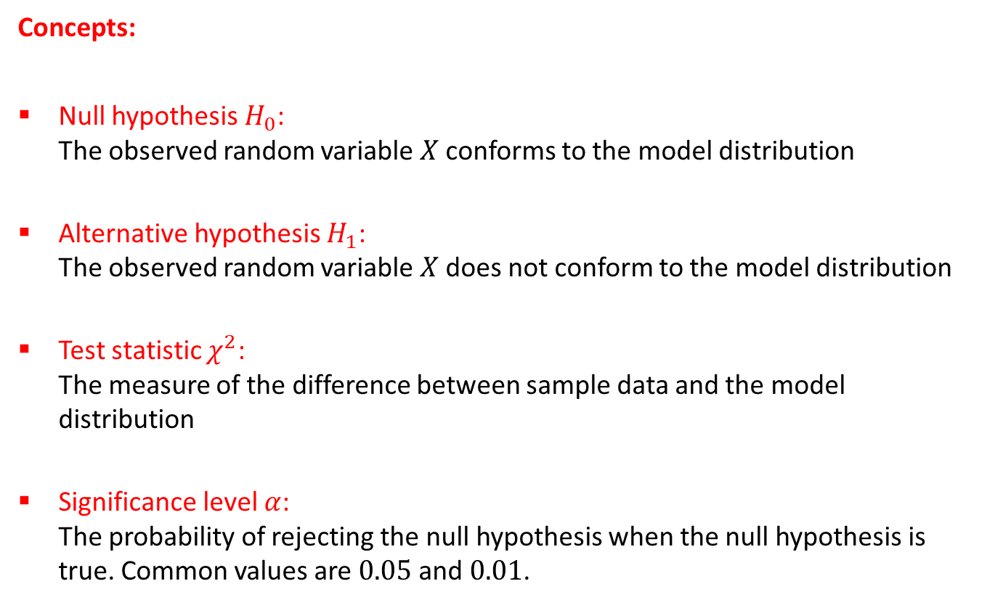
Chi-Square Test (2 of 11)
Concepts:
Null hypothesis $H_{0}$:
The observed random variable $X$ conforms to the model distribution
Alternative hypothesis $H_{1}$:
The observed random variable $X$ does not conform to the model distribution
Test statistic $χ^{2}$:
The measure of the difference between sample data and the model distribution
Significance level $α$:
The probability of rejecting the null hypothesis when the null hypothesis is true. Common values are $0.05$ and $0.01$.

Slide 32
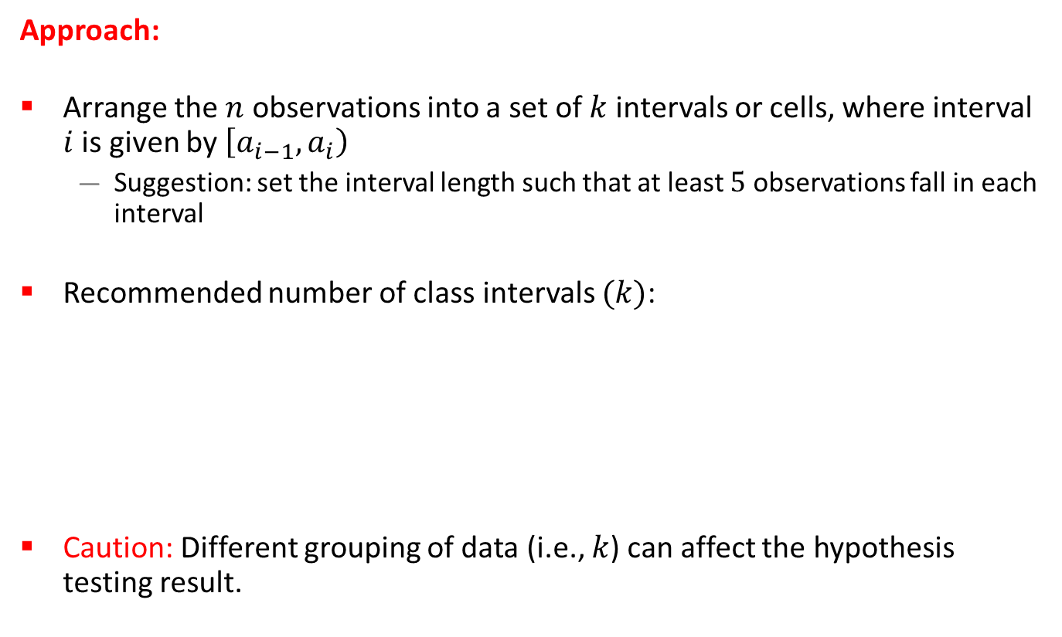
Chi-Square Test (3 of 11)
Approach:
Arrange the $n$ observations into a set of $k$ intervals or cells, where interval $i$ is given by $\left[a_{i−1}, a_{i}\right)$
  Suggestion: set the interval length such that at least $5$ observations fall in each interval
Recommended number of class intervals $(k)$:
Caution: Different grouping of data (i.e., $k$) can affect the hypothesis testing result.

Slide 33
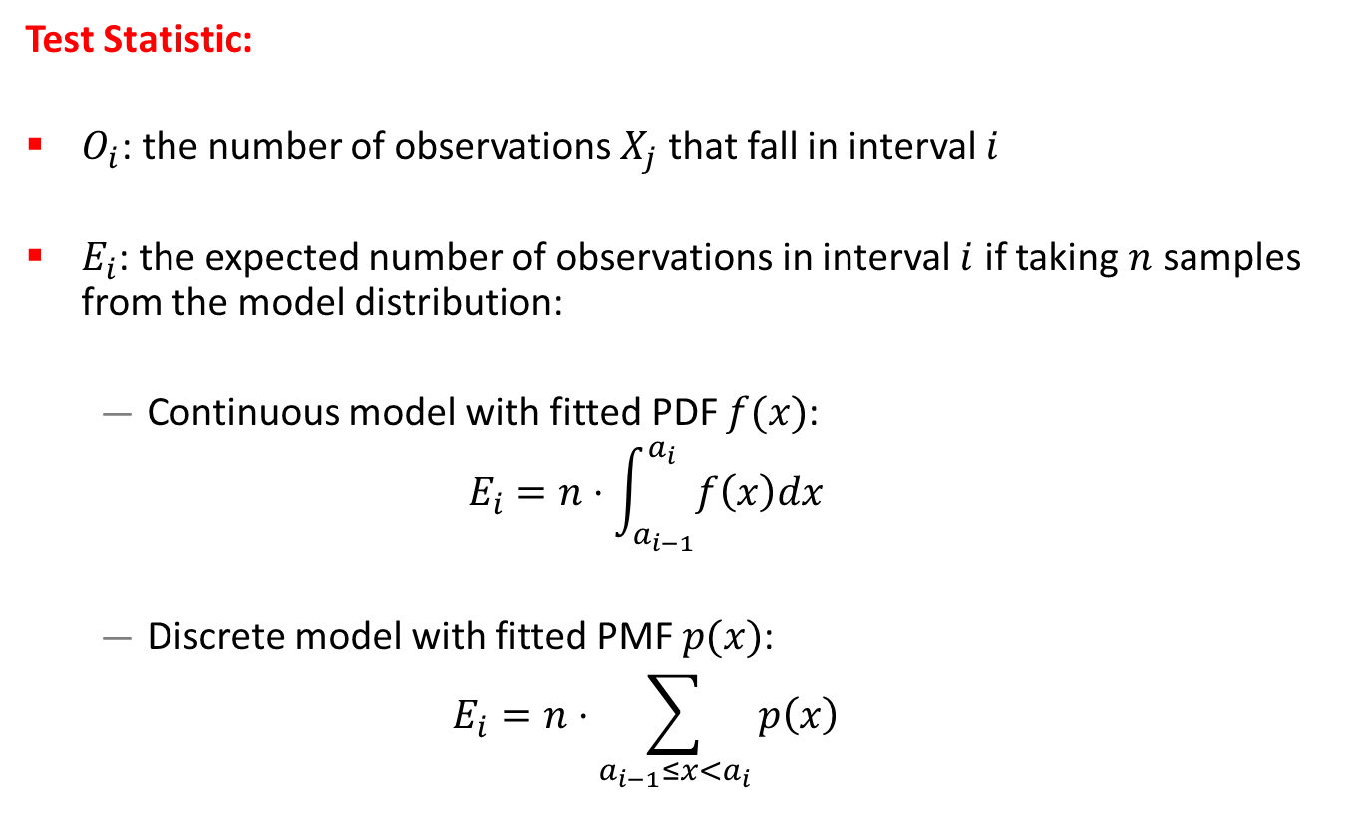
Chi-Square Test (4 of 11)
Test Statistic:
$O_{i}$: the number of observations $X_{j}$ that fall in interval $i$
$E_{i}$: the expected number of observations in interval $i$ if taking $n$ samples from the model distribution:
  Continuous model with fitted PDF $f(x)$:
  $$E_{i}=n⋅\int_{a_{i−1}}^{a_{i}}{f\left(x\right)dx}$$
  Discrete model with fitted PMF $p(x)$:
  $$E_{i}=n⋅\sum_{a_{i−1}≤x<a_{i}}{p\left(x\right)}$$

Slide 34
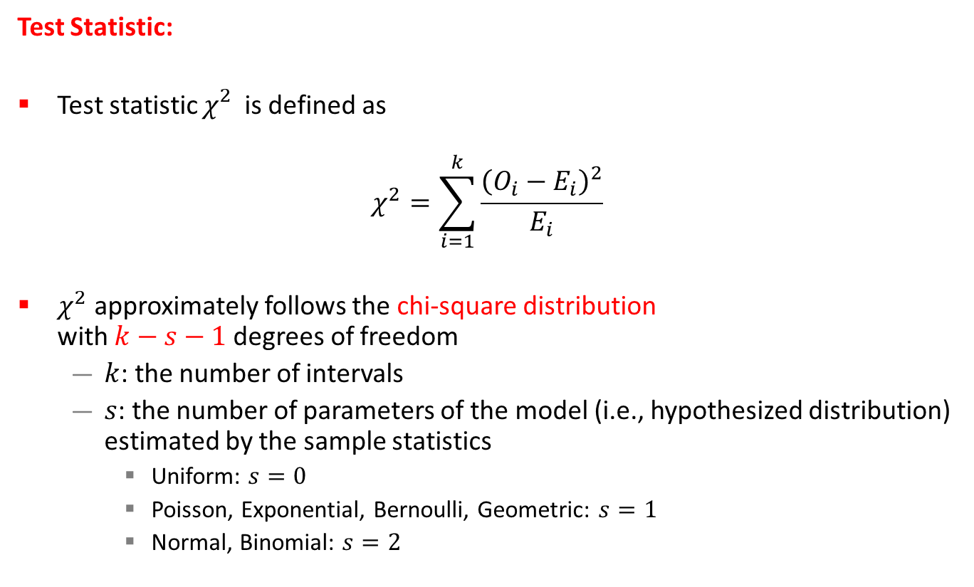
Chi-Square Test (5 of 11)
Test Statistic:
Test statistic $χ_{}^{2}$ is defined as
$$χ^{2}=\sum_{i=1}^{k}{\frac{{\left(O_{i}−E_{i}\right)}^{2}}{E_{i}}}$$
$χ^{2}$ approximately follows the chi-square distribution
with $k−s−1$ degrees of freedom
  $k$: the number of intervals
  $s$: the number of parameters of the model (i.e., hypothesized distribution) estimated by the sample statistics
    Uniform: $s=0$
    Poisson, Exponential, Bernoulli, Geometric: $s=1$
    Normal, Binomial: $s=2$

Slide 35



Chi-Square Test (6 of 11)
The distribution is not symmetric
Minimum value is 0
Mean = degrees of freedom
Chi-Square PDF
$$df=2$$
$$df=5$$
$$df=10$$

Slide 36
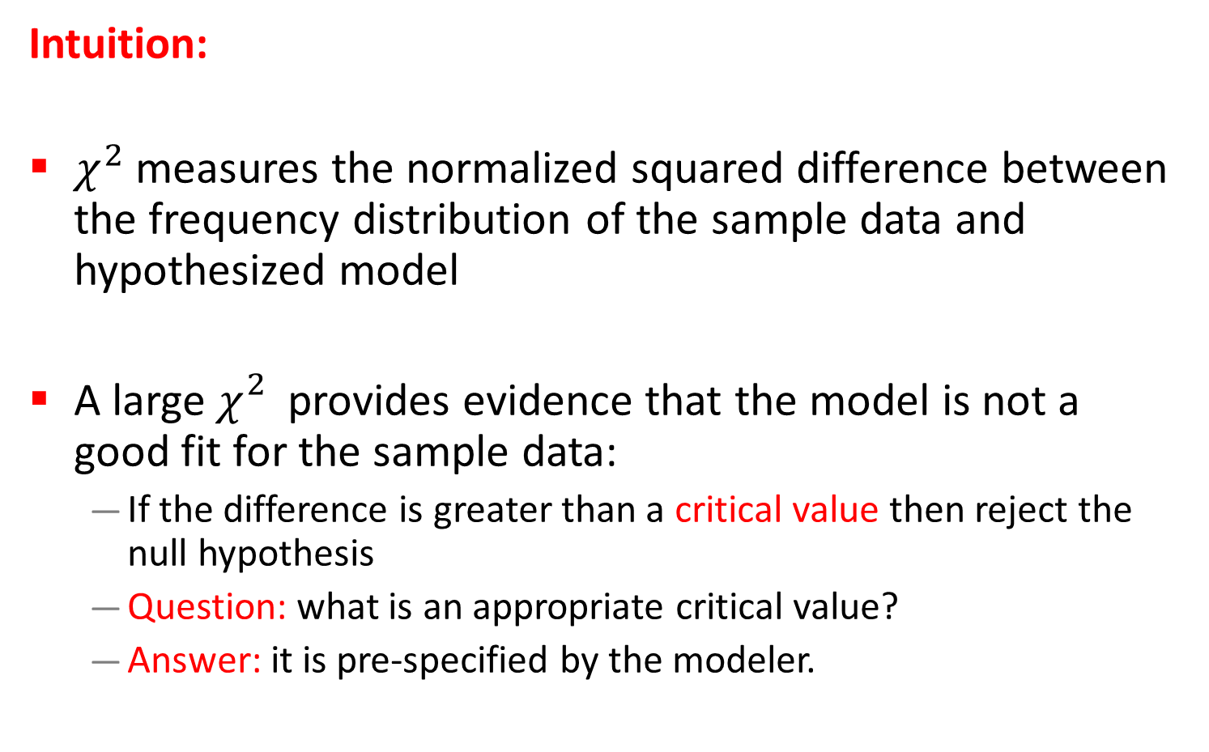
Chi-Square Test (7 of 11)
Intuition:
$χ^{2}$ measures the normalized squared difference between the frequency distribution of the sample data and hypothesized model
A large$χ_{}^{2}$ provides evidence that the model is not a good fit for the sample data:
  If the difference is greater than a critical value then reject the null hypothesis
  Question: what is an appropriate critical value?
  Answer: it is pre-specified by the modeler.

Slide 37
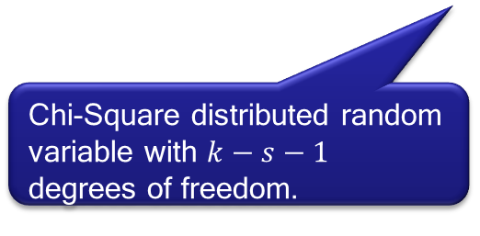
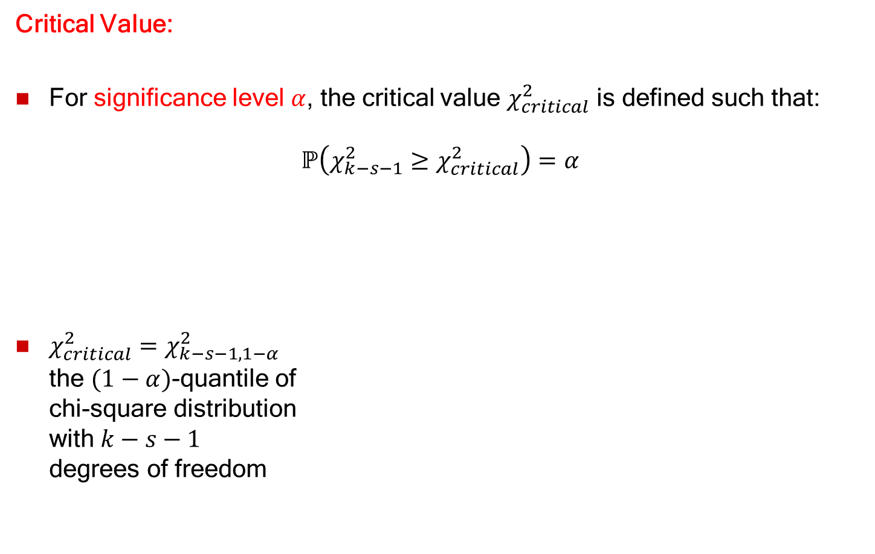


Chi-Square Test (8 of 11)
Critical Value:
For significance level $α$, the critical value $χ_{critical}^{2}$ is defined such that:
$$ℙ\left(χ_{k−s−1}^{2}≥χ_{critical}^{2}\right)=α$$
$χ_{critical}^{2}=χ_{k−s−1, 1−α }^{2}$
the $(1−α)$-quantile of
chi-square distribution
with $k−s−1$
degrees of freedom
Chi-Square distributed random variable with $k−s−1$ degrees of freedom.
Chi-square PDF
$$χ_{critical}^{2}$$
Shaded area = $α$
Do not reject
Reject

Slide 38

Chi-Square Test (9 of 11)
We say that the null hypothesis $H_{0}$ is rejected at the significance level $α$, if:
$$χ^{2}>χ_{k−s−1, 1−α }^{2}$$
Interpretation:
  The test statistic can be
  as large as the critical value
  If the test statistic is greater
  than the critical value then,
  the null hypothesis is rejected
  If the test statistic is not greater
  than the critical value then,
  the null hypothesis
  can not be rejected
Chi-square PDF
$$χ_{critical}^{2}$$
Shaded area = $α$
Do not reject
Reject

Slide 39
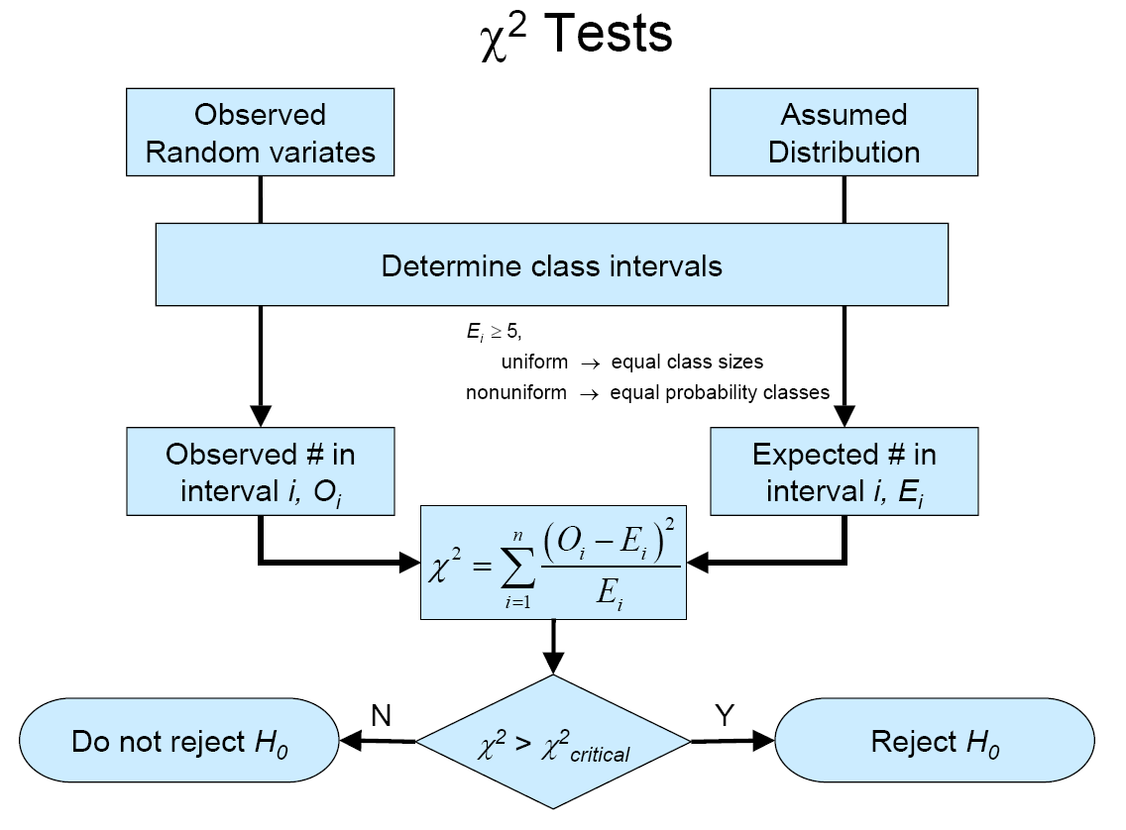
Chi-Square Test (10 of 11)

Slide 40


Chi-Square Test (11 of 11)
Vehicle Arrival Example (continued):
$H0$: the random variable is Poisson distributed (with $λ=3.64$).
$H1$: the random variable is not Poisson distributed.
  Degrees of freedom is $k−s−1 = 7−1−1 = 5$, hence, the hypothesis is rejected at the $0.05$ level of significance:
  $$χ^{2}=27.72>χ_{0.95, 5}^{2}=11.1$$
Combined because of min $Ei$

Slide 41
Kolmogorov-Smirnov Test
Intuition:
  Formalizes the idea behind examining a Q-Q plot
  The test compares the CDF of the hypothesized distribution with the empirical CDF of the sample observations based on the maximum distance between two cumulative distribution functions.
A more powerful test that is particularly useful when:
  Sample sizes are small
  No parameters have been estimated from the data

Slide 42
Selecting Model without Data (1 of 2)
If data is not available, some possible sources to obtain information about the process are:
  Engineering data: often product or process has performance ratings provided by the manufacturer or company that specify time or production standards
  Expert option: people who are experienced with the process or similar processes, often, they can provide optimistic, pessimistic and most-likely times, and they may know the variability as well
  Physical or conventional limitations: physical limits on performance, limits or bounds that narrow the range of the input process
  The nature of the process
The uniform, triangular, and beta distributions are often used as input models.

Slide 43
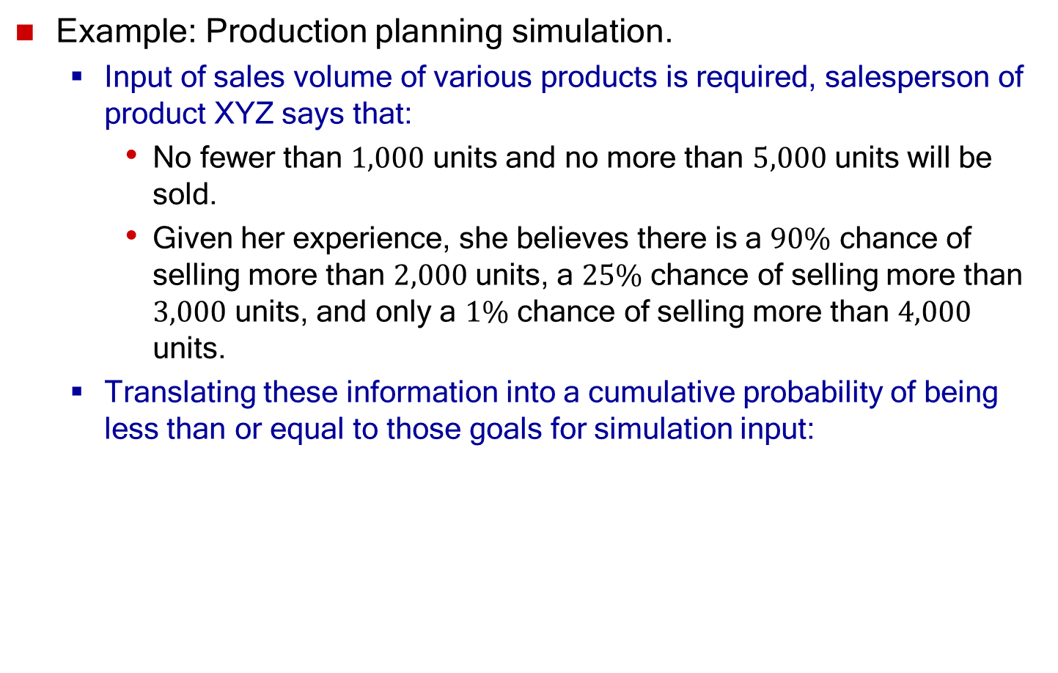
Selecting Model without Data (2 of 2)
Example: Production planning simulation.
  Input of sales volume of various products is required, salesperson of product XYZ says that:
    No fewer than $1,000$ units and no more than $5,000$ units will be sold.
    Given her experience, she believes there is a $90\%$ chance of selling more than $2,000$ units, a $25\%$ chance of selling more than $3,000$ units, and only a $1\%$ chance of selling more than $4,000$ units.
  Translating these information into a cumulative probability of being less than or equal to those goals for simulation input:

Slide 44
Multivariate and Time-Series Models
So far, we have considered:
  Single variate models for independent input parameters
To model correlation among input parameters
  Multivariate models
  Time-series models

