Slide 1

CPSC 531:
System Modeling and Simulation
Carey Williamson
Department of Computer Science
University of Calgary
Fall 2017

Slide 2
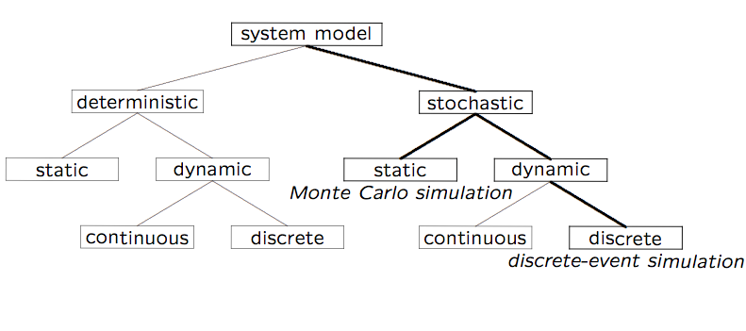
Recap: Simulation Model Taxonomy

Slide 3
Recap: DES Model Development
How to develop a simulation model:
  Determine the goals and objectives
  Build a conceptual model
  Convert into a specification model
  Convert into a computational model
  Verify the model
  Validate the model
Typically an iterative process

Slide 4
Overview of DES Module
Develops a common framework (and terminology) for the modeling of complex systems
Covers the basic building blocks for all discrete-event simulation models
Introduces and explains the fundamental concepts and methodologies underlying all discrete-event simulation packages:
  These concepts and methodologies are not tied to any particular simulation package

Slide 5
Outline
Concepts in discrete-event simulation
  Terminology and concepts
  Two pedagogical examples
Components of discrete-event simulation
  Time advance approaches
  Event scheduling approach
Manual simulation
  Grocery store example
Simulation program
  Simulation of queuing systems
  Infinite and finite population model
  Tandem queue with blocking
Verification and validation of simulation models

Slide 6
Outline
Concepts in discrete-event simulation
  Terminology and concepts
  Two pedagogical examples
Components of discrete-event simulation
  Time advance approaches
  Event scheduling approach
Manual simulation
  Grocery store example
Simulation program
  Simulation of queuing systems
  Infinite and finite population model
  Tandem queue with blocking
Verification and validation of simulation models

Slide 7
Concepts in Discrete-Event Simulation (1 of 2)
Model: an abstract representation of a (real) system
System: a collection of entities that interact together over time (e.g., people, machines, CPU, Web server)
System state: a collection of variables that contain all the information necessary to adequately describe the system at any time (e.g., occupancy)
Entity: any object or component in the system (e.g., a server, a customer, a machine)
Attributes: the properties of a given entity
List: a collection of associated entities, ordered in some logical fashion (e.g., sets, queues)

Slide 8
Concepts in Discrete-Event Simulation (2 of 2)
Event: an instantaneous occurrence that changes the state of a system (e.g., an arrival of a new customer)
Event list: a list of event notices for future events, ordered by time of occurrence, also called the future event list (FEL)
Activity (unconditional wait): a duration of time of specified length that is known when it begins (e.g., a service time)
Delay (conditional wait): a duration of time of unspecified indefinite length, which is not known until it ends (e.g., customer delay while waiting in line)
Clock: a variable representing simulated time, which can be either continuous or discrete
Note: different commercial simulation packages use different terminology for the same or similar concepts

Slide 9
Key Concepts in Discrete-Event Simulation
An activity represents a service time, an inter-arrival time, or any processing time whose duration has been defined or characterized by the modeler:
  An activity’s duration may be specified as:
    Deterministic or stochastic
    A function depending on system variables and/or entity attributes
  Duration is not affected by the occurrence of other events
A delay’s duration is determined by current system conditions (not specified by the modeller ahead of time):
  For example, a customer’s delay in a waiting line may be dependent on the number and duration of service of other customers ahead in line, and whether a server has a failure (and repair time) or not

Slide 10
Example 1: ABC Call Center
A computer technical support center with personnel taking calls and providing service:
  Three support staff: Alice, Bob, Chris (multiple support channel)
  A simplifying rule: alphabetical tie-breaker if > 1 staff are idle
Goal: to find out how well the current arrangement works in terms of the response time of the system
Random variables:
  Arrival time between calls
  Service time (different distributions for Alice, Bob, and Chris)

Slide 11
States in ABC Call Center Example
The ABC Call Center System is a discrete-event model with the following components:
System state:
  The number of callers waiting to be served at time t
  Indicator that Alice is idle or busy at time t
  Indicator that Bob is idle or busy at time t
  Indicator that Chris is idle or busy at time t
Entities: neither the caller nor the servers need to be explicitly represented, except in terms of the state variables, unless certain per-caller or per-server statistics are desired

Slide 12
Events in ABC Call Center Example
Events:
  Arrival of a call
  Service completion by Alice
  Service completion by Bob
  Service completion by Chris
Activities:
  Inter-arrival time
  Service time by Alice
  Service time by Bob
  Service time by Chris
Delay: a caller’s wait in queue until Alice, Bob, or Chris becomes free

Slide 13
Example 2: Pancake Manor
A pancake restaurant in an old church in Brisbane, Australia:
  Host/hostess for seating of customers (possible waiting here)
  Waiter/waitress for ordering/bringing food and beverages
  Kitchen and cook(s) for preparing food (possible queueing too!)
  Cashier for payment and departure
Goal: to find out how many staff (and tables) to have to keep the response time of the system reasonable
Random variables:
  Arrival times of customers
  Sizes of groups
  Time of day
  Service times for ordering, eating, payment, etc.

Slide 14
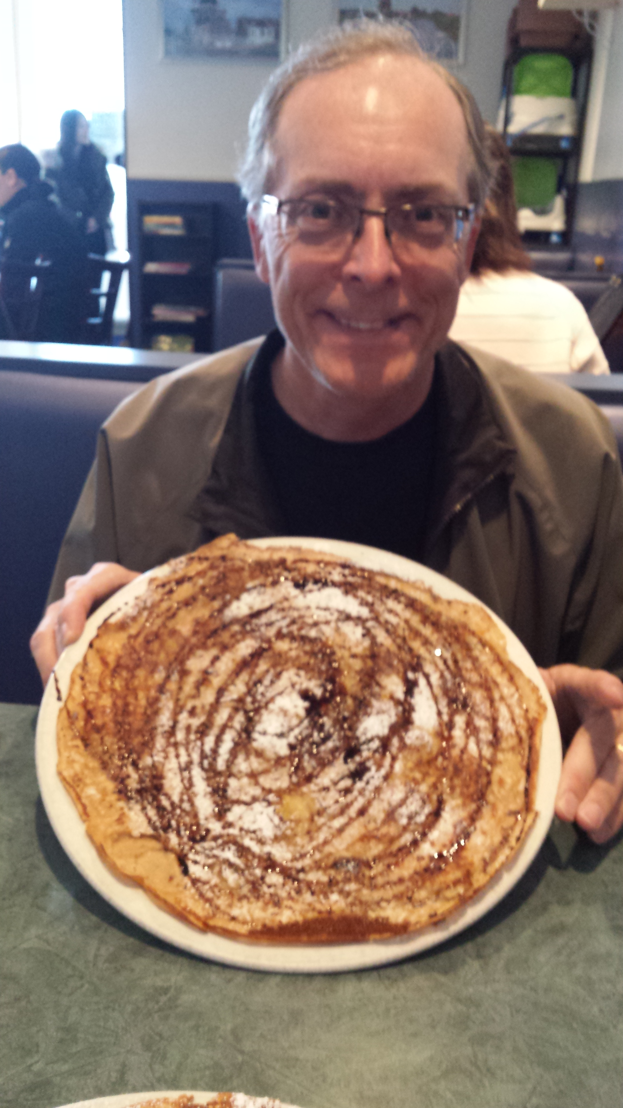
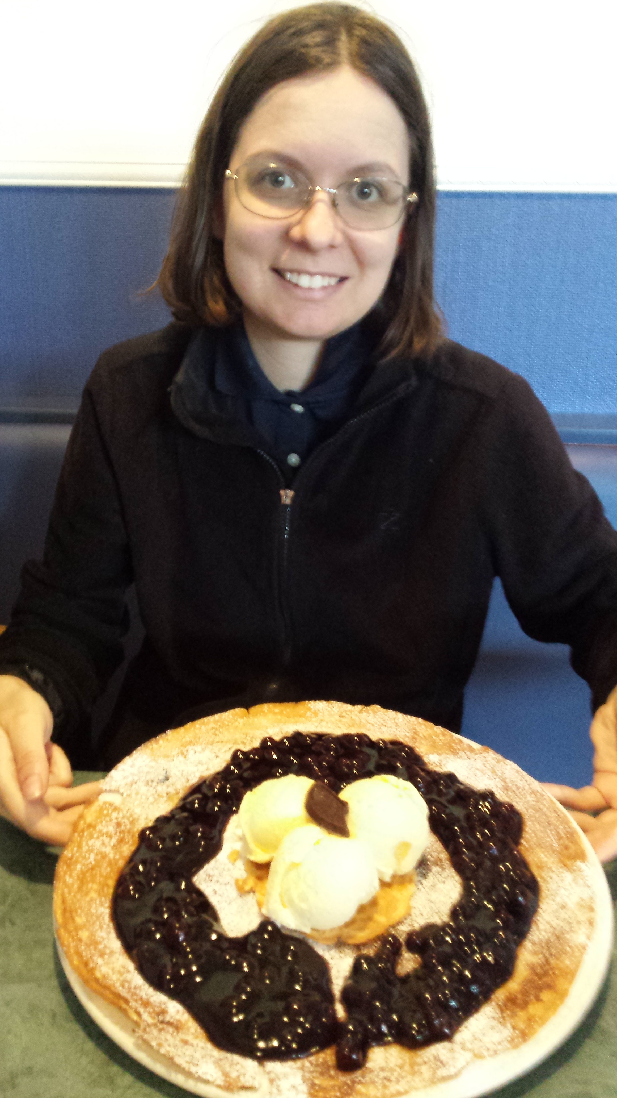
Example 2: Pancake Manor

Slide 15
States in Pancake Manor Example
The Pancake Manor restaurant is a discrete-event model with the following components:
System state:
  The number of customers waiting to be seated at time t
  The number of customers waiting to order at time t
  The number of customers waiting for food at time t
  The number of customers eating at time t
  The number of customers waiting to pay at time t
  The number of available/occupied tables at time t
Entities: customers; host/hostess; waiter/waitress; cooks in kitchen; tables in restaurant; other?

Slide 16
Events in Pancake Manor Example
Events:
  Arrival of a customer (or group of customers)
  Service completion by host/hostess
  Service completion by waiter/waitress
  Service completion by cook
  Service completion by cashier
Activities:
  Inter-arrival time
  Service time by host/hostess
  Service time by waiter/waitress
  Service time by cook
  Service time by cashier
Delay: a caller’s wait for seating, ordering, eating, paying, etc.

Slide 17
Outline
Concepts in discrete-event simulation
  Terminology and concepts
  Two pedagogical examples
Components of discrete-event simulation
  Time advance approaches
  Event scheduling approach
Manual simulation
  Grocery store example
Simulation program
  Simulation of queuing systems
  Infinite and finite population model
  Tandem queue with blocking
Verification and validation of simulation models

Slide 18
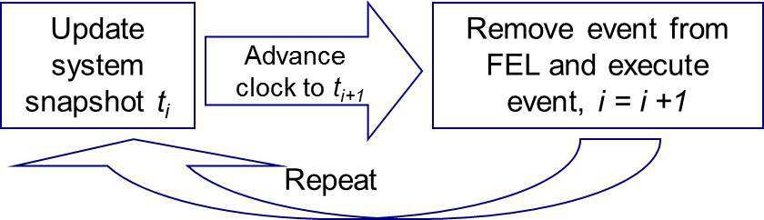
Components of a Simulation
In DES simulation:
  The simulation is driven by events
  The simulation time advances based on sequence of events
  System state changes with events
Requirements:
  Time advance algorithm
  Event scheduling
  Event processing

Slide 19
Time Advance Approaches
The mechanism for advancing simulation time and guaranteeing that all events occur in correct chronological order
General approaches:
Time-stepping approach (fixed time increment):
  Also known as the “activity scanning” approach
  At each clock advance, the conditions for each activity are checked, and if the conditions are true, then the corresponding activities begin
Event-scheduling approach (variable time advance):
  Concentrates on events and their effect on system state
  The simulation clock is advanced to the time of the next imminent event on the FEL

Slide 20
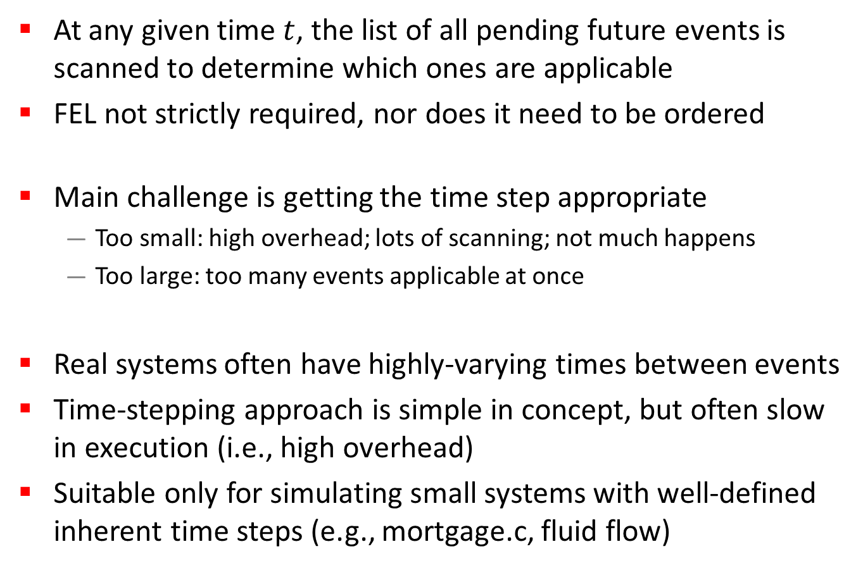
Time-Stepping Approach
At any given time $t$, the list of all pending future events is scanned to determine which ones are applicable
FEL not strictly required, nor does it need to be ordered
Main challenge is getting the time step appropriate
  Too small: high overhead; lots of scanning; not much happens
  Too large: too many events applicable at once
Real systems often have highly-varying times between events
Time-stepping approach is simple in concept, but often slow in execution (i.e., high overhead)
Suitable only for simulating small systems with well-defined inherent time steps (e.g., mortgage.c, fluid flow)

Slide 21
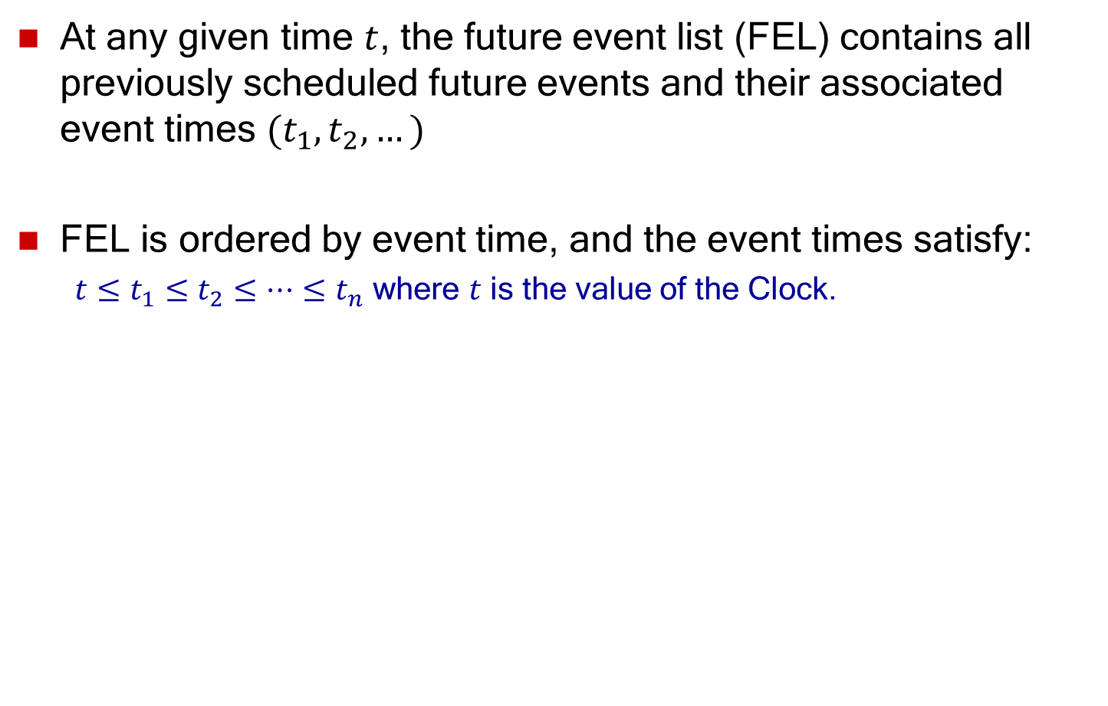
Event-Scheduling Approach
At any given time $t$, the future event list (FEL) contains all previously scheduled future events and their associated event times $(t_{1},t_{2},…)$
FEL is ordered by event time, and the event times satisfy:
  $t≤t_{1}≤t_{2}≤…≤t_{n}$ where $t$ is the value of the Clock.

Slide 22
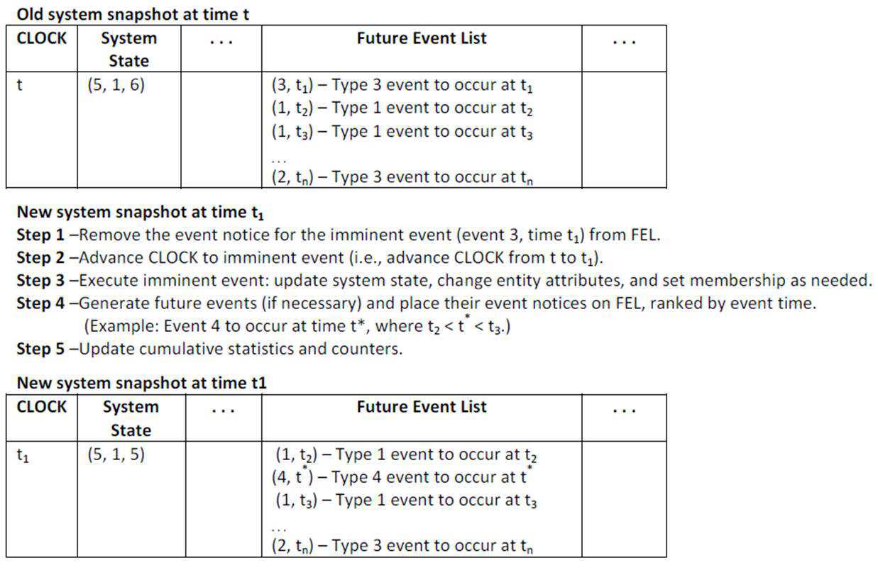
Event-Scheduling Approach

Slide 23
List Processing
The management of a list
  The major list processing operations performed on a FEL are:
    Removal of the imminent event
    Addition of a new event to the list
    Occasionally removal of some event (cancellation of an event)
  Efficiency of search within the list depends on the logical organization of the list and how the search is conducted
Data structure for FEL? Choice depends on system size:
  Variable(s)
  Arrays
  Files
  Ordered linked list
  Priority queue
  Binary heap
  Calendar queue

Slide 24
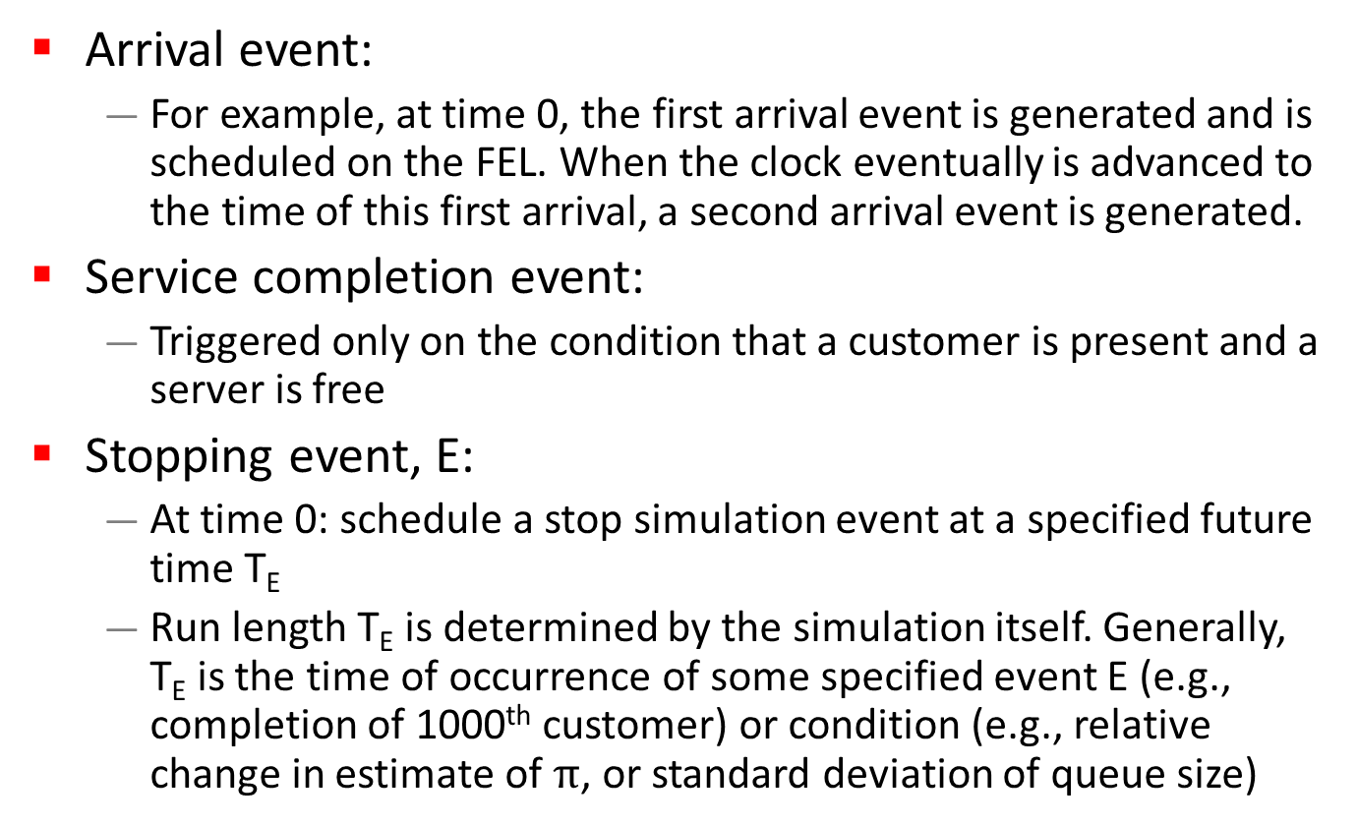
Future Events
Arrival event:
  For example, at time 0, the first arrival event is generated and is scheduled on the FEL. When the clock eventually is advanced to the time of this first arrival, a second arrival event is generated.
Service completion event:
  Triggered only on the condition that a customer is present and a server is free
Stopping event, E:
  At time 0: schedule a stop simulation event at a specified future time T_{E}
  Run length T_{E} is determined by the simulation itself. Generally, T_{E} is the time of occurrence of some specified event E (e.g., completion of 1000th customer) or condition (e.g., relative change in estimate of $π$, or standard deviation of queue size)

Slide 25
Outline
Concepts in discrete-event simulation
  Terminology and concepts
  Two pedagogical examples
Components of discrete-event simulation
  Time advance approaches
  Event scheduling approach
Manual simulation
  Grocery store example
Simulation program
  Simulation of queuing systems
  Infinite and finite population model
  Tandem queue with blocking
Verification and validation of simulation models

Slide 26
Example 3: Grocery Store
Grocery Store with single checkout
Single-channel queue:
  The system consists of those customers waiting plus the one (if any) checking out
  For this example, a stopping time of 60 minutes is set
Customer being
checked out
Customers waiting
in checkout line

Slide 27
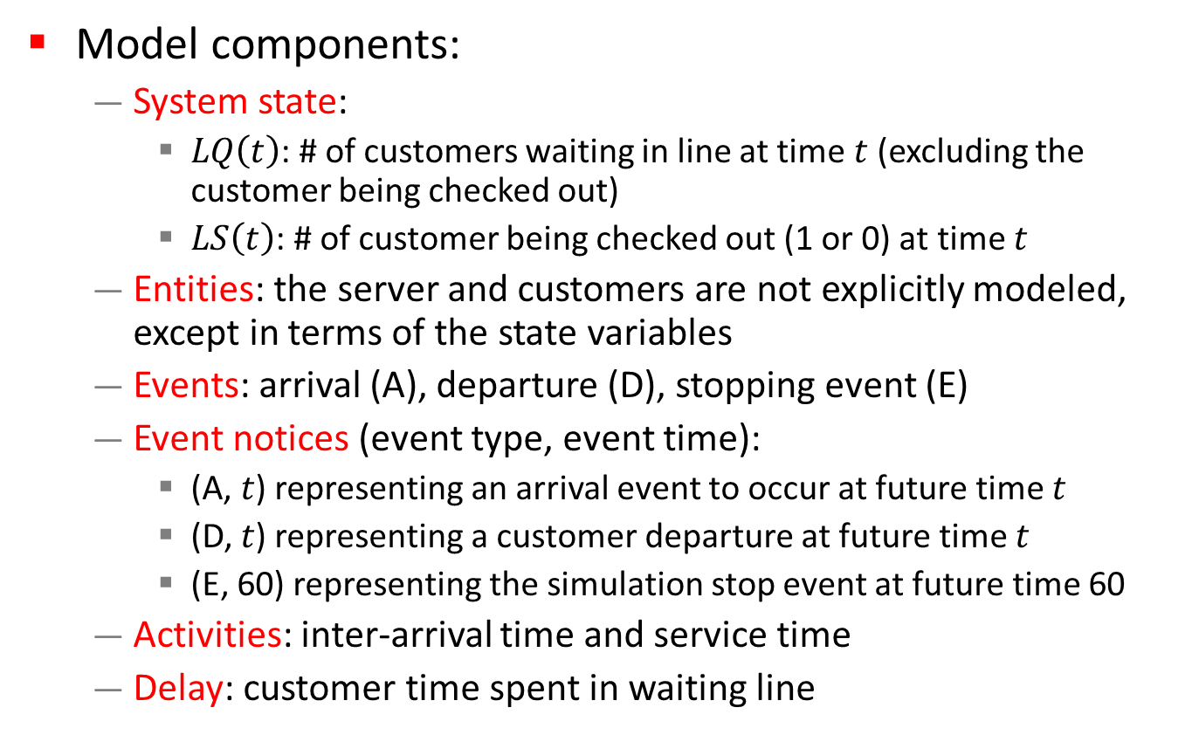
Components of Grocery Store Example
Model components:
  System state:
    $LQ\left(t\right)$: # of customers waiting in line at time$t$ (excluding the customer being checked out)
    $LS\left(t\right)$: # of customer being checked out (1 or 0) at time $t$
  Entities: the server and customers are not explicitly modeled, except in terms of the state variables
  Events: arrival (A), departure (D), stopping event (E)
  Event notices (event type, event time):
    (A, $t$) representing an arrival event to occur at future time $t$
    (D, $t$) representing a customer departure at future time $t$
    (E, 60) representing the simulation stop event at future time 60
  Activities: inter-arrival time and service time
  Delay: customer time spent in waiting line

Slide 28
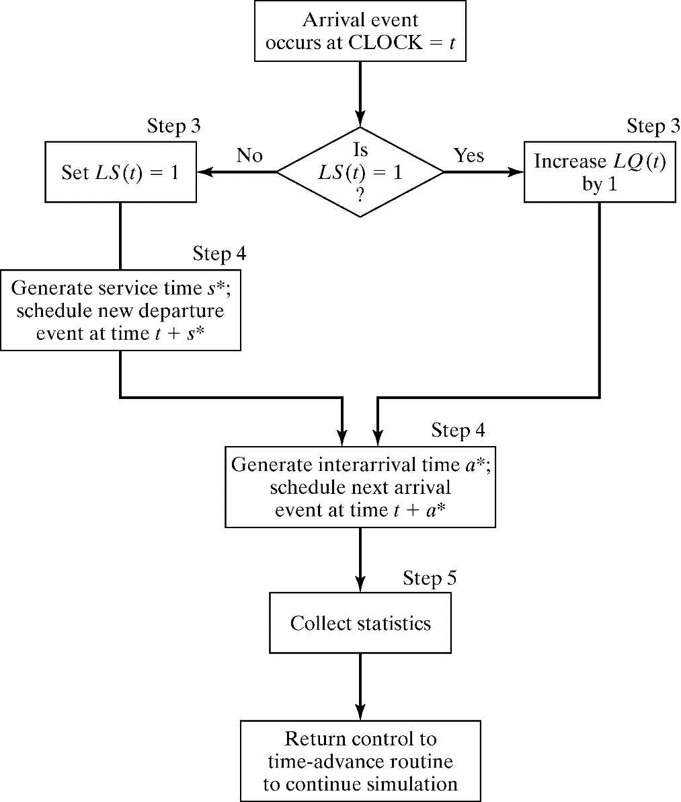
Arrivals in Grocery Store Example
Event logic: execution of arrival event

Slide 29
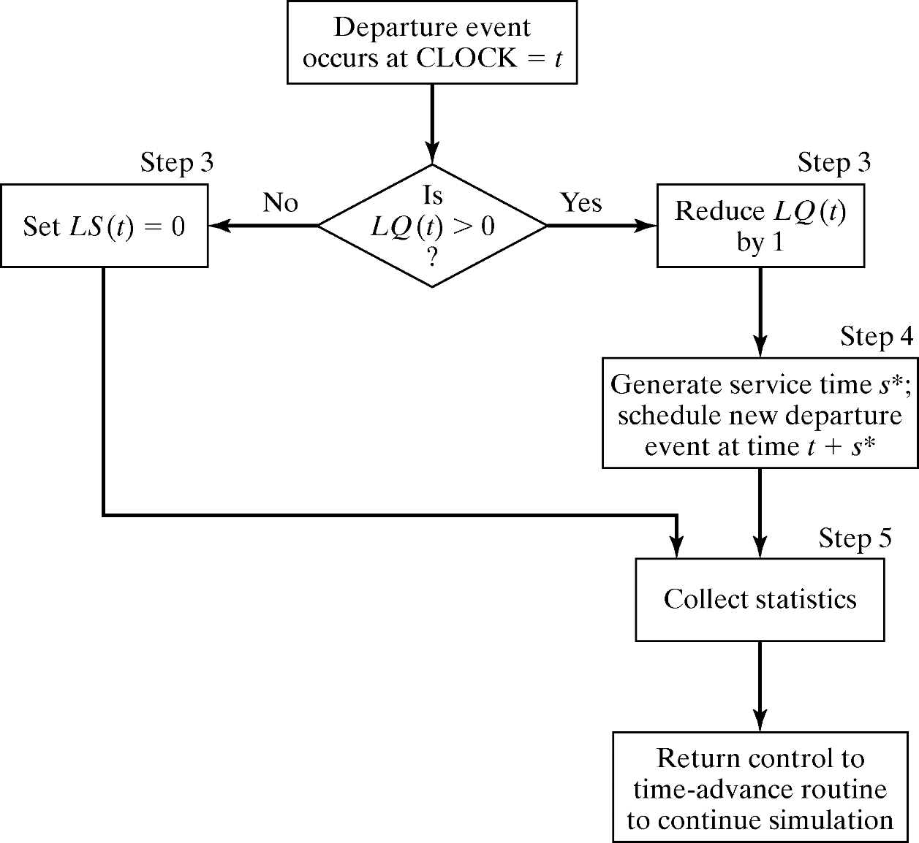
Departures in Grocery Store Example
Event logic: execution of departure event

Slide 30
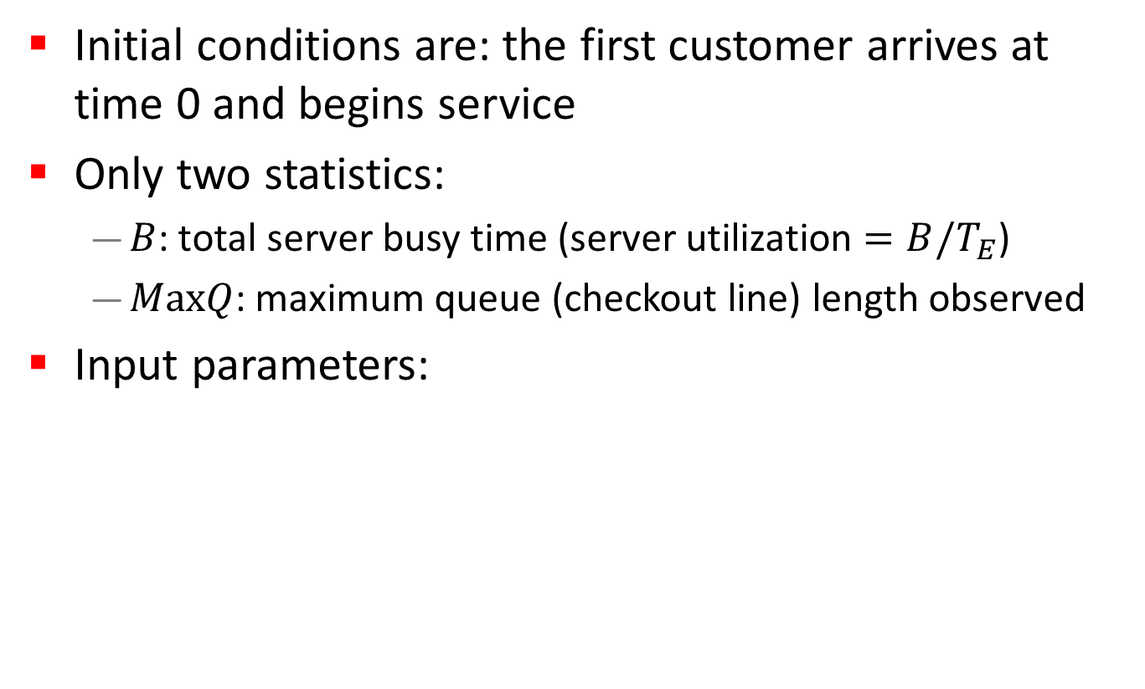
Scenario 1 in Grocery Store Example
Initial conditions are: the first customer arrives at time 0 and begins service
Only two statistics:
  $B$: total server busy time (server utilization $=B/T_{E}$)
  $MaxQ$: maximum queue (checkout line) length observed
Input parameters:
Interarrival Times | 0 | 8 | 6 | 1 | 8
Service Times | 4 | 1 | 4 | 3 | 5

Slide 31
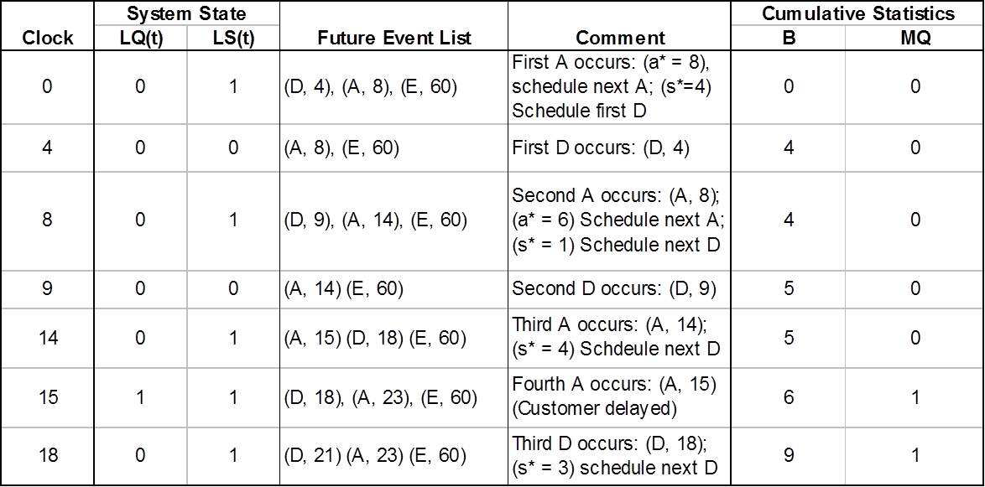
Event Summary for Grocery Store Example
Simulation Table

Slide 32
Manual vs. Computer Simulation
When an event-scheduling algorithm is computerized, only one snapshot (the current one or partially updated one) is kept in computer memory
  A new snapshot can be derived only from the previous snapshot, newly generated random variables, and the event logic
  The current snapshot must contain all information necessary to continue the simulation

Slide 33
Scenario 2 in Grocery Store Example
Suppose the simulation analyst desires to estimate
  mean response time, and,
  mean proportion of customers who spend 4 or more minutes in the system (i.e., waiting in line + checkout time)
It is necessary to expand the previous model to represent the individual customers explicitly:
  Customer entity with arrival time as an attribute will be added to the list of components
  Customer entities will be stored in a list to be called
  ‘Checkout Queue’ as C1, C2, C3, . . ..

Slide 34
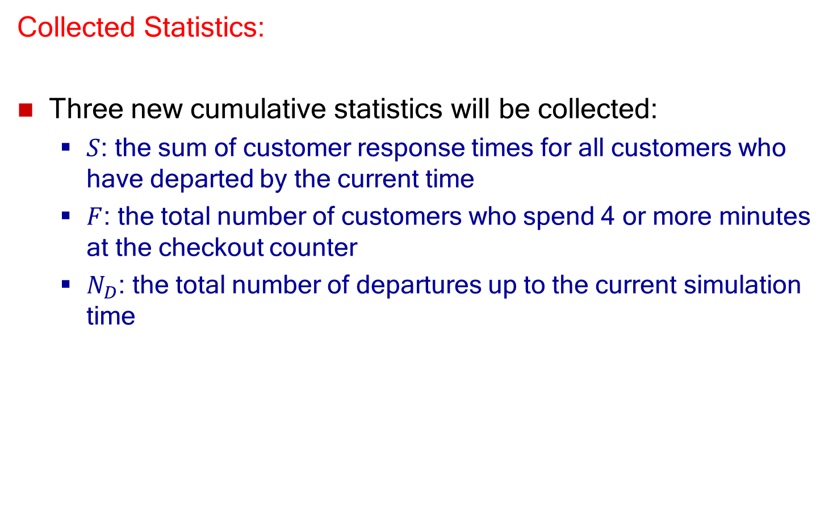
Statistics for Grocery Store Example
Collected Statistics:
Three new cumulative statistics will be collected:
  $S$: the sum of customer response times for all customers who have departed by the current time
  $F$: the total number of customers who spend 4 or more minutes at the checkout counter
  $N_{D}$: the total number of departures up to the current simulation time

Slide 35
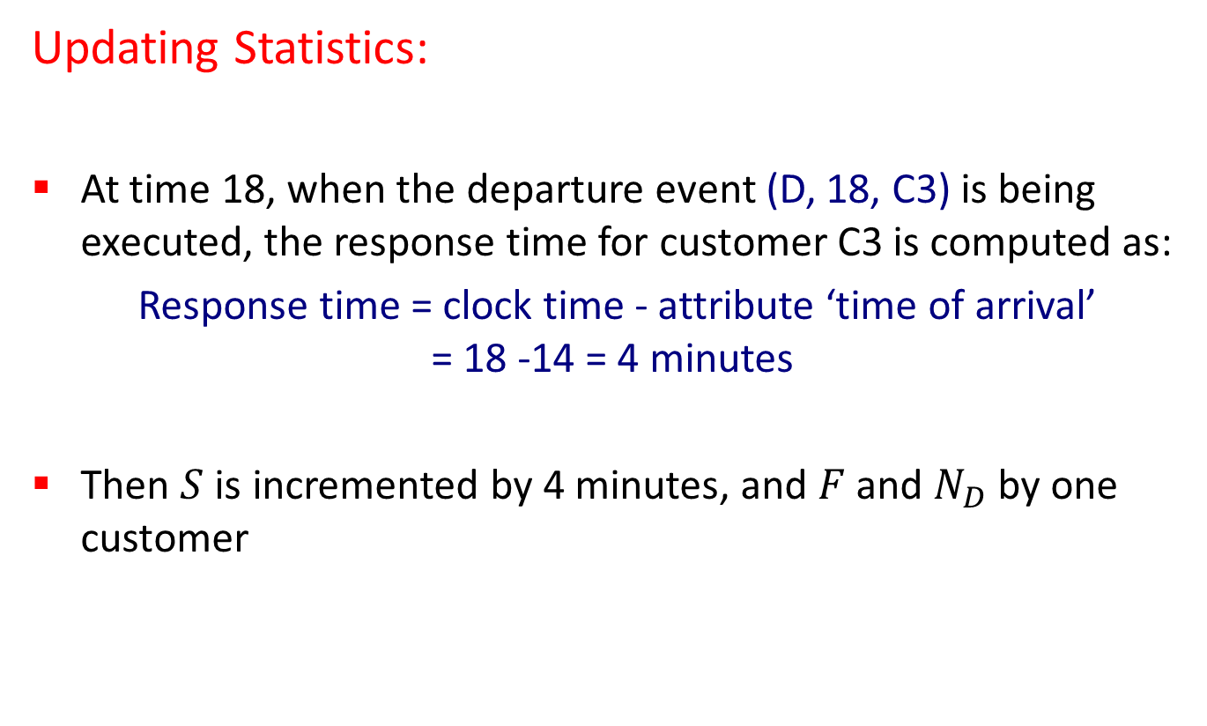
Computing Statistics for Grocery Store Example
Updating Statistics:
At time 18, when the departure event (D, 18, C3) is being executed, the response time for customer C3 is computed as:
Response time = clock time - attribute ‘time of arrival’
= 18 -14 = 4 minutes
Then $S$ is incremented by 4 minutes, and $F$ and $N_{D}$ by one customer

Slide 36
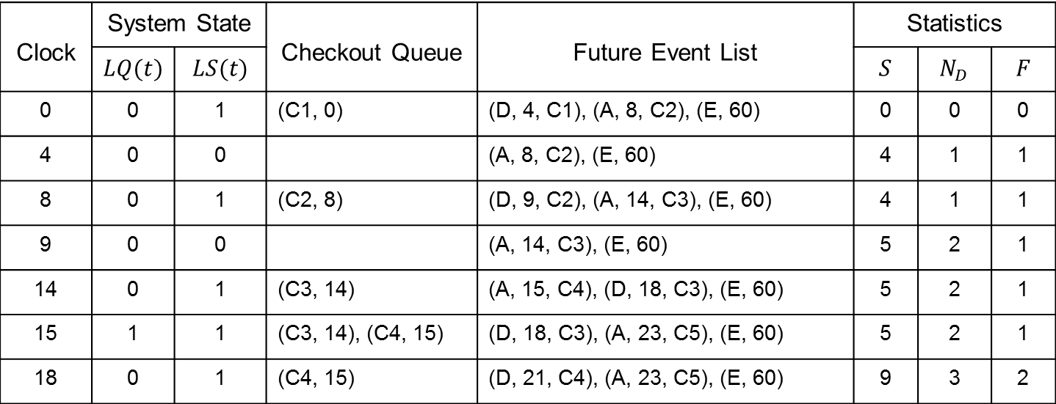
Summary Table for Grocery Store Example
Input parameters:
Interarrival Times | 0 | 8 | 6 | 1 | 8
Service Times | 4 | 1 | 4 | 3 | 5
Clock | System State |  | Checkout Queue | Future Event List | Statistics
 | $$LQ(t)$$ | $$LS(t)$$ |  |  | $$S$$ | $$N_{D}$$ | $$F$$
0 | 0 | 1 | (C1, 0) | (D, 4, C1), (A, 8, C2), (E, 60) | 0 | 0 | 0
4 | 0 | 0 |  | (A, 8, C2), (E, 60) | 4 | 1 | 1
8 | 0 | 1 | (C2, 8) | (D, 9, C2), (A, 14, C3), (E, 60) | 4 | 1 | 1
9 | 0 | 0 |  | (A, 14, C3), (E, 60) | 5 | 2 | 1
14 | 0 | 1 | (C3, 14) | (A, 15, C4), (D, 18, C3), (E, 60) | 5 | 2 | 1
15 | 1 | 1 | (C3, 14), (C4, 15) | (D, 18, C3), (A, 23, C5), (E, 60) | 5 | 2 | 1
18 | 0 | 1 | (C4, 15) | (D, 21, C4), (A, 23, C5), (E, 60) | 9 | 3 | 2
Simulation Table

Slide 37
Outline
Concepts in discrete-event simulation
  Terminology and concepts
  Two pedagogical examples
Components of discrete-event simulation
  Time advance approaches
  Event scheduling approach
Manual simulation
  Grocery store example
Simulation program
  Simulation of queueing systems
  Infinite and finite population model
  Tandem queue with blocking
Verification and validation of simulation models

Slide 38
Generic Simulation Program (1 of 4)
Initialization
  Initialize clock to zero
  Initialize state variables and statistical counters
  Initialize event list (with already known future events)

Slide 39
Generic Simulation Program (2 of 4)
Main loop (repeat until the condition for terminating the simulation is met)
  Determine the most imminent event and remove it from the event list (suppose this event is of type i)
  Advance clock to the time of this event
  Invoke event routine for type i

Slide 40
Generic Simulation Program (3 of 4)
Event routine (a separate routine for each event type)
  Update state variables
  Update statistical counters
  When required, add future events to the event list

Slide 41
Generic Simulation Program (4 of 4)
Report generator
  Invoked when simulation has terminated
  Compute and output performance measures of interest

Slide 42
Simulation of Queueing Systems
Single server infinite population
Single server finite population
Tandem queue
Tandem queue with blocking
Closed network model

Slide 43
Components of a Queueing System
1. Arrival
process
2. Service time
distribution
5. Service
discipline
4. Waiting
positions
3. Number of
servers

Slide 44
Arrival Definition
Arrival time
  Time at which a customer arrives at a service facility
Inter-arrival time
  Time between two successive arrivals to a service facility
Arrival rate
  Number of arrivals per unit of time

Slide 45
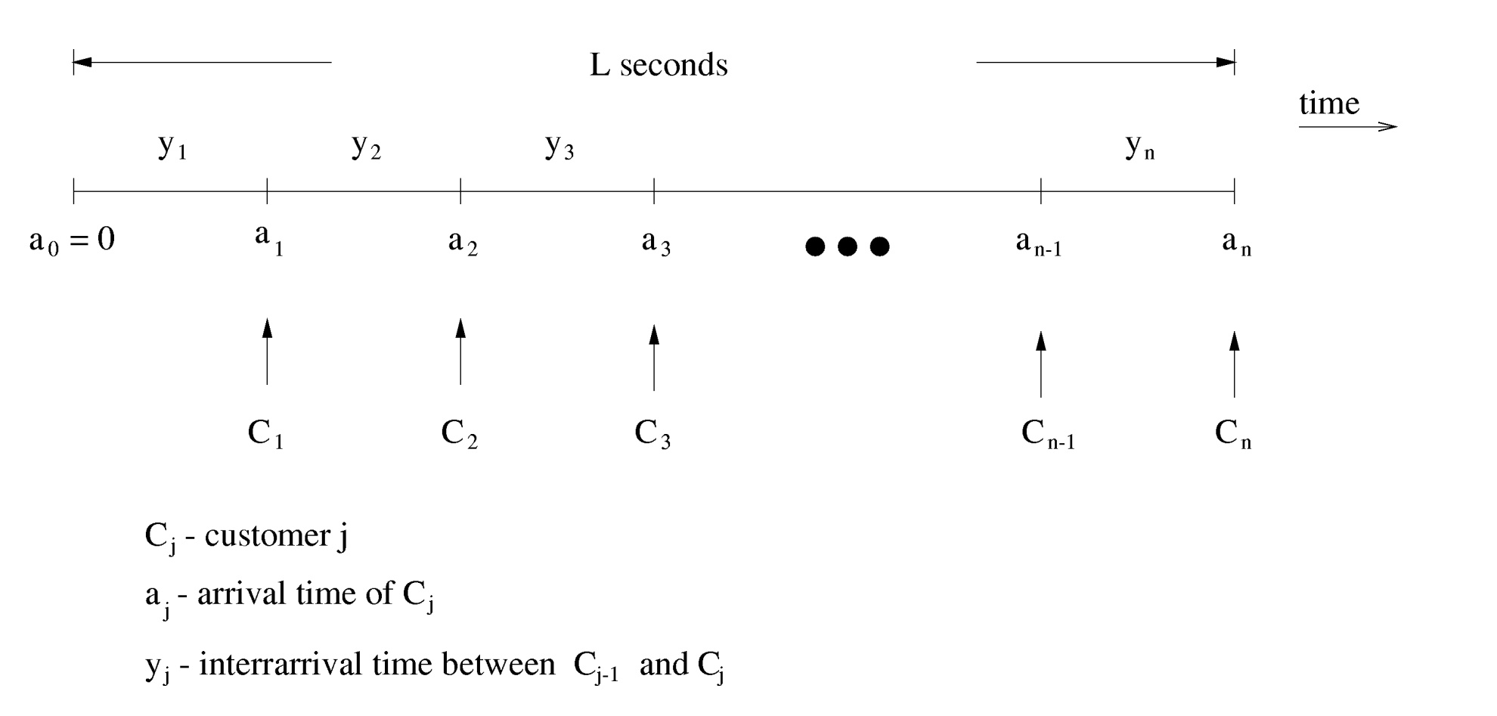
Timing Diagram

Slide 46
Relationship between Arrival Rate and Inter-arrival Time
Define:
Mean inter-arrival time
Arrival rate

Slide 47
Service Definition
Service requirement - in units of work
  Ex 1: CPU - unit of work is “instruction”
  Ex 2: communication channel - unit of work is “bit”
Server capacity - in units of work per second
  Ex 1: CPU - server capacity is in “number of instructions executed per second”
  Ex 2: communication channel - server capacity is in “number of bits transmitted per second”
Service time =
Service rate
  Number of customers served per second
  (assuming no idle time)

Slide 48
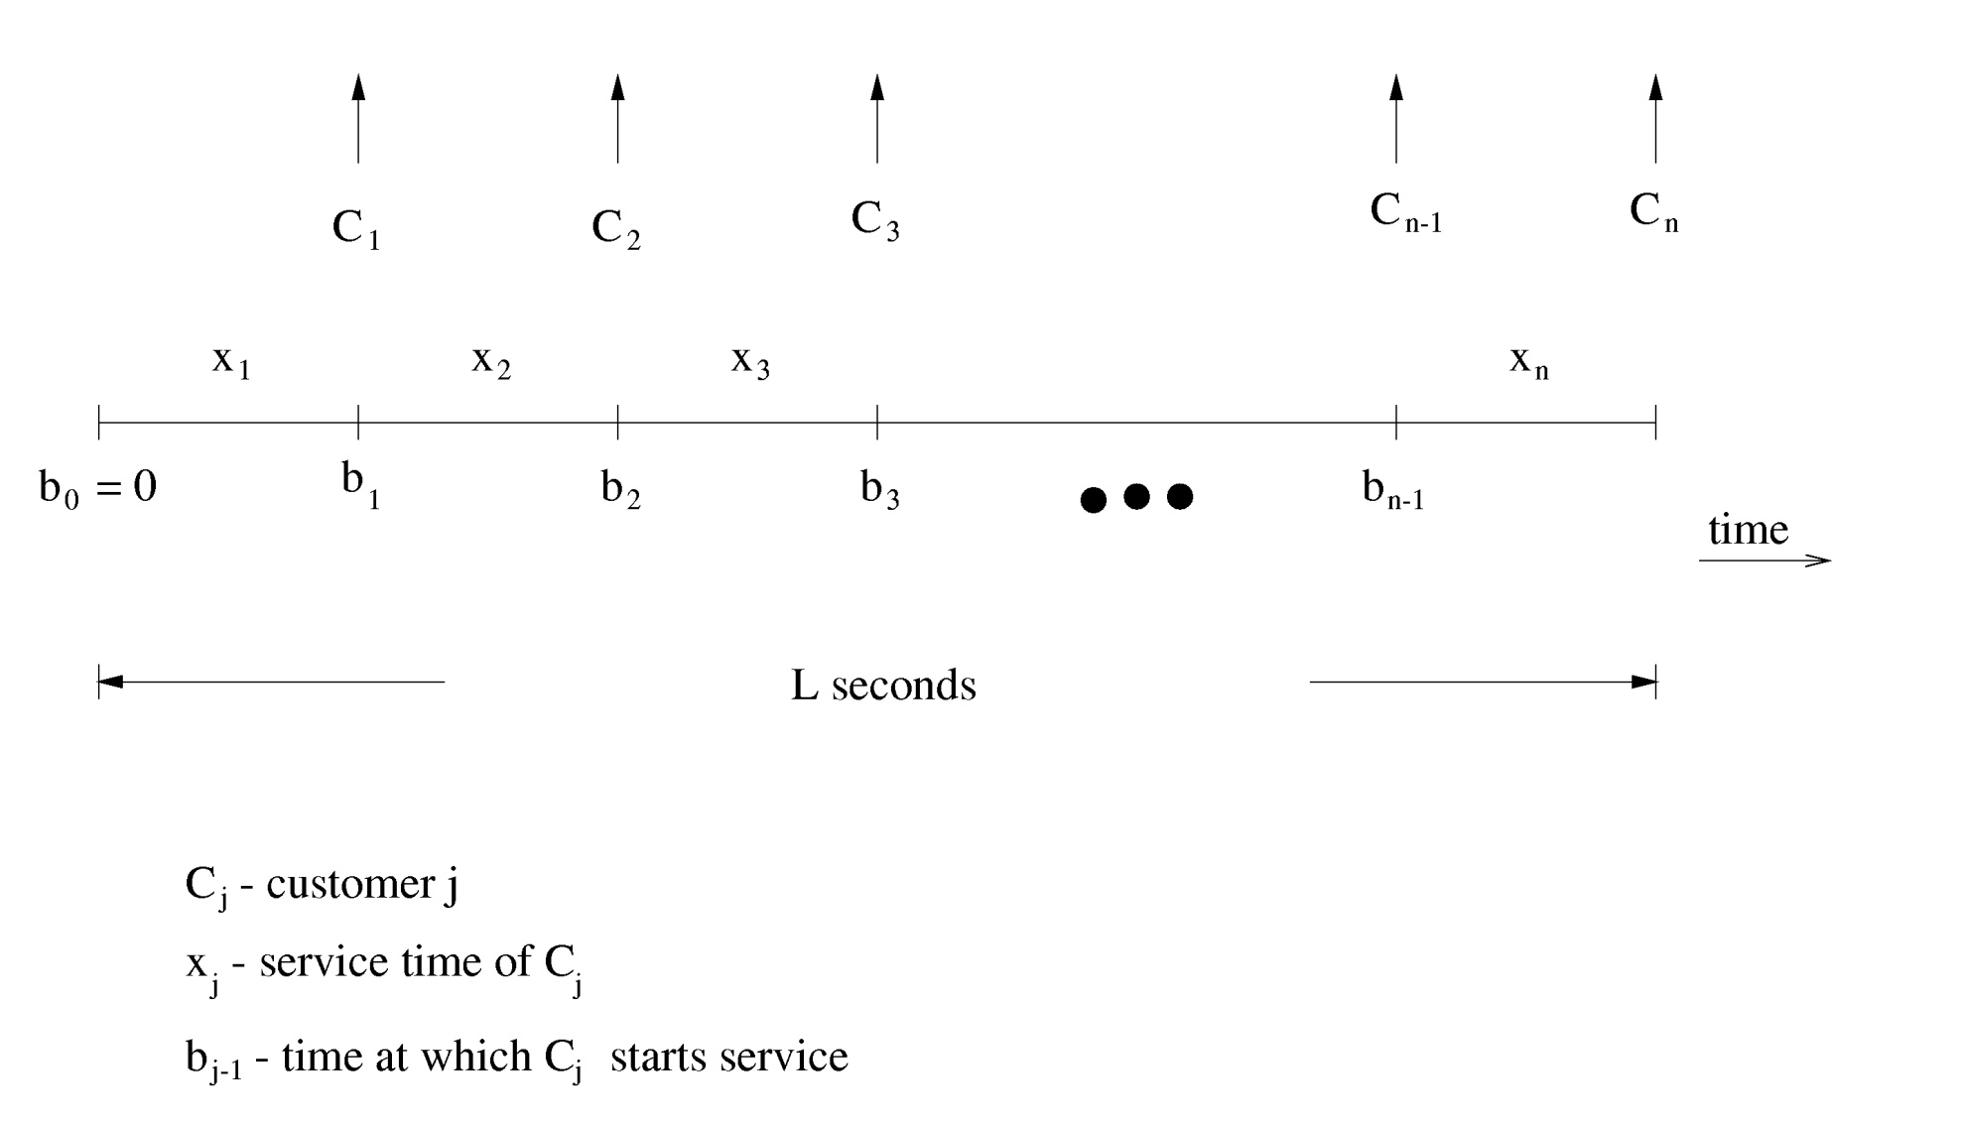
Timing Diagram

Slide 49
Relationship between Service Rate and Service Time
Define:
Mean service time
Service rate

Slide 50
Service Disciplines
Examples:
First-Come-First-Serve (FCFS) (a.k.a. FIFO)
Last-Come-First-Serve (LCFS)
Round-Robin (RR) with a fixed quantum
Infinitesimal quantum ⇒ Processor Sharing (PS)
Shortest Job First (SJF)
Shortest Remaining Processing Time (SRPT)
And many more…

Slide 51
Typical Performance Measures
Response time
  Elapsed time from arrival to departure
Waiting time
  Time spent in queue
Number of customers in system
Number of customers in queue
Server utilization
  Proportion of time that the server is busy
Throughput
  Rate at which customers leave the service facility after completing service

Slide 52
Utilization
  Proportion of time that the server is busy
  Total busy time =
  U = proportion of time server is busy =
  Note: U ≤ 1
s₁
s₂
s₃
s₄
s_{n}
• • •
0
Time
L

Slide 53
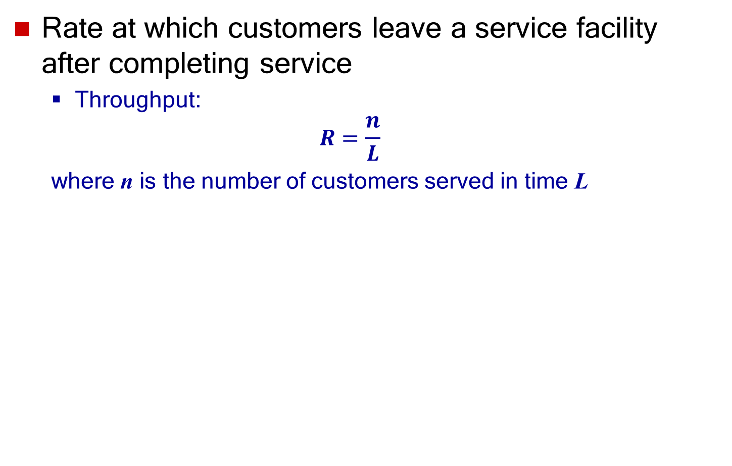
Throughput
  Rate at which customers leave a service facility after completing service
  Throughput:
  $$R=\frac{n}{L}$$
  where n is the number of customers served in time L

Slide 54
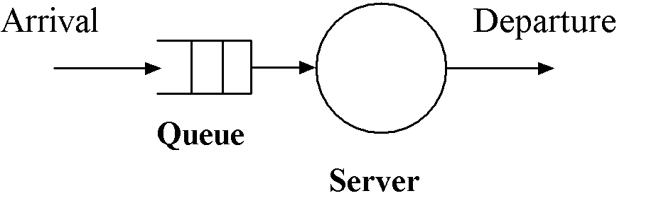
Single Server Queue Example (ssq3.c)
Infinite population model

Slide 55
Customer Arrivals - Infinite Population Model
Number of users of the service facility is large
(potentially infinite)
Pattern of customer arrivals is based on combined behavior of the customers, and is assumed to be independent of the state of the system

Slide 56
Single Server Queue Example
Events arrival start service departure
Activities waiting receiving
in queue service
time

Slide 57
Single Server Queue Model
Assumptions
  Inter-arrival times are independent of system state
  Inter-arrival times are iid (independent and identically distributed)
  Service times are independent of system state
  Service times are iid
  FCFS scheduling
  System is empty at time zero
  Arrival of first customer occurs after the first inter-arrival time
  Simulation terminates when the m-th customer starts service

Slide 58
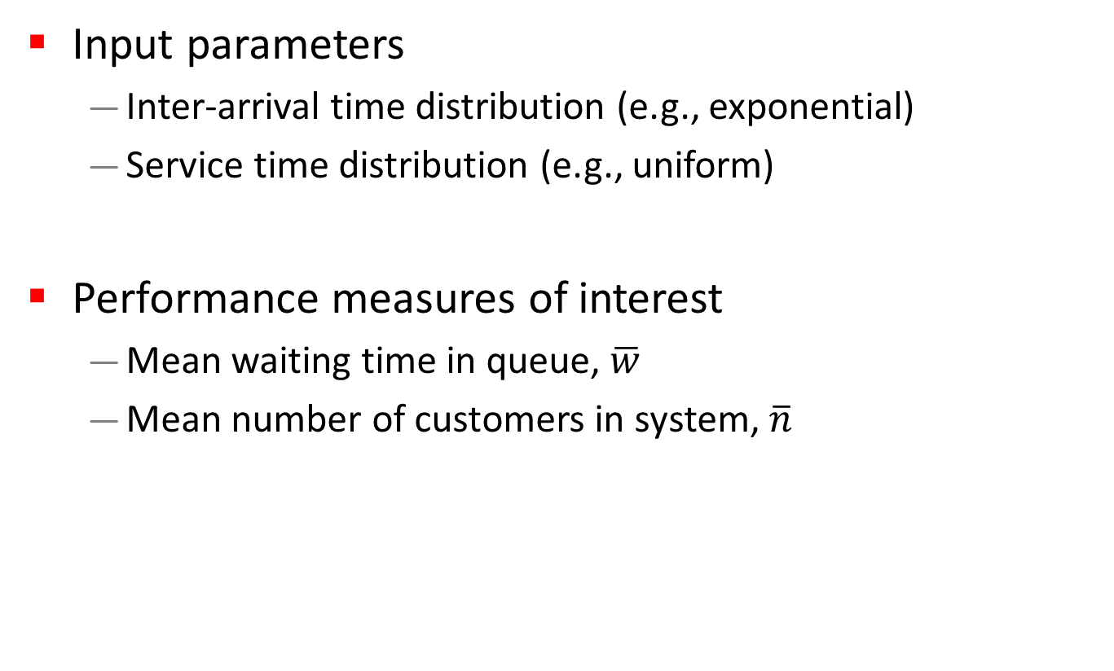
Single Server Queue Model
Input parameters
  Inter-arrival time distribution (e.g., exponential)
  Service time distribution (e.g., uniform)
Performance measures of interest
  Mean waiting time in queue, $\overline{w}$
  Mean number of customers in system, $\overline{n}$

Slide 59
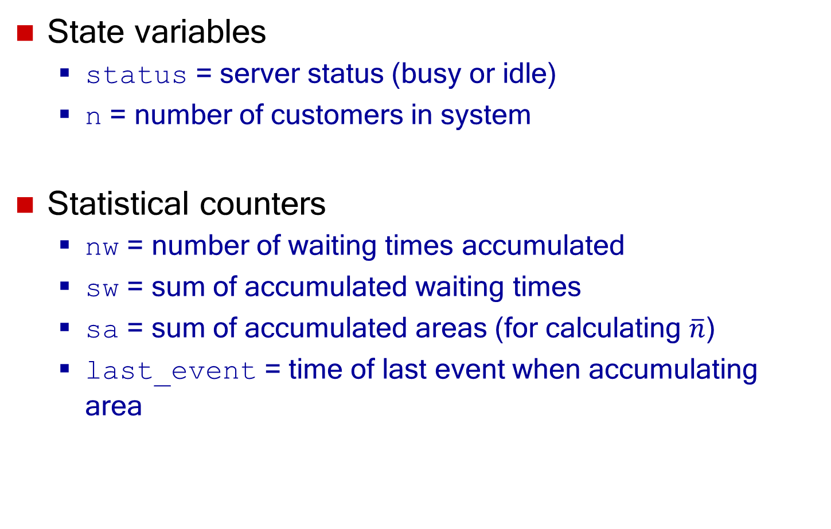
Single Server Queue Model
State variables
  status = server status (busy or idle)
  n = number of customers in system
Statistical counters
  nw = number of waiting times accumulated
  sw = sum of accumulated waiting times
  sa = sum of accumulated areas (for calculating $\overline{n}$)
  last_event = time of last event when accumulating area

Slide 60
Single Server Queue Model
Lists
  event_list
  queue
Event types
  type 1: arrival
  type 2: start_service
  type 3: departure

Slide 61
Single Server Queue Model (1 of 4)
Initialization
  clock = 0
  status = idle
  n = 0
  nw = sw = 0
  last_event = 0
  sa = 0
  Initialize queue to empty
  Initialize event_list to empty
  Determine inter_t, the first interarrival time
  Schedule an arrival event to occur at clock + inter_t

Slide 62
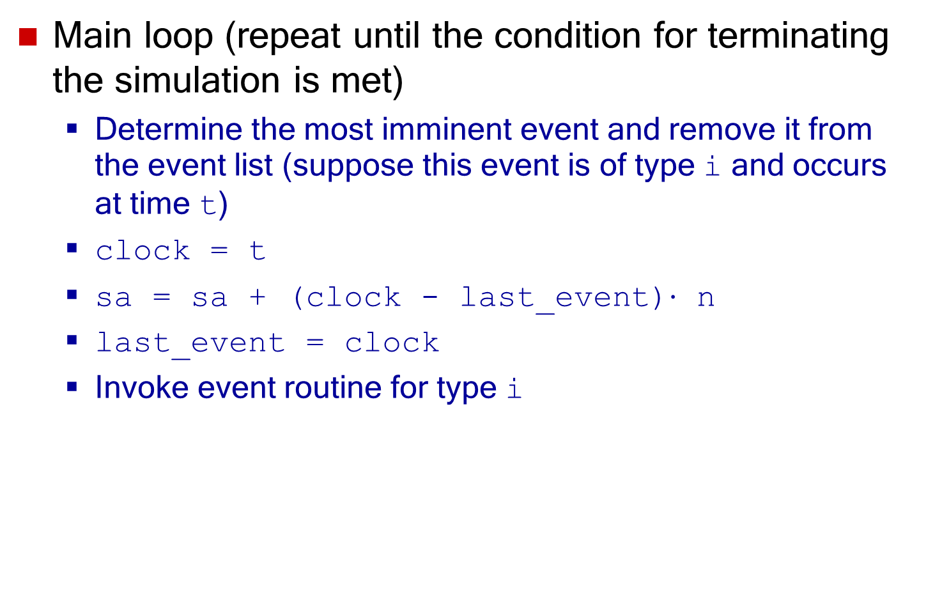
Single Server Queue Model (2 of 4)
Main loop (repeat until the condition for terminating the simulation is met)
  Determine the most imminent event and remove it from the event list (suppose this event is of type i and occurs at time t)
  clock = t
  sa = sa + (clock - last_event)$⋅$ n
  last_event = clock
  Invoke event routine for type i

Slide 63
Single Server Queue Model (3a of 4)
arrival event – type 1
  Determine inter_t, the interarrival time between the current and next arrivals
  Schedule an arrival event to occur at clock + inter_t
  n = n + 1
  Enter arriving customer to end of queue, and save its time of arrival (given by clock)
  If status is idle, invoke routine for start_service event

Slide 64
Single Server Queue Model (3b of 4)
start_service event – type 2
  Remove customer from front of queue, and retrieve time of arrival (t_arrival)
  nw = nw + 1
  sw = sw + (clock - t_arrival)
  If nw = m (condition for terminating simulation), exit main loop
  status = busy
  Determine serv_t, the customer service time
  Schedule a departure event to occur at clock + serv_t

Slide 65
Single Server Queue Model (3c of 4)
departure event – type 3
  n = n - 1
  status = idle
  If n > 0, invoke event routine for start_service event

Slide 66
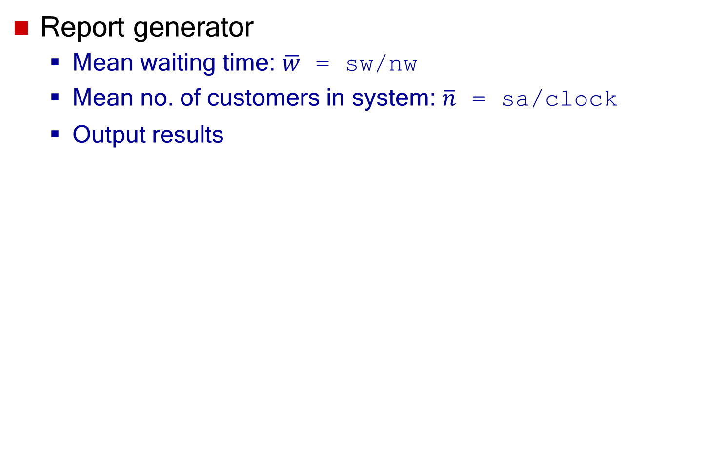
Single Server Queue Model (4 of 4)
Report generator
  Mean waiting time: $\overline{w}$ = sw/nw
  Mean no. of customers in system: $\overline{n}$ = sa/clock
  Output results

Slide 67
Sequence of Events
C1
C2
C3
departures
server
C1
C2
C3
C4
start service
queue
0
1
3
4
6
9
10
11
arrival
C1
C2
C3
C4
Cj - customer j
time
number of
customers
in system
2
1
0
1
3
4
6
9
10
11
time
Notes:
** move to earlier slides

Slide 68
Manual Trace of Single Server Queue Example
clock event status n event list queue nw sw
0 -- idle 0 (A, 1) empty 0 0
1 A busy 1 (A, 3), (D, 4) empty 1 0
3 A busy 2 (D, 4), (A, 6) (C2, 3) 1 0
4 D busy 1 (A, 6), (D, 9) empty 2 1
6 A busy 2 (D, 9), (A, 11) (C3, 6) 2 1
9 D busy 1 (D, 10), (A, 11) empty 3 4
10 D idle 0 (A, 11) empty 3 4
11 A busy 1 (A, 15), (D, 17) empty 4 4
mean waiting time = sw/nw = 1.0
Notation: A - arrival event, D - departure event
(Cj, x) - customer j in queue, time of arrival of this customer is x
n - number of customers in system

Slide 69
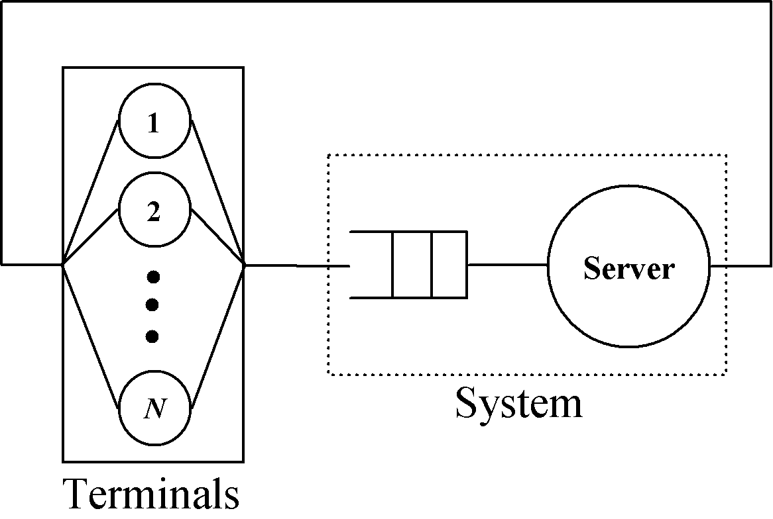
Single Server Queue Example
Finite population model

Slide 70
Finite Population Model
Number of users is not large
The behavior of each user is modeled explicitly as far as arrival pattern is concerned
Arrival rate is dependent on the state of the system
Definition
  Think time: elapsed time from completion of previous request to submission of next request

Slide 71
Finite Population Model
Events arrival start service departure arrival
Activities waiting receiving think
in queue service time
time

Slide 72
Finite Population Model
Assumptions
  Service times are iid and independent of system state
  Think times are iid and independent of system state
  FCFS scheduling
  System is empty at time zero
  For each of the N users, the first request is submitted after a think time
  Subsequent arrivals depend upon prior service completions
  Simulation terminates at time term_sim

Slide 73
Finite Population Model
Initialization
  clock = 0
  status = idle
  n = 0
  Initialize queue to empty
  Initialize event_list to empty
  for user j (j = 1 to N) Determine think_t, a think time of user j,
  and schedule an arrival event at clock + think_t
  end for
  Schedule an end_simulation event at term_sim

Slide 74
Finite Population Model
arrival event
  n = n + 1
  Enter arriving customer to end of queue
  If status is idle, invoke routine for start_service event
start_service event
  Remove customer from front of queue
  status = busy
  Determine serv_t, the service time of customer
  Schedule a departure event to occur at clock + serv_t

Slide 75
Finite Population Model
departure event
  n = n - 1
  status = idle
  Determine think_t
  Schedule an arrival event at clock + think_t
  If n > 0, invoke event routine for start_service
end-simulation event
  exit main loop

Slide 76
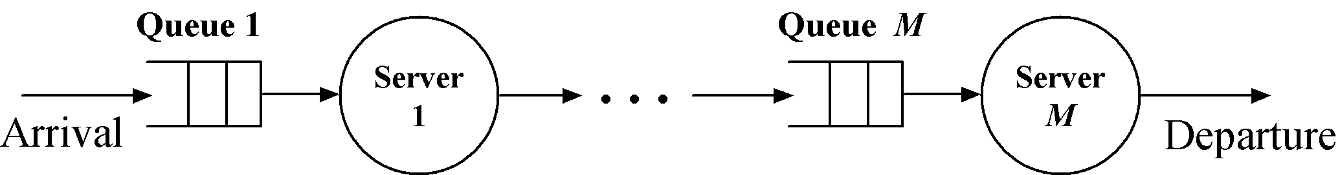
Example: Tandem Queue – M Stages
Subsystems and interactions
  M subsystems – one for each stage
  A departure from stage i becomes an arrival
  to stage i+1 (i = 1 to M-1)

Slide 77
Simulation Program
Use event routines for single server queue model for each of the M stages
Modifications to implement tandem queue:
  departure event: for stage i (i = 1 to M-1)
  - add the step
    Invoke routine for arrival event at stage i+1
  arrival event: for stage i (i = 2 to M)
  - do not schedule the next arrival event!

Slide 78
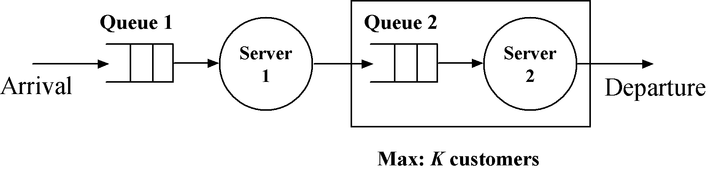
Example: Tandem Queue with Blocking

Slide 79
Tandem Queue with Blocking
Two stages
Finite waiting room at stage 2 (number of customers in system < K)
Blocking
  Server 1 is blocked if a customer completing service at stage 1 finds no queuing space at stage 2

Slide 80
Tandem Queue with Blocking
Subsystems and interaction
  2 subsystems – one for each stage
  Server 1 is blocked if a customer completing service at stage 1 finds no queuing space at stage 2
  If server 1 is in the “blocked” state, it becomes “not blocked” when a departure occurs at stage 2
  A departure from stage 1 becomes an arrival to stage 2

Slide 81
Simulation Program
Use event routines for single server queue (infinite population model) for each of the 2 stages
Modifications to implement tandem queue with blocking:
  Add state variable b
    b = 1 if server 1 is blocked and 0 if server 1 is not blocked
  Initialization : add the step
    b = 0

Slide 82
Simulation Program
Modifications (cont.):
  start_service event at stage 1: add the step
    Schedule an end_service event at stage 1 instead of a departure event at stage 1
  end_service event at stage 1: add the step
    If number in system at stage 2 < K
    invoke routine for departure event at stage 1
    else b = 1

Slide 83
Simulation Program
Modifications (cont.):
  departure event at stage 1: add the step
    Invoke routine for arrival event at stage 2
  arrival event at stage 2:
    Do not schedule the next arrival event
  departure event at stage 2: add the step
    If b = 1, then b = 0 and invoke routine for departure event at stage 1

Slide 84
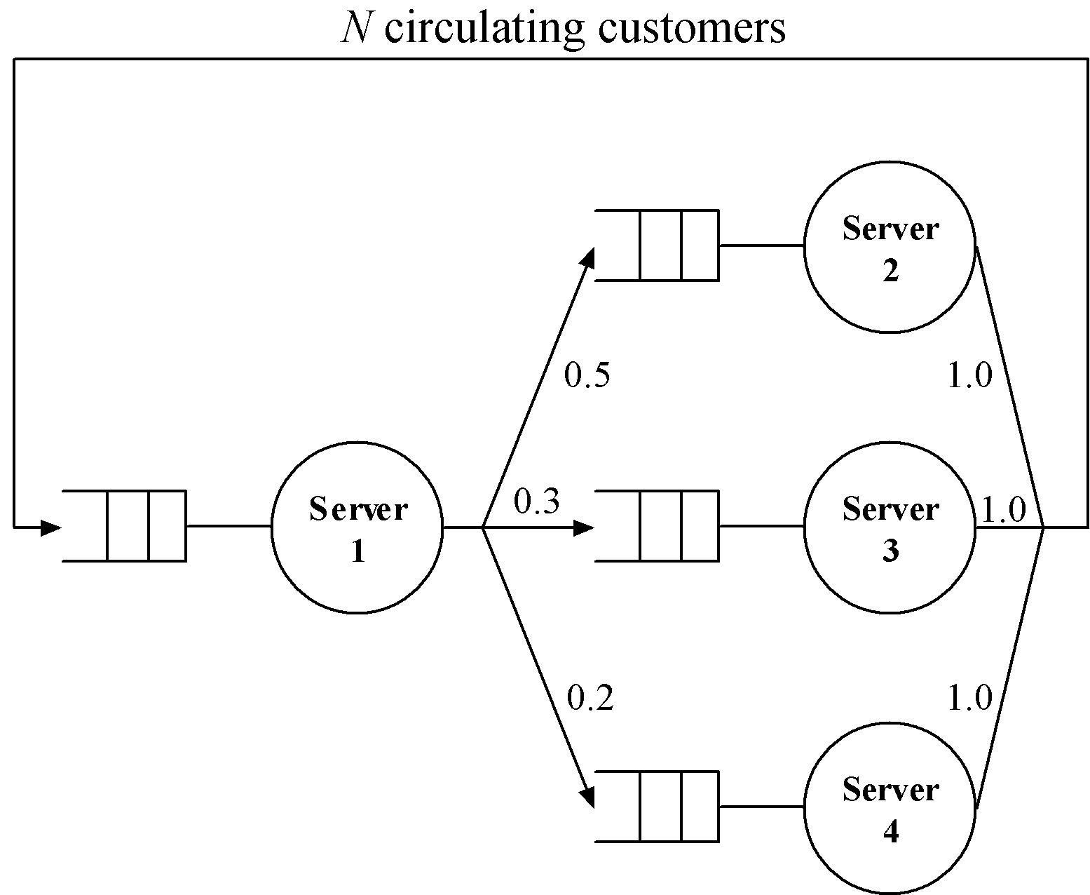
Example: Closed Network Model

Slide 85
Subsystems and Interaction
Four subsystems, one for each server
Interaction is defined by transition probabilities
  A customer departing from server 1 has
    50% probability of arriving at server 2
    30% probability of arriving at server 3
    20% probability of arriving at server 4
  A customer departing from server 2, 3 or 4 has 100% probability of arriving at server 1

Slide 86
Simulation Program
Single server queue model for each subsystem with modifications to model the interaction
Initialization
  clock = 0
  for i = 1 to 4
    Initialize queue(i) to empty
    status(i) = idle
    n(i) = 0
  Initialize event_list to empty
  Enter N customers at end of queue(1)
  n(1) = N
  Invoke start_service event at server 1

Slide 87
Simulation Program
Departure event from server 1: add the steps
  Determine k, the ID of the next server for the departing customer (k = 2 : 50%, k = 3 : 30%, k = 4 : 20%)
  Invoke arrival event to server k
Departure event from server 2, 3, or 4: add the step
  Invoke arrival event to server 1
Arrival event at server 1, 2, 3, or 4
  Do not schedule the next arrival event

Slide 88
Outline
Concepts in discrete-event simulation
  Terminology and concepts
  Two pedagogical examples
Components of discrete-event simulation
  Time advance approaches
  Event scheduling approach
Manual simulation
  Grocery store example
Simulation program
  Simulation of queuing systems
  Infinite and finite population model
  Tandem queue with blocking
Verification and validation of simulation models

Slide 89
Verification and Validation
Abstraction
=
Simulation
Program
System
Model
Validation
Verification

Slide 90
Verification
Increase the level of confidence in the correctness of simulation program
Approaches
  Use a “trace” to debug simulation program
    Trace is obtained by printing state variables, statistical counters, etc., after each event
  Verify simulation output using analytic results

Slide 91
Fundamental Results
Use fundamental results of queuing systems
Examples
  For any subsystem, mean arrival rate, mean number in system, and mean response time must be consistent with Little’s formula

Slide 92
Analytic Results
Check results for cases where analytic results are known
Examples
  Simulation model: open networks with exponential interarrival time distribution and uniform service time distribution
  Run simulation for the case of exponential service time distribution (analytic solution is available)
  Verify if the simulation output is consistent with known analytic results

Slide 93
Validation
Model should be “good enough” (subjective)
Seek expert opinion on system components that need to be carefully modeled, e.g., bottleneck
A model should be valid for the performance measures
The most valid model may not be the most cost-effective model

Slide 94
Three Step Approach to Validation
1. Build a model with high face validity
  Appears to be reasonable to people who are knowledgeable about the system being modeled
2. Validation of model assumptions
  Structural assumptions: entities, attributes, sets, etc.
  Data assumptions
    Collect reliable data
    Identify appropriate distribution
    Validate the assumed distribution

Slide 95
Three Step Approach to Validation
3. Validation of input-output relationship
  Model should be able to predict system behavior under existing conditions
Input Data
(from system measurement)
Model
Output Data
(from model)
= ?
Output Data
(from system measurement)
Could be done using historical data collected
for validation purposes.

