Slide 1
Why is my LMS so slow?
A Case Study of D2L Performance Issues
Sourish Roy
Carey Williamson
Department of Computer Science
University of Calgary

Slide 2
Introduction and Motivation
Desire-to-Learn (D2L) is the official Learning Management System (LMS) at the University of Calgary (since Spring 2014)
Many faculty and students use D2L for their courses
Context/Motivation:
  Many universities use LMS (e.g., BlackBoard, D2L, Canvas, Moodle)
  Few studies characterizing LMS usage and/or performance
  Anecdotal reports suggest that D2L at U of C is “slow”
  Network traffic measurement research provides a means to analyze, characterize, and understand D2L usage at U of C

Slide 3
Research Overview
Network traffic measurement study of D2L usage (2015-2016)
Combination of active and passive measurement approaches
Research Questions:
  How does D2L work?
  How is D2L being used at the University of Calgary?
  How can we improve the performance of D2L?

Slide 4
Results Preview
Complex configuration of D2L setup at U of Calgary
  Excessive HTTP redirection for session login and logout
Long network RTT to access remotely hosted D2L content
  Approximately 40 ms RTT to reach Kitchener, Ontario
  No local CDN node at U of C; closest node is in Toronto
Suboptimal configuration of TCP for D2L Web servers
  Uploads and downloads are window-limited (64 KB per RTT)
  D2L Web server seems very slow (IIS v7.5 on Windows 2000 R2)

Slide 5
Data Collection Methodology
Data collection from Jan. 1, 2016 – April 30, 2016 (Winter 2016)
  Microscopic analysis was performed for this period
Data collection from Jan. 1, 2015 – December 31, 2016
  Longitudinal analysis was performed for this period
Data was processed and stored in Bro logs
  Records connection summaries for all TCP and UDP traffic
    Connection logs provide inbound/outbound traffic information
    HTTP logs provide user agent information for Web browsing
    SSL logs provide server information and encryption details
Active and passive measurement tools were used in this research

Slide 6
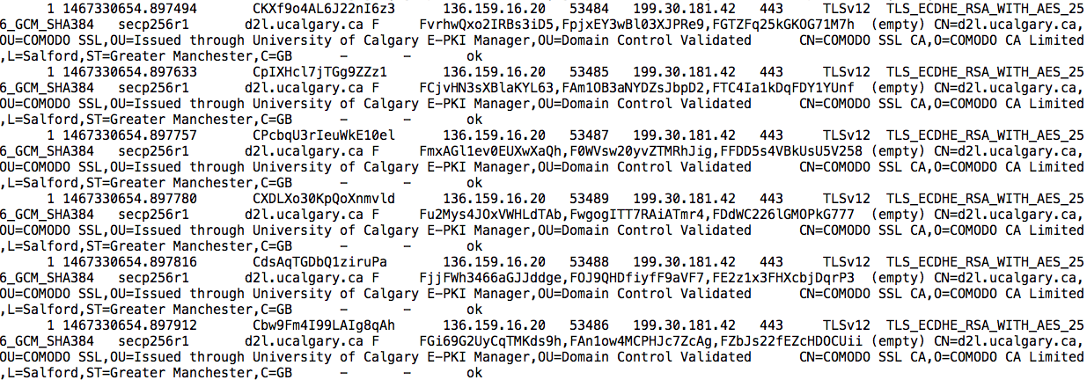
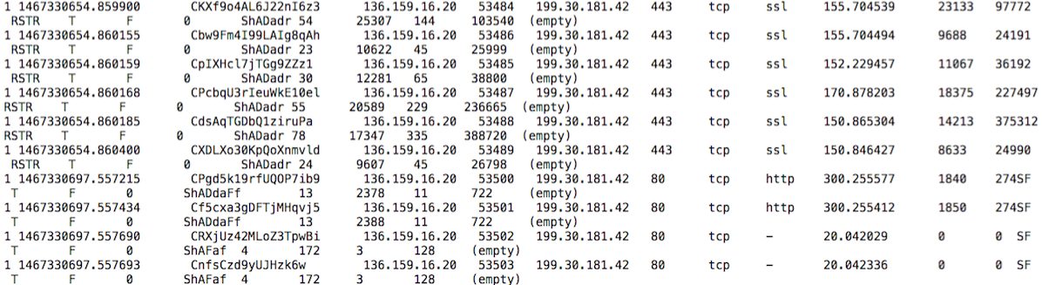
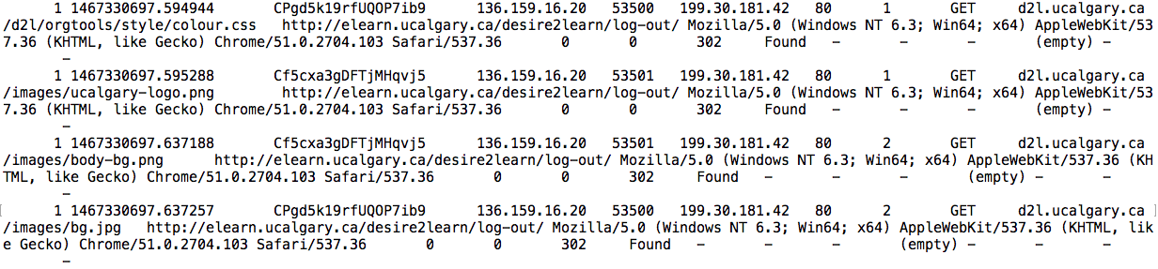
Examples of Bro Log Records for D2L Traffic Analysis
1. Connection Logs
2. SSL Logs
All D2L data extracted using bash and Python scripts
3. HTTP Logs

Slide 7
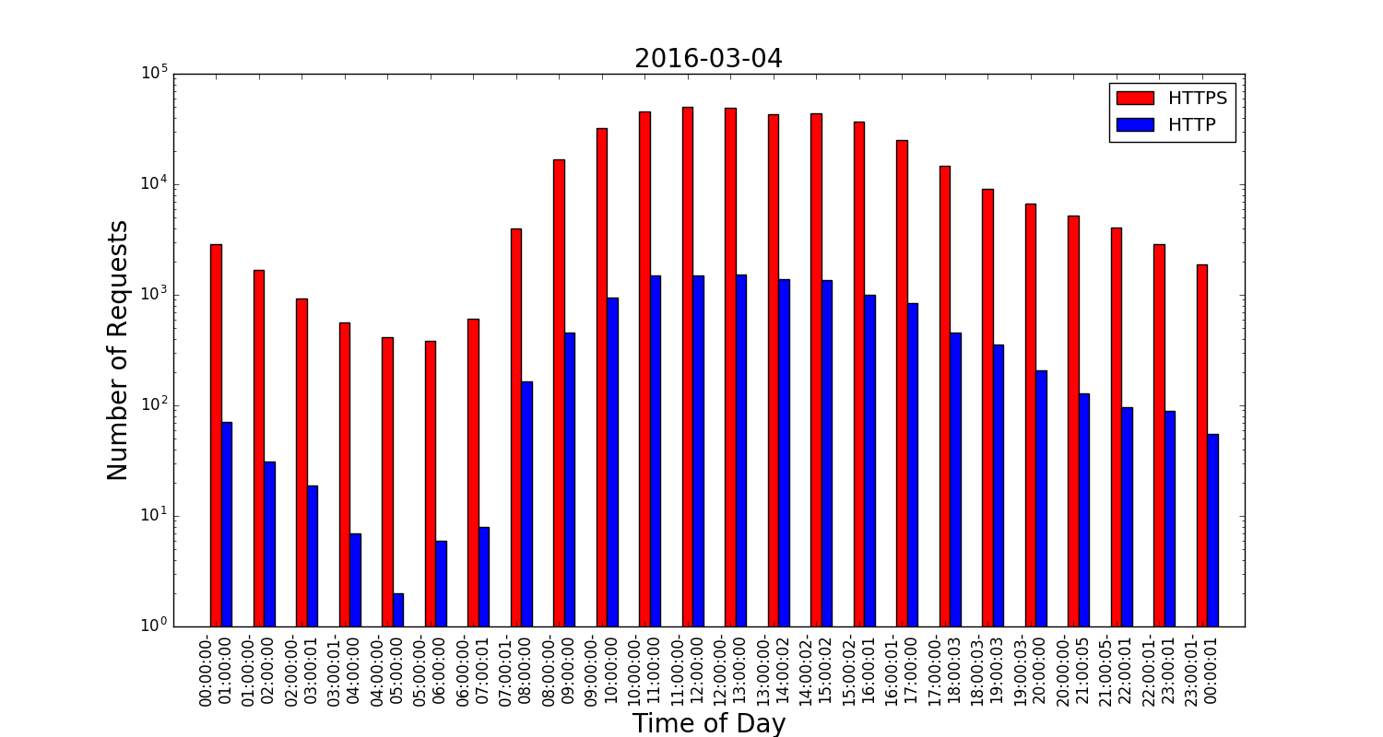
High-Level Characterization of D2L Usage Patterns
Normal Weekday
This graph shows the number of requests made to D2L per hour over a one-day (24 hour) period
Traffic pattern is diurnal
Peak HTTPS traffic is 30x larger than that of HTTP traffic
This graph shows daily totals for D2L requests for one month
Monday is the busiest day of the week for D2L traffic volume
Request volume tends to decrease throughout the week
Holidays have lower D2L traffic
Reading Week

Slide 8
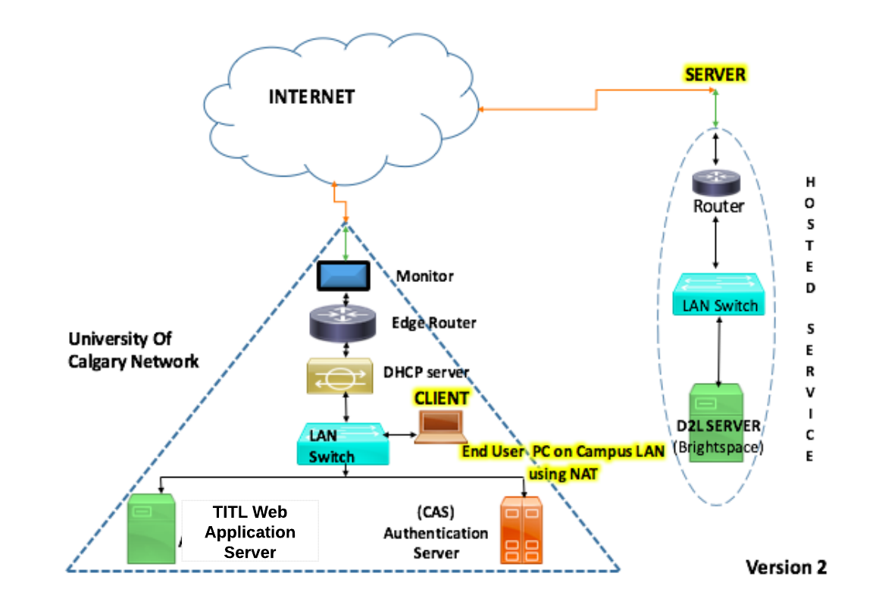
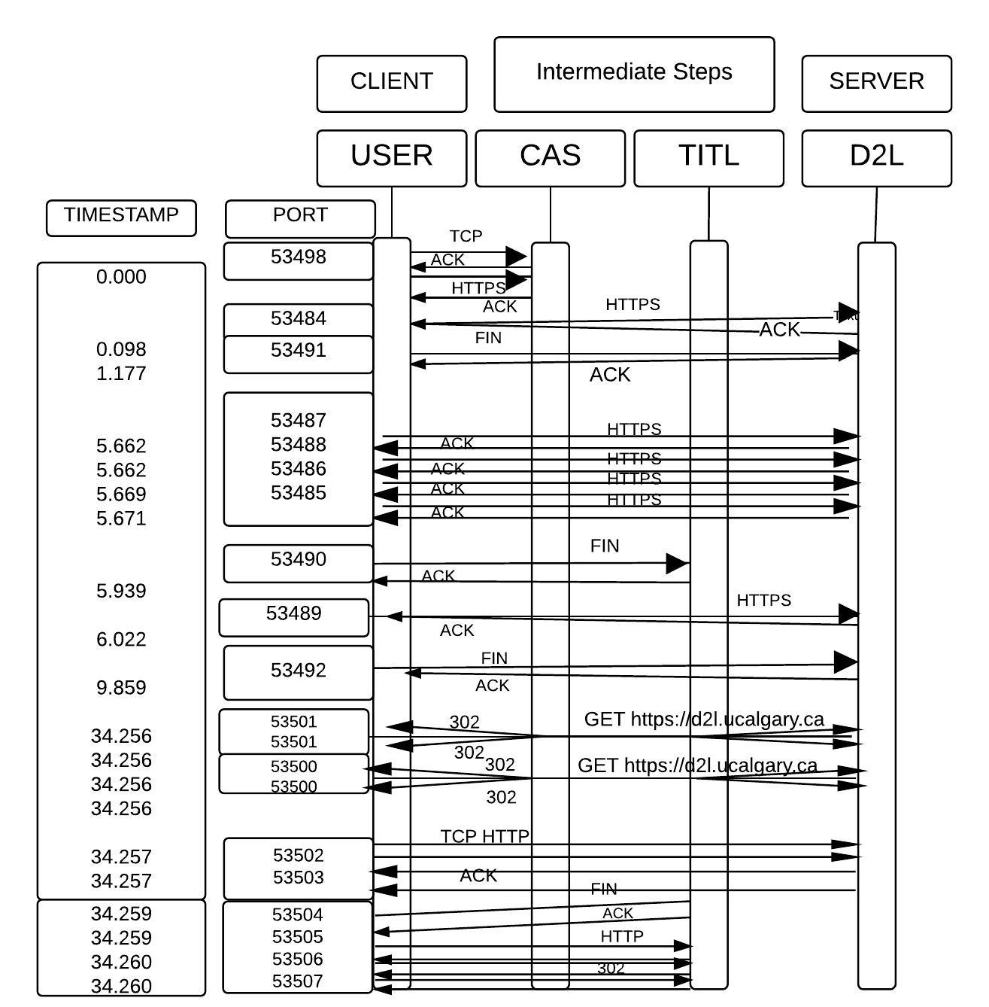
D2L Configuration at U of Calgary
File Download
Shows the role of intermediate servers
Parallel connections seen when uploading or downloading files
Persistent HTTP connections seen in D2L sessions
Typical Internet path for on-campus D2L users (including NAT, DHCP, wireless) spans 17 hops with 40 ms RTT

Slide 9
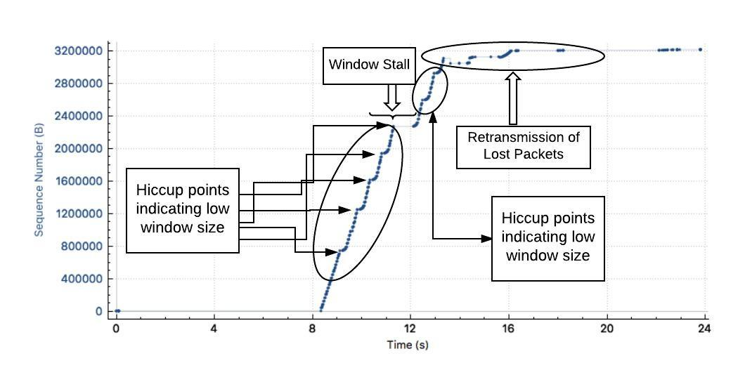
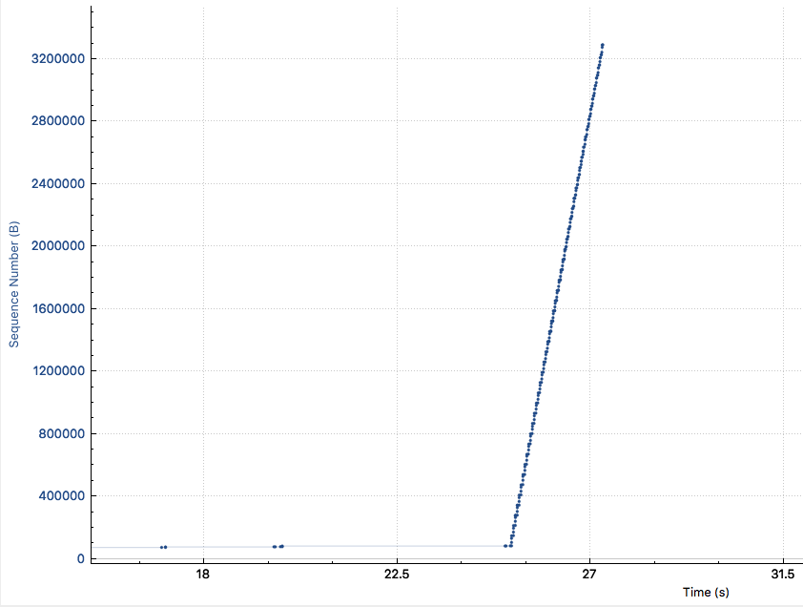
TCP Performance Issues for Downloads and Uploads
D2L File Download
D2L File Upload
Every dot represents a single packet.
D2L Browsing Steps
Download Begins
TCP Throughput: 14 Mbps
RTT Latency: 45 ms
TCP Throughput: 7 Mbps

Slide 10
Results Summary
Complex configuration of D2L setup at U of Calgary
  Excessive HTTP redirection for session login and logout
Long network RTT to remotely hosted D2L content
  Approximately 40 ms RTT to reach Kitchener, Ontario
  No local CDN node at U of C; closest node is in Toronto
Suboptimal configuration of TCP for D2L Web servers
  Uploads and downloads are window-limited (64 KB per RTT)
  D2L Web server seems very slow (IIS v7.5 on Windows 2000 R2)

Slide 11
Conclusions
Network traffic measurement can provide a better understanding of the usage of modern LMS services like D2L
D2L at the U of C has a rather complex delivery infrastructure, and several idiosyncracies that affect its user-perceived performance
Long network latencies make remotely hosted content painful!
Proposed solutions:
  Having a local CDN node could improve D2L performance
  Improving TCP configuration (version and/or socket buffer sizes) could improve throughput for D2L users

Slide 12
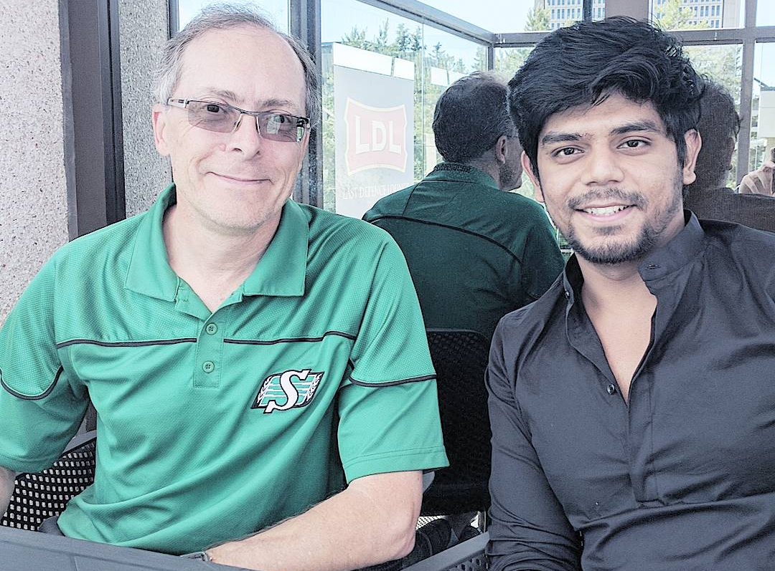
For More Information
Questions?
Email: carey@cpsc.ucalgary.ca

