Slide 1
Using Wireshark to Capture and Analyze Network Data
University of Calgary – CPSC 441

Slide 2
Wireshark
Wireshark (originally named Ethereal)is a free and open-source packet analyzer.
It is used for network troubleshooting, analysis, software and communication protocol development, and education.
It has a graphical front-end, and many more information sorting and filtering options.

Slide 3
Features and Functions
Wireshark is software that "understands" the structure of different networking protocols. Thus, it is able to display the encapsulation and the fields along with their meanings of different packets specified by different networking protocols.
Live data can be read from a number of types of network, including Ethernet, IEEE 802.11, PPP…
Data display can be refined using a display filter.

Slide 4
Installation
Download Wireshark:
http://www.wireshark.org/download.html
Choose the appropriate version according to your operating system
For Windows, during the installation, agree to install WinPcap as well.
pcap (packet capture) is an application programming interface (API) for capturing network traffic.
Unix-like systems implement pcap in the libpcap library.
Windows uses a port of libpcap known as WinPcap.
There is a good tutorial on how to capture data using WireShark:
http://wiki.wireshark.org/CaptureSetup

Slide 5
Before Capturing Data
Are you allowed to do this?
Ensure that you have permission to capture packets from the network you are connected with.
Corporate policies or applicable laws may prohibit capturing data from the network.
General Setup
Operating system must support packet capturing, e.g. capture support is enabled
You must have sufficient privileges to capture packets, e.g. root / administrator privileges
Your computer's time and time zone settings should be correct

Slide 6
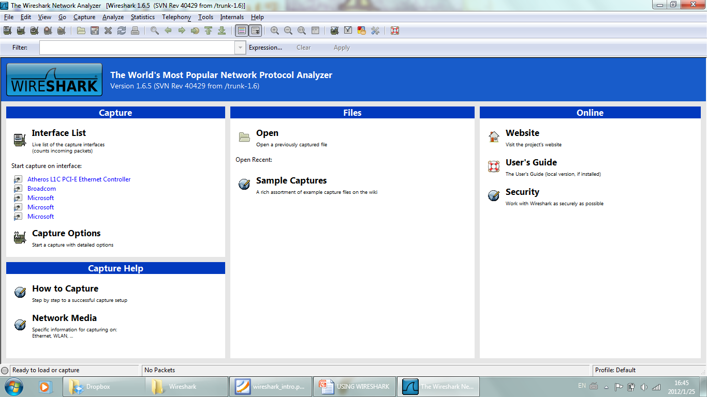
Using Wireshark
The available network interfaces are listed here.
Which interface we want to capture from?
Probably the one that has some traffic.

Slide 7
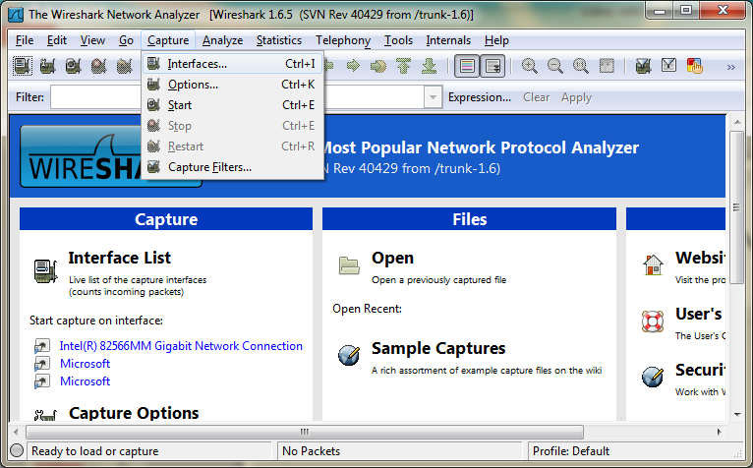
Choosing the Interface

Slide 8
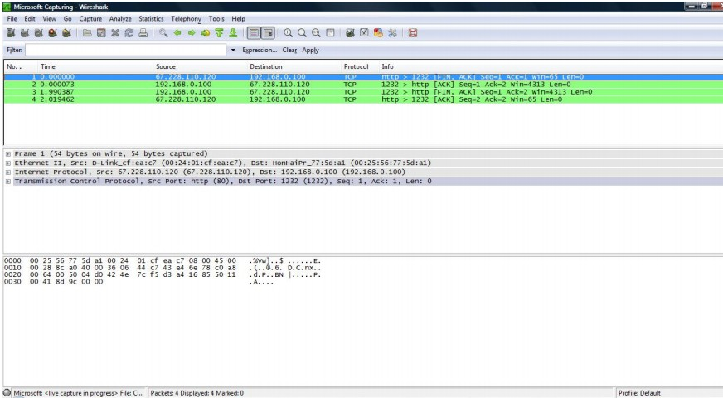
Capturing Data
Click on the specific interface you want to capture traffic from

Slide 9
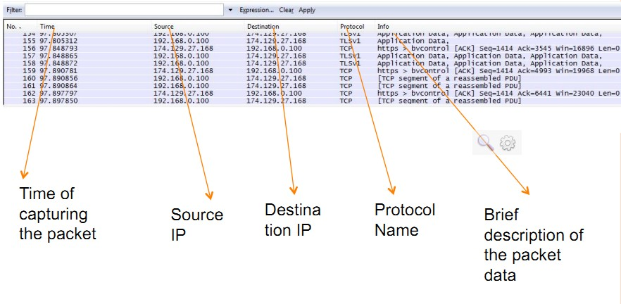
Analyzing Captured Data

Slide 10
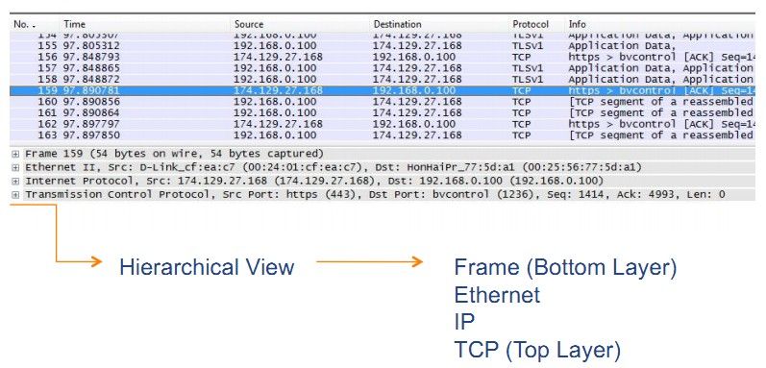
Analyzing Captured Data
Note: The hierarchical display here is upside down compared to the Internet protocol stack that you have seen in the lectures.

Slide 11
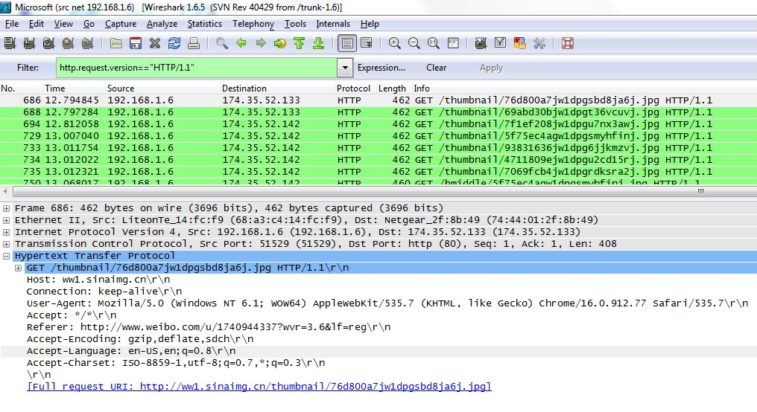
Analyzing Captured Data HTTP Header

Slide 12
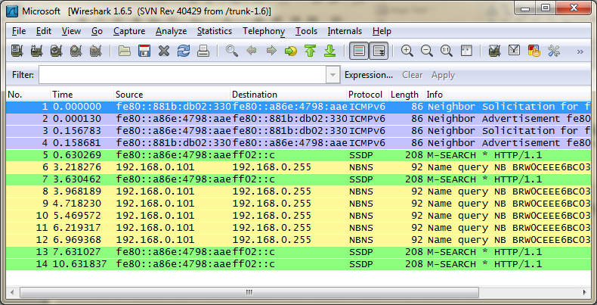
So many strange packets!
Wireshark captures everything that is sent/received on the chosen interface. You need to filter what you want.
Control
Messages
NetBIOS
Packets
Discovery
Packets

Slide 13
Wireshark Filters
Wireshark has two types of filters:
Capture Filters
A powerful capture filter engine helps remove unwanted packets from a packet trace and only retrieve the packets of interest
Display Filters
Let you compare the fields within a protocol against a specific value, compare fields against other fields, and check the existence of specified fields or protocols.

Slide 14
Capture Options

Slide 15
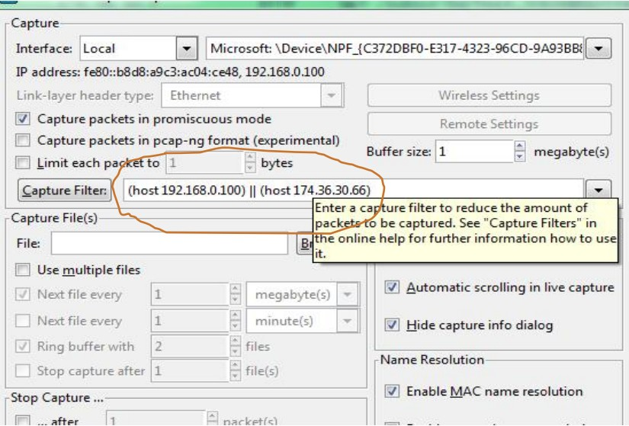
Example of a Capture Filter

Slide 16
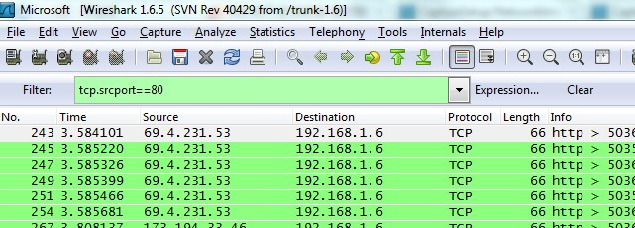
Example of a Display Filter
Display filter separates the packets to be displayed (In this case, only packets with source port 80 are displayed)

Slide 17
Filters: Comparison Operators
Fields can also be compared against values. The comparison operators can be expressed either through English-like abbreviations or through C-like symbols:
eq, == Equal
ne, != Not Equal
gt, > Greater Than
lt, < Less Than
ge, >= Greater than or Equal to
le, <= Less than or Equal to

Slide 18
Filters: Logical Expressions
Tests can be combined using logical expressions. These too are expressible in C-like syntax or with English-like abbreviations:
and, && Logical AND
or, || Logical OR
not, ! Logical NOT
Some Valid Display Filters
tcp.port == 80 and ip.src == 192.168.2.1
http and frame[100-199] contains "wireshark"

Slide 19
Filters: Slice Operator
You can take a slice of a field if the field is a text string or a byte array.
For example, you can filter the HTTP header fields.
Here the header “location” indicates that redirection happens: http.location[0:12]=="http://pages"
Another example: http.content_type[0:4] == "text"

Slide 20
Capture Filters
Syntax | Protocol | Direction | Host(s) | Logical Op. | Other Express.
Example | tcp | dst | 136.159.5.20 | and | host 136.159.5.6
Protocol
Values can be ether, fddi, ip, arp, rarp, decnet, lat, sca, moprc, mopdl, tcp and udp.
If no protocol is specified, all the protocols are used.
Direction
Values can be src, dst, src and dst, src or dst
If no source or destination is specified, the "src or dst" keywords are applied.
For example, “host 136.159.5.20” is equivalent to “src or dst host 136.159.5.20”

Slide 21
Capture Filters
Host(s)
Values can be net, port, host, portrange.
If no host(s) is specified, the "host" keyword is used.
For example, "src 136.159.5.20" is equivalent to "src host 136.159.5.20"
Logical Operations
Values can be not, and, or
Negation ("not") has highest precedence. Alternation ("or") and concatenation ("and") have equal precedence and associate left to right.
For example:
"not tcp port 3128 and tcp port 80" is equivalent to "(not tcp port 3128) and tcp port 80"

Slide 22
Capture Filters (Examples)
tcp port 80
Displays packets with tcp protocol on port 80.
ip src host 136.159.5.20
Displays packets with source IP address equals to 136.159.5.20.
host 136.159.5.1
Displays packets with source or destination IP address equals to 136.159.5.1.
src portrange 2000-2500
Displays packets with source UDP or TCP ports in the 2000-2500 range.

Slide 23
Capture Filters (Examples)
src host 136.159.5.20 and not dst host 136.159.5.1
Displays packets with source IP address equals to 136.159.5.20 and in the same time not with the destination IP address 136.159.5.1.
(src host 136.159.5.1 or src host 136.159.5.3) and tcp dst portrange 200-10000 and dst host 136.159.5.2
Displays packets with source IP address 136.159.5.1 or source address 136.159.5.3, the result is then concatenated with packets having destination TCP port range from 200 to 10000 and destination IP address136.159.5.2.

Slide 24
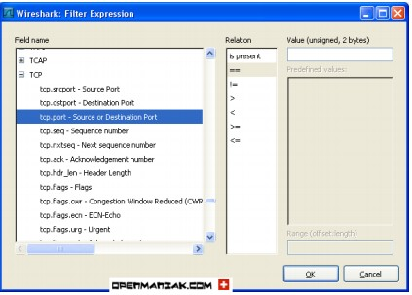
Display Filters
Syntax | Protocol | . | String 1 | . | String 2 | Comparison Operators | Value | Logical Operators | Other Expressions
Example | http | . | request | . | method | == | get | or | tcp.port == 80
String1, String2 (Optional settings): Sub protocol categories inside the protocol. To find them, look for a protocol and then click on the "+" character.

Slide 25
Display Filters (Examples)
ip.addr == 136.159.5.20
Displays the packets with source or destination IP address equals to 136.159.5.20
http.request.version=="HTTP/1.1"
Display HTTP requests with version 1.1
tcp.dstport == 25
Display TCP packets with destination port equal to 25
tcp.flags
Display packets having a TCP flag
tcp.flags.syn == 0x02
Display packets with a TCP SYN flag

