Slide 1
Transmission Media
University of Calgary – CPSC 441

Slide 2
The Physical Layer
Transfer information over a transmission medium
Converts bit streams into electrical or optical signals (and back)
The signal propagates over the transmission medium at different speeds depending on the physical characteristics of the medium.
An electromagnetic wave propagates through vacuum at a speed of c=3*10⁸ m/s and at lower speeds in other materials.

Slide 3
Quality of Transmission Media
A good transmission medium should provide communication with good quality at long distance.
For voice communication, quality of communication is determined by the voice quality.
For data communication, however, the quality of communication is mainly determined by the effective data rate of communication.

Slide 4
Classes of Transmission Media
Conducted or guided media
use a conductor such as a wire or a fiber optic cable to move the signal from sender to receiver
Wireless or unguided media
use radio waves of different frequencies and do not need a wire or cable conductor to transmit signals

Slide 5
Physical Layer Transmission Media
Transmission Media
Guided Media
Twisted Pair Cable
Coaxial Cable
Unguided Media
Radio
Fiber-Optic Cable
Microwave
Satellite

Slide 6
Design Factors
Bandwidth: All other factors remaining constant, the greater the band-width of a signal, the higher the data rate that can be achieved.
Transmission impairments: Limit the distance a signal can travel.
Interference: Competing signals in overlapping frequency bands can distort or wipe out a signal.
Number of receivers: Each attachment introduces some attenuation and distortion, limiting distance and/or data rate.

Slide 7
Guided Transmission Media
Transmission capacity depends on the distance and on whether the medium is point-to-point or multipoint
Examples
twisted pair wires
coaxial cables
optical fiber

Slide 8
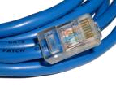
Twisted Pair
Consists of two insulated copper wires arranged in a regular spiral pattern to minimize the electromagnetic interference between adjacent pairs
Low frequency transmission medium (traditional phone wires, 10 or 100 Mbps Ethernet, enhanced Cat 5 and 6 can handle gigabit+ Ethernet)

Slide 9
Types of Twisted Pair
UTP (Unshielded Twisted Pair)
Each wire is insulated with plastic wrap, but the pair is encased in an outer covering
Category 3 UTP (16MHz Bandwidth; 10BASE-T/100BASE-T4)
Category 5 UTP (100MHz Bandwidth; 100BASE-T/1GBASE-T with Cat 5e)
More tightly twisted than Category 3 cables
Four pairs of copper wire
Category 6 UTP (250MHz Bandwidth; 10GBASE-T up to 55 meters)
STP (Shielded Twisted Pair)
The pair is wrapped with metallic foil or braid to insulate the pair from electromagnetic interference
Category 6a STP (500MHz Bandwidth; 10GBASE-T up to 100 meters)

Slide 10
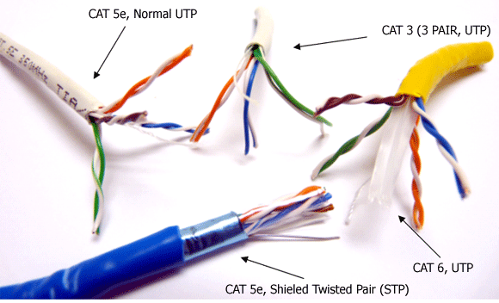
Types of Twisted Pair

Slide 11
Twisted Pair: Pros and Cons
Advantages:
Inexpensive and readily available
Flexible and light weight
Easy to work with and install
Disadvantages:
Susceptibility to interference and noise
Attenuation problem
For analog, repeaters needed every 5-6km
For digital, repeaters needed every 2-3km
Relatively low bandwidth

Slide 12
Coaxial Cable
Also known as Coax
Used for cable television, LANs, telephony
Has an inner conductor surrounded by a braided mesh
Both conductors share a common center axial, hence the term “co-axial”
outer jacket
(polyethylene)
shield (braided wire)
insulating material
copper or aluminum
conductor

Slide 13
Coaxial Cable Characteristics
Higher bandwidth
400 to 600Mhz
up to 10,800 voice conversations
Can be tapped easily
Less susceptible to interference than twisted pair
High attenuation rate makes it expensive over long distance (needs amplifiers every few km)
Notes:
One advantage of coaxial over other types of radio transmission line is that in an ideal coaxial cable the electromagnetic field carrying the signal exists only in the space between the inner and outer conductors. This allows coaxial cable runs to be installed next to metal objects such as gutters without the power losses that occur in other types of transmission lines. Coaxial cable also provides protection of the signal from external electromagnetic interference. [Wikipedia]

Slide 14
Fiber Optic Cable
Glass fiber carrying light pulses, each pulse a bit
Greater capacity
high-speed point-to-point transmission (10’s-100’s Gbps)
Smaller size and lighter weight
Lower attenuation (fewer repeaters)
Low error rate (immune to electromagnetic noise)
Hard to tap
plastic jacket
glass or plastic
cladding
fiber core

Slide 15
Fiber Optic Types
Multimode step-index fiber
The reflective walls of the fiber move the light pulses to the receiver
Multimode graded-index fiber
Acts to refract the light toward the center of the fiber by variations in the density
Single mode fiber
the light is guided down the center of an extremely narrow core

Slide 16
Wireless (Unguided Media)
Radio link types:
Common Characteristics
Terrestrial microwave
up to 45 Mbps channels
LAN (e.g., WiFi)
11 Mbps, 54 Mbps
Wide-area (e.g., cellular)
3G: ~ 1 Mbps
LTE: ~ 300 (DL), 75 (UL) Mbps
Satellite
Kbps to 45 Mbps channel (or multiple smaller channels)
270 msec end-end delay
geosynchronous versus low altitude
Signal carried in electromagnetic spectrum
No physical “wire”
Multidirectional
Propagation environment effects:
reflection
obstruction by objects
interference

Slide 17
Access Networks and Physical Media
Residential access networks
Institutional access networks (school, company)
Mobile access networks
Questions to ask:
bandwidth (bits per second) of access network?
shared or dedicated?

Slide 18
Dial-up Modem
central office
telephone
network
Internet
home
PC
home dial-up
modem
ISP modem
(e.g., AOL)
Uses existing telephony infrastructure
Home is connected to central office
up to 56Kbps direct access to router (often less)
Can’t surf and phone at same time: not “always on”

Slide 19
Digital Subscriber Line (DSL)
Existing phone line: 0-4KHz phone; 4-50KHz upstream data; 50KHz-1MHz downstream data
Internet
home
phone
DSLAM
telephone
network
splitter
DSL
modem
central
office
home
PC
Also uses existing telephone infrastructure
up to 1 Mbps upstream
up to 8 Mbps downstream
dedicated physical line to telephone central office

Slide 20
DOCSIS
Data Over Cable Service Interface Specification (DOCSIS) is an international standard for data communication via existing cable TV (CATV) systems utilizing coax cable
Build on HFC: Hybrid fiber-coaxial
Fiber optic network extends from cable operator headend to the neighborhood coaxial cable node
The coaxial cable node (and router) serves 25 – 2000 homes
Homes share access to router, unlike DSL which has dedicated access
DOCSIS 3.1 uses orthogonal frequency division multiplexing (OFDM) subcarriers with 4096 quadrature amplitude modulation (QAM) in a 200MHz baseband block
Asymmetric division of bandwidth for upstream/downstream
Up to 1 Gbit/s upstream
Up to 10 Gbit/s downstream

Slide 21
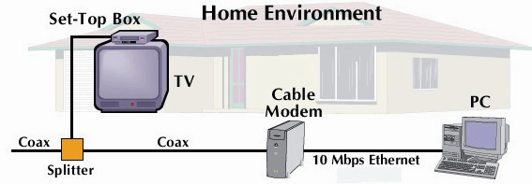
Cable Network Architecture: Overview
cable headend
cable distribution
network (simplified)
home
25-200 homes (typically 500)

Slide 22
Cable Network Architecture: Overview
FDM (more shortly):
C
O
N
T
R
O
L
V
I
D
E
O
V
I
D
E
O
V
I
D
E
O
V
I
D
E
O
V
I
D
E
O
V
I
D
E
O
D
A
T
A
D
A
T
A
1
2
3
4
5
6
7
8
9
Channels
cable headend
cable distribution
network (simplified)
home

Slide 23
Fiber to the Home
ONT
Internet
optical fibers
optical fiber
ONT
OLT
optical
splitter
central office
ONT
Optical links from central office to the home
Two competing optical technologies:
Passive Optical network (PON)
Active Optical Network (PAN)
Much higher Internet rates; fiber also carries television and phone services

Slide 24
Data Encoding Techniques
Digital Data, Analog Signals [modem]
Digital Data, Digital Signals [wired LAN]
Analog Data, Digital Signals [codec]
Frequency Division Multiplexing (FDM)
Wave Division Multiplexing (WDM) [fiber]
Time Division Multiplexing (TDM)
Pulse Code Modulation (PCM) [T1]
(digital transmission systems developed by Bell Labs)
Delta Modulation

Slide 25
Digital Data, Digital Signals [the technique used in a number of LANs]
Digital signal – is a sequence of discrete, discontinuous voltage pulses.
Bit duration : the time it takes for the transmitter to emit the bit.
Issues
Bit timing
Recovery from signal
Noise immunity

Slide 26
Binary Encoding
NRZ (non-return to zero)
NRZI (NRZ inverted)
Manchester (used by IEEE 802.3, 10 Mbps Ethernet)

Slide 27
Non-Return to Zero (NRZ)
Encode binary data onto signals
e.g., 0 as low signal and 1 as high signal
voltage does not return to zero between bits
known as Non-Return to Zero (NRZ)
Bits
0
0
1
0
1
1
1
1
0
1
0
0
0
0
1
0
NRZ

Slide 28
Problem: Consecutive 1s or 0s
Low signal (0) may be interpreted as no signal
High signal (1) leads to baseline wander
Unable to recover clock
sender’s and receiver’s clock have to be precisely synchronized
receiver resynchronizes on each signal transition
clock drift in long periods without transition
sender’s clock
receiver’s clock

Slide 29
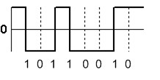
NRZI
Non-Return to Zero Inverted (NRZI)
Has a transition at a clock boundary if the bit being transmitted is “1”
Stay at current signal (maintain voltage level) to encode/ transmit a “zero”
Solves the problem of consecutive ones (shifts to 0s)
NRZI can have long series of zeros , still unable to recover clock

Slide 30
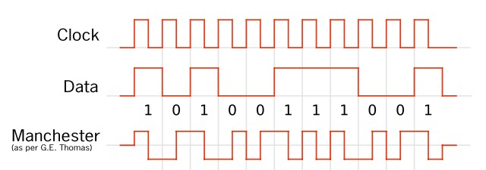
Manchester
Manchester (in IEEE 802.3 – 10 Mbps Ethernet)
Split cycle into two parts
Send high--low for “1”, low--high for “0”
Transmit XOR of NRZ encoded data and the clock
Clock signal can be recovered from the encoded data.
Only 50% efficient (1/2 bit per transition): double the transmission rate.

Slide 31
Different Encoding Schemes
Bits
0
0
1
0
1
1
1
1
0
1
0
0
0
0
1
0
NRZ
Clock
Manchester
NRZI

Slide 32
References
CPSC 441 Chapter 1 Slides 16-28
http://en.wikipedia.org/wiki/File:NRZI_example.png
CS716 Advanced Computer Networks by Dr. Amir Qayyum
zlin.ba.ttu.edu/doc/ws7.ppt

