Slide 1
Introduction to C
University of Calgary – CPSC 441

Slide 2
C verses Java
C Program
Java program
Collection of functions
One function “main()” is called by the operating system as the starting function
Compile output: executable file. Running the executable (default name a.out) starts main function
Typically, single program with all user code linked in – but can be dynamic libraries (.dll, .so)
Collection of classes
Class containing main method is starting class
Compile output: jar file. Running “java StartClass” invokes StartClass.main method
JVM loads other classes as required
C++ is C extended with object oriented functionality (and more!)

Slide 3
Simple C/C++ Example
// C
#include <stdio.h>
int main(int argc, char *argv[]))
{
printf("Hello world!\n");
return 0;
}
// C++
#include <iostream>
using namespace std;
int main(int argc, char *argv[])
{
cout << "Hello world!" << endl;
return 0;
}

Slide 4
Compiling C/C++
gcc is a driver which calls the preprocessor, compiler (cc1 or cc1plus), assembler, and linker as needed
$ gcc hello.c
$ a.out
Hello, World!
$ gcc hello.c –o hello
$ ./hello
Hello, World!

Slide 5
Compiler Options
Some useful command line options:
[-o file]: specifies the output file for object or executable
[-Wall]: show all warnings (highly recommended)
[-l libnam]: Links the library libname e.g., -lsocket
If you get errors saying the library cannot be found, make sure the path is correctly set, and you do have the libraries you need.

Slide 6
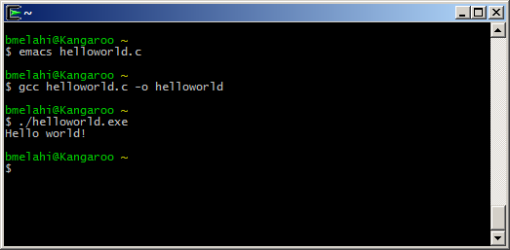
Hands On
Demo
Write code
Compile
Run

Slide 7
Main Arguments
int main(int argc, char *argv[])
argc: number of arguments passed to the program
argv: array of strings showing command line arguments
Name of executable + space-separated arguments
Name of executable is stored in argv[0]
The return value is int
convention: 0 means success, > 0 some error

Slide 8
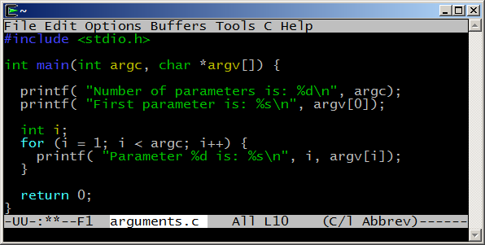
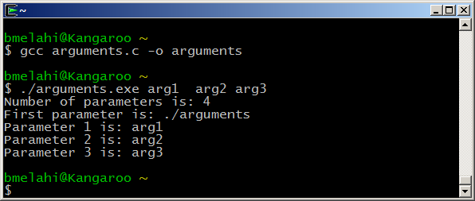
Passing Arguments Example

Slide 9
Primitive Data Types
Name | Description | Size (Bytes) | Range
char | Character or small integer. | Typically 1 | signed: -128 to 127 unsigned: 0 to 255
short int (short) | Short Integer. | >=2 | signed: -32768 to 32767 unsigned: 0 to 65535
int | Integer. Most efficient. | >=2; Typically 4 | signed: -2147483648 to 2147483647 unsigned: 0 to 4294967295
long int (long) | Long integer. | >=4 | signed: -2147483648 to 2147483647 unsigned: 0 to 4294967295
long long int | long long integer. | >=8 | signed: -9.2e18 to 9.2e18 unsigned: -1.8e19 to 1.8e19
float | Floating point number. | 4 | +/- 3.4e +/- 38 (~7 digits)
double | Double precision floating point number. | 8 | +/- 1.8e +/- 308 (~15 digits)
long double | Long double precision floating point number. | >=8; Typically 16 | +/- 1.2e +/- 4932 (~34 digits)

Slide 10
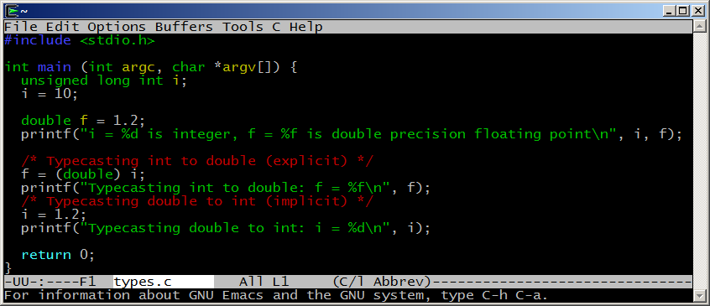
Typecasting Example

Slide 11
Arrays
Array declaration (on the stack): int a[];
C/C++ arrays have no length attribute!
Note: when passing an array to a function, typically you have to pass the array size as a separate argument as well.
You have to take care of array bounds yourself
This code could compile and run, but most likely, you’ll see unexpected behavior or crash your program.
Array’s name is a pointer to its first element
int input[10];
input[10] = 20; // out of bound!
input[-1] = 5; // out of bound!

Slide 12
Structures
C struct is a way to logically group related types
Is very similar to (but not same as) C++/java classes
Is somehow a class without methods
Members are always public (no encapsulation concept in c)
A struct component can be of any type (including other struct types), but cannot be recursive, unless it is a pointer to itself
struct address {
char* street;
char* city;
char* zip;
};
typedef struct {
char* name;
unsigned int ID;
struct address Address;
} student_item;
struct link_list {
student_item student_info;
struct link_list *next;
};
typedef struct link_list student;
Notes:
In C, there are two different namespaces of types: a namespace of struct/union/enum tag names and a namespace of typedef names. In C++, all struct/union/enum/class declarations act like they are implicitly typedef'ed, as long as the name is not hidden by another declaration with the same name.

Slide 13
Pointers
A pointer is just an address to some memory location.
Another variable
Some dynamically allocated memory
Some function
NULL
int *p = &x;
int x = 4;
&x (address of x)
4
int *p = malloc (sizeof int);
Address of allocated
memory
?
allocated
memory
Notes:
Reference Operator: &
Dereference Operator: *

Slide 14
Pointers in C
Declaration: using “*” symbol before variable name.
int * ptr = NULL; //creates pointer for integer
Allocation: allocate new memory to a pointer using the keyword malloc in C (new in C++)
int *p = malloc(sizeof(int));
int *p = (int *) malloc(10 * sizeof (int)); // array of int
Deallocation: clear the allocated memory when you are done using it. Otherwise, you have memory leak!!!
free(p);
Dereferencing: accessing data from the pointer
x = *p;
Referencing: getting the memory location for the data
p = &x;
Notes:
Reference Operator: &
Dereference Operator: *

Slide 15
Strings
In C, a string is an array of char terminated with “\0” (a null terminator: ‘\0’)
“hello” is hello\0
Declaring and initializing a string:
// strings in stack space
char str1[10]; // a string of 10 characters
char str2[10] = {"hello"}; // initialized string
char *strp1; // a char pointer
// string in heap space
// a char pointer initialized to point to a chunk of memory.
char *strp2 = malloc(sizeof(char)*10);

Slide 16
String Library
#include <string.h>
Functions:
char *strcpy(char *dest, char *source)
copies chars from source array into dest array up to NULL
char *strncpy(char *dest, char *source, int num)
copies chars; stops after num chars if no NULL before that; appends NULL
int strlen(const char *source)
returns number of chars, excluding NULL
char *strchr(const char *source, const char ch)
returns pointer to first occurrence of ch in source; NULL if none
char *strstr(const char *source, const char *search)
return pointer to first occurrence of search in source

Slide 17
Formatting Strings
int sscanf(char *string, char *format, ...)
parse the contents of string according to format
return the number of successful conversions
int sprintf(char *buffer, char *format, ...)
produce a string formatted according to format directives and place this string into the buffer
return number of successful conversions

Slide 18
Formatting Codes for sscanf
Code | Meaning | Variable
%c | Matches a single character | char
%d | Matches an integer in decimal | int
%f | Matches a real number | float
%s | Matches a string up to a white space | char *
%[^c] | Matches a string up to next c char | char *
For many more formatting options, refer to: http://www.cplusplus.com/reference/cstdio/scanf/

Slide 19
Formatting Codes for sprintf
Values normally right-justified; use negative field width to get left-justified
Code | Meaning | Variable
%nc | Char in field of n spaces | char
%nd | Integer in field of n spaces | int
%n.mf | Real number in width n.m decimals | float, double
%n.ms | First m chars from string in width n | char *
%% | Writes a single % to the stream
For many more formatting options, refer to: http://www.cplusplus.com/reference/cstdio/printf/

Slide 20
Standard C Library
#include <stdio.h>
Formatted I/O
int scanf(const char *format, ...)
read from standard input and store according to format.
int printf(const char *format, ...)
write to standard output according to format
File I/O: FILE *
FILE *fopen(const char *path, const char *mode)
open a file and return the file descriptor
int fclose(FILE *stream)
close the file; return 0 if successful, EOF if not

Slide 21
Standard C Library
#include <stdio.h>
Other I/O operations:
int getchar()
read the next character from stdin; returns EOF if none
char *fgets(char *buf, int size, FILE *in)
read the next line from a file into buf
int fputs(const char *str, FILE *out)
output the string to a file, stopping at ‘\0’
returns number of characters written or EOF

Slide 22
Code Sample
Sample C program:
Input: list of grades of student homework
Output: The computed final marks

Slide 23
References
C for Java programmers:
http://faculty.ksu.edu.sa/jebari_chaker/papers/C_for_Java_Programmers.pdf http://www.cs.columbia.edu/~hgs/teaching/ap/slides/CforJavaProgrammers.ppt
C tutorial:
http://www.cprogramming.com/tutorial/c-tutorial.html
Socket programming with C: (for next session)
Beej's Guide to Network Programming Using Internet Sockets http://beej.us/guide/bgnet/output/html/multipage/index.html

