Slide 1
The Internet Protocol
University of Calgary – CPSC 441

Slide 2
The Network Layer
IP (Internet Protocol) is a Network Layer Protocol.
RFC 791 provides the specification for IP.
application
transport
network
data link
physical
application
transport
network
data link
physical
1. Send data
2. Receive data
Network Layer

Slide 3
IP: The Waist of the Hourglass
IP is the waist of the hourglass of the Internet protocol stack.
Multiple higher-layer protocols
Multiple lower-layer protocols
One common protocol at the network layer for data transmission.

Slide 4
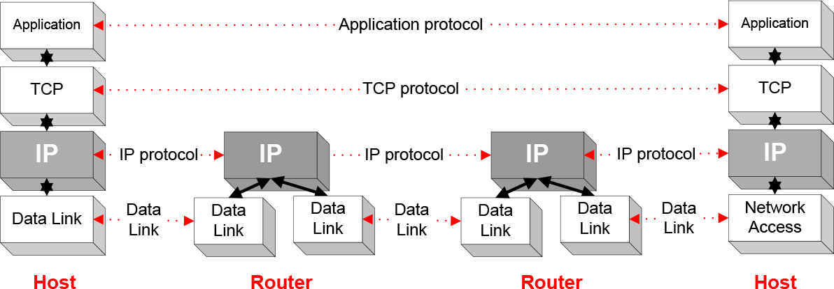
Routers
IP is the highest layer protocol which is implemented at both routers and hosts

Slide 5
Best Effort Protocol
IP provides an unreliable, connectionless, best effort service (also called: “datagram service”).
  Unreliable: no guarantee for delivery of packets
  Connectionless: Each packet (“datagram”) is handled independently. IP is not aware that packets between hosts may be sent in a logical sequence
  Best effort: IP does not make guarantees on the service (no throughput guarantee, no delay guarantee, etc.)
Consequences: Higher layer protocols have to take care of delivery guarantees.

Slide 6
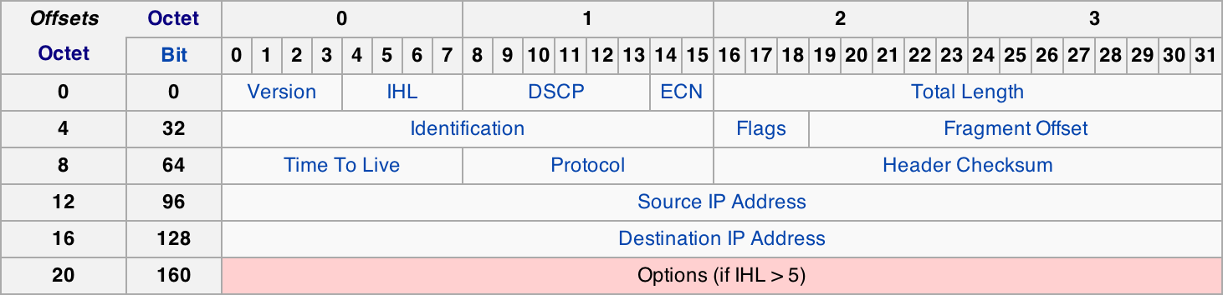
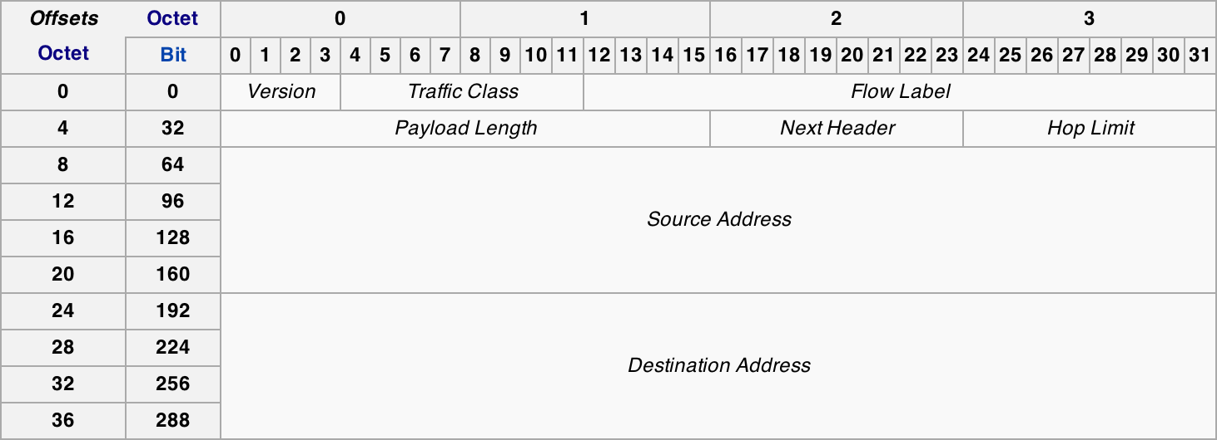
IPv4 & IPv6 Datagram

Slide 7
IP Versions
The first publicly used version of the Internet Protocol was version 4 (IPv4)
  Address space: 32 bits (~4.3 billion addresses)
  Initially it was thought to be enough!
Address exhaustion
  On February 3, 2011, the Internet Assigned Numbers Authority (IANA) officially depleted the global pool of completely fresh blocks of addresses.
  Address exhaustion was a concern as early as the 1990s.
IPv6 is the next generation IP that tries to address the shortcomings of IPv4
  Address space: 128 bits (~79 octillion times more than IPv4)
  Designed to live alongside IPv4

Slide 8
What About Version 5?
It does not exist. It is in fact intentionally skipped to avoid confusion, or at least to rectify it.
  IP version 5 relates to an experimental TCP/IP protocol called the Internet Stream Protocol, Version 2, originally defined in RFC 1190.
  This protocol was originally seen by some as being a peer of IP at the Internet Layer in the TCP/IP architecture, and in its standard, these packets were assigned IP version 5 to differentiate them from “normal” IP packets (version 4).
  This protocol apparently never went anywhere, but to be absolutely sure that there would be no confusion, version 5 was skipped over in favor of version 6.

Slide 9
A Bit of History
“The decision to put a 32-bit address space on there was the result of a year's battle among a bunch of engineers who couldn't make up their minds about 32, 128, or variable-length. And after a year of fighting, I said--I'm now at ARPA, I'm running the program, I'm paying for this stuff, I'm using American tax dollars, and I wanted some progress because we didn't know if this was going to work. So I said: OK, it's 32-bits. That's enough for an experiment; it's 4.3 billion terminations. Even the Defense Department doesn't need 4.3 billion of everything and couldn't afford to buy 4.3 billion edge devices to do a test anyway. So at the time I thought we were doing an experiment to prove the technology and that if it worked we'd have opportunity to do a production version of it. Well, it just escaped! It got out and people started to use it, and then it became a commercial thing. So this [IPv6] is the production attempt at making the network scalable.”
- Vint Cerf, one of the “fathers of the Internet”
From: Google IPv6 Conference 2008

Slide 10
IPv4 Datagram Fields
Version (4 bits): For IPv4, this has a value of 4 (hence the name IPv4)
Internet Header Length (4 bits):
  Number in 32-bit words (4 bits) of the header
  This can also be interpreted as the payload offset
  IP header can have a variable number of options
  The minimum value for this field is 5 (RFC 791) or 20 bytes; the maximum length is 15 words = 60 bytes
Differentiated Services Code Point (6 bits): Recently redefined by RFC 2474 for Differentiated services (DiffServ). Used for real-time data streaming like VoIP.

Slide 11
IPv4 Datagram Fields
Explicit Congestion Notification (2 bits): An optional feature that is defined by RFC 3168 for notification of network congestion without dropping packets.
  Both endpoints must support it and be willing to use it
  Only effective when supported by the underlying network
Total Length (16 bits): The entire IP datagram size, including the header and payload.
  Minimum-length is 20 bytes (minimal header with no payload)

Slide 12
IPv4 Datagram Fields
Identification (16 bits): Used primarily for uniquely identifying the group of fragments of a single IP datagram
  Unique identification of a datagram from a host.
  Incremented whenever a datagram is transmitted
Flags (3 bits): Bit field used to control or identify fragments
  Bit 0: Reserved; must be zero
  Bit 1: Don’t fragment (DF)
    If set, packets are dropped if they need to be fragmented
  Bit 2: More fragments (MF)
    Zero for non-fragmented packets; for fragmented packets, all but the last packet has this flag set; the last packet will have a non-zero “Fragment Offset” field

Slide 13
IPv4 Datagram Fields
Fragment Offset (13 bits): Measured in units of 64-bit words (8 byte)
Time To Live (8 bits): Limits a datagram’s lifetime to break routing circles
  Specified in seconds but in practice is used as a hop count (decrement by 1 at each router) and set to 64 at the start
  When TTL is zero, the router should discard the packet; typically an ICMP Time Exceeded message is sent to the sender
Notes:
Fragment offset is in units of 8 bytes to make up for 3 bits less compared to Total Length.
The program traceroute uses these ICMP Time Exceeded messages to print the routers used by packets to go from the source to the destination.

Slide 14
IPv4 Datagram Fields
Protocol (8 bits): Defines the protocol used in the payload
  There are over 140 protocols defined (TCP is 0x06; UDP is 0x11)
Header Checksum: the 16-bit one's complement of the one's complement sum of all 16-bit words in the header.
  For computing the checksum, the value of the checksum field is zero.
Options: not often used
  Used to control fragmenting, routing, debugging, security, etc.
  Must be padded so that the header is divisible by 32 bits (4 bytes)

Slide 15
Maximum Transmission Unit
Maximum size of IP datagram is 65535, but the data link layer protocol generally imposes a limit that is much smaller
Ethernet frames have a maximum payload of 1500 bytes
  IP datagrams encapsulated in Ethernet frame cannot be longer than 1500 bytes
The limit on the maximum IP datagram size, imposed by the data link protocol is called maximum transmission unit (MTU)
MTUs for various data link protocols:
Ethernet: 1500 FDDI: 4352
802.3: 1492 ATM AAL5: 9180
802.5: 4464 802.11(WLAN): 2272

Slide 16
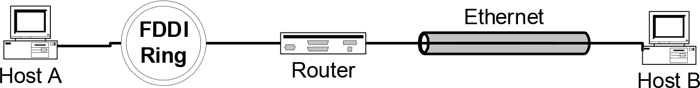
IP Fragmentation
What if the size of an IP datagram exceeds the MTU?
  IP datagram is fragmented into smaller units
What if the route contains networks with different MTUs?
MTUs: FDDI: 4352 Ethernet: 1500
Fragmentation:
  IP router splits the datagram into several datagram
  Fragments are reassembled at receiver

Slide 17
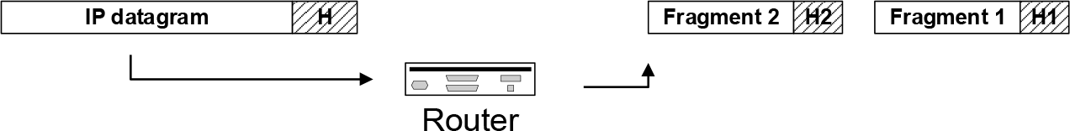
Fragmentation / Reassembly
Fragmentation can be done at the sender or at intermediate routers
The same datagram can be fragmented several times.
Reassembly of original datagram is only done at destination hosts !!

Slide 18
Example of Fragmentation
A datagram of 4000 bytes from a network with MTU 4000 to 1500
length
=4000
ID
=x
fragflag
=0
offset
=0
One large datagram becomes
several smaller datagrams
length
=1500
ID
=x
fragflag
=1
offset
=0
length
=1500
ID
=x
fragflag
=1
offset
=1480
length
=1040
ID
=x
fragflag
=0
offset
=2960

Slide 19
IPv6 Datagram Fields
Version (4 bits): For IPv6, this has a value of 6 (0110)
Traffic Class (8 bits): The same as the redefined IPv4 fields:
  The first 6 bits are differentiated services for real-time data streaming
  The last 2 bits are for ECN (Explicit Congestion Notification).

Slide 20
IPv6 Datagram Fields
Flow Label (20 bits): Originally created for giving real-time applications special service.
  When set to a non-zero value, it serves as a hint to routers and switches with multiple outbound paths that these packets should stay on the same path so that they will not be reordered.
  It has further been suggested that the flow label be used to help detect spoofed packets.

Slide 21
IPv6 Datagram Fields
Payload Length (16 bits): The size of the payload in octets, including any extension headers.
  This is different from IPv4 as it does not include the fixed IPv6 header
  The length is set to zero when a Hop-by-Hop extension header carries a Jumbo Payload option
  A Jumbo Payload has a 32 bit length in the Hop-By-Hop Options extension header allowing packets up to 4GB in size!
Next Header (8 bits): The same as the IPv4 Protocol field
  The extension headers are described here as protocols

Slide 22
IPv6 Datagram Fields
Hop Limit (8 bits): Replaces the time to live field of IPv4
  This value is decremented by one at each intermediate node visited by the packet.
  When the counter reaches 0 the packet is discarded.
Fragmented Packets
  Notice there is no fragmentation fields, so routers cannot fragment IPv6 packets as they do for IPv4.
  Hosts may use the fragmentation extension to send packets larger than an MTU
IPv6 also does not have a checksum field

Slide 23
Resources
Slides from the book: “Mastering Computer Networks: An Internet Lab Manual”, J. Liebeherr, M. El Zarki, Addison-Wesley, 2003.
Slides from the book: “Computer Networking: A Top Down Approach”, 5th edition. Jim Kurose, Keith Ross Addison-Wesley, 2009.
RFC 791: http://tools.ietf.org/pdf/rfc791.pdf
Wikipedia
  http://en.wikipedia.org/wiki/IPv4
  http://en.wikipedia.org/wiki/IPv6
  http://en.wikipedia.org/wiki/IPv6_packet

