Slide 1
Ethernet LANs
University of Calgary – CPSC 441

Slide 2
Introduction of Ethernet
Ethernet, defined under IEEE 802.3, is one of today's most widely used data communications standards
It finds its major use in Local Area Networks (LAN)
It has largely replaced competing wired LAN technologies
Founded by Xerox Palo Alto Research Center in 1975
Originally designed as a 2.94 Mbps system to connect 100 computers on a 1 km cable
Later, Xerox, Intel and DEC drew up a standard to support 10 Mbps, which was later basis for the IEEE’s 802.3 specification

Slide 3
The ETHER-net
An original drawing describing Ethernet by Bob Metcalfe
A more detailed drawing: http://www.digibarn.com/collections/diagrams/ethernet-original/composit-ethernet-sketch.jpg

Slide 4
Two Main Elements of Ethernet
The network nodes: The points to and from which the communication takes place.
Data Terminal Equipment: devices such as PCs, file servers, print servers.
Data Communications Equipment: devices that receive and forward the data frames across the network, e.g., repeaters, switches, routers.
Interconnecting media: The cable that connects the network nodes, the type determines the speed at which the data may be transmitted.
Coaxial Cable, Twisted Pair Cables, Fiber Optic Cables
Notes:
Interconnecting media: cable determine the speed at which the data may be transmitted.
Coaxial cable, twisted Pair Cables
Fibre optic cable: it provides very high immunity to pickup and radiation as well as allowing very high data rates to be communicated.

Slide 5
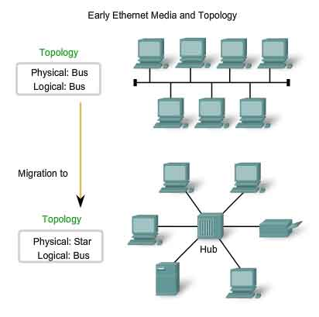
Ethernet network topologies
Point to point: This is the simplest configuration as only two network hosts are used.
Coaxial bus: Broadcast LAN - all transmitted frames travel to and are processed by all adapters connected to bus.
Hub-based star network: Also broadcast LAN – hosts are directly connected to a hub with twisted-pair copper wire. Hub sends a copy out on all of its other interfaces.
Switch-based star network: Hub is replaced by switch, which sends a copy to the target host.
Notes:
Hub: a physical-layer device that acts on individual bits rather than frames. When a bit arrives from one interface, the hub simply re-creates the bit, boost its energy strength, and transmit the bit onto all other interface
Hub-based star network: Hub sends a copy out on all of its other interfaces for whatever it receives.

Slide 6
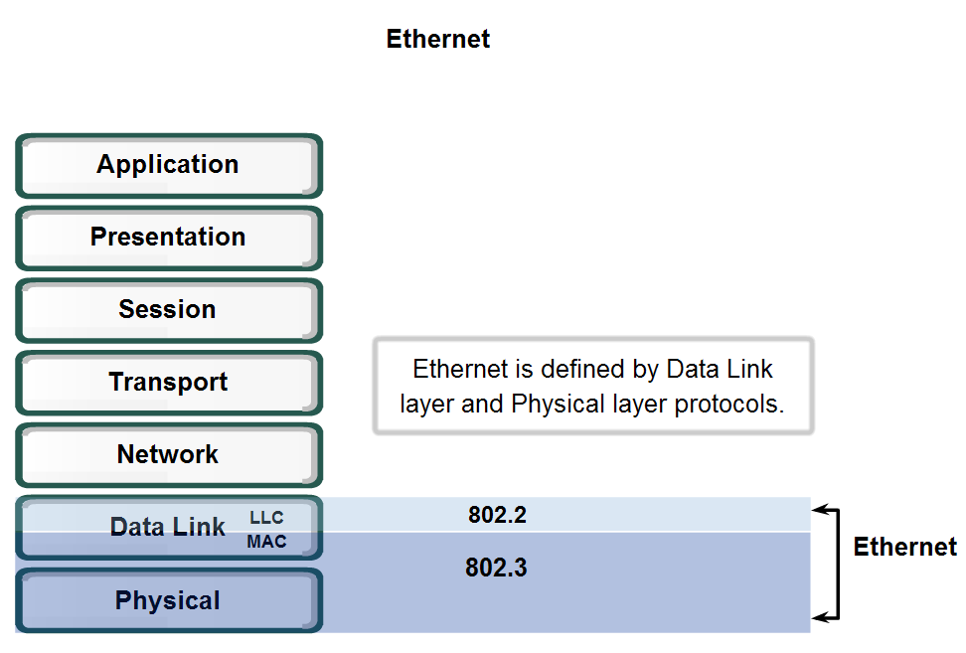
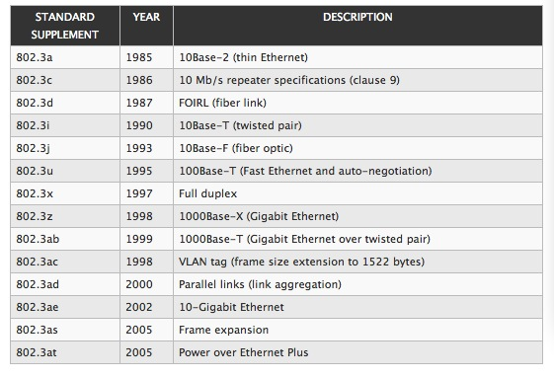
Ethernet IEEE 802.3 Standards
802.3 standard defines both MAC and physical layer details

Slide 7
Ethernet IEEE 802.3 Standards
Ethernet Naming: three parts, e.g.,
Example:10Base-T and 100Base-T
The first number (typically one of 10, 100, or 1000) indicates the transmission speed in megabits per second.
The second term indicates transmission type:
BASE = baseband
BROAD = broadband.
The final part refers to the physical media itself
T: means unshielded twisted-pair cables. Further numbers indicate the number of twisted pairs available. For example in 100BASE-T4, the T4 indicates four twisted pairs.

Slide 8
Fast Ethernet
100BaseT Ethernet (Fast Ethernet) is defined under the 802.3 family of standards under 802.3u.
One of the most widely used forms of Ethernet.
All the nodes within the network share the 100 Mbps bandwidth.
It uses the CSMA/CD access method, but there are some minor differences in the way the overall system operates.
It runs on UTP or optical fiber cable and uses a star topology.

Slide 9
MAC Addresses
Media Access Control Address:
A unique identifier assigned to network interfaces
Assigned by the manufacturer, stored in the hardware
Usually permanent, no duplication
6-byte address expressed in 12-digit hexadecimal numbers
The first 24 bits identify the manufacturer
The second half of the address is known as the extension of board ID.
e.g., broadcast address FF-FF-FF-FF-FF-FF
Link-layer addressing scheme, used as a network address for most IEEE 802 network technologies, including Ethernet.
Mac address is analogous to a person’s SIN number, while IP address is analogous to postal address.

Slide 10
Ethernet IEEE 802.3 Frame Format / Structure
Frame structures are developed within the MAC layer of the protocol stack.
10 / 100 Mbps Ethernet MAC data frame format
Header
Preamble (PRE) - informs the receiving stations that a frame is starting as well as enabling synchronization.
Start Of Frame delimiter (SOF)
Destination Address (DA) – first bit: 0-an individual address, 1-a group address. The next bit into the DA indicates whether the address is globally administered (0), or local(1). 46 remaining bits-destination address.
Source Address (SA) - always an individual address the left most bit is always a zero
Length / Type - It provides MAC information and indicates the number of client data types that are contained in the data field of the frame.
Payload: Data - minimum of 46 bytes, up to 1500 bytes long
Trailer: Frame Check Sequence (FCS) - This field is four bytes long. It contains a 32 bit Cyclic Redundancy Check (CRC).

Slide 11
Ethernet IEEE 802.3 Frame Format / Structure
1000 Mbps Ethernet MAC data frame format
Extension: When using the 1000Base-X standard, there is a minimum frame size of 416bytes, and for 1000Base-T there is a minimum frame size of 520bytes.

Slide 12
Ethernet Media Access Control Method
Ethernet uses CSMA/CD:
Carrier Sense Multiple Access / Collision Detection
Carrier Sense: each station listens on the network for traffic and it can detect when the network is quiet.
Multiple Access: the stations are able to determine for themselves whether they should transmit.
Collision Detect:
it is still possible that two
stations will start to transmit
at virtually the same time.
If this occurs then the stations
detect collision and will
stop transmitting. They then
back off a random amount of
time before attempting a
retransmission.

Slide 13
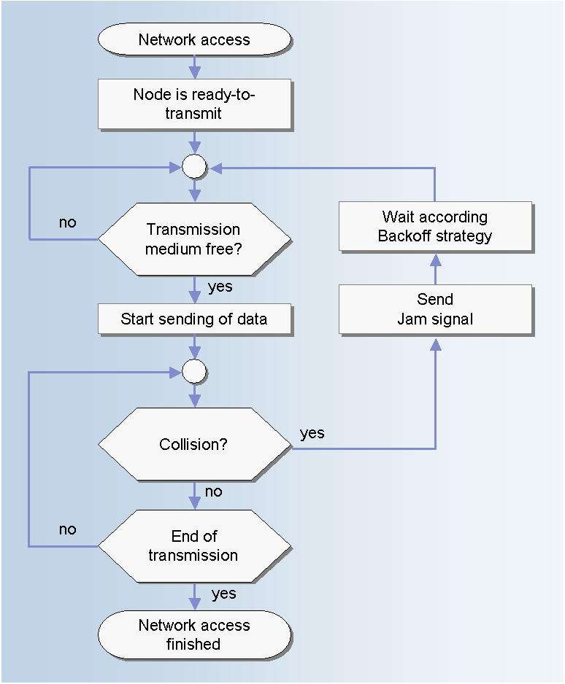
CSMA/CD Algorithm

Slide 14
Gigabit Ethernet
The next development of the Ethernet standard beyond the popular 100Base-T version.
Provides for half and full duplex operation at speeds of 1000 Mbps.
It is particularly easy to install because the 1000Base-T variant is designed to run over Cat 5 UTP (unshielded twisted pair) that is widely and cheaply available.
Uses the 802.3 Ethernet frame formats.
Uses the CSMA/CD access method with support for one repeater per collision domain.
Provides backward compatibility with 10BASE-T and 100BASE-T technologies.

Slide 15
Gigabit Ethernet
Provide for half and full duplex operation at speeds of 1000 Mbps.
Use the 802.3 Ethernet frame formats.
Use the CSMA/CD access method with support for one repeater per collision domain.
Provide backward compatibility with 10BASE-T and 100BASE-T technologies.

Slide 16
Reference
http://www.radio-electronics.com/info/telecommunications_networks/ethernet/100-mbps-ieee-802-3u-base-t.php
http://www.fujitsu.com/downloads/TEL/fnc/pdfservices/ethernet-prerequisite.pdf
http://www.eie.polyu.edu.hk/~em/it0607pdf/7%20Ethernet.ppt

