Slide 1
TCP SeqNum Plots: Examples
Department of Computer Science
CPSC 441
Carey Williamson

Slide 2
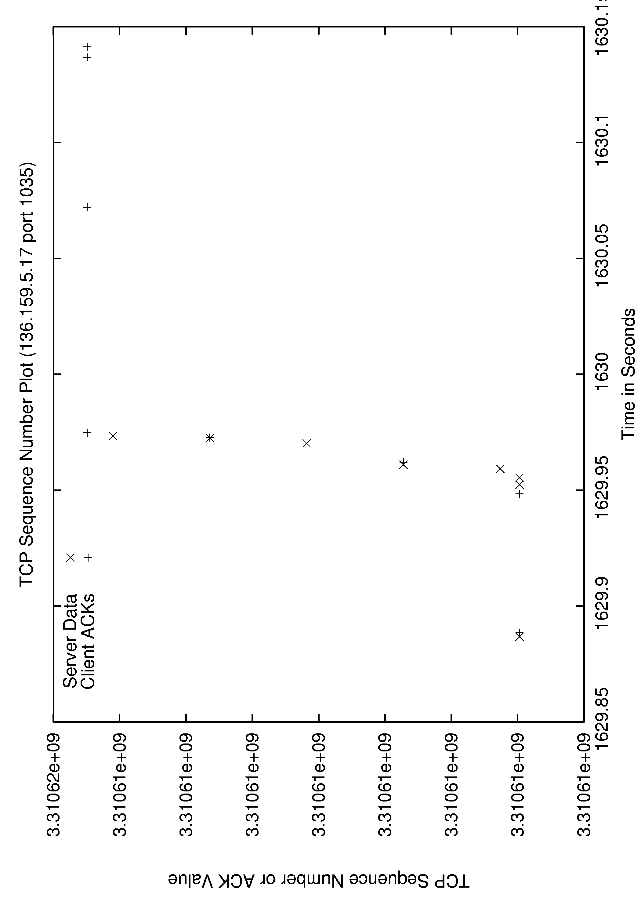
Example 1: Port 1035

Slide 3
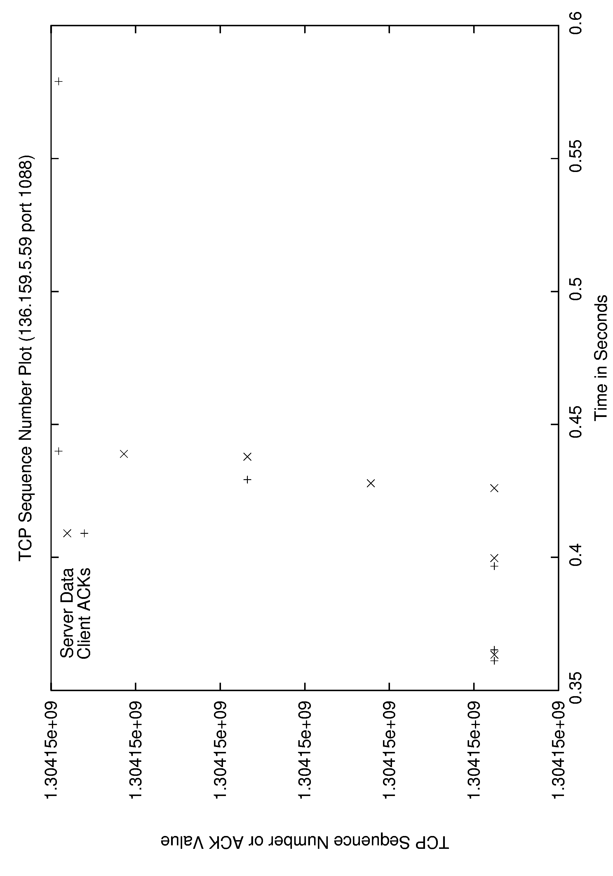
Example 2: Port 1088

Slide 4
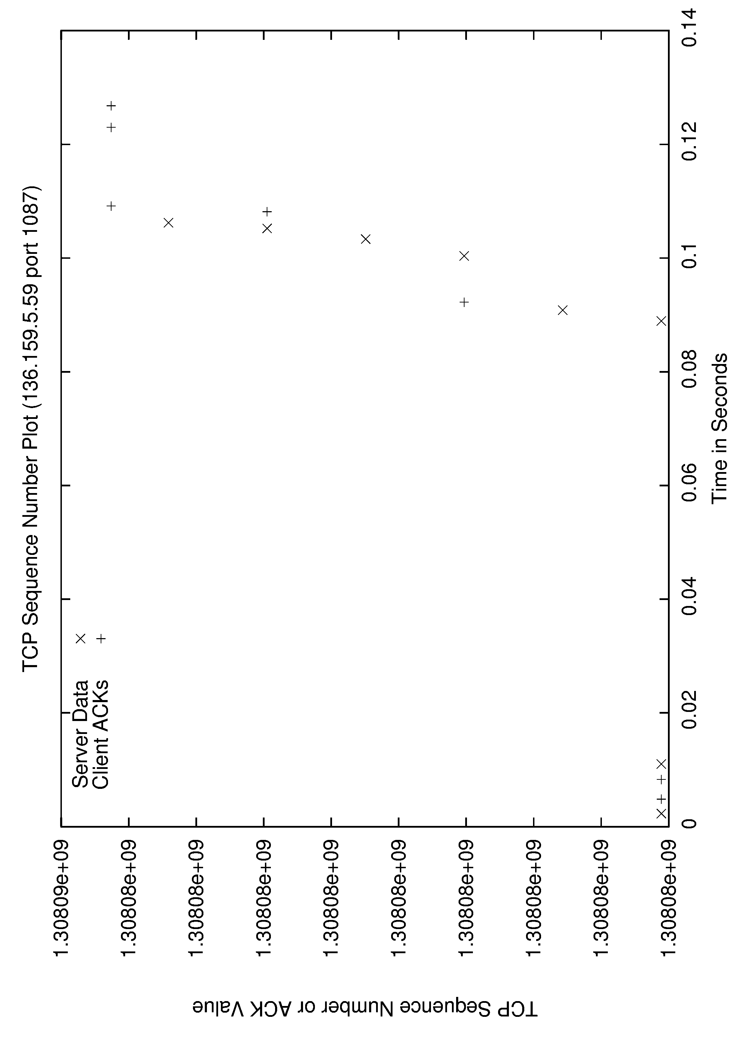
Example 3: Port 1087

Slide 5
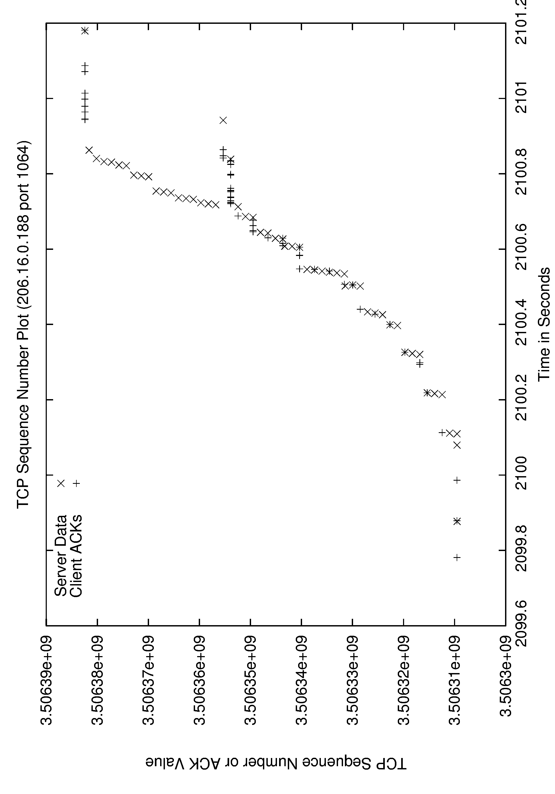
Example 4: Port 1064

Slide 6
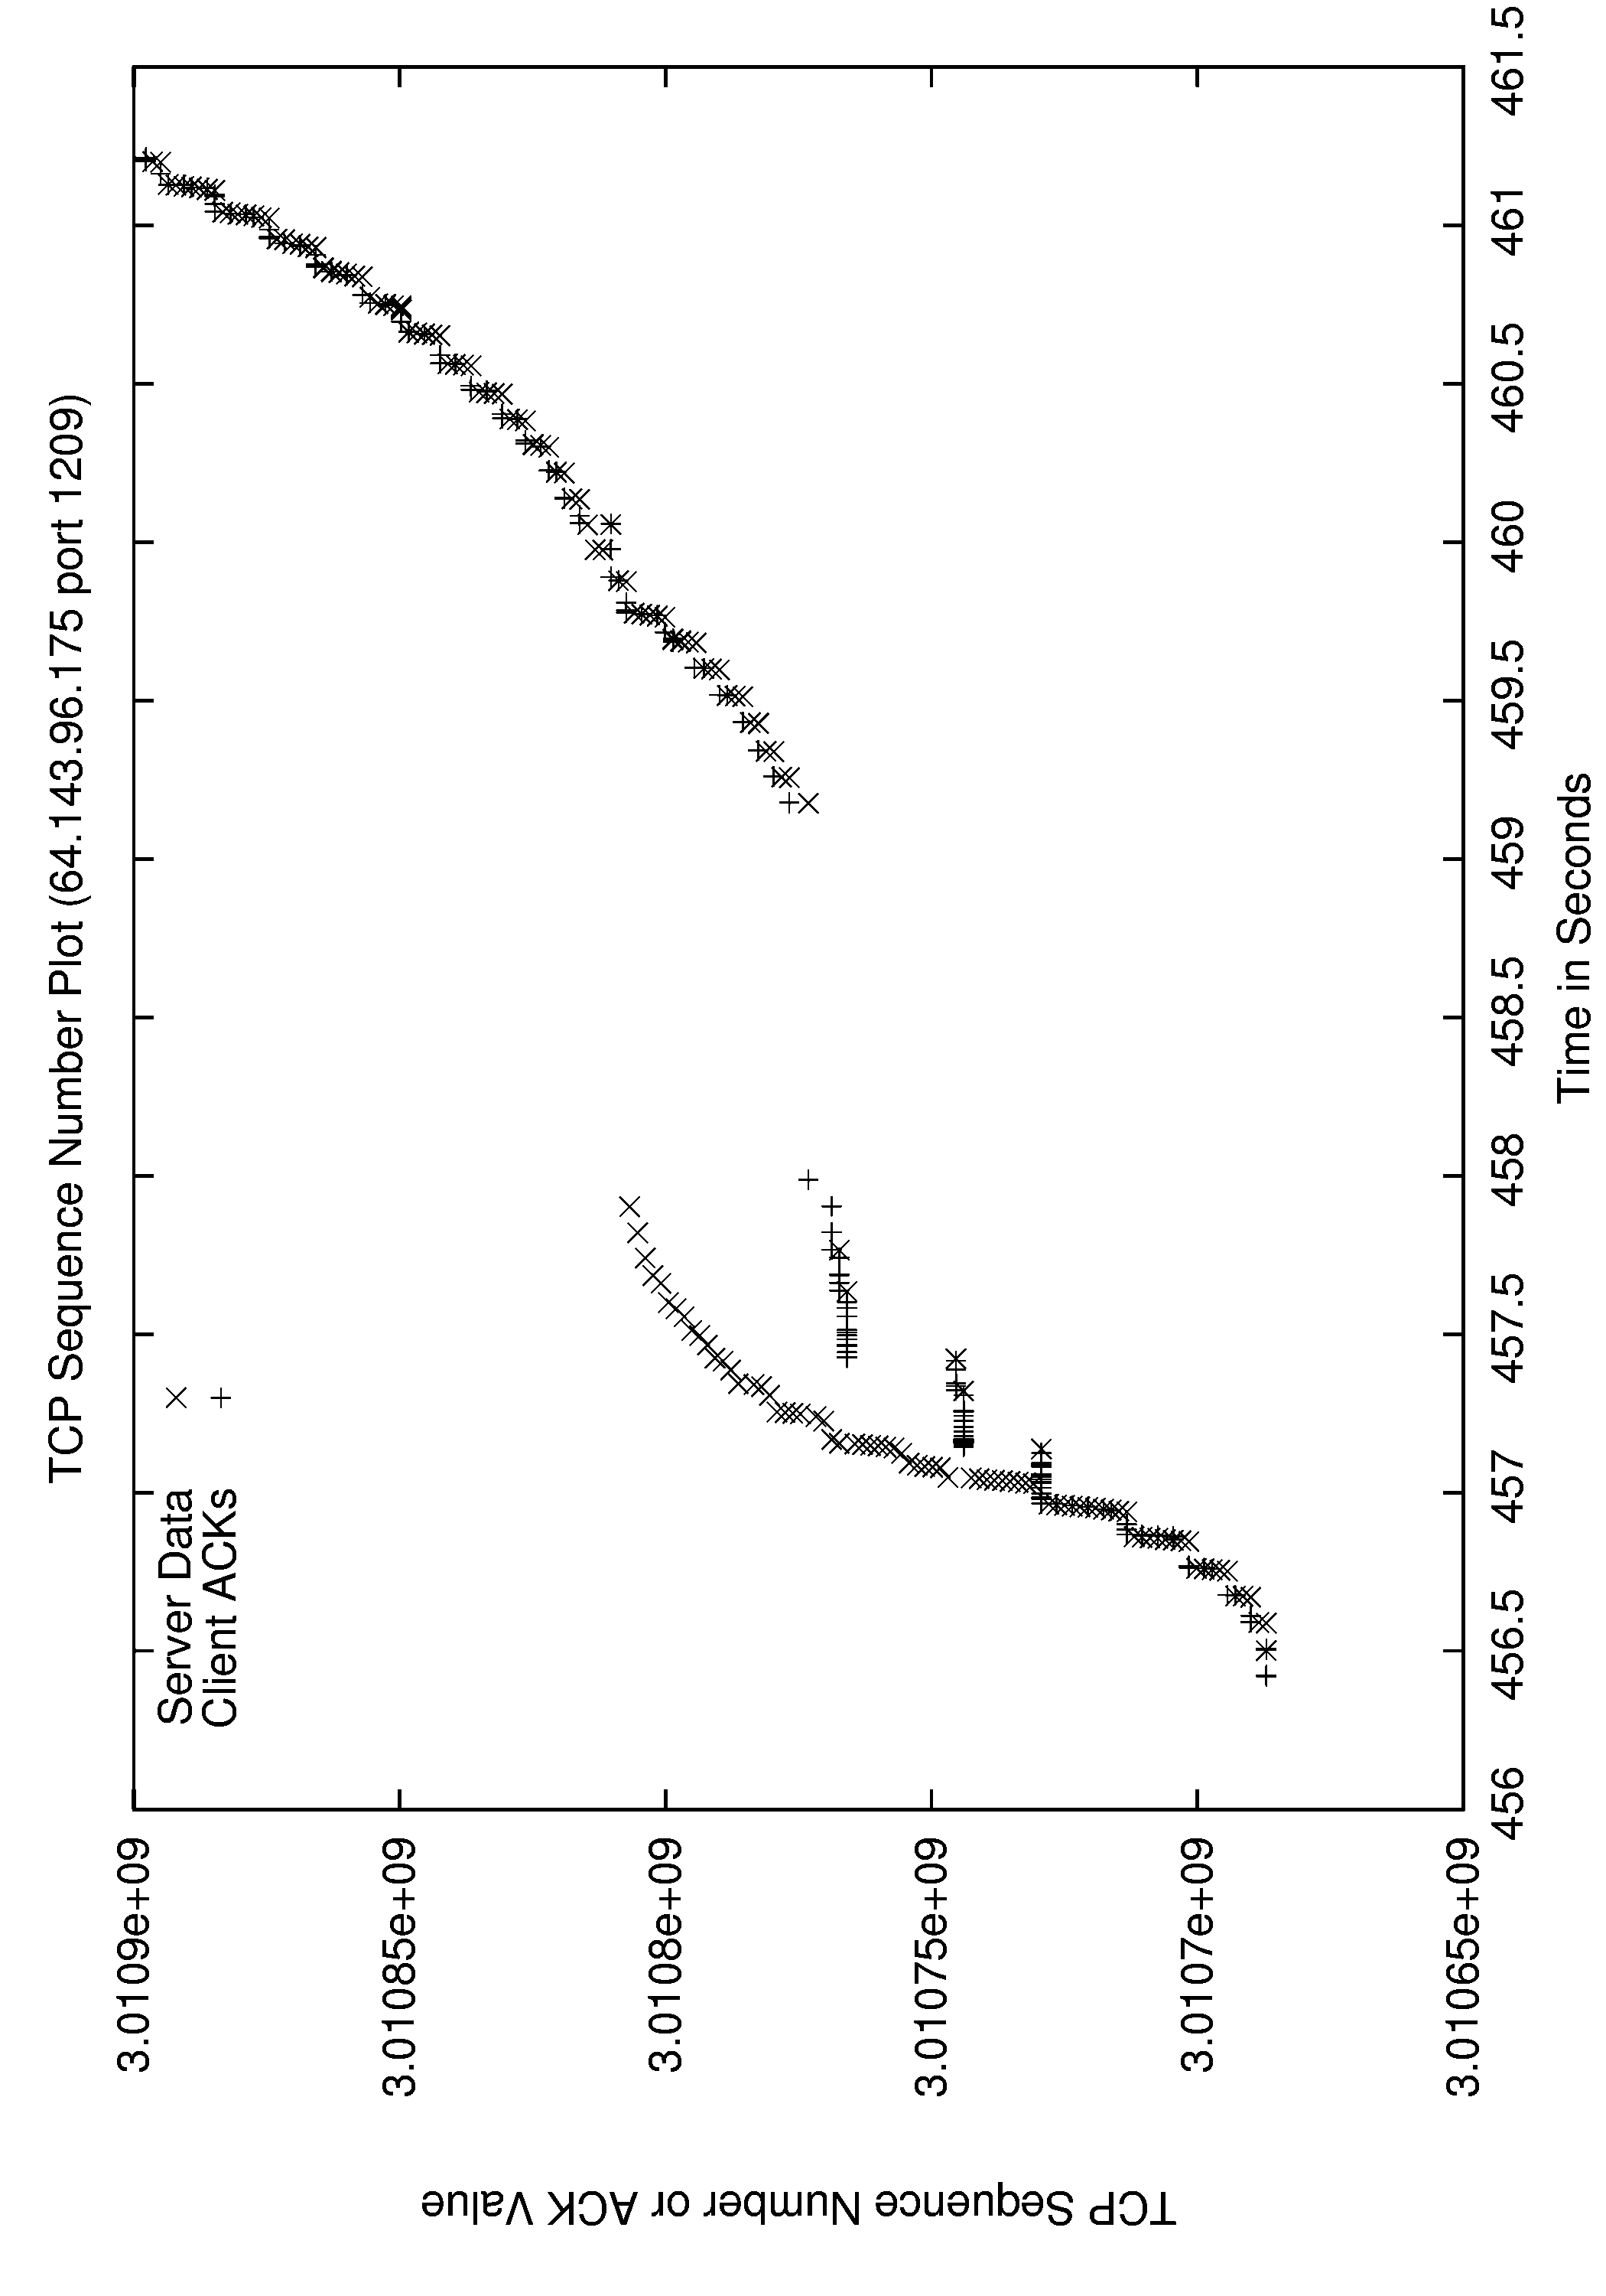
Example 5: Port 1209

