Slide 1
Hubs, Switches and Bridges
CPSC 441 Tutorial TA: Fang wang
Parts of the slides contents are courtesy of the following people:
Jim Kurose, Keith Ross: http://www.aw-bc.com/kurose_ross/
Yishay Mansour: http://www.cs.tau.ac.il/~mansour/networking-course/Icc3.ppt

Slide 2
LAN interconnection
We need to break down big networks to sub-LANs
  Limited amount of supportable traffic: on single LAN, all stations must share bandwidth
  Limited length: 802.3 (Ethernet) specifies maximum cable length. For 10 Mbps:
    Maximum length of the wire: 2,500 meter
  Large “collision domain” (can collide with many stations)

Slide 3
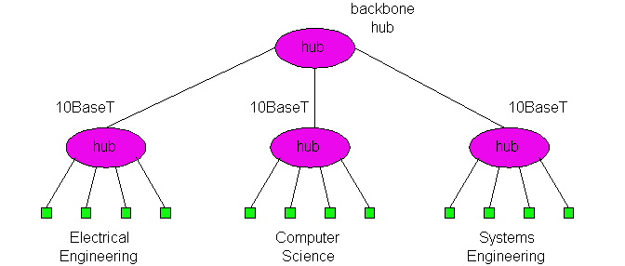
HUBS
Physical Layer devices
Essentially repeaters operating at bit levels: repeat received bits on one interface to all other interfaces
Hubs can be arranged in a hierarchy (or multi-tier design), with backbone hub at its top
Each connected LAN referred to as LAN segment
twisted pair
hub

Slide 4
Hubs: Pros
Hub Advantages:
  simple, inexpensive device
  Multi-tier provides graceful degradation: portions of the LAN continue to operate if one hub malfunctions
  extends maximum distance between node pairs (100m per Hub)
limitations : Hubs do not isolate collision domains: node may collide with any node residing at any segment in LAN
  Single collision domain results in no increase in max throughput
  multi-tier throughput same as single segment throughput
  Individual LAN restrictions pose limits on number of nodes in same collision domain and on total allowed geographical coverage
  cannot connect different Ethernet types (e.g., 10BaseT and 100baseT) Why?

Slide 5
Bridges
Link-layer devices:
  store, forward Ethernet frames
  examine incoming frame’s MAC address, selectively forward frame based on its destination. When frame is to be forwarded on segment, bridge uses CSMA/CD to access segment and transmit
Advantages:
  Isolates collision domains resulting in higher total max throughput, and does not limit the number of nodes nor geographical coverage
  Can connect different type Ethernet since it is a store and forward device
  Transparent: no need for any change to hosts LAN adapters

Slide 6
Switches
A switch could be considered a bridge with numerous ports.
A bridge only has one incoming and one outgoing port.
Switch or Layer 2 switch is often used interchangeably with bridge
Plug-and-play, self-learning
  switches do not need to be configured

Slide 7
Switch: allows multiple simultaneous transmissions
hosts have dedicated, direct connection to switch
switches buffer packets
Ethernet protocol used on each incoming link, but no collisions; full duplex
  each link is its own collision domain
switching: A-to-A’ and B-to-B’ simultaneously, without collisions
  not possible with dumb hub
A
C’
B
1
2
6
3
5
4
C
B’
A’
switch with six interfaces
(1,2,3,4,5,6)

Slide 8
Switch Table
Q: how does switch know that A’ reachable via interface 4, B’ reachable via interface 5?
A: each switch has a switch table, each entry:
  (MAC address of host, interface to reach host, time stamp)
looks like a routing table!
Q: how are entries created, maintained in switch table?
  something like a routing protocol?
A
C’
B
1
2
6
3
5
4
C
B’
A’
switch with six interfaces
(1,2,3,4,5,6)

Slide 9
Switch: self-learning
Source: A
Dest: A’
switch learns which hosts can be reached through which interfaces
  when frame received, switch “learns” location of sender: incoming LAN segment
  records sender/location pair in switch table
A
A A’
C’
B
1
2
6
3
5
4
C
MAC addr interface TTL
B’
A’
A
1
60
Switch table
(initially empty)

Slide 10
Switch: frame filtering/forwarding
When frame received:
1. record link associated with sending host
2. index switch table using MAC dest address
3. if entry found for destination
then {
if dest on segment from which frame arrived
then drop the frame
else forward the frame on interface indicated
}
else flood
forward on all but the interface
on which the frame arrived

Slide 11
Self-learning, forwarding: example
Source: A
Dest: A’
A
A A’
C’
B
frame destination unknown:
flood
1
2
6
3
A A’
A A’
A A’
A A’
destination A location known:
A A’
5
4
selective send
C
A’ A
B’
A’
MAC addr interface TTL
A
1
60
A’
4
60
Switch table
(initially empty)

Slide 12
Interconnecting switches
switches can be connected together
S₄
S₁
S₃
A
S₂
F
I
B
C
D
E
G
H
Q: sending from A to F - how does S₁ know to forward frame destined to F via S₄ and S₂?
A: self learning! (works exactly the same as in single-switch case!)

Slide 13
What will happen with loops?
Incorrect learning
B
2
2
A , 1
S1
S2
A , 1
2
1
1
A

Slide 14
Spanning Trees
Allow a path between every LAN without causing loops (loop-free environment)
Bridges communicate with special configuration messages (BPDUs- Bridge Protocol Data Units )
Standardized by IEEE 802.1D
Requirements:
  Each bridge is assigned a unique identifier
  A broadcast address for bridges on a LAN
  A unique port identifier for all ports on all bridges
    MAC address
    Bridge id + port number

Slide 15
Example Spanning Tree
B8
B3
B5
B7
B2
B1
B6
B4

Slide 16
Spanning Tree Algorithm: overview
1. Determine the root bridge among all bridges
2. Each bridge determines its root port
  The port in the direction of the root bridge
3. Determine the designated bridge on each LAN
  The bridge which accepts frames to forward towards the root bridge
  The frames are sent on the root port of the designated bridge

Slide 17
Example Spanning Tree
B8
B3
B5
Protocol operation:
Picks a root
For each LAN,
picks a designated bridge
that is closest to the root.
All bridges on a LAN
send packets towards the
root via the designated
bridge.
Root
port
B7
B2
B1
Root
B6
Designated
Bridge
B4

Slide 18
Example Spanning Tree
B8
B3
Spanning Tree:
B5
B1
Root
port
B7
B2
B2
B4
B5
B7
B1
Root
B8
B6
Designated
Bridge
B4

Slide 19
Spanning Tree Algorithm:
Selecting Root Bridge
Initially, each bridge considers itself to be the root bridge
Bridges send Bridge Protocol Data Unit (BPDU) frames to its attached LANs
BPDUs frames contain information regarding the Swithch ID, originating switch port, MAC address, switch port priority, switch port cost etc
Best one wins
  (lowest root ID/cost/priority)

Slide 20
Spanning Tree Algorithm:
Selecting Root Ports
Each bridge selects one of its ports which has the minimal cost to the root bridge
When multiple paths from a bridge are least-cost paths, the chosen path uses the neighbor bridge with the lower bridge ID. The root port is thus the one connecting to the bridge with the lowest bridge ID.
In case of another tie, two bridges are connected by multiple cables. In this case, the lowest port ID is used

Slide 21
Select Designated Bridges
Forwarding/Blocking state
Same as selecting the root bridge:
Initially, each bridge considers itself to be the designated bridge, send BDPU frames to attached LANs, best one wins!
Root and designated bridges will forward frames to and from their attached LANs
All other ports are in the blocking state

Slide 22
Spanning Tree Protocol: Execution
B8
B3
B5
B7
B2
(B1,root=B1,dist=0)
B1
(B1,root=B1, dist=0)
B6
B4
(B6, Root=B1dist=1)
(B4, root=B1, dist=1)

Slide 23
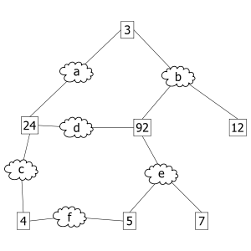
Spanning Tree Protocol: Execution
1. An example network. The numbered boxes represent bridges (the number represents the bridge ID). The lettered clouds represent network segments.

Slide 24
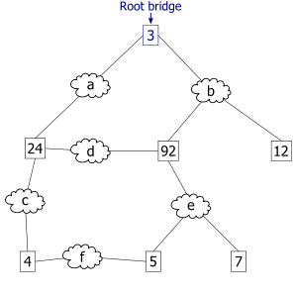
Spanning Tree Protocol: Execution
2. The smallest bridge ID is 3. Therefore, bridge 3 is the root bridge.

Slide 25
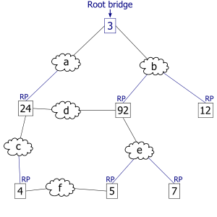
Spanning Tree Protocol: Execution
3. Assuming that the cost of traversing any network segment is 1, the least cost path from bridge 4 to the root bridge goes through network segment c. Therefore, the root port for bridge 4 is the one on network segment c.

Slide 26
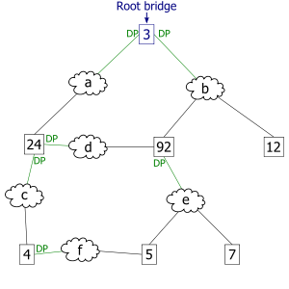
Spanning Tree Protocol: Execution
4. The least cost path to the root from network segment e goes through bridge 92. Therefore the designated port for network segment e is the port that connects bridge 92 to network segment e.

Slide 27
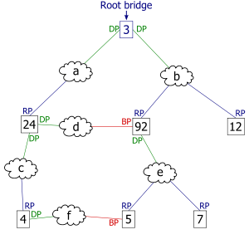
Spanning Tree Protocol: Execution
5. This diagram illustrates all port states as computed by the spanning tree algorithm. Any active port that is not a root port or a designated port is a blocked port.

Slide 28
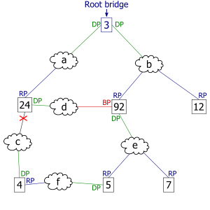
Spanning Tree Protocol: Execution
6. After link failure the spanning tree algorithm computes and spans new least-cost tree.
From: http://en.wikipedia.org/wiki/Spanning_Tree_Protocol

Slide 29
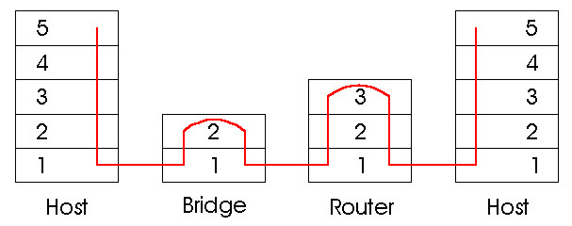
Switches vs. Routers
both store-and-forward devices
  routers: network layer devices (examine network layer headers)
  switches are link layer devices
routers maintain routing tables, implement routing algorithms
switches maintain switch tables, implement filtering, learning algorithms

