Slide 1
Introduction to Socket Programming with C
CPSC 441 TUTORIAL
TA: Fang Wang

Slide 2
What is a socket?
Socket is an interface between application and network (the lower levels of the protocol stack)
The application creates a socket
The socket type dictates the style of communication
reliable vs. best effort
connection-oriented vs. connectionless
Once a socket is setup the application can
pass data to the socket for network transmission
receive data from the socket (transmitted through the network, received from some other host)
From: Dan Rubenstein’s slides: http://www.cs.columbia.edu/~danr/courses/6761/Summer03/intro/6761-1b-sockets.ppt

Slide 3
Most popular types of sockets
TCP socket
Type: SOCK_STREAM
reliable delivery
in-order guaranteed
connection-oriented
bidirectional
We focus on TCP
UDP socket
Type: SOCK_DGRAM
unreliable delivery
no order guarantees
no notion of “connection” – app indicates destination for each packet
can send or receive

Slide 4
Server and clients
From: UNIX Network Programming Volume 1, figure 4.1
TCP Server
socket()
bind()
TCP Client
listen()
socket()
accept()
connection establishment
connect()
data request
write()
read()
data reply
write()
read()
end-of-file notification
read()
close()
close()

Slide 5
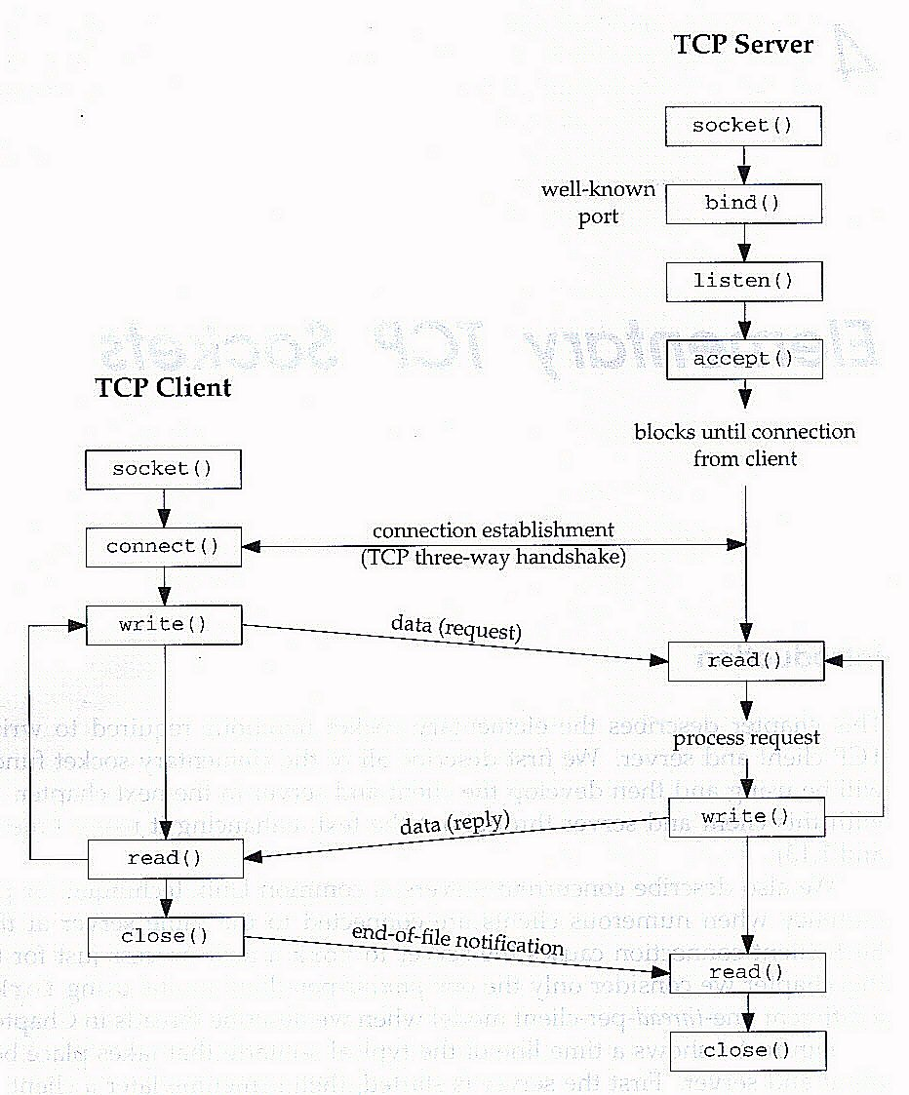
Socket Creation
From:www.cs.gsu.edu/~sguo/slides/3320/Sockets.ppt

Slide 6
SOCKET CREATION IN C
int s = socket(domain, type, protocol);
s: socket descriptor, an integer (like a file-handle)
domain: integer, communication domain
e.g., PF_INET (IPv4 protocol) – typically used
type: communication type
SOCK_STREAM: reliable, 2-way, connection-based service
SOCK_DGRAM: unreliable, connectionless,
other values: need root permission, rarely used, or obsolete
protocol: specifies protocol (see file /etc/protocols for a list of options) - usually set to 0 (choose the proper protocol for the given type)
NOTE: socket call does not specify where data will be coming from, nor where it will be going to - it just creates the interface.
From: Dan Rubenstein’s slides: http://www.cs.columbia.edu/~danr/courses/6761/Summer03/intro/6761-1b-sockets.ppt

Slide 7
Binds a socket to an address
From:www.cs.gsu.edu/~sguo/slides/3320/Sockets.ppt

Slide 8
Ports
Each host machine has an IP address (or more!)
Each host has 65,536 ports (2?)
Some ports are reserved for specific apps
20,21: FTP
23: Telnet
80: HTTP
see RFC 1700 (about 2000 ports are reserved)
Port 0
Port 1
Port 65535
A socket provides an interface to send data to/from the network through a port
From: Dan Rubenstein’s slides: http://www.cs.columbia.edu/~danr/courses/6761/Summer03/intro/6761-1b-sockets.ppt

Slide 9
Addresses, Ports and Sockets
Like apartments and mailboxes
You are the application
Your apartment building address is the address
Your mailbox is the port
The post-office is the network
The socket is the key that gives you access to the right mailbox (one difference: assume outgoing mail is placed by you in your mailbox)
Q: How do you choose which port a socket connects to?
From: Dan Rubenstein’s slides: http://www.cs.columbia.edu/~danr/courses/6761/Summer03/intro/6761-1b-sockets.ppt

Slide 10
Addresses, Ports and Sockets
Choose a port number that is registered for general use, from 1024 to 49151
Do not use ports 1 to 1023. These ports are reserved for use by the Internet Assigned Numbers Authority (IANA)
Avoid using ports 49152 through 65535. These are dynamic ports that operating systems use randomly. If you choose one of these ports, you risk a potential port conflict
From:www.cs.gsu.edu/~sguo/slides/3320/Sockets.ppt

Slide 11
The bind function
The bind function associates and (can exclusively) reserves a port for use by the socket
int status = bind(sockid, &addrport, size);
status: error status, = -1 if bind failed
sockid: integer, socket descriptor
addrport: struct sockaddr, the (IP) address and port of the machine (address usually set to INADDR_ANY – chooses a local address)
size: the size (in bytes) of the addrport structure
From: Dan Rubenstein’s slides: http://www.cs.columbia.edu/~danr/courses/6761/Summer03/intro/6761-1b-sockets.ppt

Slide 12
The struct sockaddr
The sockaddr_in structure has four parts:
sin_family: address family (e.g., AF_INET IP addresses)
sin_port: port number
sin_addr: IP-address
sin_zero: // un-used

Slide 13
Example(Server)
Some computers put the most significant byte within a
word first (this is called “big-endian” order), and others put it last (“little-endian” order).
So that machines with different byte order conventions can communicate, the Internet protocols specify a byte order convention for data transmitted over the network.
This is known as network byte order (it is big-endian).
// first, create and fill in values for the sockaddr_in structure Address
struct sockaddr_in Address;
/* create Address stucture */
Address.sin_family = AF_INET;
/* AF_INET represents the address family INET for Internet sockets. */
Address.sin_port = htons(nHostPort);
/* The function htons() converts from host byte order to network byte order*/
Address.sin_addr.s_addr = INADDR_ANY;
/* INADDR_ANY allows us to work without knowing the IP address of the machine the client program is running on (very convenient) */
// next, bind the socket to the port
if( bind(hServerSocket, (struct sockaddr *) &Address, sizeof(Address)) == -1) { printf("\nCould not connect to host\n"); return -1; }
From:www.cs.gsu.edu/~sguo/slides/3320/Sockets.ppt

Slide 14
ON THE CONNECTING END
bind can be skipped for both types of sockets. When and why?
When connecting to another host (i.e., connecting end is the client and the receiving end is the server), the OS automatically assigns a free port for the outgoing connection.
During connection setup, receiving end is informed of port)
You can however bind to a specific port if need be.

Slide 15
Connection setup
From:www.cs.gsu.edu/~sguo/slides/3320/Sockets.ppt

Slide 16
Connection Setup
A connection occurs between two ends
Server: waits for an active participant to request connection
Client: initiates connection request to passive side
Once connection is established, server and client ends are “similar”
both can send & receive data
either can terminate the connection

Slide 17
Connection setup steps
Client end:
step 2: request & establish connection
step 4: send/recv
Server end:
step 1: listen (for incoming requests)
step 3: accept (a request)
step 4: send/recv
The accepted connection is on a new socket
The old socket continues to listen for other active participants
Server
a-sock-1
l-sock
a-sock-2
Client1
Client2
socket
socket
From: Dan Rubenstein’s slides: http://www.cs.columbia.edu/~danr/courses/6761/Summer03/intro/6761-1b-sockets.ppt

Slide 18
SERVER SOCKET: LISTEN & ACCEPT
Called on server side:
int status = listen(sock, queuelen);
status: 0 if listening, -1 if error
sock: integer, socket descriptor
queuelen: integer, # of active participants that can “wait” for a connection
listen is non-blocking: returns immediately
int s = accept(sock, &addr, &addrlen);
s: integer, the new socket (used for data-transfer)
sock: integer, the orig. socket (being listened on)
addr: struct sockaddr, address of the active participant
addrlen: sizeof(addr): value/result parameter
must be set appropriately before call
adjusted by OS upon return
accept is blocking: waits for connection before returning
From: Dan Rubenstein’s slides: http://www.cs.columbia.edu/~danr/courses/6761/Summer03/intro/6761-1b-sockets.ppt

Slide 19
Client create socket and connect to remote host
First, the client must create a socket (socket call as before) and fills in its address structure
Then, the client connects to the remote host
The connect function is used by a client program to establish communication with a remote entity
int status = connect(sock, &addr, addrlen);
status: 0 if successful connect, -1 otherwise
sock: integer, socket to be used in connection
addr: struct sockaddr: address of passive participant
addrlen: integer, sizeof(addr)
connect is blocking
From: Dan Rubenstein’s slides: http://www.cs.columbia.edu/~danr/courses/6761/Summer03/intro/6761-1b-sockets.ppt

Slide 20
Sending/Receiving Data
From:www.cs.gsu.edu/~sguo/slides/3320/Sockets.ppt

Slide 21
Sending / Receiving Data
int count = send(sock, &buf, len, flags);
count: # bytes transmitted (-1 if error)
buf: void*, buffer to be transmitted
len: integer, length of buffer (in bytes) to transmit
flags: integer, special options, usually just 0
int count = recv(sock, &buf, len, flags);
count: # bytes received (-1 if error)
buf: void*, stores received bytes
len: # bytes received
flags: integer, special options, usually just 0
Calls are blocking [returns only after data is sent (to socket buf) / received]
From: Dan Rubenstein’s slides: http://www.cs.columbia.edu/~danr/courses/6761/Summer03/intro/6761-1b-sockets.ppt

Slide 22
close
When finished using a socket, the socket should be closed:
status = close(s);
status: 0 if successful, -1 if error
s: the file descriptor (socket being closed)
Closing a socket
closes a connection
frees up the port used by the socket
From: Dan Rubenstein’s slides: http://www.cs.columbia.edu/~danr/courses/6761/Summer03/intro/6761-1b-sockets.ppt

Slide 23
TIPS 1
Sometimes, an ungraceful exit from a program (e.g., ctrl-c) does not properly free up a port
Eventually (after a few minutes), the port will be freed
You can kill the process, or
To reduce the likelihood of this problem, include the following code:
In header include:
#include <signal.h>
void cleanExit(){exit(0);}
In socket code:
signal(SIGTERM, cleanExit);
signal(SIGINT, cleanExit);
From: Dan Rubenstein’s slides: http://www.cs.columbia.edu/~danr/courses/6761/Summer03/intro/6761-1b-sockets.ppt

Slide 24
Tips 2
Check Beej's Guide to Network Programming Using Internet Sockets http://beej.us/guide/bgnet/output/html/multipage/index.html
Search the specification for the function you need to use for more info, or check the man pages.

Slide 25
Tips 3
How to find the IP address of the machine my server program is running on?
Use 127.0.0.1 or localhost for accessing a server running on your local machine.
For a remote server running linux use the bash shell command: “$ /sbin/ifconfig”
For windows, use ipconfig in cmd

Slide 26
Tips for the assignment 1: Proxy
Proxy
Web
socket()
socket()
bind()
bind()
TCP Client
listen()
listen()
socket()
accept()
socket()
accept()
connect()
connect()
Get request
Get
write()
read()
read()
modify
write()
Send data
write()
data
write()
read()
read()
read()
close()
close()
close()
close()

Slide 27
Proxy Setup in Firefox

Slide 28
Lets write some code!
Sample socket program:
1. Echo server: echo’s what it receives back to client
2. Client/server example.

Slide 29
references
These are good references for further study of Socket programming with C:
Beej's Guide to Network Programming Using Internet Sockets http://beej.us/guide/bgnet/output/html/multipage/index.html
Dan Rubenstein’s lecture on Socket “Programming”:
http://www.cs.columbia.edu/~danr/courses/6761/Summer03/intro/6761-1b-sockets.ppt

