Slide 1
Introduction to C
CPSC 441 Tutorial
TA: Fang Wang

Slide 2
C VS. Java
C program
Collection of functions
One function “main()” is called by the operating system as the starting function
Compile output: executable file. Running the executable (default name a.out) starts main function
Typically, single program with all user code linked in
Java program
Collection of classes
Class containing main method is starting class
Running “java StartClass” invokes StartClass.main method
JVM loads other classes as required
C++ is C extended with object oriented functionality (and more!)

Slide 3
Simple example
#include <stdio.h>
void main(void)
{
printf(“Hello World. \n \t and you ! \n ”);
/* print out a message */
return;
}
$Hello World.
and you !
$

Slide 4
Simple example
#include <stdio.h>
include header file stdio.h
# lines processed by pre-processor
No semicolon at end
Lower-case letters only – C is case-sensitive
void main(void){ … } is the only code executed
printf(“ /* message you want printed */ ”);
\n = newline, \t = tab
\ in front of other special characters within printf.
printf(“Have you heard of \”The Rock\” ? \n”);

Slide 5
Compiling C
gcc invokes C compiler
gcc translates C program into executable for some target
default file name a.out
Example: compile and run hello.c
$ gcc hello.c
$ a.out
Hello, World!
$ gcc hello.c –o hello
$ ./hello
Hello, World!

Slide 6
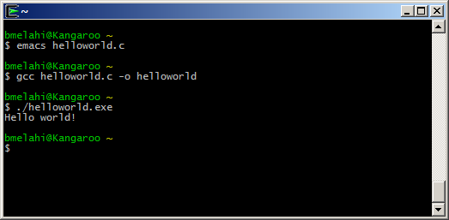
Hands on
Demo:
1. Write code
2. Compile
3. Run

Slide 7
Some OPTIONS
Some useful command line options:
[-o file]: specifies the output file for object or executable
[-Wall]: show all warnings (highly recommended)
[-l libnam]: Links the library libname, e.g., -lsocket
If you get errors saying the library cannot be found, make sure the path is correctly set, and you do have the libraries you need.

Slide 8
Libraries
#include <stdio.h>
C provides a set of standard libraries for
#include <math.h>
careful: sqrt(5) without header file may give wrong result!
gcc –o a main.c –lm
numerical math functions | <math.h> | -lm
character strings | <string.h>
character types | <ctype.h>
I/O | <stdio.h>

Slide 9
main Arguments
int main(int argc, char *argv[])
argc is the argument count
argv is the argument vector
array of strings with command-line arguments
Name of executable + space-separated arguments
Name of executable is stored in argv[0]
$ a.out 1 23 ‘third arg’
the int value is the return value
convention: 0 means success, > 0 some error
can also declare as void (no return value)

Slide 10
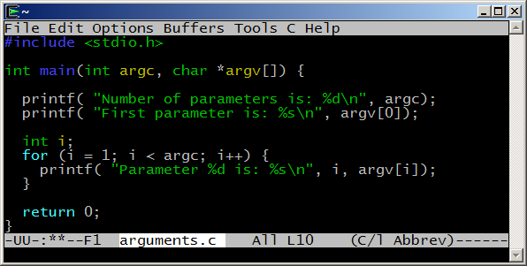
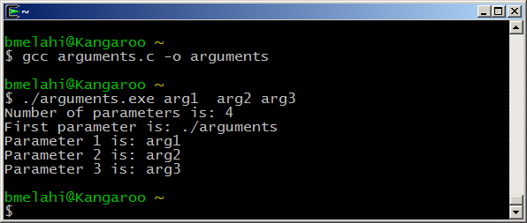
Passing arguments example

Slide 11
Passing arguments example
If no arguments, simplify:
int main() {
puts(“Hello World”);
exit(0);
}
Uses exit() instead of return – same thing.

Slide 12
Primitive Data Types
Name | Description | Size* (32bit) | Range* (32bit system)
char | Character or small integer. | 1byte | signed: -128 to 127 unsigned: 0 to 255
short int (short) | Short Integer. | 2bytes | signed: -32768 to 32767 unsigned: 0 to 65535
int | Integer. | 4bytes | signed: -2147483648 to 2147483647 unsigned: 0 to 4294967295
long int (long) | Long integer. | 4bytes | signed: -2147483648 to 2147483647 unsigned: 0 to 4294967295
bool | Boolean value. It can take one of two values: true or false. | 1byte | true or false
float | Floating point number. | 4bytes | +/- 3.4e +/- 38 (~7 digits)
double | Double precision floating point number. | 8bytes | +/- 1.7e +/- 308 (~15 digits)
long double | Long double precision floating point number. | 8bytes | +/- 1.7e +/- 308 (~15 digits)
*Size and Range depend on the system the program is compiled for.
From: http://www.cplusplus.com/doc/tutorial/variables/

Slide 13
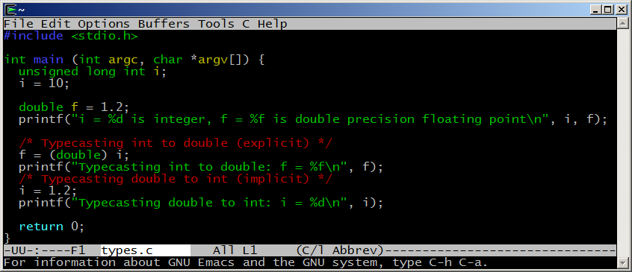
Typecasting example
Caution: be careful with typecasting, especially implicit conversions.

Slide 14
If and loops
IF statement:
if ( TRUE ) { /* Execute these statements if TRUE */ }
else { /* Execute these statements if FALSE */ }
if ( age < 100 ) { /* If the age is less than 100 */
printf ("You are pretty young!\n" ); /* Just to show you it works... */ }
else if ( age == 100 ) { /* I use else just to show an example */ printf( "You are old\n" ); }
else { printf( "You are really old\n" ); /* Executed if no other statement is */ }

Slide 15
If and loops
C has several control structures for repetition
for ( x = 0; x < 10; x++ ) {}
Statement | repeats an action...
while(c) {} | zero or more times, while condition is ≠ 0
do {...} while(c) | one or more times, while condition is ≠ 0
for (start; cond; upd) | zero or more times, with initialization and update

Slide 16
Arrays
Array declaration: int a[];
C/C++ arrays have no length attribute!
Note: when passing an array to a function, typically you have to pass the array size as a separate argument as well.
You have to take care of array bounds yourself
int input[10];
input[10] = 20; // out of bound!
input[-1] = 5; // out of bound!
This code could compile and run, but most likely, you’ll see unexpected behavior or crash your program.
Array’s name is a pointer to its first element (C references arrays by the address of their first element)
array is equivalent to &array[0]

Slide 17
Structures
C struct is a way to logically group related types
Is very similar to (but not same as) C++/java classes
Is somehow a class without methods
Members are always public (no encapsulation concept in c)
A struct component can be of any type (including other struct types), but cannot be recursive
Example:
struct address{
char* street;
char* city;
char* zip;
};
struct student{
char* name;
unsigned int ID;
struct Address;
};

Slide 18
Pointers
A pointer is just an address to some memory location.
Another variable
Some dynamically allocated memory
Some function
NULL
int *p = &x;
int x = 4;
&x (address of x)
4
int *p = malloc (sizeof int);
Address of allocated
memory
?
allocated
memory

Slide 19
Pointers in C
Declaration: using “*” symbol before variable name.
int * ptr = NULL; //creates pointer to integer
Allocation: allocate new memory to a pointer using the keyword malloc in C (new in C++)
int *p = malloc(sizeof(int));
int *p = (int *) malloc(10 * sizeof (int)); // array of int
Deallocation: clear the allocated memory when you are done using it. Otherwise, Memory Leak!!!
free(p);
Dereferencing: accessing data from the pointer x = *p;

Slide 20
String
In C, string is an array of char terminated with “\0” (a null terminator: ‘\0’)
“hello” = hello\0
Declaring and initialize a string
char str1[10]; // a string of 10 characters
char str2[10]={“hello”}; //initialized string
char *strp1; // a char pointer
char *strp2 = malloc(sizeof(char)*10);
// a char pointer initialized to point to a chunck of memory.

Slide 21
String library
#include <string.h>
Functions:
char *strcpy(char *dest, char *source)
copies chars from source array into dest array up to NUL
char *strncpy(char *dest, char *source, int num)
copies chars; stops after num chars if no NUL before that; appends NUL
int strlen(const char *source)
returns number of chars, excluding NUL
char *strchr(const char *source, const char ch)
returns pointer to first occurrence of ch in source; NUL if none
char *strstr(const char *source, const char *search)
return pointer to first occurrence of search in source

Slide 22
File I/O
#include <stdio.h>
Formatted I/O
int scanf(const char *format, ...)
read from standard input and store according to format.
int printf(const char *format, ...)
write to standard output according to format
File I/O: FILE *
FILE *fopen(const char *path, const char *mode)
open a file and return the file descriptor
FILE *fp;
fp=fopen("c:\\test.txt", "r");
int fclose(FILE *stream)
close the file; return 0 if successful, EOF if not
fclose(fp);

Slide 23
File I/O, Reading and writing
fprintf and fscanf
To work with text output and input
Similar to printf and scanf except that you must pass the FILE pointer as first argument. For example:
FILE *fp;
fp=fopen("c:\\test.txt", "w");
fprintf(fp, "Testing...\n");

Slide 24
File I/O, Reading and writing
Other I/O operations:
int getchar()
read the next character from stdin; returns EOF if none
int fgetc(FILE *stream);
returns a character from the specified FILE
char *fgets(char *buf, int size, FILE *in)
read the next line from a file into buf
int putchar(int c);
writes the character to the console
int fputs(const char *str, FILE *out)
output the string to a file, stopping at ‘\0’
returns number of characters written or EOF

Slide 25
Example
// read all characters from a file, outputting only the letter 'b's it finds in the file
#include <stdio.h>
int main(void)
{
FILE *fp;
int c;
fp = fopen("datafile.txt", "r"); // error check this!
// this while-statement assigns into c, and then checks against EOF:
while((c = fgetc(fp)) != EOF) {
if (c == 'b') {
putchar(c);
}
}
fclose(fp);
return 0;
}
From: http://beej.us/guide/bgc/output/html/multipage/getc.html

Slide 26
Lets write some code!
Sample C program:
Input: list of grades of student homework.
Output: The computed final marks.

Slide 27
References
C for Java programmers:
http://faculty.ksu.edu.sa/jebari_chaker/papers/C_for_Java_Programmers.pdf http://www.cs.columbia.edu/~hgs/teaching/ap/slides/CforJavaProgrammers.ppt
C tutorial:
http://www.cprogramming.com/tutorial/c-tutorial.html
Socket programming with C: (for next session)
Beej's Guide to Network Programming Using Internet Sockets http://beej.us/guide/bgnet/output/html/multipage/index.html

