Slide 1
History of Internet
CPSC 411 Tutorial
TA: Fang Wang

Slide 2
Fang Wang
Email:
fmwang@ucalgary.ca
9:00am-5:00pm, Mon-Fri

Slide 3
Tutorial Timeline
T03 Monday and Wednesday
9:00-9:50AM in ST057
T01 Monday and Wednesday
10:00-10:50AM in ST 063

Slide 4
Assignments
Four assignments, due on Feb.5, Mar.5, Mar.26, Apr.9
All details in course webpage http://pages.cpsc.ucalgary.ca/~carey/CPSC441
Individual assignment (mostly programming assignment)

Slide 5
Assignments
Tentative assignment topic
Web Proxy
TCP
Routing
Medium Access Control (MAC)

Slide 6
Today’s Tutorial
A video on Youtube: History of Internet

Slide 7
History of the Internet
ARPANET: 1969
Email: 1972 (Ray Tomlinson)
1982(SMTP Email protocol)
TCP: 1974 (Vint Cerf and Bob Kahn)
TCP/IP: 1983
Reference:
http://www.zakon.org/robert/internet/timeline/
On course website under “Useful Links”

Slide 8
History of the Internet
Web 1990 (Tim Berners-Lee)
Google (1998)
Facebook: 2004
YouTube: 2005
Reference:
http://www.zakon.org/robert/internet/timeline/
On course website under “Useful Links”

Slide 9
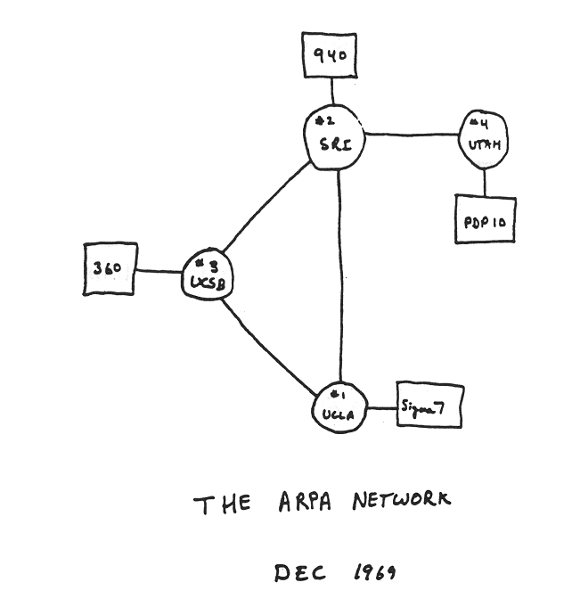
Internet History
1961-1972: Early packet-switching principles
1961: Kleinrock - queueing theory shows effectiveness of packet-switching
1964: Baran - packet-switching in military nets
1967: ARPAnet conceived by Advanced Research Projects Agency
1969: first ARPAnet node operational
1972:
ARPAnet public demonstration
NCP (Network Control Protocol) first host-host protocol
first e-mail program
ARPAnet has 15 nodes

Slide 10
Internet History
1972-1980: Internetworking, new and proprietary nets
1970: ALOHAnet satellite network in Hawaii
1974: Cerf and Kahn - architecture for interconnecting networks
1976: Ethernet at Xerox PARC
ate70’s: proprietary architectures: DECnet, SNA, XNA
late 70’s: switching fixed length packets (ATM precursor)
1979: ARPAnet has 200 nodes
Cerf and Kahn’s internetworking principles:
minimalism, autonomy - no internal changes required to interconnect networks
best effort service model
stateless routers
decentralized control
define today’s Internet architecture

Slide 11
Internet History
1980-1990: new protocols, a proliferation of networks
1983: deployment of TCP/IP
1982: smtp e-mail protocol defined
1983: DNS defined for name-to-IP-address translation
1985: ftp protocol defined
1988: TCP congestion control
new national networks: Csnet, BITnet, NSFnet, Minitel
100,000 hosts connected to confederation of networks

Slide 12
Internet History
1990, 2000’s: commercialization, the Web, new apps
Early 1990’s: ARPAnet decommissioned
1991: NSF lifts restrictions on commercial use of NSFnet (decommissioned, 1995)
early 1990s: Web
hypertext [Bush 1945, Nelson 1960’s]
HTML, HTTP: Berners-Lee
1994: Mosaic, later Netscape
late 1990’s: commercialization of the Web
Late 1990’s – 2000’s:
more killer apps: instant messaging, P2P file sharing
network security to forefront
est. 50 million host, 100 million+ users
backbone links running at Gbps

Slide 13
Internet History
2007:
~500 million hosts
Voice, Video over IP
P2P applications: BitTorrent (file sharing) Skype (VoIP), PPLive (video)
more applications: YouTube, gaming
wireless, mobility

Slide 14
Interview with Vint Cerf about the early days of the Internet and TCP/IP (by IEEE tv)

