Slide 1
Udp Review
CPSC 441 Tutorial
TA: Fang Wang

Slide 2
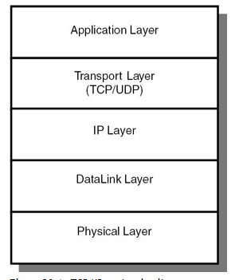
What is UDP?
UDP stands for User Datagram Protocol.
It is a simple protocol in Transport Layer of the OSI model. UDP was defined in RFC 768.
Alternative to the Transmission Control
Protocol (TCP) and, together with IP,
is also referred to as UDP/IP
Programs on networked computers
can send short messages sometimes
known as datagram (using
Datagram Sockets) to one another.

Slide 3
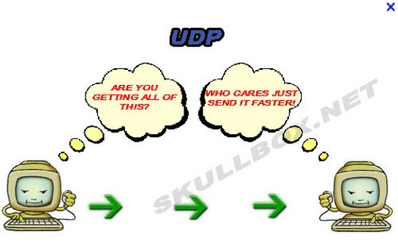
Features of UDP
UDP is a minimal message-oriented Transport Layer protocol.
Unreliable Datagram Protocol :
UDP provides no guarantees to the upper layer protocol for message delivery
the UDP protocol layer retains no state of UDP messages once sent
UDP provides application
multiplexing (via port numbers)
Provide integrity verification
(via checksum) of the header
and payload.

Slide 4
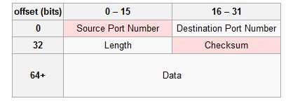
UDP header
The UDP header consists of 4 fields, each of which is 2 bytes.
The use of two of those is optional in IPv4 (pink background in table). In IPv6 only the source port is optional.
Source port number
Identifies the sender's port , should be assumed to be the port to reply to if needed.
If not used, then it should be zero.
If the source host is the client → an ephemeral port number.
If the source host is the server→ a well-known port number

Slide 5
UDP header
Destination port number
Identifies the receiver's port and is required
if the client is the destination host→ an ephemeral port number.
if the destination host is the server→ a well-known port number
Length
Specifies the length in bytes of the entire datagram: header and data
The minimum length is 8 bytes = the length of the header.
The field size sets a theoretical limit of 65,535 bytes (8 byte header + 65,527 bytes of data) for a UDP datagram

Slide 6
UDP header
Checksum
The checksum field is used for error-checking of the header and data.
If no checksum is generated by the transmitter, the field uses the value all-zeros.
This field is not optional for IPv6.
UDP uses Pseudo header to define the checksum. It is calculated over the combination of pseudo header and UDP message.
The pseudo header contains: the IP Source Address field, the IP Destination Address field, the IP Protocol field and the UDP Length field.

Slide 7
Basic Operations for Transmission using UDP
1.Higher-Layer Data Transfer: An application sends a message to the UDP software.
2.UDP Message Encapsulation: The higher-layer message is encapsulated into the Data field of a UDP message. The headers of the UDP message are filled in, including :
the Source Port of the application that sent the data to UDP
the Destination Port of the intended recipient.
The checksum value is also calculated.
3.Transfer Message to IP: The UDP message is passed to IP for transmission.

Slide 8
Difference between TCP and UDP
One interesting video about TCP vs UDP:
http://www.youtube.com/watch?v=KSJu5FqwEMM
TCP is a connection-oriented protocol; a connection can be made from client to server, and from then on any data can be sent along that connection.
UDP is a simpler message-based connectionless protocol. The UDP messages (packets) that cross the network is in the independent units.

Slide 9
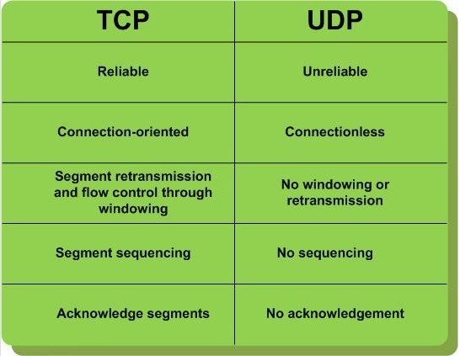
Difference between TCP and UDP

Slide 10
Why still use UDP?
TCP header is much larger than the UDP header. That header is being applied to every segments, and adds up!
UDP advantages over TCP is that its header is much smaller than TCP’s and it has much simpler processing steps.
UDP is widely used and recommended for:
When Speed Is More Important. An application values timely delivery over reliable delivery
Places where data exchanges are short and the order of reception of datagram does not matter
Acknowledgement of delivery is not needed
Applications that require multicast or broadcast transmissions, since these are not supported by TCP.

Slide 11
Some popular examples where UDP is used
Multimedia applications like streaming video , VOIP In multicast environment
If an application needs to multicast or broadcast data, it must use UDP, because TCP is only supported for unicast communication between two devices.
Domain Name System (DNS)
Simple network management protocol (SNMP)
Dynamic Host Configuration Protocol (DHCP)
Routing Information Protocol (RIP)

Slide 12
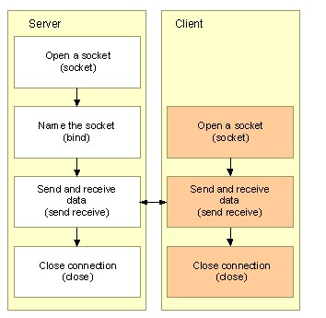
UDP Socket Programming
Interaction between the UDP server and UDP client
A UDP server does not have to listen for and accept client connections
A UDP client does not have to connect to a server.

Slide 13
UDP server socket
1. Open a datagram socket with socket.
2. Name the socket with the bind function, using a SOCKADDR_IN structure for the address parameter.
3. Exchange data with a client using the sendto and recvfrom functions
4. Close the connection with the closesocket function

Slide 14
SOCKET AND BIND FUNCTION
SOCKET FUNCTION
int socket (address format, type, int protocol);
int sock;
sock = socket( AF_INET, SOCK_DGRAM, IPPROTO_UDP )
BIND FUNCTION
int bind( SOCKET s, const struct sockaddr FAR* name, int namelen);
struct sockaddr_in myaddr;
myaddr.sin_family = AF_INET;
myaddr.sin_port = htons( 1234 );
myaddr.sin_addr = htonl( INADDR_ANY );
bind(mysock, &myaddr, sizeof(myaddr));
If no error occurs, this function returns zero. If an error occurs, it returns SOCKET_ERROR.

Slide 15
Sending DATA
SENDTO FUNCTION:
int sendto( SOCKET s, const char FAR* buf, int len, int flags, const struct sockaddr FAR* to, int tolen );
S: Descriptor identifying a possibly connected socket.
Buf: Buffer containing the data to be transmitted.
Len: Length of the data in the buf parameter.
Flags: Indicator specifying the way in which the call is made.
To: Optional pointer to the address of the target socket.
Tolen: Size of the address in the to parameter.
Return value: If no error occurs, this function returns the total number of bytes sent, if an error occurs, a value of SOCKET_ERROR is returned.

Slide 16
Receiving Data
RECEFROM FUNCTION:
int recvfrom( SOCKET s, char FAR* buf, int len, int flags, struct sockaddr FAR* from, int FAR* fromlen );
S: Descriptor identifying a bound socket.
Buf: Buffer for the incoming data.
Len: Length of the buf parameter.
Flags: Indicator specifying the way in which the call is made.
From: Optional pointer to a buffer that will hold the source address on return.
Fromlen: Optional pointer to the size of the from buffer.
Return value: If no error occurs, this function returns the number of bytes received. If the connection has been gracefully closed, the return value is zero. If an error occurs, a value of SOCKET_ERROR is returned.

Slide 17
CLOSE
More about sendto and recefrom function:
Server application calls recvfrom to prepare to receive data from a client.
The sendto function is used on a connectionless socket to send a datagram to a specific peer socket identified by the to parameter. Successfully completing a sendto function call does not confirm data was successfully delivered.
CLOSE FUNCTION
int closesocket( SOCKET s );

Slide 18
UDP client socket
1. Open a socket with the socket function.
2. Exchange data with server using sendto and recvfrom.
3. Close the connection with the closesocket function.

Slide 19
Example
One simple example: ping/pong UDP client and server

Slide 20
Reference
http://ipv6.com/articles/general/User-Datagram-Protocol.htm
http://www.decom.fee.unicamp.br/~cardoso/ie344b/User_Datagram_Protocol.pdf
http://www.youtube.com/watch?v=KSJu5FqwEMM
http://en.wikipedia.org/wiki/User_Datagram_Protocol
http://www.youtube.com/watch?v=v-CmPz73Y8Q
http://msdn.microsoft.com/en-us/library/ms881658.aspx

