Slide 1
Transmission Media
CPSC 441
TA: Fang WANG
Part of the slides are from Sudhanshu Kumar etc at slideshare.net

Slide 2
Characteristics
A good transmission medium should provide communication with good quality at long distance.
For voice communication, quality of communication is determined by the voice quality.
For data communication, however, the quality of communication is mainly determined by the effective data rate of communication.

Slide 3
Transmission Media
Guided Media
Twisted Pair Cable
Coaxial Cable
Unguided Media
Radio
Fiber-Optic Cable
Microwave
Satellite

Slide 4
Overview
Guided transmission media – wire (twisted pair, cable, fiber)
Unguided – wireless (radio wave, microwave, satellite)
Characteristics and quality determined by medium and signal
For guided, the medium is more important
For unguided, the bandwidth produced by the antenna is more important
Key concerns are data rate and distance

Slide 5
Design Factors
Bandwidth
Higher bandwidth gives higher data rate
Transmission impairments
Attenuation
Distortion during signal propagation
Noises
Interference
Number of receivers
In guided media
More receivers (multi-point) introduce more attenuation (need more amplifies or repeaters)

Slide 6
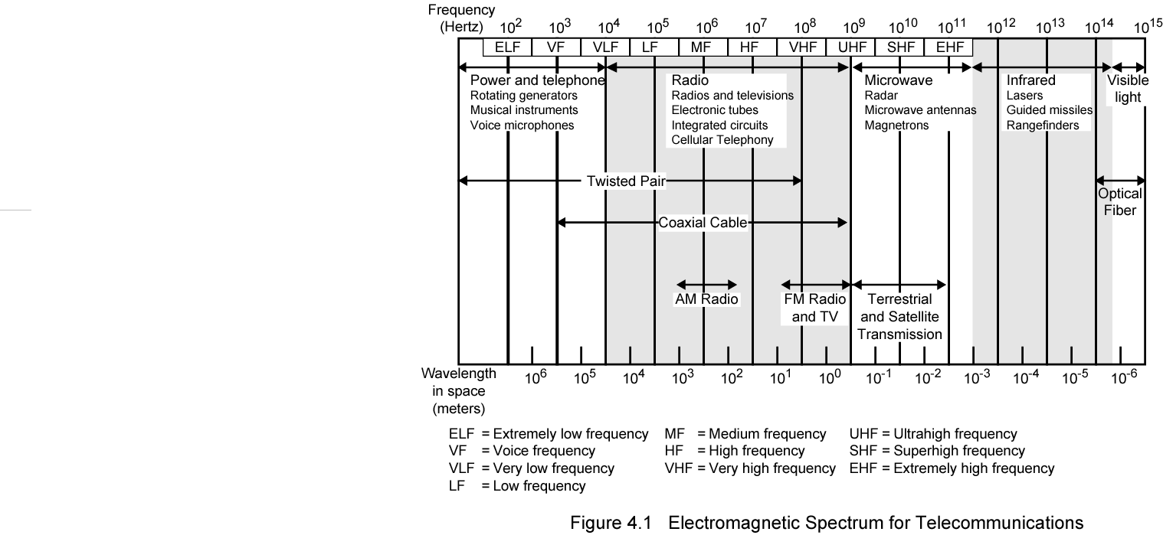
Electromagnetic Spectrum

Slide 7
Guided Transmission Media
Twisted Pair
Coaxial cable
Optical fiber

Slide 8
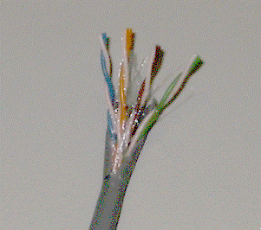
Twisted Pair

Slide 9
Twisted Pair - Applications
Most common medium
Telephone network
Between house and local exchange (subscriber loop)
Within buildings
To private branch exchange
For local area networks (LAN)
10Mbps or 100Mbps

Slide 10
Twisted Pair - Pros and Cons
Cheap
Easy to work with
Low data rate
Short range

Slide 11
Twisted Pair - Transmission Characteristics
Analog
Amplifiers every 5km to 6km
Digital
Use either analog or digital signals
repeater every 2km or 3km
Limited distance
Limited bandwidth (1MHz)
Limited data rate (100MHz)
Susceptible to interference and noise

Slide 12
Performance
One way to measure the performance of twisted pair cable is to compare attenuation versus frequency and distance.
Gauge is a measure of the thickness of the wire.

Slide 13
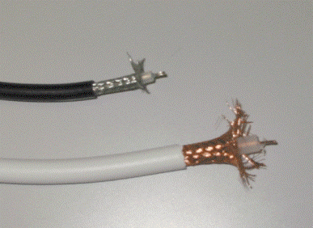
Coaxial Cable

Slide 14
Coaxial Cable Applications
Most versatile medium
Television distribution
Cable TV
Long distance telephone transmission
Can carry 10,000 voice calls simultaneously
Being replaced by fiber optic
Short distance computer systems links
Local area networks

Slide 15
Coaxial Cable - Transmission Characteristics
Analog
Amplifiers every few km
Closer if higher frequency
Up to 500MHz
Digital
Repeater every 1km
Closer for higher data rates

Slide 16
Performance
The performance is similar to the twisted pair cable.
The only difference is that the attenuation is much higher in co-axial cable than in twisted pair cable.

Slide 17
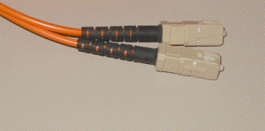
Optical Fiber

Slide 18
Optical Fiber - Benefits
Greater capacity
Data rates of hundreds of Gbps
Smaller size & weight
Lower attenuation
Electromagnetic isolation
Greater repeater spacing
10s of km at least

Slide 19
Optical Fiber - Applications
Long-haul trunks
Metropolitan trunks
Rural exchange trunks
Subscriber loops
LANs

Slide 20
Optical Fiber - Transmission Characteristics
Act as wave guide for 10¹⁴ to 10¹⁵ Hz
Portions of infrared and visible spectrum
Light Emitting Diode (LED)
Cheaper
Wider operating temp range
Last longer
Injection Laser Diode (ILD)
More efficient
Greater data rate
Wavelength Division Multiplexing

Slide 21
Performance
The performance can be measured by plot of attenuation versus wavelength.
Attenuation is flatter than in case of twisted pair cable and co-axial cable.

Slide 22
SOME BASIC DIFFERENCES --Twisted Wire
It is inexpensive and already is in use.
Twisted wires are slow, high-speed transmission causes interference (crosstalk).
Limiting factors: skin effect & radiation effect.

Slide 23
SOME BASIC DIFFERENCES -- Coaxial Cable
It is often used in place of twisted wire for important links in a network because it is faster.
More interference-free transmission medium (speed: 200 megabits per second).
Coaxial cable is thick, is hard to wire in many buildings. It does not support analog conversations.

Slide 24
SOME BASIC DIFFERENCES -- Optical Fiber
Optical fibers are faster, lighter, and suitable for transferring large amount of data.
Fiber-optic cable is more difficult to work with, more expensive.
Its difficult to install them.

Slide 25
Unguided Media
Unguided media is still ‘media’ (stuff that signal travels though). The trick is that the media is usually not directional, like air, space, etc. Because the effect is usually much wider than with guided media, there have been a lot of regulation, licensing, and standardization of transmissions via unguided media.

Slide 26
Wireless Transmission
Wireless transmission that sends signals through air or space without any physical wire.
Common uses of wireless data transmission include pagers, cellular telephones, microwave transmissions, communication satellites, mobile data networks, personal digital assistants, television remote controls.

Slide 27
Radio Waves
Although there is no clear cut demarcation between radio waves and microwaves , electromagnetic waves ranging in frequencies between 3KHz and 1GHz normally called radio waves.
Radio waves are omnidirectional.
Radio waves particularly those waves that propagate in the sky mode , can travel long distances .This makes Radio waves a good candidate for long distance broadcasting such as AM Radio

Slide 28
Applications
The omnidirectional characteristics of Radio waves make them useful for multicasting, in which there is one sender but many receivers.
AM and FM Radio, television ,maritime radio , cordless phone , and paging are examples of multicasting.

Slide 29
Microwaves
Electromagnetic waves having frequency between 1 and 300 GHz are called as Micro waves.
Micro waves are unidirectional.
Microwave propagation is line of sight.
Very high frequency Micro waves can not penetrate walls.
The microwave band is relatively wide, almost 299 GHz

Slide 30
Applications
Microwaves due to their unidirectional properties are very useful when unicast (one to one ) communication is needed between the sender and the receiver.
They are used in Cellular phones, satellite networks and wireless LANs.

Slide 31
Infrared Waves
Infrared waves , with frequencies from 300GHz-400THz can be used for short range communication
Infrared waves having high frequencies can not penetrate walls.
When we use our Infrared control , we do not interfere with use of the remote by our neighbors.
We cannot use Infrared waves outside a building because the suns rays Contain Infrared waves that can interfere with communication.

Slide 32
Applications
The infrared band almost 400 THz has an excellent potential for data transmission.
Such a wide bandwidth can be used to transmit digital data with a very high data rate.
Infrared waves is used in communication between devices such as Keyboard, PCs and Printers.

Slide 33
Reference
Transmission media ppt, Sudhanshu Kumar etc at slideshare.net
Chapter 4, Transmission Media slides, William Stallings, Data and Computer Communications 7th Edition

