Slide 1
Network Security
CPSC 441 Tutorial
TA: Fang WANG

Slide 2
Network security
The field of network security is about:
  how bad guys can attack computer networks
  how we can defend networks against attacks
  how to design architectures that are immune to attacks
Internet not originally designed with (much) security in mind
  original vision: “a group of mutually trusting users attached to a transparent network” ☺
  Security considerations in all layers!

Slide 3
Malware
Malware can get in host from a virus, worm, or trojan horse.
Spyware malware can record keystrokes, web sites visited, upload info to collection site.
Infected host can be enrolled in a botnet, used for spam and DDoS (denial of service)attacks.
Malware is often self-replicating: from an infected host, seeks entry into other hosts

Slide 4
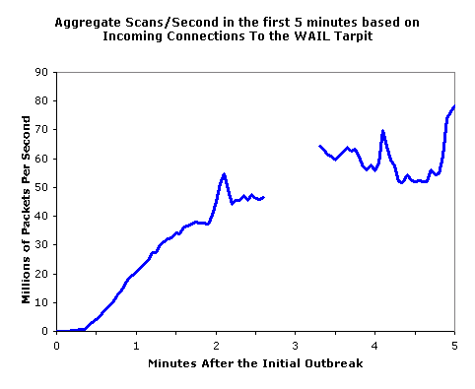
Types of malware
Trojan horse
  Hidden part of some otherwise useful software
  Today often on a Web page (Active-X, plugin)
Virus
  infection by receiving object (e.g., e-mail attachment), actively executing
  self-replicating: propagate itself to other hosts, users
Worm:
  infection by passively receiving object that gets itself executed
  self- replicating: propagates to other hosts, users
Sapphire Worm: aggregate scans/sec
in first 5 minutes of outbreak (CAIDA, UWisc data)

Slide 5
Denial of service
Bad guys can attack servers and network infrastructure
  Denial of service (DoS): attackers make resources (server, bandwidth) unavailable to legitimate traffic by overwhelming resource with bogus traffic
1. select target
2. break into hosts around the network
3. send packets toward target from compromised hosts
target

Slide 6
Packet Sniffing
The bad guys can sniff packets
  broadcast media (shared Ethernet, wireless)
  reads/records all packets (e.g., including passwords!) passing by
A
C
src:B dest:A payload
B
  Wireshark software is an example of a packet-sniffer

Slide 7
IP spoofing
The bad guys can use false source addresses
  IP spoofing: send packet with false source address
A
C
src:B dest:A payload
B

Slide 8
Record and playback
The bad guys can record and playback
  sniff sensitive info (e.g., password), and use later
    password holder is the legit user from system point of view
C
A
src:B dest:A user: B; password: foo
B

Slide 9



Secure communication
Bob and Alice want to communicate securely.
Trudy (intruder) may intercept, delete, add messages
Alice
Bob
channel
data, control messages
secure
sender
secure
receiver
data
data
Trudy

Slide 10
Cryptography
“… is the practice and study of techniques for secure communication”[Wikipedia].
Goals:
Confidentiality: only sender, intended receiver should “understand” message contents
  sender encrypts message
  receiver decrypts message
Authentication: sender, receiver want to confirm identity of each other
Message integrity: sender, receiver want to ensure message not altered (in transit, or afterwards) without detection
Access and availability: services must be accessible and available to users

Slide 11
The language of cryptography
Alice’s
encryption
key
Bob’s
decryption
key
K
K
A
B
plaintext
encryption
algorithm
ciphertext
decryption
algorithm
plaintext
m plaintext message
K_{A}(m) ciphertext, encrypted with key K_{A}
m = K_{B}(K_{A}(m))

Slide 12
Simple encryption scheme
substitution cipher: substituting one thing for another
  monoalphabetic cipher: substitute one letter for another
plaintext: abcdefghijklmnopqrstuvwxyz
ciphertext: mnbvcxzasdfghjklpoiuytrewq
E.g.:
Plaintext: bob. i love you. alice
ciphertext: nkn. s gktc wky. mgsbc
Key: the mapping from the set of 26 letters to the set of 26 letters

Slide 13
Types of Cryptography
Crypto often uses keys:
  Algorithm is known to everyone
  Only “keys” are secret
Public key cryptography
  Involves the use of two keys
Symmetric key cryptography
  Involves the use one key
Hash functions
  Involves the use of no keys
  Nothing secret: How can this be useful?

Slide 14
Message Integrity
Allows communicating parties to verify that received messages are authentic.
  Content of message has not been altered
  Source of message is who/what you think it is
  Message has not been replayed
  Sequence of messages is maintained
Hash functions are useful here.

Slide 15
Message Digests
Function H( ) that takes as input an arbitrary length message and outputs a fixed-length string: “message signature”
H( ) is often called a “hash function”
To be able check the integrity of a message:
Sender sends the message signature along with the message
Receiver applies the hash function on the received message and compares it to the message signature
large
message
m
H: Hash
Function
H(m)
Desirable properties:
  Easy to calculate
  Irreversibility: Can’t determine m from H(m)
  Collision resistance: Computationally difficult to produce m and m’ such that H(m) = H(m’)
  Seemingly random output

Slide 16
Symmetric key cryptography
K
K
plaintext
message, m
encryption
algorithm
ciphertext
decryption
algorithm
plaintext
K (m)
m = K(K(m))
symmetric key crypto: Bob and Alice share same (symmetric) key: K
Q: how do Bob and Alice agree on key value?

Slide 17
Public Key Cryptography
Problem with symmetric keys cryptography:
  requires sender, receiver know shared secret key
  Q: how to agree on key in first place (particularly if never “met”)?
public key cryptography
radically different approach [Diffie-Hellman76, RSA78]
sender, receiver do not share secret key
public encryption key known to all
private decryption key known only to receiver

Slide 18
IP Vulnerabilities
• Unencrypted transmission
– Eavesdropping possible at any intermediate host during routing
• No source authentication
– Sender can spoof source address, making it difficult to trace packet back to
attacker
• No integrity checking
– Entire packet, header and payload, can be modified while en route to
destination, enabling content forgeries, redirections, and man-in-the-middle
attacks
• No bandwidth constraints
– Large number of packets can be injected into network to launch a denial-ofservice attack
– Broadcast addresses provide additional leverage

Slide 19
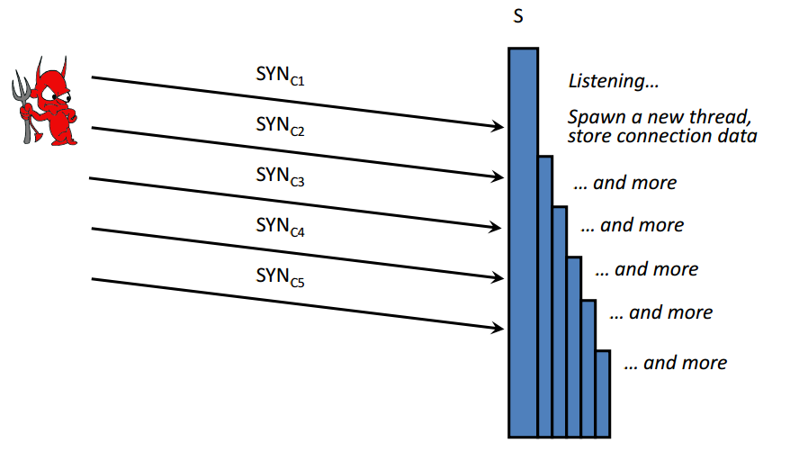
TCP syn flooding attack

Slide 20
References
Some of the slides are from the course of CPSC626 network security
Some slides from Computer Networking: A Top Down Approach, 5th edition. Jim Kurose, Keith Ross, Addison-Wesley, April 2009.

