Slide 1
Transmission Media
CPSC 441 Tutorial – April 2, 2012
TA: Ruiting zhou

Slide 2
Residential access: cable modems
Does not use telephone infrastructure
Instead uses cable TV infrastructure
It is integrated into the cable TV infrastructure analogously to DSL which uses the existing telephone network.
DSL: Digital subscriber line, provide internet access by transmitting digital data over the wires of a local telephone network
HFC: hybrid fiber coax
Asymmetric: up to 30 Mbps downstream, 2 Mbps upstream
network of cable and fiber attaches homes to ISP router
homes share access to router
unlike DSL, which has dedicated access

Slide 3
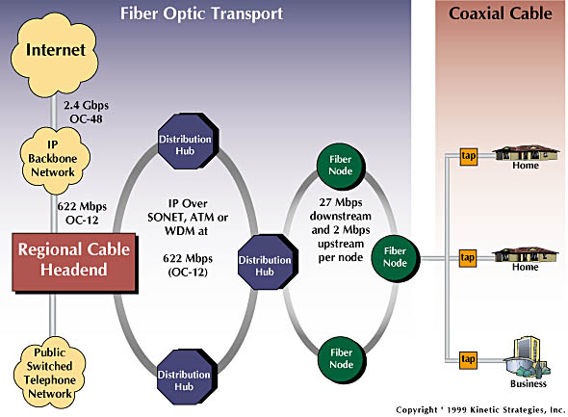
Residential access: cable modems
tap, a device that monitors data on a computer network

Slide 4
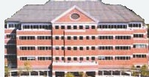
Cable Network Architecture: Overview
Typically 500 to 5,000 homes
cable headend
cable distribution
network (simplified)
home

Slide 5
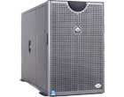
Cable Network Architecture: Overview
server(s)
cable headend
cable distribution
network
home

Slide 6
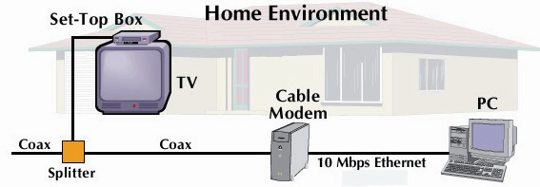
Cable Network Architecture: Overview
cable headend
cable distribution
network (simplified)
home

Slide 7
Cable Network Architecture: Overview
FDM Frequency-division multiplexing
(more shortly):
C
O
N
T
R
O
L
V
I
D
E
O
V
I
D
E
O
V
I
D
E
O
V
I
D
E
O
V
I
D
E
O
V
I
D
E
O
D
A
T
A
D
A
T
A
1
2
3
4
5
6
7
8
9
Channels
cable headend
cable distribution
network
home

Slide 8
Fiber to the Home
ONT
Internet
optical fibers
optical fiber
ONT
OLT
optical
splitter
central office
Optical links from central office to the home
Two competing optical technologies:
Passive Optical network (PON) : uses electrically powered switching equipment, such as a router or a switch aggregator, to manage signal distribution and direct signals to specific customers
Active Optical Network (AON): uses optical splitters to separate and collect optical signals as they move through the network
Much higher Internet rates; fiber also carries television and phone services
ONT

Slide 9
Home networks
Typical home network components:
DSL or cable modem
router/firewall/NAT
Ethernet
wireless access point
wireless
laptops
to/from
cable
headend
cable
modem
router/
firewall
wireless
access
point
Ethernet

Slide 10
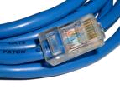
Physical Media
Bit: propagates between transmitter/rcvr pairs
physical link: what lies between transmitter & receiver
guided media:
signals propagate in solid media: copper, fiber, coax
unguided media:
signals propagate freely, e.g., radio
Twisted Pair (TP)
two insulated copper wires
Category 3: traditional phone wires, 10 Mbps Ethernet
Category 5: 100 Mbps Ethernet

Slide 11
Physical Media: coax, fiber
Coaxial cable:
two concentric copper conductors
bidirectional
baseband:
single channel on cable
legacy Ethernet
broadband:
multiple channels on cable
HFC
Fiber optic cable:
glass fiber carrying light pulses, each pulse a bit
high-speed operation:
high-speed point-to-point transmission (e.g., 10’s-100’s Gbps)
low error rate: repeaters spaced far apart ; immune to electromagnetic noise

Slide 12
Physical media: radio
signal carried in electromagnetic spectrum
no physical “wire”
bidirectional
propagation environment effects:
reflection
obstruction by objects
interference
Radio link types:
terrestrial microwave
e.g. up to 45 Mbps channels
LAN (e.g., WiFi)
11 Mbps, 54 Mbps
wide-area (e.g., cellular)
3G cellular: ~ 1 Mbps
satellite
Kbps to 45 Mbps channel (or multiple smaller channels)
270 msec end-end delay
geosynchronous versus low altitude

Slide 13
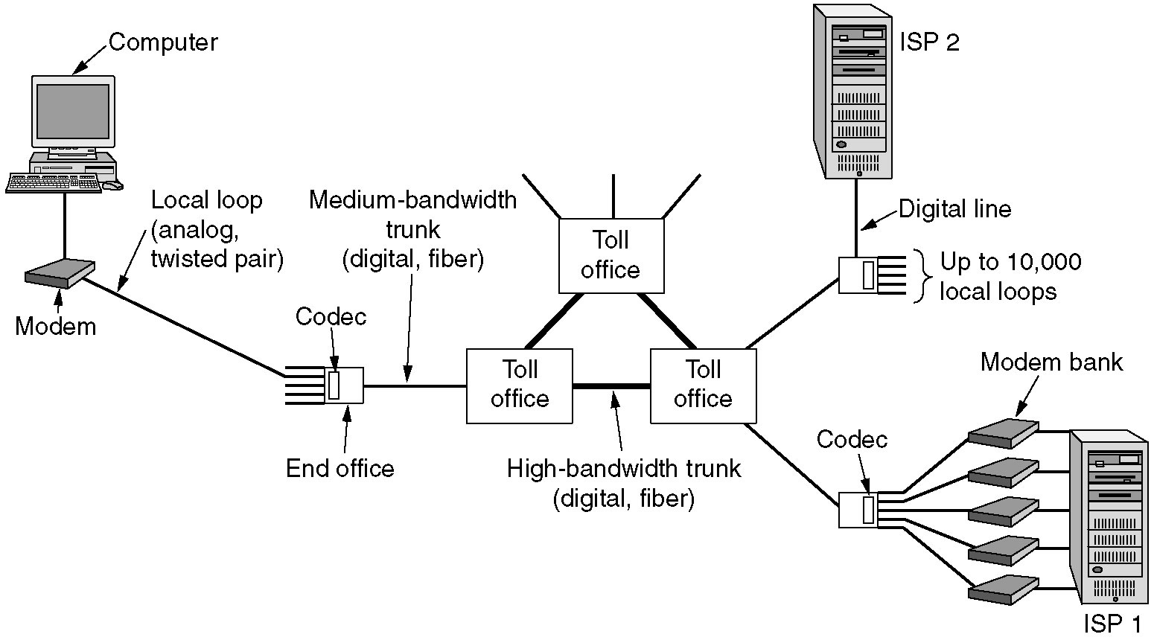
Analog and Digital Transmissions
use of both analog and digital transmissions for a computer to computer call. Conversion is done by the modems and codecs.

Slide 14
Data Encoding Techniques
Digital Data, Analog Signals [modem]
Digital Data, Digital Signals [wired LAN]
Analog Data, Digital Signals [codec]
Frequency Division Multiplexing (FDM)
Wave Division Multiplexing (WDM) [fiber]
Time Division Multiplexing (TDM)
Pulse Code Modulation (PCM) [T1]
Delta Modulation

Slide 15
Digital Data, Digital Signals [the technique used in a number of LANs]
Digital signal – is a sequence of discrete, discontinuous voltage pulses.
Bit duration : the time it takes for the transmitter to emit the bit.
Issues
Bit timing
Recovery from signal
Noise immunity

Slide 16
Binary Encoding
NRZ (non-return to zero)
NRZI (NRZ inverted)
Manchester (used by IEEE 802.3, 10 Mbps Ethernet)

Slide 17
Non-Return to Zero (NRZ)
Encode binary data onto signals
e.g., 0 as low signal and 1 as high signal
voltage does not return to zero between bits
known as Non-Return to Zero (NRZ)
Bits
0
0
1
0
1
1
1
1
0
1
0
0
0
0
1
0
NRZ

Slide 18
Problem: Consecutive 1s or 0s
Low signal (0) may be interpreted as no signal
High signal (1) leads to baseline wander
Unable to recover clock
sender’s and receiver’s clock have to be precisely synchronized
receiver resynchronizes on each signal transition
clock drift in long periods without transition
sender’s clock
receiver’s clock

Slide 19
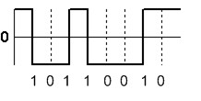
NRZI
Non-Return to Zero Inverted (NRZI)
has a transition at a clock boundary if the bit being transmitted is “1”
Stay at current signal (maintain voltage level) to encode/ transmit a “zero”
Solves the problem of consecutive ones (shifts to 0s)
NRZI can have long series of zeros , still unable to recover clock

Slide 20
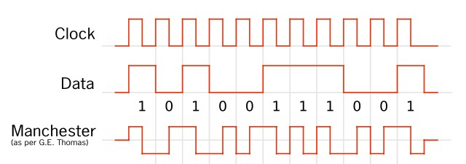
Manchester
Manchester (in IEEE 802.3 – 10 Mbps Ethernet)
Split cycle into two parts
Send high--low for “1”, low--high for “0”
Transmit XOR of NRZ encoded data and the clock
Clock signal can be recovered from the encoded data.
Only 50% efficient (1/2 bit per transition): double the transmission rate.

Slide 21
Different Encoding Schemes
Bits
0
0
1
0
1
1
1
1
0
1
0
0
0
0
1
0
NRZ
Clock
Manchester
NRZI

Slide 22
Reference
CPSC 441 Chapter 1 Slides 16-28
http://en.wikipedia.org/wiki/File:NRZI_example.png
CS716 Advanced Computer Networks by Dr. Amir Qayyum

