Slide 1
Introduction to C
CPSC 441 Tutorial – January 16, 2012
TA: Maryam Elahi

Slide 2
C VS. Java
C program
Collection of functions
One function “main()” is called by the operating system as the starting function
Compile output: executable file. Running the executable (default name a.out) starts main function
Typically, single program with all user code linked in – but can be dynamic libraries (.dll, .so)
Java program
Collection of classes
Class containing main method is starting class
Compile output: jar file. Running “java StartClass” invokes StartClass.main method
JVM loads other classes as required
C++ is C extended with object oriented functionality (and more!)

Slide 3
Simple C/C++ example
// C
#include <stdio.h>
int main(int argc, char *argv[])) {
printf("Hello world!\n");
return 0;
}
----------------------------------------
// C++
#include <iostream>
using namespace std;
int main(int argc, char *argv[]) {
cout << "Hello world!" << endl;
return 0;
}

Slide 4
Compiling C
gcc invokes C compiler
gcc translates C program into executable for some target
default file name a.out
Example: compile and run hello.c
$ gcc hello.c
$ a.out
Hello, World!
$ gcc hello.c –o hello
$ ./hello
Hello, World!

Slide 5
Compiling C++
To compile C++, use g++
Example: compile and run hello.c
$ g++ hello.c
$ a.out
Hello, World!
$ g++ hello.c –o hello
$ ./hello
Hello, World!

Slide 6
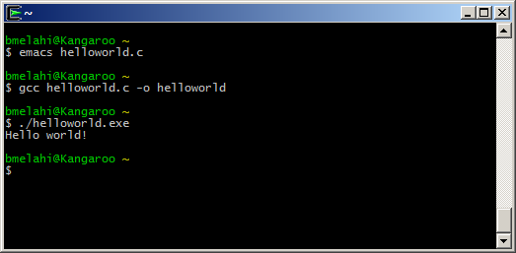
Hands on
Demo:
1. Write code
2. Compile
3. Run

Slide 7
Some OPTIONS
Some useful command line options:
[-o file]: specifies the output file for object or executable
[-Wall]: show all warnings (highly recommended)
[-l libnam]: Links the library libname, e.g., -lsocket
If you get errors saying the library cannot be found, make sure the path is correctly set, and you do have the libraries you need.

Slide 8
main Arguments
int main(int argc, char *argv[])
argc: number of arguments passed to the program
argv: array of strings showing command line arguments
Name of executable + space-separated arguments
Name of executable is stored in argv[0]
The return value is int
convention: 0 means success, > 0 some error

Slide 9
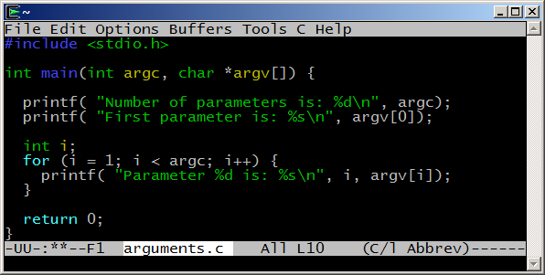
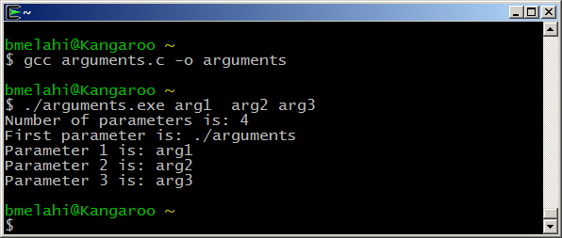
Passing arguments example

Slide 10
Primitive Data Types
Name | Description | Size* (32bit) | Range* (32bit system)
char | Character or small integer. | 1byte | signed: -128 to 127 unsigned: 0 to 255
short int (short) | Short Integer. | 2bytes | signed: -32768 to 32767 unsigned: 0 to 65535
int | Integer. | 4bytes | signed: -2147483648 to 2147483647 unsigned: 0 to 4294967295
long int (long) | Long integer. | 4bytes | signed: -2147483648 to 2147483647 unsigned: 0 to 4294967295
bool | Boolean value. It can take one of two values: true or false. | 1byte | true or false
float | Floating point number. | 4bytes | +/- 3.4e +/- 38 (~7 digits)
double | Double precision floating point number. | 8bytes | +/- 1.7e +/- 308 (~15 digits)
long double | Long double precision floating point number. | 8bytes | +/- 1.7e +/- 308 (~15 digits)
*Size and Range depend on the system the program is compiled for.
From: http://www.cplusplus.com/doc/tutorial/variables/

Slide 11
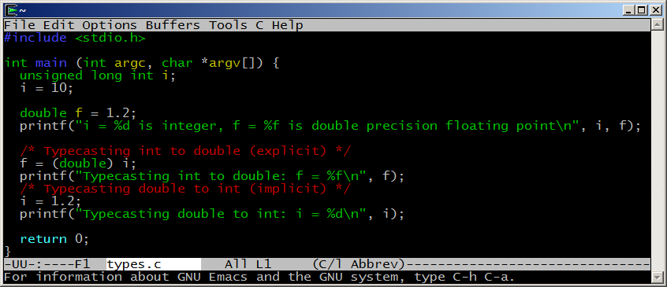
Typecasting example
Caution: be careful with typecasting, especially implicit conversions.

Slide 12
Arrays
Array declaration: int a[];
C/C++ arrays have no length attribute!
Note: when passing an array to a function, typically you have to pass the array size as a separate argument as well.
You have to take care of array bounds yourself
int input[10];
input[10] = 20; // out of bound!
input[-1] = 5; // out of bound!
This code could compile and run, but most likely, you’ll see unexpected behavior or crash your program.
Array’s name is a pointer to its first element

Slide 13
Structures
C struct is a way to logically group related types
Is very similar to (but not same as) C++/java classes
Is somehow a class without methods
Members are always public (no encapsulation concept in c)
A struct component can be of any type (including other struct types), but cannot be recursive
Example:
struct address{
char* street;
char* city;
char* zip;
};
struct student{
char* name;
unsigned int ID;
struct Address;
};

Slide 14
Pointers
A pointer is just an address to some memory location.
Another variable
Some dynamically allocated memory
Some function
NULL
int *p = &x;
int x = 4;
&x (address of x)
4
int *p = malloc (sizeof int);
Address of allocated
memory
?
allocated
memory

Slide 15
Pointers in C
Declaration: using “*” symbol before variable name.
int * ptr = NULL; //creates pointer to integer
Allocation: allocate new memory to a pointer using the keyword malloc in C (new in C++)
int *p = malloc(sizeof(int));
int *p = (int *) malloc(10 * sizeof (int)); // array of int
Deallocation: clear the allocated memory when you are done using it. Otherwise, Memory Leak!!!
free(p);
Dereferencing: accessing data from the pointer x = *p;

Slide 16
String
In C, string is an array of char terminated with “\0” (a null terminator: ‘\0’)
“hello” = hello\0
Declaring and initialize a string
char str1[10]; // a string of 10 characters
char str2[10]={“hello”}; //initialized string
char *strp1; // a char pointer
char *strp2 = malloc(sizeof(char)*10);
// a char pointer initialized to point to a chunck of memory.

Slide 17
String library
#include <string.h>
Functions:
char *strcpy(char *dest, char *source)
copies chars from source array into dest array up to NUL
char *strncpy(char *dest, char *source, int num)
copies chars; stops after num chars if no NUL before that; appends NUL
int strlen(const char *source)
returns number of chars, excluding NUL
char *strchr(const char *source, const char ch)
returns pointer to first occurrence of ch in source; NUL if none
char *strstr(const char *source, const char *search)
return pointer to first occurrence of search in source

Slide 18
Formatted strings
int sscanf(char *string, char *format, ...)
parse the contents of string according to format
return the number of successful conversions
int sprintf(char *buffer, char *format, ...)
produce a string formatted according to format directives and place this string into the buffer
return number of successful conversions

Slide 19
Formatted strings
Formatting codes for sscanf
Code | meaning | variable
%c | matches a single character | char
%d | matches an integer in decimal | int
%f | matches a real number (ddd.dd) | float
%s | matches a string up to white space | char *
%[^c] | matches string up to next c char | char *
http://www.cs.columbia.edu/~hgs/teaching/ap/slides/CforJavaProgrammers.ppt

Slide 20
Formatted strings
Formatting codes for sprintf
Values normally right-justified; use negative field width to get left-justified
Code | meaning | variable
%nc | char in field of n spaces | char
%nd | integer in field of n spaces | int, long
%n.mf | real number in width n, m decimals | float, double
%n.mg | real number in width n, m digits of precision | float, double
%n.ms | first m chars from string in width n | char *
http://www.cs.columbia.edu/~hgs/teaching/ap/slides/CforJavaProgrammers.ppt

Slide 21
Standard C library
#include <stdio.h>
Formatted I/O
int scanf(const char *format, ...)
read from standard input and store according to format.
int printf(const char *format, ...)
write to standard output according to format
File I/O: FILE *
FILE *fopen(const char *path, const char *mode)
open a file and return the file descriptor
int fclose(FILE *stream)
close the file; return 0 if successful, EOF if not

Slide 22
Standard C library
#include <stdio.h>
Other I/O operations:
int getchar()
read the next character from stdin; returns EOF if none
char *fgets(char *buf, int size, FILE *in)
read the next line from a file into buf
int fputs(const char *str, FILE *out)
output the string to a file, stopping at ‘\0’
returns number of characters written or EOF

Slide 23
Lets write some code!
Sample C program:
Input: list of grades of student homework.
Output: The computed final marks.

Slide 24
References
C for Java programmers:
http://faculty.ksu.edu.sa/jebari_chaker/papers/C_for_Java_Programmers.pdf http://www.cs.columbia.edu/~hgs/teaching/ap/slides/CforJavaProgrammers.ppt
C tutorial:
http://www.cprogramming.com/tutorial/c-tutorial.html
Socket programming with C: (for next session)
Beej's Guide to Network Programming Using Internet Sockets http://beej.us/guide/bgnet/output/html/multipage/index.html

