Slide 1
Qualitative Analysis
DATA 201: Thinking With Data
Winter 2022
Jonathan Hudson, Ph.D
Instructor
Department of Computer Science
University of Calgary
Tuesday, March 22, 2022

Slide 2
What is Qualitative Analysis?
Why Qualitative Analysis?

Slide 3
What is?
Analyze (initially) unquantifiable information
Focus on how and why (sometimes what)

Slide 4
Why?
Identify & characterize previously undescribed behaviour or phenomena
Understand the rationale behind quantitative differences
Help form hypotheses for quantitative analysis

Slide 5
Sources of Qualitative Data

Slide 6
Sources of Qualitative Data
Places
Actions
Speech and Text
Artifacts and Documents
People’s thoughts, feelings, emotions, judgements

Slide 7
Methods to Obtain Qualitative Data

Slide 8
Methods to Obtain Qualitative Data
Interviews
Observation
Diary Study
Surveys (open-response)
Focus Group
Field Study

Slide 9
Recording Qualitative Data

Slide 10
Recording Qualitative Data
Video Recording
Audio Recording
Interview
Transcripts
Photography
Gathering/Sampling
Documents or Artifacts
Observation Field Notes

Slide 11
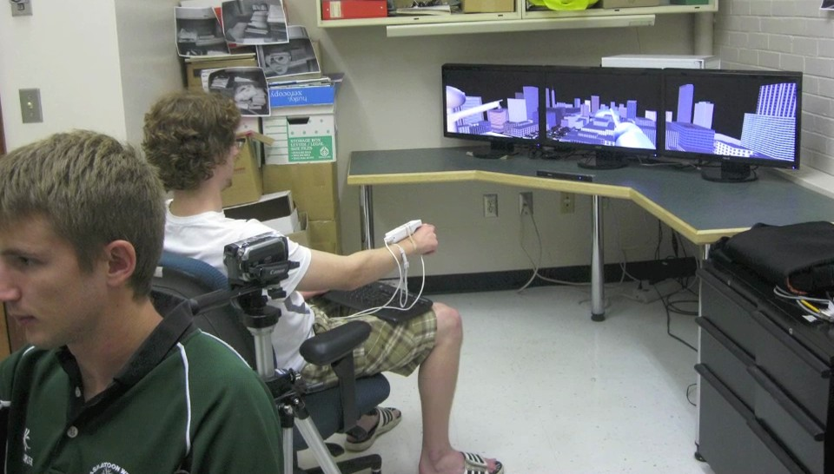
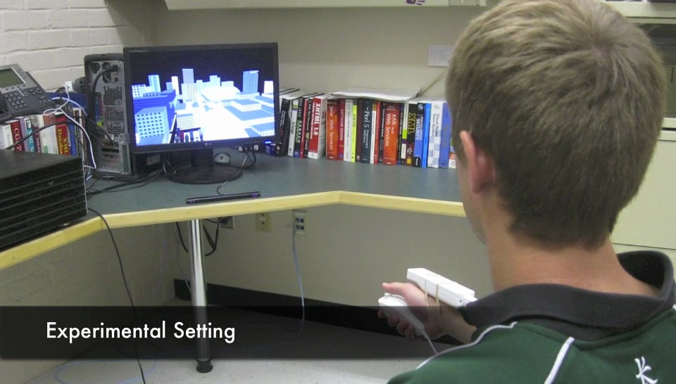

Slide 12
How to Make Sense of Qualitative Data?

Slide 13
Segmentation
Well, we were in it. Every one was caught in it and the small rain would not quiet it. "Good-night, Catherine," I said out loud. "I hope you sleep well. If it’s too uncomfortable, darling, lie on the other side," I said. "I’ll get you some cold water. In a little while it will be morning and then it won’t be so bad. I’m sorry he makes you so uncomfortable. Try and go to sleep, sweet."
I was asleep all the time, she said. You’ve been talking in your sleep.
- Ernest Hemingway, A Farewell to Arms

Slide 14
Segmentation
Well, we were in it. Every one was caught in it and the small rain would not quiet it. "Good-night, Catherine," I said out loud. "I hope you sleep well. If it’s too uncomfortable, darling, lie on the other side," I said. "I’ll get you some cold water. In a little while it will be morning and then it won’t be so bad. I’m sorry he makes you so uncomfortable. Try and go to sleep, sweet."
I was asleep all the time, she said. You’ve been talking in your sleep.
- Ernest Hemingway, A Farewell to Arms

Slide 15
Segmentation
Its vanished trees, the trees that had made way for Gatsby’s house, had once pandered in whispers to the last and greatest of all human dreams; for a transitory enchanted moment man must have held his breath in the presence of this continent, compelled into an aesthetic contemplation he neither understood nor desired, face to face for the last time in history with something commensurate to his capacity for wonder.
- F. Scott Fitzgerald, The Great Gatsby

Slide 16
Qualitative Coding
Open Coding
“The story will emerge from the data”
Grounded Theory
Can be used to develop a structured coding schema
Structured Coding
“I know what I’m looking for”
Pre-defined codes, clearly defined rubric

Slide 17
Tips
Check against collaborators’ alternate perspectives
Record what you observe, not what you interpret

Slide 18
Software
Chronovis (OSX only) http://chronoviz.com
NVivo http://www.qsrinternational.com
Dedoose (web-based) http://www.dedoose.com
Atlas.ti http://atlasti.com
Saturate (web-based, text-only) http://www.saturateapp.com

Slide 19
Qualitative/Quantitative Analysis
Draft Process Example

Slide 20
Draft Process
Typical sports draft processes consist of both quantitative and qualitative data analysis
Quantitatively -> player stats prior to draft at lower competition levels and younger age, as well as measurements from combine/health assessments
Qualitatively -> scouting reports, watching tape, interviews
What would be your arguments for quantitative?
What would be your arguments for qualitative?

Slide 21
Draft Process
One argument
  Qualitative are replaceable by better ‘analytics’ as we introduce tools that can measure things scouts are currently ‘observing’.
  Tracking data and machine learning based analytics will provide better insight than tape in future
  (Human brain is acting like flawed machine learning pattern algorithm)
  Interviews have danger of bias of avoiding hiring those who are different without assessing anything about capability of athlete
  https://vidcruiter.com/video-interviewing/hiring-biases/#:~:text=Interviewer%20bias%20is%20when%20different,simply%20because%20of%20interviewer%20partiality.

Slide 22
Draft Process
Opposing argument
  Once you decide to measure and reward something that is all you will get
    (Goodhart’s Law) https://whyisthisinteresting.substack.com/p/why-is-this-interesting-the-goodharts
    Wells Fargo Cross-Selling https://hbr.org/2019/09/dont-let-metrics-undermine-your-business
  A very messy process to convert some concepts to a stat and in doing so you may create a measurement bias.
  Integrating a stat with high randomness or lack of control on the athletes side can destroy usefulness of combined statistic.
    Adding NHL goalies save percentage to a summative stat for defensemen
  Human brain flexibility is an asset.

Slide 23
Onward to …
More Data Science or
Computer Science Courses?
Jonathan Hudson
jwhudson@ucalgary.ca
https://pages.cpsc.ucalgary.ca/~jwhudson/

