Slide 1
Presentations
DATA 201: Thinking With Data
Winter 2022
Jonathan Hudson, Ph.D
Instructor
Department of Computer Science
University of Calgary
Tuesday, March 22, 2022

Slide 2
Why presentations?

Slide 3
Main Components

Slide 4
Main Components
Contents
Tools
You

Slide 5
Contents

Slide 6
General Structure

Slide 7
General Structure
Title
Message / Goal
Outline (maybe)
Body
Conclusion / Summary (maybe)

Slide 8
Pay Attention To

Slide 9
Pay Attention To
Types of presentation
Audience
Time

Slide 10
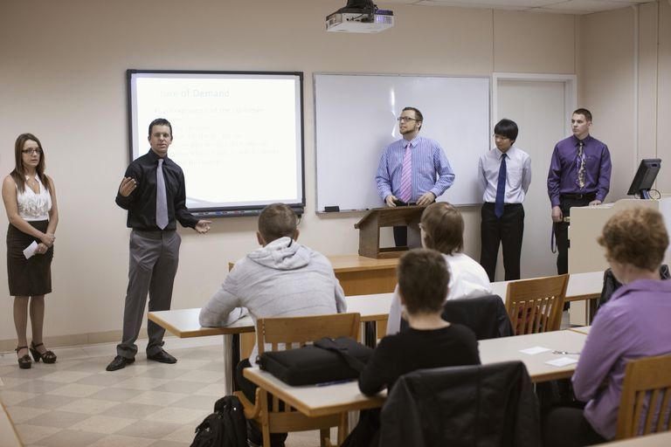
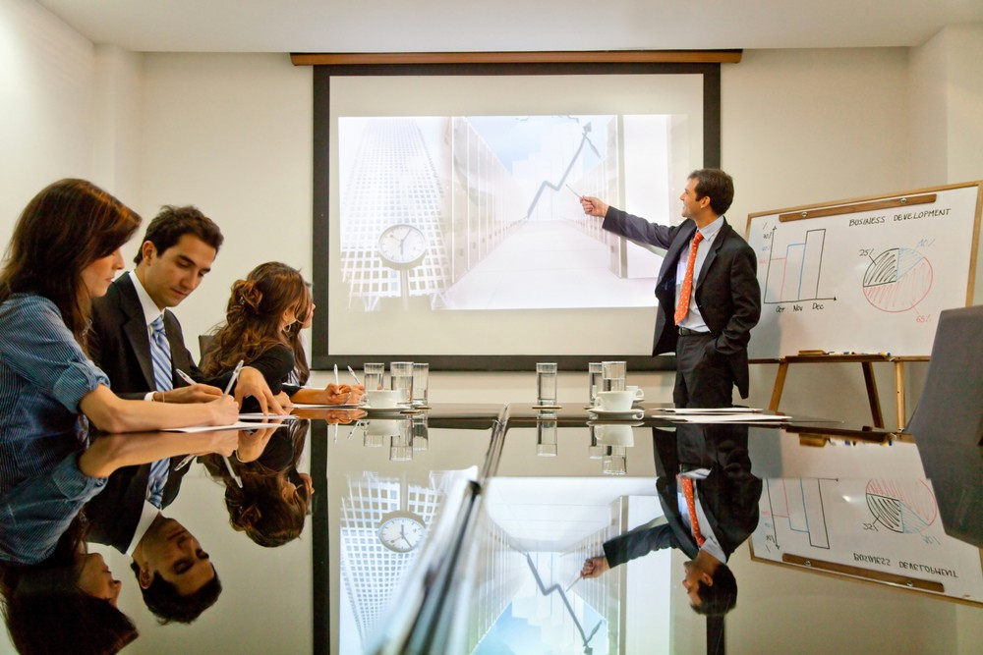
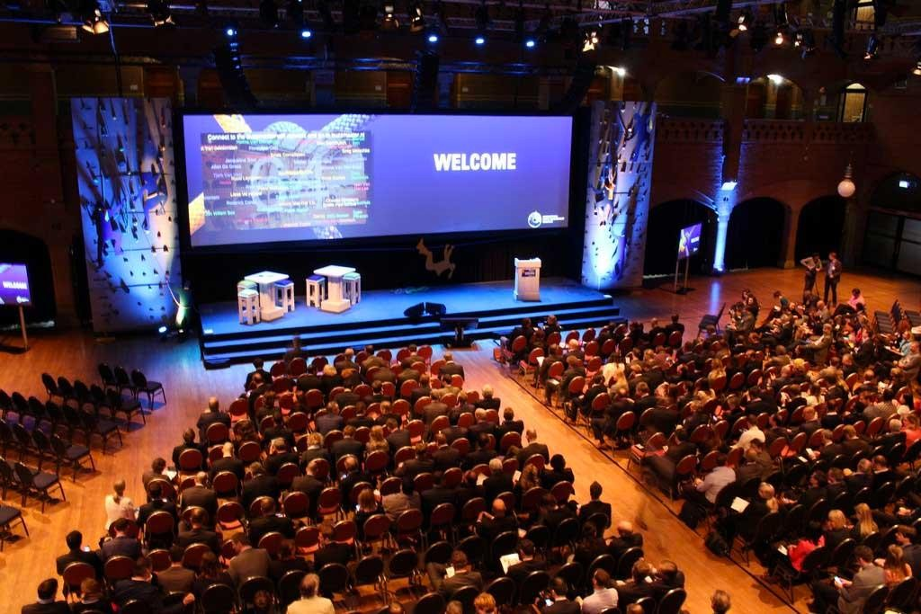
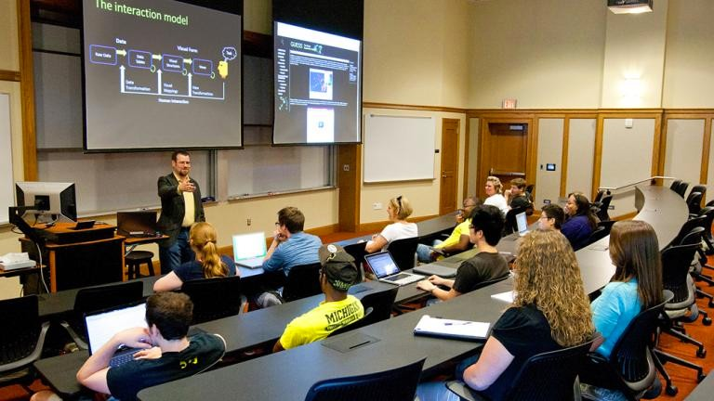
Types of Presentation

Slide 11
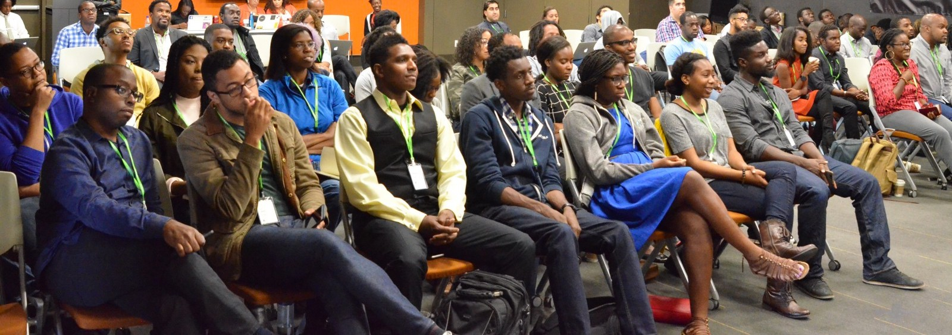
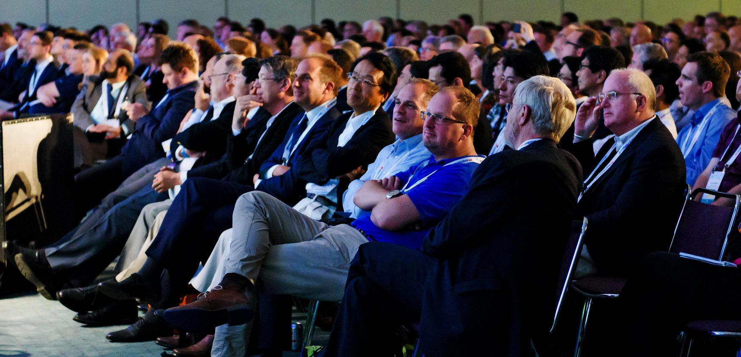
Audience

Slide 12


Time

Slide 13
Tools

Slide 14
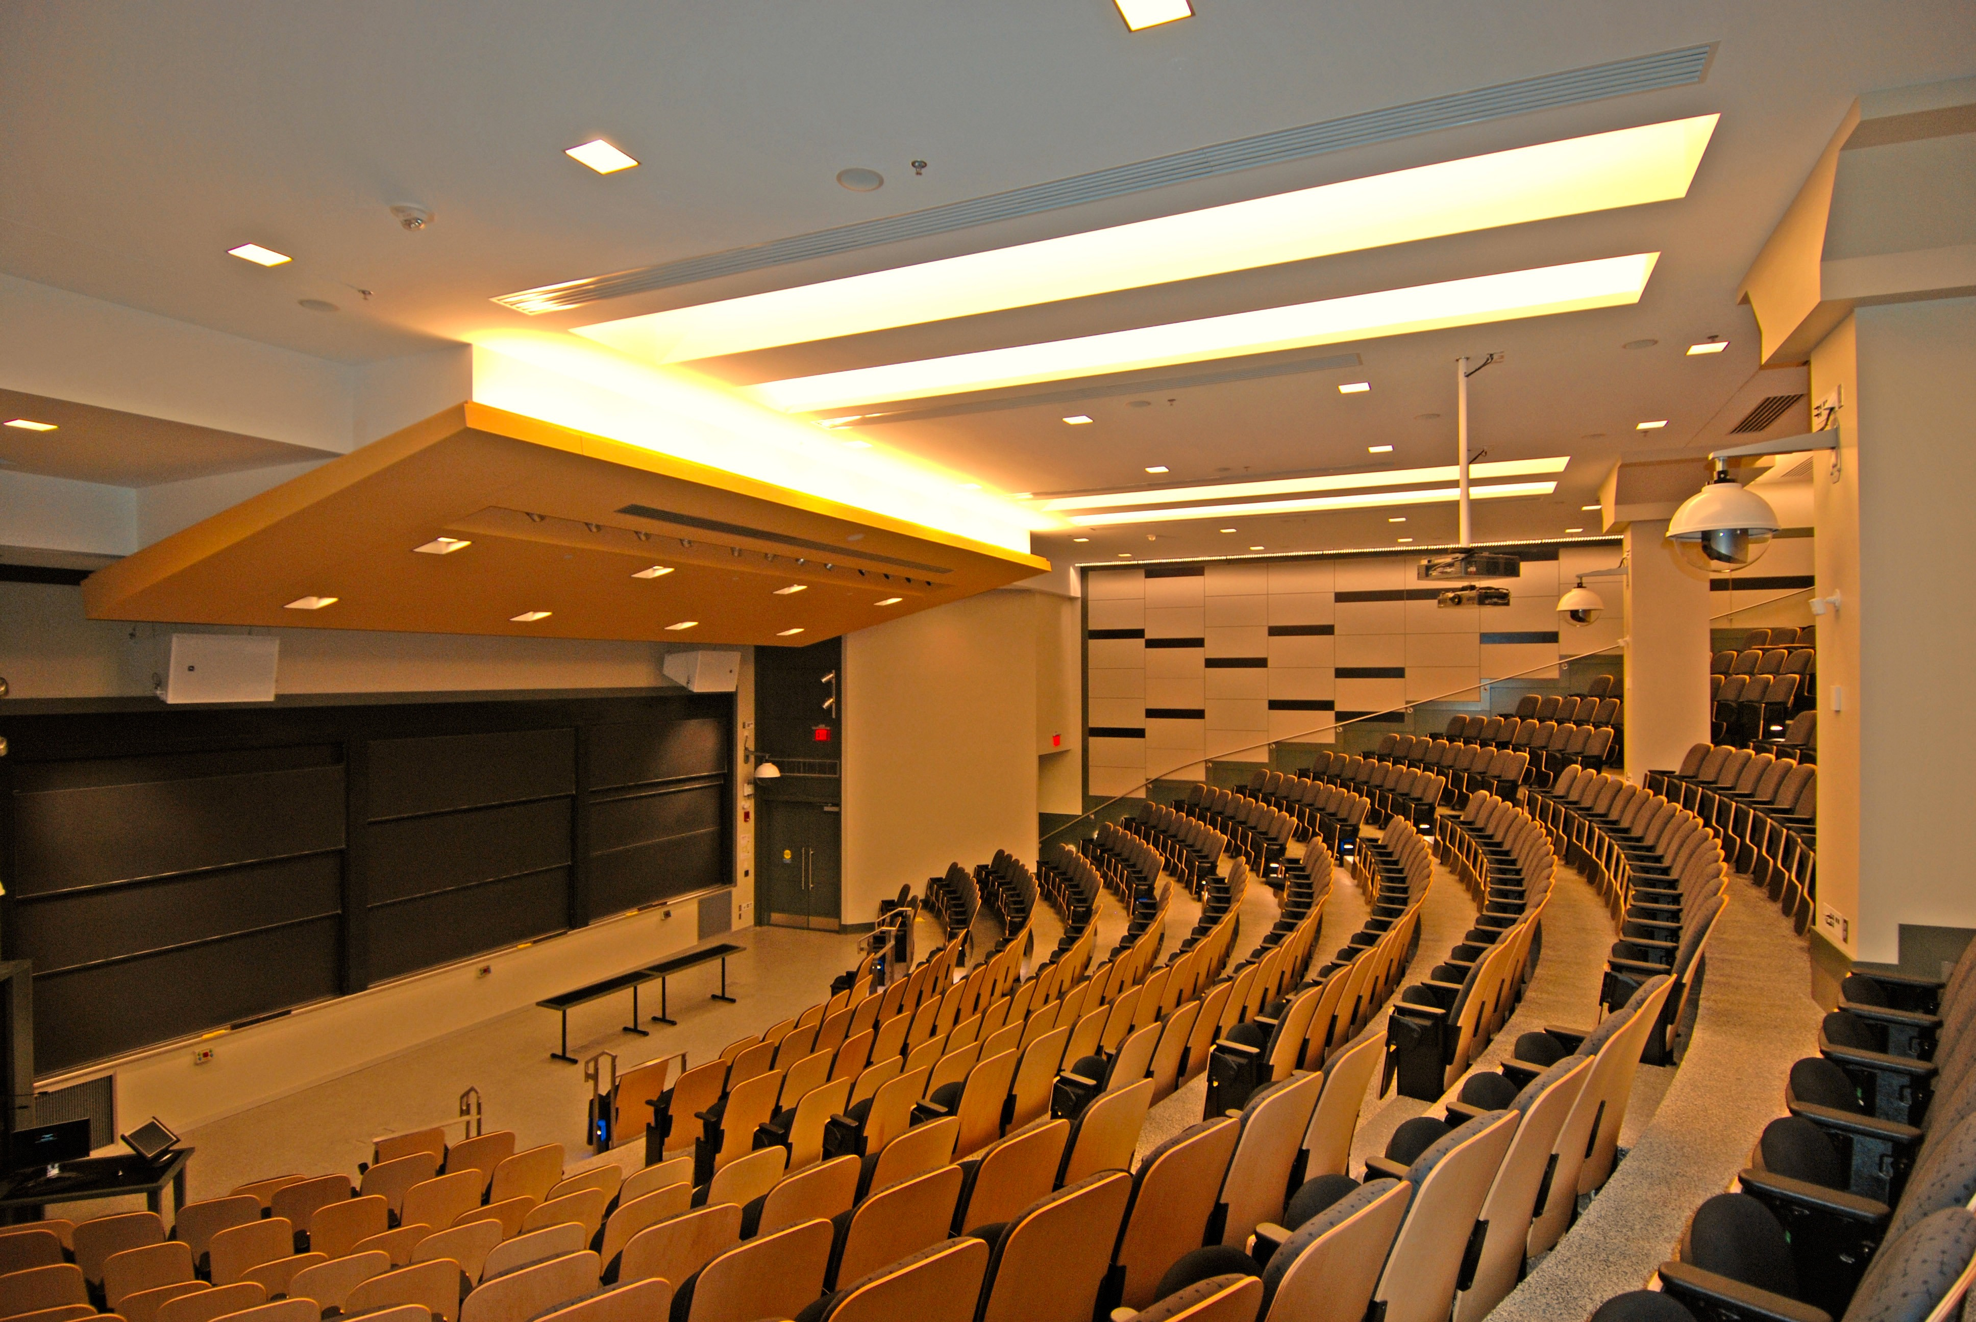
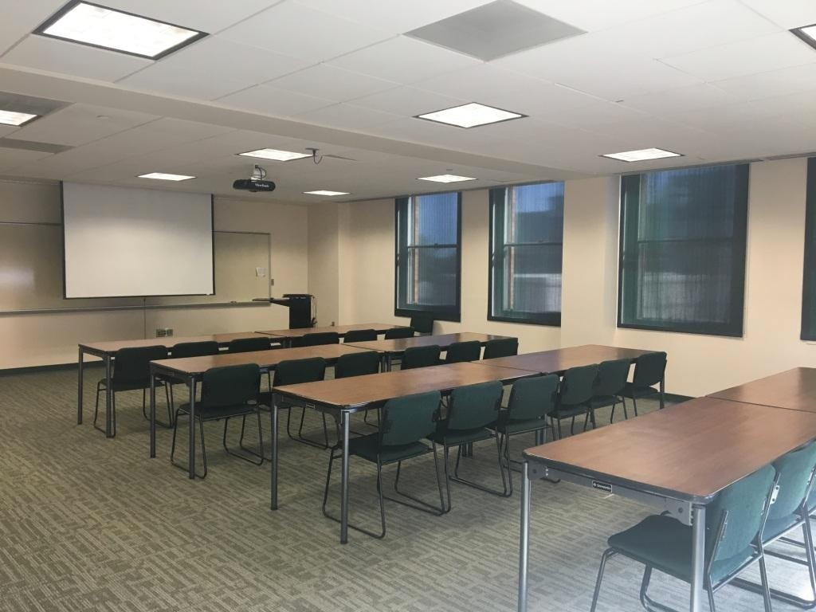
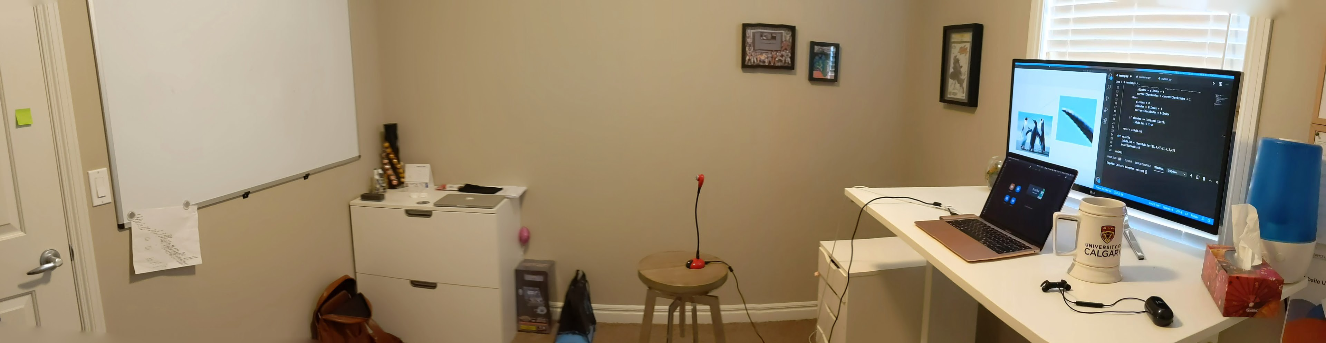
Environment

Slide 15


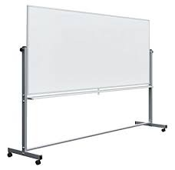


Slide 16
Slides

Slide 17
Slides
Keep slides simple, what is your core message
  Focus on your audiences needs
  Connect content to people (stories)
Can’t listen and read different text at the same time
  ‘Each equation loses half your audience’
Limit distractions and points of interests in slides
Typeface
serif vs. sans-serif
Colours

Slide 18
Slides should be simple because they are just tools to help us deliver contents to the audience. They are not the presentation. In addition, it is difficult to read and listen at the same time. So having a lot of text like this slide is bad.
You should also take typefaces and colours in consideration. It is easier to see sans-serif on screens; serif on paper. Avoid using red and green together to generally advised because red-green colour blind is the most common kind of colour blindness.
This slide has plenty of bad examples. Remember don’t do this in your presentations!

Slide 19
Slides should be simple because they are just tools to help us deliver contents to the audience. They are not the presentation. In addition, it is difficult to read and listen at the same time. So having a lot of text like this slide is bad.
You should also take typefaces and colours in consideration. It is easier to see sans-serif on screens; serif on paper. Avoid using red and green together to generally advised because red-green colour blind is the most common kind of colour blindness.
This slide has plenty of bad examples. Remember don’t do this in your presentations!

Slide 20
Slides should be simple because they are just tools to help us deliver contents to the audience. They are not the presentation. In addition, it is difficult to read and listen at the same time. So having a lot of text like this slide is bad.
You should also take typefaces and colours in consideration. It is easier to see sans-serif on screens; serif on paper. Avoid using red and green together to generally advised because red-green colour blind is the most common kind of colour blindness.
This slide has plenty of bad examples. Remember don’t do this in your presentations!

Slide 21
Do and Don’t
Less text per slide
Typefaces
  San-serif for screen, serif for paper
Colour
  Has meaning by itself
  Red-green colourblind is most common
Structure does the work for you

Slide 22
Do and Don’t
Less text per slide
Typefaces
  San-serif for screen, serif for paper
Colour
  Has meaning by itself
  Red-green colourblind is most common
Structure does the work for you

Slide 23
You

Slide 24
You
Relax
Enthusiasm and Connection
Eye contact and engage
Posture
Hand gestures
Voice projection
Outfit
Confidence

Slide 25
10 bonus tips
1. Practice
2. Pause, breathe, continue
3. Revise
4. Don’t worry about making mistakes
5. Practice
  Out-loud, talking is slower
6. Practice
  Use tools, screen switching is slower
7. Practice
  Show some else for feedback
8. Practice
  Others often notice grammar mistakes
9. Practice
  Time yourself
10. Practice
  Everyone gets better with time

Slide 26
Onward to …
Quantitative Analysis
Jonathan Hudson
jwhudson@ucalgary.ca
https://pages.cpsc.ucalgary.ca/~jwhudson/

