Slide 1
Charts
DATA 201: Thinking With Data
Winter 2022
Jonathan Hudson, Ph.D.
Instructor
Department of Computer Science
University of Calgary
Tuesday, March 22, 2022

Slide 2
What and Why?

Slide 3
Tables
(are not charts)

Slide 4
Tables
A type of visualization
Mostly values
Colours and formatting
Most accurate way to indicate and compare data
Don’t scale well, and can be hard to draw conclusions from

Slide 5
Tables
If numbers were all that matters it would be all we communicate in papers.
Good scientific papers have both, a table and a visualization like a chart.

Slide 6
Bar/Column Charts

Slide 7
Column Chart / Vertical Bar Chart Bar Chart / Horizontal Bar Chart
70
Apple
52.5
Orange
35
Pear
17.5
Banana
0
Apple
Orange
Pear
Banana
0
17.5
35
52.5
70

Slide 8
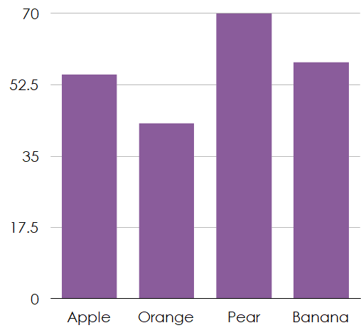
Column Charts
Compare across categories
Ex. What percentage of people like each type of fruit?
Y is response (or count)
X is category
Column charts are best in terms of Y as a response variable
Bar charts work well when labels are long or data is more of a natural horizontal idea (length!)

Slide 9
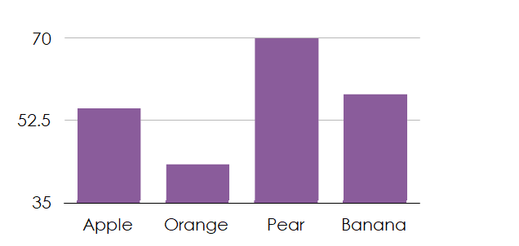
Column Charts
Start your Y axis at 0!
Alternate Y axis origins can be acceptable but when they are used it is because those reading chart understand context of non-zero origin.
Many non-zero origin choices are deceptive.

Slide 10
Wong et al., 2009 (Multi-set Bar Chart) Example of primary/secondary categories
Colour of bar (or texture, etc.) indicates another category for comparison

Slide 11
Histograms

Slide 12
Histograms
100
0-9
75
10-19
50
20-29
30-39
25
40-49
0
0-9
10-19
20-29
30-39
40-49
0
25
50
75
100

Slide 13
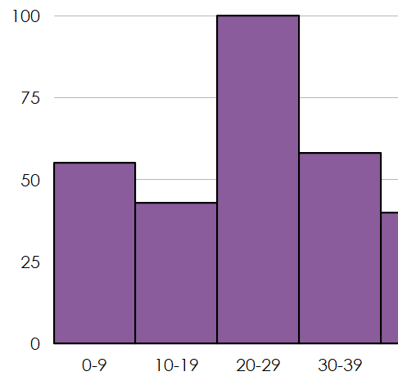
Histograms
Distribution based data
Ex. Student grades, data that might have categories or groupings
Each x in X is a bucket (a smaller range portion of the total range)
Y is response (count in category)
Like bar chart but categories are related as being ranges which are part of a complete range
Range choice can be used to manipulate data’s appearance.

Slide 14
Stacked Charts / Histograms

Slide 15
Stacked Charts
300
225
150
75
0
Canada
USA
Japan
China

Slide 16
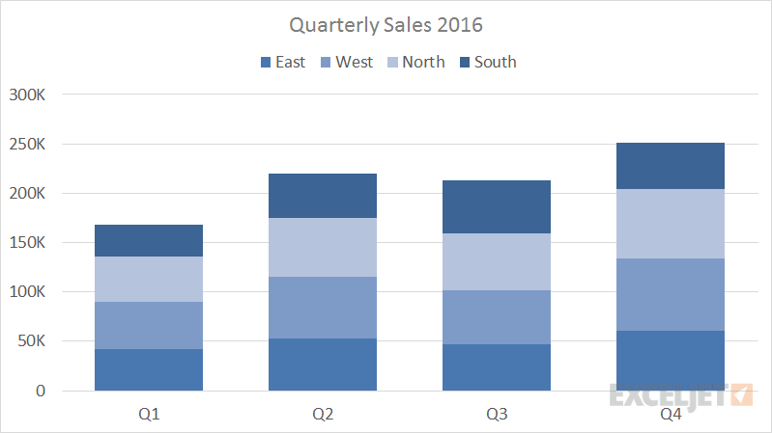
Stacked Charts
Variant of bar type charts
Part to whole comparisons
Primary and secondary categories, but the secondary categories are all part of the whole for each primary category
Ex. Sales per quarter for company, but also divided by area of country within that quarter.
Note that secondary categories become hard to numerically compare.

Slide 17
Box-And-Whisper Charts

Slide 18
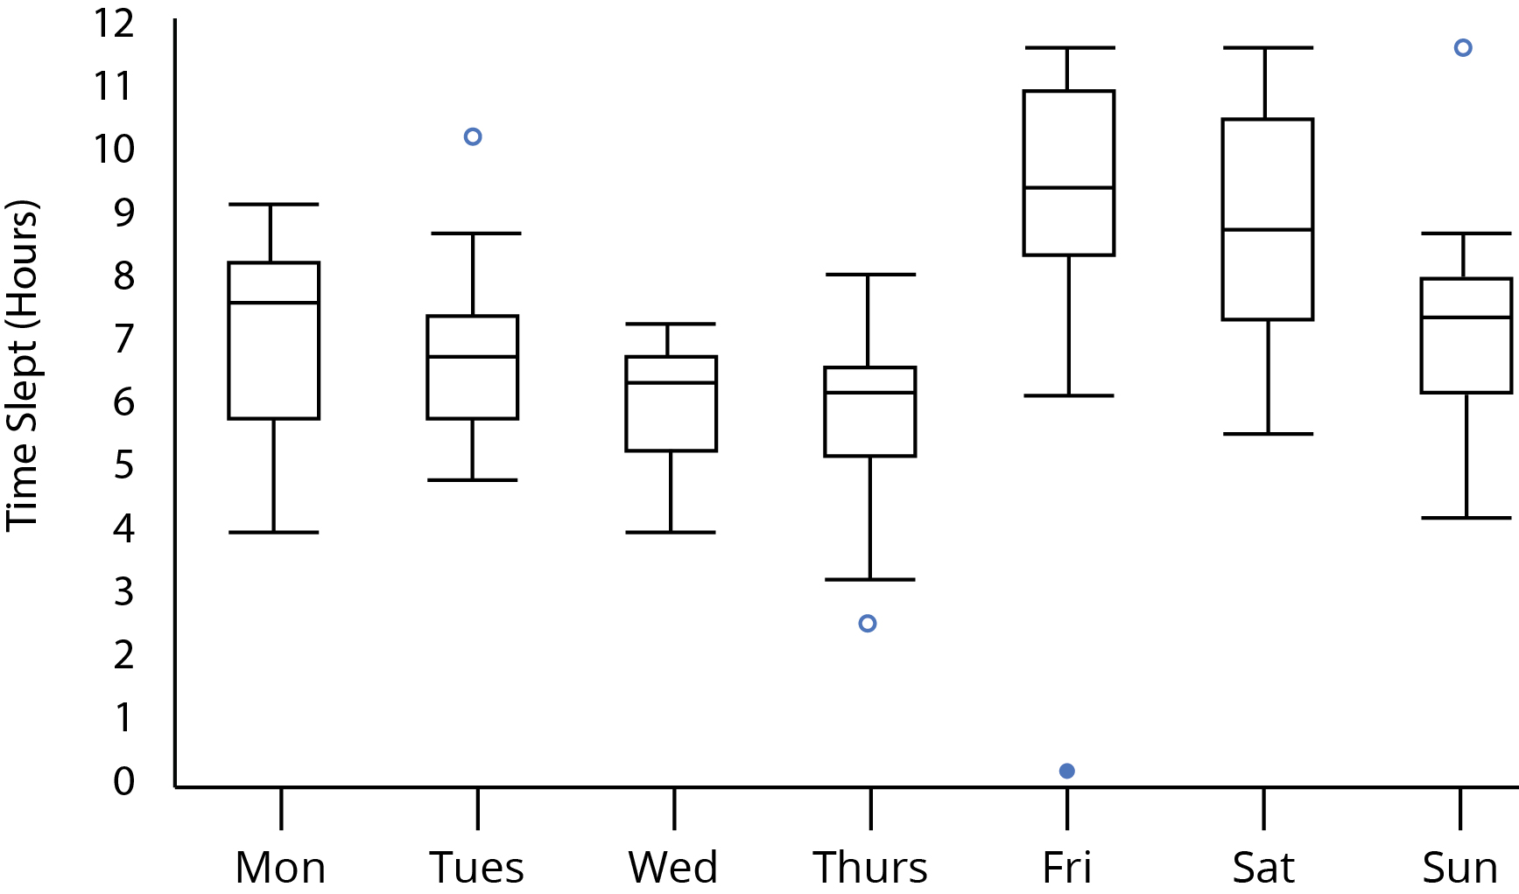
Box-And-Whisper
This Photo is licensed under CC BY-SA

Slide 19
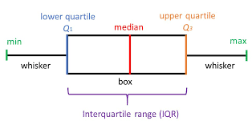
Box-And-Whisper
Center line (sometimes an X) is the median of the collection of values in the category
The top/bottom of box are 25% and 75% quartile values.
The whiskers (top and bottom thin pieces) are the minimum and maximum values
Dots are outliers that fall a certain extent away from the mean (technically they are the true mimima and maxima)
Common in sciences to convey multiple data points in more statistical manner
This Photo is licensed under CC BY-SA

Slide 20
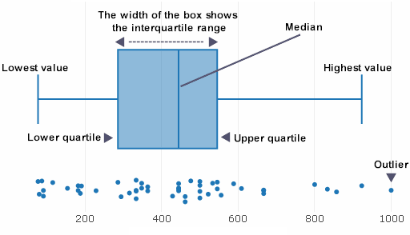
Box-And-Whisper and Bee Swarm Chart
Same data can be shown as a ‘bee swarm’
A plot of points but ‘jittered’ (randomly distributed when they overlap)
Gives more exact data but is often not detail that is needed

Slide 21
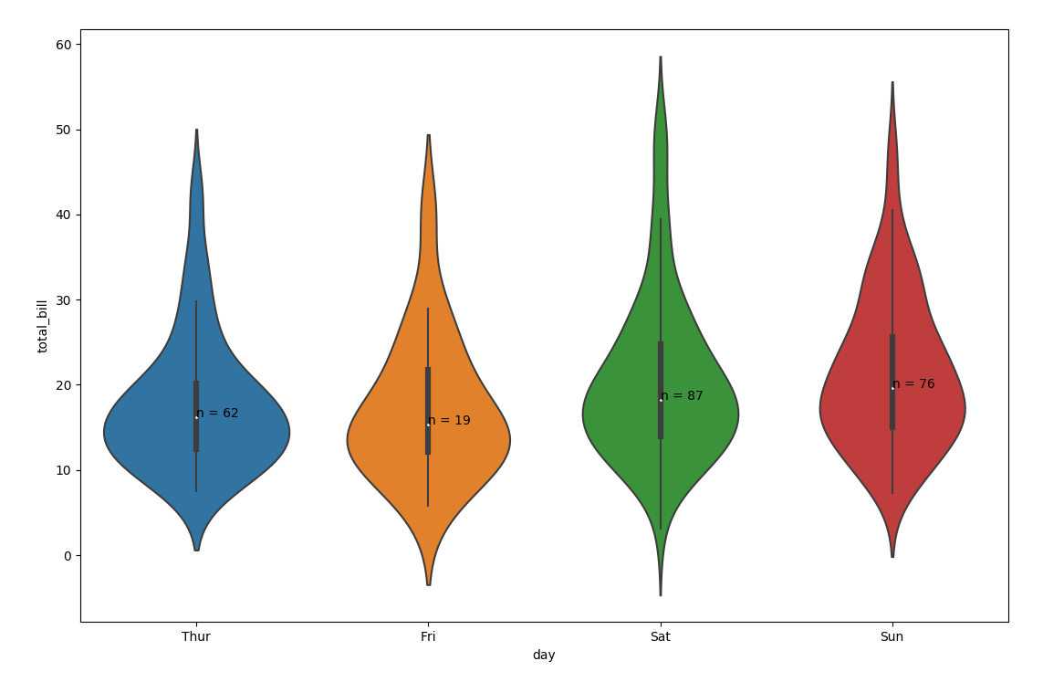
Box-And-Whisper and Violin Chart
Same data can be shown as a ‘violin’
A variant of ‘bee swarm’ where the points aren’t ‘jittered’ but instead of a box and whisper box, a variable width shape is used.
Some degree of smoothing of data is done to width change to give smooth shape.
This Photo by Unknown Author is licensed under CC BY-SA

Slide 22
Line Charts

Slide 23
Line Charts
70
52.5
35
17.5
0
2017
2018
2019
2020

Slide 24
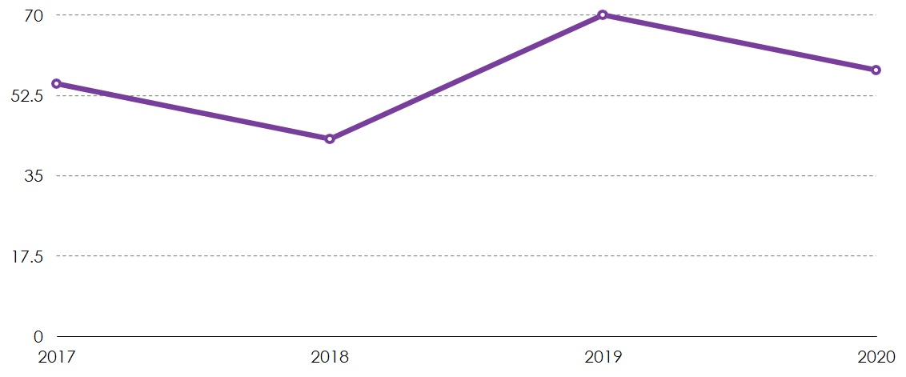
Line Charts
Data changing over time
Y (up-down is response)
X is interval (it is clearest if this is consistent scale)
Predict trends

Slide 25
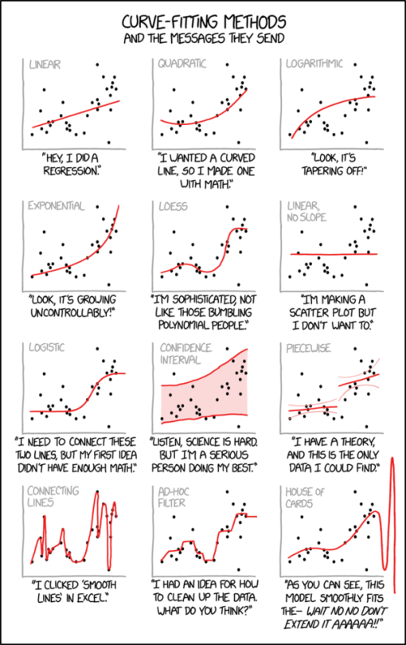
Line Charts
Data changing over time
Y (up-down is response)
X is interval (it is clearest if this is consistent scale)
Imply trends?

Slide 26
Area Charts

Slide 27
Area Charts
70
52.5
35
17.5
0
2017
2018
2019
2020

Slide 28
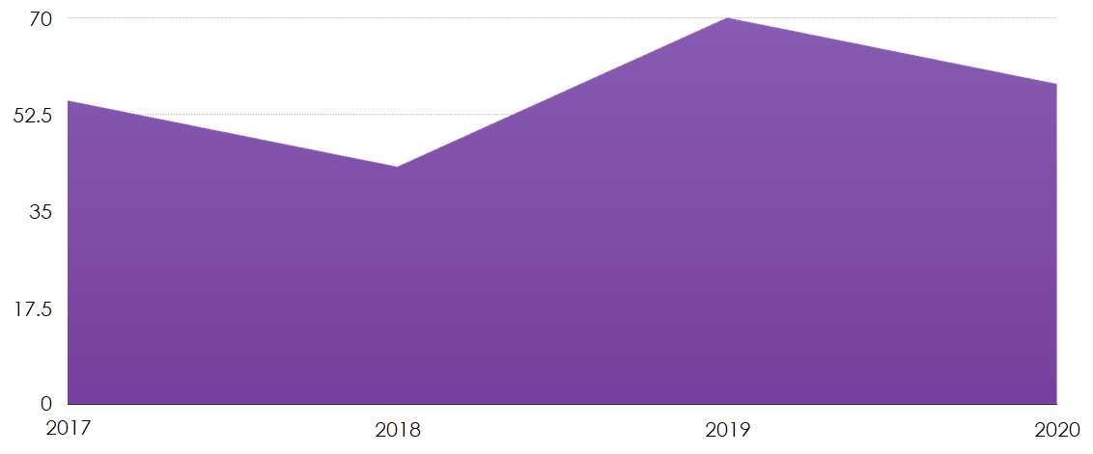
Area Charts
No immediate benefit over a line chart, but when only 1 line gives more emphasis to quantity
Also works better when 0 is meaningful quantity relative to Y data
Most useful when combined with stacking

Slide 29
Line vs. Area

Slide 30
Line Chart
100
75
50
25
0
April
May
June
July

Slide 31
Area Chart
100
75
50
25
0
April
May
June
July

Slide 32
William Playfair - The Commercial and Political Atlas, 1786

Slide 33
Stacked Area Charts

Slide 34
Stacked Area Charts
200
150
100
50
0
April
May
June
July

Slide 35
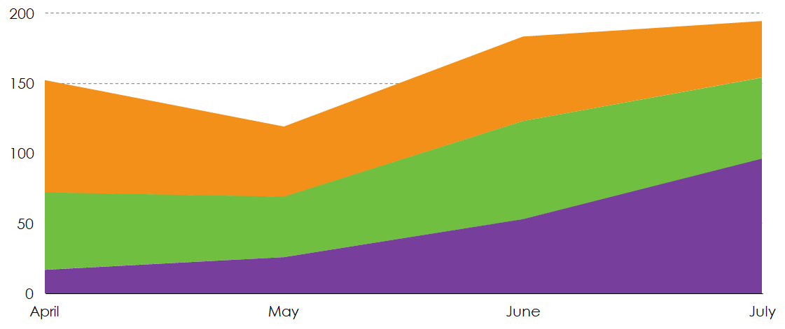
Stacked Area Charts
A line chart form of stacked bar chart
The top line becomes cumulative measure and partial measures are indicated by portions between each line
Choice of stack order can be deceiving
A danger with these is that visual area can be a distraction from being able to determine numerical data from chart

Slide 36
Pie Charts and Donut Charts

Slide 37
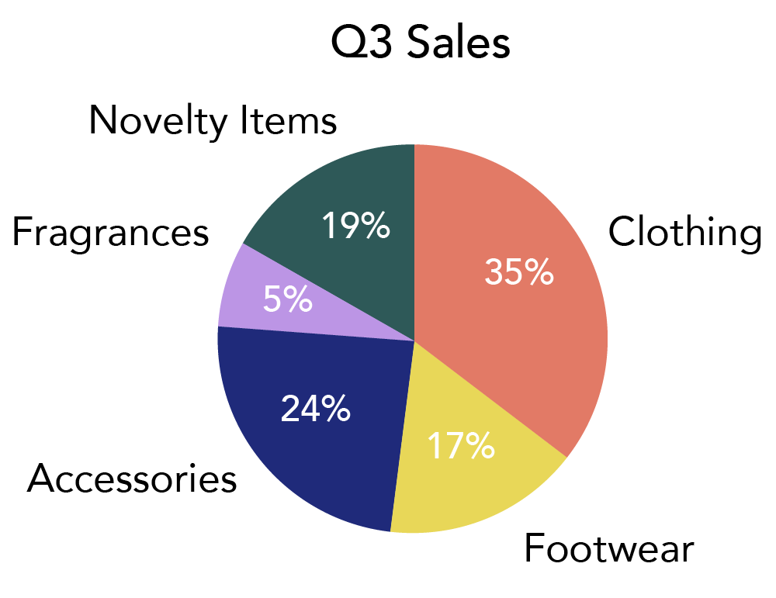
Pie/Donut Charts
Part of whole
Natural idea of 100% being the complete circle (or donut)
Each slice should have area proportional category value
Hard to accurately draw by hand
This Photo by Unknown Author is licensed under CC BY

Slide 41
Mekko Charts (Colour Blocking Charts)

Slide 42
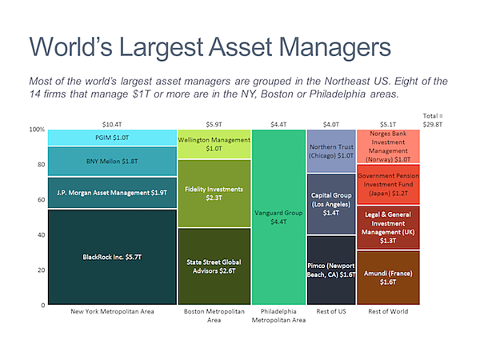
Mekko Chart

Slide 43
Mekko Chart
Combination of column chart with pie chart functionality
Parts of a whole idea
Each sub area is relative part of whole area
Also can compare data as a category and often stacked part of category as seen in this example
Colour block charts don’t include column chart properties (basically a rectangular pie chart)

Slide 44
Scatter Charts (Plots)

Slide 45
Scatter Plots

Slide 46
Scatter Plots
Relationship between two variables
Often from numerous experiments or measurements
Reveals distributions (clusters of points, or pattern of points imply relationships or correlations)
Can find outliers in data otherwise existing in a table of data

Slide 47
Bubble Charts

Slide 48
Bubble Chart
30
22.5
15
7.5
0
0
4
8
12
16

Slide 49
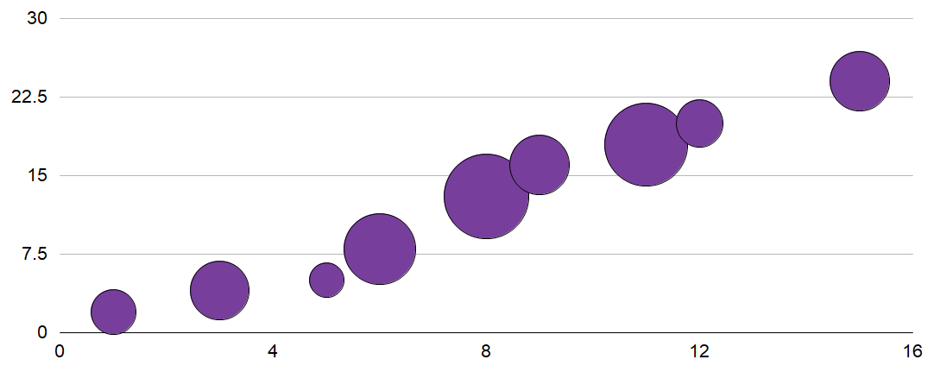
Bubble Chart
Generally lets you expand data with and X and Y to have a third Z characteristic
Sometimes X is category and Y is response, but sometimes both are inputs and Z (area) is response
Remember from visualization that size isn’t great for quantitative data (I get gut reaction of ordering but not clear numerical number)
Sometimes colour is a fourth variable and often a way to give a category when X and Y are both input variables

Slide 50
Radar Charts

Slide 51
Radar Charts

Slide 52
Radar Charts
Like a circular line chart of categories
Ordering and area are deceiving visually
Stacking becomes hard to perceive
Quantity of categories also makes data less clear
Is there a common scale for categories?

Slide 53
Parallel Coordinates

Slide 54
Parallel Coordinates

Slide 55
Map Charts

Slide 57
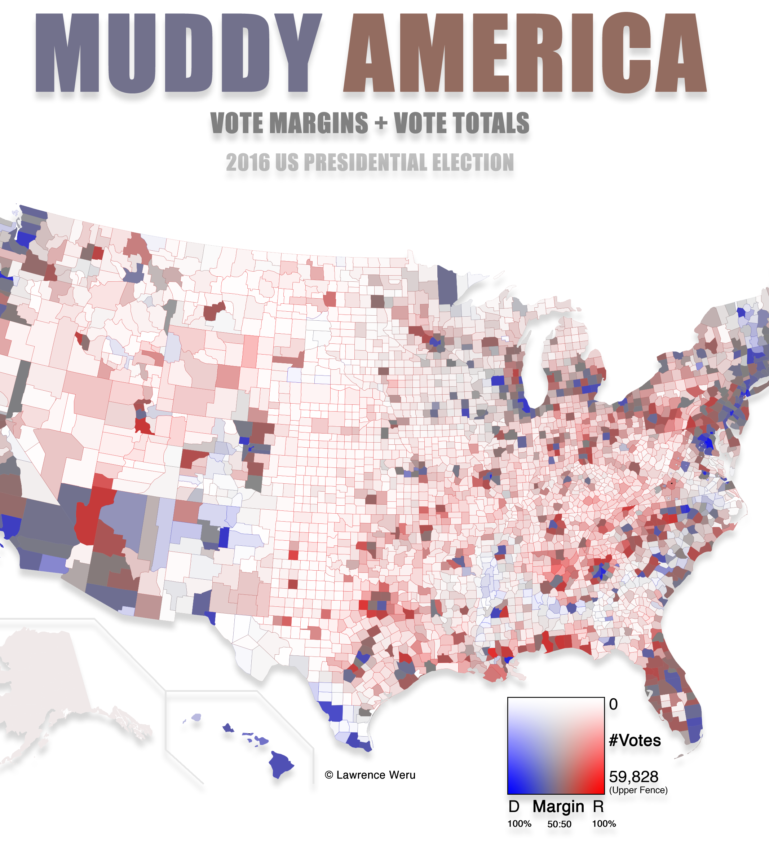
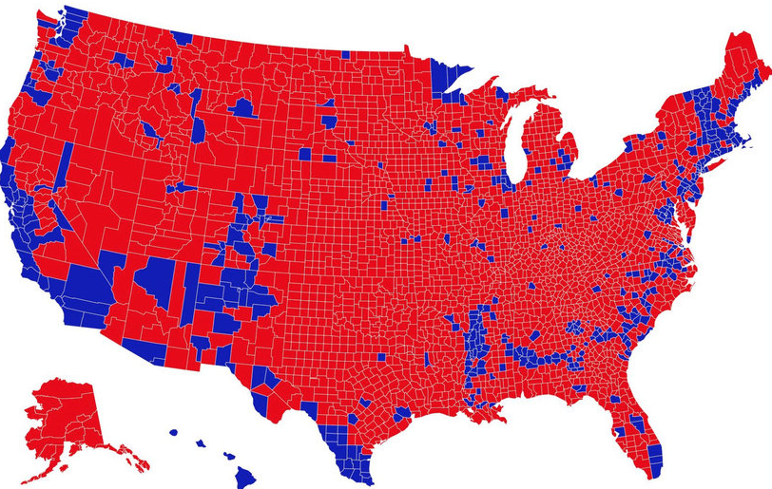
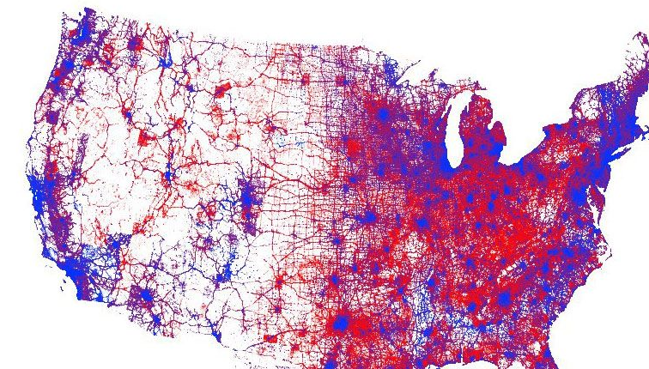
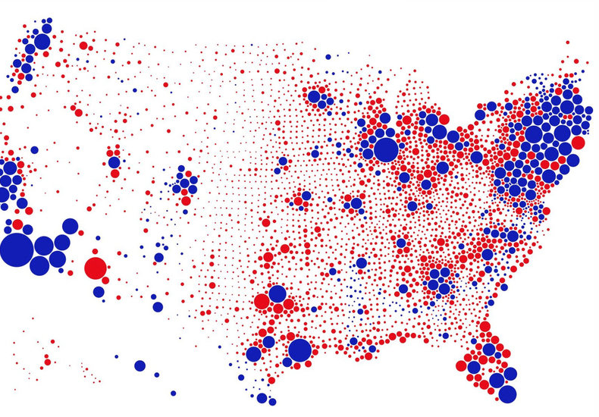
Area/Colour Can Be Deceptive
Top left is county based voting in 2016 US Presidential election
Bottom left one dot per vote, density map (https://nymag.com/intelligencer/2018/03/a-new-2016-election-voting-map-promotes-subtlety.html)
Bottom right is one circle per county, sized per population (https://www.core77.com/posts/90771/A-Great-Example-of-Better-Data-Visualization-This-Voting-Map-GIF)
Top right is counties colour by scale for both population and extremity of vote (https://nymag.com/intelligencer/2018/03/a-new-2016-election-voting-map-promotes-subtlety.html)

Slide 58
2D vs. 3D

Slide 59
https://peltiertech.com/excel-3d-charts-charts-with-no-value

Slide 60
https://peltiertech.com/excel-3d-charts-charts-with-no-value

Slide 61
Two-Axis Charts?

Slide 62
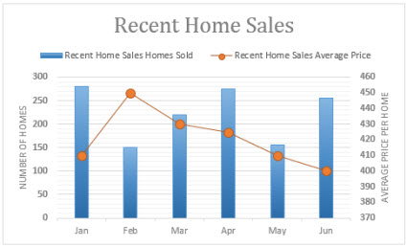
Two-Axis Charts
Used to imply correlation
Generally considered to be bad practice and often deceptive
Easy to change y-axis scale to manipulate ‘apparent correlation’
This Photo by Unknown Author is licensed under CC BY-SA

Slide 63
Chart Junk

Slide 64
More Art than Data?
Bateman et al. 2010

Slide 65
More Art than Data?
Bateman et al. 2010

Slide 66
More Art than Data?
Bateman et al. 2010

Slide 67
More Art than Data?
Bateman et al. 2010

Slide 68
More Art than Data?
Bateman et al. 2010

Slide 69
Onward to … Presentations
Jonathan Hudson
jwhudson@ucalgary.ca
https://pages.cpsc.ucalgary.ca/~jwhudson/

