Slide 1
Data Cleaning
DATA 201: Thinking With Data
Winter 2022
Jonathan Hudson, Ph.D
Instructor
Department of Computer Science
University of Calgary
Tuesday, March 22, 2022

Slide 2
What is Data Cleaning?

Slide 3
Why Data Cleaning?

Slide 4
“I spend more than half of my time integrating, cleansing and transforming data without doing any actual analysis.
Most of the time I’m lucky if I get to do any analysis.
Most of the time once you transform the data you just do an average… the insights can be scarily obvious.
It’s fun when you get to do something somewhat analytical.”
–Kandel et al. 2012

Slide 5
Where does “dirty” data come from?

Slide 6
Sources of Error
What are some of your ideas on where errors in stored data comes from?

Slide 7
Sources of Error
Data entry
Measurement
Distillation
Data integration

Slide 8
Data Entry Errors

Slide 9
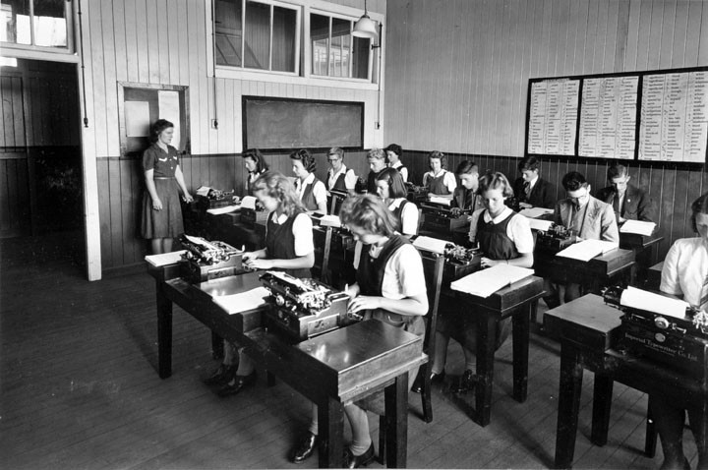
Data Entry Errors

Slide 10
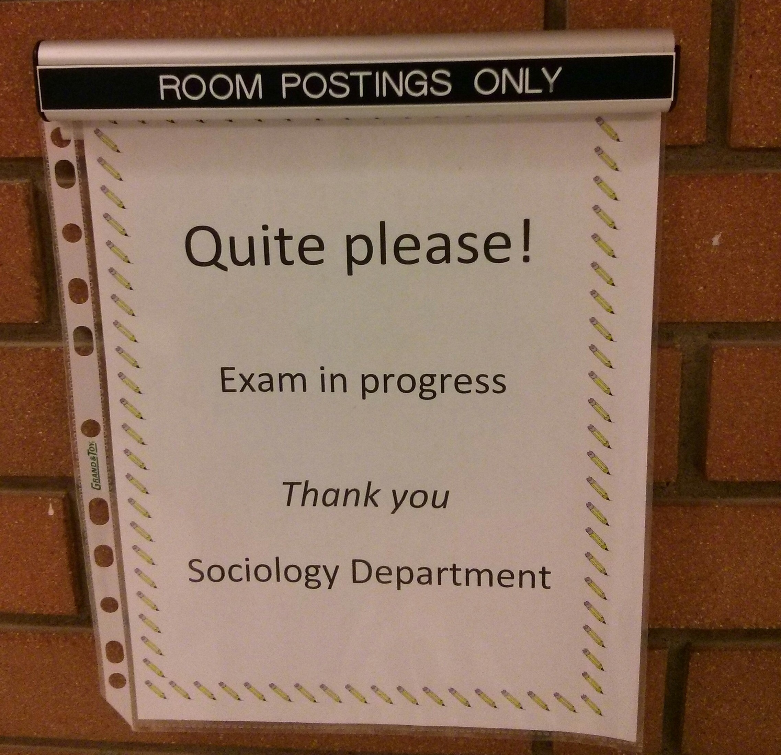
Data Entry Errors
Science B

Slide 11
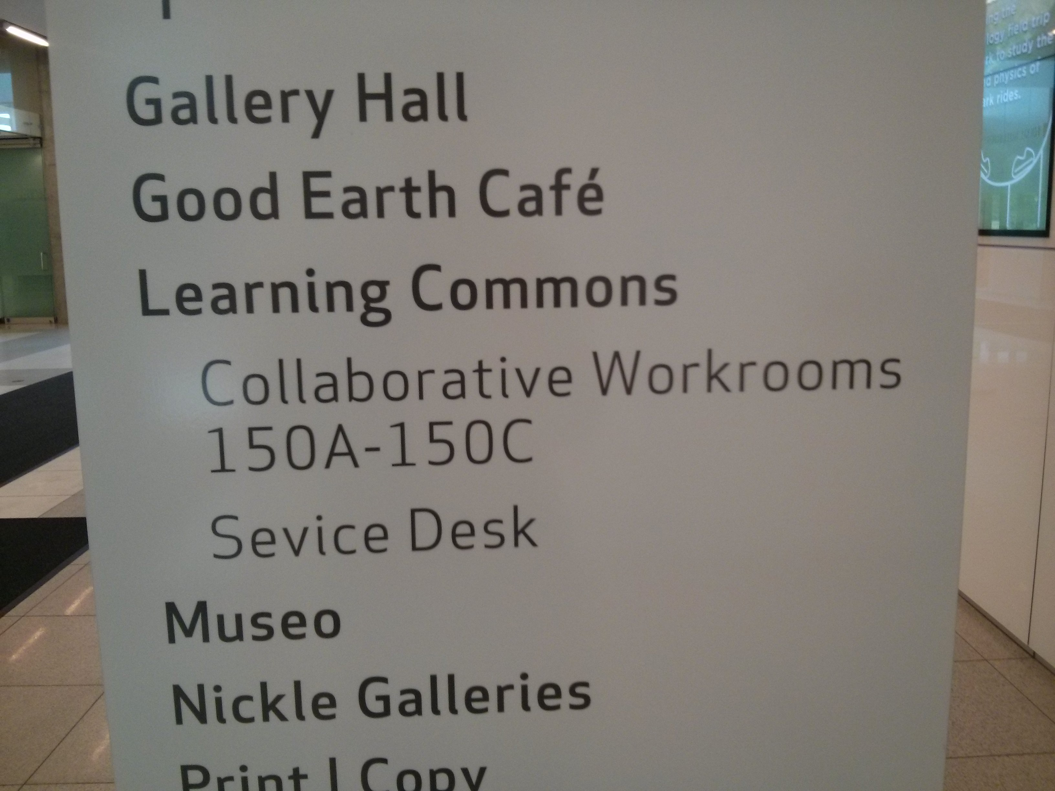
Data Entry Errors
Taylor Family Digital Library

Slide 12
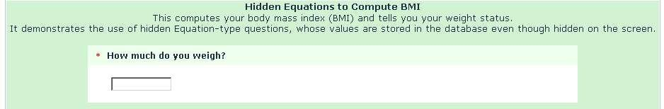
Data Entry Errors

Slide 13
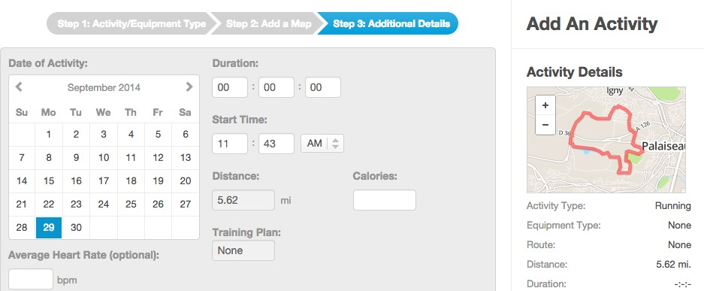
Data Entry Errors

Slide 14
Measurement Errors

Slide 15
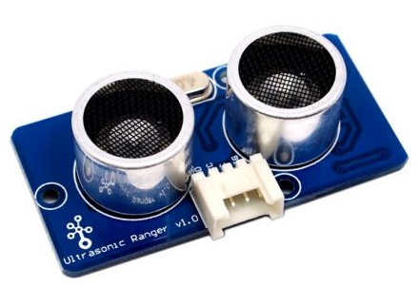
Measurement Errors

Slide 16
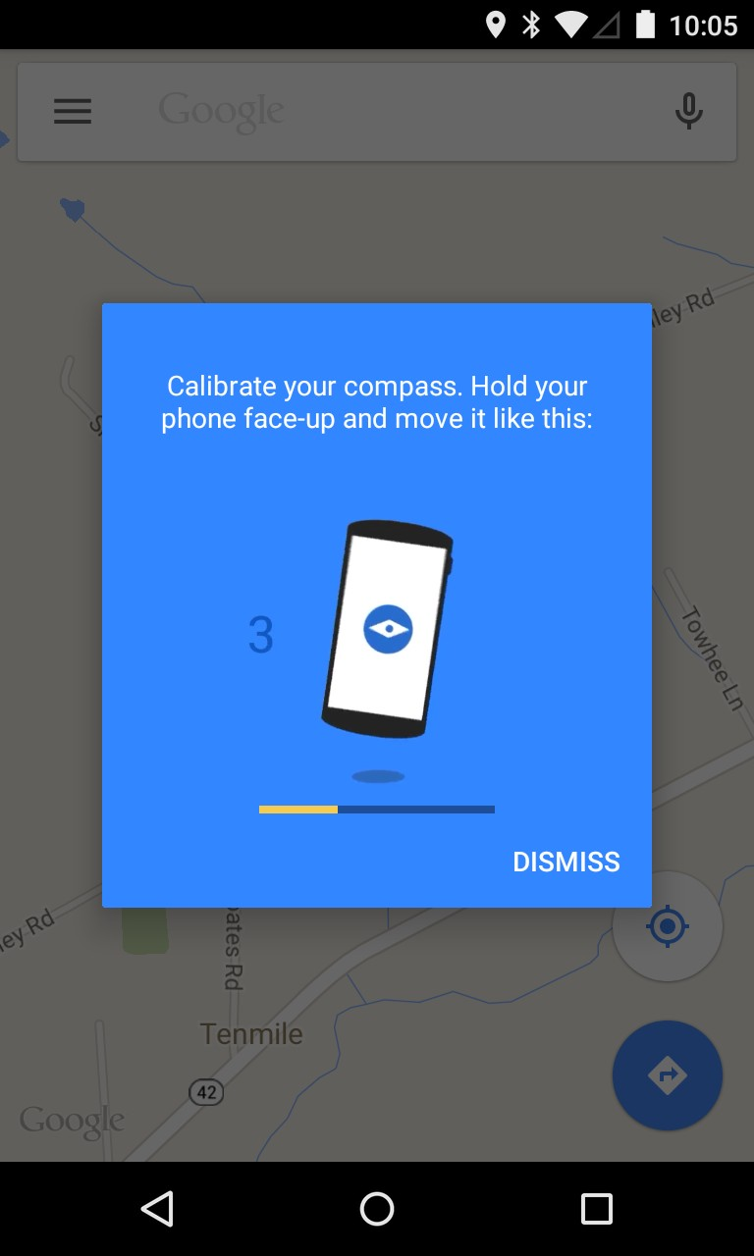
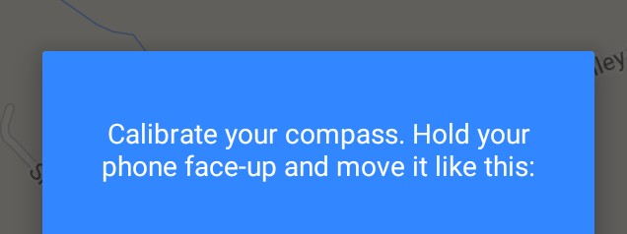
Measurement Errors

Slide 17
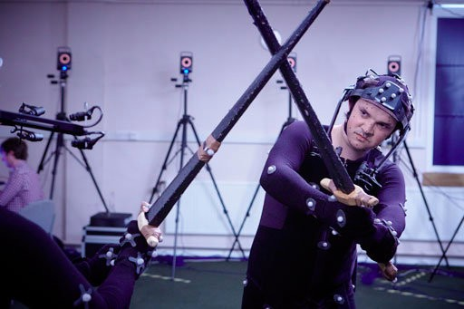
Measurement Errors

Slide 18
Distillation Errors

Slide 19
Distillation Errors
0.345413 => 0.35
Goods and Services Tax => GST

Slide 20
Distillation Errors
2017, $2, Apples
2017, $2, Oranges
2017, $2, Bananas
=> 2017, $2, “Apples, Oranges, Bananas”

Slide 21
Data Integration Errors

Slide 22
Data Integration Errors
Data often comes from multiple sources

Slide 23
Data Integration Errors
Data often comes from multiple sources
Schemas change over time

Slide 24
Data Integration Errors
Data often comes from multiple sources
Schemas change over time
Same data may have different format from different sources

Slide 25
Preventing Errors

Slide 26
Integrity Constraints

Slide 27
Integrity Constraints
Temperature

Slide 28
Integrity Constraints
Temperature
ºC

Slide 29
Integrity Constraints
*Temperature
ºC
*required

Slide 30
Integrity Constraints
*Temperature
ºC
(-50 ºC to 50 ºC)
*required

Slide 31

Integrity Constraints
Temperature

Slide 32
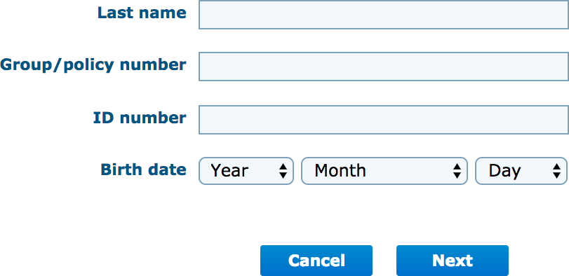
Integrity Constraints

Slide 33
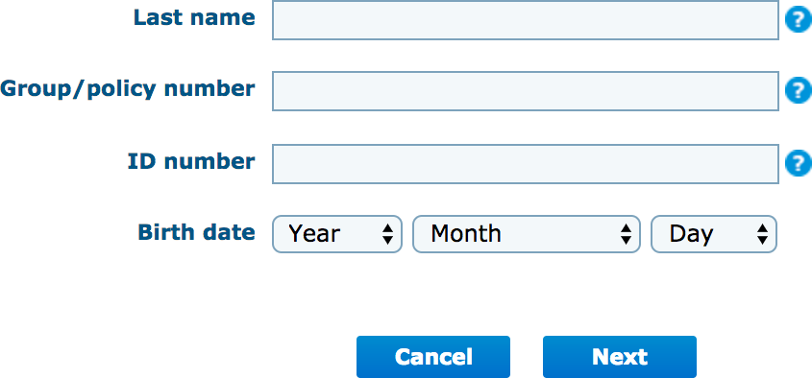
Integrity Constraints

Slide 34
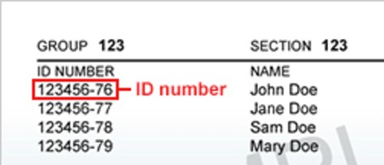
Integrity Constraints

Slide 35
Prediction and Friction
Use data quality measures to predict how likely a value is to be correct
Adjust the interface to add friction when entering unlikely responses

Slide 36
Integrity Constraints
Integrity constraints do not prevent bad data
Enforcing constraints may lead to frustration

Slide 37
Minimize Sensor Errors

Slide 38
Minimize Sensor Errors
Check sensors before deployment

Slide 39
Minimize Sensor Errors
Check sensors before deployment
Periodically revalidate equipment

Slide 40
Minimize Sensor Errors
Check sensors before deployment
Periodically revalidate equipment
Use redundant sensors

Slide 41
Minimize Sensor Errors
Check sensors before deployment
Periodically revalidate equipment
Use redundant sensors
Check data against historical logs or computed models

Slide 42
Minimize Sensor Errors
Check sensors before deployment
Periodically revalidate equipment
Use redundant sensors
Check data against historical logs or computed models
Use common sense

Slide 43
Double Data Entry

Slide 44
Double Data Entry
Perform all data entry twice
Identify mismatches then discard or repair

Slide 45
Detecting Errors

Slide 46
Data Auditing & Error Detection

Slide 47
Data Auditing & Error Detection
Look for outliers / anomalies

Slide 48
Data Auditing & Error Detection
Look for outliers / anomalies
Examine data types

Slide 49
Data Auditing & Error Detection
Look for outliers / anomalies
Examine data types
Schema checking

Slide 50
Data Auditing & Error Detection
Look for outliers / anomalies
Examine data types
Schema checking
Validate with other data

Slide 51
Data Auditing & Error Detection
Look for outliers / anomalies
Examine data types
Schema checking
Validate with other data
Common Sense

Slide 52
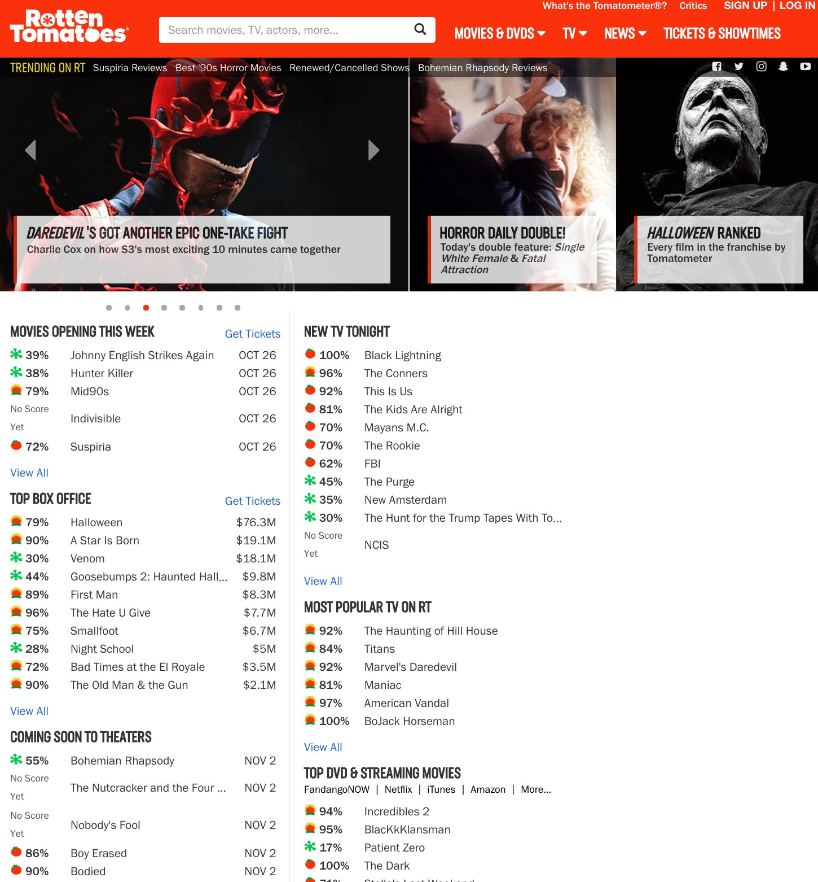
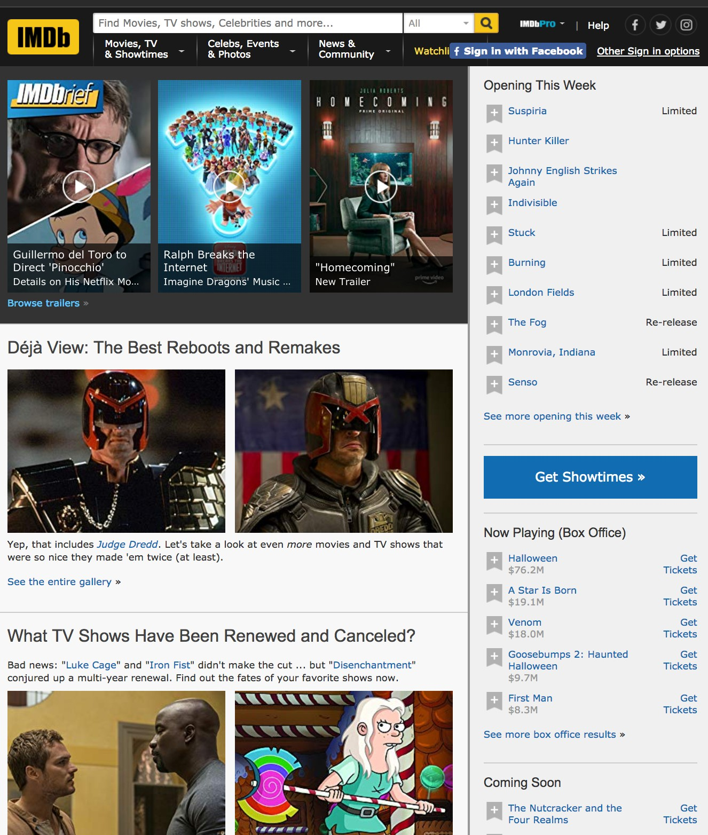

Slide 53
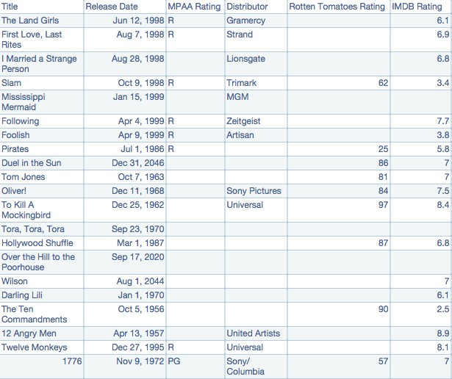

Slide 54
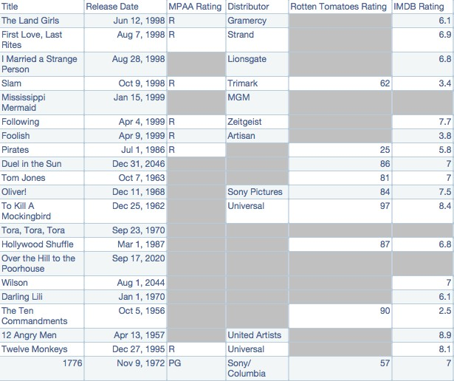

Slide 55
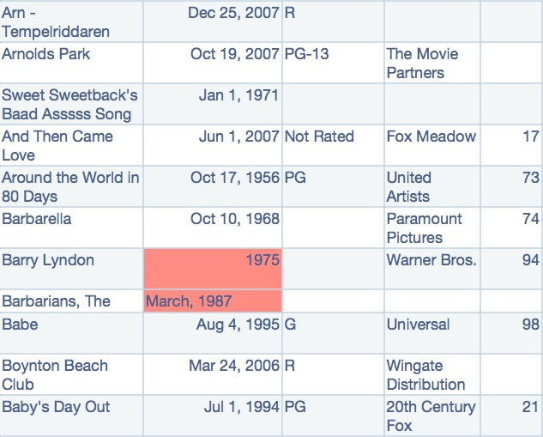

Slide 56
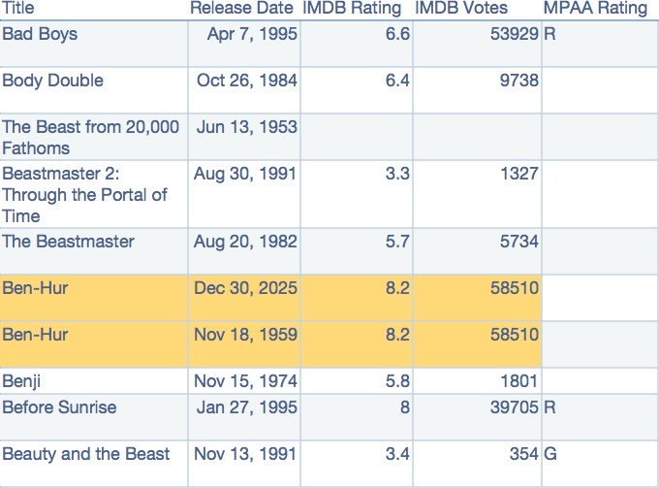

Slide 57
Common Data Quality Issues

Slide 58
Common Data Quality Issues
Missing Data —
Erroneous Values —
Entity Resolution —
Type Conversion —
Data Integration —

Slide 59
Common Data Quality Issues
Missing Data — Missed measurements, redacted items, incomplete forms, etc.
Erroneous Values —
Entity Resolution —
Type Conversion —
Data Integration —

Slide 60
Common Data Quality Issues
Missing Data — Missed measurements, redacted items, incomplete forms, etc.
Erroneous Values — Misspellings, outliers, “spurious integrity”, etc.
Entity Resolution —
Type Conversion —
Data Integration —

Slide 61
Common Data Quality Issues
Missing Data — Missed measurements, redacted items, incomplete forms, etc.
Erroneous Values — Misspellings, outliers, “spurious integrity”, etc.
Entity Resolution — Different values, abbrevs., 2+ entries for the same thing
Type Conversion —
Data Integration —

Slide 62
Common Data Quality Issues
Missing Data — Missed measurements, redacted items, incomplete forms, etc.
Erroneous Values — Misspellings, outliers, “spurious integrity”, etc.
Entity Resolution — Different values, abbrevs., 2+ entries for the same thing
Type Conversion — e.g., postal code or place name to lat-lon
Data Integration —

Slide 63
Common Data Quality Issues
Missing Data — Missed measurements, redacted items, incomplete forms, etc.
Erroneous Values — Misspellings, outliers, “spurious integrity”, etc.
Entity Resolution — Different values, abbrevs., 2+ entries for the same thing
Type Conversion — e.g., postal code or place name to lat-lon
Data Integration — Mismatches and inconsistencies when combining data

Slide 64
Detect Duplicates

Slide 65
Duplicates
TITLE
Ben-Hur Ben Hur BEN-HUR
Ben-Hur (1959)
NAME
Anand Vaskar Anand Vaskkar
A. Vaskar Vaskar, Anand

Slide 66
Levenshtein Distance
How many edits do I need to change one value to another?

Slide 67
Levenshtein Distance
Ben-Hur Ben Hur
Distance = 1

Slide 68
Levenshtein Distance
Anand Vaskar Anand Vaskkar
Distance = ?

Slide 69
Levenshtein Distance
Ben-Hur
Ben Hur (1959 film)
Distance = ?

Slide 70
Soundex / Metaphone
How similar do they sound?

Slide 71
Soundex / Metaphone
Ben-Hur Ben-Hurr Been Her
Anana Vaskar Anand Vaskkar Ahnund Vachkar

Slide 72
Fingerprinting
Strip away unimportant details (e.g., punctuation and capitals)

Slide 73
Fingerprinting
Ben-Hur => ben hur

Slide 74
Fingerprinting
Anand Vaskar => anand vaskar

Slide 75
How to Fix Problems?

Slide 76
Questions to Think About
Which duplicate to keep?
Outliers: keep, remove, or repair?
How to deal with bad formats (e.g., dates and addresses)?

Slide 77
Some Ways to Fix Problems
Fuzzy matching systems
Machine learning to detect/resolve errors
Usually requires human judgement (especially for new data)

Slide 78
Cleaning

Slide 79
Common Operations
Correct and remove errors
Change formats
Remove formatting

Slide 80



Spreadsheets
+ Easily accessible
+ Visual
Tedious
Time-consuming
Repetitive

Slide 81
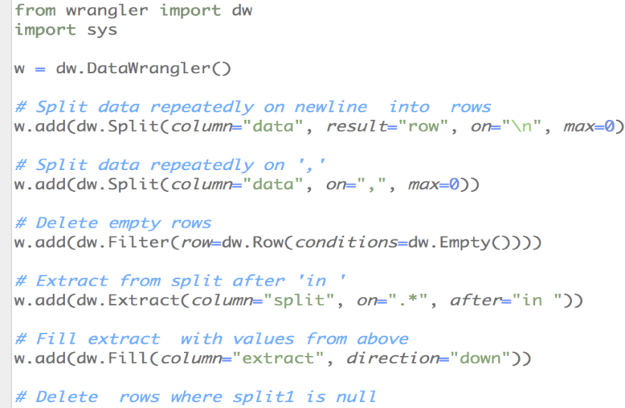
Scripts
+ Reusable
+ Scalable
Difficult
Tedious
Time-consuming

Slide 82
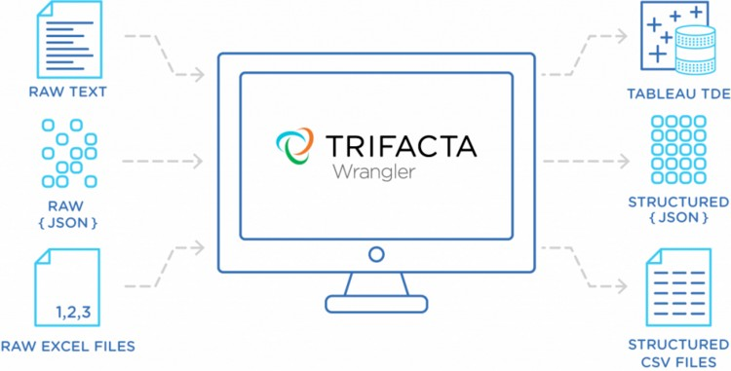


Interactive Data Cleaning
Trifacta Wrangler https://www.trifacta.com
Wrangler (Stanford HCI Group) http://vis.stanford.edu/wrangler
OpenRefine (formerly Google Refine) http://openrefine.org

Slide 83
Onward to …
Charts
Jonathan Hudson
jwhudson@ucalgary.ca
https://pages.cpsc.ucalgary.ca/~jwhudson/

