Slide 1
Overview
DATA 201: Thinking With Data
Winter 2022
Jonathan Hudson, Ph.D
Instructor
Department of Computer Science
University of Calgary
Tuesday, March 22, 2022

Slide 2
What is Data Science?

Slide 3
What (do you think) is Data Science?

Slide 4
Data science is a ‘concept to unify statistics, data analysis, machine learning and their related methods’ in order to ‘understand and analyze actual phenomena’ with data.
“Data science is the discipline of making data useful.”

Slide 5
Drew Conway
Drew Conway is an American data scientist known for his venn diagram definition of data science as well as applying data science to study terrorism.

Slide 8
Area Knowledge
This Photo by xkcd.com is licensed under CC BY-SA-NC

Slide 10
Short History – How We Got Here
The Design of Experiments is a 1935 book by the English statistician Ronald Fisher about the design of experiments
Deming edited a series of lectures delivered by Shewhart at USDA, Statistical Method from the Viewpoint of Quality Control, into a book published in 1939
IBM Peter Luhn paper 1958 “An automatic system is being developed to disseminate information to the various sections of any industrial, scientific or government organization. “
1977 This book serves as an introductory text for exploratory data analysis.
In 1989 Gartner analyst Howard Dresner again brought the phrase “business intelligence” into the common vernacular. He employed it as a general term to cover the cumbersome-sounding names for data storage and data analysis.
Tom Michell 1997 Machine Learning is the study of computer algorithms that improve automatically through experience.

Slide 11
Short History – How We Got Here
The first version of Google was released in August 1996 on the Stanford website. It used nearly half of Stanford's entire network bandwidth. Algorithm to rank documents (webpages).
2007 Data is fourth paradigm. Outlines a two-part plea for the funding of tools for data capture, curation, and analysis, and for a communication and publication infrastructure. He argued for the establishment of modern stores for data and documents that are on par with traditional libraries.

Slide 12
Short History – How We Got Here
2009 Problems that involve interacting with humans, such as natural language understanding, have not proven to be solvable by concise, neat formulas like F = ma. Instead, the best approach appears to be to embrace the complexity of the domain and address it by harnessing the power of data.
2010 Analysing it, to spot patterns and extract useful information, is harder still. Even so, the data deluge is already starting to transform business, government, science and everyday life. It has great potential for good—as long as consumers, companies and governments make the right choices about when to restrict the flow of data, and when to encourage it.

Slide 13
Why Data Science?

Slide 14
Data Science Pipeline - Collection
Collecting
Cleaning
Analyzing
Presenting

Slide 16
Data Science Pipeline - Cleaning
Collection
Cleaning
Analyzing
Presenting

Slide 17
COMPUTER SCIENCE
Computer Science
Math and Statistics
Domain Knowledge

Slide 18
COMPUTER SCIENCE
Computer Science
Math and Statistics
Domain Knowledge
Duplicate values, incorrect formatting, etc.

Slide 19
COMPUTER SCIENCE
Computer Science
Math and Statistics
Domain Knowledge
Duplicate values, incorrect formatting, etc.
Data doesn’t look right?
Answer doesn’t look right?

Slide 20
COMPUTER SCIENCE
Computer Science
Math and Statistics
Domain Knowledge
Duplicate values, incorrect formatting, etc.
Data doesn’t look right?
Answer doesn’t look right?
Selection bias, dependence, etc.

Slide 22
Data Science Pipeline - Analysis
Collection
Cleaning
Analyzing
Presenting

Slide 23
Q ?
A !
Repeat

Slide 24
gather data, clean data, apply statistical tools, visualize data to address questions
Q ?
A !
Repeat

Slide 25
gather data, clean data, apply statistical tools, visualize data to address questions
Q ?
A !
Repeat
inspect “answers” and ask new questions

Slide 28
Sc a tte r Plo t
50
40
30
20
10
0
50
75
100
125 150
Io niza tio n Ene rgy
175
200
225
250

Slide 29
Sc a tte r Plo t
50
40
30
20
10
0
50
75
100
125 150
Io niza tio n Ene rgy
175
200
225
250

Slide 30
Sc a tte r Plo t
50
40
He
30
20
10
0
Rn
50
75
100
125 150
Io niza tio n Ene rgy
175
200
225
250

Slide 31
Extrapolating?
This Photo by xkcd.com is licensed under CC BY-SA

Slide 32
Correlation?
This Photo by xkcd.com is licensed under CC BY-NC

Slide 33
Causation?
This Photo by xkcd.com is licensed under CC BY-SA-NC

Slide 34
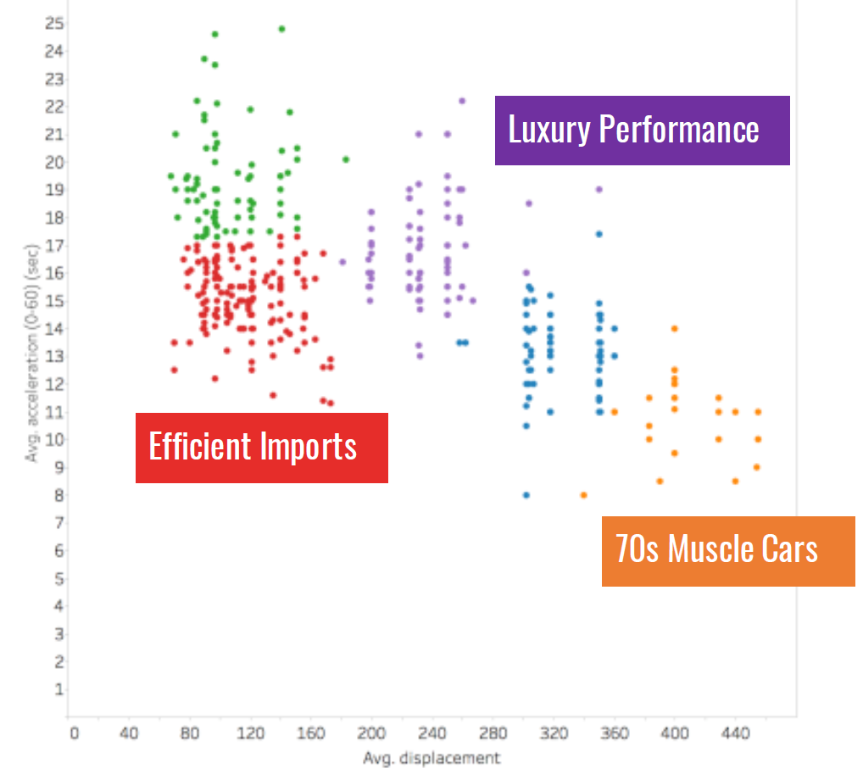

Slide 37
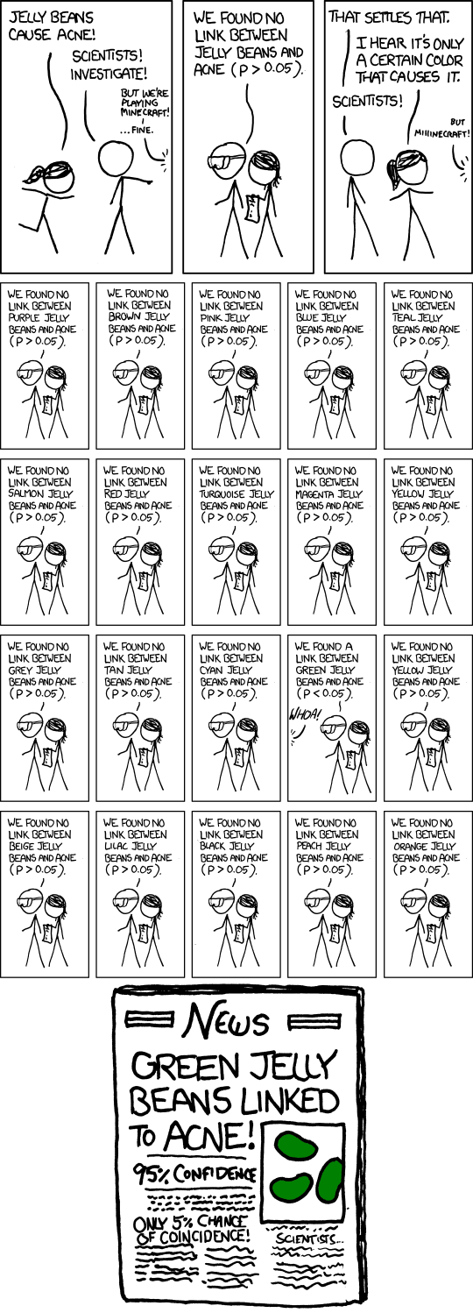
Significance
This Photo by xkcd.com is licensed under CC BY-SA

Slide 38
Curve-Fitting

Slide 39
Data Science Pipeline - Presentation
Collection
Cleaning
Analyzing
Presenting

Slide 40
Visualization via Drawing - XKCD
This Photo by xkcd.com is licensed under CC BY-SA

Slide 43
Presentation
This Photo by xkcd.com is licensed under CC BY-NC-ND

Slide 45
Written Reports
Written reports and responses
How well can you convey ideas?
How much details have you provided?
Are you effectively using the combination of text and images? Is your report well structured?
Is it easy for people to follow?

Slide 46
Data Pipeline – Automation?
Collection
Cleaning
Analyzing
Presenting

Slide 47
Machine Learning

Slide 48
Onward to … Visualization
Jonathan Hudson
jwhudson@ucalgary.ca
https://pages.cpsc.ucalgary.ca/~jwhudson/

