Slide 1
Ethics
DATA 201: Thinking With Data
Winter 2022
Jonathan Hudson, Ph.D
Instructor
Department of Computer Science
University of Calgary
Tuesday, March 22, 2022

Slide 2
Human Research Ethics

Slide 3
UofC Ethics
https://research.ucalgary.ca/conduct-research/ethics-compliance/human-research-ethics
The University of Calgary promotes high ethics standards consistent with the Tri-Council Policy Statement (TCPS2 2018), Ethical Conduct for Research Involving Humans thereby ensuring respect for persons, concern for their welfare and justice
All research, funded or unfunded, involving humans, their data, or human biological materials conducted within the University of Calgary’s jurisdiction or under its auspices, regardless of where the research is conducted must be reviewed by, and receive approval from, the appropriate University of Calgary Research Ethics Board (REB) before research begins.

Slide 4
Research?
Research is defined as “an undertaking intended to extend knowledge through a disciplined inquiry and/or systematic investigation” (TCPS2: p 13)
There are two REBs that review research applications:
the Conjoint Faculties Research Ethics Board (CFREB)
Rest of us
the Conjoint Health Research Ethics Board (CHREB)
Kinesiology, Nursing, and the Cumming School of Medicine

Slide 5
Training
Training
All University of Calgary researchers engaging in research with humans must complete human research ethics training prior to submitting an application for ethics review.
This training requirement can be fulfilled by completing either
TCPS2 CORE Tutorial, or
CITI Human Subjects Research Course
Principal Investigators are responsible for ensuring that all study team members have one of the above training modules complete. These must be available upon request.

Slide 6
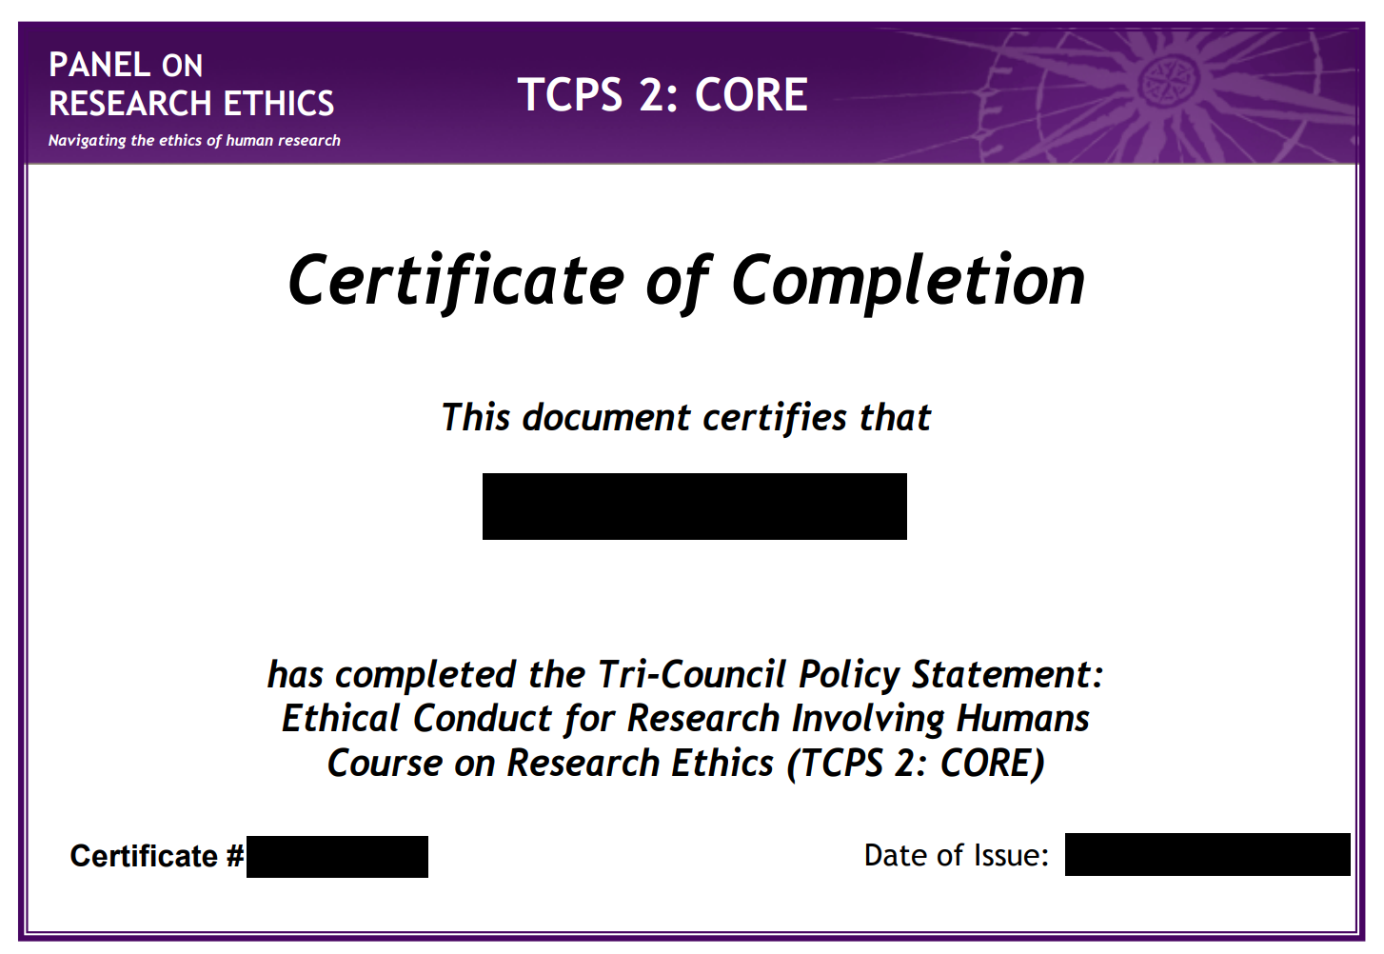
TCPS2 CORE Tutorial tcps2core.ca
Adhering to the TCPS2 guidelines helps foster a community of conscientious researchers who carry out research in an ethically sound environment and are aware of how to ethically conduct research involving humans.
Retroactive to 2012, ethics applications require the CORE Tutorial certificate.
Once the tutorial is complete and you are issued a certificate, include your certificate in your application.

Slide 7
TCPS2 CORE Tutorial tcps2core.ca
CORE-2022 consists of nine modules and a knowledge consolidation exercise:
Module A1 – Introduction
Module A2 – Scope of TCPS 2
Module A3 – Risks and Benefits
Module A4 – Consent
Module A5 – Fairness and Equity
Module A6 – Privacy and Confidentiality
Module A7 – Conflicts of Interest
Module A8 – Research Ethics Board Review
Module A9 – Research Involving Indigenous Peoples
Knowledge Consolidation Exercise

Slide 8
TCPS2 CORE Tutorial tcps2core.ca
Each module ends with 4-5 quiz questions for you to test the knowledge that you have acquired.
CORE-2022 also includes a knowledge consolidation exercise consisting of 25 multiple-choice questions randomly selected from a larger question bank.
To obtain a CORE-2022 Certificate of Completion, you will need to correctly respond to 20 questions (80%).
Those who do not correctly respond to at least 20 questions will not obtain a Certificate of Completion. However, they will have the opportunity to retake the knowledge consolidation exercise.
Completing CORE-2022 should take approximately 4 hours.

Slide 9
TCPS2 CORE Tutorial tcps2core.ca
Each module ends with 4-5 quiz questions for you to test the knowledge that you have acquired.
CORE-2022 also includes a knowledge consolidation exercise consisting of 25 multiple-choice questions randomly selected from a larger question bank.
To obtain a CORE-2022 Certificate of Completion, you will need to correctly respond to 20 questions (80%).
Those who do not correctly respond to at least 20 questions will not obtain a Certificate of Completion. However, they will have the opportunity to retake the knowledge consolidation exercise.
Completing CORE-2022 should take approximately 4 hours.

Slide 10
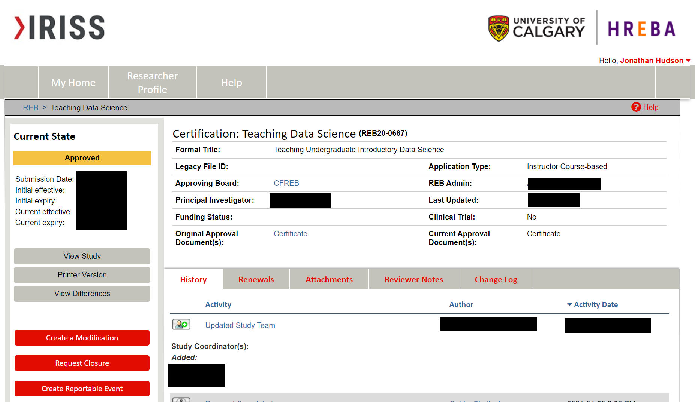
IRISS
IRISS (Institutional Research Information Services Solution) is an online system that manages all human ethics and animal care protocols for the University of Calgary.

Slide 11
A Study?
Identify a PI (Principle Investigator) must have TCPS2 CORE
Also add co-investigators (or other study coordinators)
PI owns, CO-I can make changes, study coordinators are knowledgeable but don’t control
Pick what type of research (in this case instructor-led course-based )
Course-based research activities are pedagogical activities normally required of students at all levels with the objective of providing them with exposure to research methods in their field of study. This form is for instructors who have designed a course assignment that involves research with human participants. This can be instructor-designed (where all students do the same project and use the same materials) or instructor guided (where students plan their own research projects within the parameters established by the instructor and vetted by the REB for recruitment, data collection, etc.).

Slide 12
A Study?
Will be questions unique to each type. A sample for Course-Based
Is the goal of the student research activity entirely pedagogical and limited to developing research methods skill?
Provide a brief description of the human participant component in the course assignment(s) from the perspective of the research participants, including what research methods will be used, the nature of the research experience, and the range of topics:
Will all students have the same or similar topics, methods, participants, participant materials?
Briefly explain the oversight the instructor will have over the students while conducting the course assignment:
List the potential types of participants and describe the range of methods by which they will be recruited:

Slide 13
A Study?
Will be questions unique to each type. A sample for Course-Based
Describe the potential risks to participants, and the measures that will be taken to minimize risks, as well as mitigate harm:
Explain how the instructor will prepare students to comply with Tri-Council Policy Statement (TCPS2) guidelines.
How will informed consent be indicated and documented? (Select all that apply)
If there is a possibility that the course assignment will involve participants who might not be capable of providing informed consent?
How will confidentiality of the data be maintained?
Describe who will have access to the raw data and how any data collected will be stored (physical and electronic storage to protect confidentiality and privacy). Specify the plans for destruction of the data once the course-based research activities are complete.

Slide 14
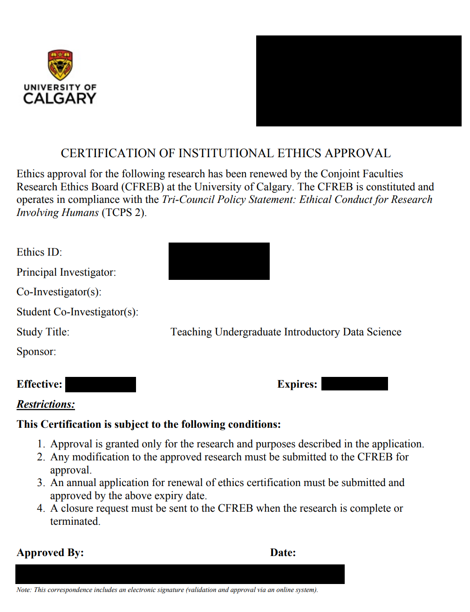
A Study?
Providing a sample
Recruitment message
Sample consent form
Sample project topic
Course outline

Slide 15
TCPS2 Ethics

Slide 16
Core Principles
Respect for Persons
Concern for Welfare
Justice

Slide 17
Respect for Persons
Respect for Persons recognizes the
intrinsic value of human beings and
the respect and consideration that they are due.
It encompasses the treatment of persons involved in research directly as
participants and
those who are participants because their data or human biological are used in research.
Respect for Persons incorporates the dual moral obligations to respect autonomy and to protect those with developing, impaired or diminished autonomy.

Slide 18
Concern for Welfare
The welfare of a person is the quality of that person’s experience of life in all its aspects. Welfare consists of the impact on individuals of factors such as their
physical,
mental and
spiritual health, as well as
their physical, economic and social circumstances.
Thus, determinants of welfare can include housing, employment, security, family life, community membership and social participation, among other aspects of life.

Slide 19
Justice
Justice refers to the obligation to treat people fairly and equitably. Fairness entails treating all people with equal respect and concern.
Equity requires distributing the benefits and burdens of research participation in such a way that no segment of the population is unduly burdened by the harms of research or denied the benefits of the knowledge generated from it.

Slide 20
Justice
Treating people fairly and equitably does not always mean treating people in the same way!!!!!
Differences in treatment or distribution are justified when failures to take differences into account may result in the creation or reinforcement of inequities.

Slide 21
Justice
One important difference that must be considered for fairness and equity is vulnerability.
Vulnerability is often caused by
limited decision-making capacity, or
limited access to social goods, such as
rights,
opportunities and
power.
Individuals or groups whose circumstances may make them vulnerable in the context of research have historically included children, the elderly, students, women, prisoners, those with mental health issues and those with diminished capacity for self-determination.

Slide 22
Proportionate Approach to Research Ethics Board Review
Given that research involving humans spans the full spectrum of risk, from minimal to substantial, a crucial element of REB review is to ensure that the level of scrutiny of a research project is determined by the level of risk it poses to.
the intention is to ensure adequate protection of participants is maintained while reducing unnecessary impediments to, and facilitating the progress of, ethical research.

Slide 23
The Law!
In addition to the principles and guidelines in this Policy, researchers are responsible for ascertaining and complying with all applicable legal and regulatory requirements with respect to consent and the protection of privacy of participants.
These legal and regulatory requirements may vary depending on the jurisdiction in Canada in which the research is being conducted, and who is funding and/or conducting the research. They may comprise constitutional, statutory, regulatory, common law, and/or international or legal requirements of jurisdictions outside of Canada.
Where the research is considered to be a governmental activity, for example, standards for protecting privacy flowing from the Canadian Charter of Rights and Freedoms, federal privacy legislation and regulatory requirements would apply.

Slide 24
The Perspective of Participant
In designing and conducting research or reviewing the ethics of research, researchers and REBs must be mindful of the perspective of the participant.
It may be necessary to consider the various contexts (e.g., social, economic, cultural) that shape the participant’s life, to properly evaluate the implications of the research in terms of the core principles.

Slide 25
Something that doesn’t require REB review is not by default ethical!
Quality assurance and quality improvement studies, program evaluation activities, and performance reviews, or testing within normal educational requirements when used exclusively for assessment, management or improvement purposes, do not constitute research for the purposes of this Policy, and do not fall within the scope of REB review.
The above may still raise ethical issues that would benefit from careful consideration by an individual or a body capable of providing some independent guidance, other than an REB.

Slide 26
Consent!

Slide 27
Definition
Throughout TCPS2, the term “consent” means “free, informed and ongoing consent.”
“free” and “voluntary” are used interchangeably.
Respect for Persons implies that individuals who participate in research should do so voluntarily, understanding the purpose of the research, and its risks and potential benefits, as fully as reasonably possible.
Where a person has the capacity to understand this information, and the ability to act on it voluntarily, the decision to participate is generally seen as an expression of autonomy.
Equally, Respect for Persons implies that those who lack the capacity to decide for themselves should nevertheless have the opportunity to participate in research that may be of benefit to themselves or others. (Authorized third party consent!)

Slide 28
Responsibility
The head of the research team, also known as the “principal investigator,” is responsible for ensuring that the consent process is followed.
This person is also responsible for the actions of any member of the research team involved in the consent process.

Slide 29
Article 3.1
Consent shall be given voluntarily.
Free of undue influence (coercion)
What about incentives? ($25 gift card? More?))
Consent can be withdrawn at any time.
If a participant withdraws consent, the participant can also request the withdrawal of their data or human biological materials.

Slide 30
Incentives
Because incentives are used to encourage participation in a research project, they are an important consideration in assessing voluntariness.
Where incentives are offered to participants, they should not be so large or attractive as to encourage reckless disregard of risks.
This is a particular consideration in the case of healthy volunteers for the early phases of clinical trials
The offer of incentives in some contexts may be perceived by prospective participants as a way for the to gain favour or improve their situation.
This may amount to undue inducement and thus negate the voluntariness of participants’ consent.
This Policy neither recommends nor discourages the use of incentives. Up to REB.

Slide 31
Informed and on-going

Slide 32
Article 3.2 Informed
Researchers shall provide to prospective participants, or authorized third parties, full disclosure of all information necessary for making an informed decision to participate in a research project.
That they were invited
Purpose in plain language
Risks/benefits clear
Assurance of obligation not required, request withdrawal, etc.
Commercialization
Disseminations
Identify contact for questions, another non research group contact
What information collected
Incentives
Waiver and points of possible removal

Slide 33
Article 3.3 On-Going
Consent shall be maintained throughout the research project.
Researchers have an ongoing duty to provide participants with all information relevant to their ongoing consent to participate in the research.
Article 3.4 Within the limits of consent provided by the participant, researchers shall disclose to the participant any material incidental findings discovered in the course of research.
Material -> Important to the participant
Incidental -> Not part of research
If a study on a different medical condition determines you have cancer!

Slide 34
Article 3.5/3.10
Research shall begin only after the participants, or their authorized third parties, have provided their consent.
Consent should be documented.

Slide 35
Inclusion

Slide 36
Appropriate Inclusion
Researchers shall not exclude individuals from the opportunity to participate in research on the basis of attributes such as culture, language, religion, race, disability, sexual orientation, ethnicity, linguistic proficiency, gender or age, unless there is a valid reason for the exclusion.
Women shall not be inappropriately excluded from research solely on the basis of gender or sex, reproductive capacity, or because they are pregnant or breastfeeding.
Other categories
Children, elderly, lack decision making capacity, vulnerable groups
Key is that any exclusion must be justifiable and not for ‘ease of study’ or other non research based reasoning.

Slide 37
Dissemination
Researchers have to disseminate results, even those that don’t support the hypothesis and
Encouraged to make data available if it is possible while safe-guarding privacy of participants.

Slide 38
Privacy

Slide 39
Privacy terms
Privacy – right to be free from intrusion or interference of others
Confidentiality – obligation to safetrust information
Security – measure used to protect information
Identifiable information – no one single answer and it is responsibility of researchers to consider for each piece of information is this information able to identify someone by itself, or in combination with other information
This info can be collected be falls under much greater protections than non-identifiable information

Slide 40
Types of information
Directly identifying (SIN, UCID) [most concern]
Indirectly identifying (DOB and location of birth)
Coded information (replace data)
Anonymized information – the information is irrevocably stripped of direct identifiers, a code is not kept to allow future re-linkage, and risk of re-identification of individuals from remaining indirect identifiers is low or very low.
Anonymous information – the information never had identifiers associated with it (e.g., anonymous surveys) and risk of identification of individuals is low or very low [least concern here]

Slide 41
Ethical Duty of Confidentiality
Article 5.1
Researchers shall safeguard information entrusted to them and not misuse or wrongfully disclose it.
Institutions shall support their researchers in maintaining promises of confidentiality.
Qualtrics!
Delete data after grading is complete!

Slide 42
Safeguard!
Article 5.3
Researchers shall provide details to the REB regarding their proposed measures for safeguarding information, for the full life cycle of information: its collection, use, dissemination, retention and/or disposal.

Slide 43
Conflicts of Interest

Slide 44
Examples
Institutional
Obligations association to institution (benefits from research to school)
REB
Someone on review board could benefit
Researcher
Person running study could benefit, or create pressure, changes, etc.

Slide 45
Research Involving First Nations, Inuit, and Metis People

Slide 46
Newer Chapter/Module 9 Addition to TCPS Core
Research involving Indigenous peoples in Canada, including Indian (First Nations
First Nations, Inuit and Métis communities have unique histories, cultures and traditions.
They also share some core values such as reciprocity – the obligation to give something back in return for gifts received – which they advance as the necessary basis for relationships that can benefit both Indigenous and research communities.

Slide 47
Colonialized Research
Research involving Indigenous peoples in Canada has been defined and carried out primarily by non Indigenous researchers.
The approaches used have not generally reflected Indigenous world views, and the research has not necessarily benefited Indigenous peoples or communities.
As a result, Indigenous peoples continue to regard research, particularly research originating outside their communities, with a certain apprehension or mistrust.

Slide 48
Repairing Research
The landscape of research involving Indigenous peoples is rapidly changing.
Growing numbers of First Nations, Inuit and Métis scholars are contributing to research as academics and community researchers.
Communities are becoming better informed about the risks and benefits of research.
Technological developments allowing rapid distribution of information are presenting both opportunities and challenges regarding the governance of information.

Slide 49
Fundamentals
Requirement of Community Engagement in Indigenous Research
Article 9.1
Where the research is likely to affect the welfare of an Indigenous community, or communities, to which prospective participants belong, researchers shall seek engagement with the relevant community. The conditions under which engagement is required include, but are not limited to:

Slide 50
Fundamentals
a. research conducted on First Nations, Inuit or Métis lands;
b. recruitment criteria that include Indigenous identity as a factor for the entire study or for a subgroup in the study;
c. research that seeks input from participants regarding a community’s cultural heritage, artefacts, traditional knowledge or unique characteristics;
d. research in which Indigenous identity or membership in an Indigenous community is used as a variable for the purpose of analysis of the research data; and
e. interpretation of research results that will refer to Indigenous communities, peoples, language, history or culture.

Slide 51
Qualitative Research

Slide 52
Qualitative Research (Unique!)
Qualitative research aims to understand how people think about the world and how they act and behave in it.
This approach requires researchers to understand phenomena based on discourse, actions and documents, and how and why individuals interpret and ascribe meaning to what they say and do, and to other aspects of the world (including other people) they encounter.

Slide 53
Qualitative Research (Unique!)
Some qualitative studies extend beyond individuals’ personal experiences to explore interactions and processes within organizations or other environments.
Knowledge at both an individual and a cultural level is treated as socially constructed.
This implies that all knowledge is, at least to some degree, interpretive, and hence, dependent on social context. It is also shaped by the personal perspective of the researcher as an observer and analyst.
As a result, qualitative researchers devote a great deal of attention to demonstrating the trustworthiness of their findings using a range of methodological strategies.

Slide 54
Qualitative Research (Unique!)
General Approach and Methodological Requirements and Practices
Inductive Understanding (need different mindset, open questioning of own bias)
Diversity of Approaches (more likely to be biased if done one way)
Dynamic, Reflective and Continuous Research Process
Diverse, Multiple and Often Evolving Contexts (highly varied)
Data Collection and Sample Size (often smaller)
Research Goals and Objectives (‘giving voice’ can be a challenge)
Dynamic, Negotiated and Ongoing Consent (negotiation may add bias)
Research Partnerships (to get access setup biases may set in)
Results (transferable)

Slide 55
Resources
https://research.ucalgary.ca/conduct-research/agreements
https://research.ucalgary.ca/conduct-research/additional-resources/iriss-human-ethics-and-animal-care
https://ethics.gc.ca/eng/documents/tcps2-2018-en-interactive-final.pdf
https://tcps2core.ca/

Slide 56
Onward to … Constructive Criticisms?
Jonathan Hudson
jwhudson@ucalgary.ca
https://pages.cpsc.ucalgary.ca/~jwhudson/

